Slide 1
Python Crash Course
For Data Scientist

Slide 2
Notice
Please note, this is not meant to be a comprehensive overview of Python or programming in general.

Slide 3
Outline – Part 1
Introduction
Data types
  Numbers
  String
  Printing
  Lists
  Dictionaries
  Booleans
  Tuples
  Sets
Python Comparison Operators
Python statements
  if, elif, else Statements
  for Loops
  while Loops
Methods and functions
  lambda expressions
  map and filter
Error handling
Modules and Packages
Object Oriented Programming

Slide 4
Outline – Part 2
Most popular data Python Data Science Libraries
  NumPy
  SciPy
  Pandas
  MetplotLab
  Seaborn
  Scikit-learn
  And much more (Dask, …)
Notes:
SciPy is a free and open-source Python library used for scientific computing and technical ... SciPy builds on the NumPy array object and is part of the NumPy stack which includes tools like Matplotlib, pandas and SymPy, and an expanding set ...
Dask : https://towardsdatascience.com/why-every-data-scientist-should-use-dask-81b2b850e15b

Slide 5
Outline – Part 3
Data Science project
  Cross-industry standard process for data mining
  Exploratory data analysis
  Data preparation
    Missing data imputation
    Data Encoding and scaling
    Feature selection
  Model construction
    Cross-validation
    Grid-search
    Ensemble methods
  Model deployment
Notes:
SciPy is a free and open-source Python library used for scientific computing and technical ... SciPy builds on the NumPy array object and is part of the NumPy stack which includes tools like Matplotlib, pandas and SymPy, and an expanding set ...
Dask : https://towardsdatascience.com/why-every-data-scientist-should-use-dask-81b2b850e15b

Slide 6
Python version
Python 2 or Python 3 ? Definitely 3
https://www.python.org/
https://pythonclock.org/

Slide 7




Python version
Why Python ?
The rich ecosystem of libraries and tooling, and the convenience of the language itself, make Python an excellent choice.
Many distributions of Python, such as
  WinPython,
  ActivePython,
  Anaconda,
  Enthought Canopy,
  Python(x,y),
  Pyzo

Slide 8
Python version
Why Python ?
For this course, let’s install Anaconda for python 3
  https://www.anaconda.com/download
Notes:
Make some examples using python anaconda

Slide 9
Python version
Virtual Environment
  Virtual Environments allow you to set up virtual installations of Python and libraries on your computer
  You can have multiple versions of Python or libraries and easily activate or deactivate these environments
  Virtual environment = a self-contained directory tree that contains a Python installation for a particular version of Python, plus a number of additional packages
Notes:
Make some examples using python anaconda

Slide 10
Python version
Why Virtual Environment?
  Sometimes you’ll want to program in different versions of a library
  For example:
    You develop a program with SciKit-Learn 0.17
    SciKit-Learn 0.18 is released
    You want to explore 0.18 but don’t want you old code to break
Notes:
Make some examples using python anaconda

Slide 11
Python version
Virtual Environment
Several ways to create a virtual environment
  Using venv module of python (python-venv)
    python3 -m venv tutorial-env
    source tutorial-env/bin/activate
    pip3 search astronomy
    pip3 install novas or pip install novas=2.1.0
    source deactivate
    Virtual Environments allow you to set up virtual installations of Python and libraries on your computer
  Using Virtualenv Environment
  Using Pipenv Environment
Notes:
Make some examples using python anaconda

Slide 12
Python version
Virtual Environment
Several ways to create a virtual environment
  Using Anaconda (Conda) a Environment
  https://conda.io/docs/user-guide/tasks/manage-environments.html
    conda create --name myenv
    conda install numpy
    conda install anaconda
    source deactivate
Notes:
Make demo

Slide 13
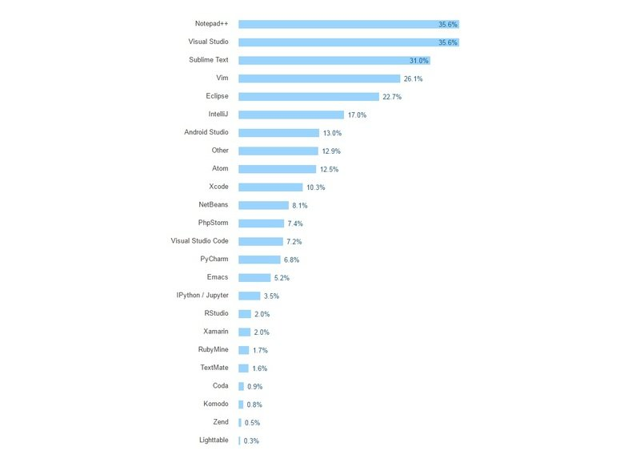
Python IDE
IDEs versus Text Editors
Notes:
https://www.datacamp.com/community/tutorials/data-science-python-ide

Slide 14
Python IDE
Python IDEs for Data Science
  Spyder
  PyCharm
  Rodeo
  Atom
  Jupyter Notebook
  According to the ranking given by https://www.datacamp.com/community/tutorials/data-science-python-ide
Notes:
https://www.datacamp.com/community/tutorials/data-science-python-ide

Slide 15
Python IDE
Python IDEs for Data Science
  http://www.jupyter.org/ and
  try it with python in http://jupyter.org/try
    Code Cell
    Markdown Cell
Notes:
Make instalation and demo for jupyter

Slide 16
Python IDE
Python IDEs for Data Science
Now, Let’s launch Jupyter Notebook in your PC
  Open a terminal window.
  Enter the startup folder with cd
  Type jupyter notebook to launch the Jupyter Notebook App
    If note installed, use conda install jupyter or using pip3
  The notebook interface will appear in a new browser window or tab.
Notes:
Make instalation and demo for jupyter

Slide 17
Python IDE
Python IDEs for Data Science
  Now, Let’s install PyCharm
  Education edition
  https://www.jetbrains.com/pycharm-edu/download/#section=mac
  Or the community edition
  See plugins (ideavim …)
  See packages
  Run jupyter

Slide 18
Python IDE
Python characteristics
Simple
  Python is a simple and minimalistic language in nature
  Reading a good python program should be like reading English
  Its Pseudo-code nature allows one to concentrate on the problem rather than the language
Easy to Learn
Free & Open source
  Freely distributed and Open source
  Maintained by the Python community
High Level Language –memory management
Portable – *runs on anything c code will

Slide 19
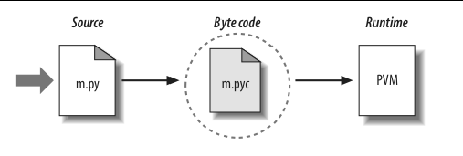
Python IDE
Python characteristics
Interpreted (mixted)
  You run the program straight from the source code.
  Python program →Bytecode →a platforms native language
  You can just copy over your code to another system and it will auto-magically work (with python platform)

Slide 20
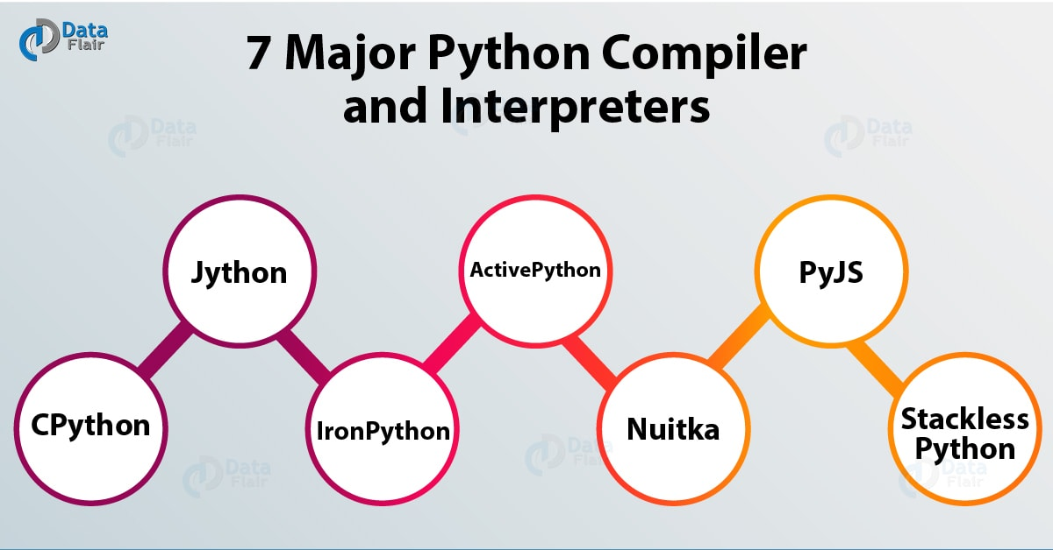
Python IDE
Python characteristics
Interpreted (mixted)
  You run the program straight from the source code.
  Python program →Bytecode →a platforms native language
  You can just copy over your code to another system and it will auto-magically work (with python platform)

Slide 21

Python IDE
Python characteristics
  PyPy = an alternative implementation of Python which often runs faster than the standard implementation of Python, CPython.
  The reason PyPy is a just-in-time compiler, while CPython is an interpreter. Most Python code runs well on PyPy, except for code that relies on CPython extensions, which either does not work or incurs some overhead when run in PyPy.
Notes:
Python as a programming language has no saying about if it's an compiled or interpreted programming language, only the implementation of it. The terms interpreted or compiled is not a property of the language but a property of the implementation. Python program runs directly from the source code . so, Python will fall under byte code interpreted. The .py source code is first compiled to byte code as .pyc. This byte code can be interpreted (official CPython), or JIT compiled (PyPy). Python source code (.py) can be compiled to different byte code also like IronPython (.Net) or Jython (JVM). There are multiple implementations of Python language . The official one is a byte code interpreted one. There are byte code JIT compiled implementations too.

Slide 22
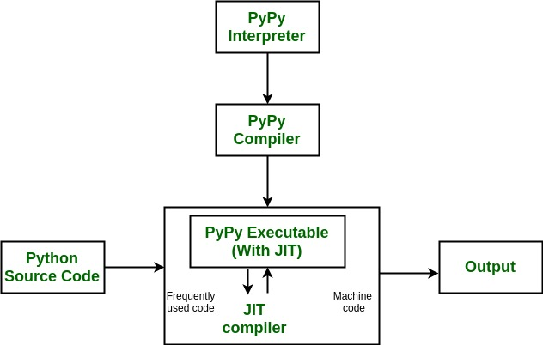
Python IDE
Python characteristics
Notes:
La compilation à la volée, dite « Just In Time » est un mécanisme qui permet à une machine virtuelle d’optimiser les performances en compilant des parties du programme au lieu de les interpréter.
It's worth it at this point to read up on how tracing JIT compilers work. Here's a brief explanation: The interpreter is usually running your interpreter code as written. When it detects a loop of code in the target language is executed often, that loop is considered "hot" and marked to be traced. The next time that loop is entered, the interpreter gets put in tracing mode where every executed instruction is logged.
When the loop is finished, tracing stops. The trace of the loop is sent to an optimizer, and then to an assembler which outputs machine code. That machine code is then used for subsequent loop iterations.
This machine code is often optimized for the most common case, and depends on several assumptions about the code. Therefore, the machine code will contain guards, to validate those assumptions. If a guard check fails, the runtime falls back to regular interpreted mode.

Slide 23
Python IDE
Python characteristics
Numba: Numba is an open source JIT compiler that translates a subset of Python and NumPy code into fast machine code.
http://numba.pydata.org/

Slide 24
Python IDE
Python characteristics
Object-Oriented
  Simple and additionally supports procedural programming
Extensible – easily import other code
Embeddable –easily place your code in non-python programs
Extensive libraries
  (i.e. reg. expressions, doc generation, CGI, ftp, web browsers, ZIP, WAV, cryptography, etc...) (wxPython, Twisted, Python Imaging library)

