Slide 1
Python Crash Course
For Data Scientist

Slide 2
Notice
Please note, this is not meant to be a comprehensive overview of Python or programming in general.

Slide 3
Python
Overview
A hobby project by Guido Van Rossum and was first released in 1991.
A general purpose language
Guido compares Python to languages like Java or Swift and says that while the latter two are a great choice for software developers — people whose day job is programming, but
Python was made for people whose day job has nothing to do with software development but they code mainly to handle data.
Python is an interpreted, high-level, general-purpose programming language. It is dynamically typed and garbage-collected.

Slide 4
Python
Python characteristics
Simple
  Python is a simple and minimalistic language in nature
  Reading a good python program should be like reading English
  Its Pseudo-code nature allows one to concentrate on the problem rather than the language
Easy to Learn
Free & Open source
  Freely distributed and Open source
  Maintained by the Python community
High Level Language –memory management
Portable – *runs on anything c code will (c compiler)

Slide 5
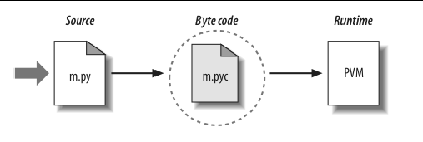
Python
Compilation vs Interpretation
Compilation = translating your human understandable code to machine understandable code. Machine code is the base level form of instructions that can be directly executed by the CPU.
Interpretation = executing a program by reading the source code a line at a time, and doing what it says (shell like).
Python is an interpreted language and not a compiled one, although compilation is a step. Python code, written in .py file is first compiled to what is called bytecode which is stored with a .pyc or .pyo format.
Notes:
An important aspect of Python’s compilation to bytecode is that it’s entirely implicit. You never invoke a compiler, you simply run a .py file. The Python implementation compiles the files as needed. This is different than Java, for example, where you have to run the Java compiler to turn Java source code into compiled class files. For this reason, Java is often called a compiled language, while Python is called an interpreted language. But both compile to bytecode, and then both execute the bytecode with a software implementation of a virtual machine.

Slide 6
Python
Compilation vs Interpretation
Platform-independent: you can just copy over your code to another system and it will auto-magically work (with python platform):.
Dynamic typing:
  In static-typed languages like C++, you have to declare the variable type and any discrepancy like adding a string and an integer is checked during compile time.
  In strongly typed languages like Python, it is the job of the interpreter to check the validity of the variable types and operations performed.
  Dynamic typing provides a lot of freedom, but simultaneously it makes your code risky and sometimes difficult to debug
Garbage Collector: automatically frees up space without you doing anything.

Slide 7
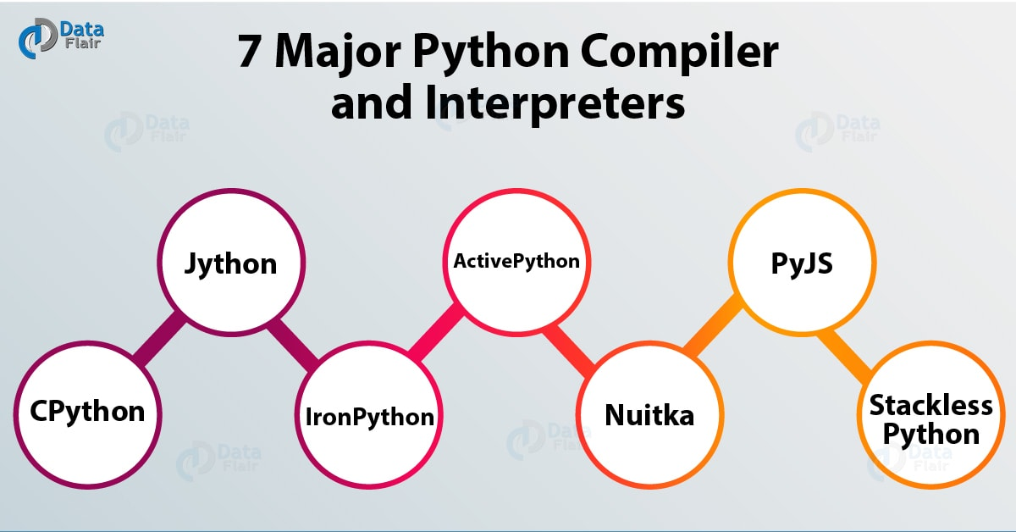
Python
Python characteristics
Interpreted (mixted)
  You run the program straight from the source code.
  Python program →Bytecode →a platforms native language
  You can just copy over your code to another system and it will auto-magically work (with python platform)
Notes:
https://hackr.io/blog/best
Python as a programming language has no saying about if it's an compiled or interpreted programming language, only the implementation of it. The terms interpreted or compiled is not a property of the language but a property of the implementation. Python program runs directly from the source code . so, Python will fall under byte code interpreted. The .py source code is first compiled to byte code as .pyc. This byte code can be interpreted (official CPython), or JIT compiled (PyPy). Python source code (.py) can be compiled to different byte code also like IronPython (.Net) or Jython (JVM). There are multiple implementations of Python language . The official one is a byte code interpreted one. There are byte code JIT compiled implementations too.
-python-compilers

Slide 8

Python
Python characteristics
  PyPy = an alternative implementation of Python which often runs faster than the standard implementation of Python, CPython.
  The reason PyPy is a just-in-time compiler, while CPython is an interpreter. Most Python code runs well on PyPy, except for code that relies on CPython extensions, which either does not work or incurs some overhead when run in PyPy.
Notes:
Python as a programming language has no saying about if it's an compiled or interpreted programming language, only the implementation of it. The terms interpreted or compiled is not a property of the language but a property of the implementation. Python program runs directly from the source code . so, Python will fall under byte code interpreted. The .py source code is first compiled to byte code as .pyc. This byte code can be interpreted (official CPython), or JIT compiled (PyPy). Python source code (.py) can be compiled to different byte code also like IronPython (.Net) or Jython (JVM). There are multiple implementations of Python language . The official one is a byte code interpreted one. There are byte code JIT compiled implementations too.

Slide 9
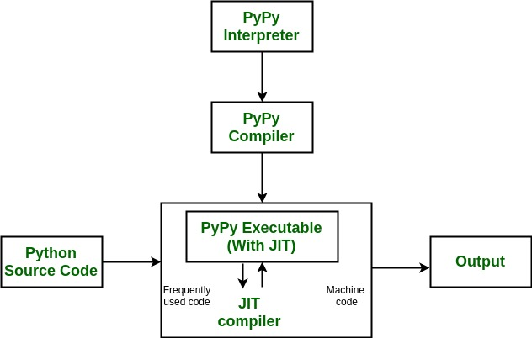
Python
Python characteristics
Notes:
La compilation à la volée, dite « Just In Time » est un mécanisme qui permet à une machine virtuelle d’optimiser les performances en compilant des parties du programme au lieu de les interpréter.
It's worth it at this point to read up on how tracing JIT compilers work. Here's a brief explanation: The interpreter is usually running your interpreter code as written. When it detects a loop of code in the target language is executed often, that loop is considered "hot" and marked to be traced. The next time that loop is entered, the interpreter gets put in tracing mode where every executed instruction is logged.
When the loop is finished, tracing stops. The trace of the loop is sent to an optimizer, and then to an assembler which outputs machine code. That machine code is then used for subsequent loop iterations.
This machine code is often optimized for the most common case, and depends on several assumptions about the code. Therefore, the machine code will contain guards, to validate those assumptions. If a guard check fails, the runtime falls back to regular interpreted mode.

Slide 10
Python
Python characteristics
Numba: Numba is an open source JIT compiler that translates a subset of Python and NumPy code into fast machine code.
http://numba.pydata.org/

Slide 11
Python
Python characteristics
Object-Oriented
  Simple and additionally supports procedural programming
Extensible – easily import other code
Embeddable –easily place your code in non-python programs
Extensive libraries
  (i.e. reg. expressions, doc generation, CGI, ftp, web browsers, ZIP, WAV, cryptography, etc...) (wxPython, Twisted, Python Imaging library)

