Slide 1
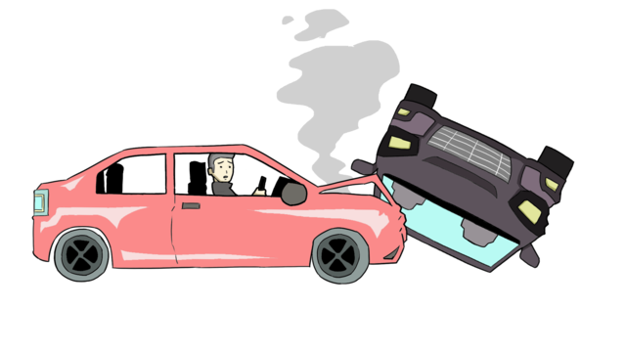
Behind The Wheel
Berk Güler
Mustafa Barış Emektar
Notes:
Hello everyone, I’m Barış and my friend is Berk.Today we are going to talk about our project Behind The Wheel.

Slide 2

The Problem
Exploration of relationships between various features (such as weather conditions, time of day, and location) and their impact on accidents occured in U.S.
Actionable insights for improving road safety and minimizing the consequences of accidents.
Notes:
In this project, we’re looking into the accidents occured in the United States to figure out the common factors and how serious accidents are.
We want to see how different things like weather, time and the location of the incident affect an accident.
That is we want to explore the interesting relationships in accidents occured in United States.
This will help us to find practical ways to make roads safer and reduce the harm of accidents.

Slide 3
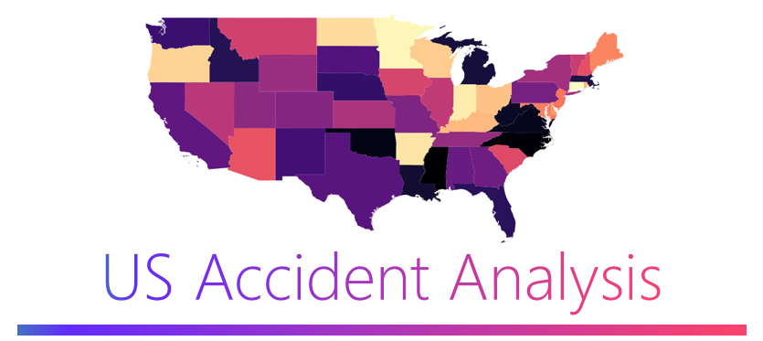

Dataset
US Accidents dataset from Kaggle (2016 to 2023)
Time Scope and Size
Accidents occurred in the 49 states of the USA.
7.7 million accident records with 3.06GB of data.
Rich Features
46 different aspects such as the exact location, the weather and road conditions, when it happened.
Severity Labels
Four level of accident severity (such as fatal, highly severe, moderate and minor)
Notes:
For this project, we chose the US Accidents dataset from Kaggle, which covers traffic accidents across the United States from 2016 to 2023. This data set is suited to our needs for several reasons:
Firstly This dataset covers a seven-year period and includes information from 49 states, total of 7.7 million records of accidents with 3 GB in size.
Also the dataset offers Rich Features for each accident, covering 46 different aspects such as the exact location, weather conditions at the time, when it happened, and what was the road conditions.
These details help us spot trends and understand the factors contributing to the accidents.
Finally The dataset includes severity Labels, it categorizes accidents based on their severity, with labels such as fatal, highly severe, moderate and minor.
This classification is essential for our research because it allows us to gain deeper insights.

Slide 4

Solution
Exploratory Data Analysis
Relationship Discovery
Scaling Up
Visualization and Interpretation
Notes:
So, you can see the four main steps of our solution..
First, we started with exploring the dataset. We identified the key features like location, time, and weather that might influence accident.
Then, the relationships between features are investigated. For instance, are certain weather conditions associated with more severe accidents? Does accident severity vary by location? Are there temporal patterns? Are there more accidents during rush hours?
After that,We used apache Spark for handling large datasets efficiently since it parallelizes computations to speed up processing and optimizes memory/storage usage.
Finally, Visualizations like bar graphs, pie charts are created to highlight relationships. Also, the model results will be interpreted to understand which features contribute most to accident severity.

Slide 5
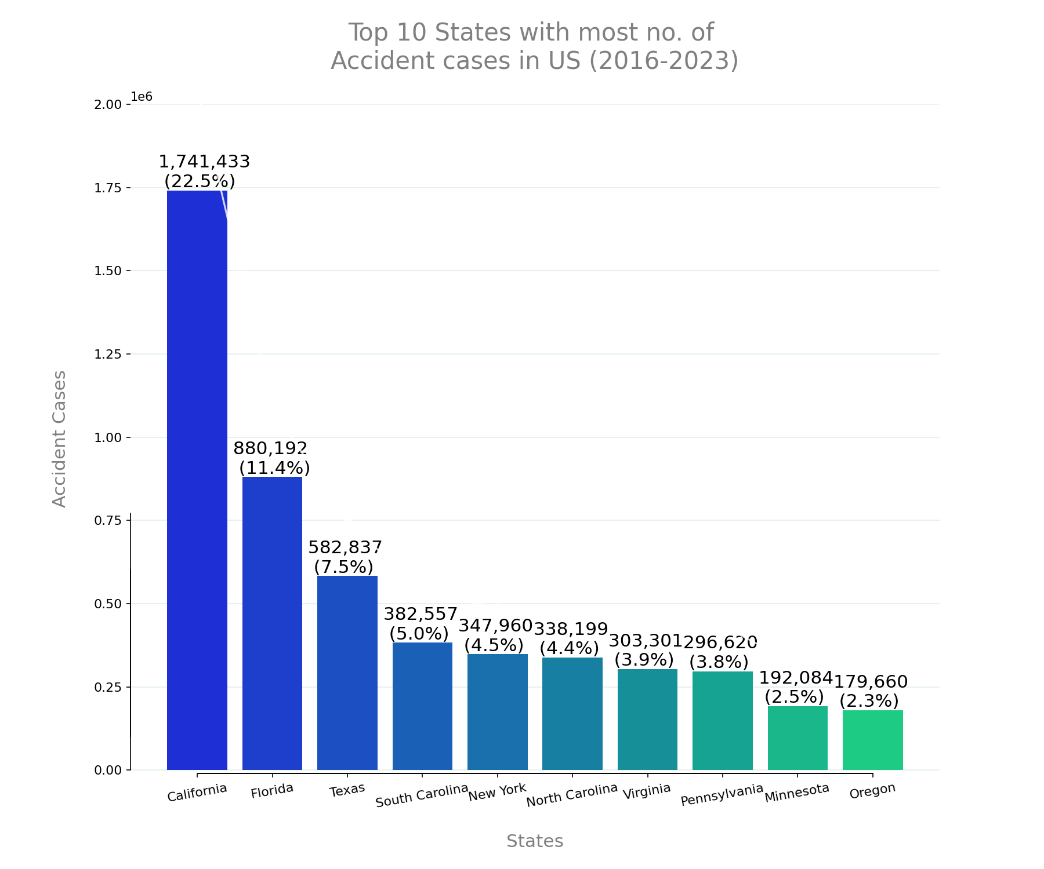
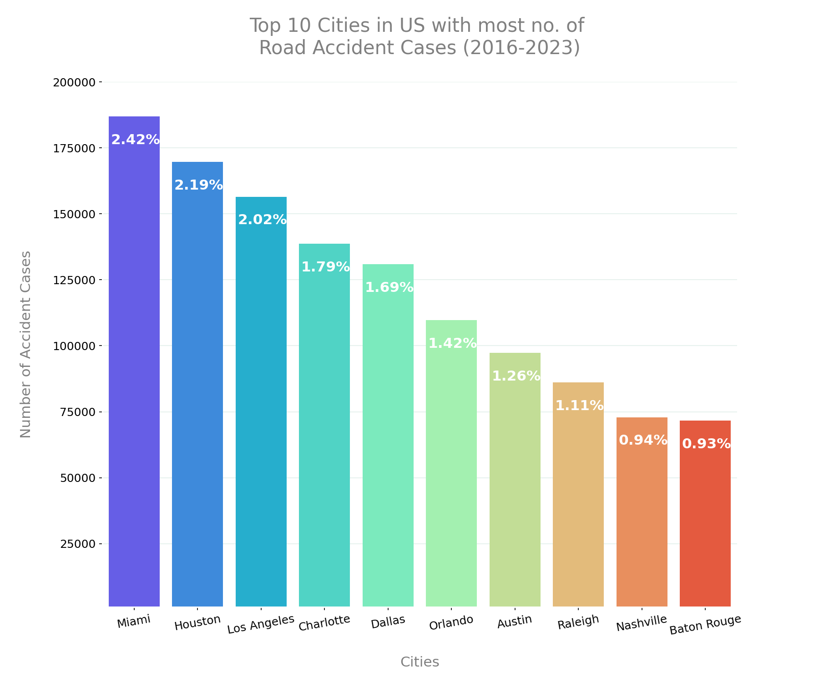
Results
Notes:
Here we can see the top 10 states and cities with the most number of road accidents cases in the US between the years from 2016 to 2023.
As we can see from the figures, California is the state with the most road accidents cases, with over 1.7 Million traffic accidents. Afterwards, Florida and Texas follows it.
Miami is the city with the most road accidents cases, with over 175,000 traffic accidents. Afterwards, Houston follows it.

Slide 6
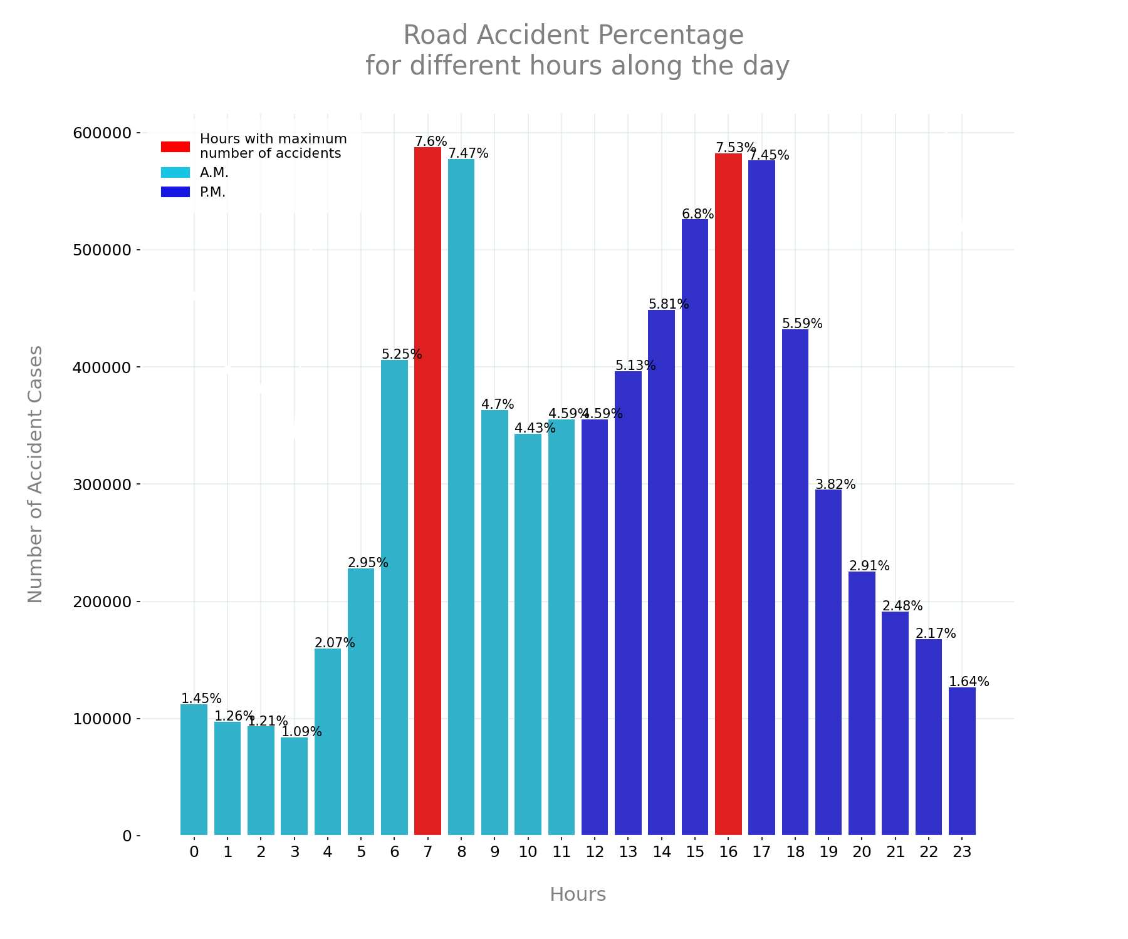
Results
Notes:
The hours with the highest number of accidents are 7-8 A.M. (7.6%) and 4-5 P.M. (7.53%). These hours are highlighted in red, indicating they are the peak times for road accidents.
These times correspond to typical rush hours when traffic is dense due to people commuting to and from work.
Early morning (midnight to 4 A.M.) has the lowest accident percentages, likely due to fewer vehicles on the road.
The data suggests heightened caution during rush hours (7-8 A.M. and 4-5 P.M.) is necessary to reduce accidents. Traffic management and safety measures might be most needed during these peak times to mitigate risks.

Slide 7
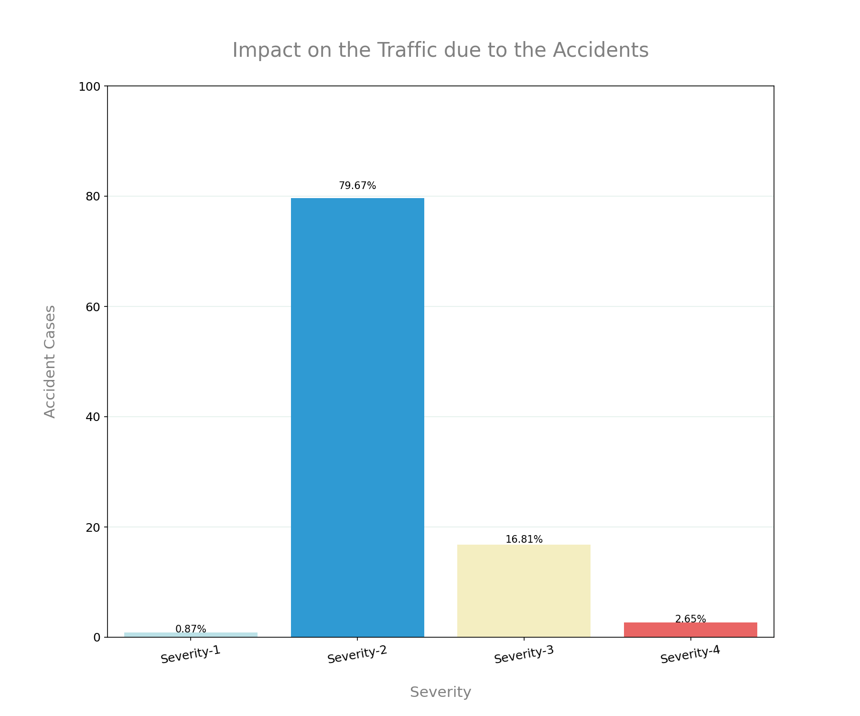
Results
Notes:
In this figure you can see the four different levels of severity. Our insights about the severity are as follows:
In nearly 80% Cases of road accidents, the impact on the traffic was Moderate (Severity-2). That is injuries that usually do not require extensive medical treatment.
In 2.65% Cases of road accidents, the impact on the traffic was highly Severe (Severity-4) which resulting in the loss of life.
—-----------------------
No Injury: Situations where the individuals involved in the road accident do not sustain any injuries.
Slight Injury: Injuries that are not severe and usually do not require extensive medical treatment.
Severe Injury: Serious injuries that require medical attention and may have long-term effects on the individuals’ health.
Fatal Injury: The most severe outcome, resulting in the loss of life1.

Slide 8
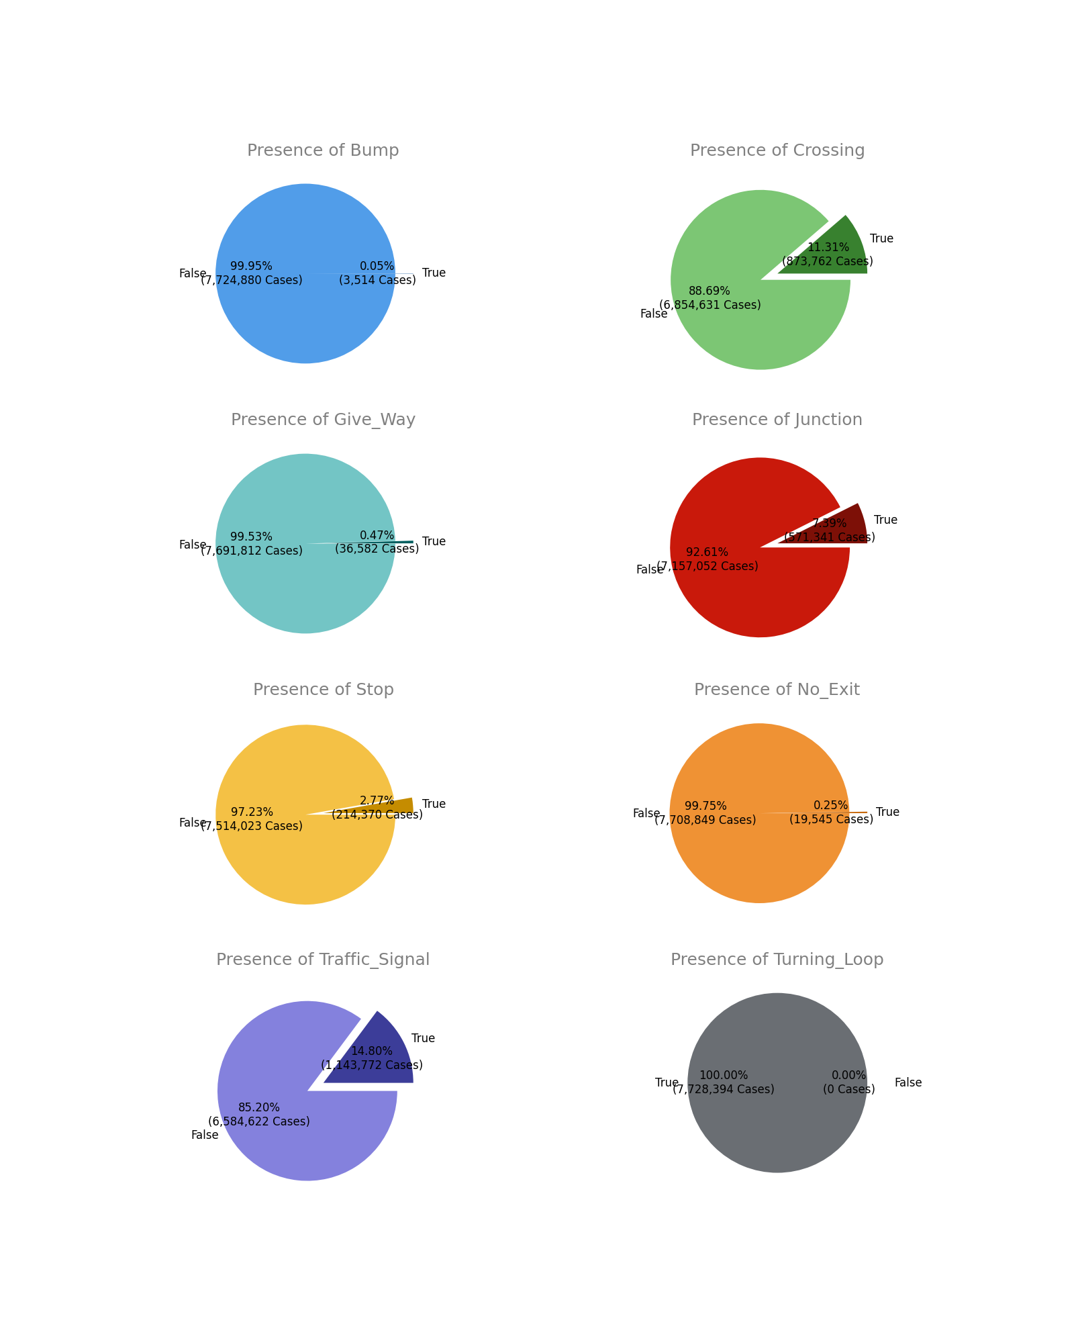
Results
Notes:
Road Condition
In 97.23% of the cases, there were no Stop sign near the accident area.
14.80% road accident cases recorded near the traffic signal.
In 11.31% cases, road accidents happened near the crossing.
13.49% road accident cases recorded near the junctions.

Slide 9

Conclusion
Depend on multiple factors
Other figures
Predictions
Apache Spark
Notes:
As we have mentioned before, we have seen that these traffic accidents depend on multiple factors.
In order to reduce road accidents we should consider these factors and take the necessary precautions. For instance, we must pay attention and obey the traffic signs. Or while commuting to and from work we should consider using public transportations.
There are other graphs that we couldn't show due to time constraints. For example, accident statistics by month/day, by weather etc.
If we have time, we also want to make predictions about the severity of the road accident by using machine learning.
We used Apache Spark for the development of the project and this has been a great benefit. Because it would have taken much more time to process and graph a large data of 3 GB without spark. Spark shortened this time considerably for us.

Slide 10
THANK YOU
Berk Güler
Mustafa Barış Emektar

