Slide 1


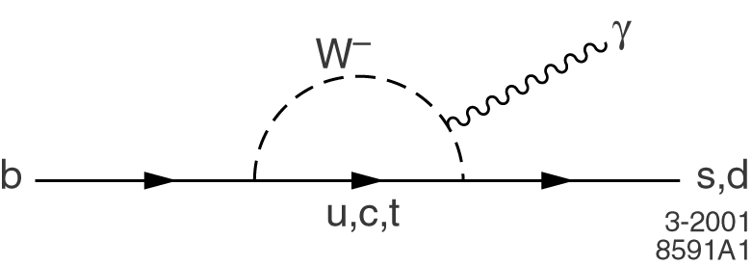
TM
Measurements of
Radiative Penguin B Decays at BaBar
All results preliminary unless explicitly indicated
Jeffrey Berryhill
University of California, Santa Barbara
For the BaBar Collaboration
32nd International Conference on High Energy Physics
August 17, 2004

Slide 2
Radiative Penguin Decays and New Physics
Radiative penguin decays: b → sγ and b → dγ FCNC transitions
SM leading order = one EW loop
V_{ts}, V_{td} dependent
FCNCs probe a high virtual energy scale comparable to high-energy colliders
Radiative FCNCs have precise SM predictions:
BF(b→sγ)_{TH} = 3.57 ± 0.30 x 10⁻⁴ (SM NLO)
BF(b→sγ)_{EXP} = 3.54 ± 0.30 x 10⁻⁴ (HFAG)
Decay rate agreement highly constrains new physics at the electroweak scale!
Further tests presented here:
Exclusive b→sγ decay rates
b→sγ CP asymmetries
b→dγ penguins
Multiple new BF(b→sγ)
measurements coming soon from BaBar

Slide 3
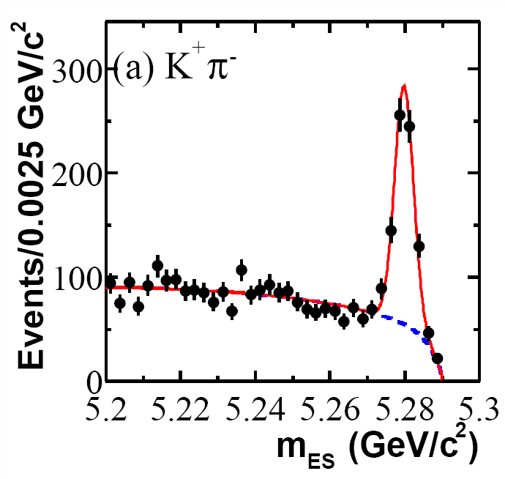
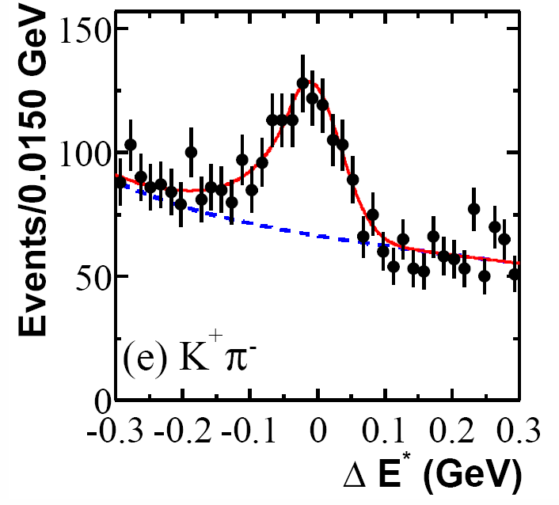



Measuring Exclusive Radiative Penguin Decays
Small rates (BF < 10⁻⁴) on top of large backgrounds
Common strategy :
select photon + hadrons with strict particle ID
cut when possible on meson masses
reduce continuum background with multivariate methods
extract signal with multi-dimensional maximum likelihood fit
Best kinematic constraints
from B candidate momentum and
energy, compared with E_{beam}:
Ex: signal fit for B → K*⁰γ, K*⁰ → K⁺π⁻
583±30 events
* denotes CM frame
For signal, m_{ES} ≈ m_{B}, σ(m_{ES}) ≈ 3 MeV
ΔE* ≈ 0, σ(ΔE*) ≈ 50 MeV

Slide 4
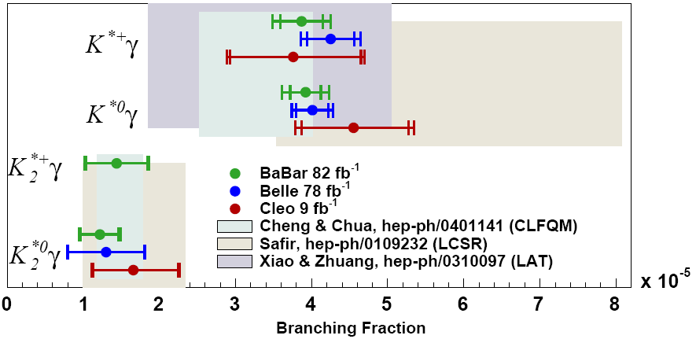
B → K* γ Branching Fractions: Summary
BaBar preliminary measurements on 82 fb⁻¹
Becoming systematics limited
Exp. vs. theory: data more accurate
than form factor predictions!

Slide 5
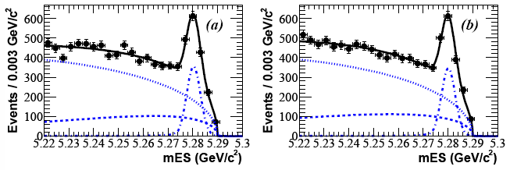
Direct CP Asymmetry: b →sγ and B → K* γ
< 1% in the SM, could receive ~10% contributions from new EW physics
Either inclusive or exclusive decays could reveal new physics
B or K charge tags the flavor of the b quark with ~1-2% asymmetry systematic
Sum of 12 exclusive,
self-tagging
B→X_{s} γ final states
X_{s} = K/K_{s} + 1-3 pions
Eγ∗ > 2.14 GeV
b→sγ
b→sγ
b →sγ A_{CP} = (N – N)/(N + N) = 0.025 ± 0.050 ± 0.015
PRL 93 (2004) 021804, hep-ex/0403035
Asymmetries also measured precisely in exclusive K*γ decays:
B →K*γ A_{CP} = -0.013 ± 0.036 ± 0.010
submitted to PRL, hep-ex/0407003
Δ₀₋ = Γ(K*⁰ γ) – Γ(K*⁻ γ) = 0.050 ± 0.045 ± 0.028 ± 0.024
Γ(K*⁰ γ) + Γ(K*⁻ γ)
preliminary

Slide 6
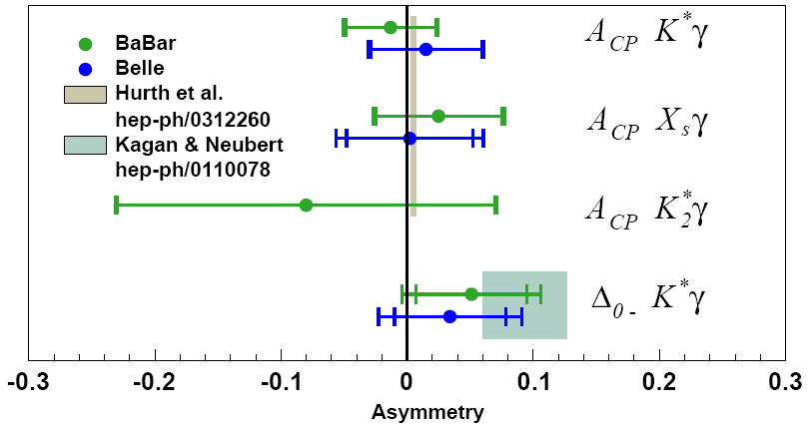
b → s γ Asymmetries: Summary
BaBar measurements on 82 fb⁻¹
K*γ, K₂*γ preliminary; X_{s}γ published
CP asymmetries consistent with SM (0.4%) at the ~5% level
K*γ isospin asymmetry Δ₀₋ consistent with C₇ < 0
Statistics limited up to ~1 ab⁻¹
sgn Δ₀₋ = -sgn C₇
Can we exclude C₇ > 0 ?

Slide 7
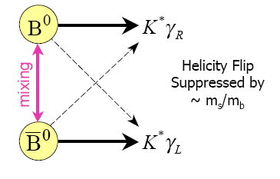
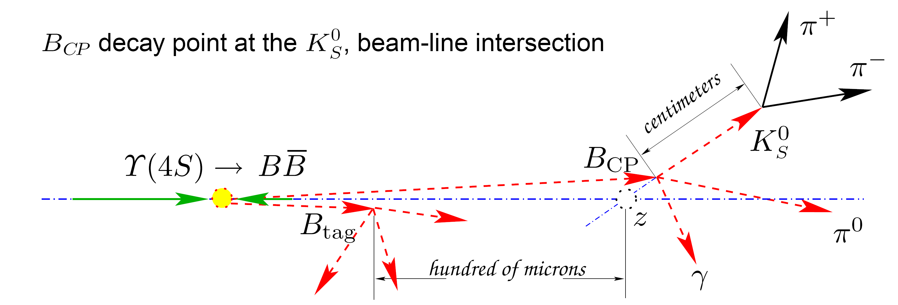
Time-Dependent CP Asymmetry in B →K*γ (113 fb⁻¹)
As in B⁰→J/ψ K_{S}, interference between mixed and
non-mixed decay to same final state required for CPV.
In the SM, mixed decay to K*γ requires wrong photon
helicity, thus CPV is suppressed:
In SM: C = -A_{CP} ≈ -1% S ≈ 2(m_{s}/m_{b})sin 2β ≈ 4%
Measuring Δt of K*(→K_{S}π⁰) γ events requires novel beam-constrained vertexing techinque:
Vertex signal B with intersection of K_{S} trajectory and beam-line
Usable resolution for K_{S} decaying inside the silicon tracker
Validated with B⁰→J/ψ K_{S} events

Slide 8
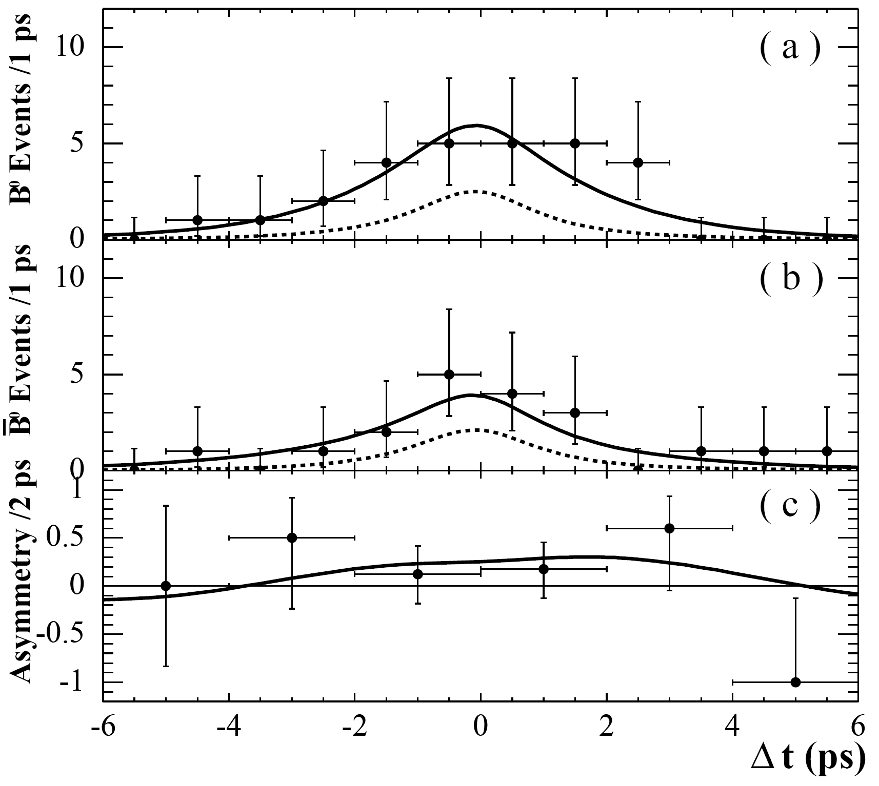
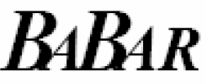
Time-Dependent CP Asymmetry in B →K*γ (113 fb⁻¹)
Likelihood fit of three components
(qq, BB, K*γ)
to 5D data
(m_{ES},ΔE,Fisher,m_{K*},Δt)
K*γ signal = 105 ± 14 events
S = +0.25 ± 0.63 ± 0.14
C = -0.57 ± 0.32 ± 0.09
submitted to PRL, hep-ex/0405082
Consistent with SM
For C fixed to 0, S = 0.25 ± 0.65 ± 0.14
preliminary
First ever measurement of time-dependent CP asymmetries in radiative penguins!

Slide 9
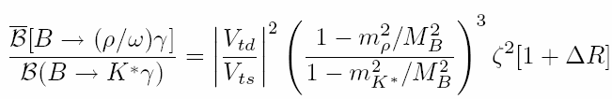
Search for B → ργ, ωγ (191 fb⁻¹)
NEW!
Simplest and most “common” b → dγ exclusive decays are ργ and ωγ:
B⁺ → ρ⁺ γ, ρ⁺ → π⁺ π⁰ BF ≈ BF K*γ x |V_{td}/V_{ts}|² ≈ 1.6 x 10⁻⁶
B⁰ → ρ⁰ γ, ρ⁰ → π⁺ π⁻ BF ≈ ½ BF ρ⁺γ
B⁰ → ω γ, ω → π⁺ π⁻ π⁰ BF ≈ ½ BF ρ⁺γ
Previous BaBar limit: BF ρ⁺γ < 1.9 x 10⁻⁶ 90% CL (78 fb⁻¹)
Preliminary Belle evidence (3.5σ): BF ρ⁺γ = 1.8 ± 0.6 ± 0.1 x 10⁻⁶ (140 fb⁻¹)
Comparable to rarest
B decays measured!
Ratio of exclusive b → dγ and b → sγ decay rates measures |V_{td}/V_{ts}| via
Ali et al. hep-ph/0405075
ΔR weak annhilation correction
ζ² SU(3) symmetry breaking of exclusive form factors

Slide 10
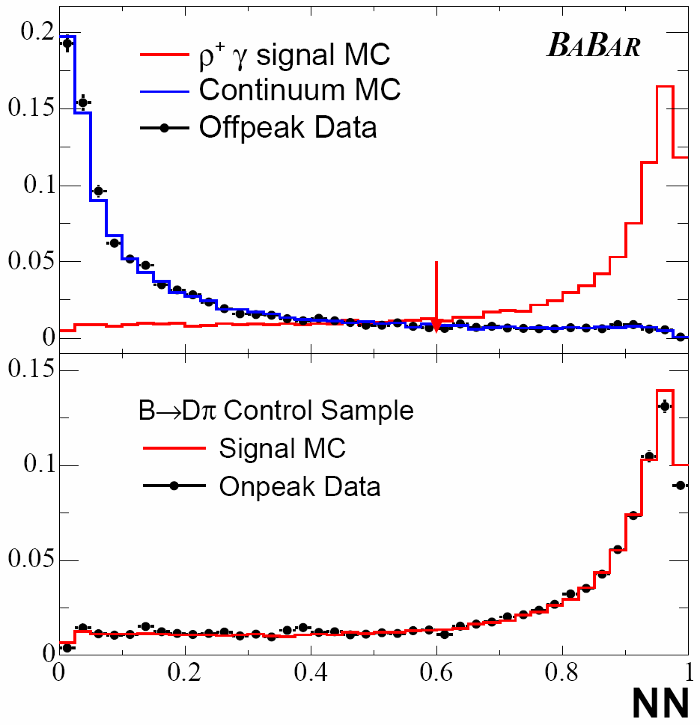
Continuum Background Suppression
e⁺e⁻ → qq continuum events are
the dominant background
Combine properties discriminating
B → γ + X from continuum
into a single-output neural net:
Event shape variables: spherical B vs.
jet-like continuum
B flavor tagging variables: kaons and
leptons in the rest of the event
B candidate vertex separation from
rest of the event
Neural net trained on simulated signal
and continuum samples
ε = 76%
cut
Neural net distribution for both signal and background described well by simulation

Slide 11
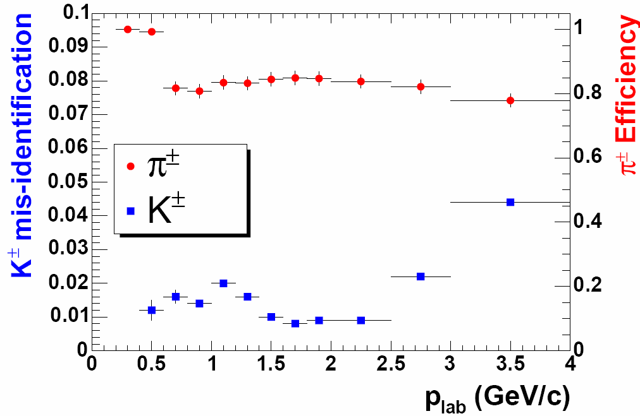
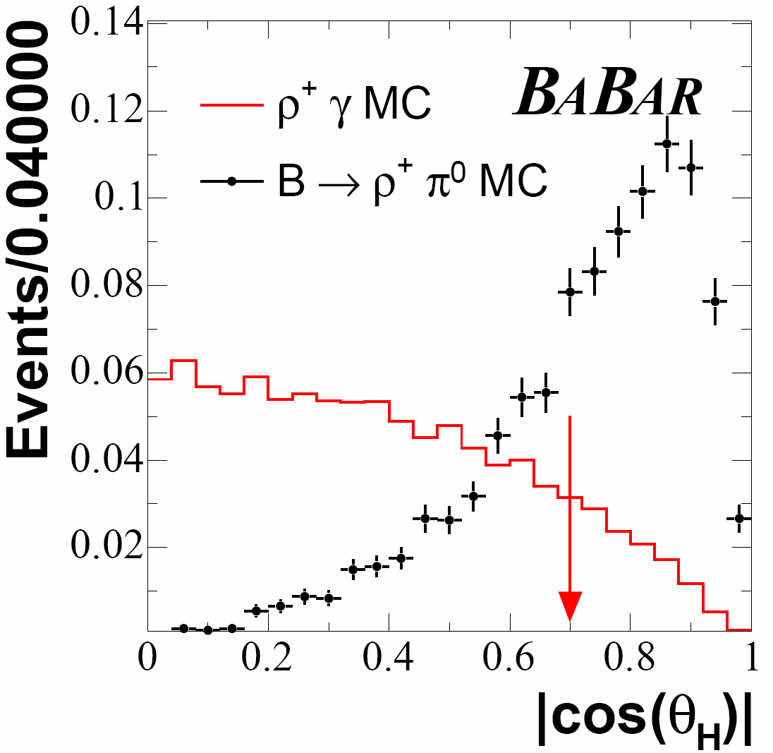
B Background Suppression
Large (40 x signal) K* γ background
reduced by strict π⁺ PID requirements
(track dE/dx, DIRC θ_{c} , DIRC N_{γ} )
K⁺ misid 1-2% for most of acceptance
ΔE provides additional separation
of K*γ from ργ
B decays to ρπ⁰, ρη, ωπ⁰, ωη
suppressed by cut on helicity angle
Combine helicity angle, B production angle,
Dalitz angle (ω only) into B Fisher discriminant
for additional background separation in signal fit
cut

Slide 12
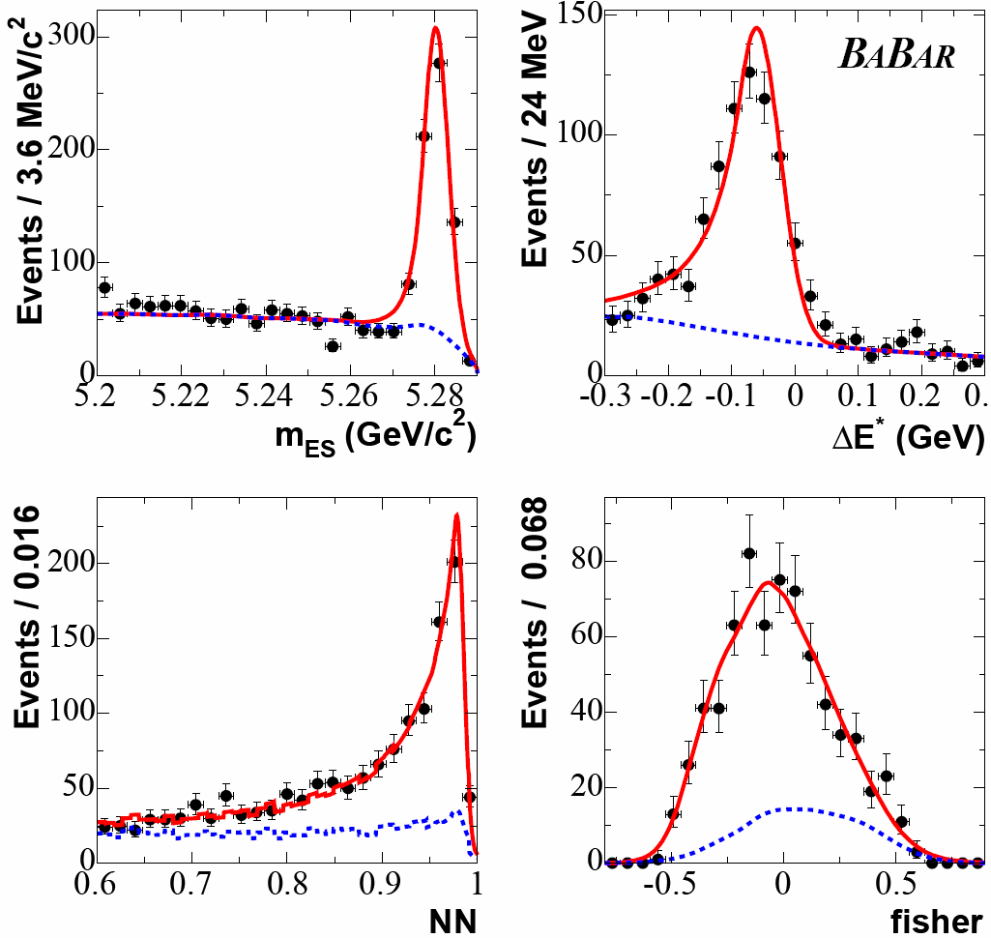
Signal Fit: K*γ Control Sample
Validate fit procedure on
data with K*γ sample
(ρ⁰γ candidates with
no PID requirement)
Unbinned extended ML
fit of three background components
(qq, X_{s} γ, ρ⁰(π⁰/η))
and K*γ component
to 4D data (m_{ES},ΔE,NN,Fisher)
qq, X_{s} γ, K*γ yield are free parameters
Large K*γ signal yield
consistent with BaBar
BF measurement
K*γ + background
preliminary
ΔE shifted
background

Slide 13
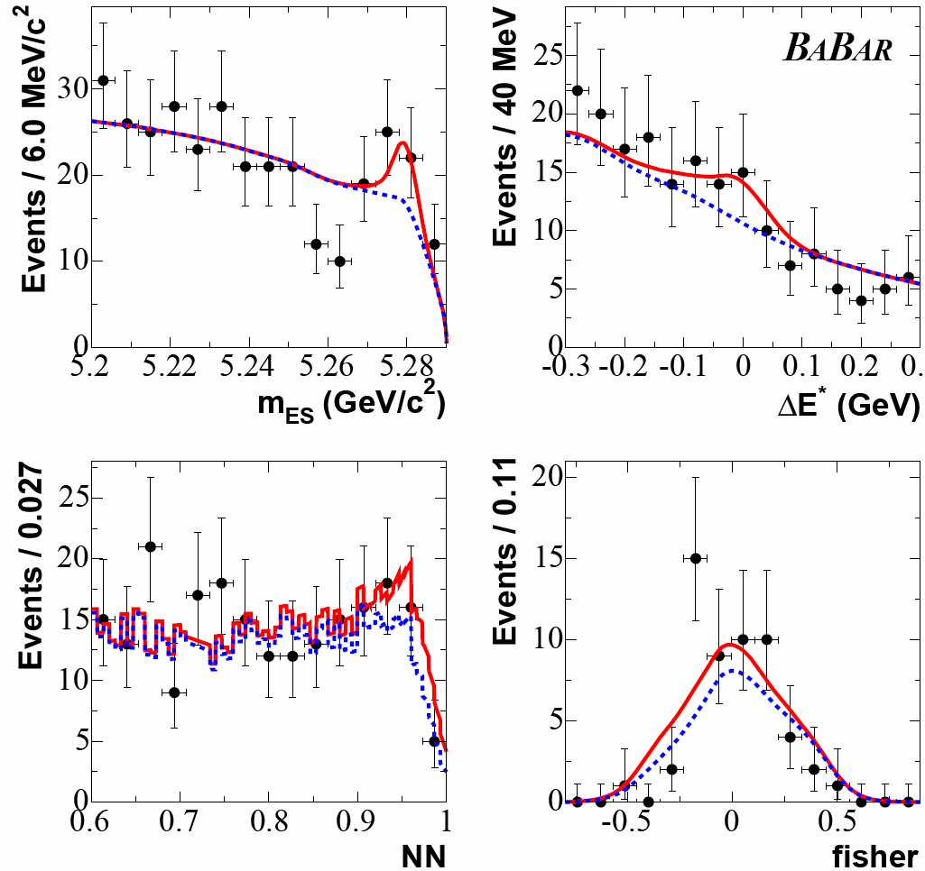
Signal Fit: B⁺ → ρ⁺ γ
ρ+γ + background
N(signal) = 26 ± 15 ± 2 significance = 1.9 σ
ε = 13.2 ± 1.4 %
BF = (0.9 ± 0.6 ± 0.1) x10⁻⁶
BF < 1.8 x10⁻⁶ 90% CL
preliminary
background
Fit of four backgrounds
(qq, X_{s} γ, ρ⁺(π⁰/η), K*γ)
and ρ+γ signal
qq, X_{s} γ, ρ⁺γ yield are free parameters

Slide 14
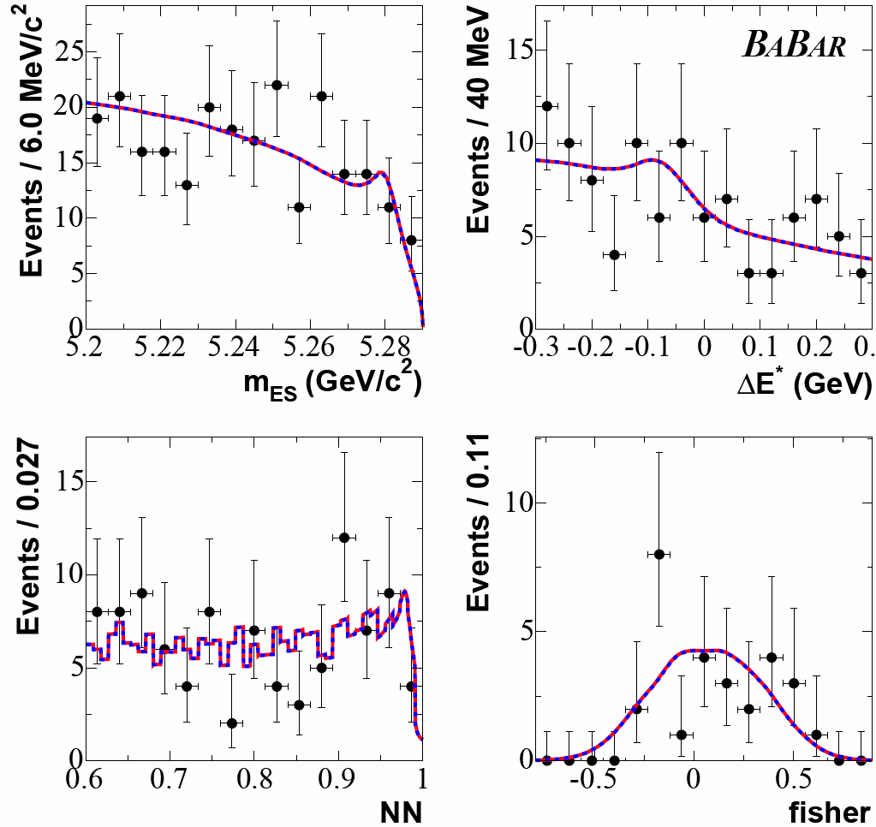
Signal Fit: B⁰ → ρ⁰ γ
small peaking background
+7.2 +1.7
- 5.4 - 1.6
N(signal) = 0.3
significance = 0.0 σ
ε = 15.8 ± 1.9 %
BF = (0.0 ± 0.2 ± 0.1) x10⁻⁶
BF < 0.4 x10⁻⁶ 90% CL
preliminary
Fit of four backgrounds
(qq, X_{s} γ, ρ⁰(π⁰/η), K*γ)
and ρ⁰γ signal
qq, X_{s} γ, ρ⁰γ yield are free parameters

Slide 15
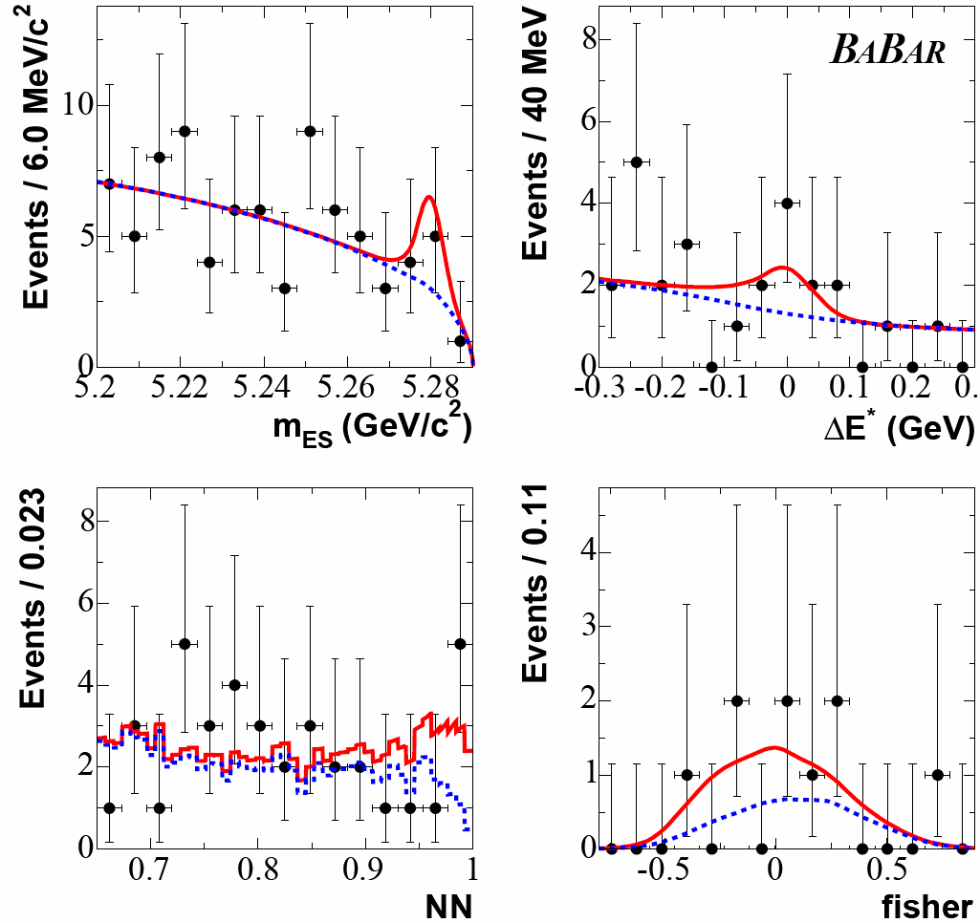
Signal Fit: B⁰ → ω γ
+5.7 +1.3
- 4.5 – 1.9
N(signal) = 8.3
significance = 1.5 σ
ε = 8.6 ± 0.9 %
BF = (0.5 ± 0.3 ± 0.1) x10⁻⁶
BF < 1.0 x10⁻⁶ 90% CL
preliminary
Fit of two backgrounds
(qq, ω(π⁰/η))
and ωγ signal
qq, ωγ yield are free parameters

Slide 16
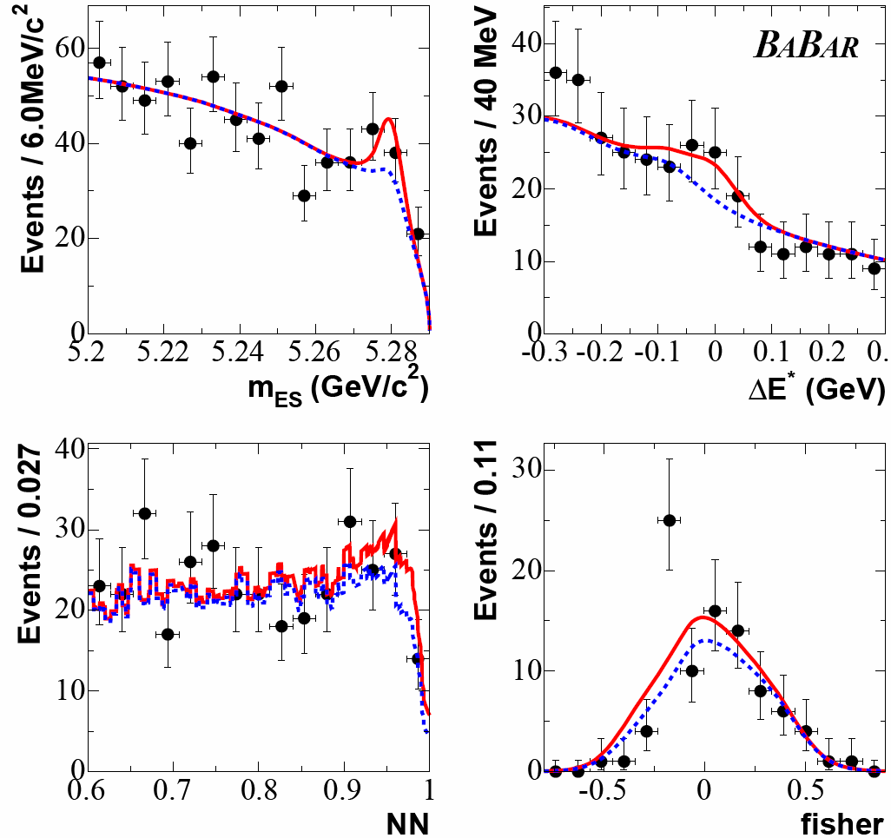
Combined Fit: B → ρ, ω γ
Simultaneous fit to all three samples with the constraint
Combined BF(ρ,ωγ) ≡ BF(ρ⁺γ) =
2(τ₊/τ₀) BF(ρ⁰ γ) =
2(τ₊/τ₀) BF(ω γ)
BF = (0.6 ± 0.3 ± 0.1) x10⁻⁶
significance = 2.1σ
BF < 1.2 x10⁻⁶ 90% CL
preliminary

Slide 17
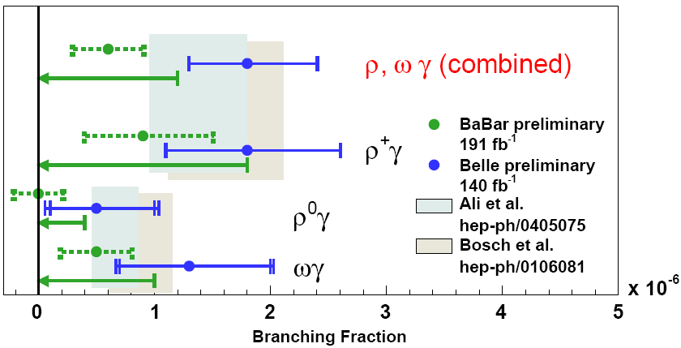
b → d γ Branching Fractions: Summary
Comparison of measurements with predictions for individual modes and combined BF
central value
90% C.L. upper limit
Belle BF vs.
BaBar BF
2.0σ difference

Slide 18
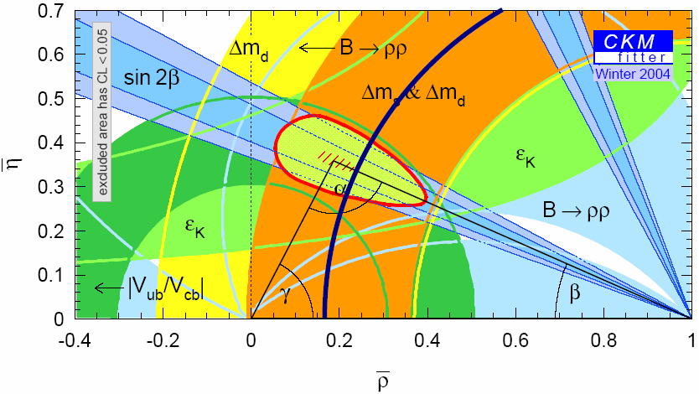
CKM matrix constraint
BaBar BF ratio upper limit < 0.030 → |V_{td}/V_{ts}| < 0.19 (90% CL)
Ali et al. hep-ph/0405075
no theory error
Penguins are starting to
provide meaningful CKM
constraint
(ζ²,ΔR) = (0.85,0.10)
ργ 95% C.L. allowed

Slide 19

CKM matrix constraint
BaBar BF ratio upper limit < 0.030 → |V_{td}/V_{ts}| < 0.19 (90% CL)
Ali et al. hep-ph/0405075
weak annhilation
correction ΔR = 0.1 ± 0.1
SU(3) breaking of
form factors ζ²= 0.85 ± 0.10
w/ theory error
no theory error
Penguins are starting to
provide meaningful CKM
constraint
Reduction of theory errors
necessary to be competitive
with B_{d},B_{s} mixing
(ζ²,ΔR) = (0.75,0.00)
(ζ²,ΔR) = (0.85,0.10)
ργ 95% C.L. allowed

Slide 20
Summary
Decay rate measurements of b→ sγ penguins are well into the precision era.
CP asymmetries of b→ sγ penguins are statistics limited and will continue to test
the SM
A_{CP} in B → X_{s} γ PRL 93 (2004) 021804, hep-ex/0403035
BF, A_{CP}, and Isospin asymmetry in B→ K*γ submitted to PRL, hep-ex/0407003
time-dependent CPV in B⁰ → K*⁰ γ submitted to PRL, hep-ex/0405082
b→ dγ penguins are only now beginning to reveal themselves in B-factory data.
They could also uncover new physics, or measure the poorly known |V_{td}|.
BaBar finds no evidence for B → ργ in 211 million BB events
submitted to PRL, hep-ex/0408034
BF(B → ρ,ω γ) < 1.2 X 10⁻⁶ |V_{td}/V_{ts}| < 0.19 (90% CL)
First measurement!

Slide 21
TM
Backup Slides

Slide 22
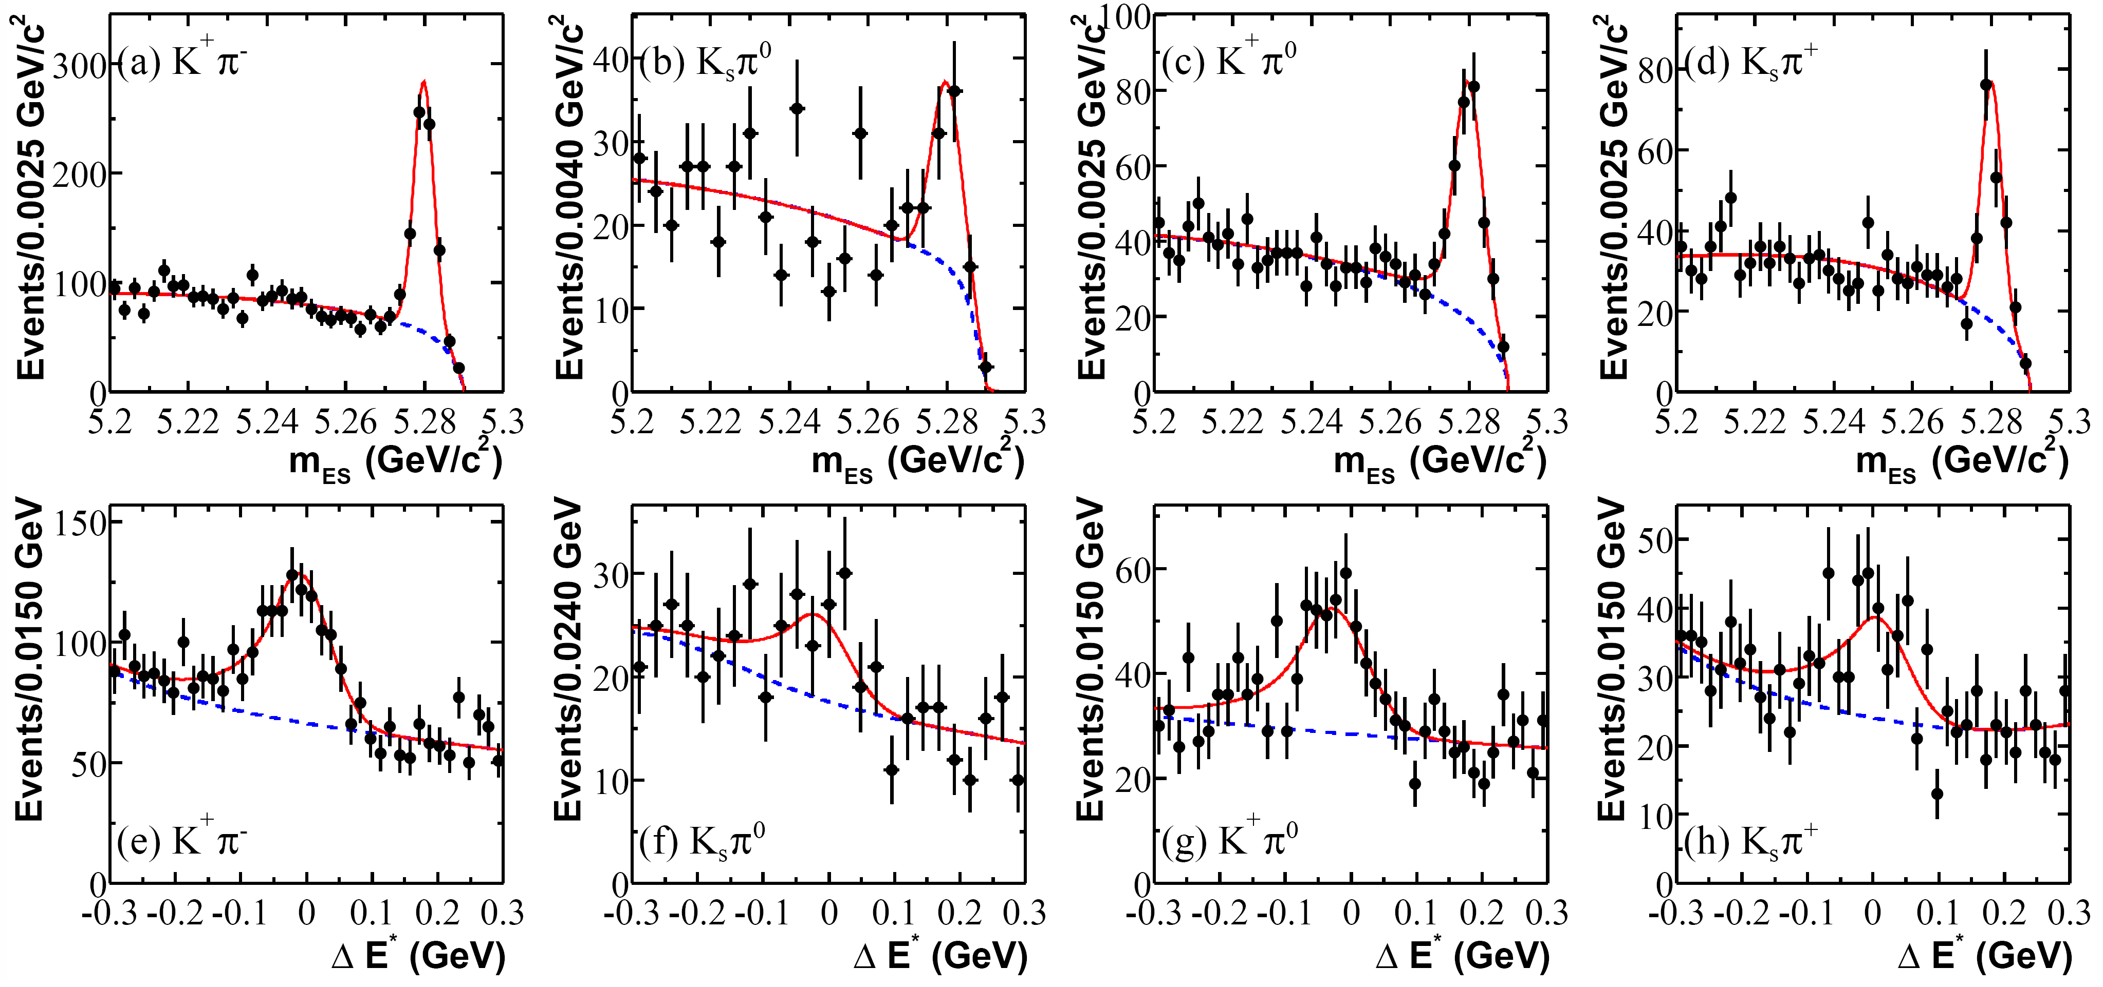
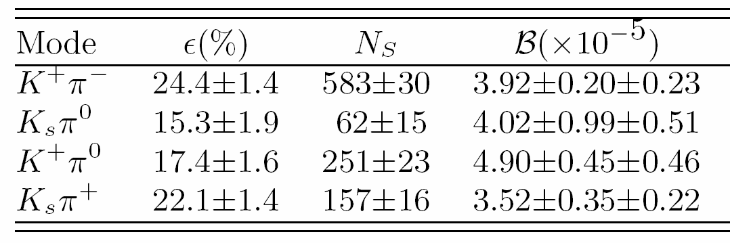
B → K*γ (82 fb⁻¹): Signal fits

Slide 23
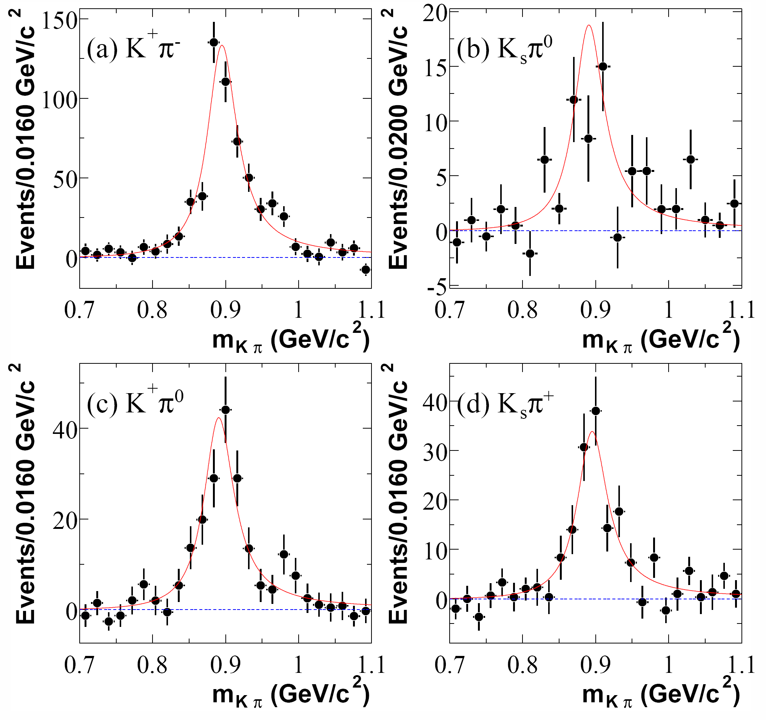
B → K*γ (82 fb⁻¹): K*γ lineshape
K* lineshape for
events with:
m_{ES} > 5.27 GeV/c²
-0.2 GeV < ΔE < 0.1 GeV
Background subtracted
with shape from m_{ES}
sideband
Fit to relativistic
Breit-Wigner with
PDG Γ(K*), m_{K*}

Slide 24
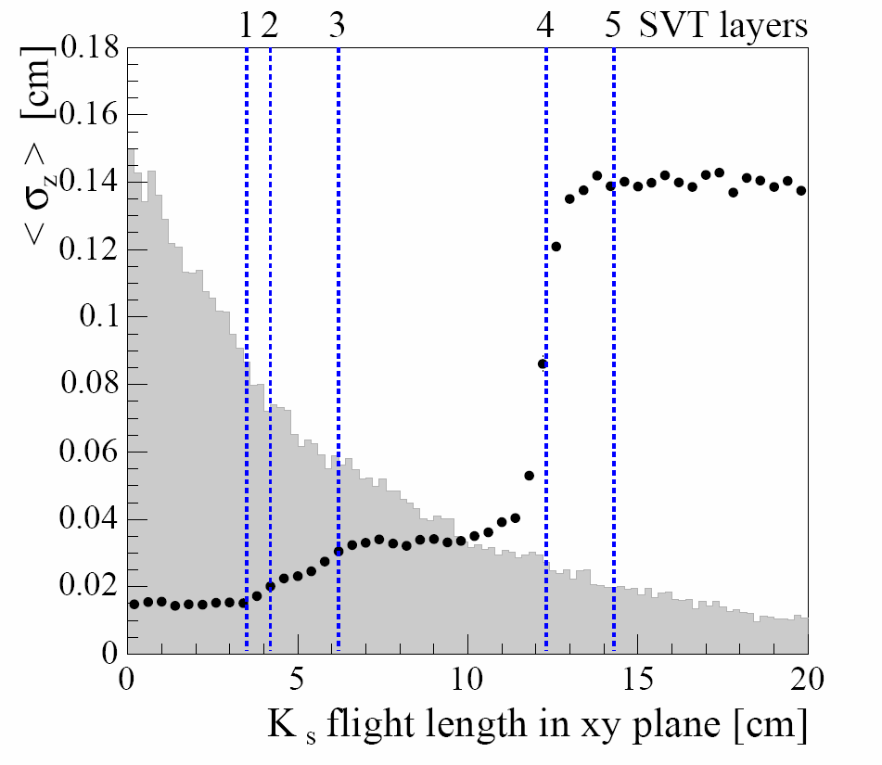
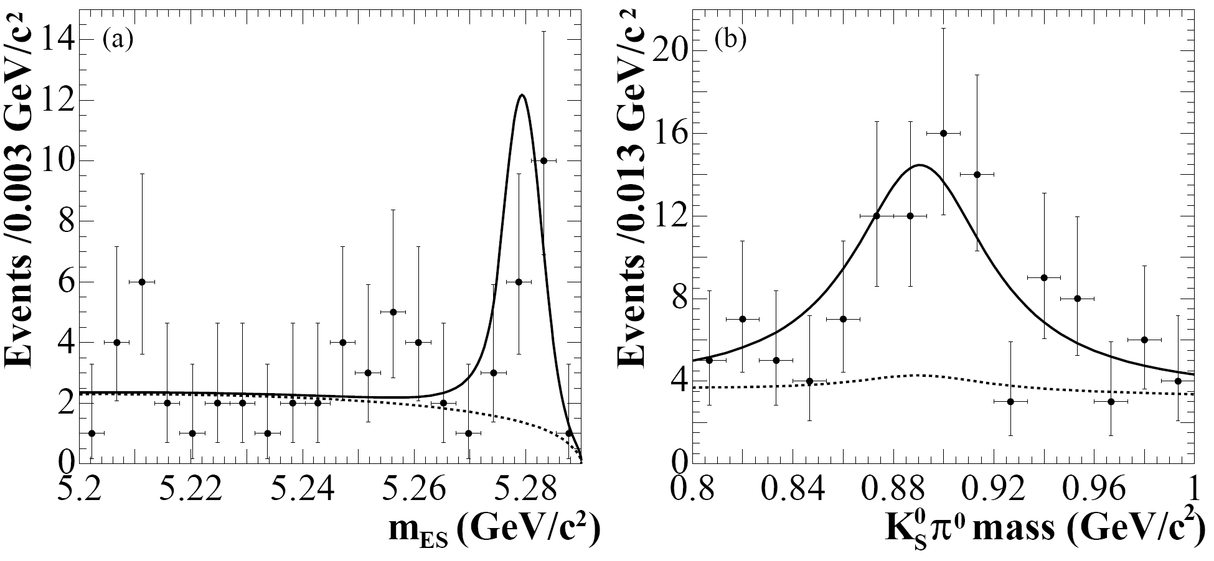
Time-Dependent CP Asymmetry in B →K*γ
Z resolution vs. K_{S} decay radius
Projection of fit with likelihood cut

Slide 25
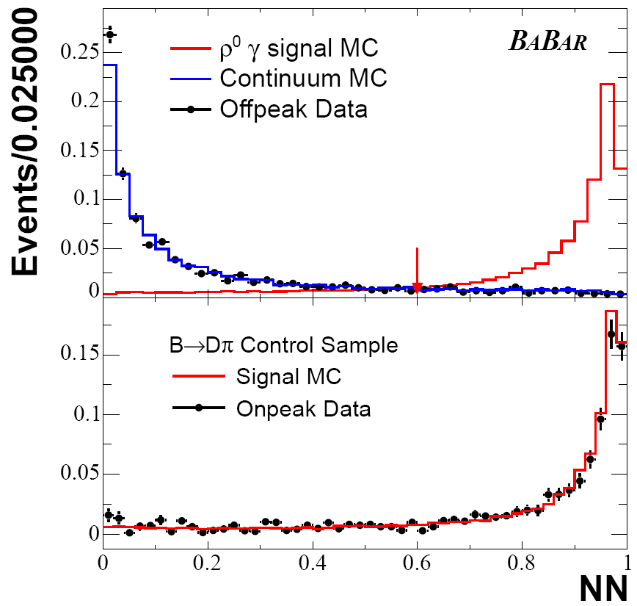
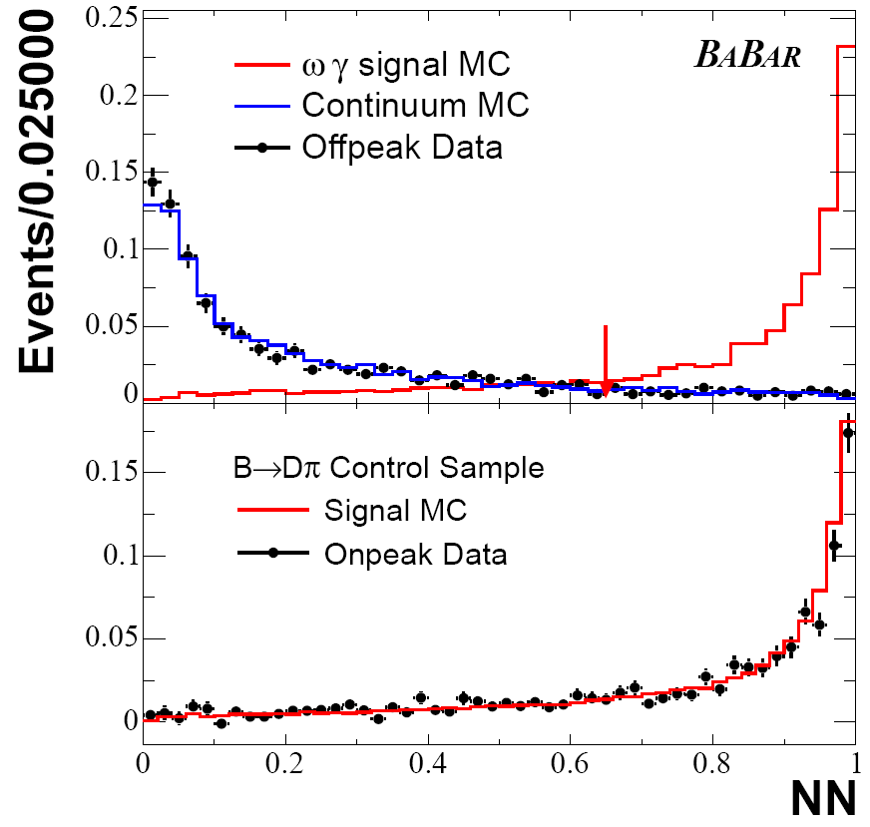
B → ργ: Neural net performance

Slide 26
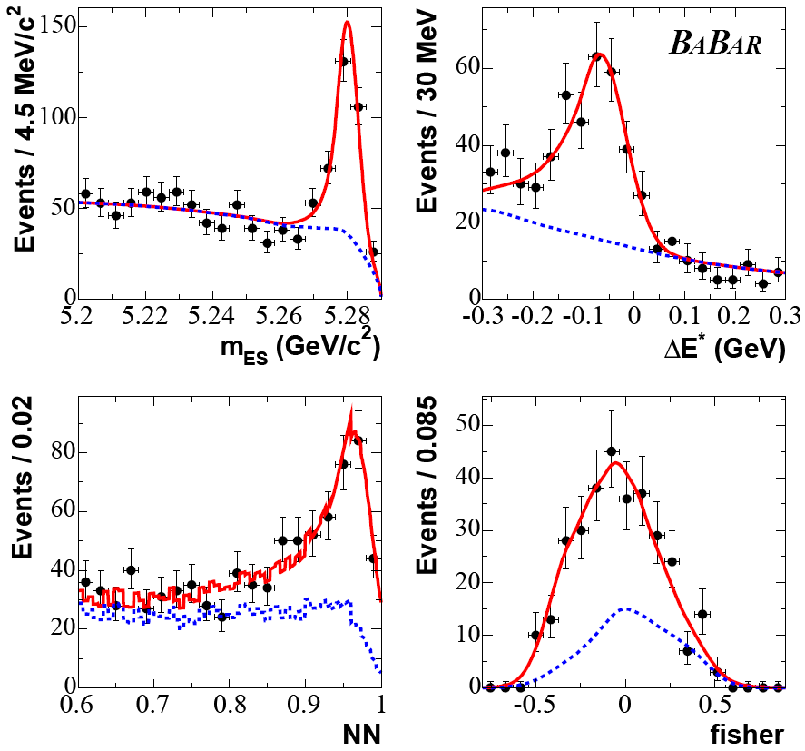
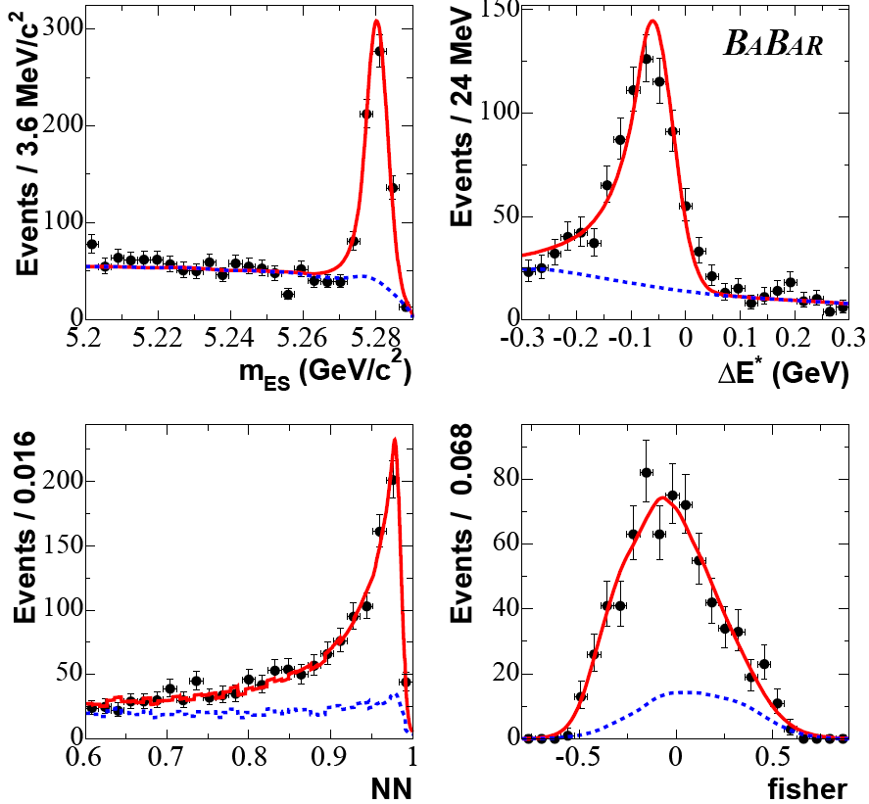
B → ργ: Κ∗γ Control Sample
ρ⁺γ, no PID
ρ⁰γ, no PID

