Slide 1
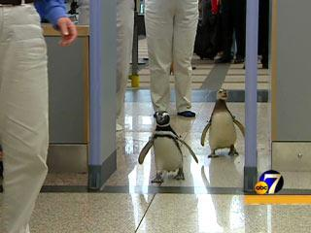
Electroweak Penguin
B Decays:
b→s,d γ and b→s,d ll
Jeffrey Berryhill
University of California, Santa Barbara
For the BaBar Collaboration
LNS Journal Club Seminar
April 1, 2005
Penguins being inspected carefully for new physics.

Slide 2
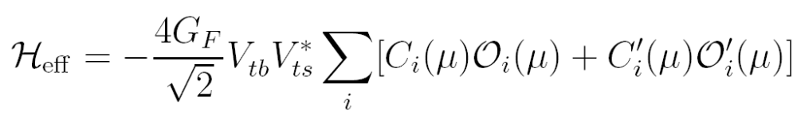
b→ s,d Penguin Operators
general Hamiltonian
of b→s transitions
C7 “photon penguin”
C8 “gluon penguin”
C9 “Z penguin”
C10 “W box”
C7’, C9’, C10’ = opposite helicity projection of C7, C9, C10
Plus:
CS, CP = scalar and pseudoscalar FCNCs (e.g. Higgs penguin)
In SM, “t-penguins” dominate b→s; u- and c-penguins non-negligible for b→d
b→s, b→d, s→d, etc. could all have different C_{i} from new physics

Slide 3
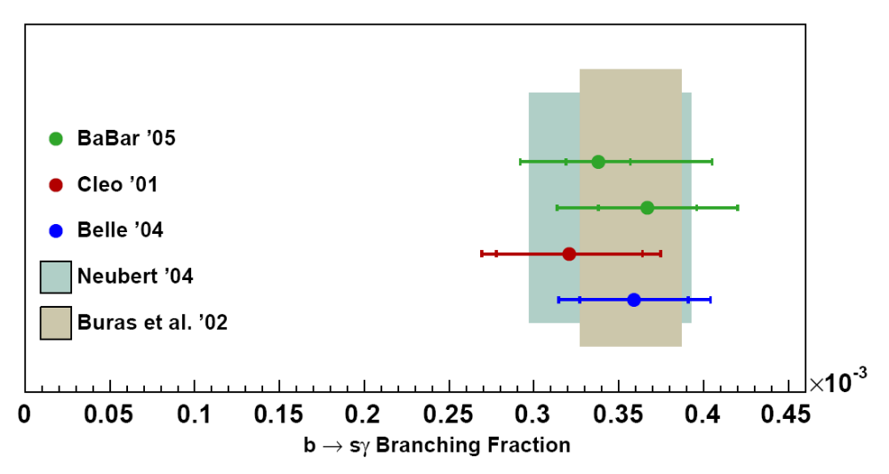
Inclusive b→s γ Rate
“Total Branching Fraction” → PBF at Eγ (min) = 1.6 GeV
Requires (model-dependent) extrapolation of spectral shape
Excellent agreement with Standard Model predictions at 10% level
Constrains |C7|² + |C7’|²
BaBar sum of exclusive
BaBar Inclusive, Eγ > 1.9 GeV
CLEO Inclusive, Eγ > 2.0 GeV
Belle Inclusive, Eγ > 1.8 GeV
Theory uncertainty could improve to ~5% (NNLO)??
Experimental uncertainty:
systematics limited from large background subtraction
Could improve to 5% with 500-1000 fb⁻¹

Slide 4
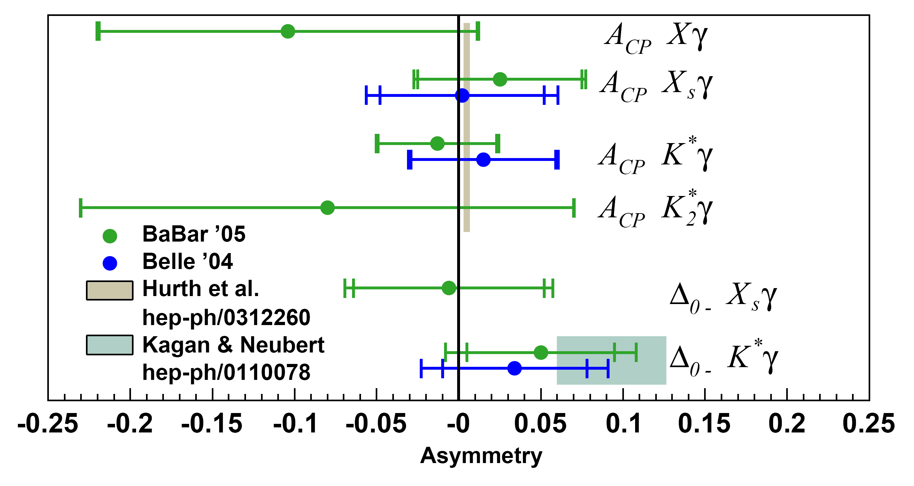
b→ sγ Asymmetries
Direct CP asymmetry generally constrained to < 5%
Isospin asymmetry precision ~5%
All measurements statistics limited for forseeable future
First ever
CP asymmetry
measurement of
b→(s+d) γ
First ever
isospin breaking
measurement
of b→s γ
Optimal b→sγ asymmetries truncate photon spectrum. (For ACP, E_{γ} > 2.1 GeV)
Does this spoil SM comparison?

Slide 5
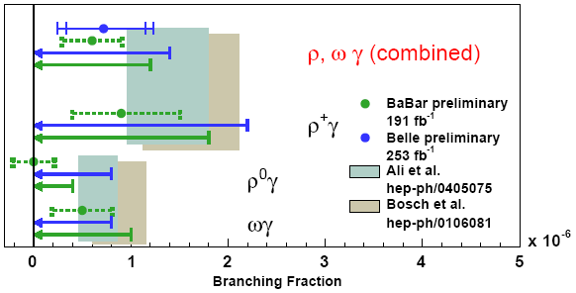
b → d γ Branching Fractions
central value
90% C.L. upper limit
Combined significance
Belle+BaBar = 2.6 σ
5σ observation expected for 1 ab⁻¹/experiment

Slide 6
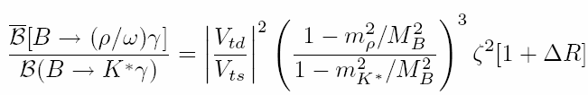
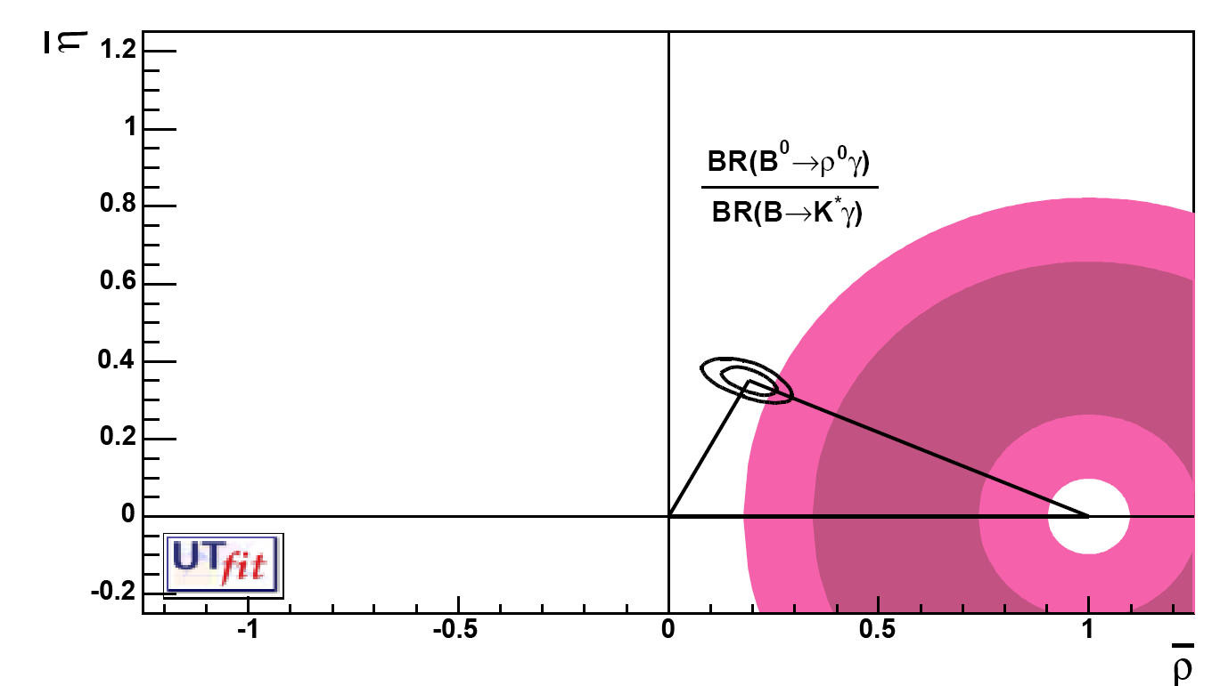
B→ργ CKM Impact
For ρ⁰γ, ΔR is negligible and form factor ratio
ζ² ~ 1.2 ± 0.1
What, if anything, can be done
to improve the estimate of the
form factor ratio (B→ρ/B→Κ∗)?
Belle+BaBar ρ⁰γ
Until Bs mixing is observed,
this will be the most
experimentally precise
estimator of Vtd/Vts
Taken at face value, an intriguingly low |Vtd/Vts|
is inferred.

Slide 7
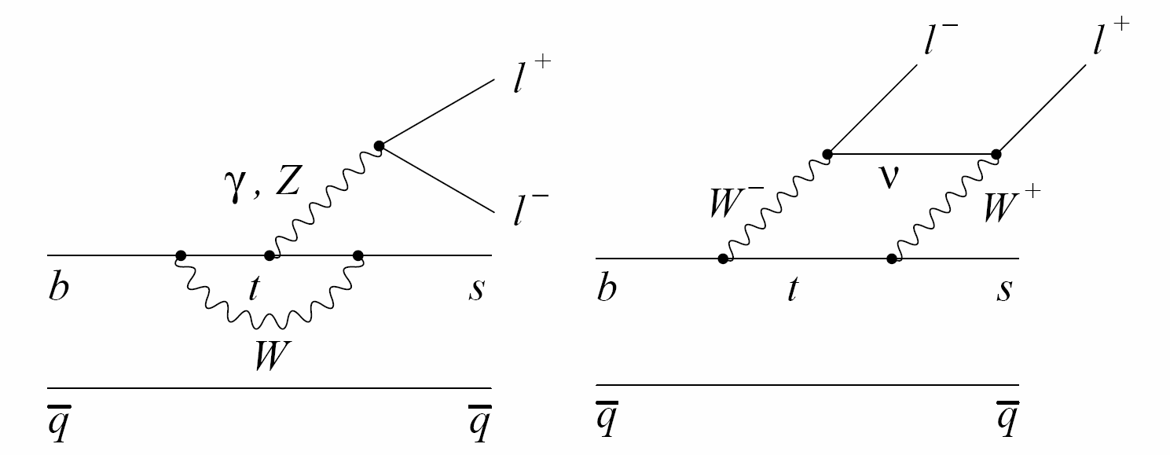
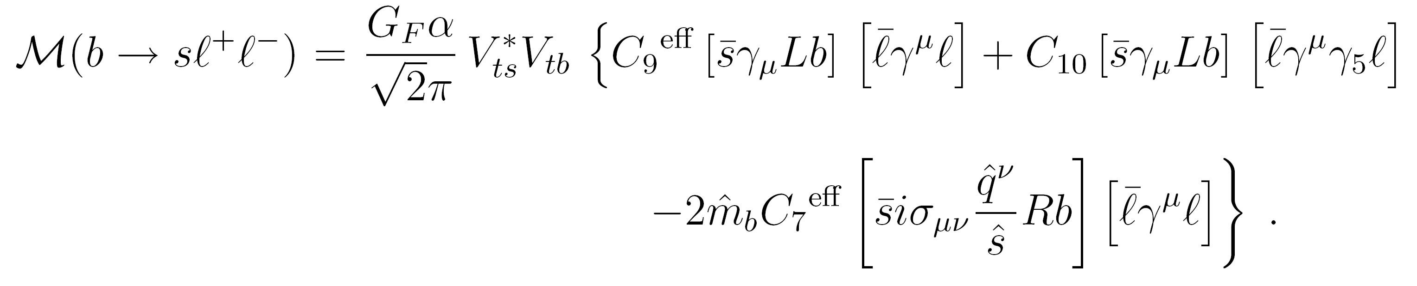
The Physics of b → s l l
3 separate penguin diagrams, 3 body decay has non-trivial kinematic distributions
C₇ photon penguin from b → s γ
C₉ (mostly) Z penguin
C₁₀ (mostly) W box unique to b→ s ll
Also sensitive to
Ci’, CS, CP
BF(b→sμμ) = 4.2 ± 0.7 10⁻⁶
15% uncertainty in inclusive rate

Slide 8
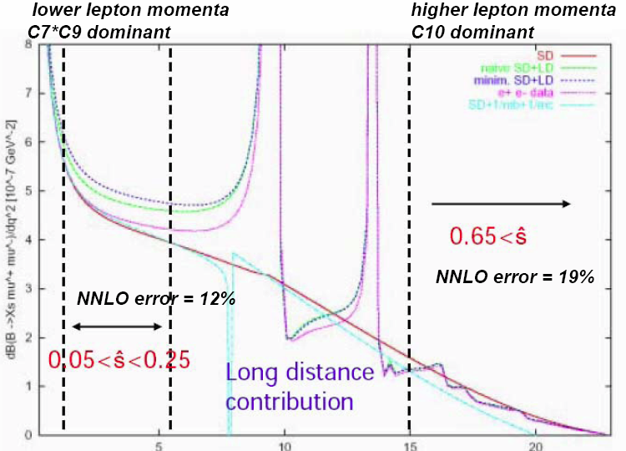
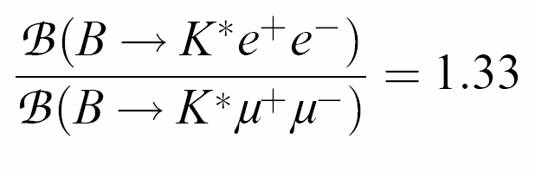
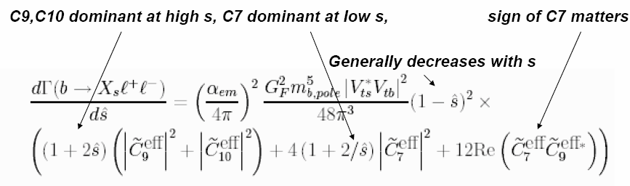
Dilepton Mass Distribution
Pole at q² ≈ 0 for K*ee
(nearly on-shell B→K*γ)
Huge long-distance
contribution from
B →charmonium decays
What q² range is
insensitive to long
distance contributions,
LD-SD interference??
J/Ψ K^{(*)}
Ψ(2S)K(*)
Dilepton q²

Slide 9
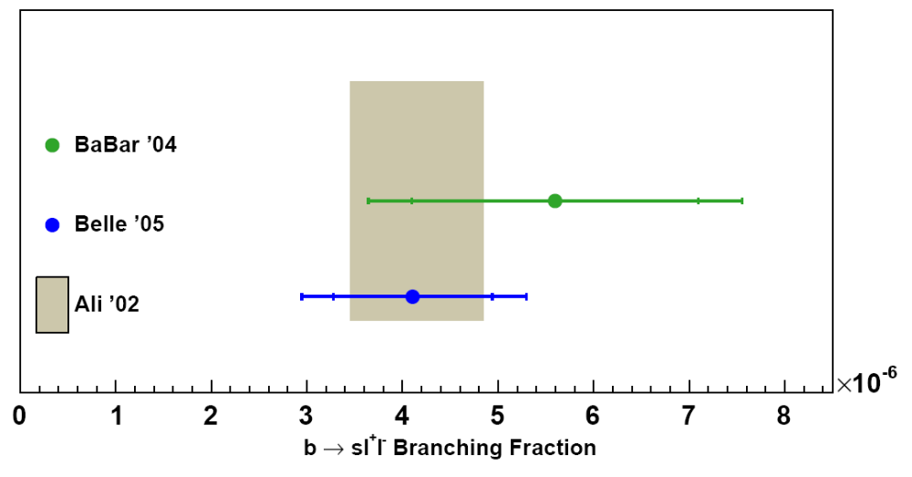
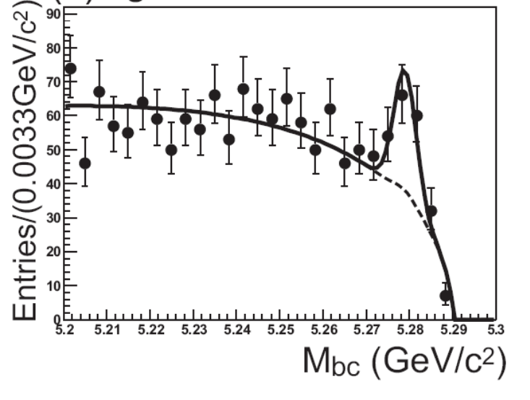
Inclusive b→sll Rate
Agreement with Standard Model predictions at 10% level
Total rate constrains |C9|² + |C10|²
70±14 events in 140 fb⁻¹
(Belle)
Other observables:
Partial rate vs. q²
AFB
ACP
ACP in AFB
Sums over exclusive final states K(Ks) + nπ + ll
Cuts on M(Xs) to suppress B backgrounds
M(Xs) < 2 GeV. Does this spoil the inclusive
predictions??

Slide 10
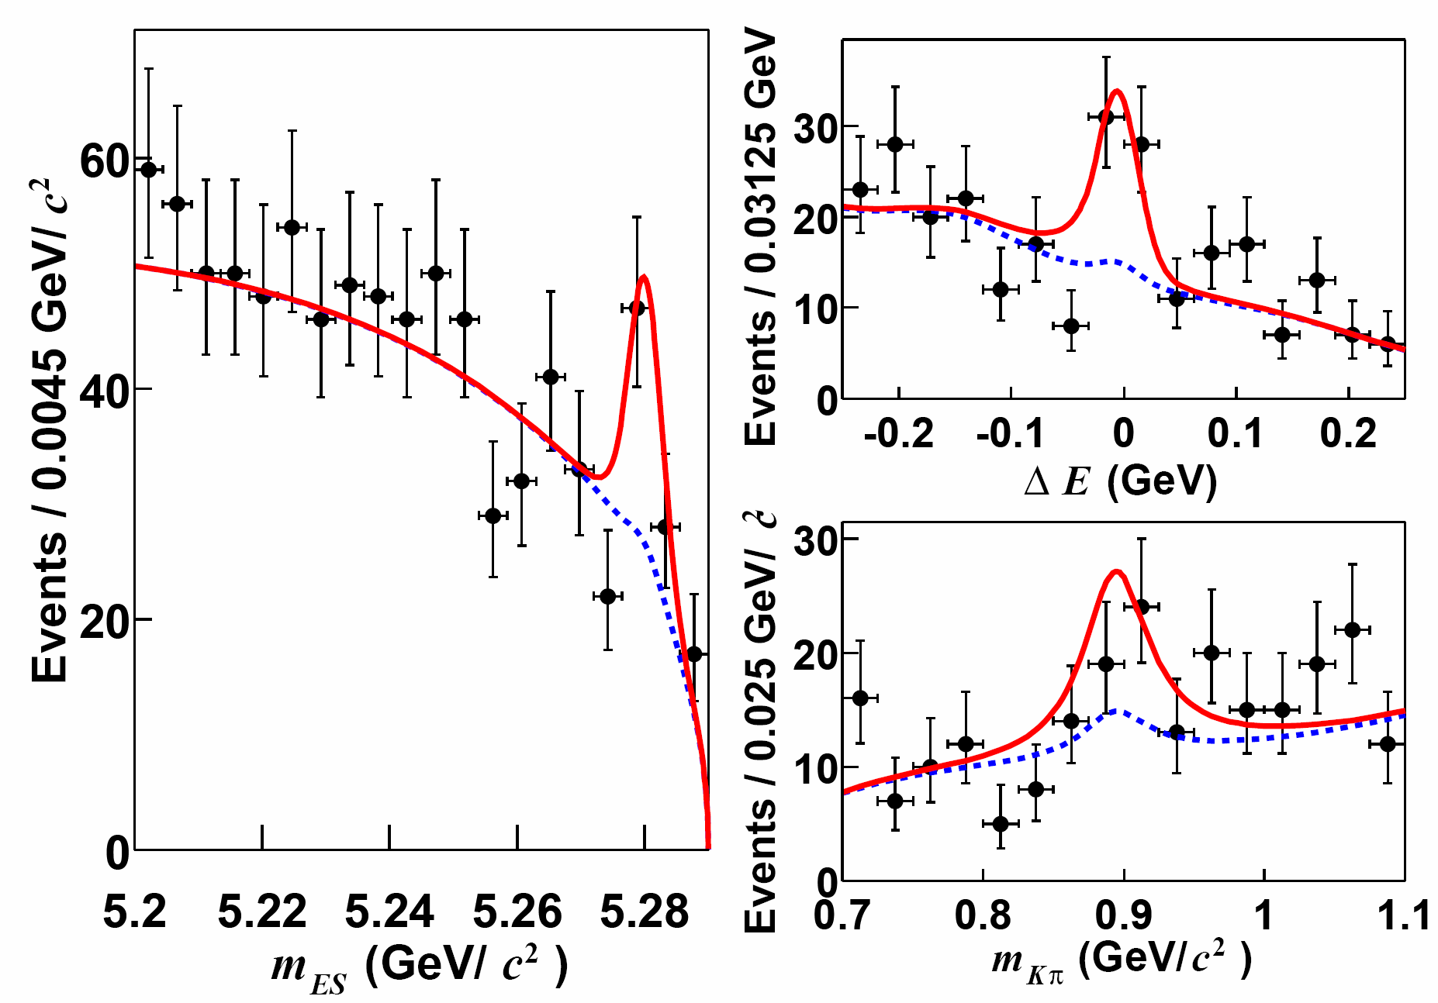
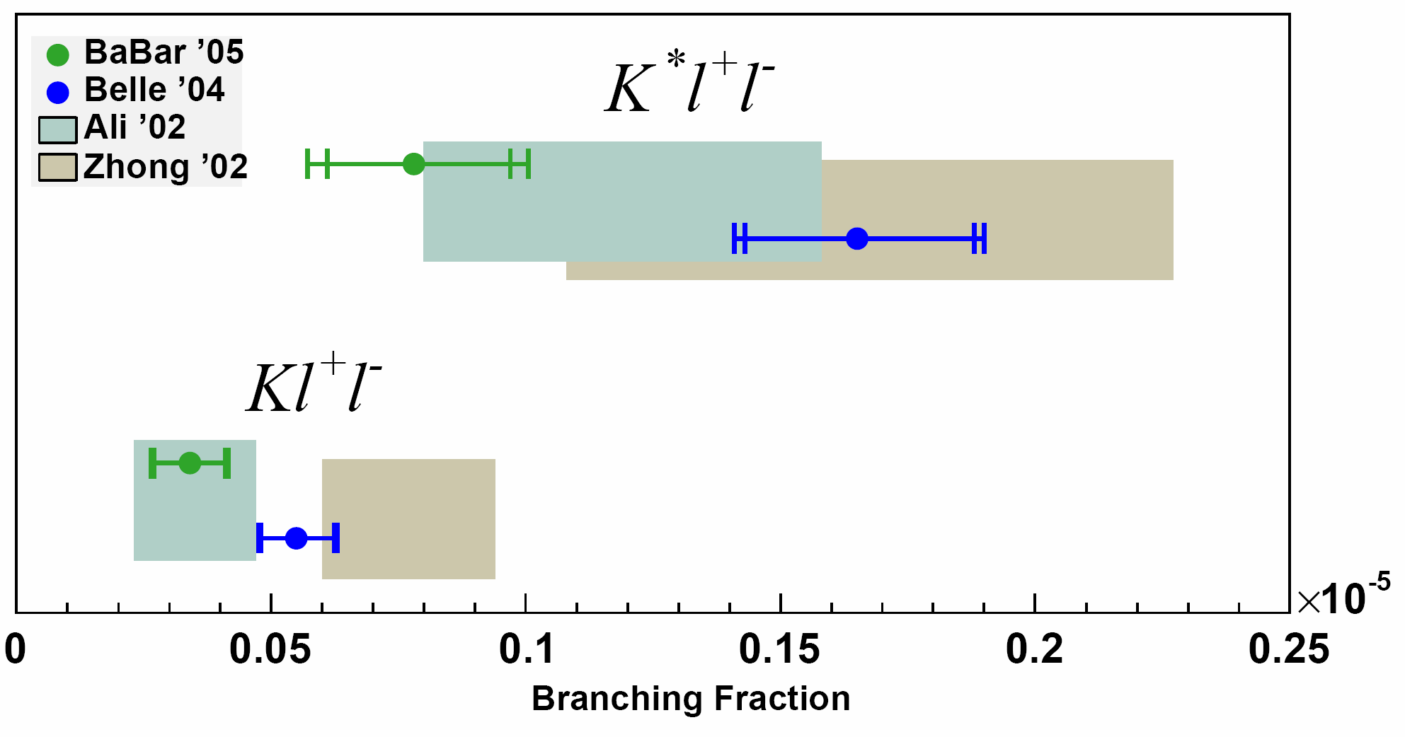
B → K(*)ll Total Rates
BaBar and Belle branching fractions agree with SM predictions
Experimental uncertainty already better than theory
Difference between BaBar and Belle becoming significant?
difference = 2.6σ
difference = 1.9σ
45±12 K*ll events in 208 fb⁻¹
above photon pole (BaBar)
79±11 K*ll events in 253 fb⁻¹
Above photon pole (Belle)
Smallest B branching fractions ever measured

Slide 11
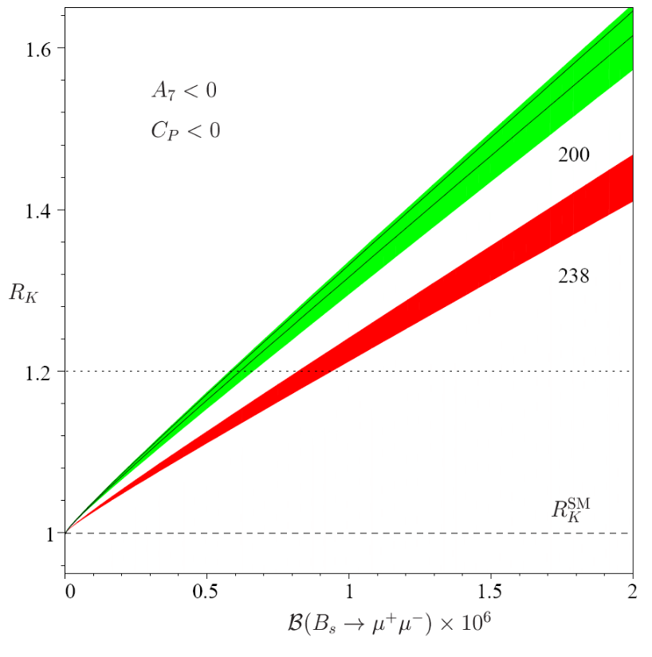
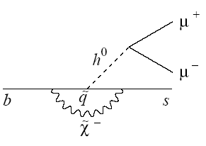
K(*)μμ/K(*)ee Ratio
R_{K} excluded
b→ sμμ = B_{s} → μμ turned sideways
Sensitive to “neutral Higgs penguin”
for SUSY with large tan β,
scalar penguins CS, CP
Ratio R(K) = BF(B→ Kμμ)/BF(B→Kee)
isolates Yukawa enhancement in muon mode
In SM, equal to unity with very high precision
Also contributes to R(K*)
(=1 above the photon pole)
(My BaBar + Belle) average
RK < 1.85 90%CL
Complementary to Tevatron B_{s}→μμ limit,
but B_{s} → μμ will be the bellwether for forseeable future
Hiller & Kruger hep-ph/0310219
B_{s} →μμ excluded

Slide 12
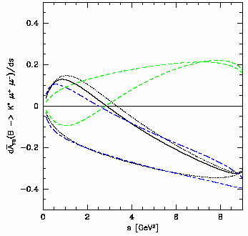
Forward-Backward Asymmetry
Angular asymmetry of lepton (anti-lepton)
angle with B (anti-B) momentum in dilepton
rest frame
Varies with dilepton q²
Theoretically clean(??) probe of relative
size and phase of C₇/C₉/C₁₀
What is form factor uncertainty of A_{FB}??
Can be dramatically modified by
new physics
Zero of A_{FB} provides simple, precise (15%)
relation between C₇ and C₉ (for LHCb/SuperB)
Standard Model
dA_{FB}/dq²
C_{i} modified by SUSY
Dilepton q²

Slide 13
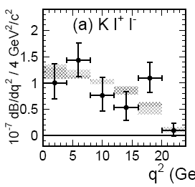
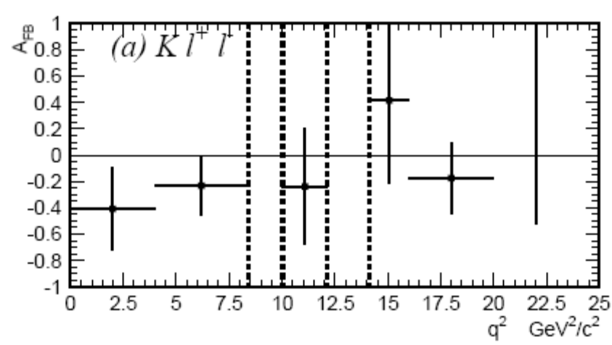
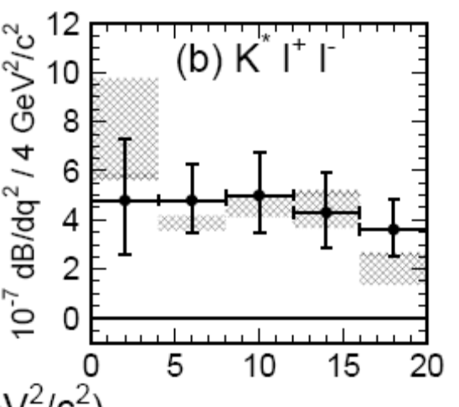
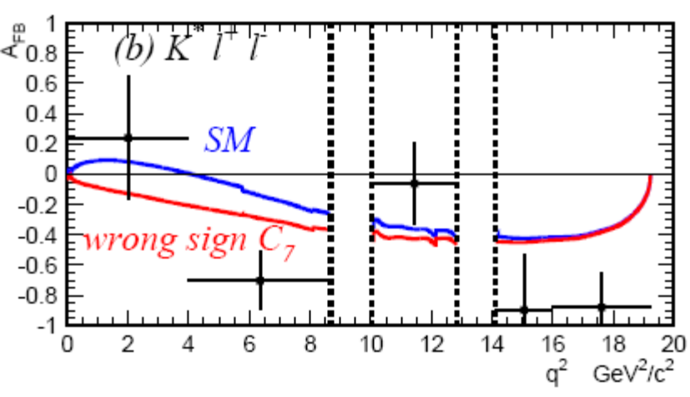
K(*)ll Partial Rates & “raw AFB” (Belle, 253 fb⁻¹)
Raw AFB appears to have SM sign for C10*Re(C9) at high q²
Need quantitative, efficiency corrected measurement

Slide 14
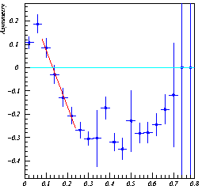
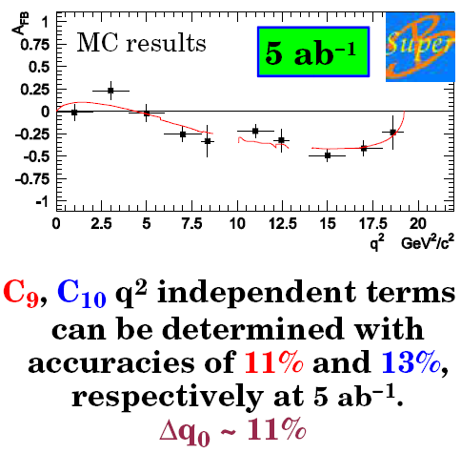

B → K*l⁺l⁻ AFB at Future Experiments
^
A_{FB}(s)
s = (m_{μμ}/m_{B})²
^
LHCb: 4400 K*⁰ μμ events/year, S/B > 0.4
A_{FB}(s) reconstructed using toy MC
(two years data, background subtracted)
Zero point located to ±0.04
ATLAS: 2000 events, S/B = 7 (30 fb⁻¹)
^
What range of q² has comparable
theory error?

Slide 15
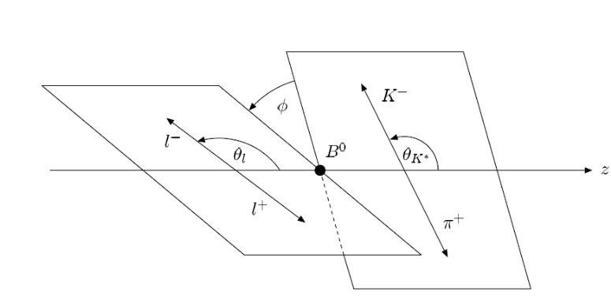
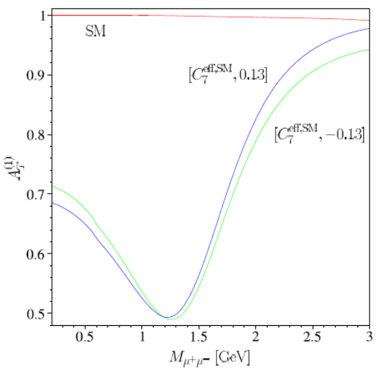
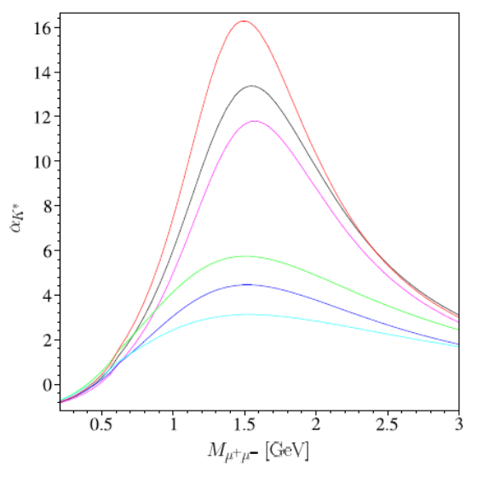
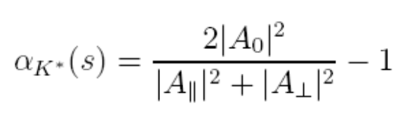
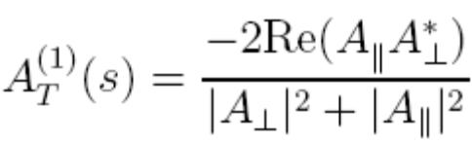
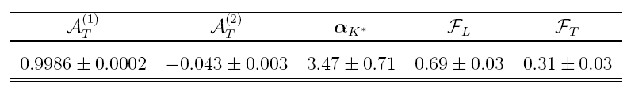
There is more than one angle
We know from B→ VV studies that triple diff.
Dist. of all three angles (θ(l), θ(Κ∗), φ) is useful
Kruger&Matias (hep-ph/0502060) predicted features of
this distribution integrated over low q² region < 6 GeV²
SM
SM
C7’ from NP
C7’ from NP
Competitive alternative to B→K*γ TDCPV?

Slide 16
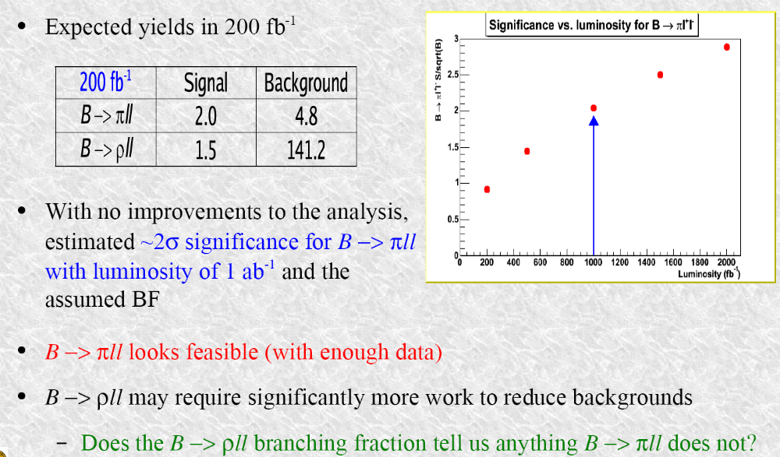
b→ dll decays
SM rate for B → πll (few 10⁻⁸) may eventually be observable at B factories

Slide 17
Summary
b → s γ penguin decays:
precision constraints on C7, C7’
rates are systematics limited
asymmetries are statistics limited and theoretically precise
b→ d γ penguin decays:
nearing observation of exclusive decays
improved theory precision would have a big impact on CKM constraints
b→ s ll penguin decays:
total rates: exp. error comparable to theory error
rich set of new constraints on penguin operators emerging from
partial rates
angular asymmetries (lepton angle and possibly K* polarization?)
e/μ rate asymmetries
b→ d ll penguin decays:
B →π ll may eventually be observable by B factories

