Slide 1
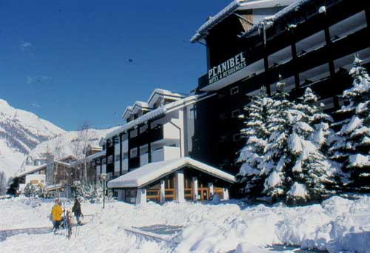

XLIst Rencontres de Moriond:
Electroweak Interactions and Unified Theories
New results from BaBar:
Rare Meson Decays and the Search for New Phenomena
B →K ll , K* ll
B→ K η γ, K η’ γ
T/CP/CPT Violation in B⁰ mixing
D⁺_{S} →μ⁺ν
Jeffrey Berryhill (UC Santa Barbara)
for the BaBar Collaboration
March 12, 2006
TM
All results preliminary,
based on 210 fb⁻¹ (230M B pairs)

Slide 2
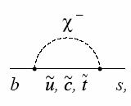
B →K ll and B →K* ll
Photon penguin (C7)
Vector EW (C9)
Axial-vector EW (C10)
Exclusive decays from three b→ sll penguin diagrams
New physics possible for each diagram, and also new operators
(scalar penguins, right-handed currents)
Three-body kinematic distributions and decay rates to measure
all three (complex) penguin amplitudes
Rare process with BF ~ 10⁻⁶
Decay Rates Well-Measured; Next step: distributions and asymmetries

Slide 3
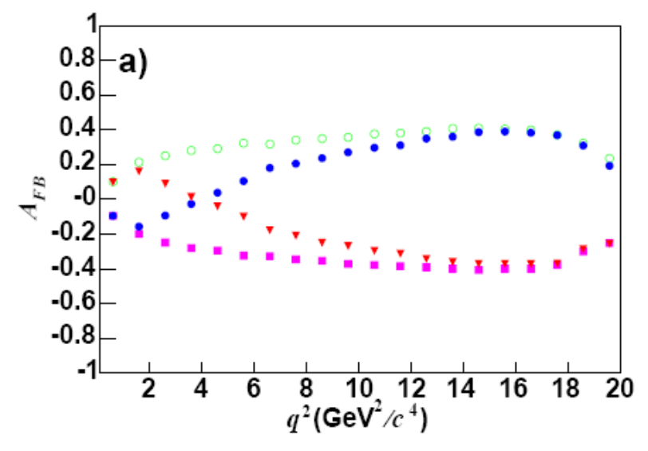
B →K ll and B →K* ll
New set of observables: angular distributions
B→ K*ll decay kinematics uniquely described by 3 angles + dilepton mass (q²)
Cos θ* lepton- angle in dilepton rest frame. Forward-backward asymmetric!
due to axial vector penguin (C10) amplitude
Asymmetry A_{FB} vs. dilepton mass q² gives C10 evolution
relative to symmetric C9 and C7
Cos θ_{K} kaon angle in K* rest frame. Gives K* polarization
l⁻
θ*
SM
C7 = -C7(SM)
C9C10 = -C9C10(SM)
C7 = -C7(SM),
C9C10 = -C9C10(SM)
B
l⁺
θ_{K}
K
B
π

Slide 4
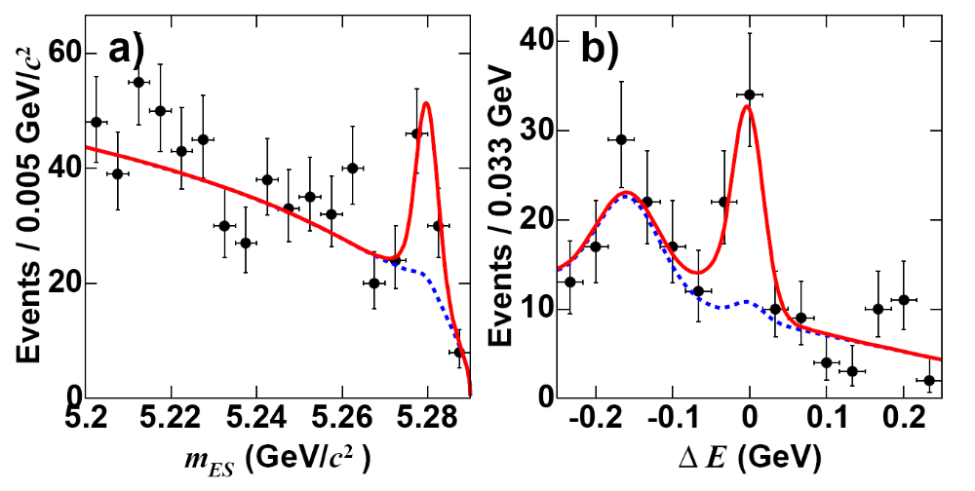

B →K ll and B →K* ll
Find ~50 needles in a haystack of 500 million B’s + 2 billion light quarks
Full B decay reconstruction to charged tracks: K⁺ll, K_{S}ll, K*⁰ll, K*⁺ll, l = e or μ
Strict particle ID requirements
Veto “peaking” backgrounds of B decays similar to signal
Construct multivariate discriminants to suppress “combinatorial” backgrounds
Signal yield extraction via multi-dimensional unbinned maximum likelihood fit
B→ Kll
B→ Kll
Preliminary

Slide 5

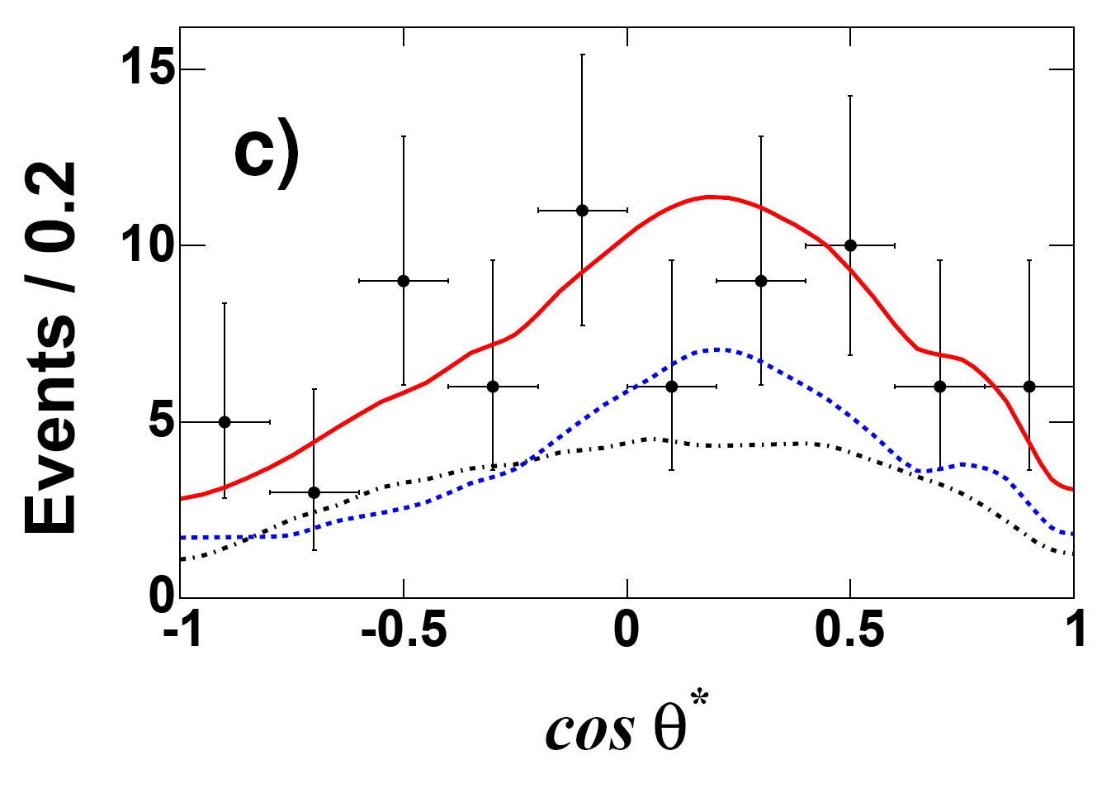
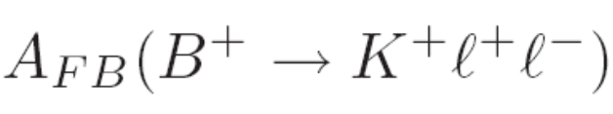




B →K ll Angular Distribution
A_{FB} is non-zero only for non-zero scalar penguin contribution F_{S}
B →Kll
Preliminary
total
Consistent with SM
expectation F_{S} = A_{FB} = 0
bkg
signal

Slide 6
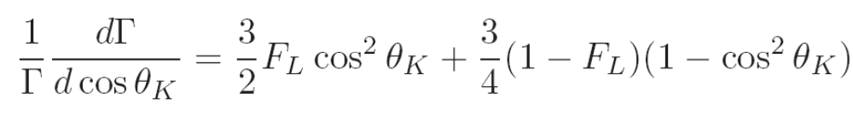

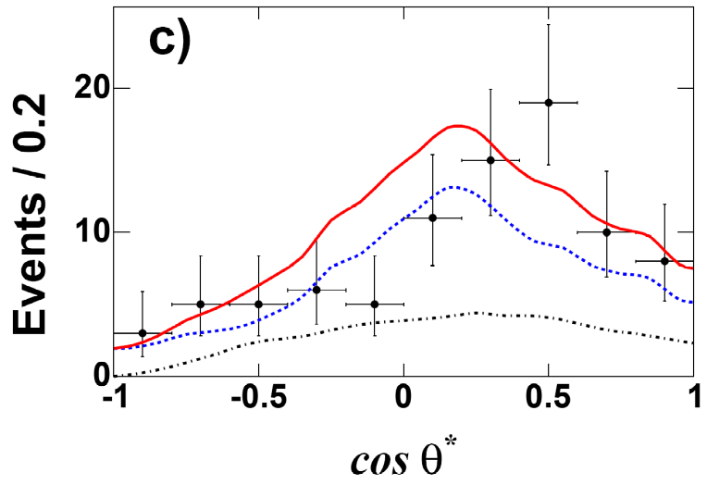
B →K* ll Angular Distribution
F_{L} fit
B →K*ll,
q² > 0.1 GeV²
Fit F_{L} in q² bins with 4d (m_{ES}, ΔE, m(Kπ), cos θ_{K})
Fix F_{L}, fit A_{FB} in q² bins with 4d (m_{ES}, ΔE, m(Kπ), cos θ*)
All procedures validated by J/ψ K(*) control samples
Background shape modeled from m_{ES},ΔE sidebands
Preliminary
A_{FB} fit

Slide 7
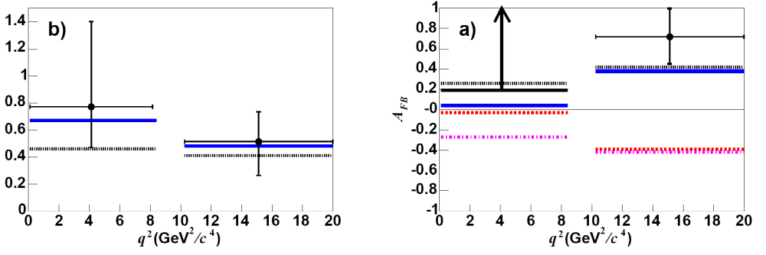
B →K* ll Angular Distribution
Preliminary
K* polarization consistent
with Standard Model
Possible to exclude
C7 = -C7(SM) with 1 ab⁻¹
K* polarization F_{L}
SM
C7 = -C7(SM)

Slide 8

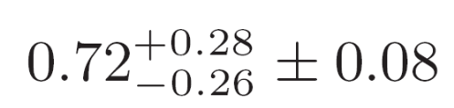
B →K* ll Angular Distribution
Low q² lower limit excludes
SM at 98% CL (2.05σ)
A_{FB}
A_{FB} (SM) = 0.03
SM
SM
At high q², wrong-sign C₉C₁₀
is excluded at >3σ
C9C10 = -C9C10(SM)
Preliminary
A_{FB} =
A_{FB} (SM) = 0.38
SM and alternate predictions from
NNLO OPE + LCSR form factors,
Ali et al. Phys. Rev. D 66 034002 (2002)
Ball and Zwicky Phys. Rev. D 71 014029 (2005)

Slide 9
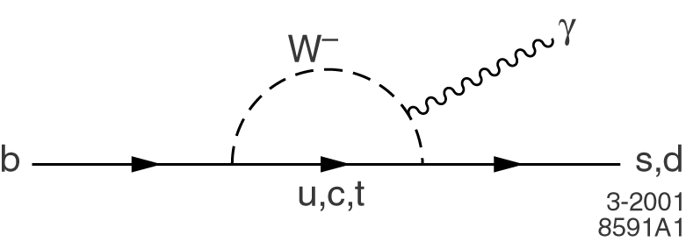




B →K η γ and Search for B →K η' γ
B →Kηγ, Kη'γ are 3-body exclusive decays from
b→ sγ photon penguin diagram
B⁺ → K⁺ηγ decay observed by Belle in 2004,
and 3.4σ evidence for neutral K⁰ηγ decay
Charged mode K⁺ηγ: test direct CP asymmetry for new weak phase in
photon penguins
Neutral mode K⁰ηγ: a CP eigenstate, can measure
time-dependent CPV like K_{S}π⁰γ as a SM null test
(Atwood, Gershon, Hazumi, and Soni, Phys. Rev. D71 076003)
Kη'γ has never been searched for; could be enhanced like Kη'?
BF =

Slide 10
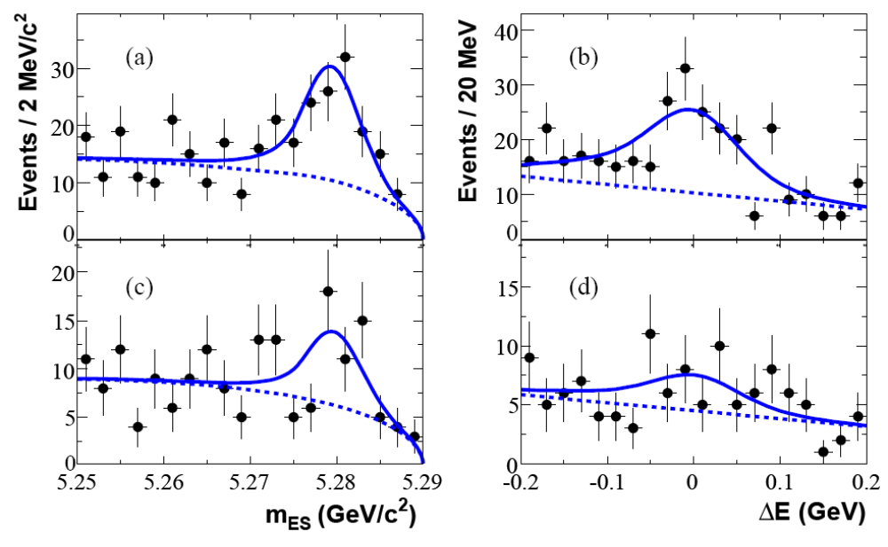





B →K η γ and Search for B →K η' γ
Require high-energy photon with E_{γ}* > 1.6 GeV
Separate large qq background with Fisher discriminant of event shape data
Signal extraction with multi-dimensional unbinned likelihood fit to
(m_{ES}, ΔE, Fisher, η(') mass)
K⁺ηγ
rate consistent with Belle
A_{CP} consistent with 0
Preliminary
K⁺ηγ
K⁺ηγ
K⁰ηγ
K⁰ηγ
5.3σ observation of K⁰ηγ
Fit projections of m_{ES}, ΔE w/LH cut

Slide 11
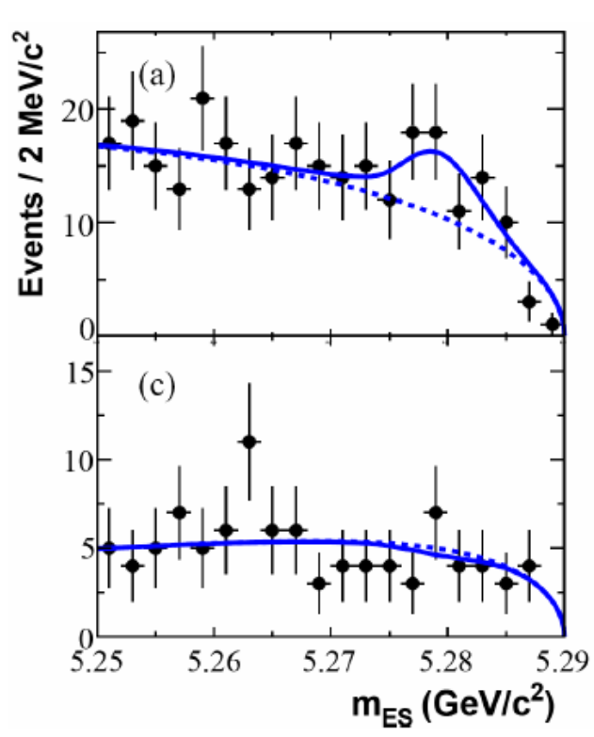







B →K η γ and Search for B →K η' γ
2σ
excess
No evidence for B → K η' γ decays
Consistent with prediction of
Lipkin, Phys.Lett. B254, 247 (1991)
of suppression relative to B → K η γ
First limits for this decay mode
Preliminary
K⁺η'γ
K⁰η'γ

Slide 12

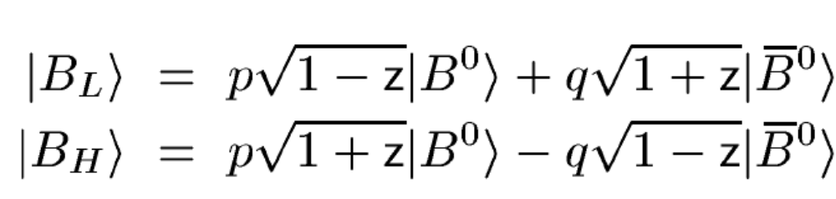
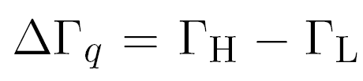

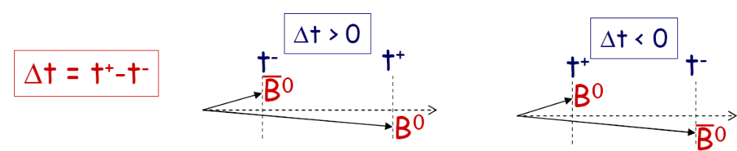


T/CP/CPT Violation in B⁰ Mixing
General complex amplitudes for neutral meson mixing:
CPT conservation → z = 0 T conservation → |q/p| = 1
CP conservation → z = 0 and |q/p| = 1
Standard Model CP violation in B⁰ mixing expected to give 1 - |q/p|² ~ 10⁻³ or less
Measure mixing matrix via asymmetries in Δt distribution of B⁰-B⁰ system
Δt sign determined by which B flavor decayed first

Slide 13






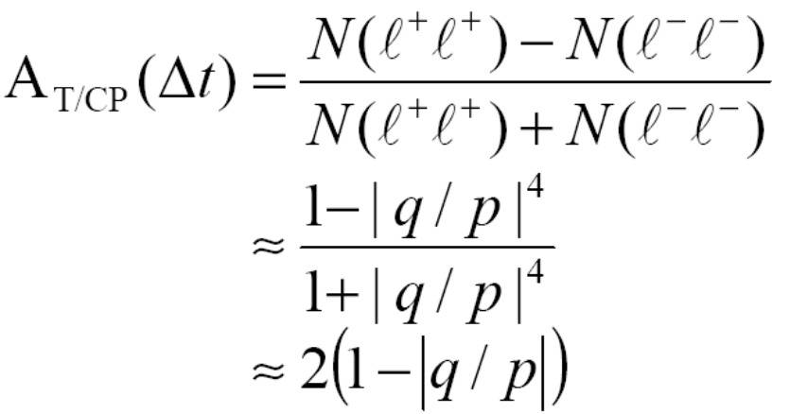
T/CP/CPT Violation in B⁰ Mixing
Traditional mixing method at Y(4S): count charge combinations where both
B’s decay semileptonically, as a function of lifetime difference Δt
CASE I:
SAME-SIGN
DILEPTONS
Same-sign dilepton charge asymmetry:
sensitive to CP or T violation in |q/p|

Slide 14

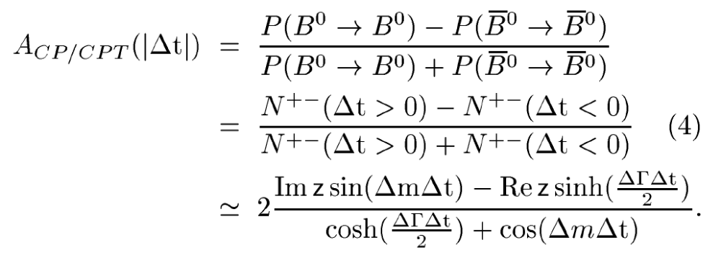
T/CP/CPT Violation in B⁰ Mixing
CASE II:
OPPOSITE-SIGN
DILEPTONS
Opposite-sign dilepton Δt asymmetry:
Δt sign-asymmetry amplitude sensitive to CPT or CP violation in z
Im z or ΔΓ Re z (fix ΔΓ in cosh term)

Slide 15
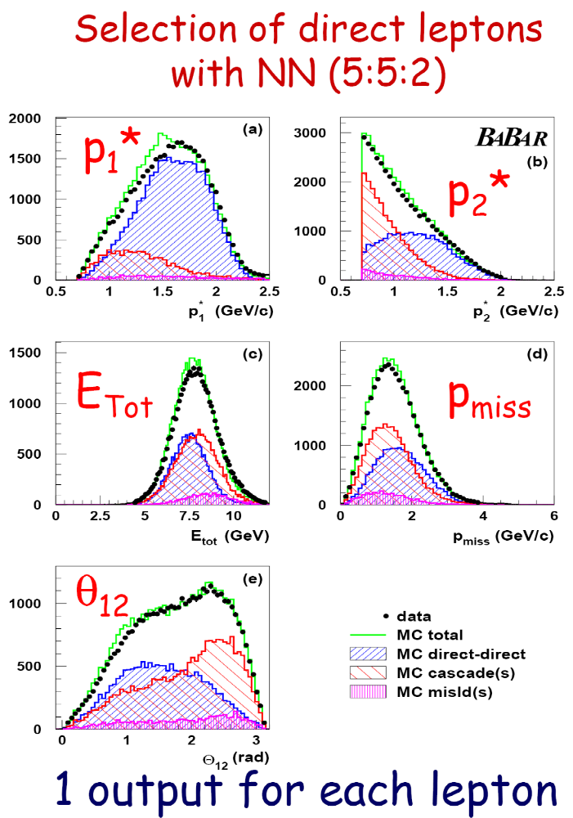
T/CP/CPT Violation in B⁰ Mixing
Select dilepton events with 0.8 < P* <2.3 GeV
Veto conversions and charmonia
Reject b →c → l cascade bkg with neural net
Selects 1.4 million events!
(1.2 M Opp. sign, 0.2 M Same sign)
Sample composition:
signal 81%
1 cascade + 1 direct 9%
2 cascade 4%
1 tau cascade + 1 direct 3%
other 3%
continuum 3%
Cascade background Δt distribution wider than
direct signal decay Δt → separate with a Δt fit
Preliminary
Neural net inputs for
cascade rejection

Slide 16
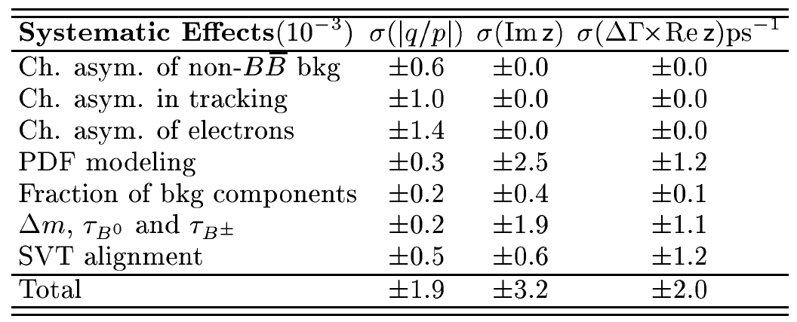
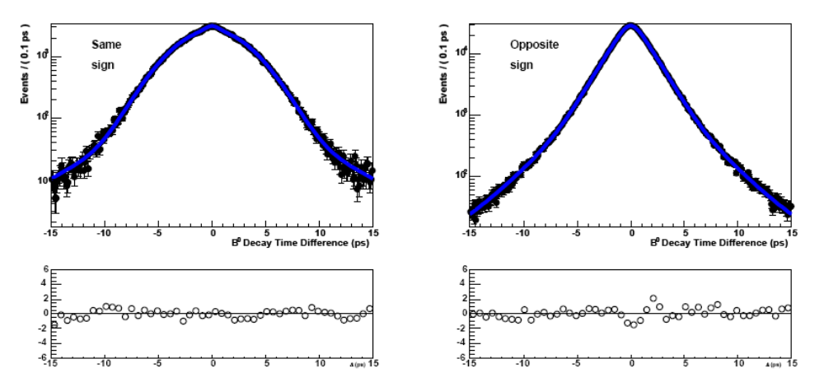
T/CP/CPT Violation in B⁰ Mixing
Binned likelihood fit of Δt distribution with 11 components (10 background + signal)
Simultaneous fit over 16 samples (4 lepton flavor comb. X 4 lepton charge comb.)
Muon charge asymmetry is floating in the fit; electron asymmetry fixed from Bhabha data
Charge asymmetry largest
CPV systematic
Alignment/Δt model largest
CPTV systematic
Same sign
Δt fit
Opp. sign
Δt fit
Preliminary

Slide 17
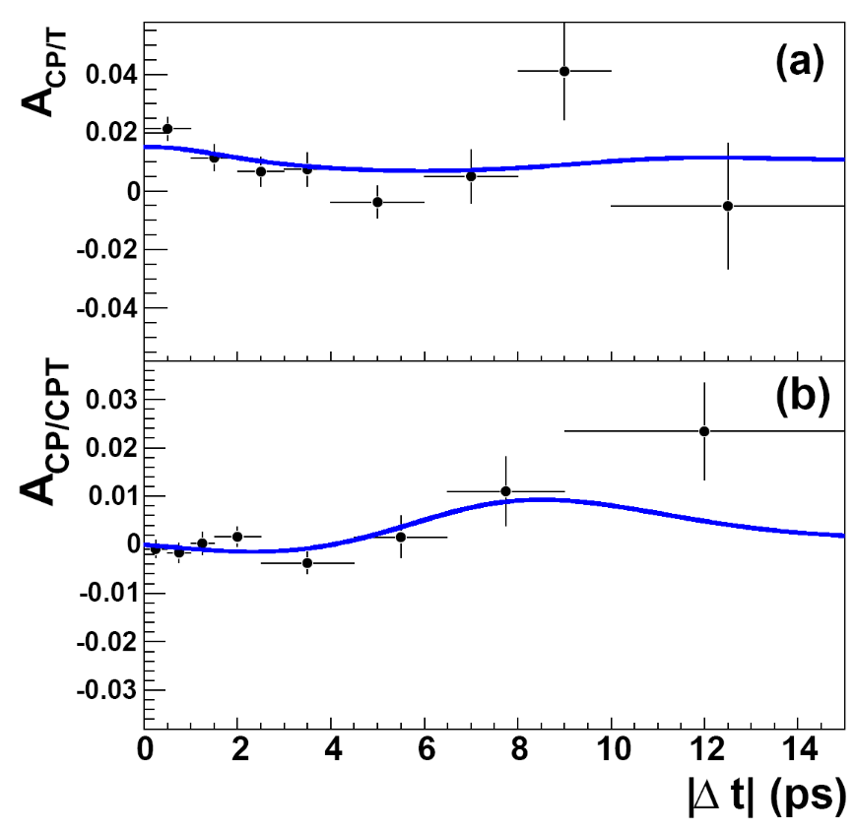
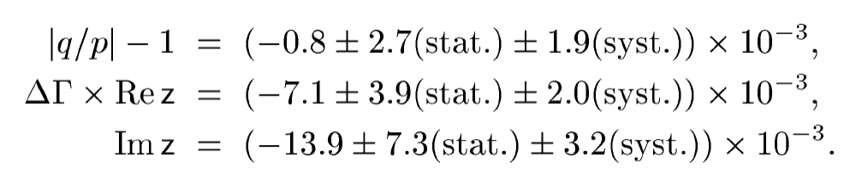
T/CP/CPT Violation in B⁰ Mixing
Preliminary
Preliminary
Same-sign charge asymmetry
Opposite-sign Δt asymmetry
Consistent with
CP/T/CPT
conservation
|ΔΓ| fixed to 0.005 ps⁻¹
Re z, Im z 76% corr.
Re(ε)/(1 + |ε|²) = (1 - |q/p|²)/4 = (+0.4 ± 1.4 ± 0.9) ×10⁻³ BaBar Preliminary 2006
(-1.1 ± 1.0 ± 0.7) ×10⁻³ D0 Preliminary 2006
(-0.3 ± 2.0 ± 1.8) ×10⁻³ Belle 2005

Slide 18
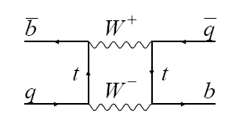


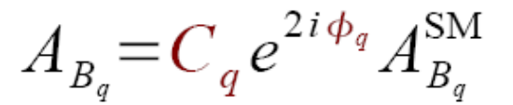
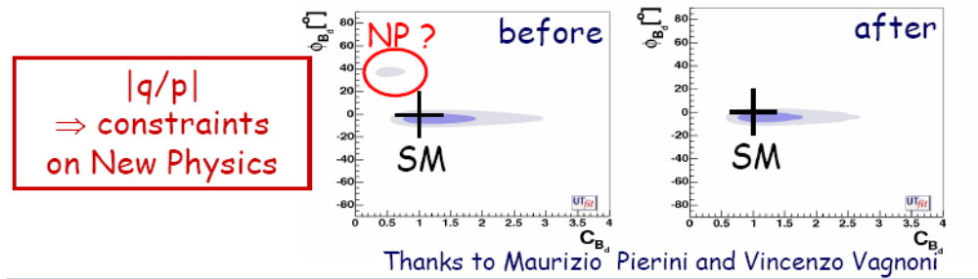
T/CP/CPT Violation in B⁰ Mixing
New physics constraints in CP violating B mixing
+
+
Less room for new weak
phase in B mixing

Slide 19
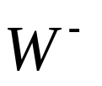
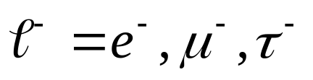
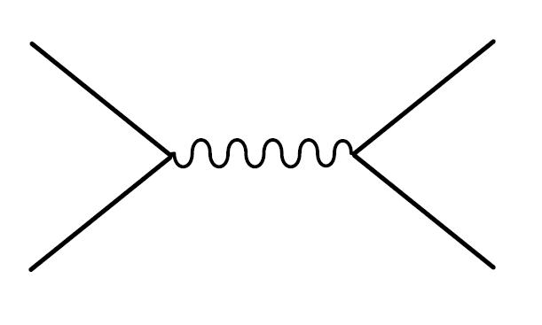
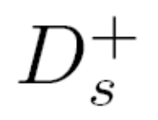
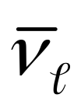
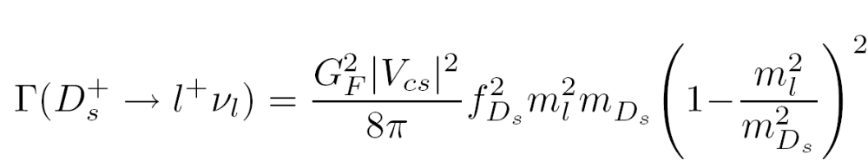
D_{S} →μν and Decay Constant f_{Ds}
Leptonic decay proceeding through weak annihilation of quarks:
c
+
+
+
+
+
=
s
Leptonic meson decay rate simply related to meson decay constants:
Helicity suppressed by light lepton mass: decay rate to muons ~10⁻³
Confidence in decay constant predictions necessary for interpretation of B, B_{s} mixing

Slide 20










D_{S} →μν and Decay Constant f_{Ds}
New method exploiting high statistics of e⁺e⁻ → cc: “D reco” sample
Tag one c quark via full reconstruction of D(*) meson
Reconstruct other signal c quark via D*_{S} → D_{S} γ → μ ν γ
D reco dramatically reduces background from u, d, s quarks and B mesons
Signal is a peak in the variable
ΔM = M(D_{S}*) – M(D_{S})
Normalize to D_{s} → φ π

Slide 21
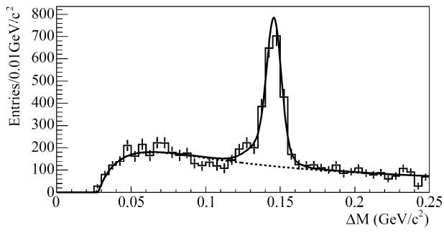



D_{S} →μν and Decay Constant f_{Ds}
Preliminary
Preliminary
Nμν = 489±55
D_{s} → μν signal
fake D tags bkg from tag D mass sidebands
Signal from binned likelihood fit of ΔM in background-subtracted events
D_{s} to leptons bkg from e ν control sample
Use BaBar measurement for D_{s} →φπ BF
for D_{s} → μν BF
Preliminary
D_{s} → φπ norm.
BaBar, Phys.Rev. D 71, 091104 (2005),
Normalize D_{s} →μν signal to D_{s} → φπ

Slide 22
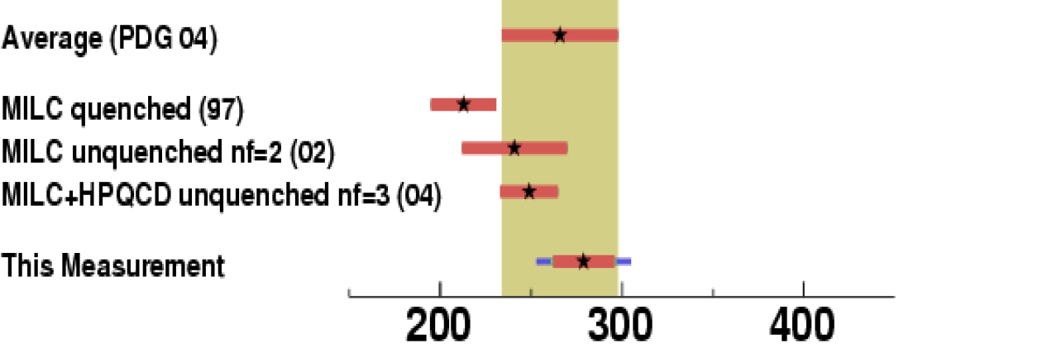
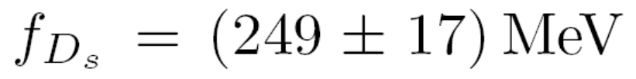
D_{S} →μν Decay Constant f_{Ds}
Significant improvement on
world average
Good agreement with
unquenched lattice QCD
BaBar (230 fb⁻¹)
BF, D_{S} lifetime, and V_{cs} give D_{s} decay constant:
BaBar (230 fb⁻¹)
Preliminary
stat syst D_{s} →φπ
Lattice QCD
Aubin et al. PRL 95 122002 (2005)
Validates recent QCD predictions at 10% level
will improve to <5% precision with 1 ab⁻¹

Slide 23
Summary
B →Kll , K*ll angular distributions test complete
set of electroweak penguin amplitudes
CP violation tested in B→ K η γ,
first search for K η’ γ
New bounds on T/CP/CPT violation in B⁰ mixing
Measurement of D⁺_{S} →μ⁺ν and f_{Ds} a precision
confirmation of lattice QCD

Slide 24
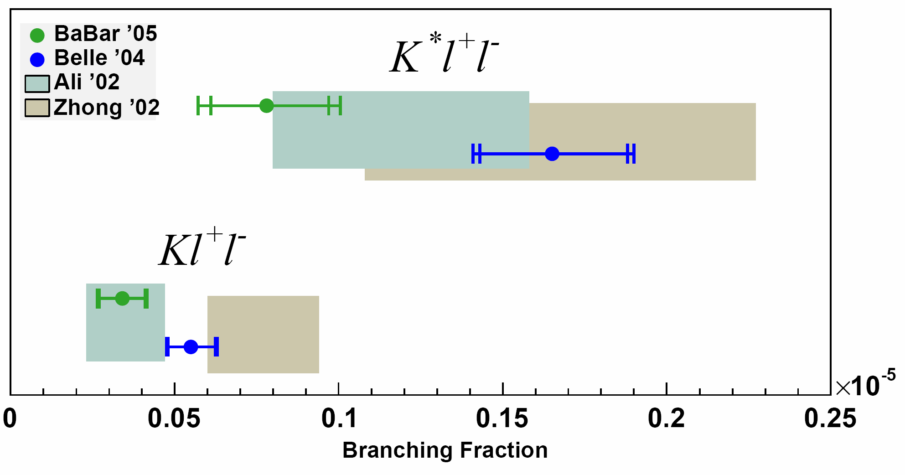
B →K ll and B →K* ll
BaBar and Belle branching fractions agree with SM predictions
Experimental uncertainty already better than theory
Difference between BaBar and Belle becoming significant?
Preliminary
Also A_{CP} consistent with 0 at 25% level, e/μ ratio consistent with unity
RAREST B DECAYS EVER OBSERVED

Slide 25
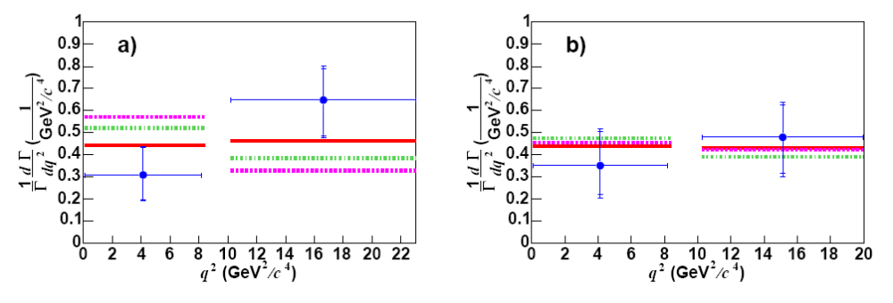
Partial branching fractions vs. dilepton mass consistent with SM + form factors

Slide 26
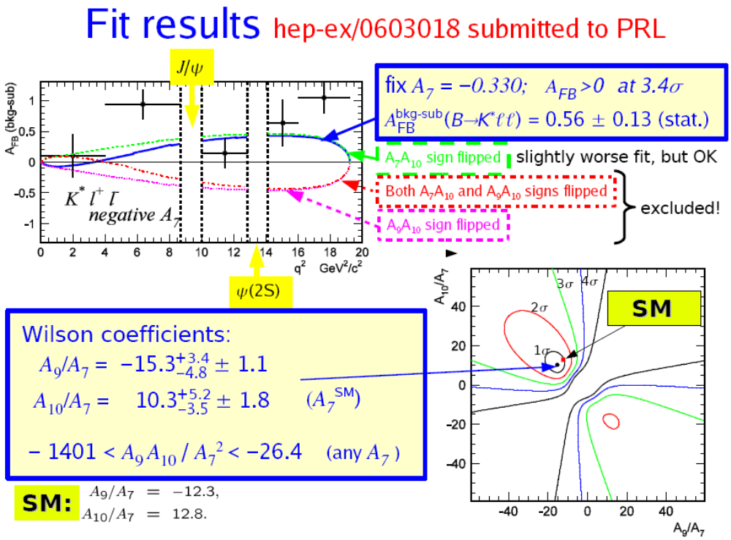
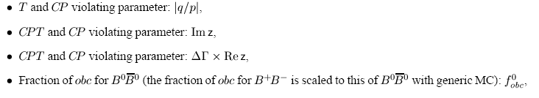
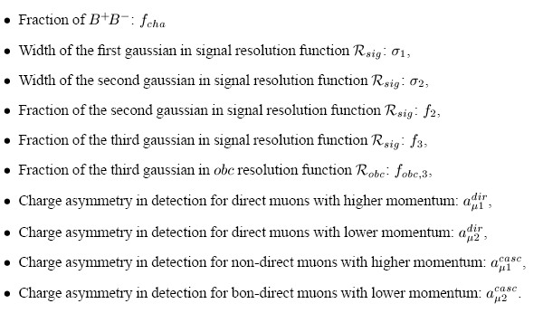
Belle K*ll Results
Floating fit parameters

Slide 27
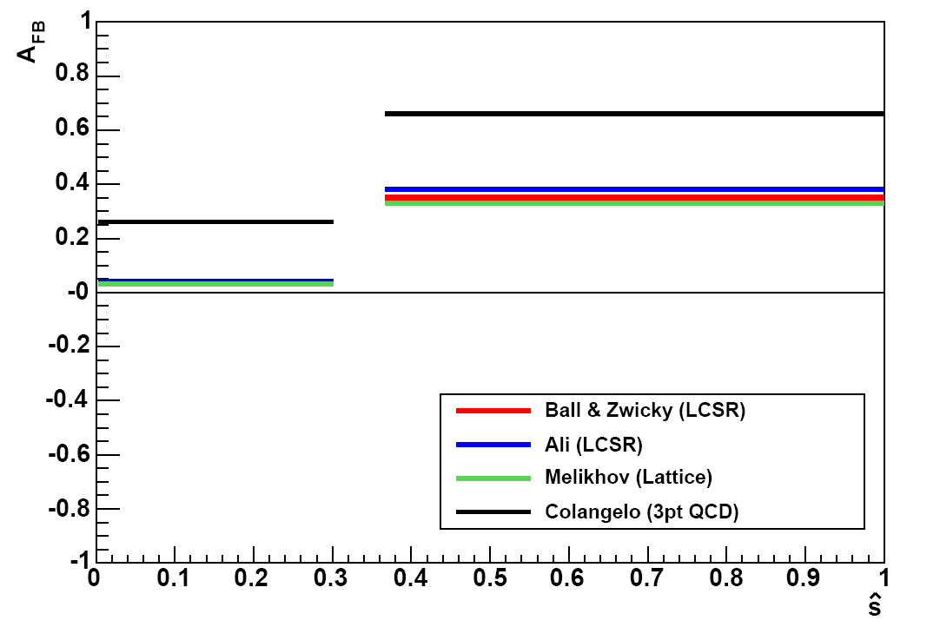
Form Factor Model Dependence: AFB
Colangelo strongly disagrees with LCSR and Lattice (T3 form factor)

Slide 28
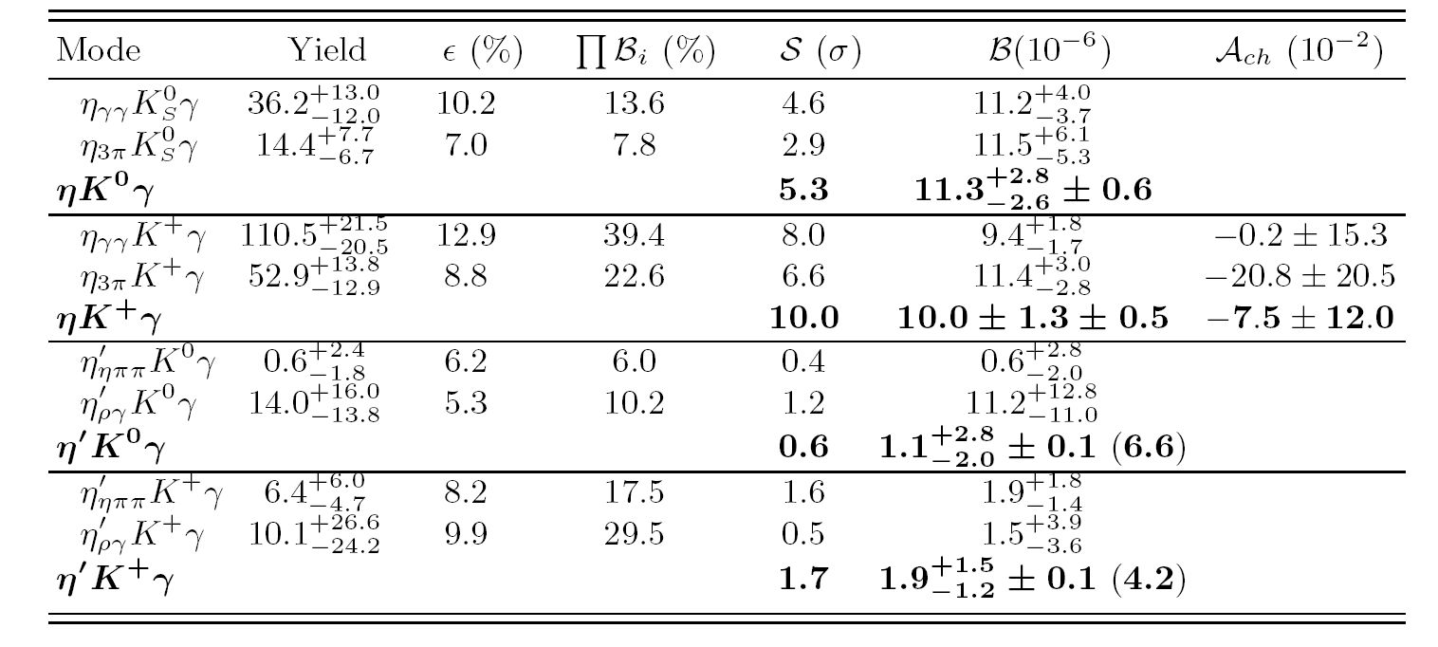
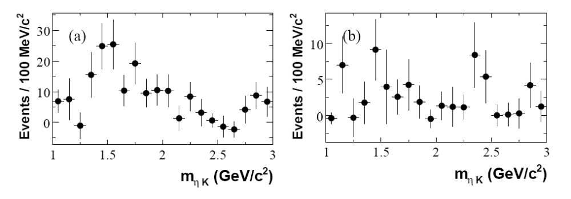
B →K η γ and Search for B →K η’ γ
Observation of K⁰ηγ
M(ηK⁺)
New precise measurement of K⁺ηγ
in agreement with initial Belle observation
First measurment of direct CP asymmetry
in this decay
Background-subtracted M(ηK) has no
sharp structure
M(ηK⁰)

Slide 29
B →K η γ and Search for B →K η’ γ
No evidence for B → K η’ γ decays
Consistent with prediction of
Lipkin, Phys.Lett. B254, 247 (1991)
of suppression relative to B → K η γ
First ever search for this decay
K⁺η’γ
K⁰η’γ

Slide 30
B →K η γ and Search for B →K η’ γ
Observation of K⁰ηγ
New precise measurement of K⁺ηγ
in agreement with initial Belle observation
First measurement of direct CP asymmetry
in this decay
Background-subtracted M(ηK) has no
sharp structure

Slide 31
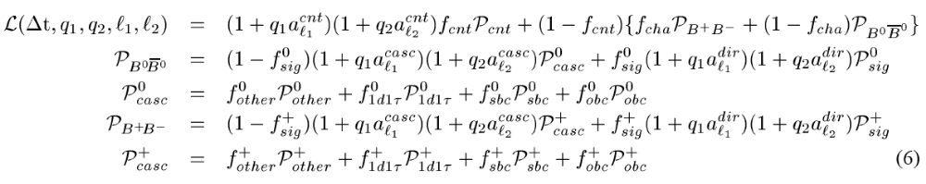
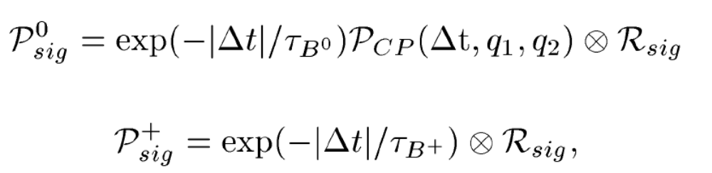
T/CP/CPT Violation in B⁰ Mixing
Δt PDF

Slide 32
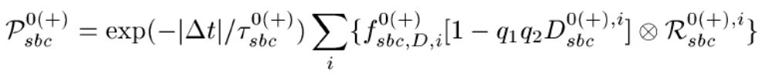
T/CP/CPT Violation in B⁰ Mixing
Δt PDF

Slide 33
T/CP/CPT Violation in B⁰ Mixing
Δt PDF
Floating fit parameters

