Slide 1
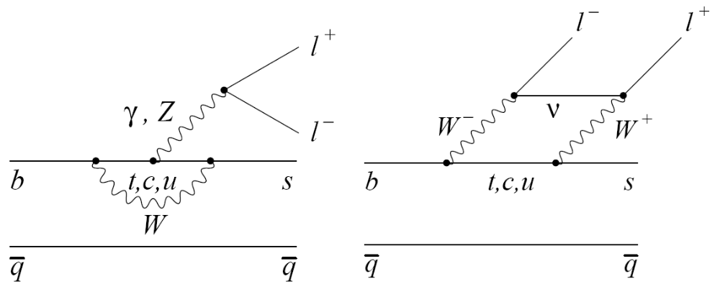

Working Group 2:
Recent Experimental Progress in b → sll and Plans for Report
Jeffrey Berryhill (UC Santa Barbara)
for the BaBar Collaboration
May 15, 2006
TM

Slide 2
Recent K*ll Results from BaBar
TM

Slide 3
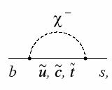
B →K ll and B →K* ll
Photon penguin (C7)
Vector EW (C9)
Axial-vector EW (C10)
Exclusive decays from three b→ sll penguin diagrams
New physics possible for each diagram, and also new operators
(scalar penguins, right-handed currents)
Three-body kinematic distributions and decay rates to measure
all three (complex) penguin amplitudes
Rare process with BF ~ 10⁻⁶
Decay Rates Well-Measured; Next step: distributions and asymmetries

Slide 4
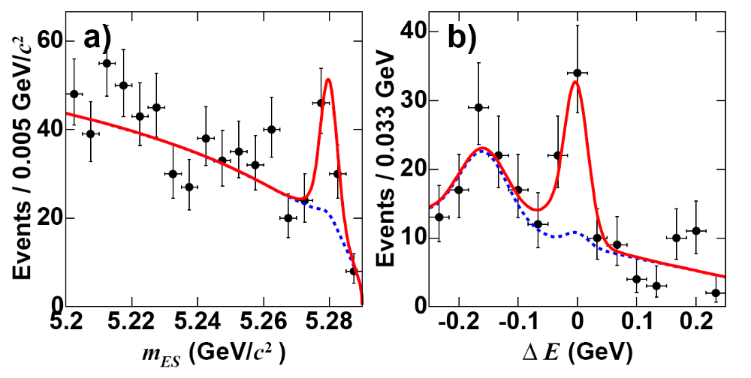
B →K ll and B →K* ll at BaBar
Latest published result, 208 fb⁻¹, hep-ex/0604007, PRD 73 092001 (2006)
Full B decay reconstruction to charged tracks: K⁺ll, K_{S}ll, K*⁰ll, K*⁺ll, l = e or μ
Strict particle ID requirements
Veto “peaking” backgrounds of B decays similar to signal
Construct multivariate discriminants to suppress “combinatorial” backgrounds
Signal yield extraction via multi-dimensional unbinned maximum likelihood fit
B→ Kll
B→ Kll

Slide 5
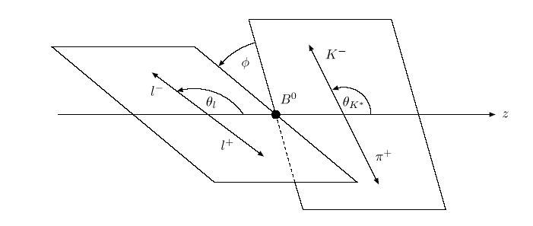
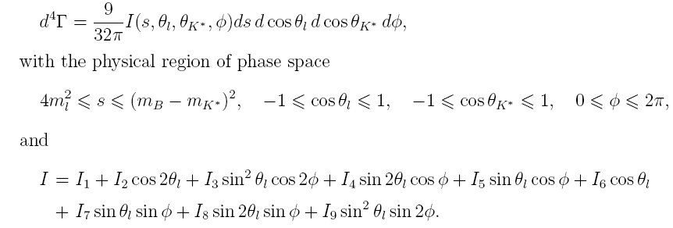
General angular distribution of B → K*ll
3 angles
Lepton angle θ_{l}
Kaon angle θ_{K}
Decay plane angle φ
See for example
Kruger&Matias hep-ph/0502060
Ali&Safir hep-ph/0205254
Integrating out φ leaves 3 terms

Slide 6
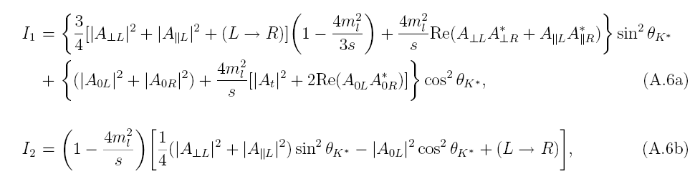
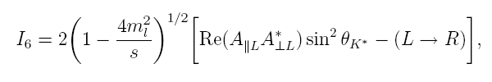
Angular distribution of B → K*ll
Transversity amplitude (A‖ , A⊥ , A₀) dependence of I1,I2,I6
Neglecting terms of order m_{l}²/s, simple dependence of the general
angular distribution on transversity (or helicity) amplitudes

Slide 7
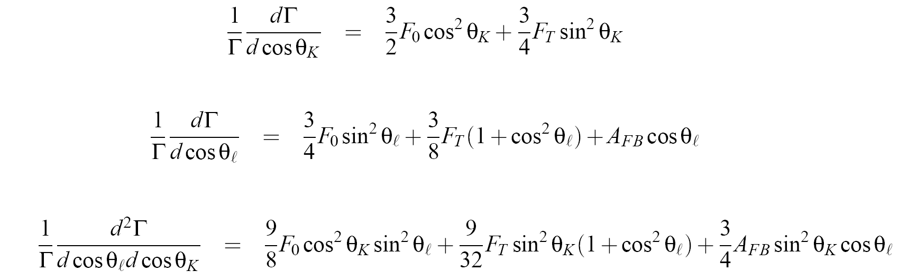
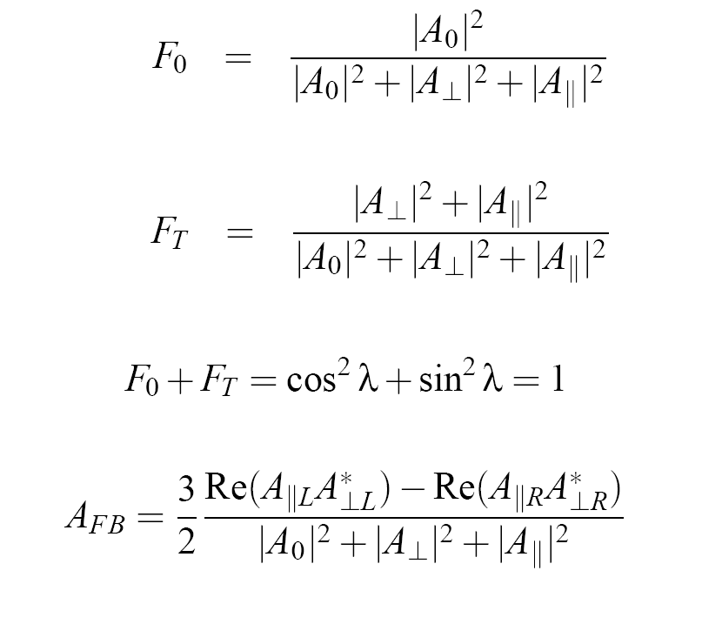
Angular parameterizations
Integrate out θ_{l} OR
Integrate out θ_{K} OR
Measure correlated dist.
NB including cos θ_{K} does not increase number of fit parameters!

Slide 8
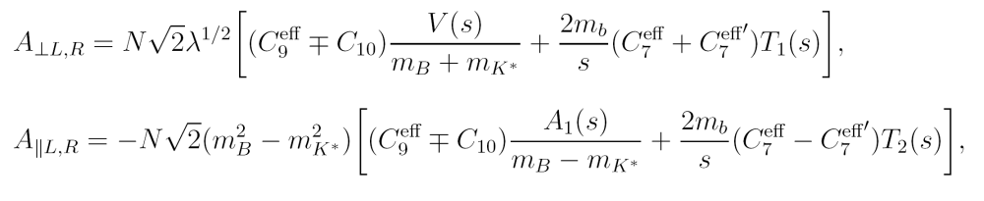
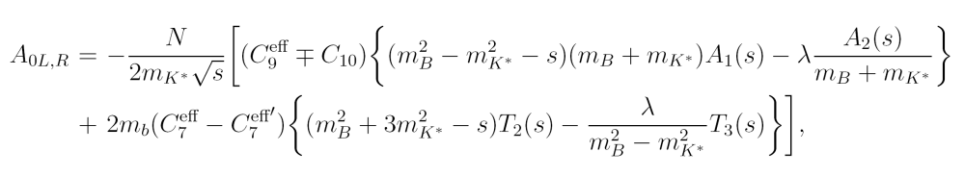
Transversity Amplitudes vs. Wilson Coefficients
Lepton asymmetry comes from differing transverse AL, AR
Includes (non-SM) right-handed current contribution C7’
(can be extended to C9’ and C10’ also)

Slide 9
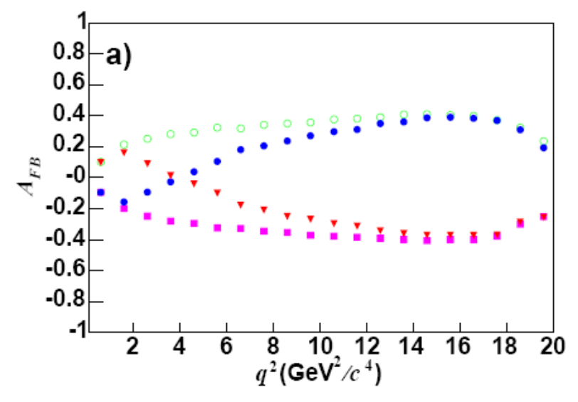
B →K* ll Lepton Angular Asymmetry
Cos θ* lepton- angle in dilepton rest frame. Forward-backward asymmetric!
due to axial vector penguin (C10) amplitude
Asymmetry A_{FB} vs. dilepton mass q² gives C10 evolution
relative to symmetric C9 and C7
Cos θ_{K} kaon angle in K* rest frame. Gives K* polarization
l⁻
θ*
SM
C7 = -C7(SM)
C9C10 = -C9C10(SM)
C7 = -C7(SM),
C9C10 = -C9C10(SM)
B
l⁺
θ_{K}
K
B
π

Slide 10

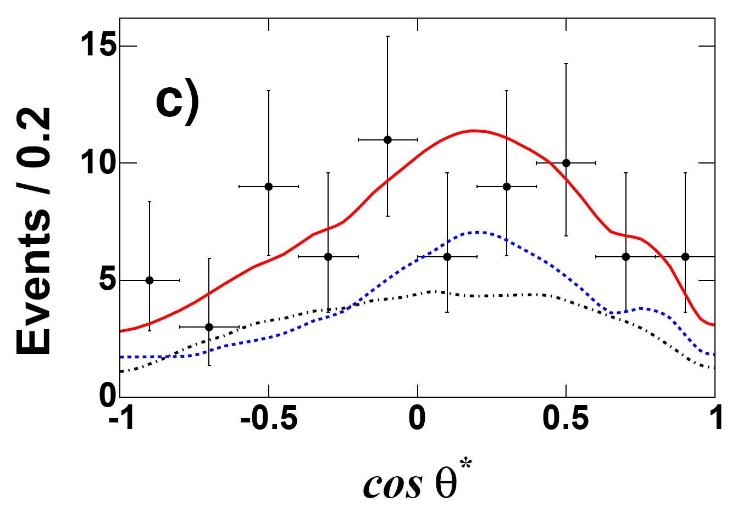
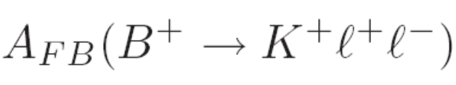





B →K ll Angular Distribution
A_{FB} is non-zero only for non-zero scalar penguin contribution F_{S}
B →Kll
Preliminary
total
Consistent with SM
expectation F_{S} = A_{FB} = 0
bkg
signal

Slide 11
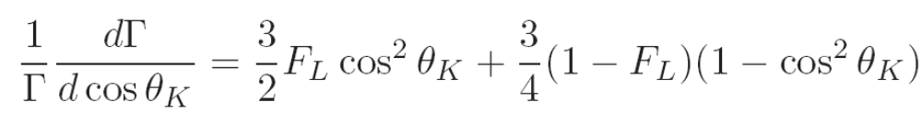

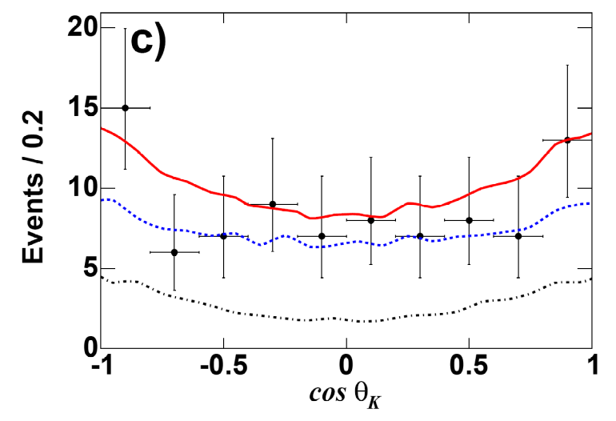
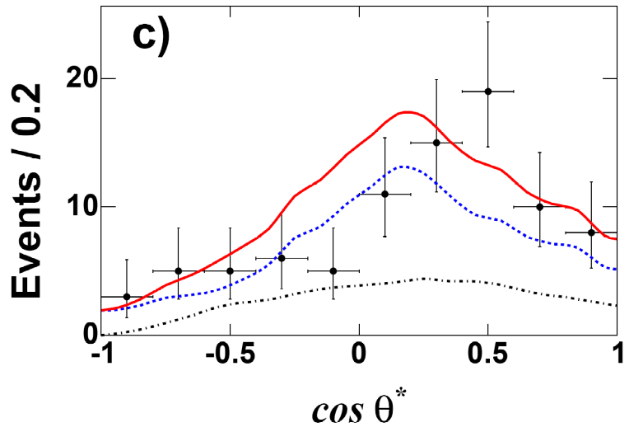
B →K* ll Angular Distribution
F_{L} fit
B →K*ll,
q² > 0.1 GeV²
Fit F_{L} in q² bins with 4d (m_{ES}, ΔE, m(Kπ), cos θ_{K})
Fix F_{L}, fit A_{FB} in q² bins with 4d (m_{ES}, ΔE, m(Kπ), cos θ*)
All procedures validated by J/ψ K(*) control samples
Background shape modeled from m_{ES},ΔE sidebands
A_{FB} fit

Slide 12
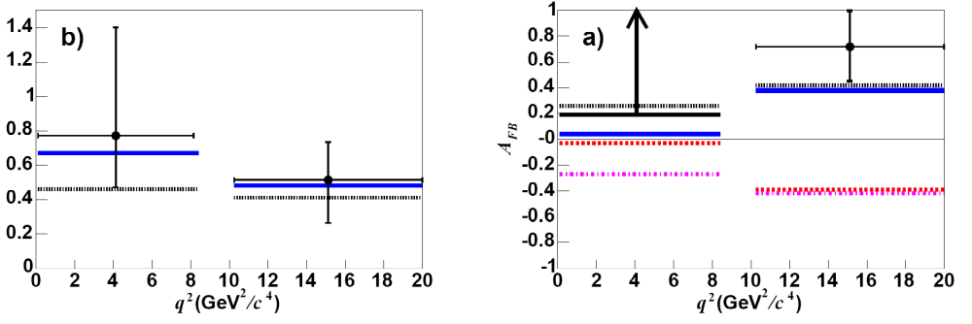
B →K* ll Angular Distribution
K* polarization consistent
with Standard Model
Possible to exclude
C7 = -C7(SM) with 1 ab⁻¹
K* polarization F_{L}
SM
C7 = -C7(SM)

Slide 13

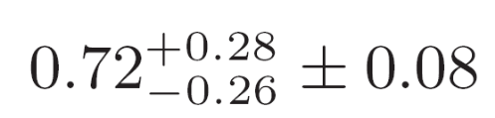
B →K* ll Angular Distribution
Low q² lower limit excludes
SM at 98% CL (2.05σ)
A_{FB}
A_{FB} (SM) = 0.03
SM
SM
At high q², wrong-sign C₉C₁₀
is excluded at >3σ
C9C10 = -C9C10(SM)
A_{FB} =
A_{FB} (SM) = 0.38
SM and alternate predictions from
NNLO OPE + LCSR form factors,
Ali et al. Phys. Rev. D 66 034002 (2002)
Ball and Zwicky Phys. Rev. D 71 014029 (2005)

Slide 14
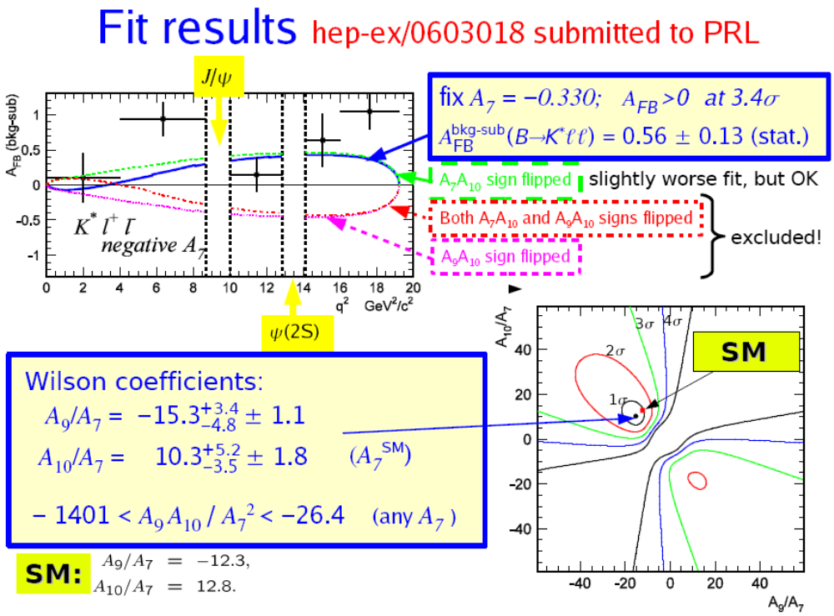
Belle K*ll Results

Slide 15
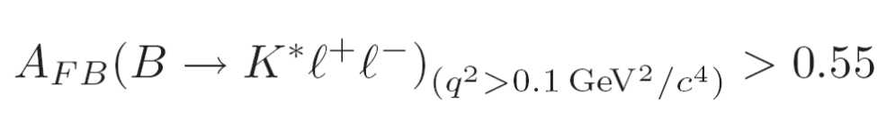
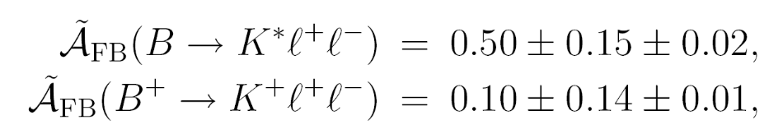
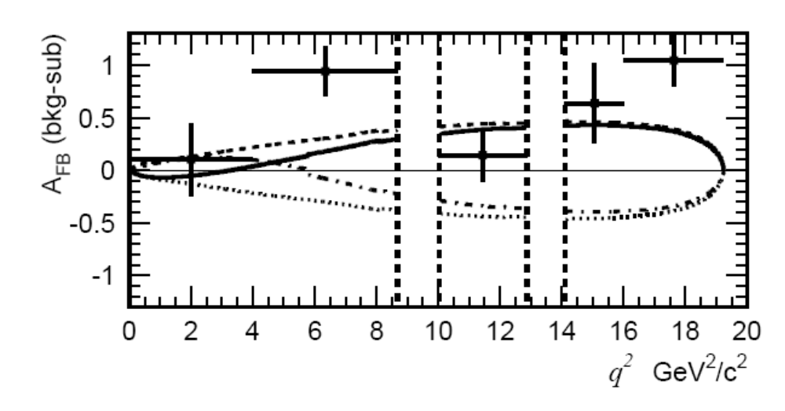


BaBar vs. Belle Results
BaBar and Belle measure consistent values for global K*ll and Kll AFB
BaBar
Belle
Also consistent conclusions for K*ll AFB vs. Q²
Large positive asymmetry at high Q²
BUT large positive asymmetry at low Q² too!
What is going on here?

Slide 16
BaBar vs. Belle Observables
BaBar
AFB and F0 in two separate fits of lepton angle and kaon angle
In two bins of dilepton mass + fit to sum over all dilepton mass
Belle
A9 and A10 from global fit to lepton angle and dilepton mass
AFB computed for sum over all dilepton mass
BaBar method
includes more angular information
model independent and form factor independent
analgous to B → VV analyses, readily interpreted by experimental community
Belle method
exploits global constraints of allowed standard model operators
readily interpreted by phenomenological/model-builder community
FUTURE MEASUREMENTS NEED BOTH INTERPRETATIONS!

Slide 17
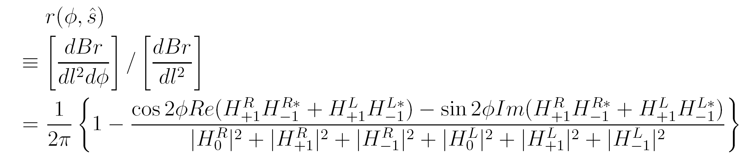
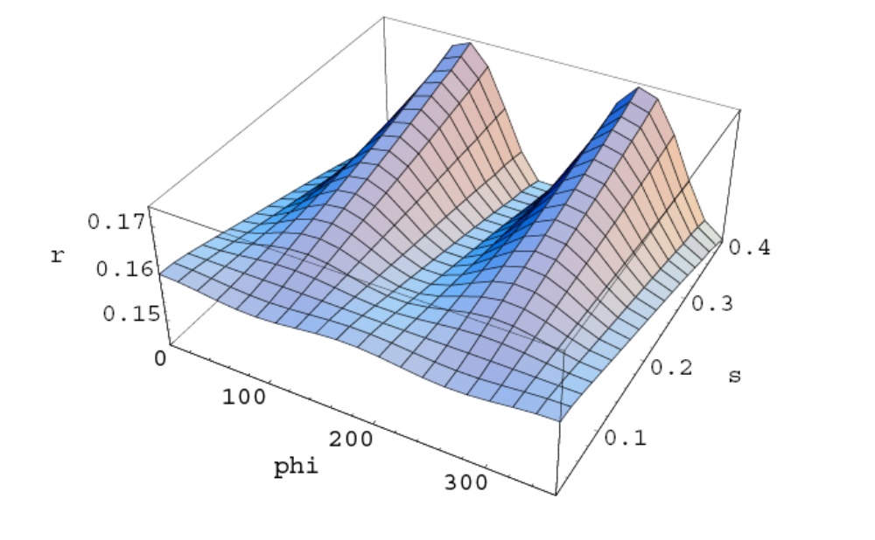
Another angular observable
Decay plane angle φ distribution has simple form if other angles
integrated out:
Kim/Kim/Lu/Morozumi hep-ph/0001151
Phys.Rev.D62:034013,2000
Sin 2φ term vanishes in SM
Cos 2φ is small for small Q²
Non-flat behavior could indicate
right-handed currents

Slide 18
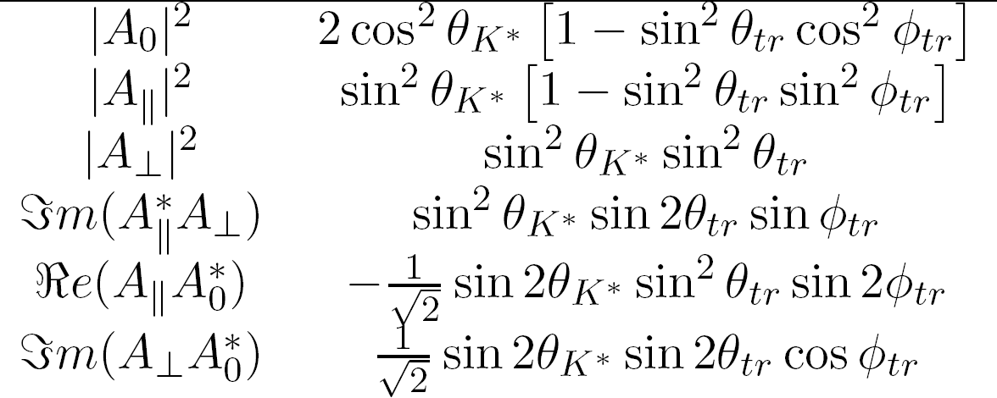
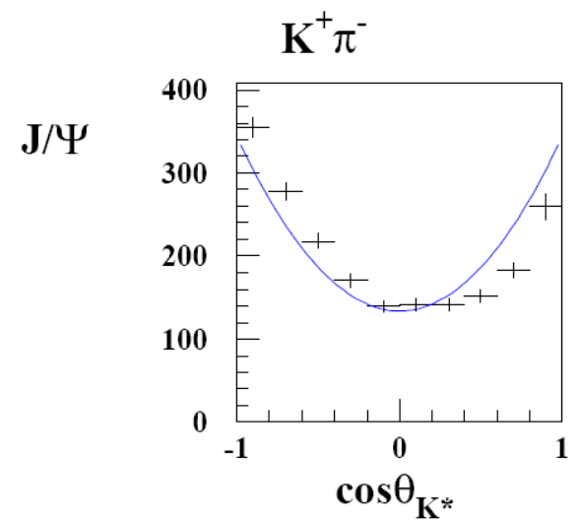
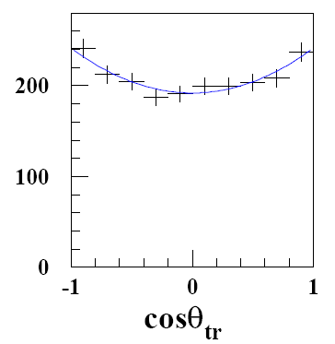
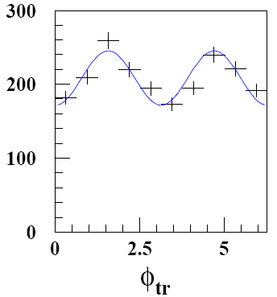
Fully Correlated Angular Analysis: J/ψ K*
With thousands of K*ll events expected in LHCb/Superb era, full 4d angular analysis should be statistically feasible, as is already done in B →VV
Amplitude
Angular dependence
(integrated) transversity
amplitudes can be extracted
with several % precision
Studies of phases, CP/T violation

Slide 19
WG2 Report Task/Wish List for Experimenters

Slide 20
WG2 Report Task/Wish List
K*ll angular analysis prospects for Superb and LHCb
Extrapolate Babar observables in (more finely) binned Q² fits to 10, 50 ab⁻¹
Extrapolate Belle Wilson Coefficient global fits to 10, 50 ab⁻¹
LHCb estimates with more recently computed MC
what is the most realistic S/B?
Perhaps test one or more of the other untried observables (φ, triple product asymmetries, CP/T asymmetries, general amplitudes)?
Kll measurements
Same tasks for AFB, RK, FS observables
CMS/ATLAS: at the very least, projections of reconstructed K*⁰μμ

Slide 21
WG2 Report Task/Wish List
sll sum-of-exclusive prospects
Superb studies of expected precision for dΓ/dQ² and its impact on Wilson coefficient constraints
Feasibility of extending BaBar/Belle results to higher Mx to reduce
shape function effects.
AFB expected precision and possible decay model systematics
Other sll/dll decays
B → πll, ρll
Angular analysis of Λb →Λ ll
Bs →φ ll
B→ K + npi ll
Is there UNIQUE information on EW
penguins to be gained here beyond
K*ll et al.?

Slide 22
WG2 Report Task/Wish List
Some questions/tasks for theorists
What is the unique role, if any, in whatever new physics model,
of b → sll in light of expected precision for b →sγ, Bs→ μμ, and Bs mixing
Is it possible to estimate contemporary theoretical uncertainties
for FORM FACTOR RATIOS?
What is possible irreducible contamination to K*ll observables from J/ψΚ* and Kπll?
Implement new MX models for b →sll in EvtGen or other common generator?
Explanation in simple terms of how angular observables relate to
various Wilson coefficients?

Slide 23
Backup Slides

Slide 24
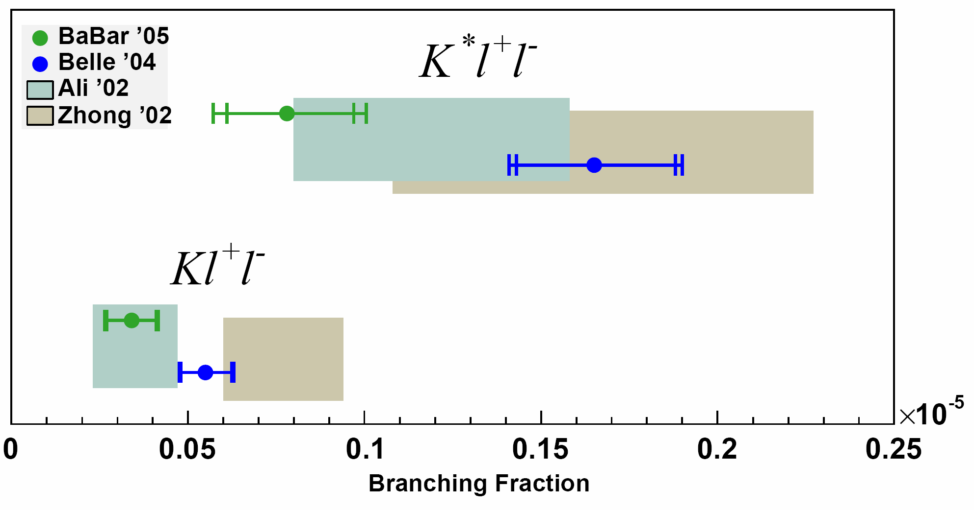
B →K ll and B →K* ll
BaBar and Belle branching fractions agree with SM predictions
Experimental uncertainty already better than theory
Difference between BaBar and Belle becoming significant?
Also A_{CP} consistent with 0 at 25% level, e/μ ratio consistent with unity
RAREST B DECAYS EVER OBSERVED

Slide 25
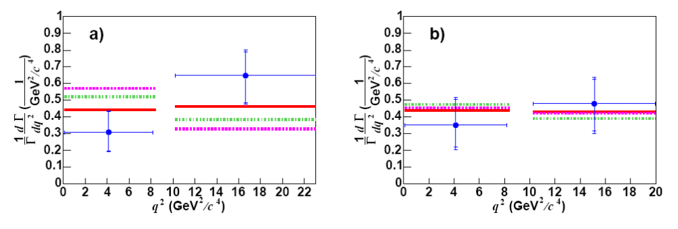
Partial branching fractions vs. dilepton mass consistent with SM + form factors

Slide 26
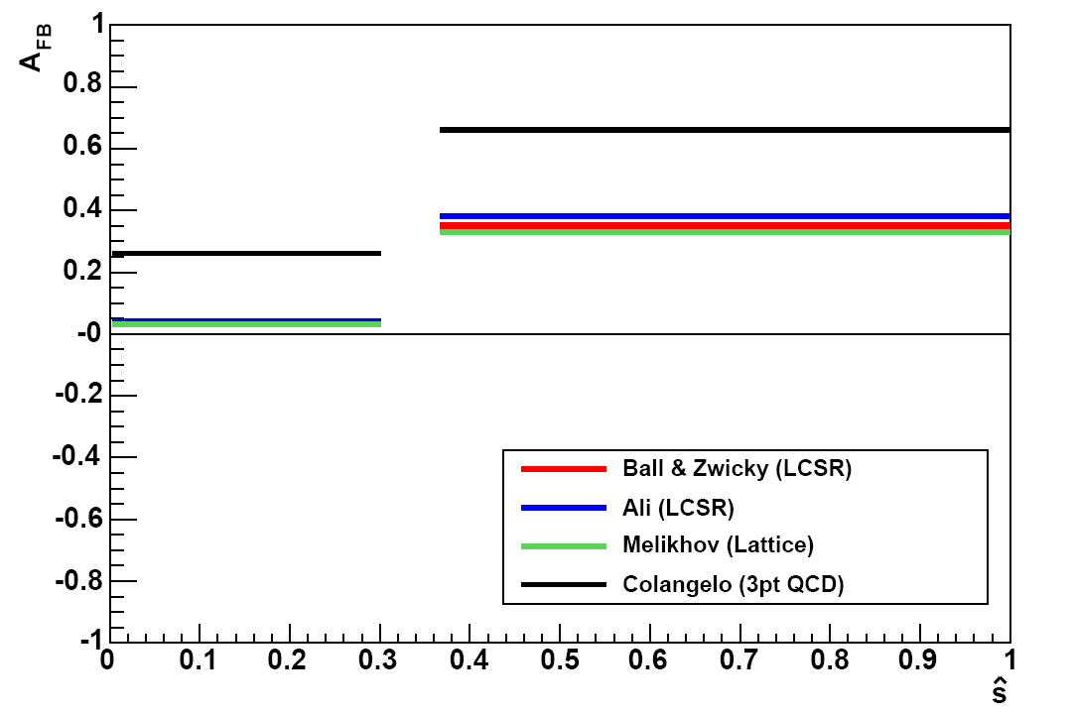
Form Factor Model Dependence: AFB
Colangelo strongly disagrees with LCSR and Lattice (T3 form factor)

