Slide 1
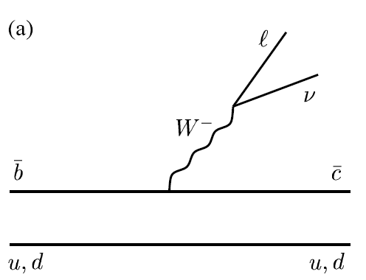

TM
Studies of semileptonic B decays
with the BaBar experiment:
Measurement of |V_{cb}| and Heavy Quark Parameters
hep-ex/0403030, 0403031, 0404017
Jeffrey Berryhill
University of California, Santa Barbara
For the BaBar Collaboration
APS Meeting
Denver, Colorado
May 1, 2004

Slide 2
Why study semileptonic B decays?
V_{cb}
Tree level, short distance:
Precision electroweak physics
Decay properties depend directly on fundamental Standard Model parameters: |V_{cb}| , m_{b}, m_{c}
|V_{cb}| : essential ingredient in tests of CKM unitarity
m_{b}, m_{c}: important in predictions of B decay rates,
precision electroweak observables

Slide 3
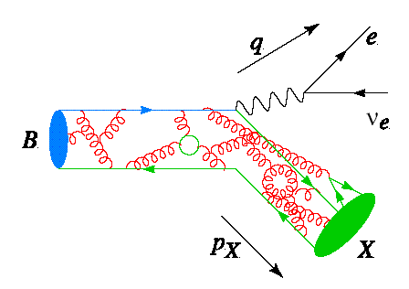
Why study semileptonic B decays?
+ higher order & long distance:
W
b
c
QCD phenomenology of heavy quarks
Higher order QCD (α_{s}^{n}) corrections to short-distance interaction
Non-perturbative, long-distance interactions of b quark with light quark
Need theoretical technology to factorize these two effects and
produce observables with precise relation to short distance parameters

Slide 4
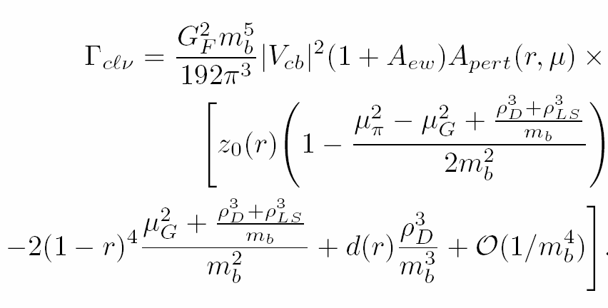

The Heavy Quark Expansion (HQE)
An operator product expansion in the heavy quark limit
Short-distance, perturbative physics in the coefficients of operator products
(to some order in α_{s}). Calculable!
Long-distance, non-perturbative physics in exp. values of products of
quark operators (to some order in 1/m_{b}). NOT calculable. Measure them!
N.B. Several HQE schemes exist; op’s and coeff’s are scheme dependent

Slide 5
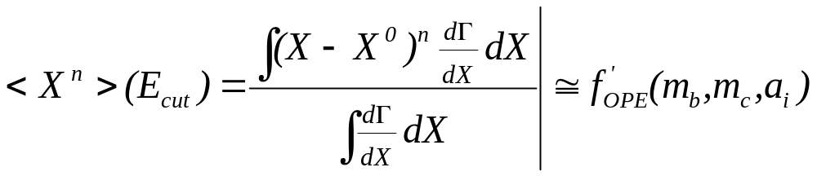
HQE and spectral moments
  Multiple b → c l ν observables needed for simultaneous extraction of all HQE parameters
  HQE calculations now exist for several inclusive spectral moments of the semileptonic decay products, as a function of the minimum (B rest frame)
  lepton energy , E_{cut} , required:
E_{l}>E_{cut}
Partial branching fraction n = 0 moment
Lepton-energy spectrum <E_{l}^{n}> n = 1, < E_{l}^{n} - <E_{l}¹> >, n = 2,3
Hadronic-mass distribution <M_{X}^{n}> n= 1,2,3,4
photon energy spectrum in b→sγ decays <E_{γ}^{n}> (not discussed here)

Slide 6
Lepton Energy Spectrum: Selection
Tag Y(4S) events with high energy electron
(p* > 1.4 GeV in Y(4S) frame) “e_{tag}”
Measure spectrum of any second electron in the event (p* > 0.5 GeV in Y(4S) frame) “e_{sig}”
Split into same sign (mostly from D to X l ν ) and opposite sign (mostly signal) samples
e_{sig}
e⁻
B_{sig}
400,000 events!
Data sample:
∫ L dt = 47.4 fb⁻¹
B_{tag}
e⁺
e_{tag}
ν

Slide 7
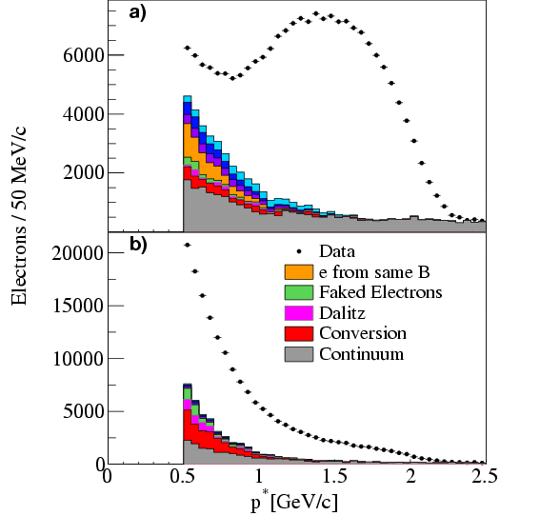
Lepton Energy Spectrum: Background
Suppress charm decay electrons in opp. sign sample
with opening angle cut and J/psi veto
Subtract remaining background:
continuum with off-resonance data
charm decays with same sign dielectron data (corrected for mixing)
fake/conversion/Dalitz electrons estimated from data
b to ccs and b to cτν decays from MC
Same sign (mostly from D decays)
Opp. sign (mostly from B decays)
BABAR
BABAR
B→Xτ⁺ν_{τ}
B→ D^{(*)} D^{(*)}K
--
B→ D_{s}⁺ D

Slide 8
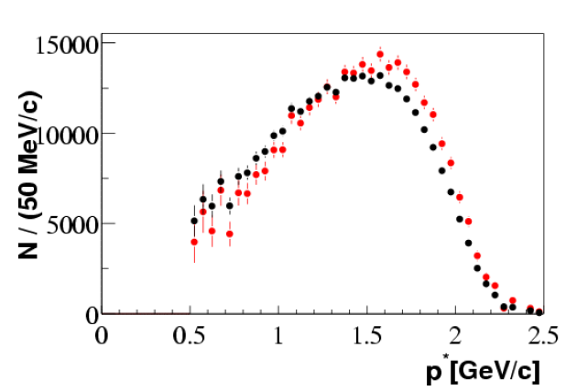
Lepton Energy Spectrum: Corrections
Electron ID efficiency precisely measured in radiative Bhabhas
vs. (p, cos θ, +/-)
Detector Bremsstrahlung corrected via inversion of smearing matrix
(detector material model X₀ agrees with data to 0.14%!)
B momentum correction from
B spectrum in data
B →X_{u}lν background estimated
from measured BF,
MC spectral shape
Before brem. corr.
After

Slide 9
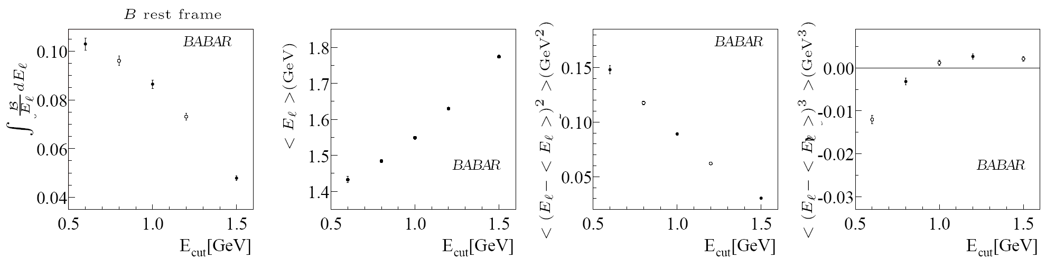
Lepton Energy Spectrum: Moments
Individual measurements are highly correlated!
submitted to Phys. Rev. D: hep-ex/0403030

Slide 10
Lepton Energy Spectrum: Moments
Individual measurements are highly correlated!
submitted to Phys. Rev. D: hep-ex/0403030

Slide 11
Hadronic-Mass Spectrum: Selection
Tag Y(4S) decays with fully reconstructed hadronic B decays “B_{reco}”
Measure X_{c} mass in “B_{recoil}” side of the event:
  exactly one “right sign” lepton (e or μ)
  lepton p* in B rest frame > 0.9 GeV
  |net charge| <= 1
  E_{miss} and P_{miss} consistent with neutrino
π
e⁻
B_{reco}
D*
7000 events
Data sample:
∫ L dt = 82 fb⁻¹
B_{recoil}
e⁺
l
ν
X_{c}

Slide 12
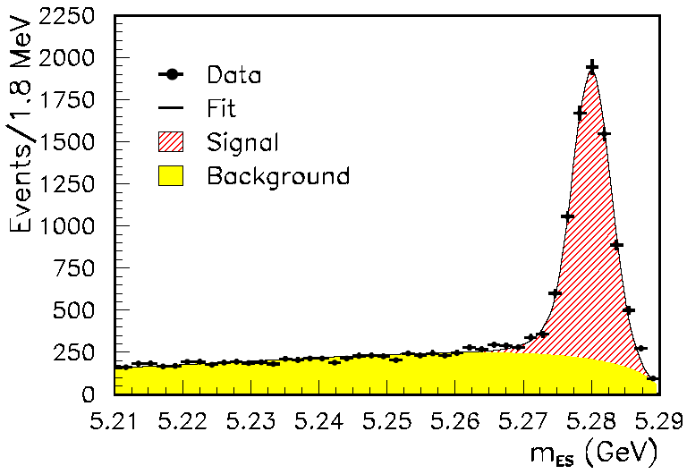
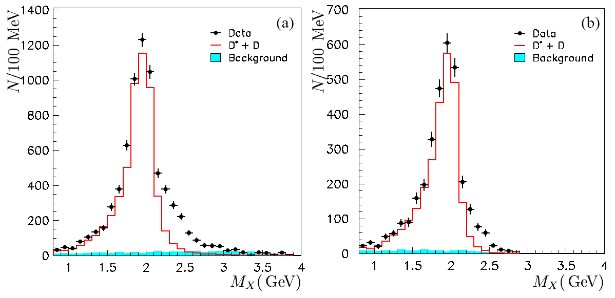
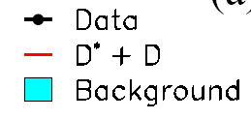
Hadronic-Mass Spectrum: Background
M_{x} extracted from kinematic fit
to the entire event
B_{reco} mass peak in selected events
σ(M_{X}) ≈ 350 MeV
7114 Signal Events
p* > 0.9 GeV
p* > 1.6 GeV
MC
MC
BABAR
BABAR
BABAR
Combinatoric background M_{x} spectrum
estimated from B_{reco} m_{ES} sideband
M_{X}
Small remaining background spectrum
estimated from MC

Slide 13
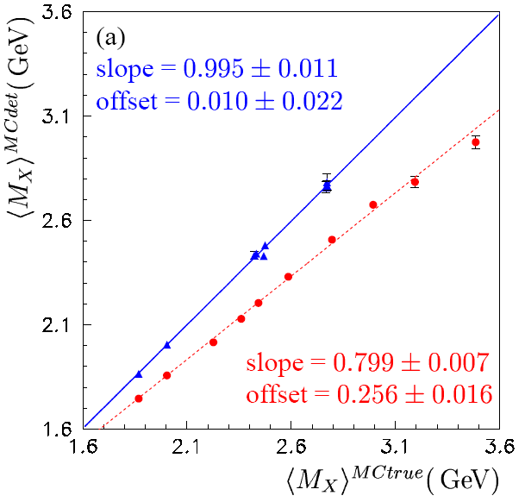
Hadronic-Mass Moments: Corrections
Exploit observed linear relations between measured and generated masses
Calibrate on an event-by-event basis, separately for each moment
9 MC calib. curves for each moment: 3X3 bins of (multiplicity, Emiss – Pmiss)
Calibration curve from inclusive X_{c} l ν MC
Validated in MC on exclusive final states
D^{(*)}π
Validated on partially reconstructed
B →D*±lν (D*±→D⁰π±) DATA
D**
D*
D
Main uncertainties:
Detector Response
Background Subtraction
Little model dependence!!

Slide 14
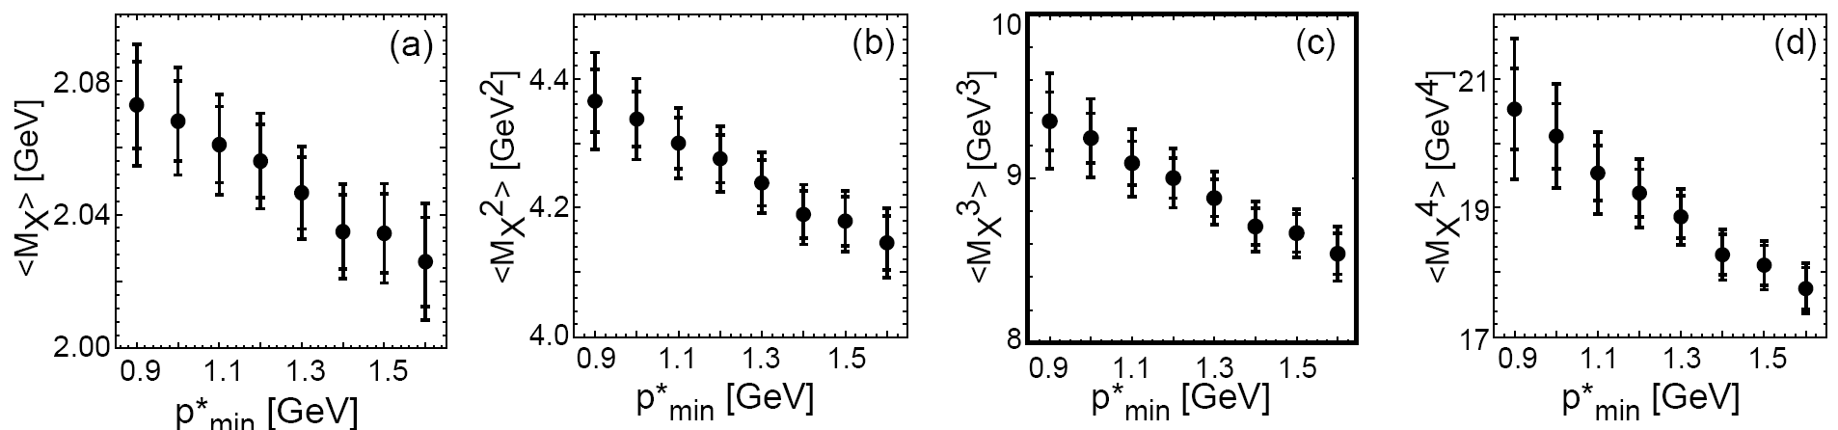
Hadronic-Mass Moments
Moments <M_{X}^{n}> (n=1,…4) of the hadronic mass spectrum
in B →X_{c}lν decays for 0.9 GeV < E_{cut} < 1.6 GeV
Clear dependence on E_{cut} of lepton.
Comparable statistical and systematic errors.
Individual measurements are highly correlated!
BABAR
BABAR
BABAR
BABAR
E_{cut}
E_{cut}
E_{cut}
E_{cut}
submitted to Phys. Rev. D: hep-ex/0403031

Slide 15
Fit of HQE Parameters to Moments
We use calculations in kinetic mass scheme by Gambino and Uraltsev
(HQE to order 1/m_{b}³, α_{s}² )
8 Fit Parameters:
BF(B→X_{c}lν), |V_{cb}|, m_{b}, m_{c} and 4 HQE parameters:
μ_{π}² - exp. value of kinetic energy of b quark inside B meson
μ_{G}² - exp. value of chromomagnetic moment operator
ρ_{D}³ - exp. value of Darwin operator
ρ_{LS}³ – exp. value of Spin-Orbit operator
27 lepton-energy and hadronic-mass moment measurements
27 separate HQE prediction functions in the 8 fit parameters
(higher order moments sensitive to higher order HQE parameters)
hep-ph/0401063
hep-ph/0403166
Ơ(1/m_{b}²){
Ơ(1/m_{b}³){

Slide 16
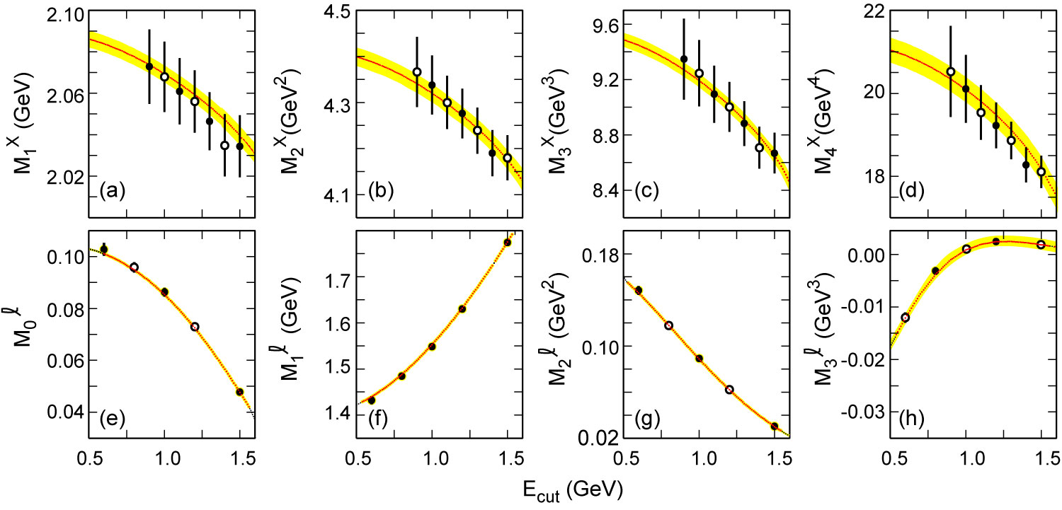
HQE Fit Results
All parameters unconstrained.
Only solid points are used in the fit.
Correlations taken into account.
Error bars show experimental errors
(stat. & syst.)
Bands correspond to theoretical uncertainties.
BABAR
BABAR
BABAR
BABAR
χ² = 15
N_{dof} = 20
BABAR
BABAR
BABAR
BABAR

Slide 17
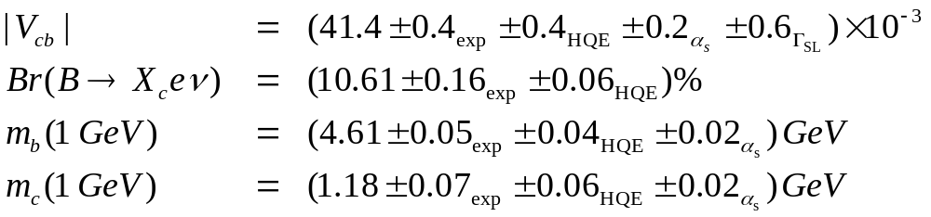
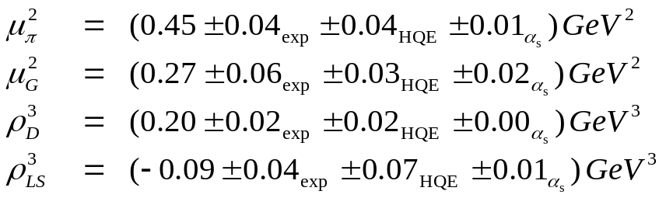
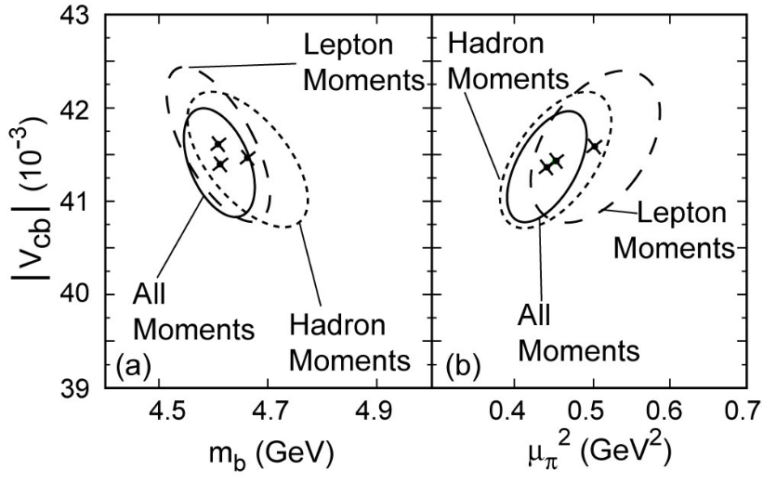
Fit Results
submitted to
Phys. Rev. Lett.
hep-ex/0404017
kinetic mass scheme
2D projections
of the fit result:
BABAR
BABAR
Δχ²=1 ellipses
of separate fits
to lepton or
hadron moments are consistent

Slide 18
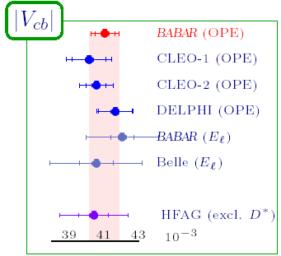
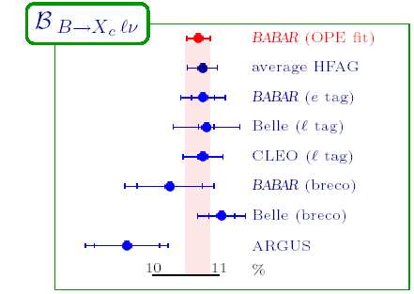
Comparison with previous Determinations
First measurement with all parameters
floating to order 1/m_{b}³

Slide 19
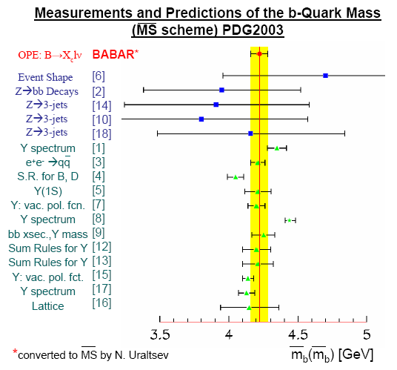
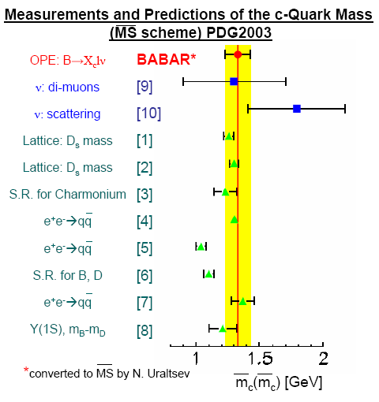
Comparison with other Determinations
m_{b}(m_{b}) = 4.22 ± 0.06 GeV
BABAR
m_{c}(m_{c}) = 1.33 ± 0.10 GeV
Conversion from kinetic mass scheme
to MS scheme with hep-ph/9708372, hep-ph/0302262
See also report from CKM WS hep-ph/0304132

Slide 20
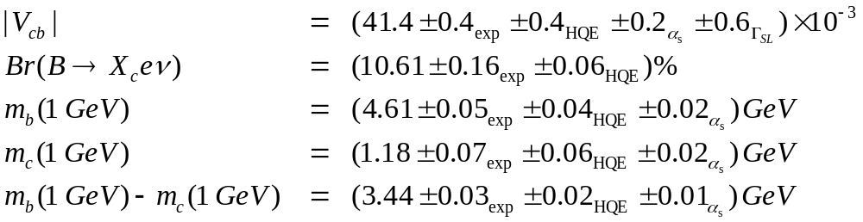
Summary
New Measurements of
Hadronic Mass Moments up to 4th order for 0.9 GeV < E_{cut} < 1.6 GeV hep-ex/0403031
Lepton Energy Moments up to 3rd order for 0.6 GeV < E_{cut} < 1.5 GeV hep-ex/0403030
Serve as input to OPE fit with no external constraints:
2% error on |V_{cb}| from BaBar
submitted to Phys. Rev. Lett.
hep-ex/0404017
TM

