Slide 1

Union density its Relationship with OTHER ECONOMIC measurements
Notes:
NOTE:
To change the image on this slide, select the picture and delete it. Then click the Pictures icon in the placeholder to insert your own image.

Slide 2
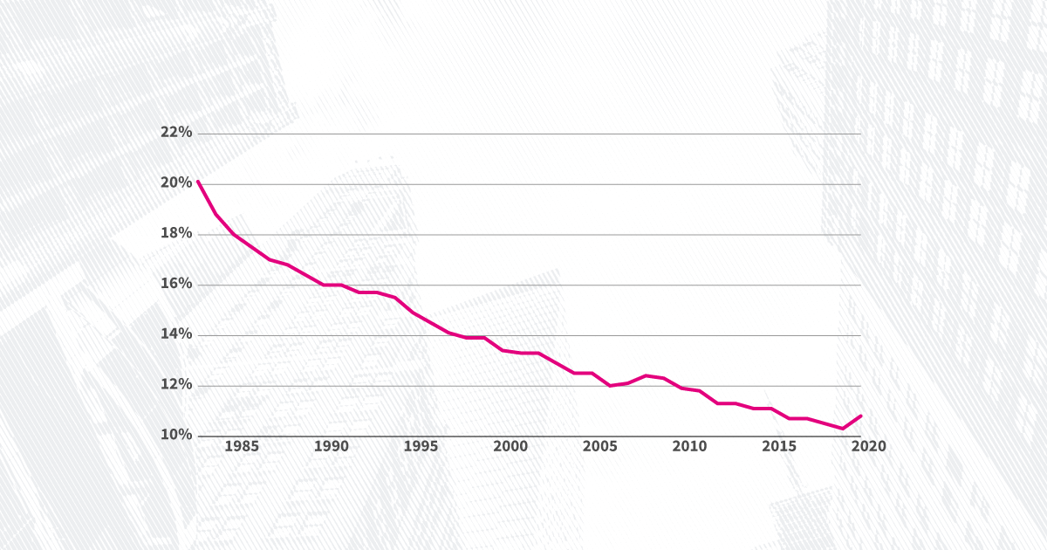
Preliminary Information
Over the last forty years, the legal and political climate in the United States has become very hostile to labor unions.
The 2016 Republican Party platform declared: "[w]e support the right of states to enact Right-to-Work laws and call for a national law to protect the economic liberty of the modern workforce.“
Since 1980 the amount of workers in the United States that are members of a labor union has declined drastically.

Slide 3
Union Density and Income inequality

Slide 4
What is the relationship between union density and income inequality within the countries of the OECD?
Data Needed:
Information regarding “union density” in OECD countries
“Trade Union Density” expresses union membership as a proportion of the eligible workforce
Information regarding income inequality and GDP in OECD countries
The Gini Coefficient measures the extent to which the distribution of income among individuals or households within an economy deviates from a perfectly equal distribution
Sources:
Union Density Data Source: OECD (2021), Trade Union (database), stats.oecd.org
Gini Coefficient Data Source: OECD (2021), Income Distribution (database), stats.oecd.org

Slide 5
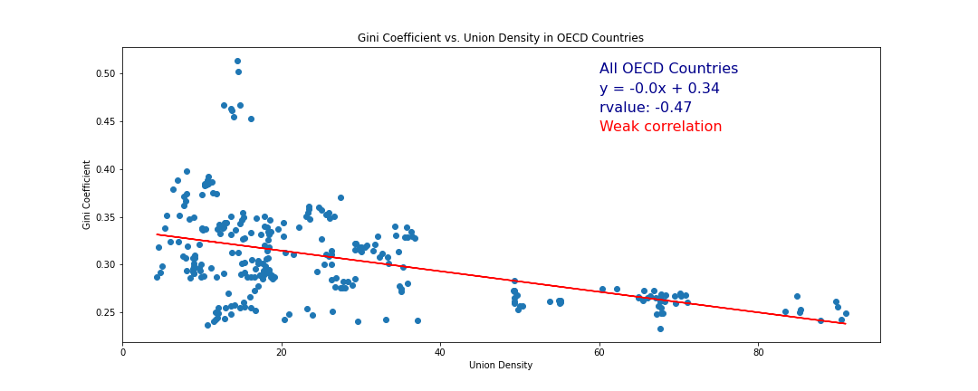
Analysis
A linear regression analysis of data between 2009 and 2019 indicates there is a weak and negative correlation between Union Density and Income Inequality in the OECD countries.

Slide 6
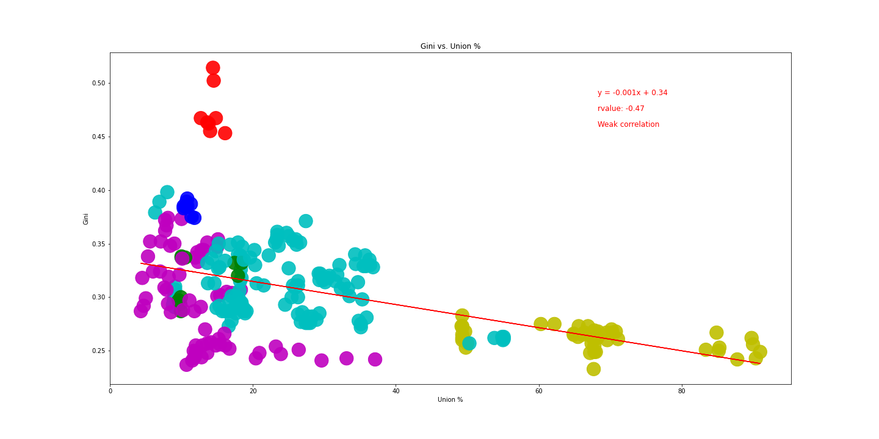
Analysis
The same analysis, with the countries of the OECD grouped by region indicates the data from the Latin American countries are statistical outliers.

Slide 7
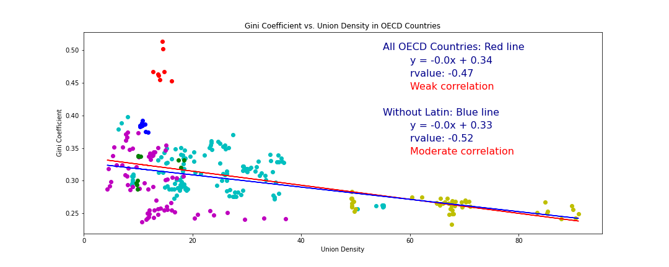
Analysis
When the Latin American countries are removed from the analysis the correlation is stronger. The “r-value” increases to -0.52.

Slide 8
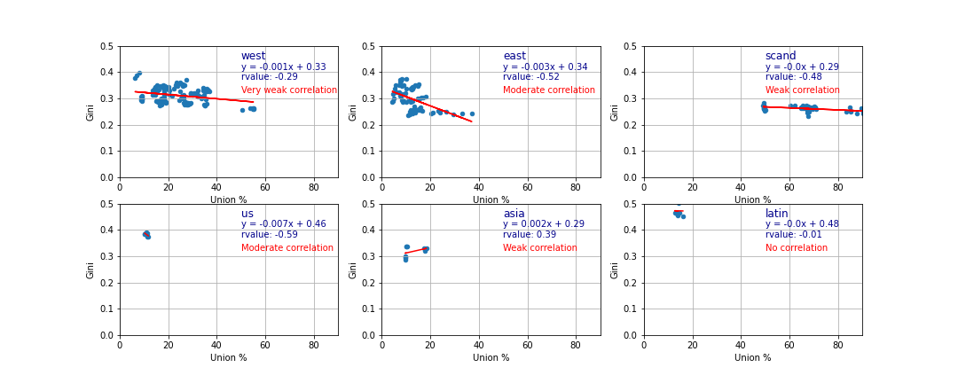
Analysis
An analysis by region indicates the correlation is strongest in the United States and Eastern Europe and weakest in Latin America and the “Western” countries (i.e., Western Europe, Israel, Australia, New Zealand, and Canada, but excluding the Scandinavian countries).

Slide 9
Conclusion
In the OECD there appears to be a moderate negative correlation between Union Density and the Gini Coefficient. Meaning that as Union Density increases there is a moderate decrease in income inequality.

Slide 10
Union Density and GDP

Slide 11
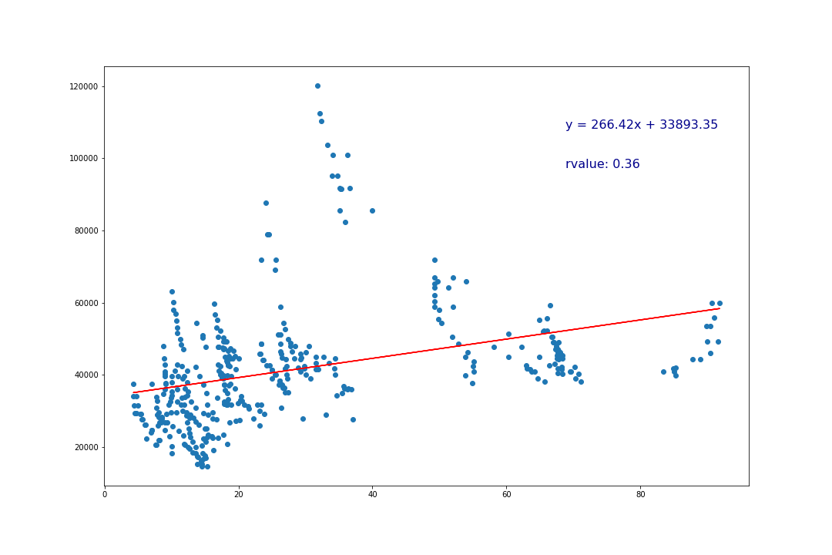
Analysis
A linear regression analysis of GDP and Union Density indicates a weak positive correlation (r-value = .36) between Union Density on the x-axis, and GDP on the y-axis.

Slide 12
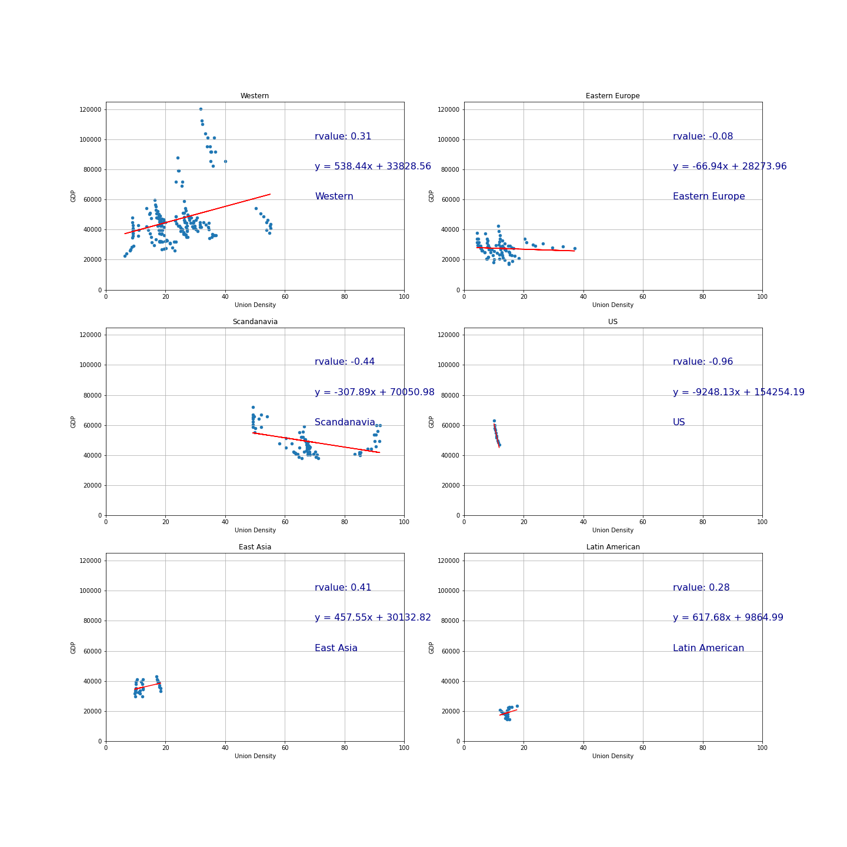
Analysis
When the countries are separated into regions, one can see a moderate positive correlation in the Western countries, but interestingly, a weak negative correlation in the Scandinavian countries.

Slide 13
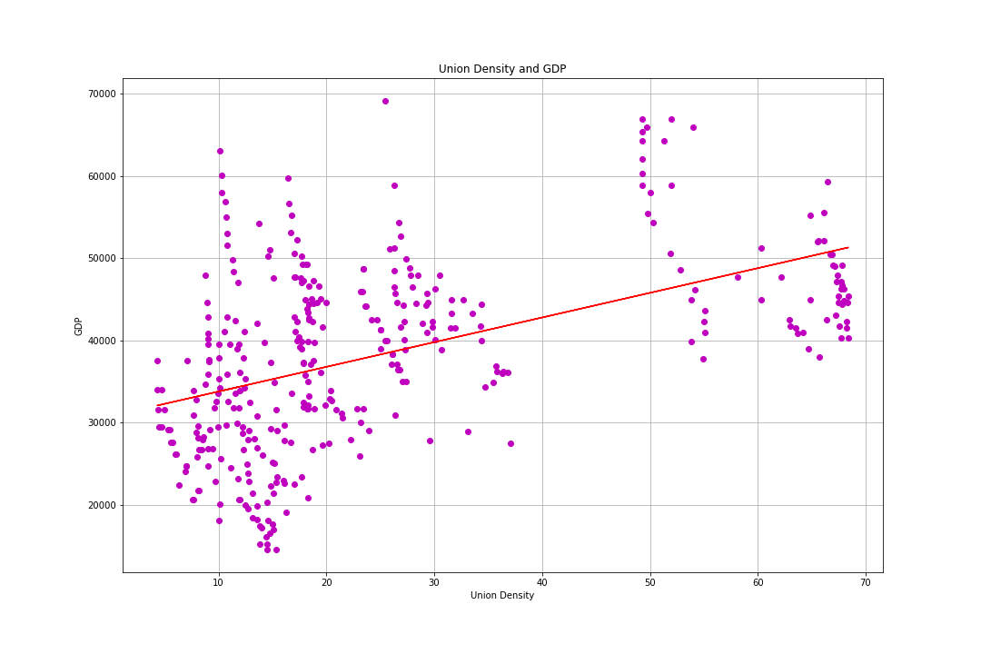
Removing Statistical Outliers
After calculating the Inter-Quartile Ranges for both GDP and Union Density and removing the datapoints outside those ranges the r-value increases to 0.49.

Slide 14
Conclusion
In the OECD there appears to be a moderate positive correlation between Union Density and GDP. Meaning that as Union Density increases there is a moderate increase in GDP.

Slide 15
How does the political and legal environment within each country affect income inequality?
Data Needed:
A way to delineate how the concept can be measured
The ITUC Global Rights Index is based on information recorded in the ITUC Survey, the world’s most comprehensive database on workers’ rights violations. It covers violations in law and in practice
Countries are rated on a scale from 1 to 5. A high score effectively means that many violations were committed which in turn results in a poor rating
Data Source:
International Trade Union Confederation

Slide 16
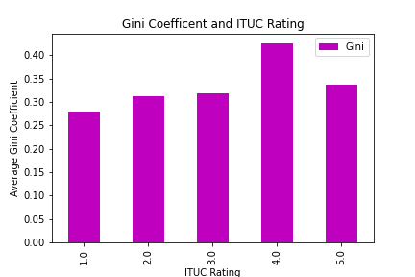
Analysis
Conclusion: Countries with a more labor union “friendly” political and legal environment appear to have lower levels of income inequality on average and as the climate becomes less friendly to labor unions the average level of income inequality increases.
Interestingly this is not true for the three OECD countries with the worst political and legal climate for labor unions.

