Slide 1
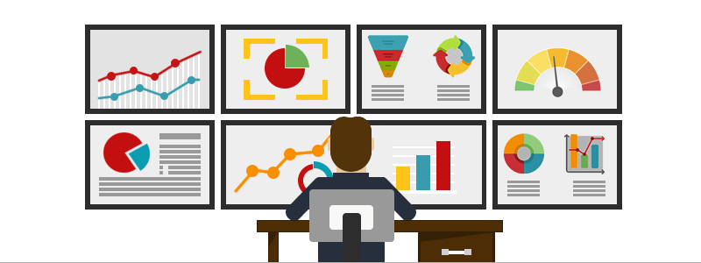
Monitoring

Slide 2
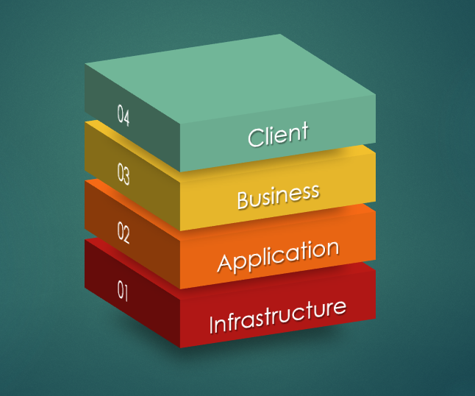
What is Monitoring?
Monitoring is the activity of tracking how apps, servers and network behave in a business or company.
Monitoring Layers

Slide 3
Infrastructure Monitoring
This is a process owned and managed by the IT organization and focused to collect and analyze data from the IT Infrastructure Environment that can be hardware, On-Premise environment or in the Cloud as well as Container solutions.
With Infrastructure Monitoring we can track metrics like CPU Usage, Memory Usage, Disk Space usage, Load Average, Logs Analysis and Network.

Slide 4
Application Monitoring
This is a task that tracks the behavior and performance of the Business applications. It gathers performance metrics from software applications bases on end user experience.
Application monitoring focuses on metrics like the Apdex, the Average response time(Transaction response time), number of transactions detected, error rate, count of Application instances, Request rate, Application Availability and Garbage collection, just to mention some of the most tracked metrics.
(10) What Is Apdex and Why Is It Important? - YouTube

Slide 5
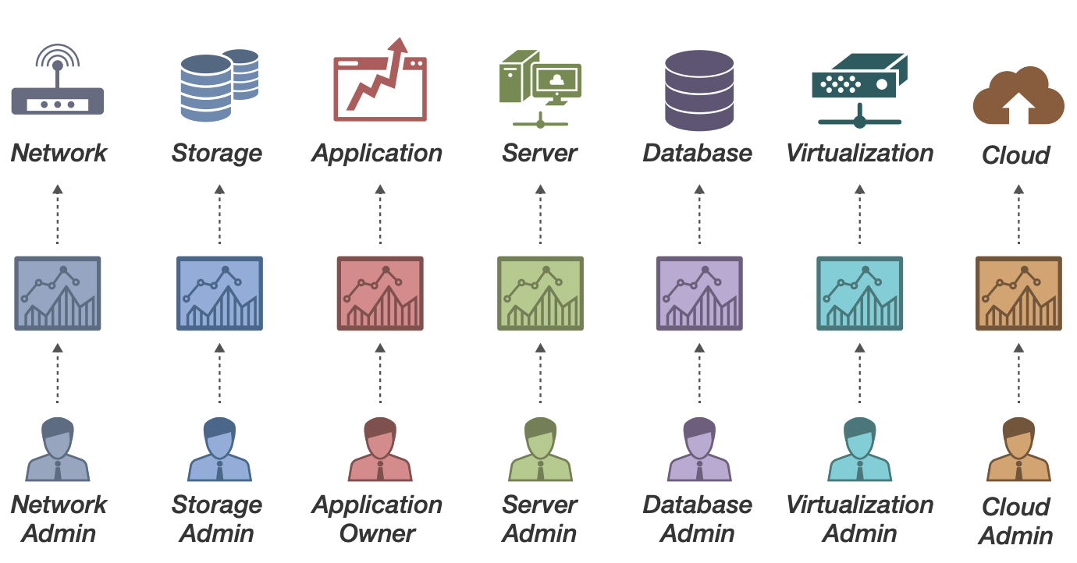
Monitoring responsible

Slide 6
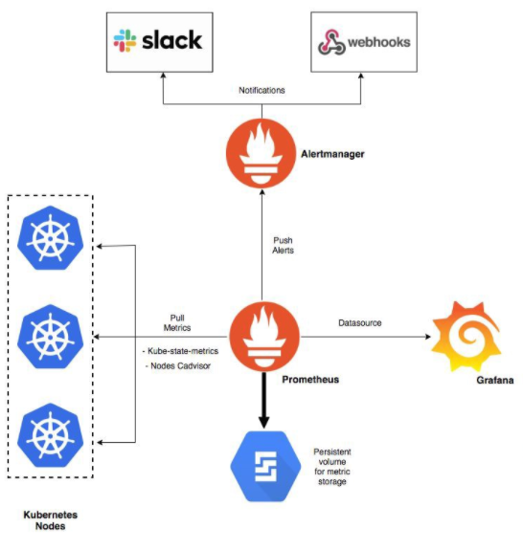

Slide 7
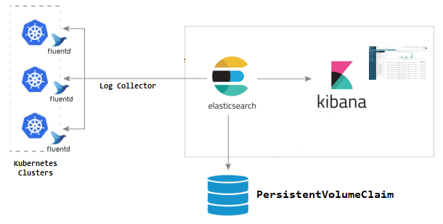
Centralizing logs for Application Monitoring

