Slide 1

EEG worksop Day 2 Single participant processing
Dr. Berry van den Berg
Researcher in
Experimental Psychology
University of Groningen
berry.van.den.berg@rug.nl
20 September 2019, Nanjing

Slide 2
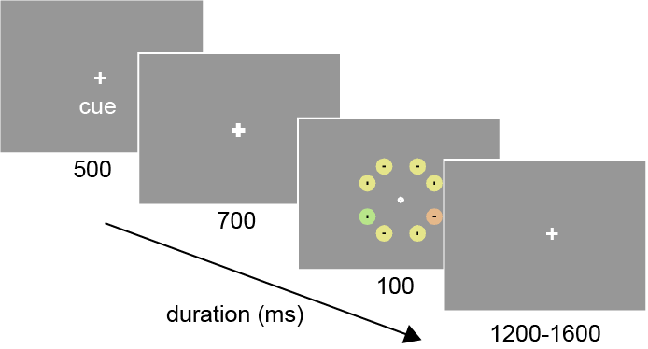
Our dataset:

Slide 3
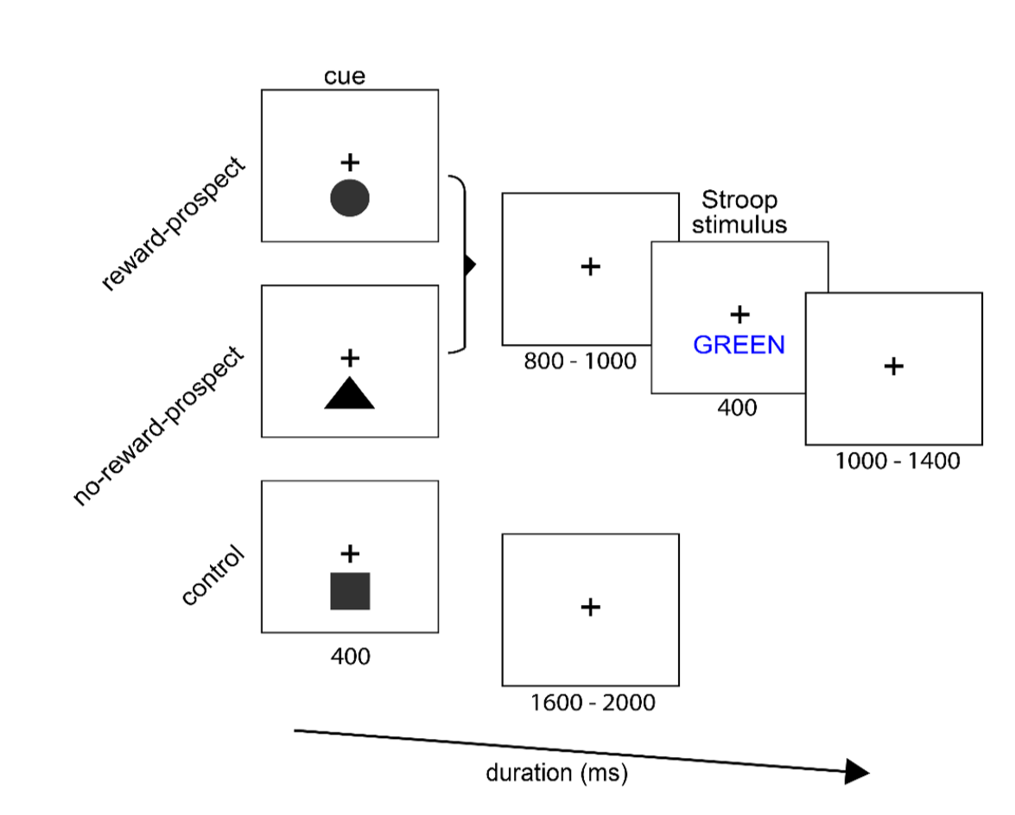
Van den Berg et al., under review

Slide 4
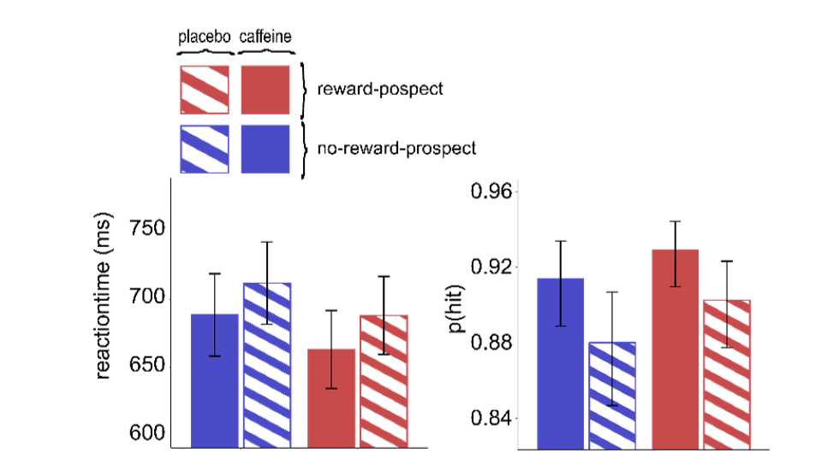

Slide 5
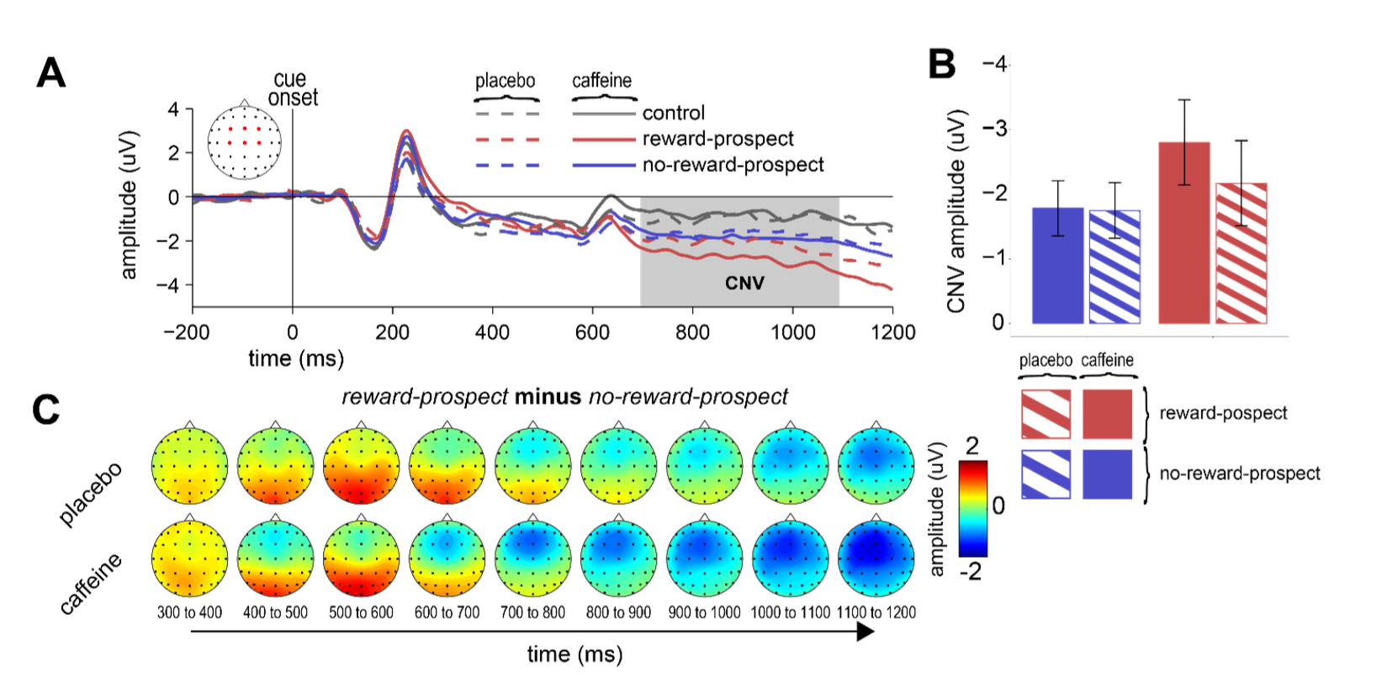

Slide 6
DIY - GUI
Start MATLAB
Add EEGlab to the path (?)
Load data
Plot data
Identify most common artefacts

Slide 7
DIY
figure;imagesc(EEG.data(:,1:100))
Q. What are we seeing?
figure;imagesc(EEG.data(:,1:100)-repmat(mean(EEG.data(:,1:100),2),1,100))

Slide 8
DIY
Pivot table (?)
Pieces:
unique(EEG.events)
for iEvents = ….
sprintf(‘%s events of type’,…)

Slide 9
Design

Slide 10
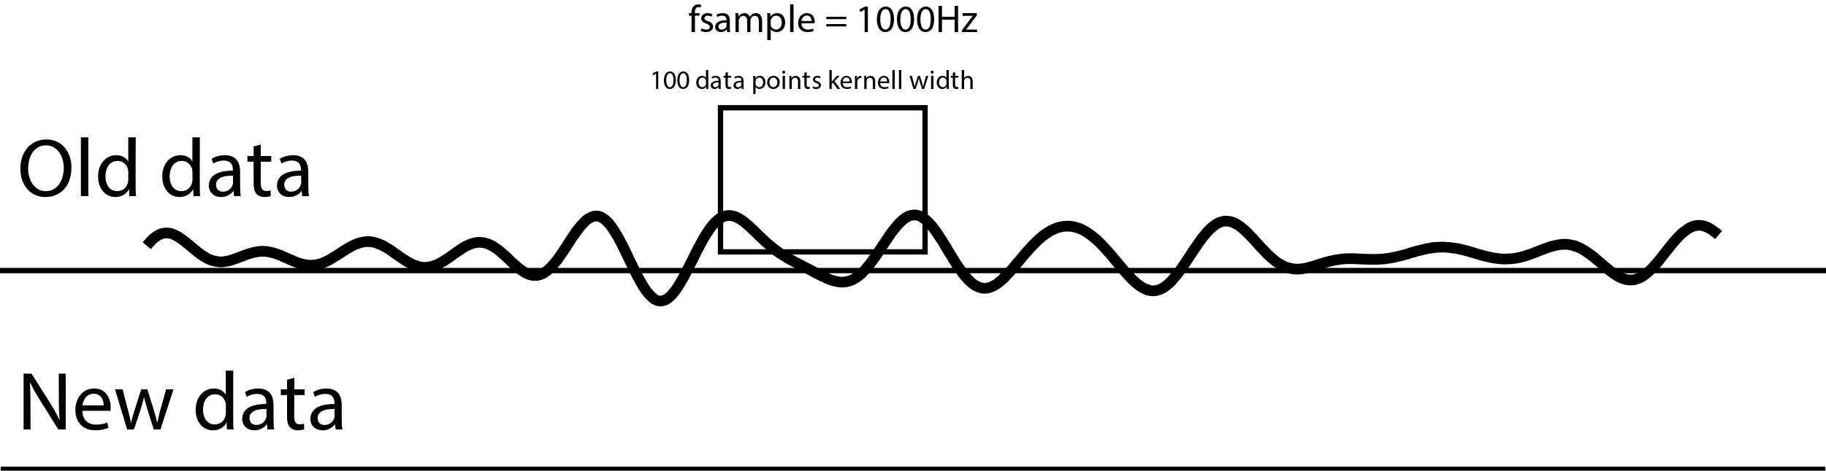
Why is jittering important? // Boxcar filtering

Slide 11
Day 2
Preprocessing
Filtering
Bookkeeping
Data inspection (again?!)

Slide 12
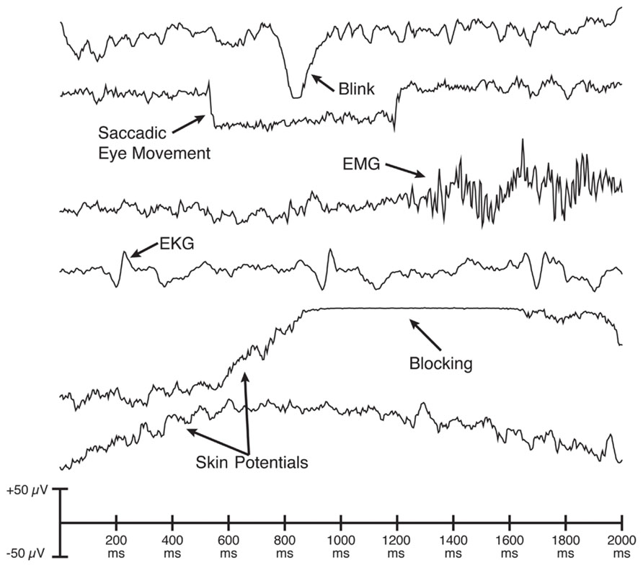
Luck, 2014

Slide 13
So blocking doesn’t matter anymore? – not exactly…
The combination of high-temporal resolution EEG and high-spatial resolution of EEG…
I tried it once….
Lets have a look how that went…

Slide 14
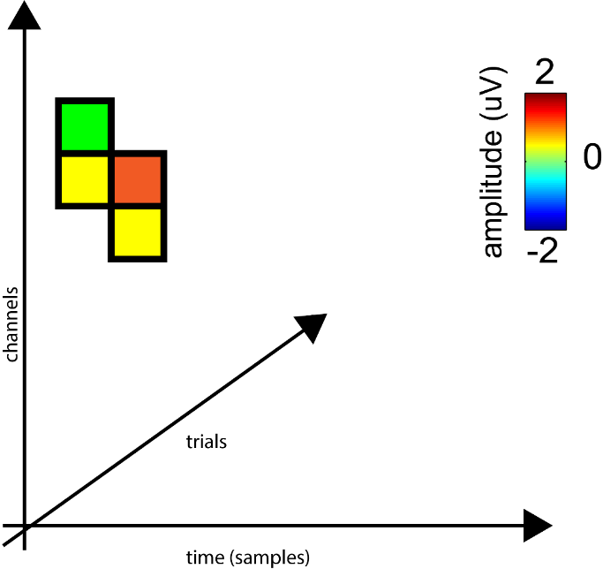
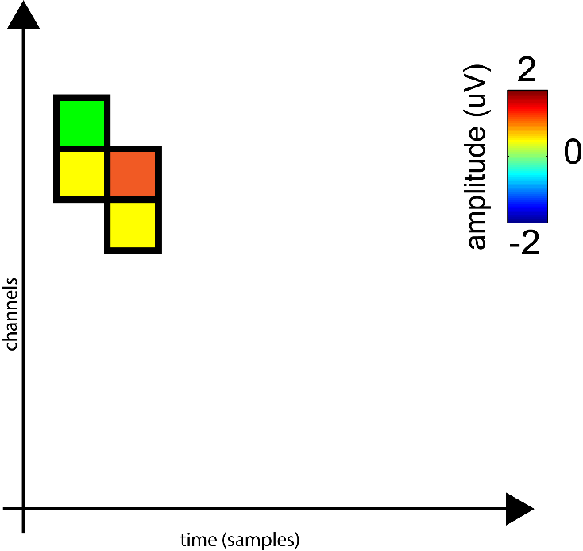
Preprocessing steps
HP filtering
ICA
Creating epochs

Slide 15
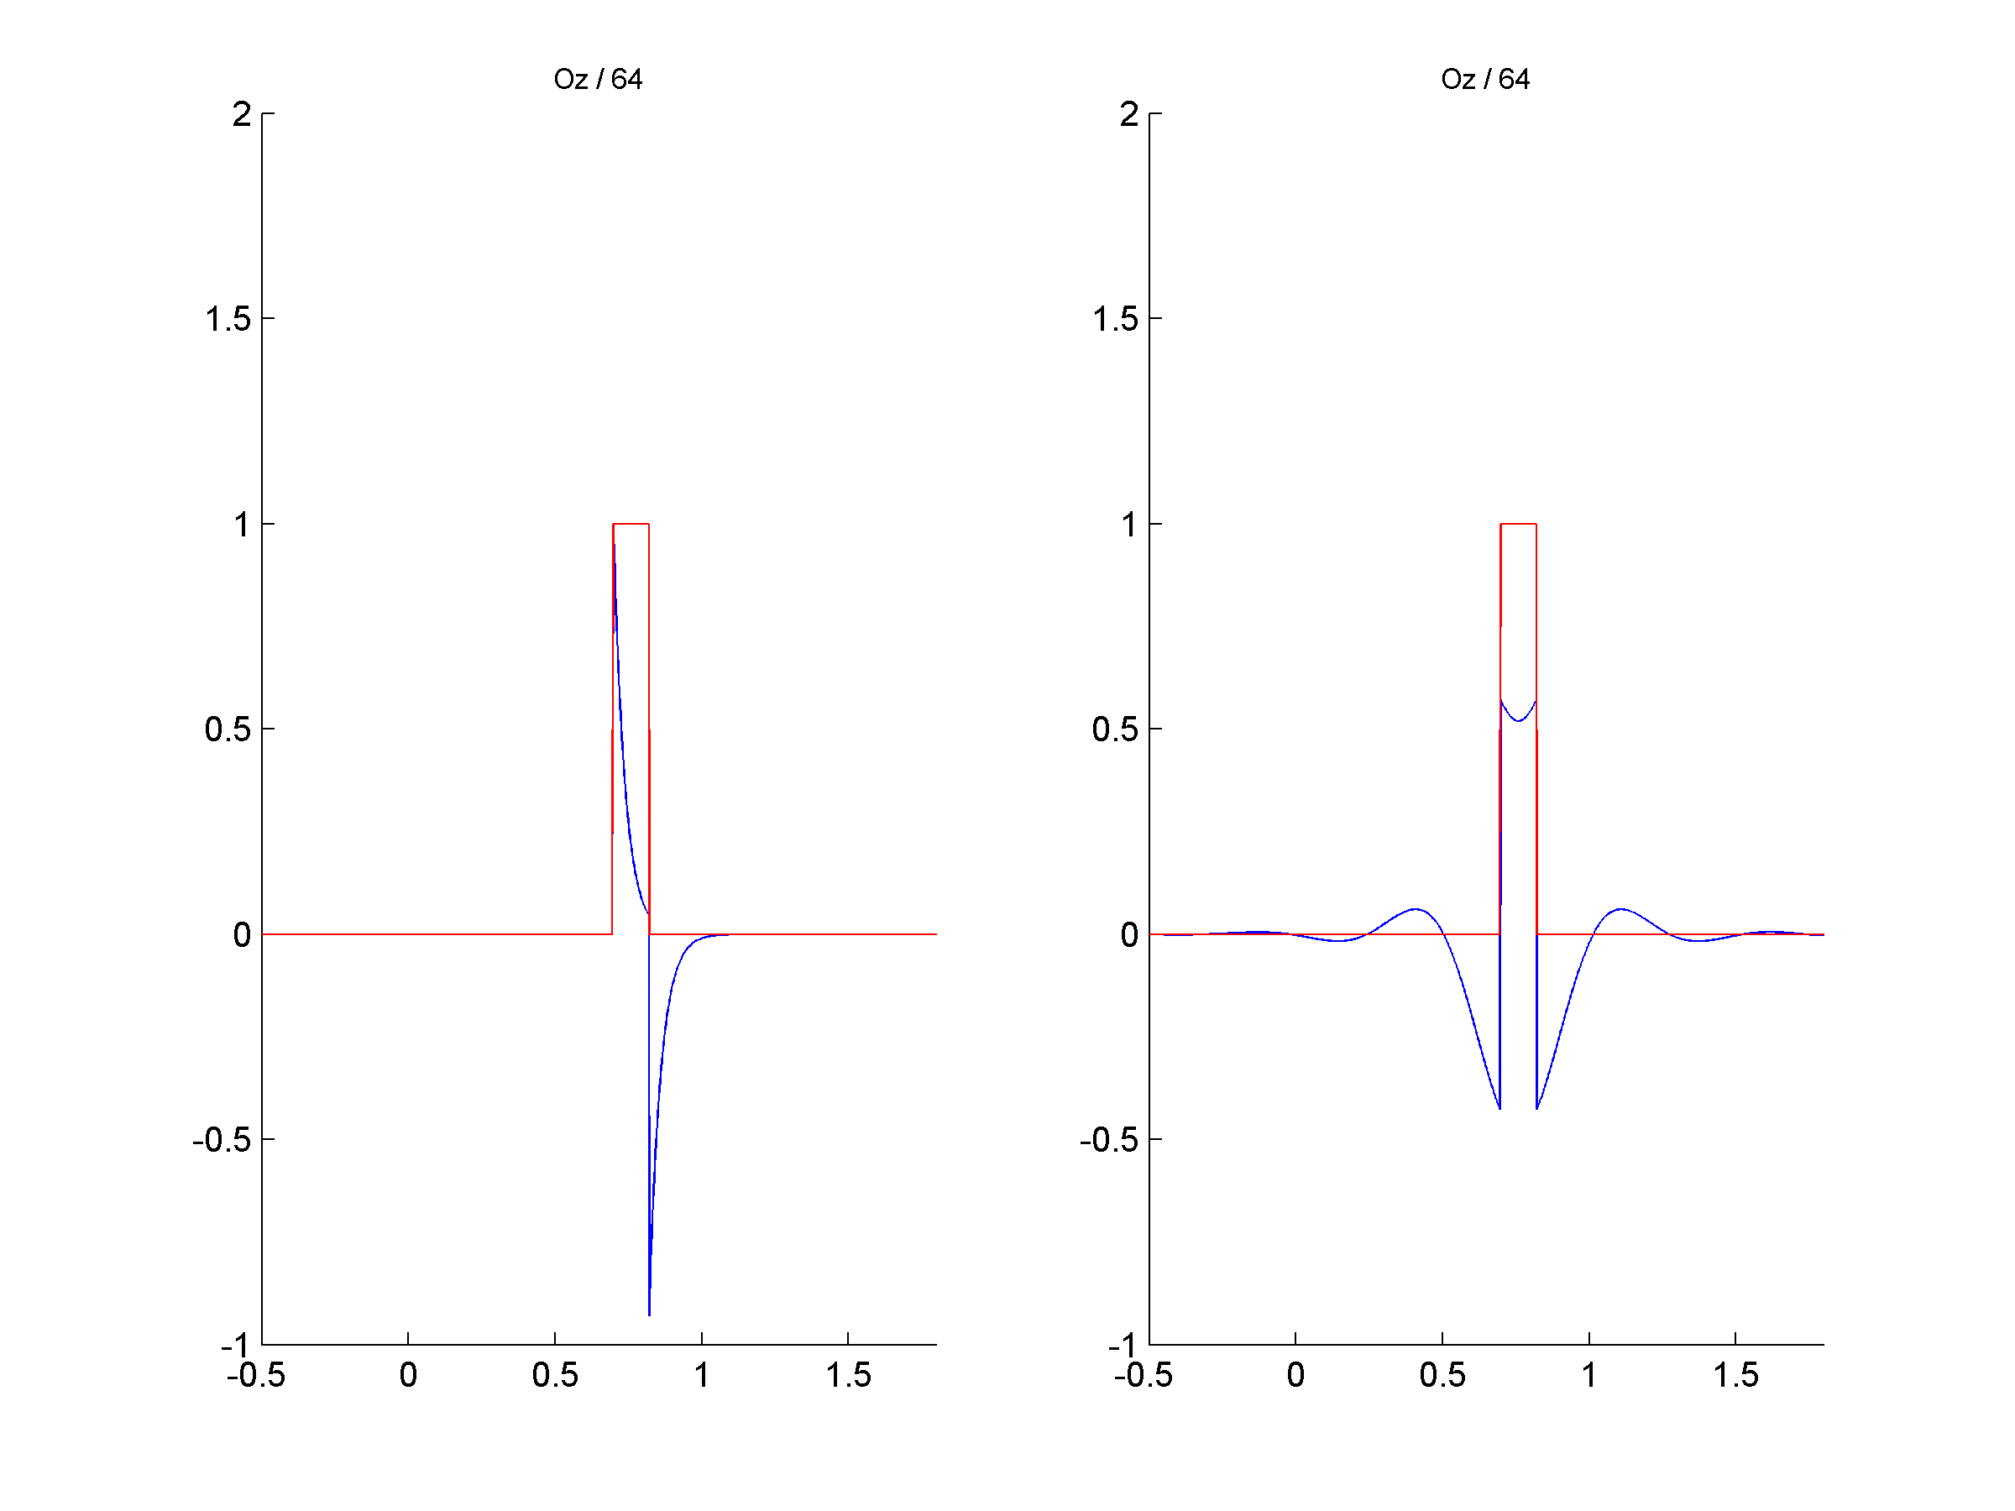
Preprocessing
Filtering

Slide 16


Slide 17
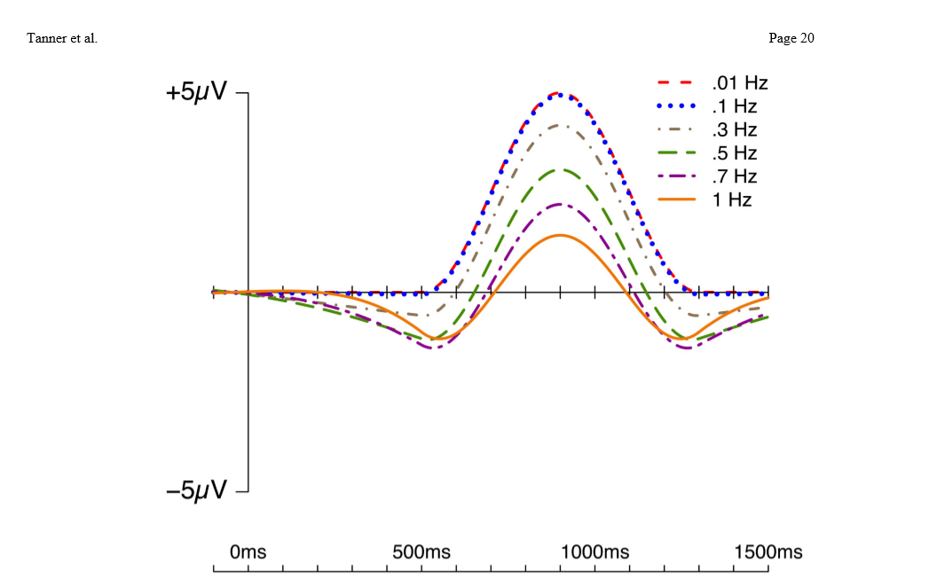

Slide 18
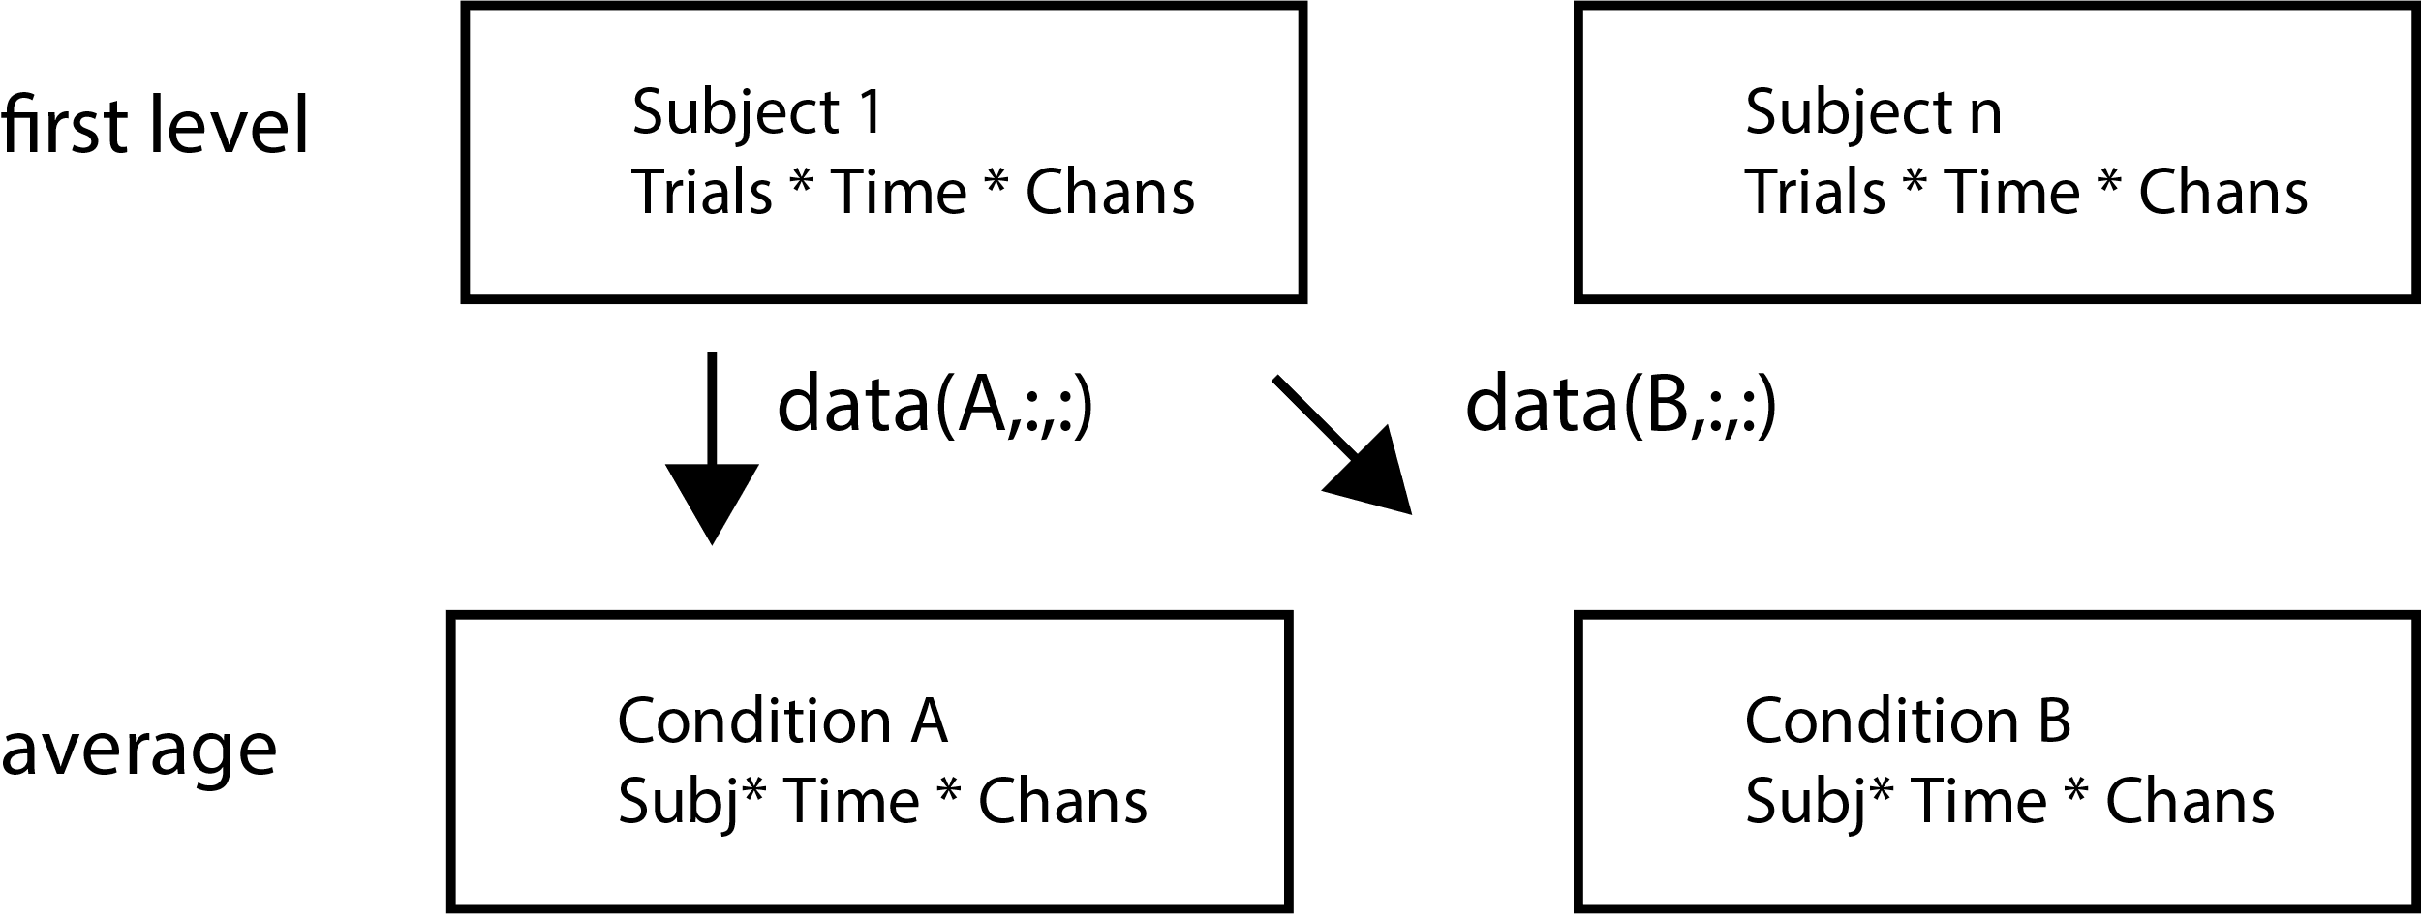
2. Creating Epochs

Slide 19
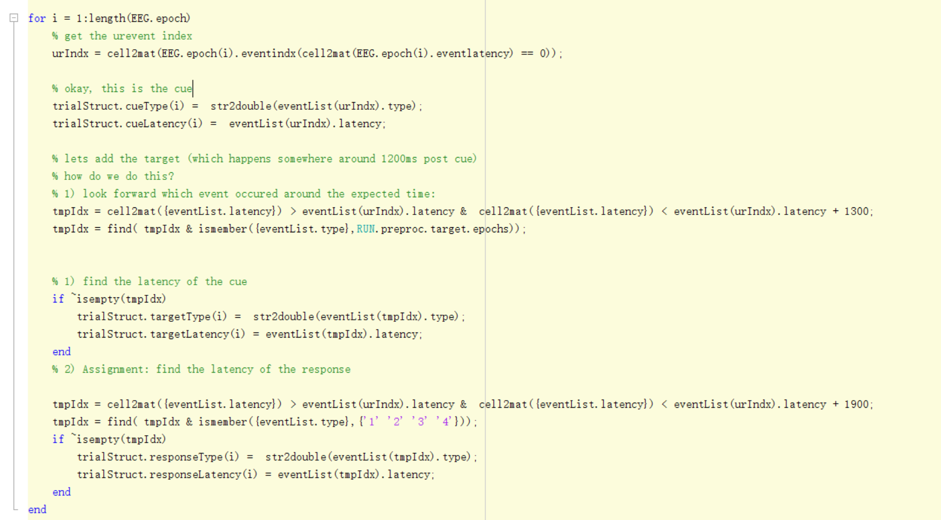
Bookkeeping
Create a list of information about each trial.

Slide 20
Reminder: plan day 3-5
Day 3 – xx Jan
Day 4 – xx Jan
Day 5 – begin Feb

