Slide 1
Lab: Visualization and Medical Image Analysis
1. Meeting
TractSeg - Fast and accurate
white matter tract segmentation
November 02, 2023
Bertan Karacora
Institute of Computer Science, University of Bonn
bertan.karacora@uni-bonn.de

Slide 2
Note
I like to prepare slides to provide some structure for our meeting(s) in case that this is my responsibility
I don’t want to forcibly impose this structure
Feedback always welcome

Slide 3
Contents
Introducing ourselves
Organizational matters
Clarifying the goal
TractSeg
Next steps

Slide 4
Contents
Introducing ourselves
Organizational matters
Clarifying the goal
TractSeg
Next steps

Slide 5
Introducing myself (if you want)
Interests: Visual Computing, Deep Learning, Machine Learning
Currently: Image Acquisition and Analysis in Neuroscience
Past semester: Visual Data Analytics
Previous projects:
  Extracurricular: Proteomic Analysis of Stress Granules-Associated Proteins
  Master seminar: Neural Parametric Models for 3D Deformable Shapes
  Bachelor thesis: Inverse Rendering of Wave Optical BRDFs
  Bachelor PG: LMB Network for Animal Re-Identification
  Computer Graphics course project: Development of racing game prototype

Slide 6
Contents
Introducing ourselves
Organizational matters
Clarifying the goal
TractSeg
Next steps

Slide 7
Important Dates
January 15, 2024: Intermediate presentation
February 23, 2024: Submission of report draft to Prof. Schultz
TBA: Submission of report draft to Johannes
TBA: Test presentation with Johannes
March 8, 2024: Submission of final report and code
March 15, 2024: Final presentation

Slide 8
Organizational matters
Meetings: Weekly, biweekly, …? Time? Flexible duration?
Online or in-person?
Expectations?
Anything else?

Slide 9
Contents
Introducing ourselves
Organizational matters
Clarifying the goal
TractSeg
Next steps

Slide 10
Clarifying the goal
Replace the directions input of TractSeg with fODFs
-> additional information, resolve directional ambiguity
“Analyzing, evaluating, experimenting with original work” vs. “Actually providing own novel contribution”?
To what extend should original paper be elaborated on (as in a seminar)?

Slide 11
Plan (as I imagine it right now)
Understand methods
Get TractSeg to work
Setup some example data, create reference results, …
Identify how inputs (tract directions) in TractSeg code are used
Insert fODFs using bonndit somehow :)
Experiment, evaluate, …

Slide 12
Notes for myself: Practical result
Implementation of a method
Experiments to demonstrate capabilities and limitations
Code: correctness, efficiency, readability
Independent work and own ideas
Carefully designed, conducted, and interpreted experiments

Slide 13
Notes for myself: Written report
Describe the overall design of the software, usage, dependencies
Highlight the steps that took most of your time and effort
Present and interpret experiments
Conclude with a clear statement about achievements and future work
Typical length: 5-10 pages per person

Slide 14
Notes for myself: Oral presentation
<= 30 minutes per person, followed by discussion
Understanding of the tools you have been using
Defend design choices and experimental setups
Introduction: topic and motivation

Slide 15
Contents
Introducing ourselves
Organizational matters
Clarifying the goal
TractSeg
Next steps

Slide 16
TractSeg - Overview
Segmentation framework designed to extract white matter tracts from the brain
Utilizing multiple U-nets and local peak directions as input

Slide 17
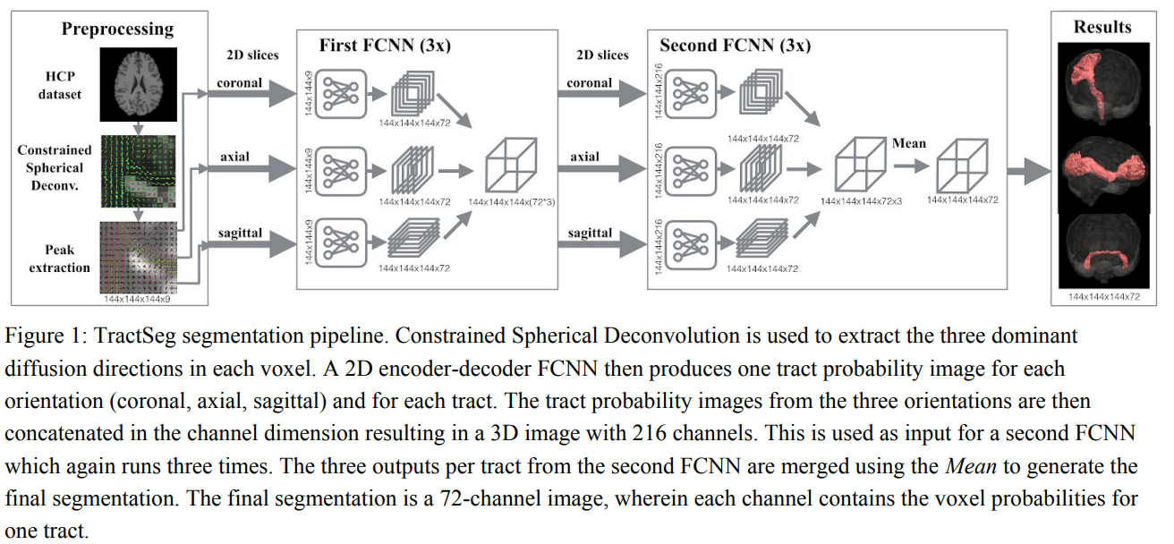
Approach
Input: fODF peaks -> Output: 3D segmentation for each tract

Slide 18
fODFs
From spherical deconvolution
Per voxel fiber orientation probability density
Local maxima as indicator of fiber directions

Slide 19
Motivation
Avoid typical preprocessing (registration, parcellation, tractography, clustering)
-> Direct segmentation (vs. ROI vs. clustering)
Applications: characterize brain, identify abnormal morphology in diseased brains, neurosurgical planning, …

Slide 20
Direct segmentation of brain white matter tracts in diffusion MRI
TODO

Slide 21
Contents
Introducing ourselves
Organizational matters
Clarifying the goal
TractSeg
Next steps

Slide 22
Next steps
Read paper again - multiple times :)
TractSeg installation
Get dataset, run TractSeg, try out parameters, …

Slide 23
Thank you!

