Slide 1
Lab Visualization and Medical Image Analysis
Intermediate Presentation
TractSeg - Fast and Accurate
White Matter Tract Segmentation
January 17, 2024
Bertan Karacora
Institute of Computer Science, University of Bonn
bertan.karacora@uni-bonn.de

Slide 2
Contents
Introduction
Methods
Current progress
Evaluation
Outlook

Slide 3
Contents
Introduction
Methods
Current progress
Evaluation
Outlook

Slide 4
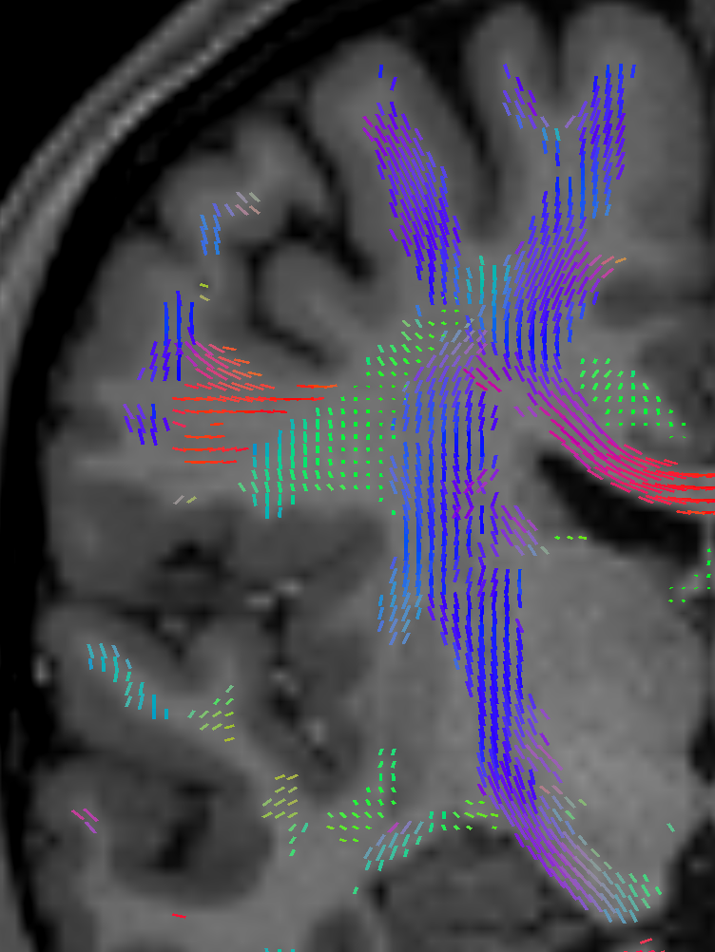
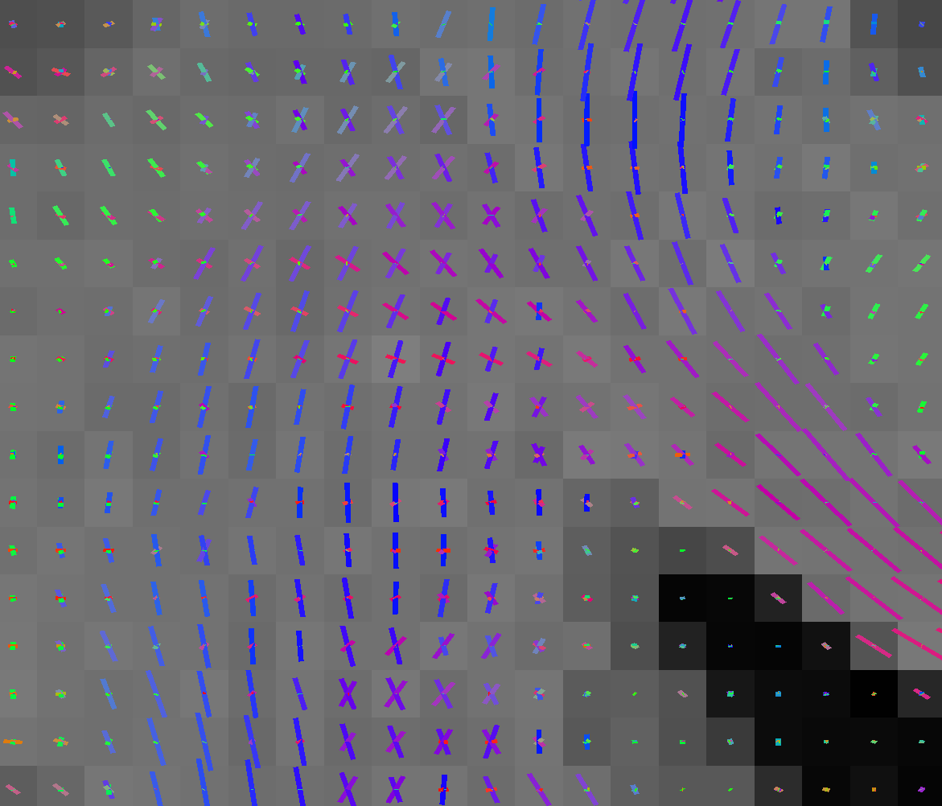
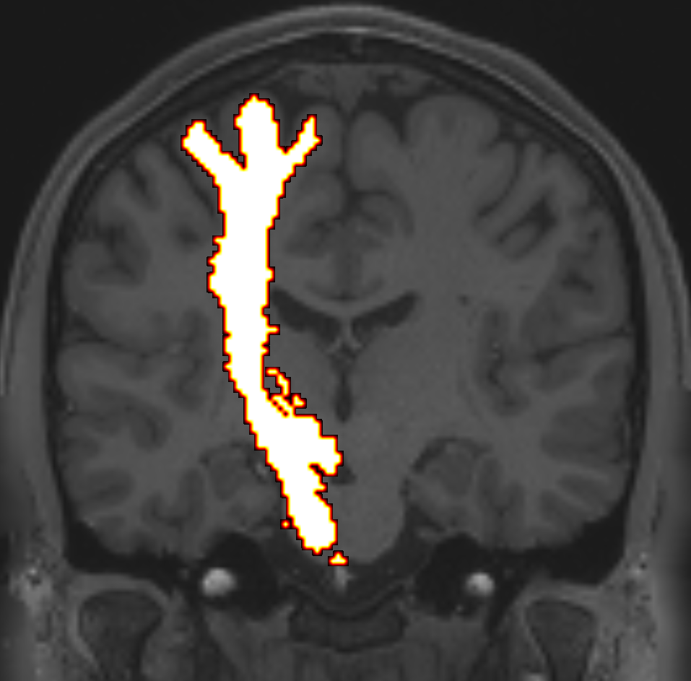
TractSeg - Overview
Segmentation of white matter tracts in DWI
More accurate and faster than tractography-based methods
Image of fODF peaks
U-net
Segmentation

Slide 5
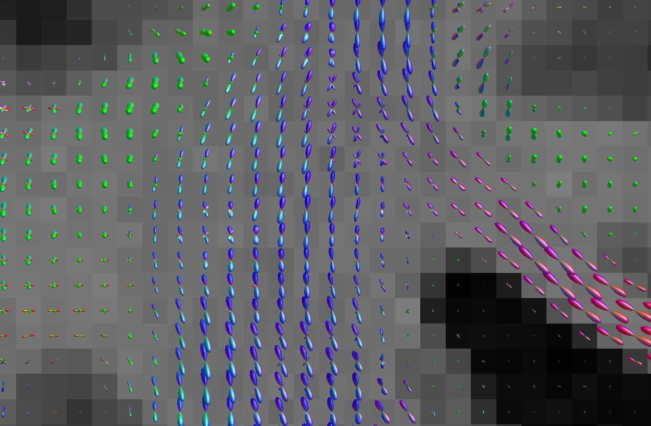
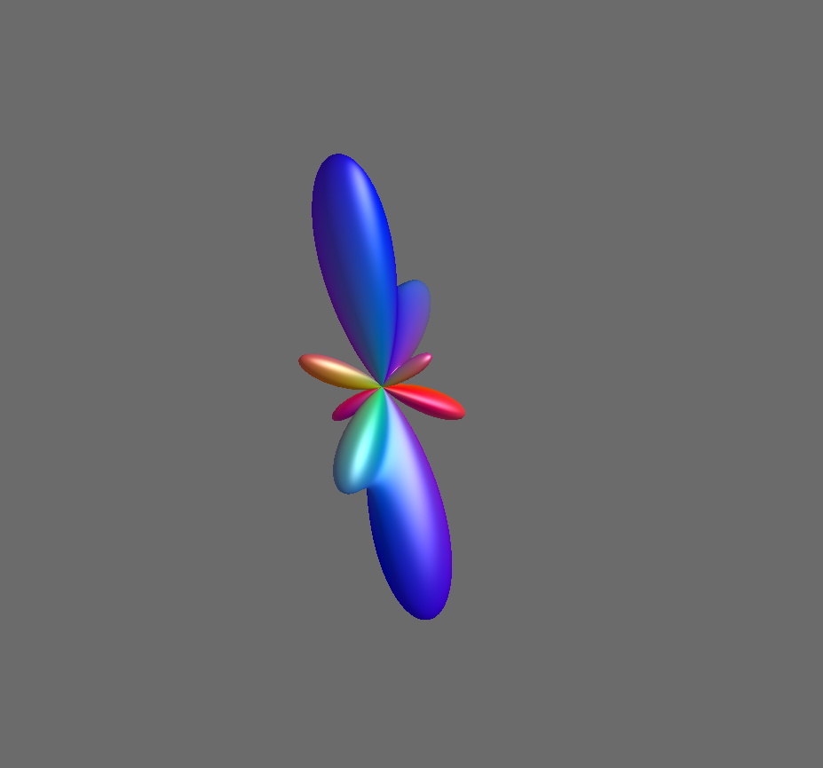
Goal of this lab
Setup data and get the code running
Make the model learn from the entire fODFs instead of peaks
  More complete information
  Resolving the directional ambiguity

Slide 6
Contents
Introduction
Methods
Current progress
Evaluation
Outlook

Slide 7
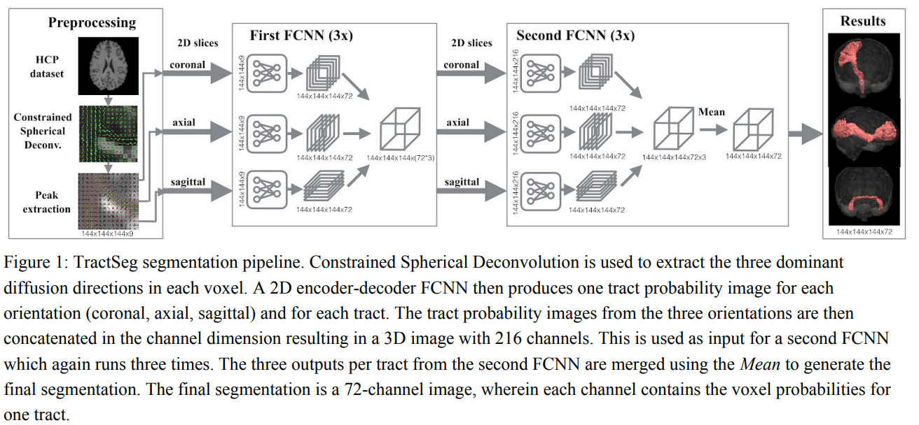
Segmentation pipeline
3 peaks per voxel to 72 independent probability maps
U-net architecture with deep supervision
Mean fusion of directional outputs
Image: Wasserthal et al., NeuroImage 2018]

Slide 8
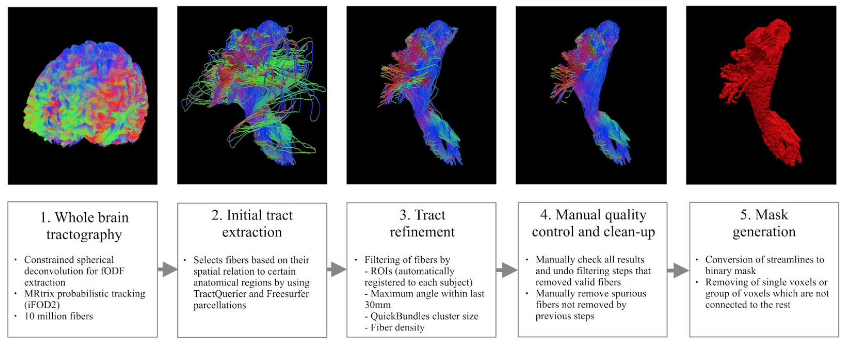
Supervision
Reference segmentations of 105 HCP subjects, 5-fold CV
2D slice sampling from random axis
Heavy data augmentation on peak images
Image: Wasserthal et al., NeuroImage 2018]

Slide 9
Contents
Introduction
Methods
Current progress
Evaluation
Outlook

Slide 10
My work so far
Technical setup
  Installation, fixing pre-existing bugs, writing utility scripts, etc.
  Adjusting code to hardware constraints
Preprocessing features and reference labels
  Mask generation, concatenation, cropping, etc.
Adjust model training for 3 experiments:
  Peaks extracted using MRtrix multi-shell CSD (baseline)
  Rank-3 approximation of fODFs extracted using bonndit
  4th-order fODFs extracted using bonndit

Slide 11
Contents
Introduction
Methods
Current progress
Evaluation
Outlook

Slide 12
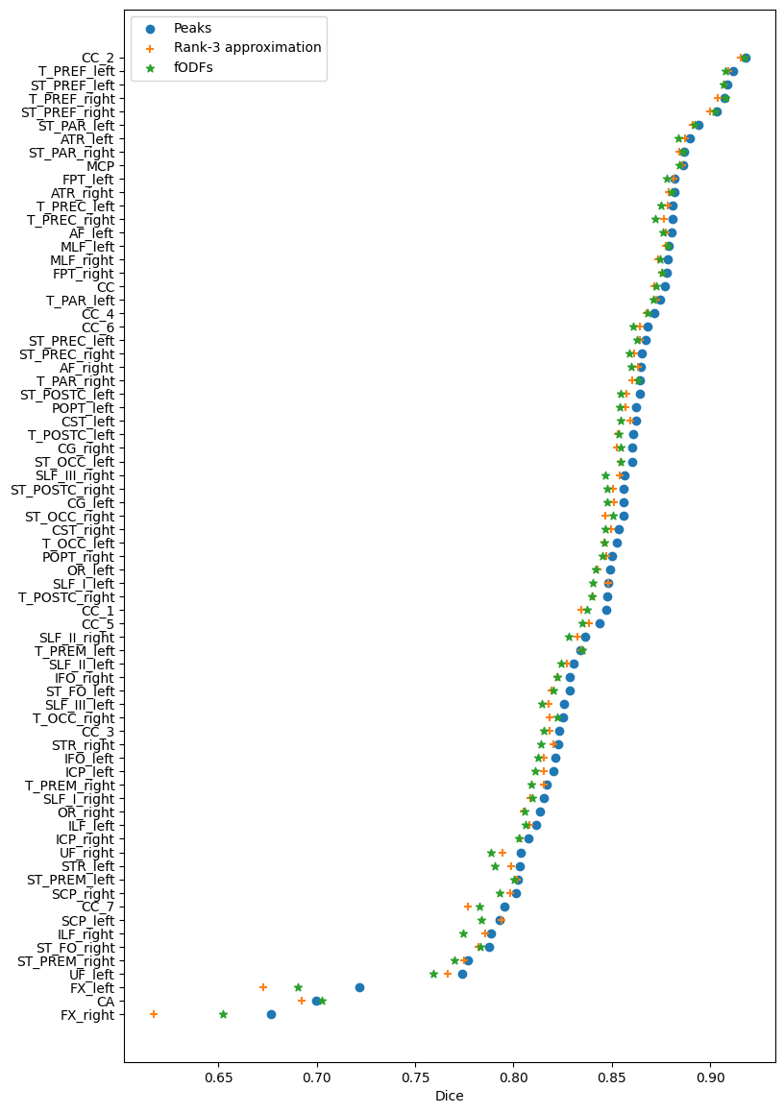
Quantitative evaluation
Note: Results not final
Mean Dice scores:
  Peaks: 0.8426
  Rank-3 approximation: 0.8368
  fODFs: 0.8359

Slide 13
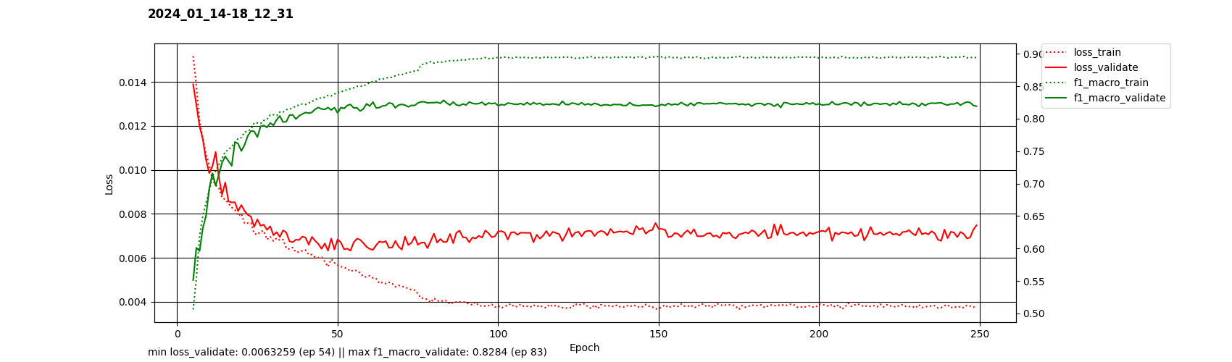
Overfitting with fODFs
No data augmentation for fODFs yet
Here: Overfitting effect mitigated by learning rate scheduler

Slide 14
Contents
Introduction
Methods
Current progress
Evaluation
Outlook

Slide 15
Outlook
Augmentation of fODF representation
Statistical evaluation (H: There are differences to baseline)
Qualitative evaluation
More experiments
  Representing each peak as tensor (with data augmentation)
  Raw DWI data from random gradient directions (similar to Kebiri et al., ArXiv 2023)

Slide 16
Thank you!

Slide 17
Additional Slides

Slide 18
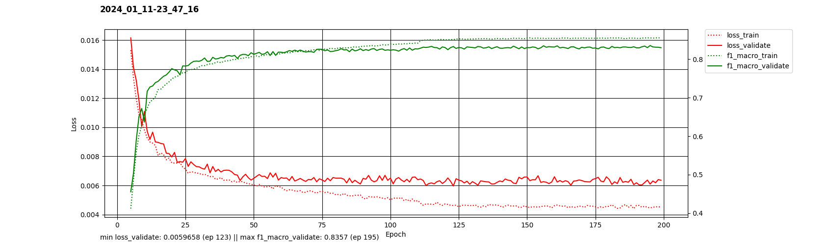
Training with peaks

Slide 19
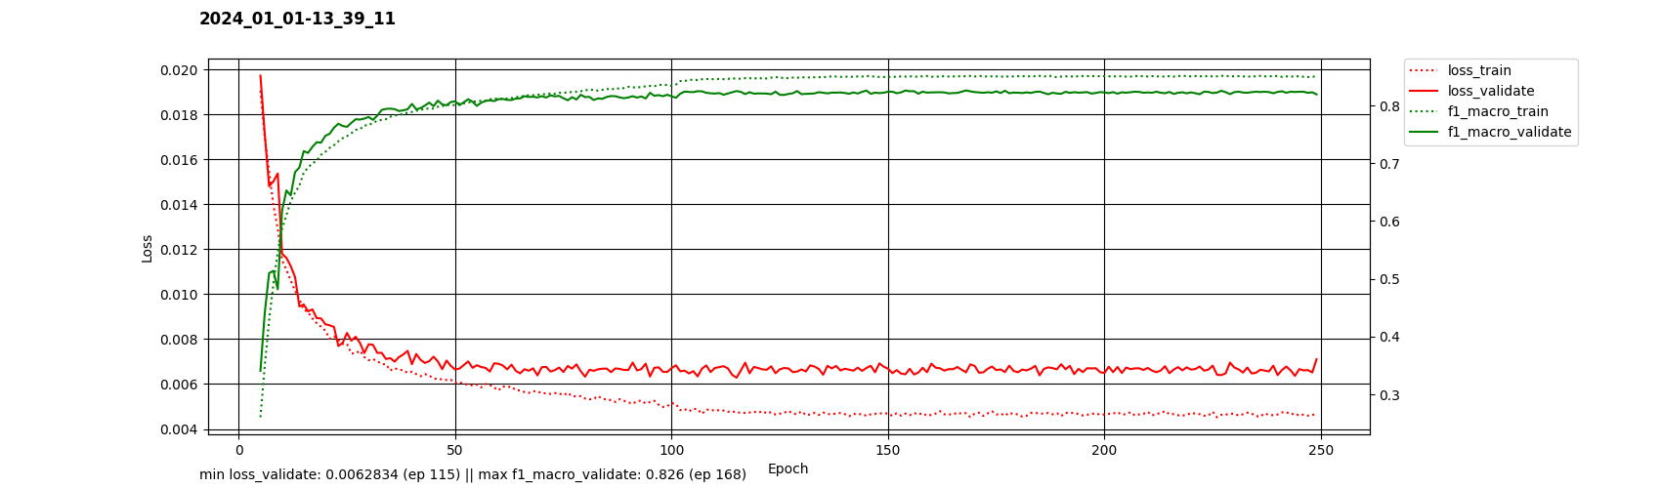
Training with rank-3 approximation

Slide 20
TractSeg - Overview - With second FNN
Segmentation of white matter tracts in DWI
CNN approach based on U-net
More accurate and faster than tractography-based methods
Image: Wasserthal et al., NeuroImage 2018]

Slide 21
What happened to the second FCNN?
“This is only training the first FCNN. Also the TractSeg version you can download via pip is also only using the first FCNN. The second one gives only very minor improvements but increases runtime a lot. Therefore, I actually never use it.”
Jakob Wasserthal
Source: https://github.com/MIC-DKFZ/TractSeg/issues/244

Slide 22
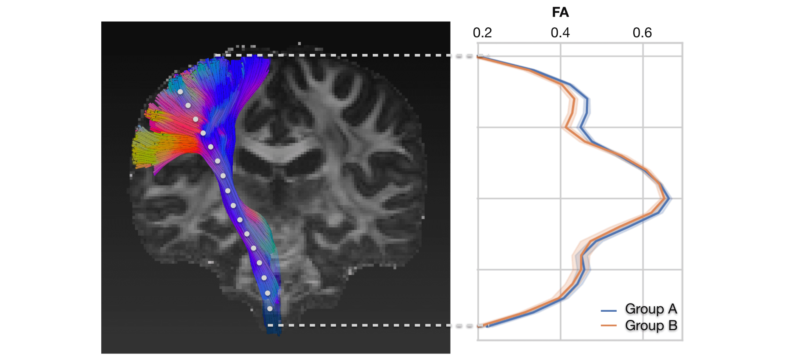
Applications of tract segmentation
Brain characterization
Identification of abnormal morphology in diseased brains
Statistical analysis in tract areas (e.g., based on FA or MD)
Neurosurgical planning (extend, position, shape of tracts)
Tract Orientation Maps (TOMs) for tractography
Image: Wasserthal et al., NeuroImage 2018]

