Slide 1
The Impact of Fiber Orientation Features on Direct White Matter Tract Segmentation
Lab Visualization and Medical Image Analysis
Final Presentation
March 15, 2024
Bertan Karacora
Institute of Computer Science, University of Bonn
bertan.karacora@uni-bonn.de
Notes:
Welcome to the final presentation of my lab project about The Impact of Fiber Orientation Features
on Direct White Matter Tract Segmentation.

Slide 2
Contents
Introduction
Methods
Experiments and results
Discussion
Conclusion
Notes:
These are the contents of my presentation.

Slide 3
Contents
Introduction
Methods
Experiments and results
Discussion
Conclusion
Notes:
In the introduction, I will start by motivating the this project and elaborate on the context.

Slide 4
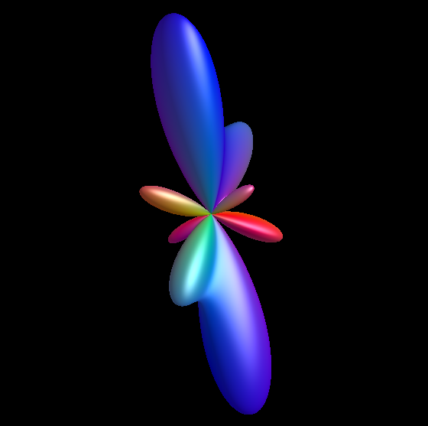
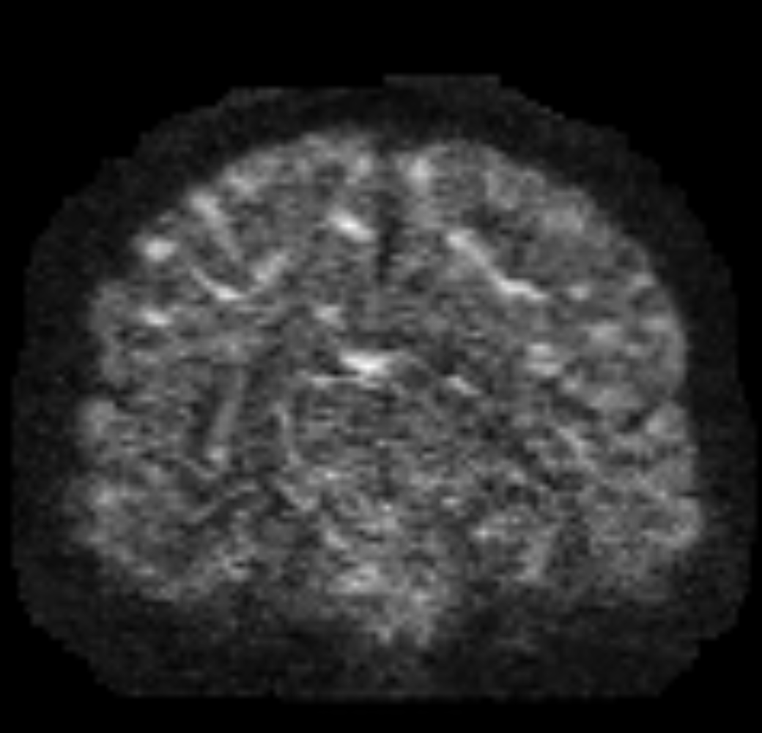
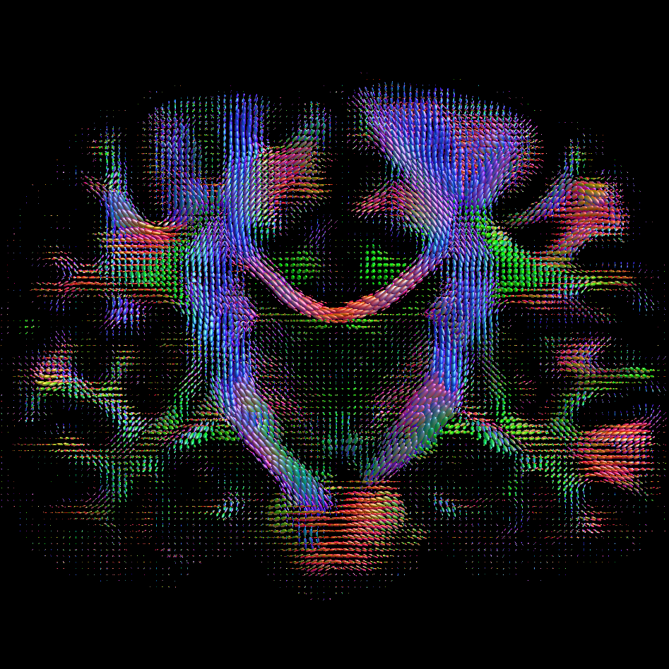
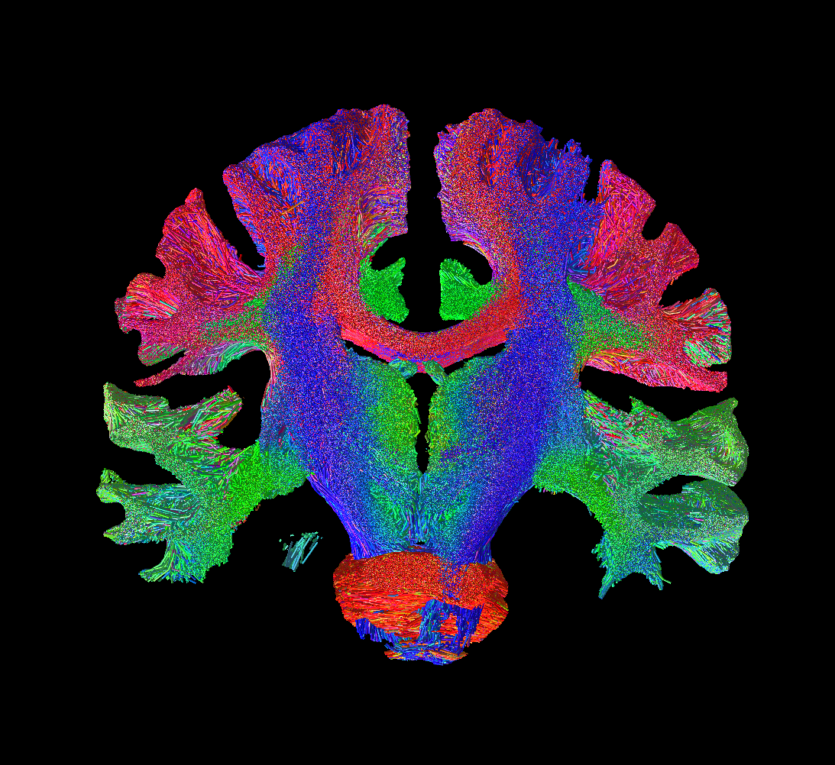
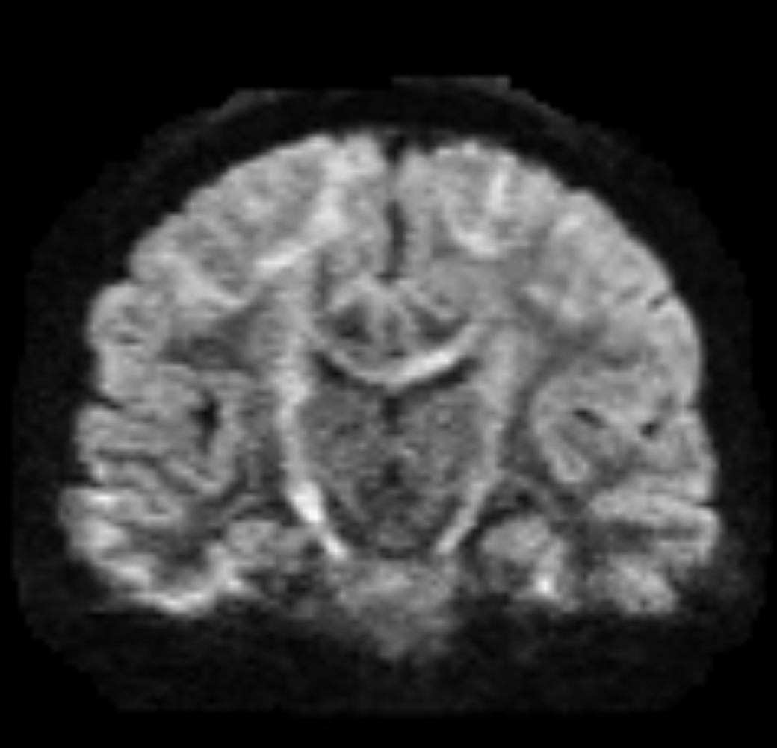
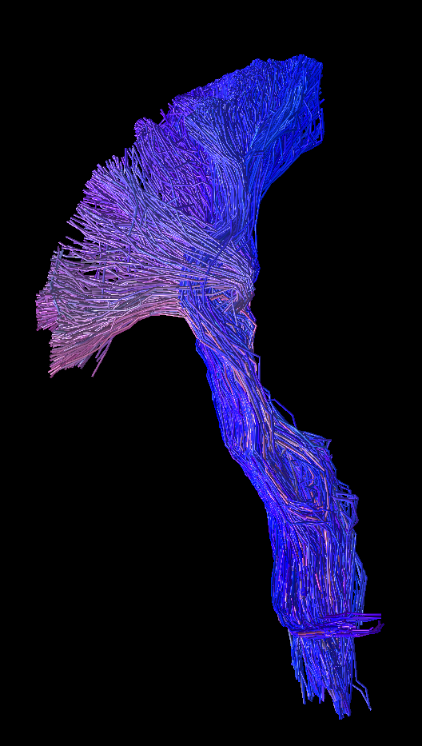
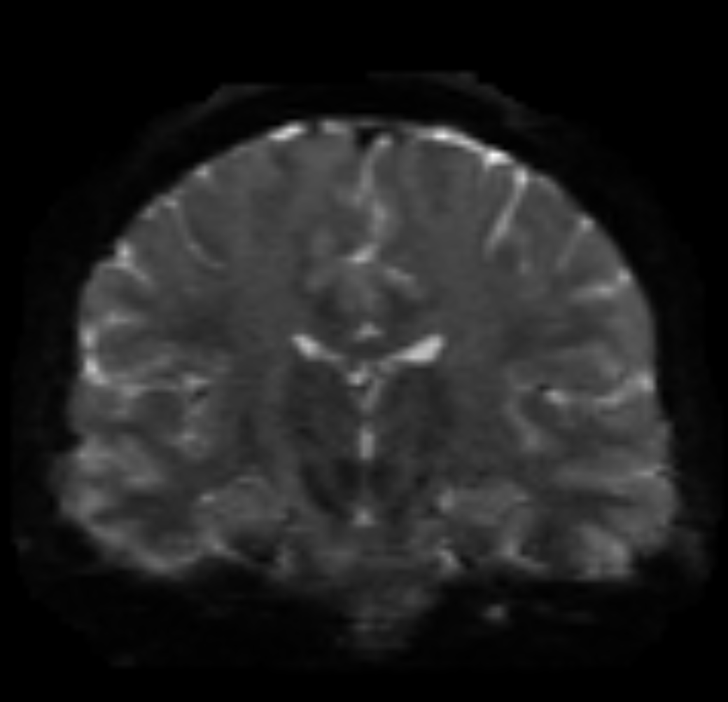
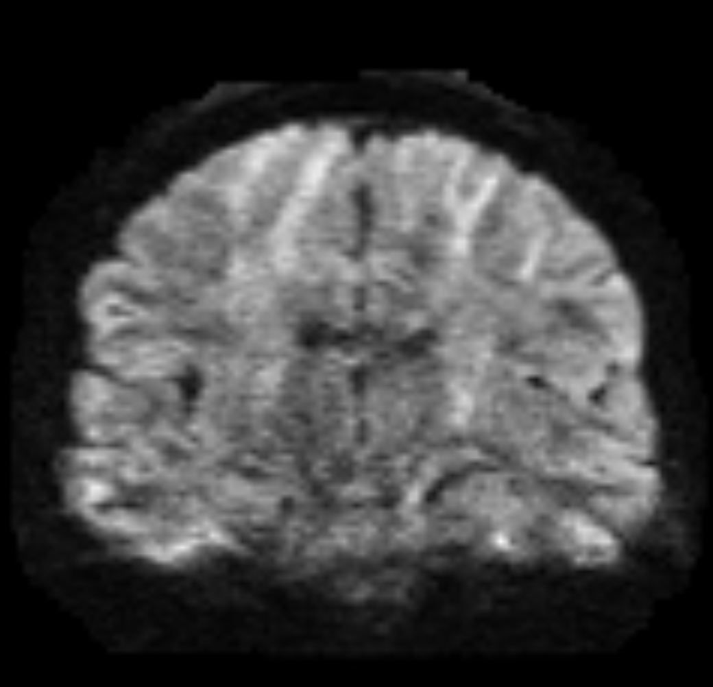
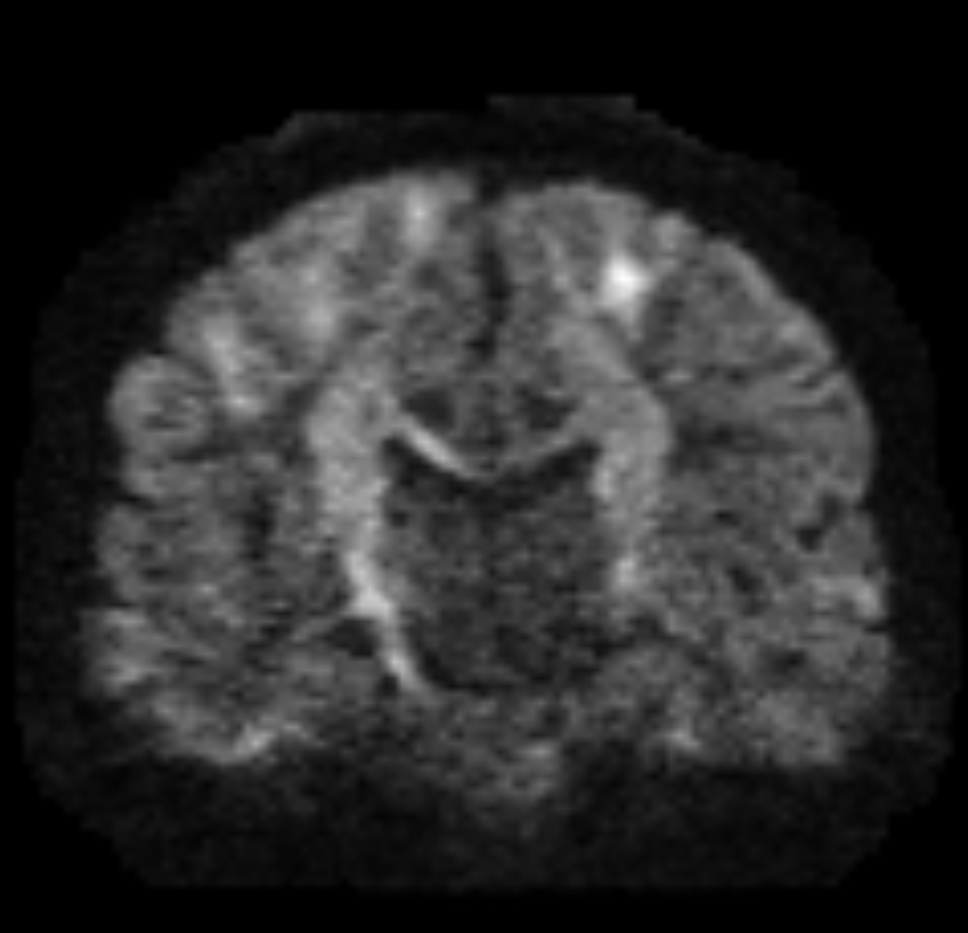
Identifying white matter tracts
Raw dMRI data
Fiber orientations (e.g., fODFs)
Tractogram (streamlines)
Tract identification difficult and strongly dependent on acquisition.
More condensed and robust representation but delinea-
tion hard for a human expert.
Identification from explicit global properties (ending regions, trajectory, …).
Figure 1: Types of data for identifying white matter tracts. Left: Raw dMRI data contains all information but is susceptible to acquisition effects. Center: Local fiber orientations serve as abstraction of diffusion measurements. Right: Estimating fiber trajectories as streamlines makes more global properties explicit. Figure created by virtue of MRtrix3 [1] and Slicer3D [2].
Tract identification = local information + spatial arrangement
Notes:
White matter tracts consist of myelinated nerve fibers that share certain properties, for example, their location in the brain volume, their connectivity to gray matter regions, and consequently their neurological function.
Due to the fibrous nature of the white matter tissue diffusion-wieghted MRI is the modality of choice to study white matter tracts.
A great amount of information is obtained from a high angular resolution and multi-shell acquisition schemes.
Therefore, identifying individual tracts is difficult and dependent on the acquisition.
As a first level of abstraction, models for the local fiber orientation within each voxel introduce some degree of normalization, as they are more robust to the image acquisition settings, and also a more condensed representation of the raw data.
In this image, we can see a visualization of the fiber orientation distribution function in a voxel, or fODF, which estimates the “likelihood” differently oriented fiber at that location.
However, the information is difficult to interpret for a human expert with regard to the properties of tracts like fiber connectivity.
Tractography aims to extrapolate the local information and estimate 3D streamlines that represent fiber trajectories. Since tracts are easier recognizable at a global scale, experts are able to virtually dissect the fibers by specifying ROIs that the tracts are known to terminate in or traverse through. However, tractography is a costly and at times inaccurate procedure which does not make use of the full local information.

Slide 5
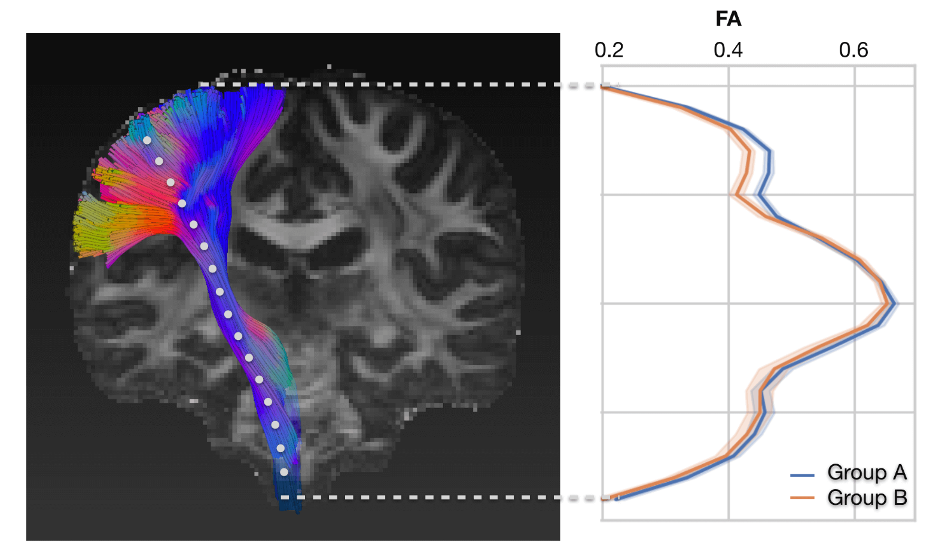
Applications
Brain characterization, connectomics [4, 5]
Neurosurgical planning (extend, position, shape of tracts) [6]
Statistical analysis in tract areas or along their trajectory (tractometry [7])
Guide tractography and
segmentation of streamlines [8, 9, 10]
Figure 3: Concept image of tractometry. Fractional anisotropy (FA) is evaluated along streamlines of the CST tract. From [10].
Notes:
Connectomics explores how neurons in the brain and nervous system are connected and interact with each other to produce behavior and cognition.
For example, the degeneration of fiber density in specific tracts might be related to certain diseases.
Bottom right shows a concept image, comparing the fractional anisotropy of two groups of subjects along the right corticospinal tract.

Slide 6
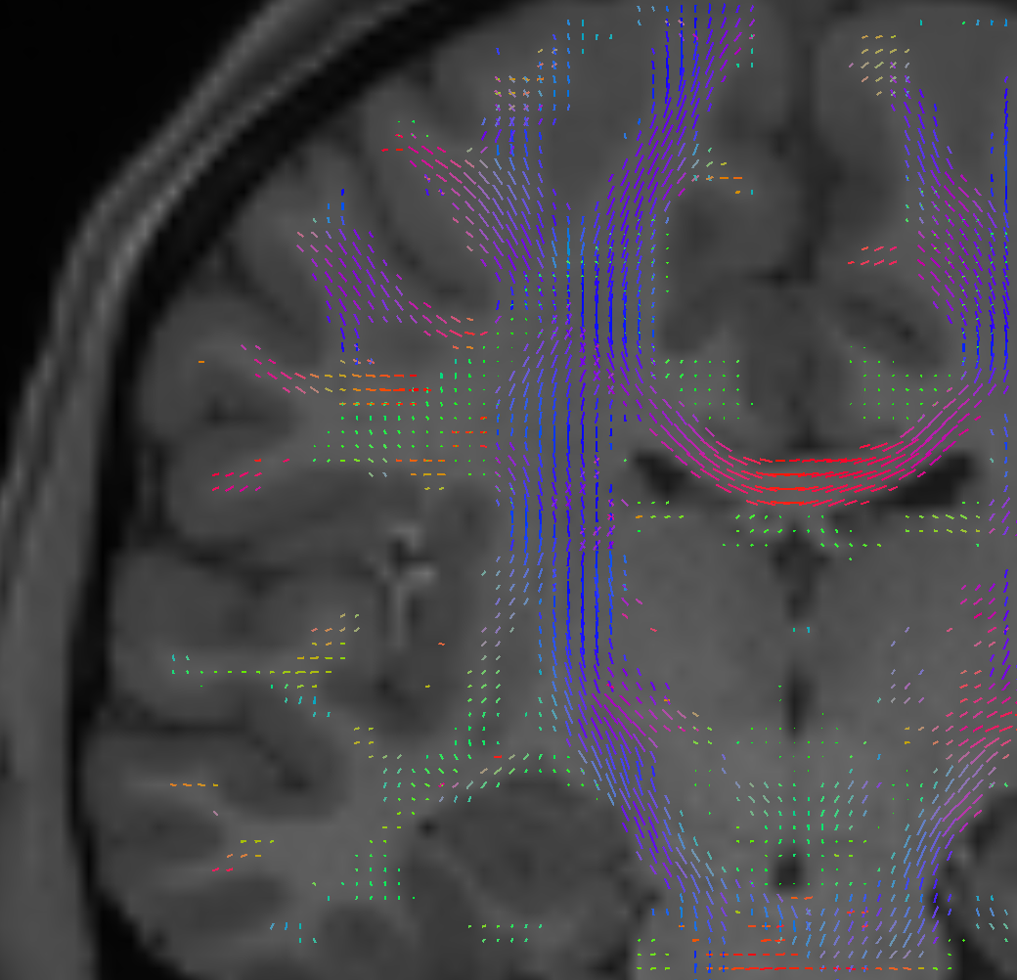
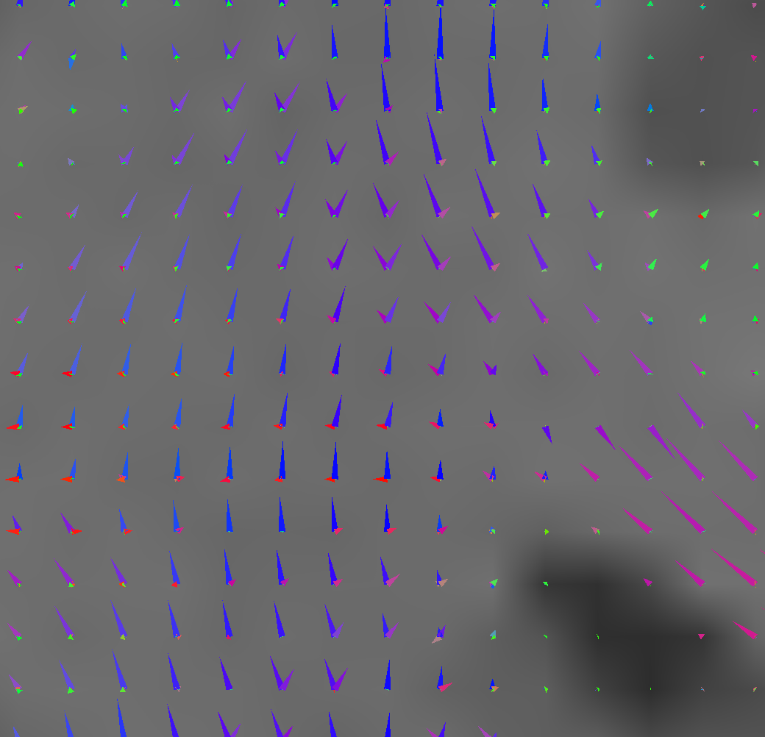
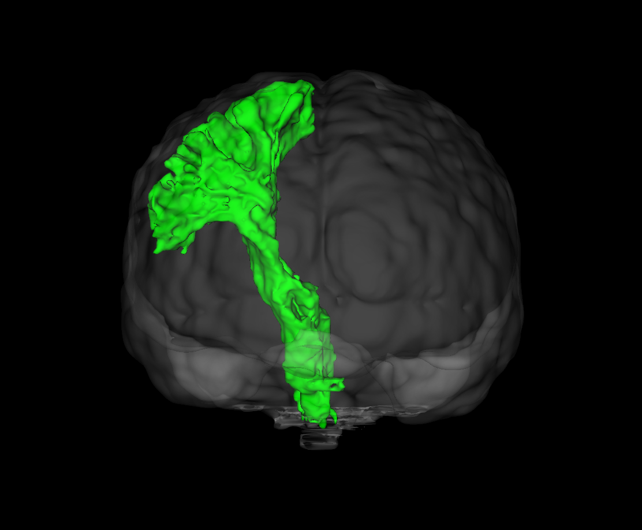
Direct tract segmentation
Efficient voxel-wise labeling of tracts
State-of-the-art CNN-based example: TractSeg [3]
3 fODF peaks per voxel
2D U-Net + view aggregation
Segmentation
Figure 2: High-level view on TractSeg. A 2D CNN segments tracts in fields of fODF peaks. 2D Slices are aggregated to 3D. Figure created by virtue of MRtrix3 [1] and Slicer3D [2].

Slide 7
Motivation of this project
Address limitations of fODF peaks in TractSeg
  Oversimplification of the fODF
  Inherent directional ambiguity of 3D vector representation
  Biases from interference
Explore challenges and capabilities of alternative fODF features as model input

Slide 8
Contents
Introduction
Methods
Experiments and results
Discussion
Conclusion

Slide 9
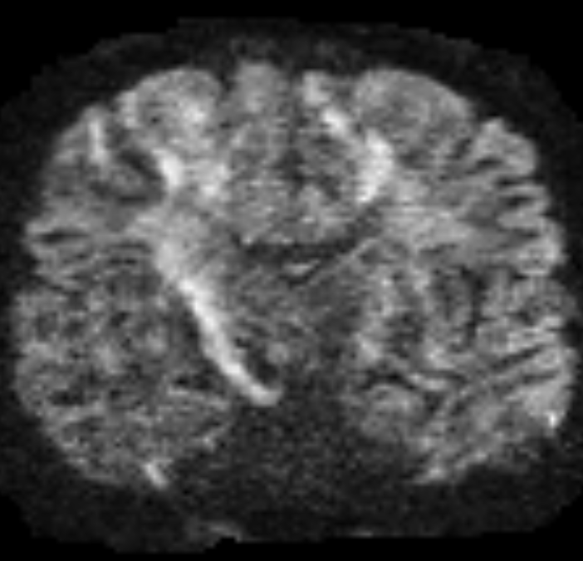
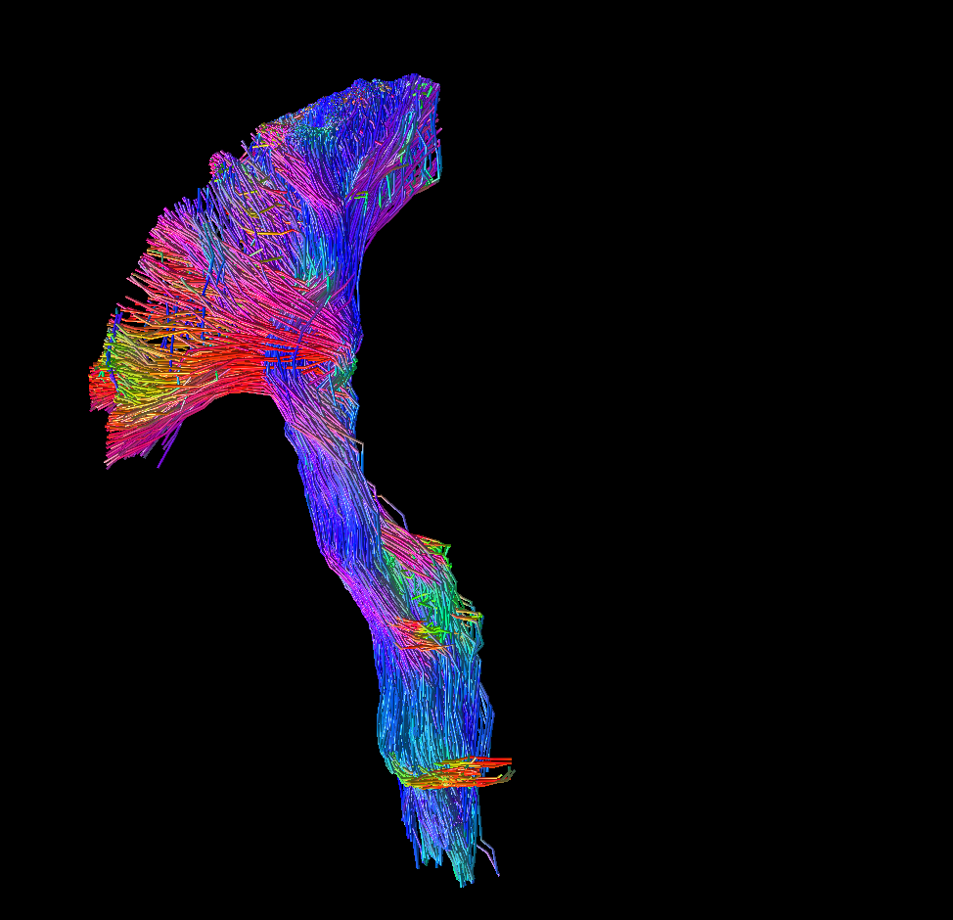

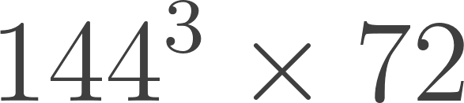
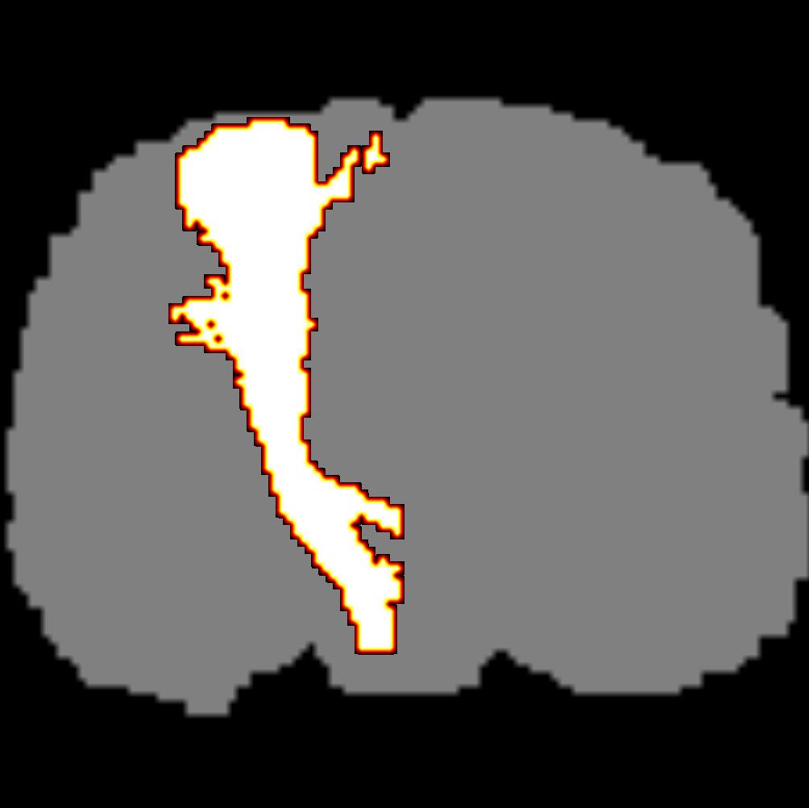

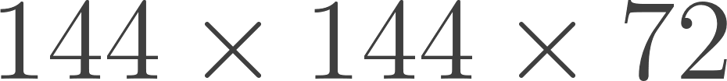
Overview
Training
Inference
Raw data
dMRI data
Reference tracts
Binary masks
Input features
Preprocessing
coronal
axial
sagittal
CSD
Annotation
fODF tensors
U-Net
2D segmentation
2D prediction
Data augmentation
Mean fusion
Features
Labels
3D segmentation
U-Net
Figure 4: Method overview. The supervised training requires input features and reference labels from preprocessed data. During inference, the model predicts segmentations in 2D slices from coronal, axial, and sagittal directions, which are fused to 3D by averaging. The numbers below the boxes indicate the data dimensions after each step, exemplary for the case of fODF tensor inputs.
Notes:
As a supervised deep learning method, TractSeg’s performance is crucially dependent on the quality of the training data. The construction of the reference tracts is a key aspect of the success of TractSeg.

Slide 10
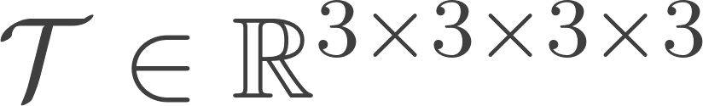
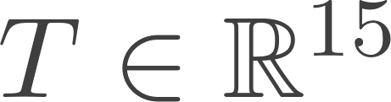
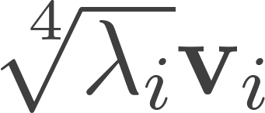
Fiber orientation features
Foundational idea: Constrained spherical deconvolution
Voxel-wise representations
  fODF as fourth-order tensor
Exploiting symmetry:
  3 fODF peaks (local maxima directions scaled by magnitude)
  Rank-3 tensor approximation vectors from

Slide 11
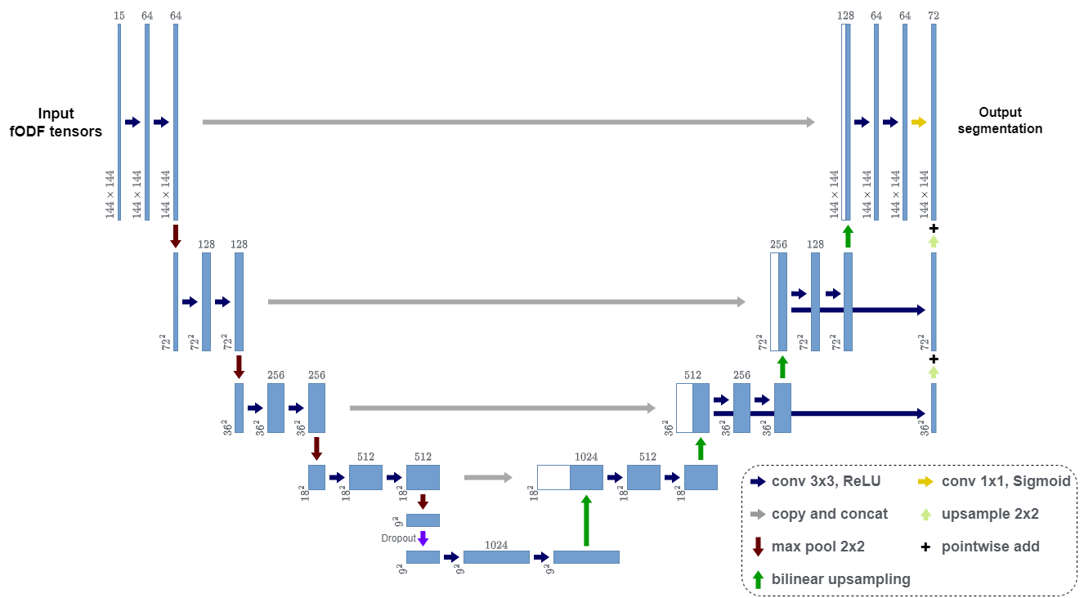
CNN architecture
Figure 6: CNN architecture. Blue and white boxes represent generated and copied feature maps, respectively. Numbers denote their dimensions. Network operations are illustrated by the colored arrows and symbols shown at the bottom right. To learn from different fiber orientation such as fODF tensors, the channel width of the first convolutional layer is adapted to fit the feature dimension.

Slide 12

Notable training details
Cropping of features and labels to bounding box,
padding to fixed input/output resolution
Uniform sampling of slicing axis and slices
Slice normalization to zero mean and unit variance
Binary cross-entropy loss

Slide 13
Data augmentation
Transformations applied to each slice sample
  Spatial: Rotation, displacement, scaling, elastic deformation
  Noise: Gaussian blurring, additive Gaussian noise
Key challenge: efficient implementation for fODF tensors
  Scale standard deviation of Gaussian noise according to “multiplicity” of tensor components
  Vectorize multilinear matrix product for rotation and sum coefficients corresponding to unique tensor components

Slide 14
Contents
Introduction
Methods
Experiments and results
Discussion
Conclusion

Slide 15
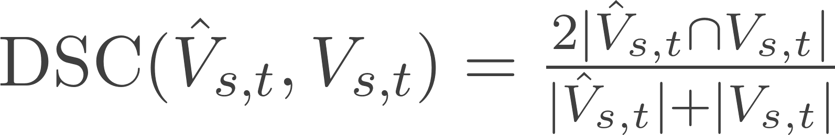
Evaluation
Fixed train-validation-test split of 105 subjects from the Human Connectome Project (HCP) [11]
Best-epoch selection based on validation set performance
Dice similarity coefficient per subject per tract:

Slide 16
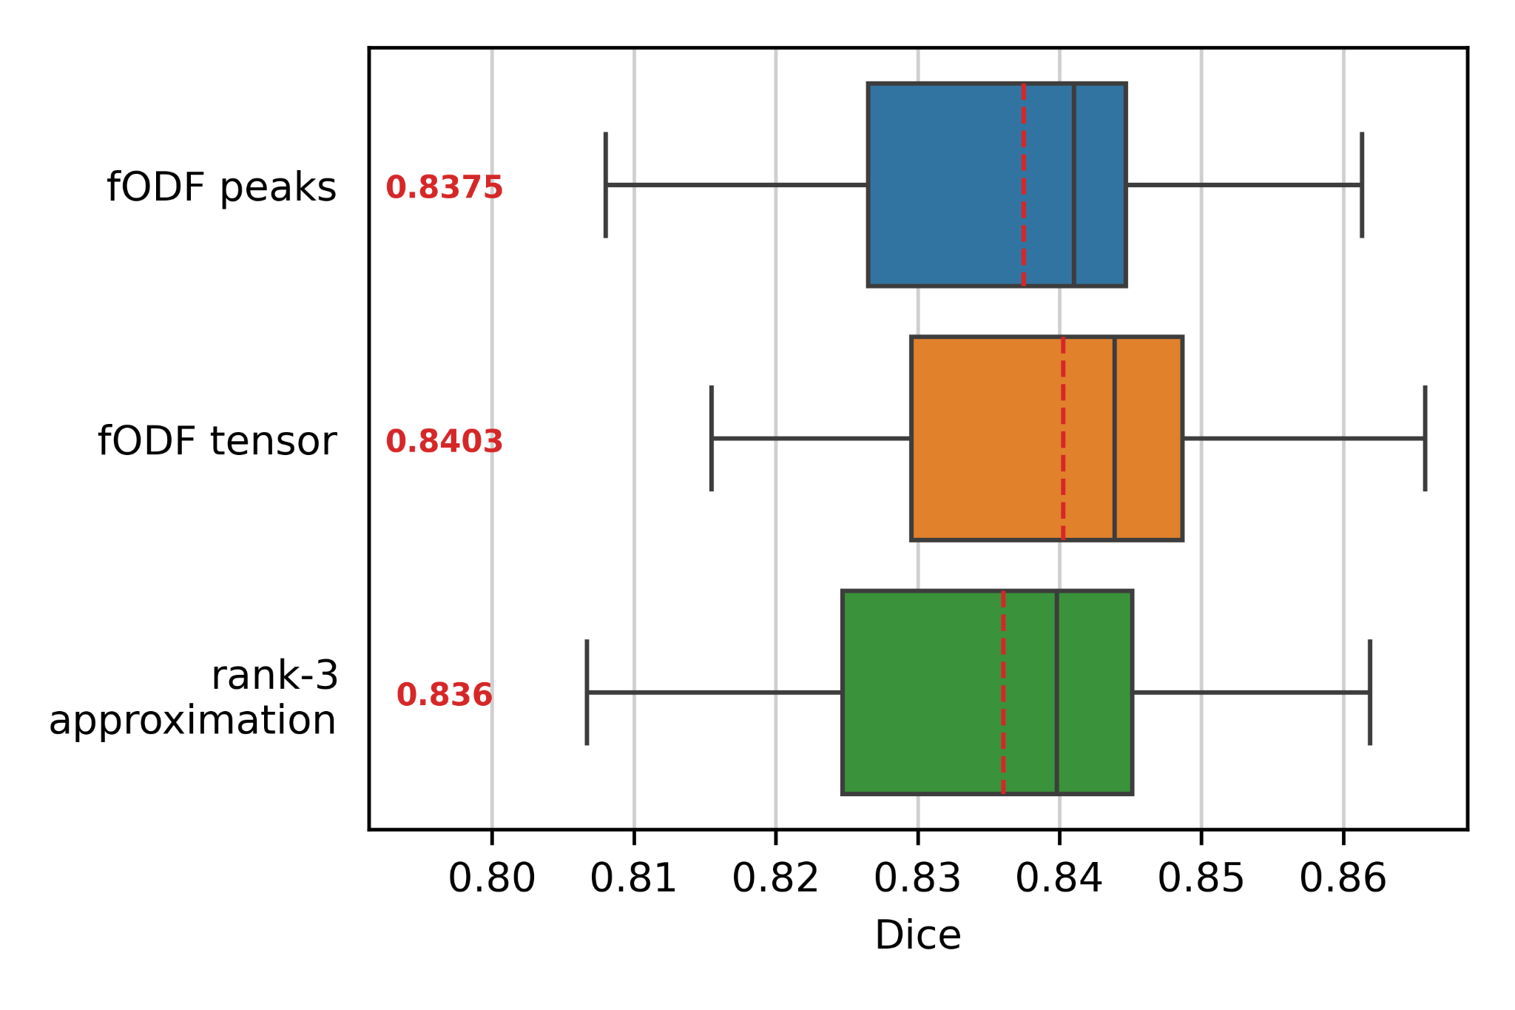
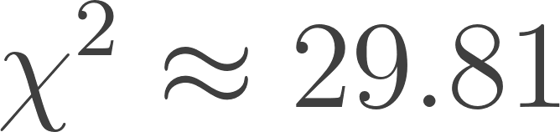
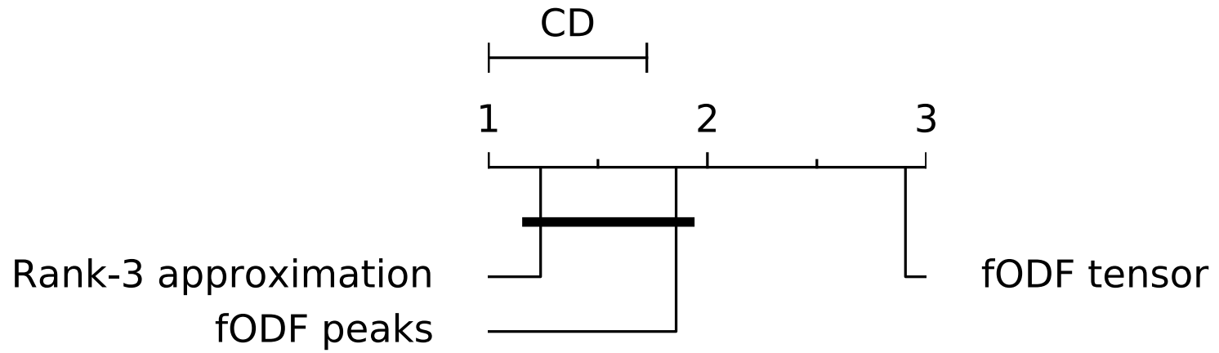
Quantitative results - per test subject
Two-step statistical test
Friedman test ( , p << 0.001)
Nemenyi post-hoc test:
Figure 7: Comparison of segmentation accuracy using different fiber orientation features. The box plot shows the distributions of Dice scores (mean over all 72 tracts per subject). The mean across all test subjects scores is indicated by the dashed red line and the red number on the left.
Figure 8: Critical distance diagram for the Nemenyi post-hoc test. A difference in the performance ranks larger than the critical distance (CD) indicates statistical significance (with p < 0.05).

Slide 17
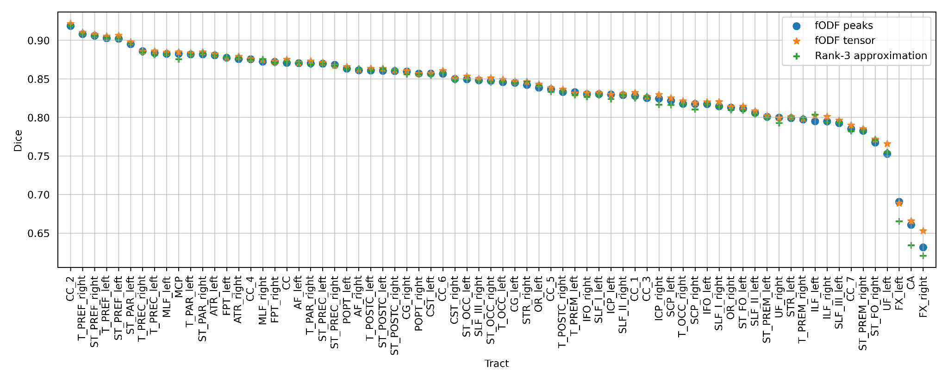
Quantitative results - per tract
Figure 9: Mean Dice scores over all test subjects of each tract per model input.

Slide 18
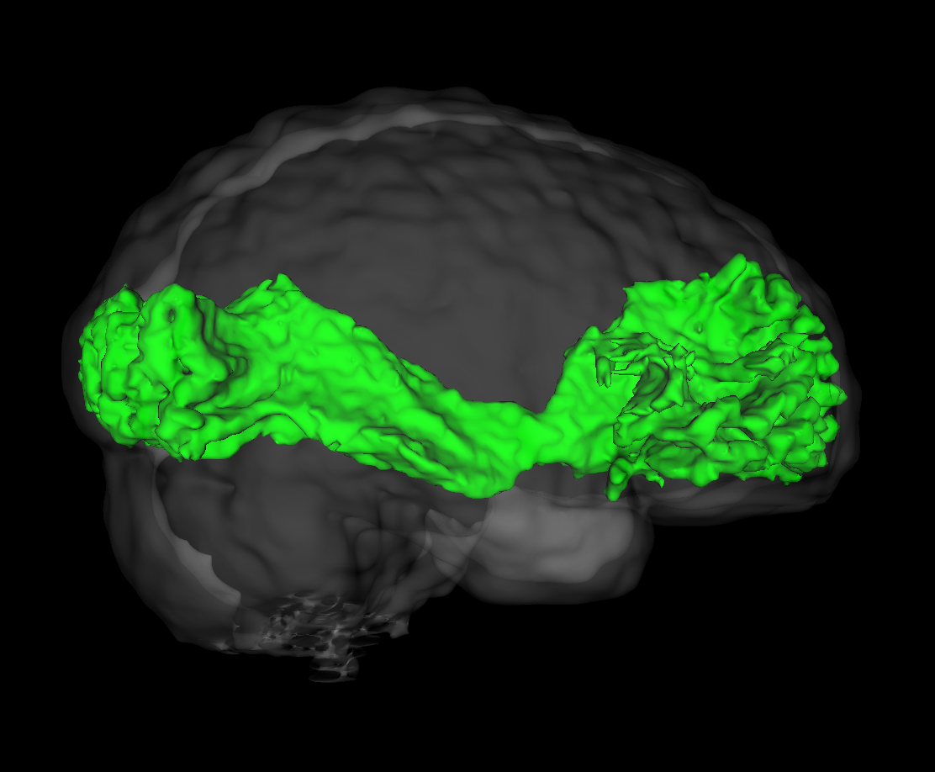
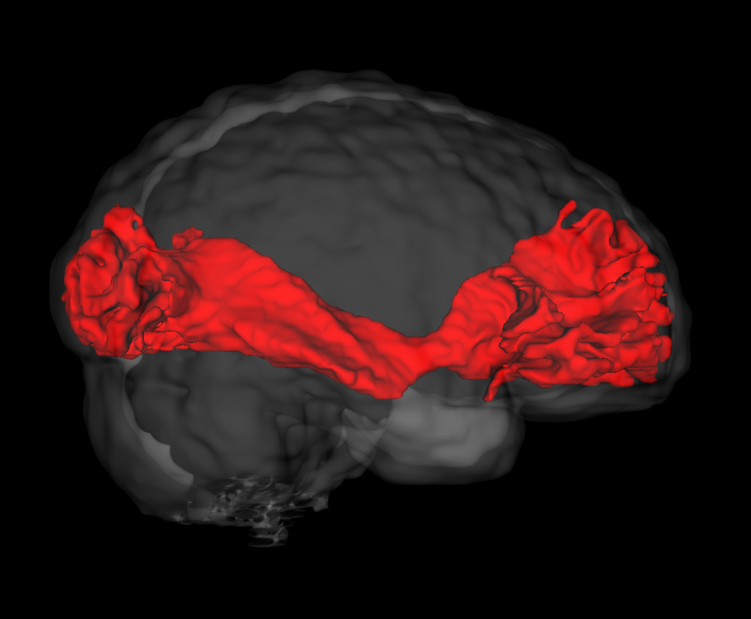
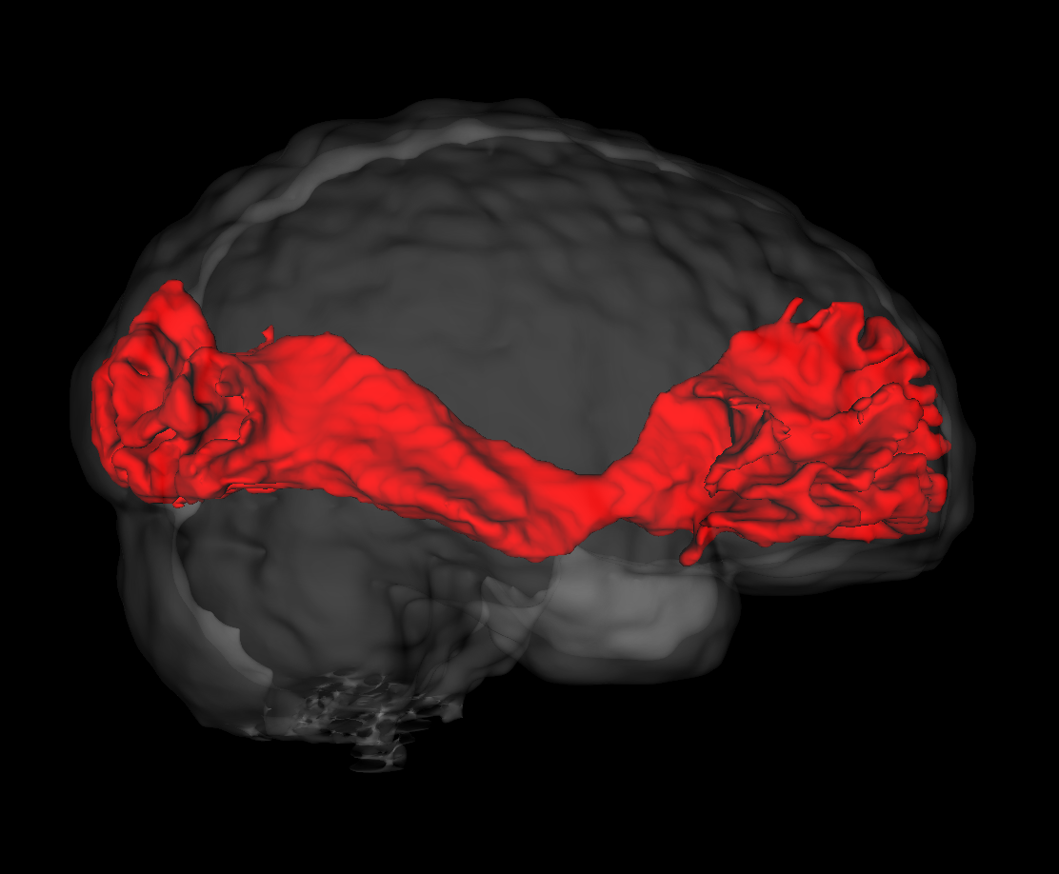
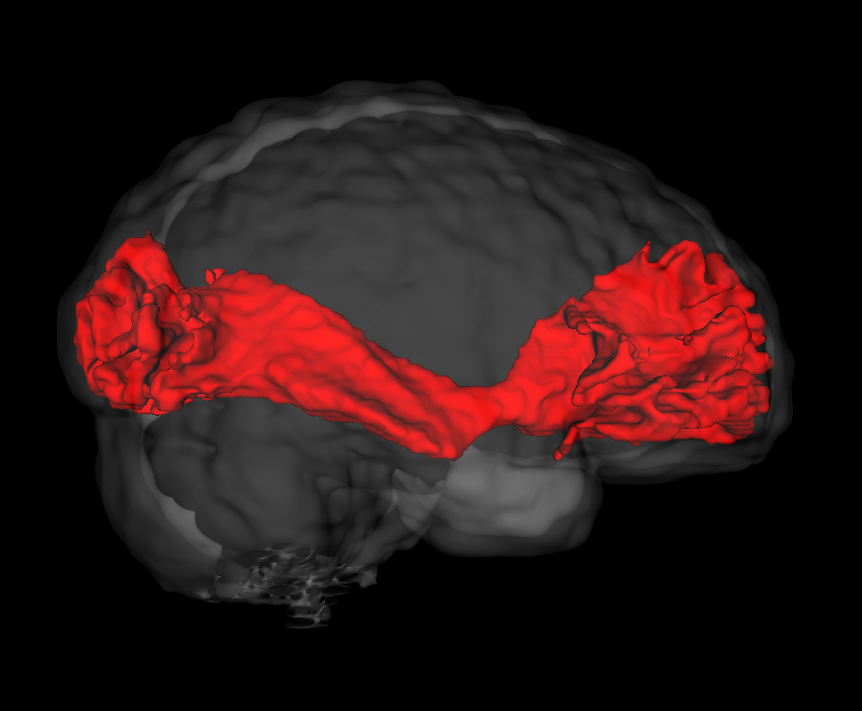
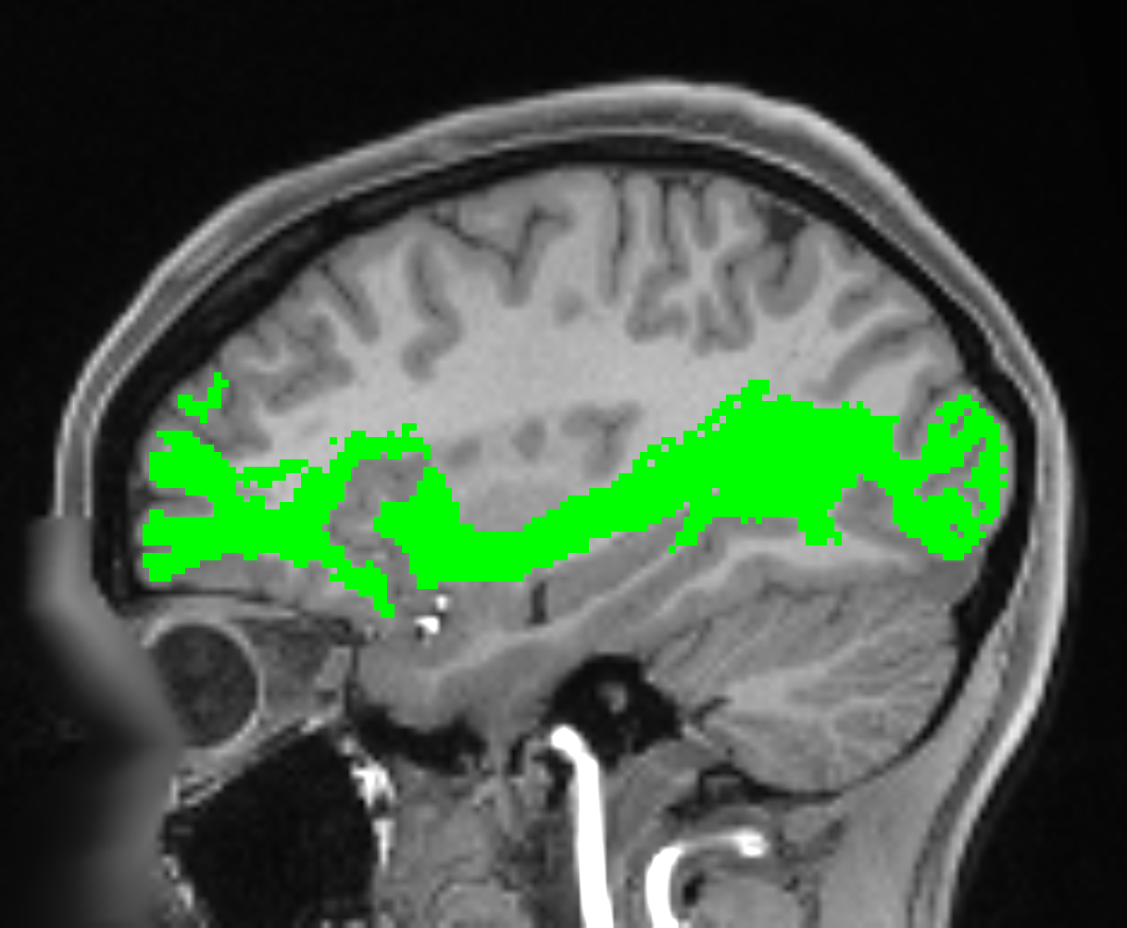
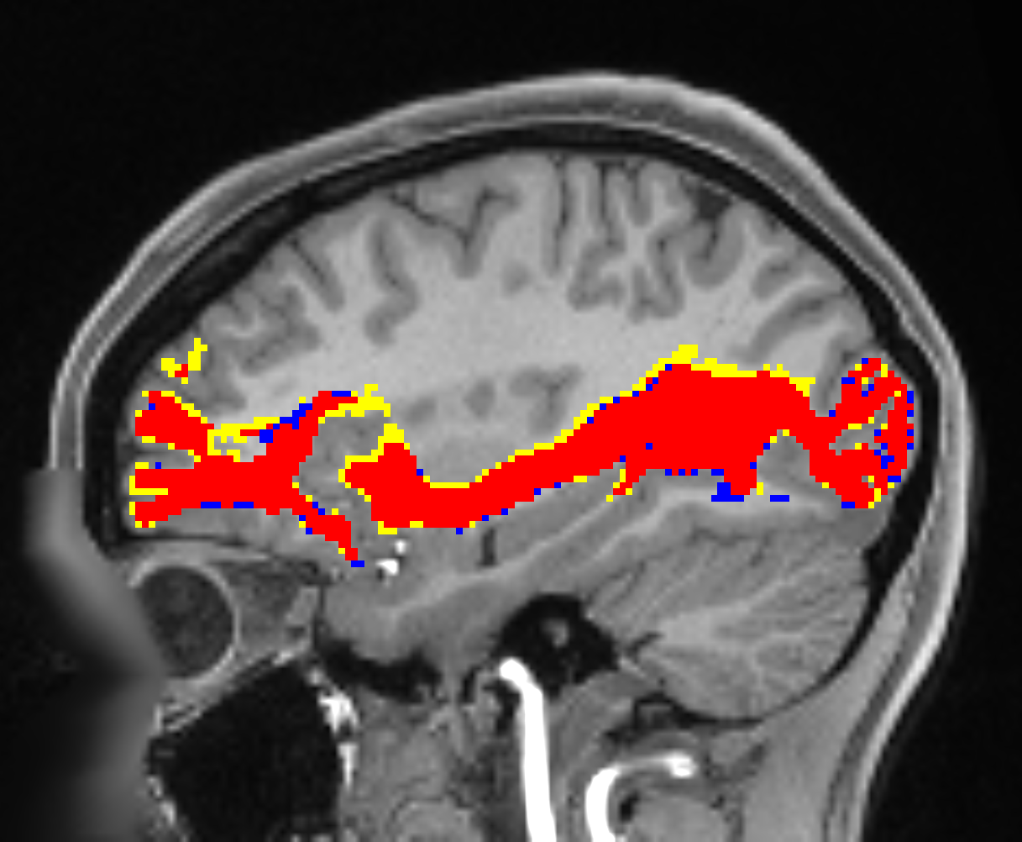
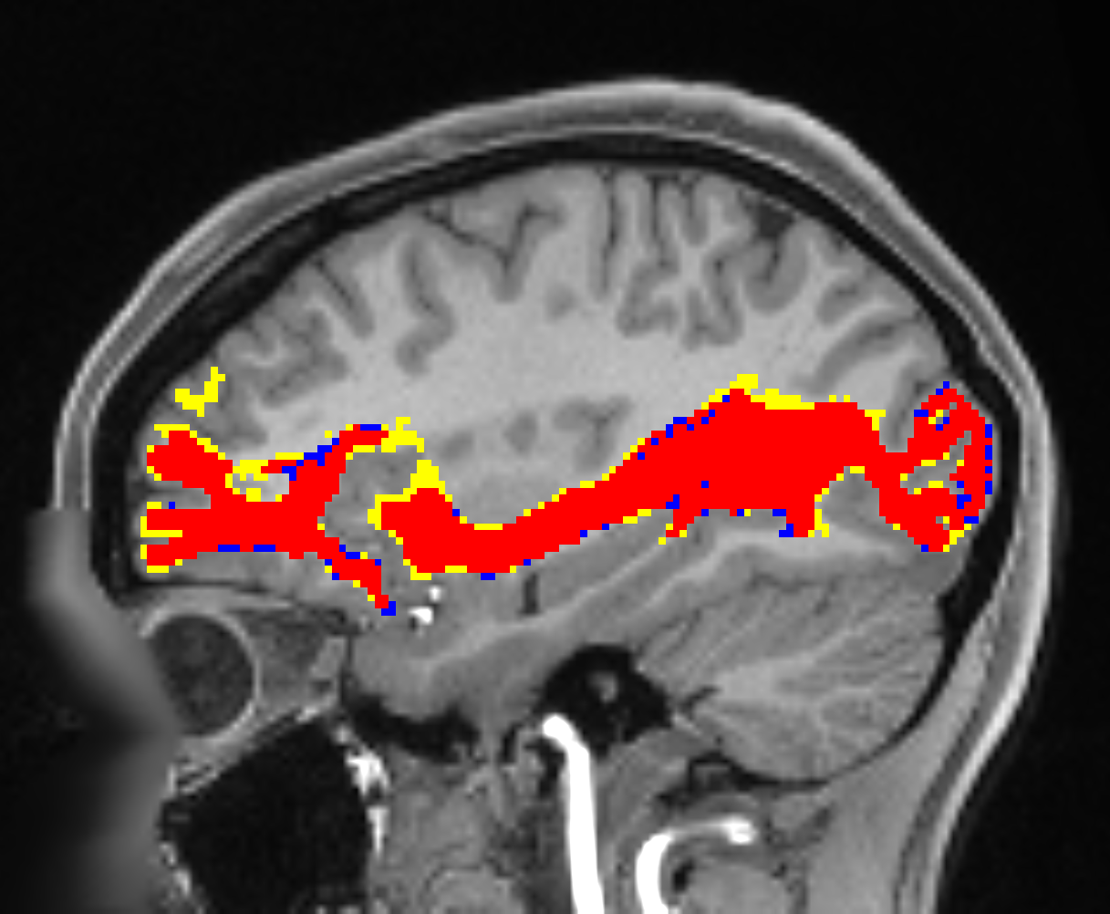
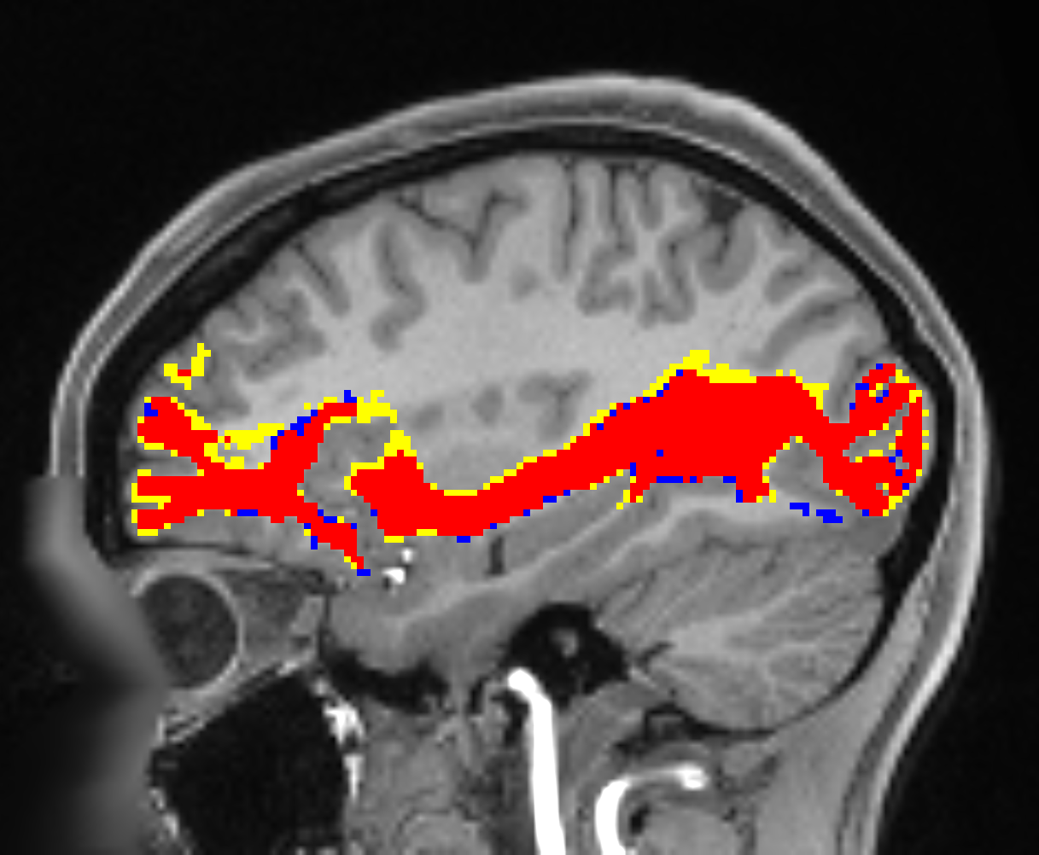
Qualitative results - IFO
Reference
fODF peaks
fODF tensor
Rank-3 approximation
3D
IFO_right
Axial
Figure 10: Qualitative results using different fiber orientation features. Reconstruction of right inferior occipito-frontal fascicle (IFO_right) of HCP subject 987983. Reference segmentation and model prediction are shown in green and red, respectively. Blue and yellow indicate false positives and false negatives, respectively. Figure created by virtue of MRtrix3 [1] and Slicer3D [2].
Notes:
IFO: Inferior occipito-frontal fascicle.
according to Maier-Hein et al., 2017: The challenge of mapping the human connectome based on diffusion tractography.f

Slide 19
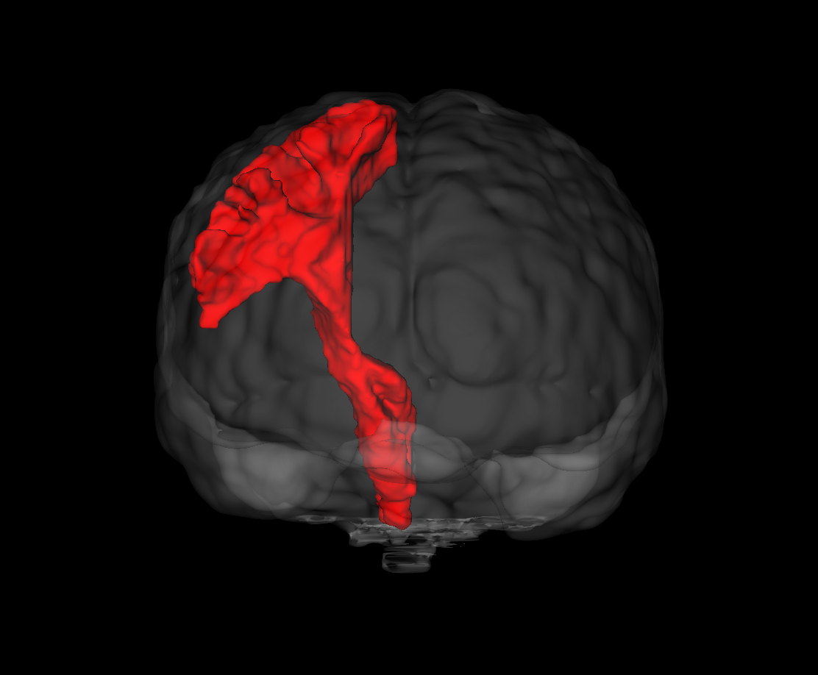


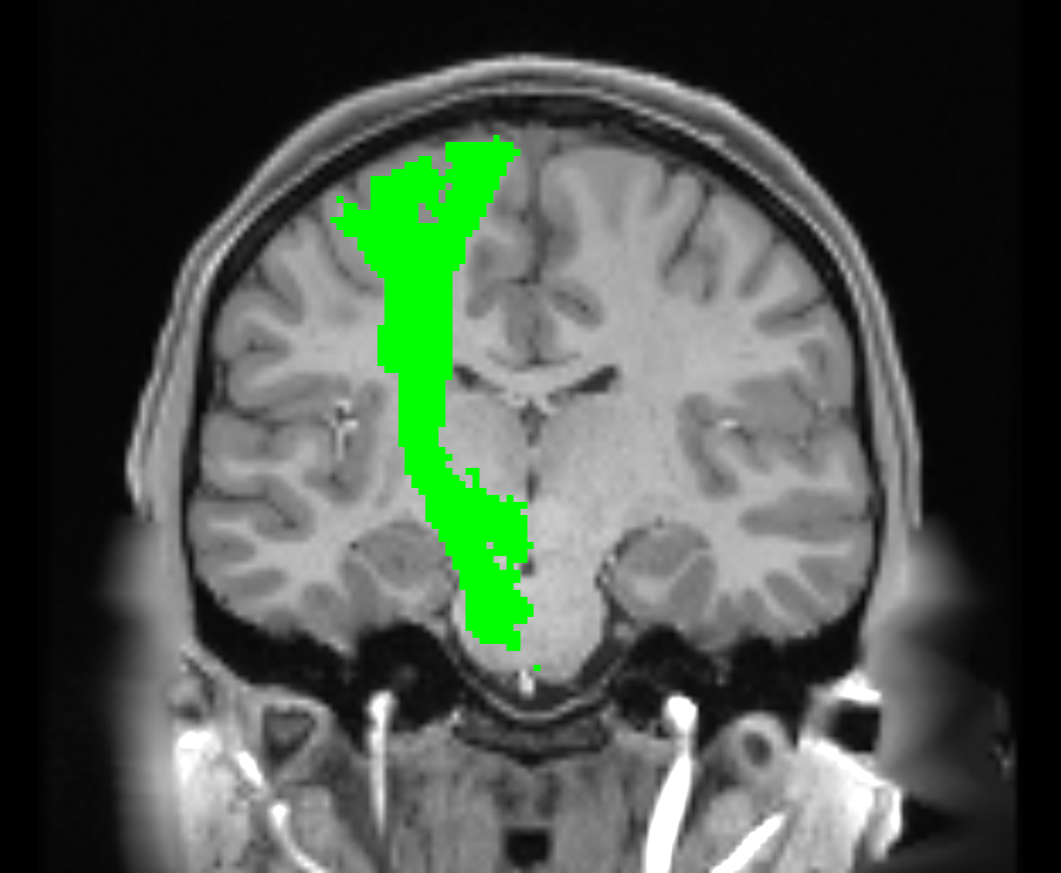
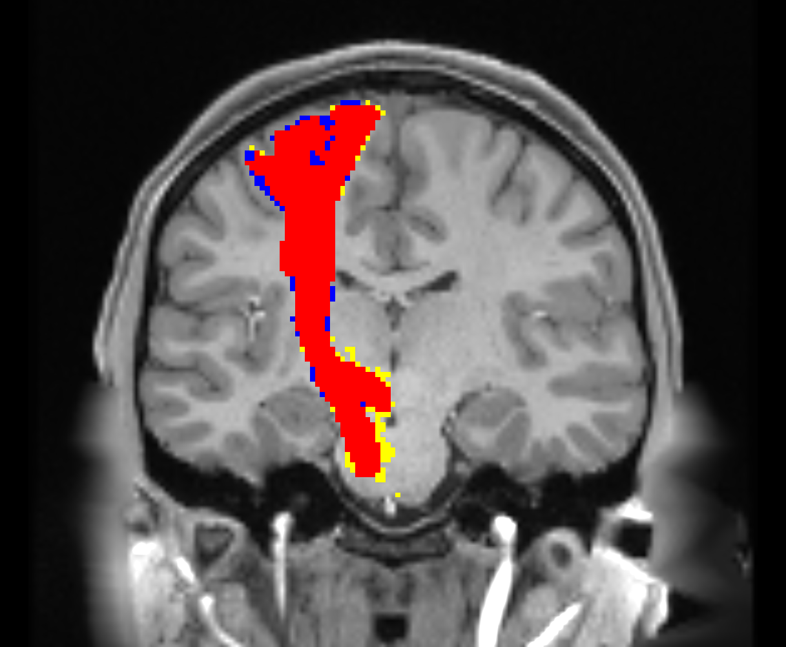
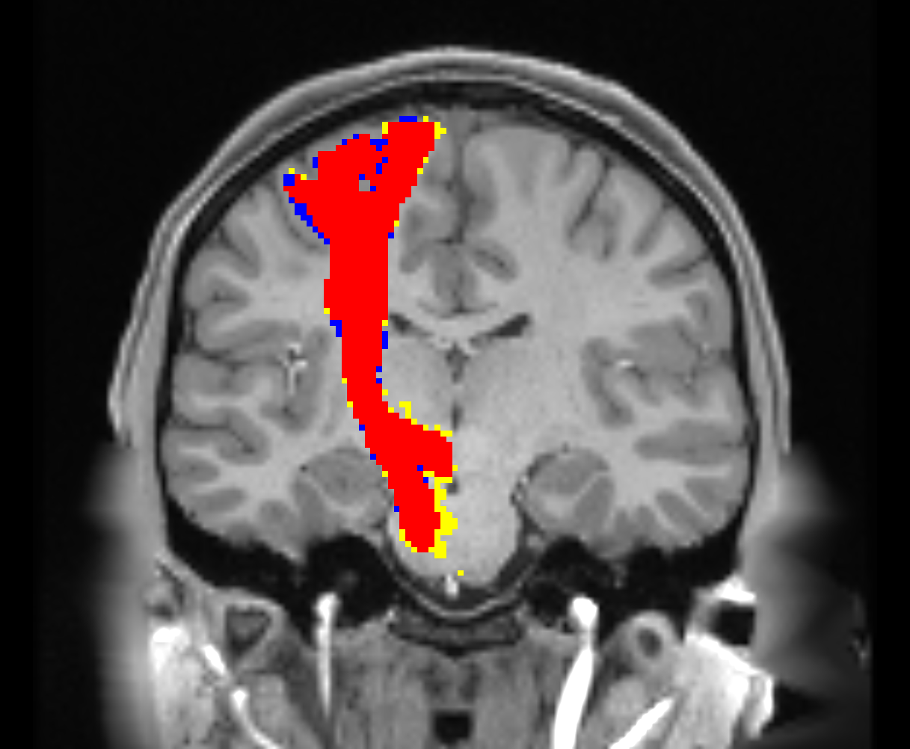

Qualitative results - CST
Reference
fODF peaks
fODF tensor
Rank-3 approximation
3D
CST_right
Coronal
Figure 11: Qualitative results using different fiber orientation features. Reconstruction of right corticospinal tract (CST_right) of HCP subject 987983. Reference segmentation and model prediction are shown in green and red, respectively. Blue and yellow indicate false positives and false negatives, respectively. Figure created by virtue of MRtrix3 [1] and Slicer3D [2].
Notes:
CST: Corticospinal tract.

Slide 20
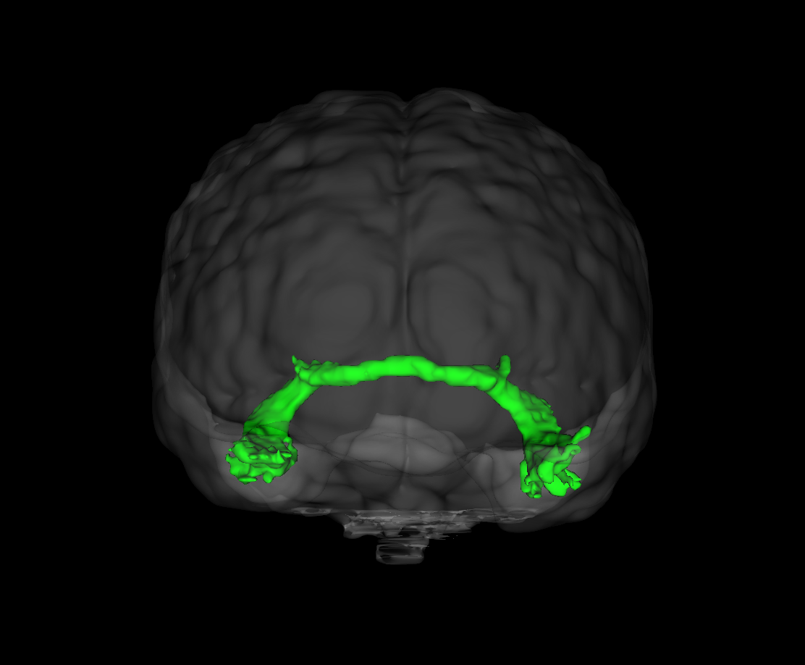
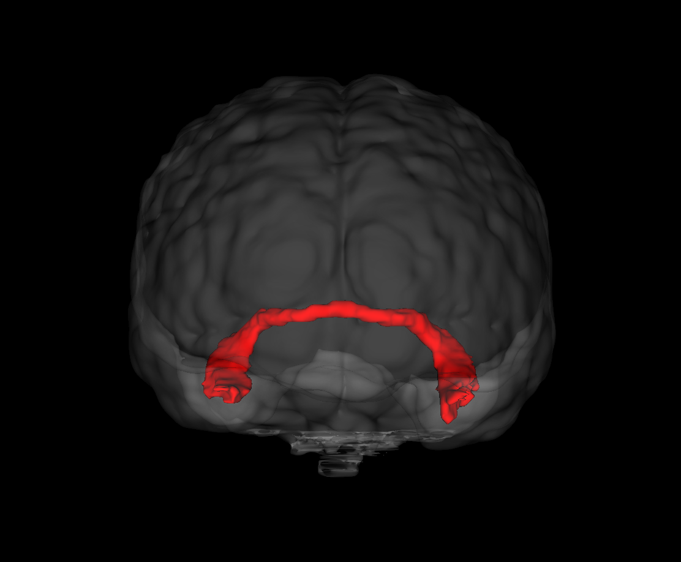

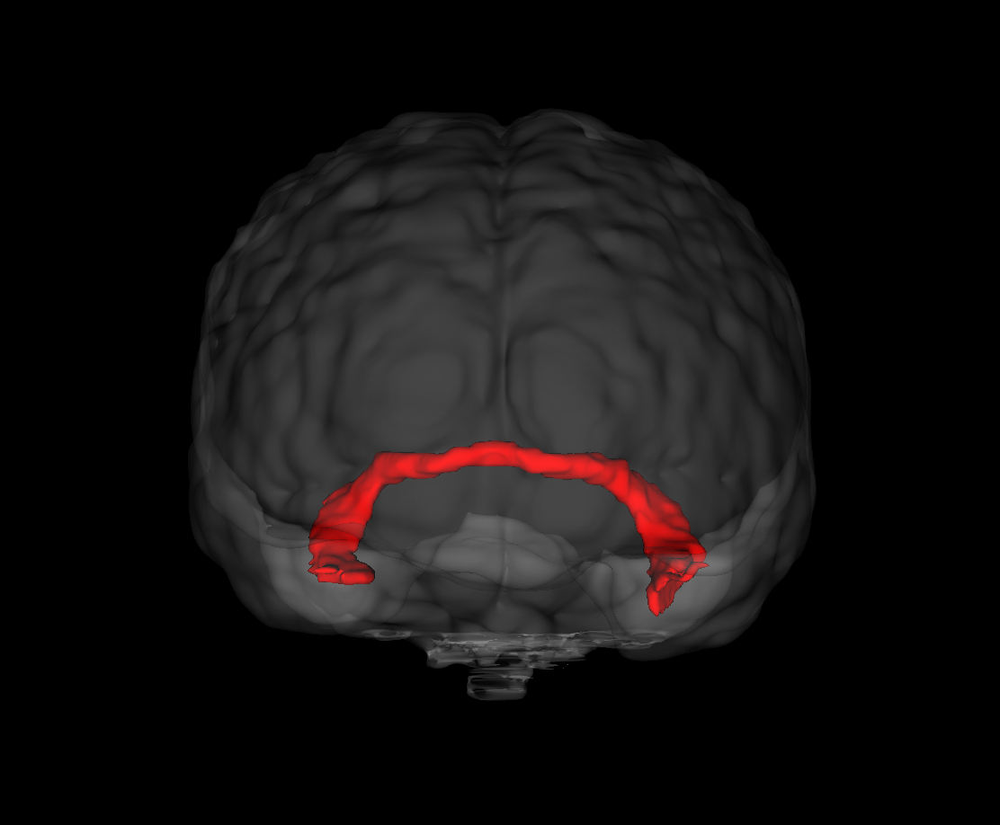
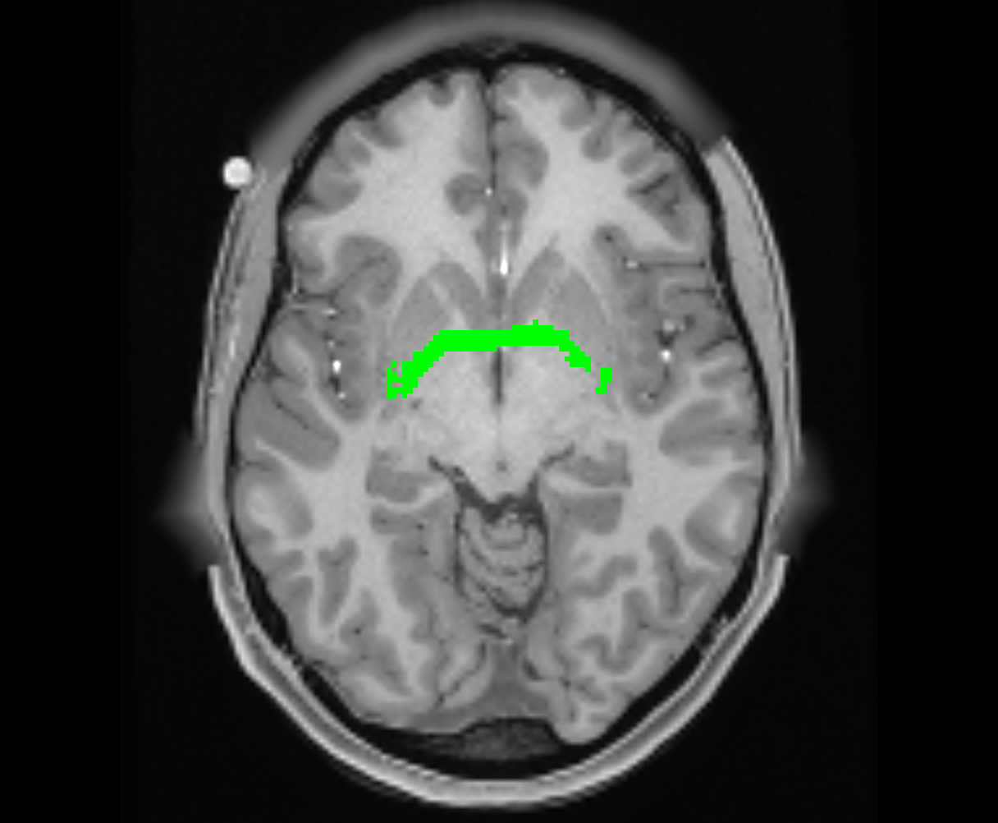
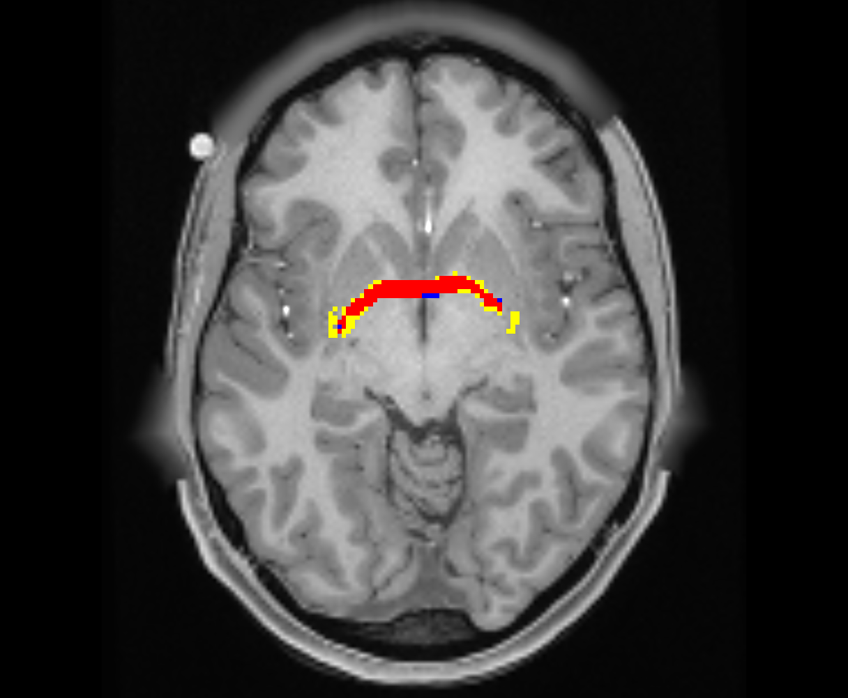

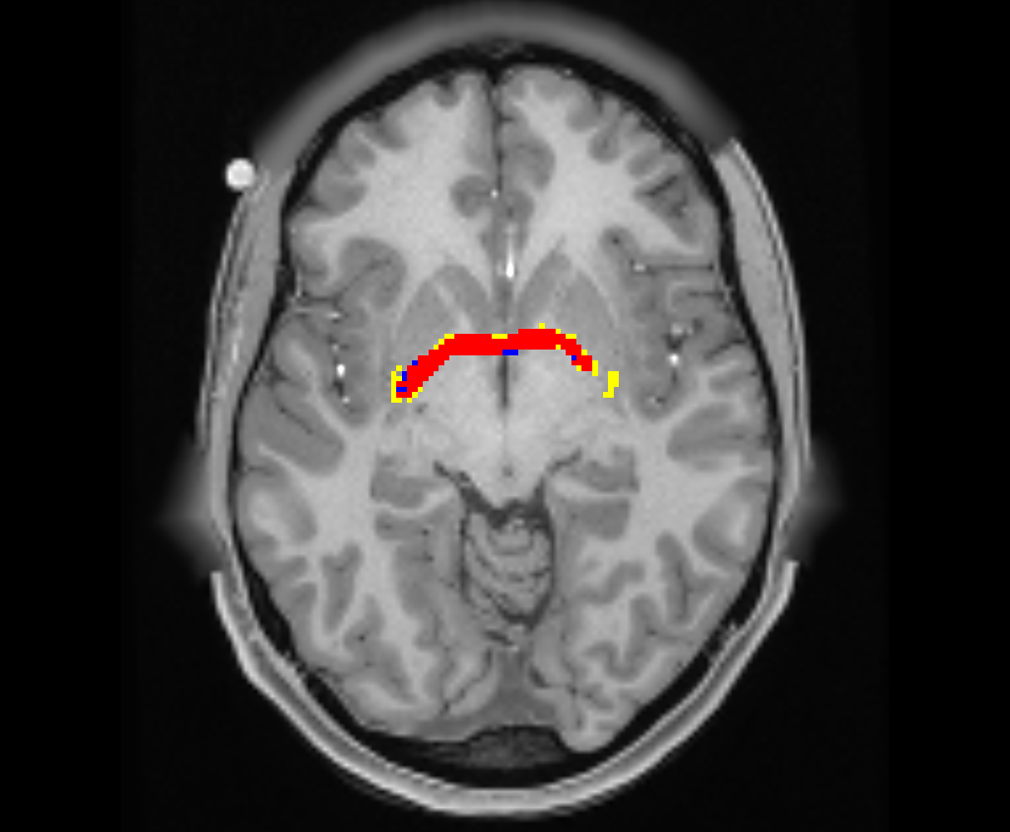
Qualitative results - CA
Reference
fODF peaks
fODF tensor
Rank-3 approximation
3D
CA
Sagittal
Figure 12: Qualitative results using different fiber orientation features. Reconstruction of commissure anterior (CA) of HCP subject 987983. Reference segmentation and model prediction are shown in green and red, respectively. Blue and yellow indicate false positives and false negatives, respectively. Figure created by virtue of MRtrix3 [1] and Slicer3D [2].
Notes:
CA: Commissure Anterior.

Slide 21
Concatenation with structural features
Additional experiment: Simple concatenation of
  fODF tensors
  a co-registered T1-weighted image
  a partial volume map of the white matter
Mean Dice score: approx. 0.8290
Conflicting information or fODF interpretation obstructed
Likely normalization issues

Slide 22
Contents
Introduction
Methods
Experiments and results
Discussion
Conclusion

Slide 23
Limitations of fODF features
Improvement from more comprehensive inputs small
Plus increased memory and training cost (inference cost negligible)
No explicit description of overall fiber geometry
  Difficulties from anatomical variability (e.g., tumors, lesions)
  Lack of intuition for tract identification (vs. streamline segmentation)
  Accounting for spatial arrangement requires inconvenient solutions like view aggregation
Still affected by dMRI acquisition, assumptions and numerical errors of CSD methods
Notes:
intuition and interpretability

Slide 24
Further developments and outlook
TractSeg has highest degree of reproducibility among state-of-the-art methods (Schilling et al., 2021) [12]
Improvements over TractSeg achieved for special applications
Recent trend: direct segmentation using diffusion features or multi-modal inputs (e.g., AGYNet [13])
Own observation: impact of fODF tensors most evident in difficult tract identification
Fusion of dMRI-derived features with additional information.
Notes:
Approximation of fODF mostly sufficient. Alternative inputs most efficient for specialized applications, e.g., where only limited data is available, or additional data sources are available. Or the focus is on special requirements, e.g., robustness against anatomical variabilities.

Slide 25
Contents
Introduction
Methods
Experiments and results
Discussion
Conclusion

Slide 26
Conclusion
Local fODF expressive for efficient tract identification
Example: TractSeg
  CNN for spatial and more abstract features
  High robustness
fODF tensors improve over peaks by approx. 0.3 Dice points
No significant effect from rank-3 approximations
Prospective: combining dMRI-derived features with additional information
Notes:
spatial and more abstract features (vs. tractography)

Slide 27
References
In order of occurrence:
[1] TOURNIER J.-D., SMITH R., RAAFFELT D., TABBARA R., DHOLLANDER T., PIETSCH M., CHRISTIAENS D., JEURISSEN B., YEH C.-H., CONNELLY A.: MRtrix3: A fast, flexible and open software framework for medical image processing and visualisation. Neuroimage 202 (2019), 116137.
[2] FEDOROV A., BEICHEL R., KALPATHY-CRAMER J., FINET J., FILLION-ROBIN J.-C., PUJOL S., BAUER C., JENNINGS D., FENNESSY F., SONKA M., ET AL.: 3D Slicer as an image computing platform for the Quantitative Imaging Network. Magnetic resonance imaging 30, 9 (2012), 1323–1341.
[3] WASSERTHAL J., NEHER P., MAIER-HEIN K. H.: TractSeg - Fast and accurate white matter tract segmentation. NeuroImage 183 (2018), 239–253.
[4] BULLMORE E., SPORNS O.: Complex brain networks: graph theoretical analysis of structural and functional systems. Nature reviews neuroscience 10, 3 (2009), 186–198.
[5] MAIER-HEIN K. H., NEHER P. F., HOUDE J.-C., CÔTÉ M.-A., GARYFALLIDIS E., ZHONG J., CHAMBERLAND M., YEH F.-C., LIN Y.-C., JI Q., ET AL.: The challenge of mapping the human connectome based on diffusion tractography. Nature communications 8, 1 (2017), 1349.
[6] YANG J. Y.-M., YEH C.-H., POUPON C., CALAMANTE F.: Diffusion MRI tractography for neurosurgery: the basics, current state, technical reliability and challenges. Physics in Medicine & Biology 66, 15 (2021), 15TR01.
[7] BELLS S., CERCIGNANI M., DEONI S., ASSAF Y., PASTERNAK O., EVANS C., LEEMANS A., JONES D.: Tractometry - comprehensive multi-modal quantitative assessment of white matter along specific tracts. In Proc. ISMRM (2011), vol. 678.
[8] WASSERTHAL J., NEHER P. F., MAIER-HEIN K. H.: Tract orientation mapping for bundle-specific tractography. In Medical Image Computing and Computer Assisted Intervention - MICCAI 2018: 21st International Conference, Granada, Spain, September 16-20, 2018, Proceedings, Part III 11 (2018), Springer, pp. 36–44.
[9] WASSERTHAL J., NEHER P. F., HIRJAK D., MAIER-HEIN K. H.: Combined tract segmentation and orientation mapping for bundle-specific tractography. Medical image analysis 58 (2019), 101559.
[10] WASSERTHAL J., MAIER-HEIN K. H., NEHER P. F., NORTHOFF G., KUBERA K. M., FRITZE S., HARNEIT A., GEIGER L. S., TOST H., WOLF R. C., ET AL.: Multiparametric mapping of white matter microstructure in catatonia. Neuropsychopharmacology 45, 10 (2020), 1750–1757.
[11] VAN ESSEN D. C., SMITH S. M., BARCH D. M., BEHRENS T. E., YACOUB E., UGURBIL K., CONSORTIUM W.-M. H., ET AL.: The WU-Minn human connectome project: an overview. Neuroimage 80 (2013), 62–79.
[12] SCHILLING K. G., TAX C. M., RHEAULT F., HANSEN C., YANG Q., YEH F.-C., CAI L., ANDERSON A. W., LANDMAN B. A.: Fiber tractography bundle segmentation depends on scanner effects, vendor effects, acquisition resolution, diffusion sampling scheme, diffusion sensitization, and bundle segmentation workflow. Neuroimage 242 (2021), 118451.
[13] NELKENBAUM I., TSARFATY G., KIRYATI N., KONEN E., MAYER A.: Automatic segmentation of white matter tracts using multiple brain MRI sequences. In 2020 IEEE 17th International Symposium on Biomedical Imaging (ISBI) (2020), IEEE, pp. 368–371.

Slide 28
Additional slides

Slide 29
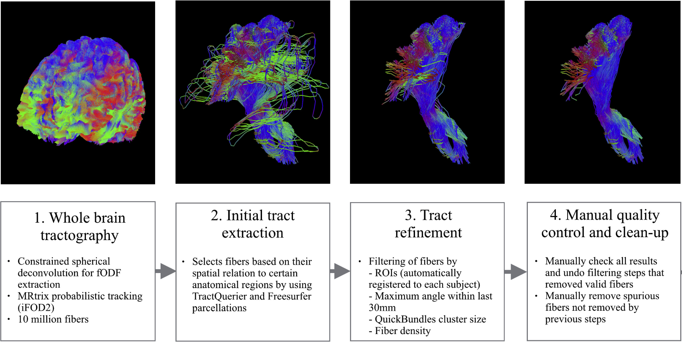
Supervision
High-quality tract dissections of 72 major white matter tracts
provided by Wasserthal et al. [3]
Figure 5: Semi-automatic dissection pipeline for creation of reference tracts. Images show the left CST of subject 898176. Adapted from [3].
Notes:
As a supervised deep learning method, TractSeg’s performance is crucially dependent on the quality of the training data. The construction of the reference tracts is a key aspect of the success of TractSeg.

Slide 30
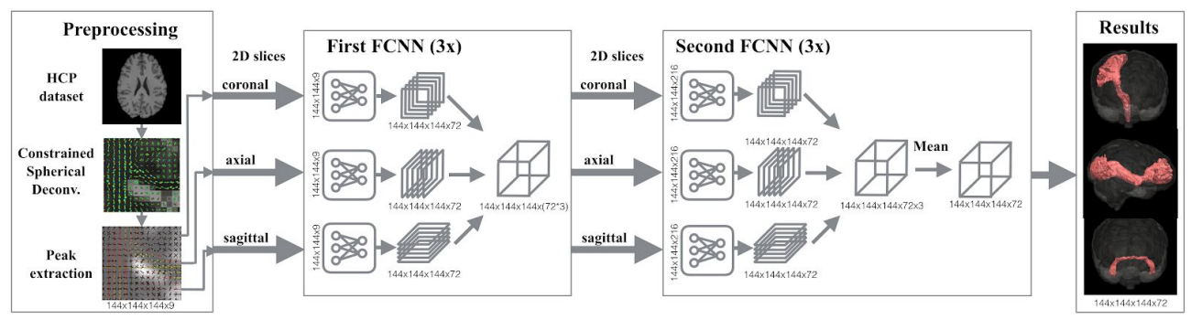
TractSeg - Overview with second FNN
Segmentation of white matter tracts in dMRI
CNN approach based on U-net architecture
More accurate and faster than tractography-based methods
Image: Wasserthal et al., NeuroImage 2018]

Slide 31
What happened to the second FCNN?
Second CNN takes input slices with 3 · 72 = 216 channels
Excessive increase of hardware requirements and training duration
Jakob Wasserthal on GitHub:
“This is only training the first FCNN. Also the TractSeg version you can download via pip is also only using the first FCNN. The second one gives only very minor improvements but increases runtime a lot. Therefore, I actually never use it.”
Source: https://github.com/MIC-DKFZ/TractSeg/issues/244

Slide 32
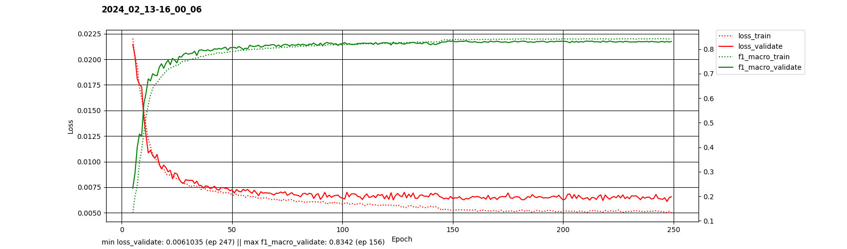
Loss - peaks

Slide 33
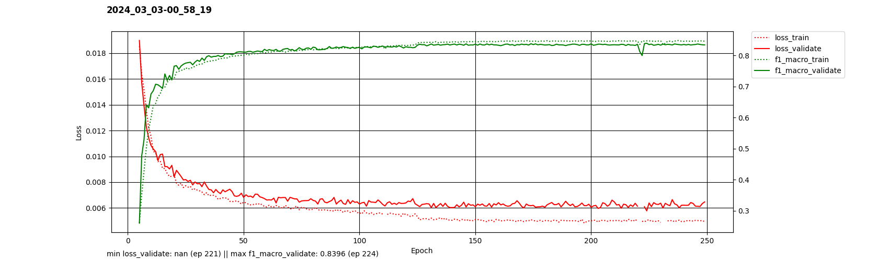
Loss - fODF tensors

Slide 34
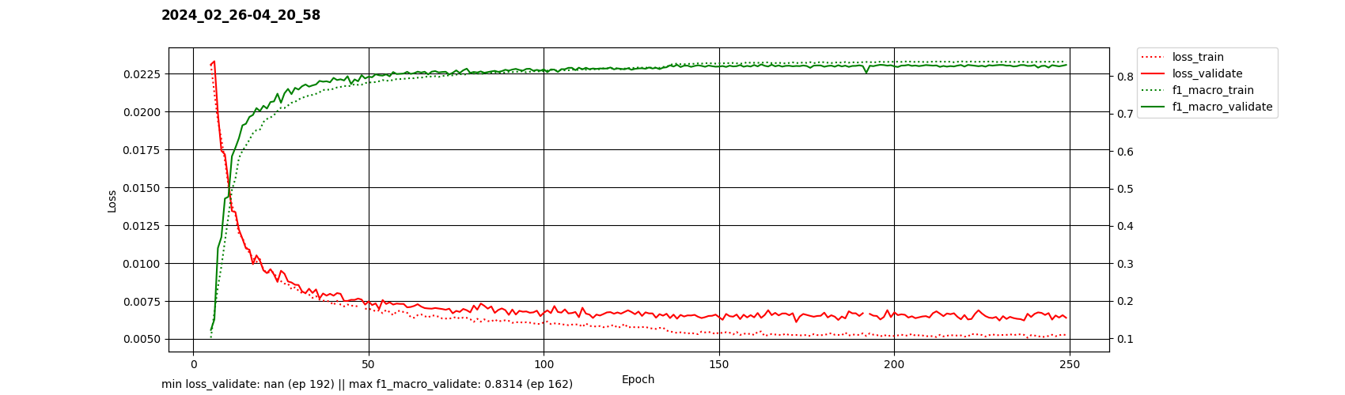
Loss - rank-3 approximation

Slide 35

Overfitting with fODFs
Experiment without data augmentation
Overfitting effect mitigated by learning rate scheduler

