Slide 1
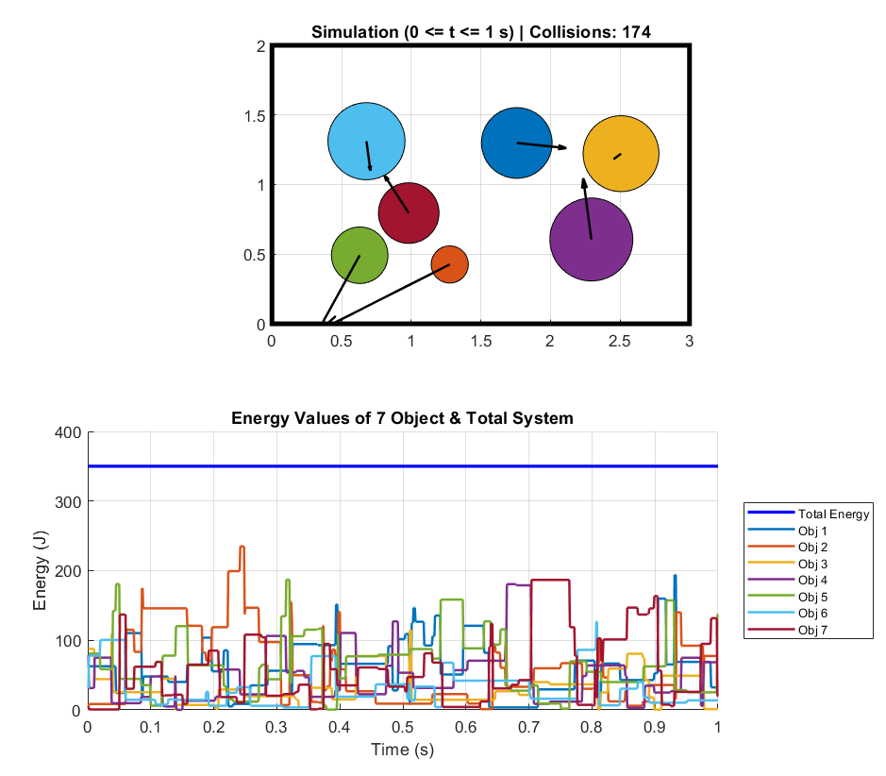
Mech 307 Project : Moving and Bouncing Balls
Bertan Erman 83155

Slide 2
Project Objectives
To model the elastic collision dynamics of multiple particles within a 2D planar domain.
To implement Newton’s Laws of Motion and Conservation of Linear Momentum principles using MATLAB.
To translate theoretical kinetics equations (based on R.C. Hibbeler, Ch. 15) into a computational numerical algorithm.
To validate the physical accuracy of the system through real-time energy conservation graphs.

Slide 3
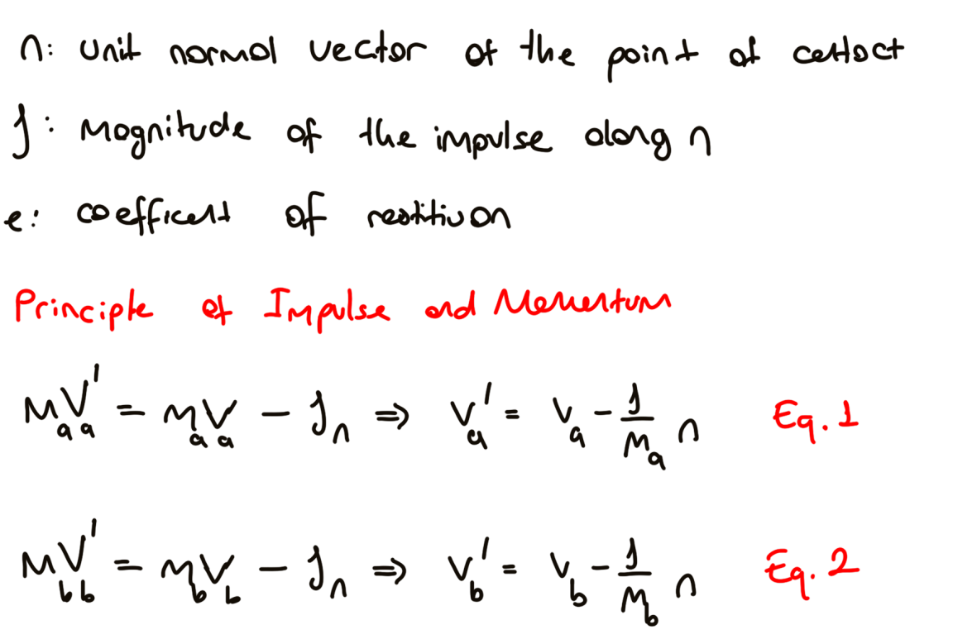
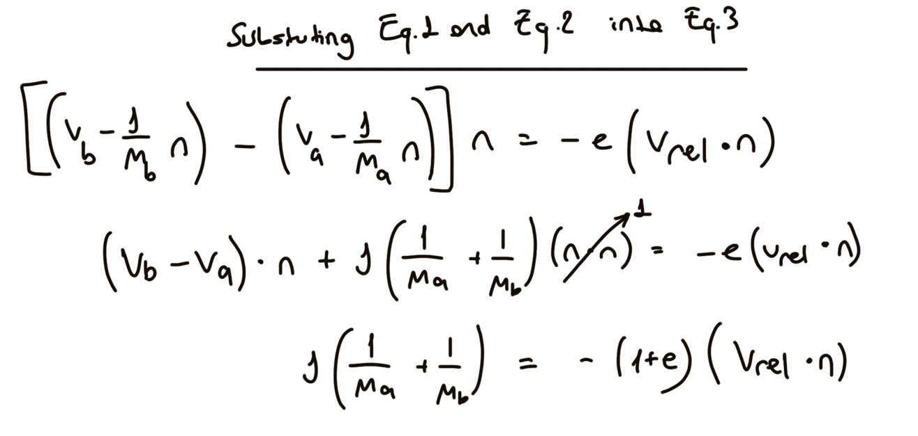
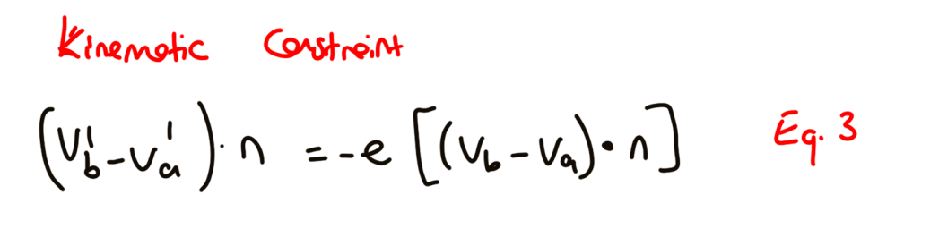
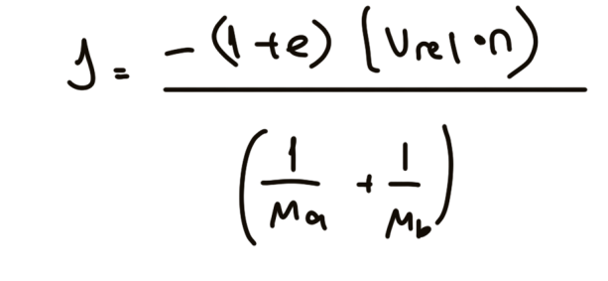
First, I wrote the momentum equations for both particles A and B. As you can see in Equations 1 and 2, the impulse J changes their velocities in opposite directions.
Next, I applied the definition of the Coefficient of Restitution (e), which relates the relative velocities before and after the impact.
Finally, by substituting the velocity equations into the restitution constraint, I solved for J.

Slide 4
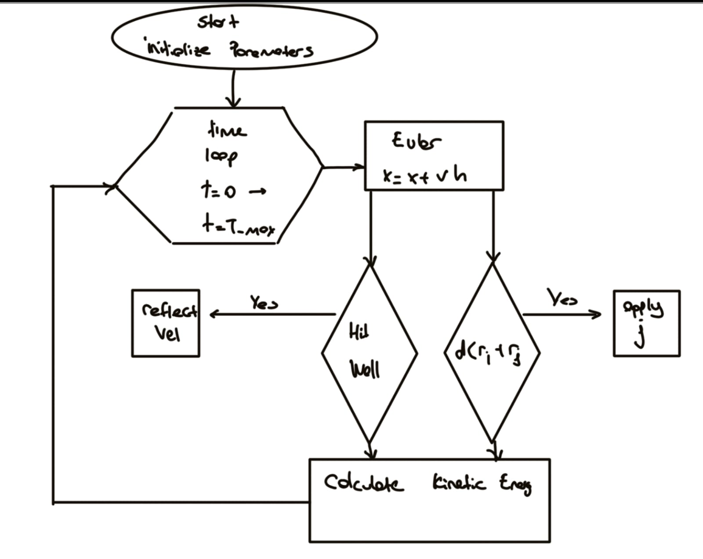
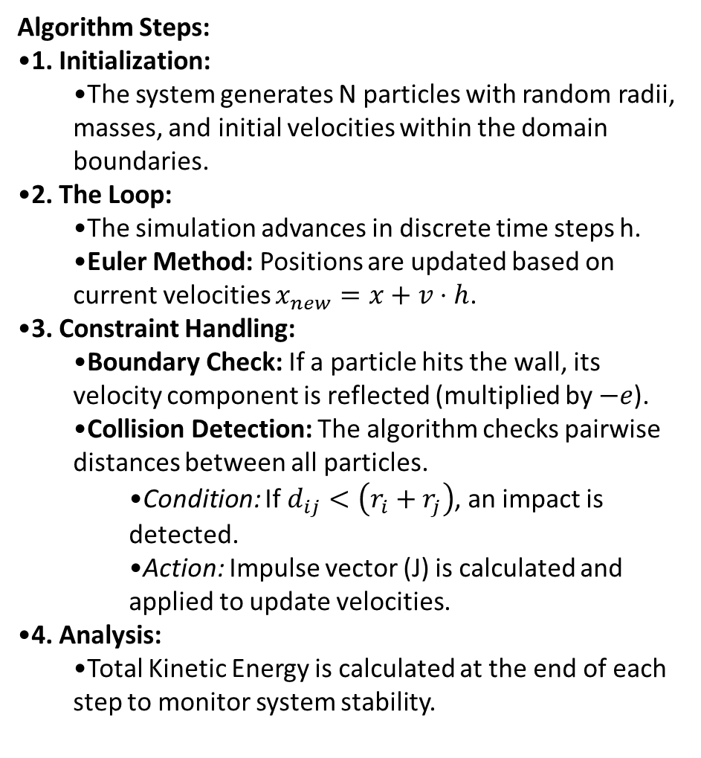
Algorithm Steps:
1. Initialization:
  The system generates N particles with random radii, masses, and initial velocities within the domain boundaries.
2. The Loop:
  The simulation advances in discrete time steps h.
  Euler Method: Positions are updated based on current velocities $x_{new}=x+v⋅h$.
3. Constraint Handling:
  Boundary Check: If a particle hits the wall, its velocity component is reflected (multiplied by $−e$).
  Collision Detection: The algorithm checks pairwise distances between all particles.
    Condition: If $d_{ij}<\left(r_{i}+r_{j}\right)$, an impact is detected.
    Action: Impulse vector (J) is calculated and applied to update velocities.
4. Analysis:
  Total Kinetic Energy is calculated at the end of each step to monitor system stability.

Slide 5
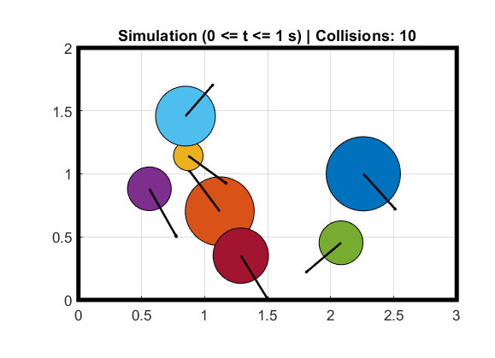
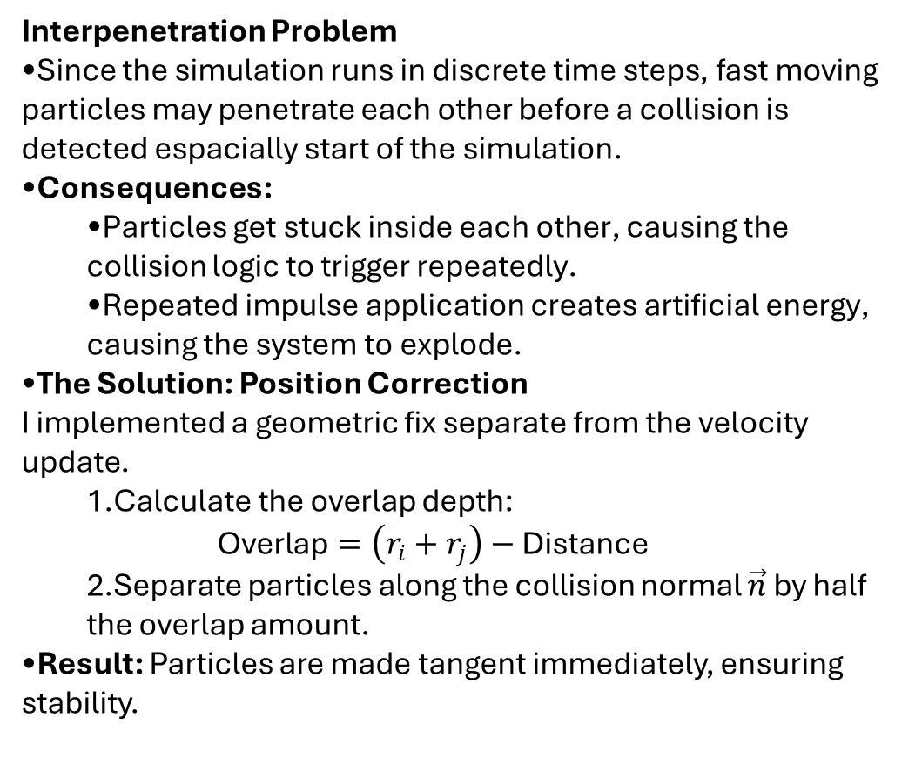
Interpenetration Problem
Since the simulation runs in discrete time steps, fast moving particles may penetrate each other before a collision is detected espacially start of the simulation.
Consequences:
  Particles get stuck inside each other, causing the collision logic to trigger repeatedly.
  Repeated impulse application creates artificial energy, causing the system to explode.
The Solution: Position Correction
I implemented a geometric fix separate from the velocity update.
  Calculate the overlap depth:
  $\text{Overlap}=\left(r_{i}+r_{j}\right)−\text{Distance}$
  Separate particles along the collision normal $\vec{n}$ by half the overlap amount.
Result: Particles are made tangent immediately, ensuring stability.

Slide 6
