Slide 1

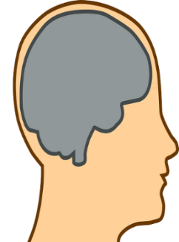

good
neutral
QoE
bad
x
y
r
θ
preference
feedback
adaptation
‘intelligent’
design agent
Notes:
The one rule to rule them all?

