Slide 1
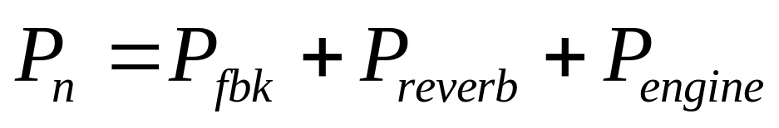
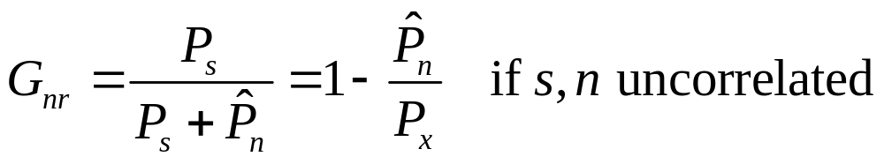

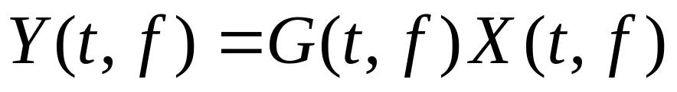
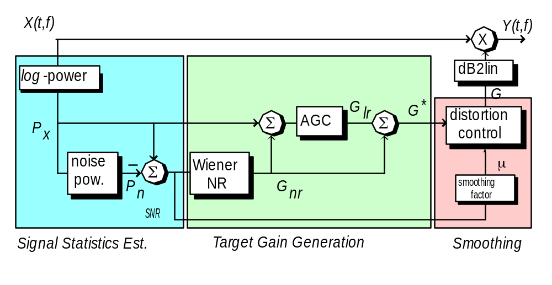
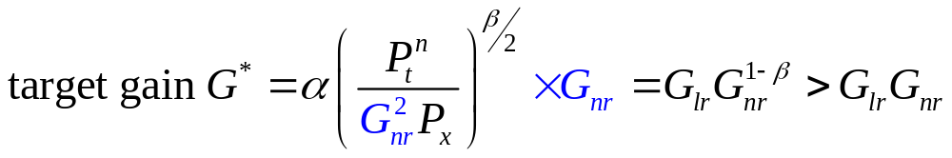
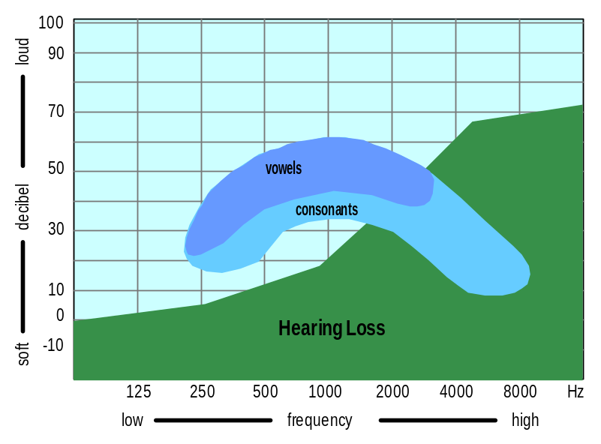
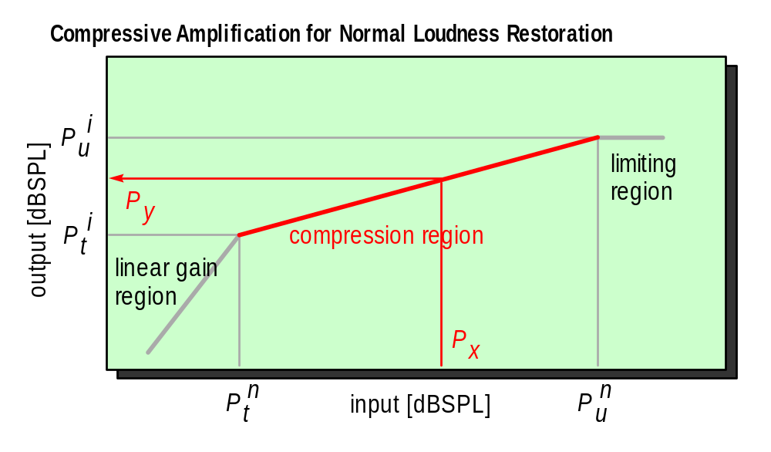


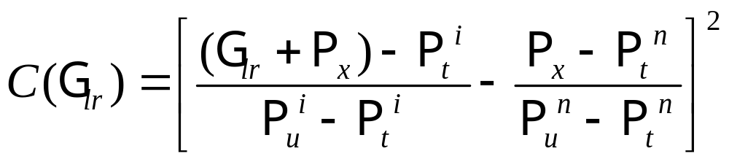
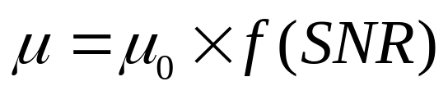
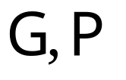
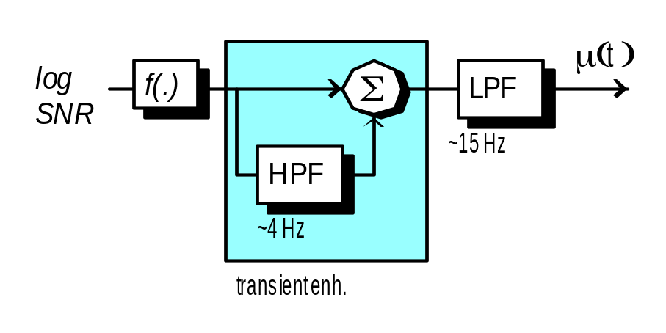
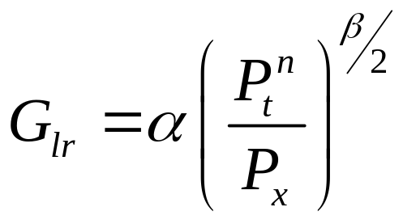
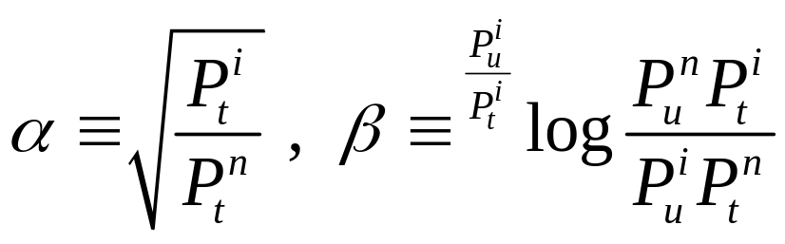


An Integrated Approach to Hearing Aid Algorithm Design for Enhancement of Audibility, Intelligibility and Comfort
Bert de Vries^{1,2} and Rob de Vries¹
(1) Algorithm R&D group, GN ReSound, Horsten 1, 5612 AX Eindhoven, the Netherlands
(2) Signal Processing Systems Group, Dept. EE, Technical University Eindhoven
{bdevries,rdevries}@gnresound.com
Introduction
Hearing Aid Algorithm Goals
Audibility: maximize normal loudness restoration
Intelligibility: maximize signal-to-noise ratio
Comfort: minimize perceptual distortion
Signal Processing Goal
Integrated approach to gain control algorithm
Processing model
Analyze received signal into time-frequency grid
Process signal by adaptive (real) gain
Prior Art
Bottom-up approach: ad hoc network of gain modules (for, e.g., noise reduction, compression, de-reverberation, feedback suppression etc.)
Problem
Signal distortion vs. residual noise trade-off is uncontrolled
Hearing aids patients are not satisfied (~20% of patients do not wear their hearing aids)
Improving Signal-to-Noise Ratio
Estimate 1 (global) SNR(t,f), where S refers to target signal (usually speech) and N integrates (power of) everything else, including all sources of noise, feedback and reverberation.
  e.g.
Compute a (motivated) gain, e.g., Wiener gain
Integration
capture HA goals into cost criterion:- loudness restoration of “cleaned-up” signal (target gain G*), subject to personal “tolerable distortion”
‘Normal Loudness’ Restoration
Problem
Increased hearing threshold leads to dynamic range reduction and loudness distortion
Restore relative loudness to normal
(where
in log-domain)
leads to where
G_{lr} implements compressive amplification
Comfort
spectral smoothing of target gain
  with ‘target gain changes’
Scaling factors by psycho-acoustic considerations and tuning
  constant μ = μ₀, λ = 0 (no freq. smoothing)
  (SNR-dependent) ← BEST
  transient-enhanced SNR-dependent
TU/e
AvM 00.05.09

