Slide 1
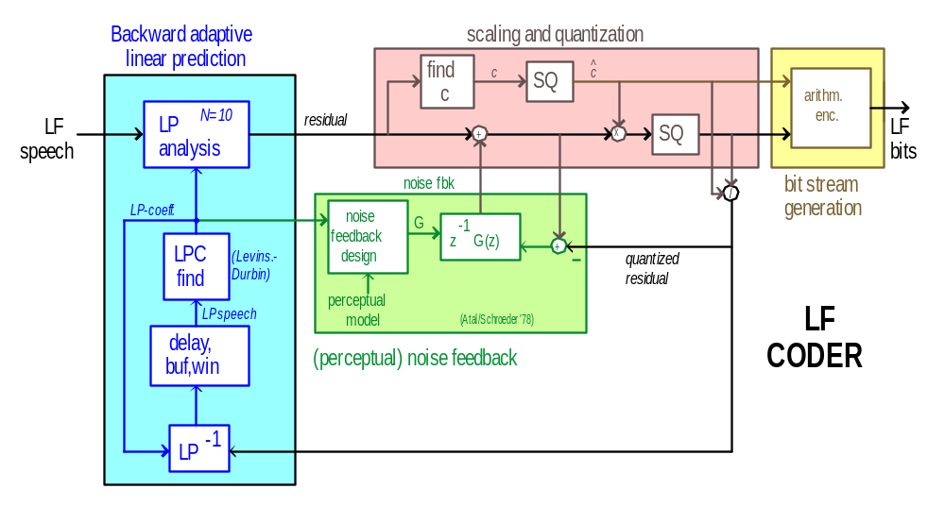
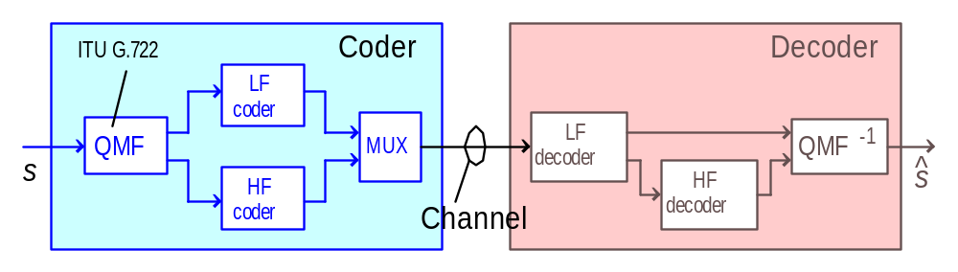


Speech Coding for Wireless Communications in the
Hearing Aid Environment
Harald Pobloth¹, Bastiaan Kleijn¹ and Bert de Vries²
(1) KTH (Royal Institute of Technology), Stockholm, Sweden, {Harald,Bastiaan}@s3.kth.se
(2) Algorithm R&D group, GN ReSound, Eindhoven, the Netherlands, bdevries@gnresound.com
Abstract
Potential attractive applications of wireless communications of speech signals in the hearing aid environment include binaural and remote processing. Today, these applications have not been realized due to the power demands of wireless communication. An important way to reduce power consumption is to minimize the number of bits that need to be communicated, while retaining satisfactory speech signal quality. Standard speech coding algorithms are not appropriate since the hearing aid environment imposes a unique set of (latency and computational) constraints that are much more severe than, for instance, in a mobile phone application.
We have developed a prototype wideband speech coding system for wireless communication between hearing aids. This system operates on speech sampled at 16 [kHz], has an average rate of 30 [kbit/s] (i.e., data reduction by factor 4.3), a total (coder plus decoder) algorithmic delay of 6.4 [ms] and produces perceptually high-quality speech at a computational rate of about 4M [mult./s].
Coder Details
Backward adaptive linear prediction (N=10)
  low delay; no need to transmit LP coefficients
Entropy-constrained scalar quantization
  novel adaptive scaling factor
  optimization by perceptual noise feedback
    similar to Atal/Schroeder (1978)
    van de Par masking/distortion model (2002)
Variable-length bit-stream generation
  the length of bit-streams varies with probability of occurrence of the indices
HF speech coding as LF speech coding without noise feedback
Performance
Average rate 30 kbit/s
Delay 6.375 ms (5 for coder, 1.375 for QMF)
Total complexity 4M mult./s (including 1.4M mult./s for noise fbk)
Segm. SNR 12 dB (optimized for perception)
Sound examples available
Introduction and Overview
What
speech coder for hearing aids
Why
better beamforming
connectivity to modern wireless devices
Requirements
wideband speech, f_{s}=16 kHz
low delay, low complexity
excellent perceptual quality
Overview
separate coding of low- and high-freq. speech
  use QMF from ITU-T G.722
  perceptual noise feedback only for low-freq band
no pitch coding (too much delay and complexity)
Future Plans / Conclusion
Parameter optimization, e.g.:
  rate balance in different streams
  perceptual feedback
  efficient implementations
  entropy vs. resolution constraint
Working prototype for low-latency, low-complexity speech transmission to or between hearing aids has been developed

