Slide 1


Assignment - Diver

Slide 2
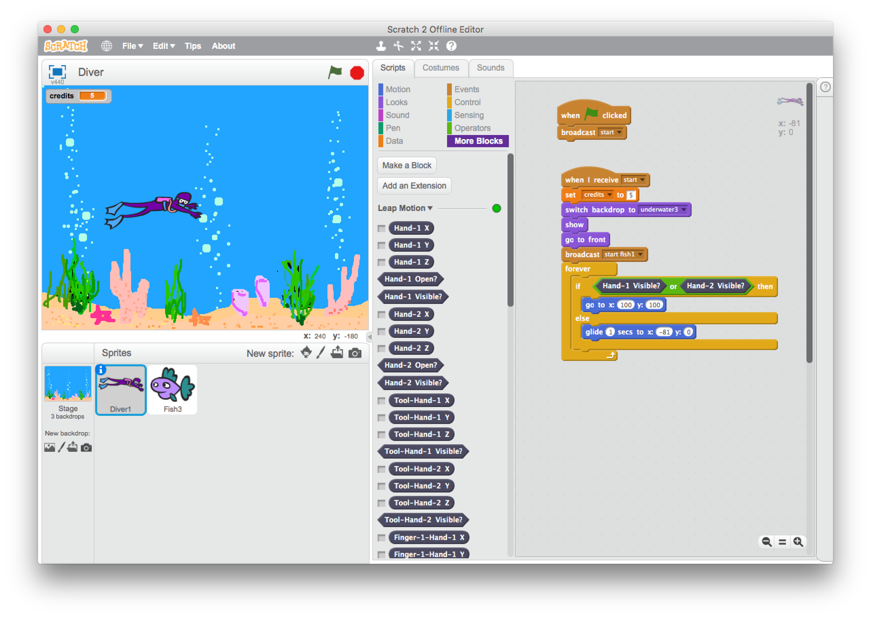
Diver
The goal of this assignment is to finish building the game.
For this, you’ll need to open the project ‘Diver.sb2’.
To do so, you choose for the menu item:
File->Open
And then: ‘Diver.sb2’

Slide 3
Diver
You see a diver under water.
Your job is to let him swim without touching any of the fish.
The game is not yet finished, because we would like:
the diver to following our hand.
to restart the game.
to be able to win the game.

Slide 4
Diver
Look what happens when you click on the green flag.
When you move your hand above the Leap Motion, the diver will move to the position x=100 and y=100. If you move your hand away from the Leap Motion, the diver will go back to the starting point.

Slide 5
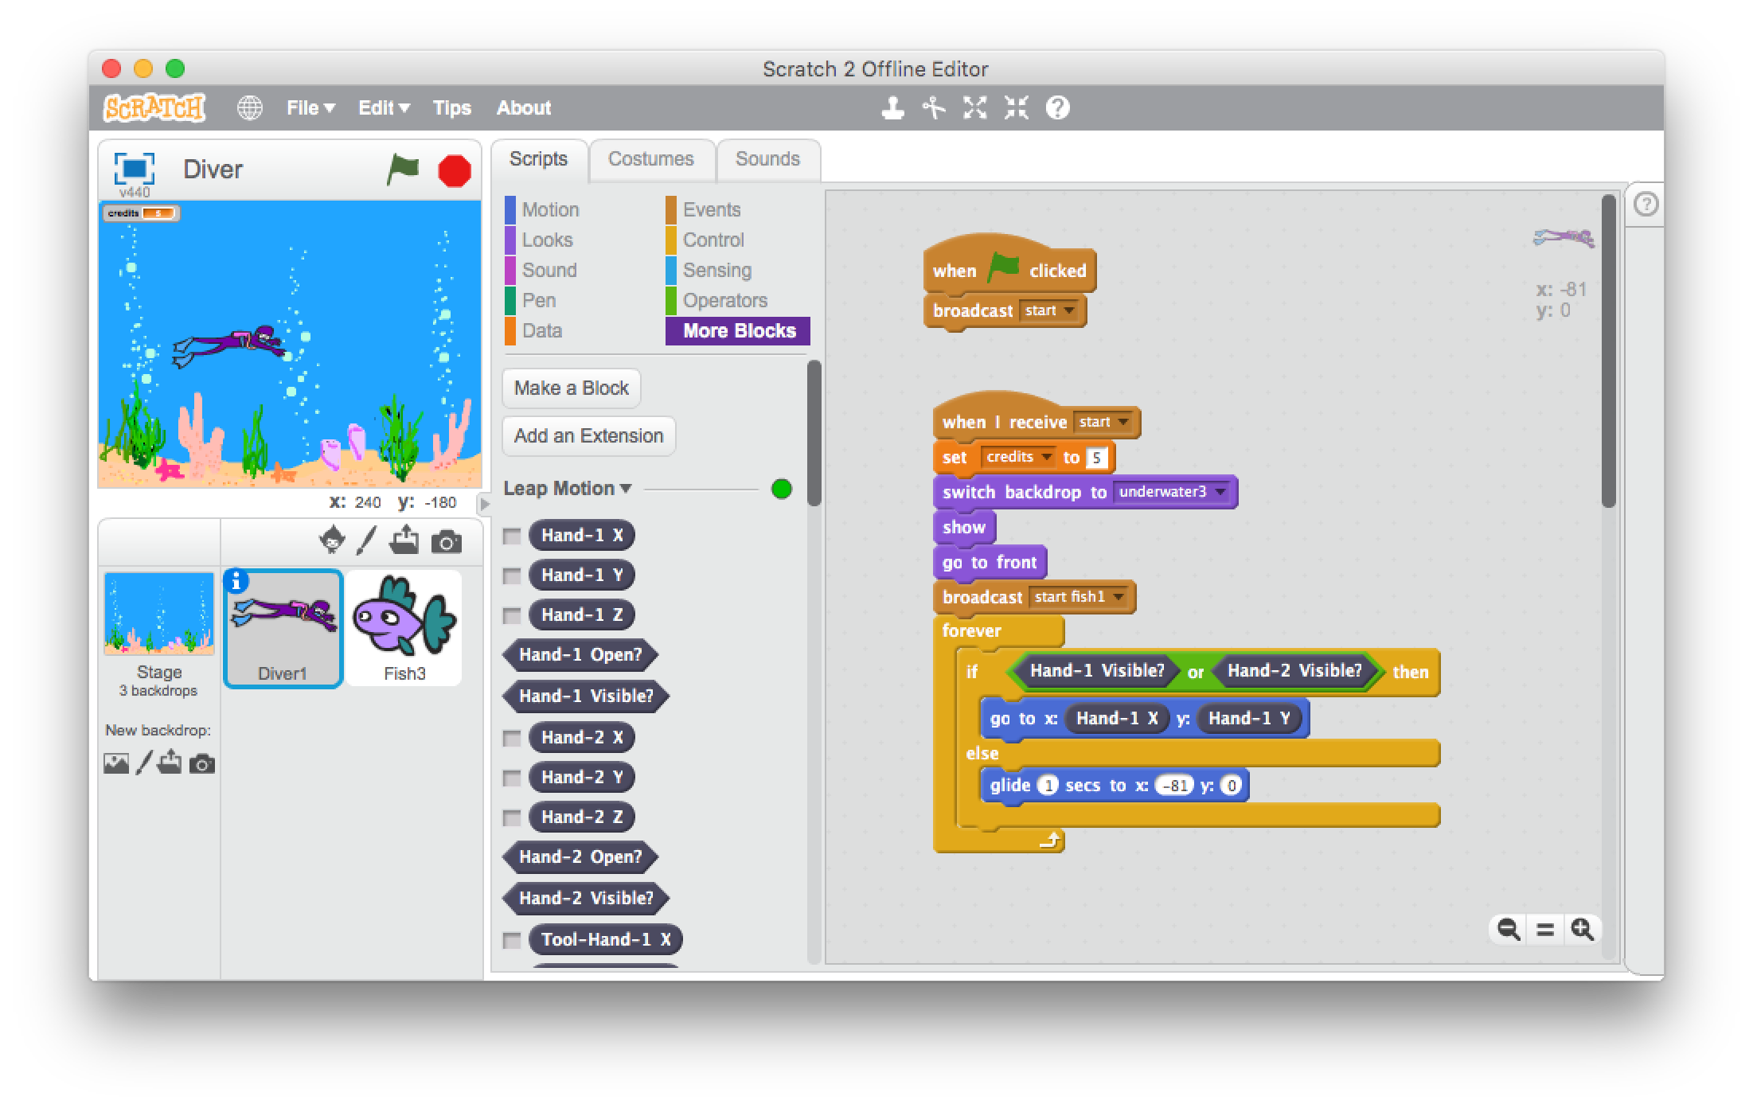
Diver
But… we would like the diver to follow our hand gestures.
Click the diver in the Sprite panel.
On the program panel you’ll see the building blocks that control the diver’s movement.
Click on ‘More blocks’.
Then drag the building block ‘Hand-1 X’ to the program panel and put it in the x field of building block ‘go to x: 100 y: 100’.
Do the same for ‘Hand-1 Y’

Slide 6
Diver
Now click on the green flag. When you move your hand above the Leap Motion, the diver will follow your hand movements. If you move your hand away, the diver will move back to the starting point.

Slide 7
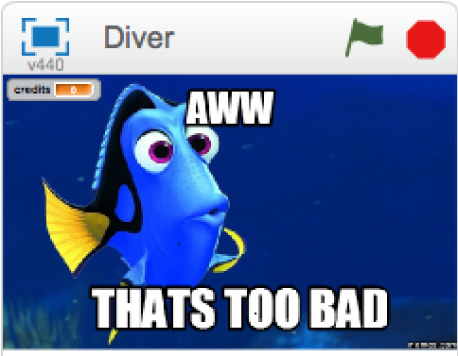
Diver
Ok, we’ve already finished one goal.
the diver to following our hand.
to restart the game.
to be able to win the game.
Now let’s make the game restartable.
We do so by adding a new button sprite.

Slide 8
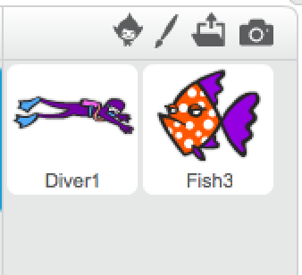
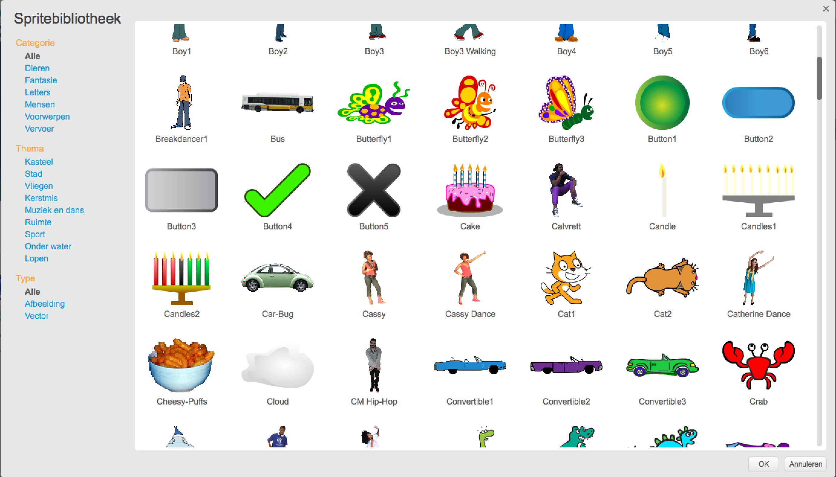
Diver
You can add a new sprit by clicking
on the head in the sprite panel.
Then find the button and click ‘OK’.

Slide 9
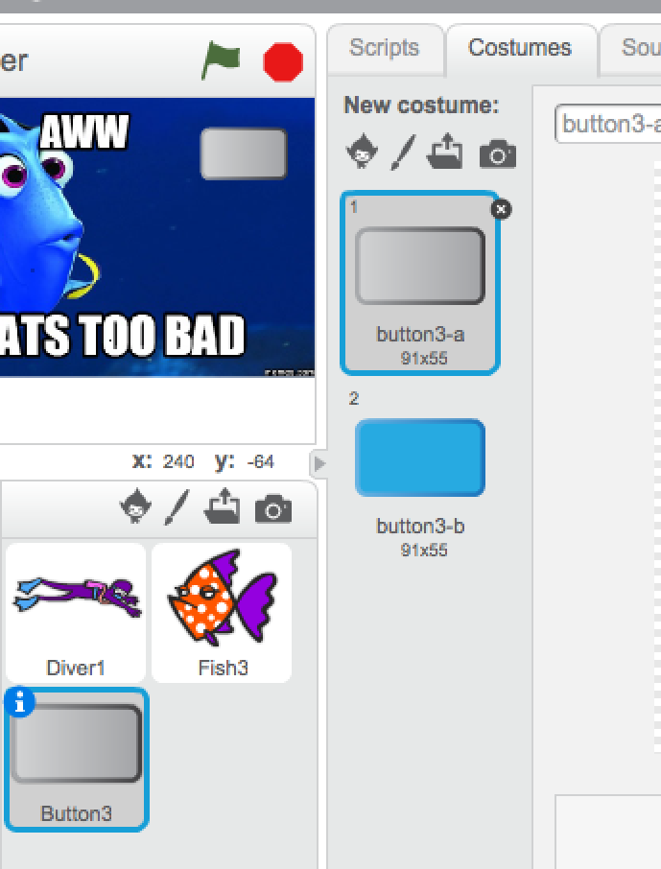
Diver
Choose a nice place for the button using the mouse.
But it’s just a button. Let’s write a text on it
Click the ‘Costumes’ tab.

Slide 10
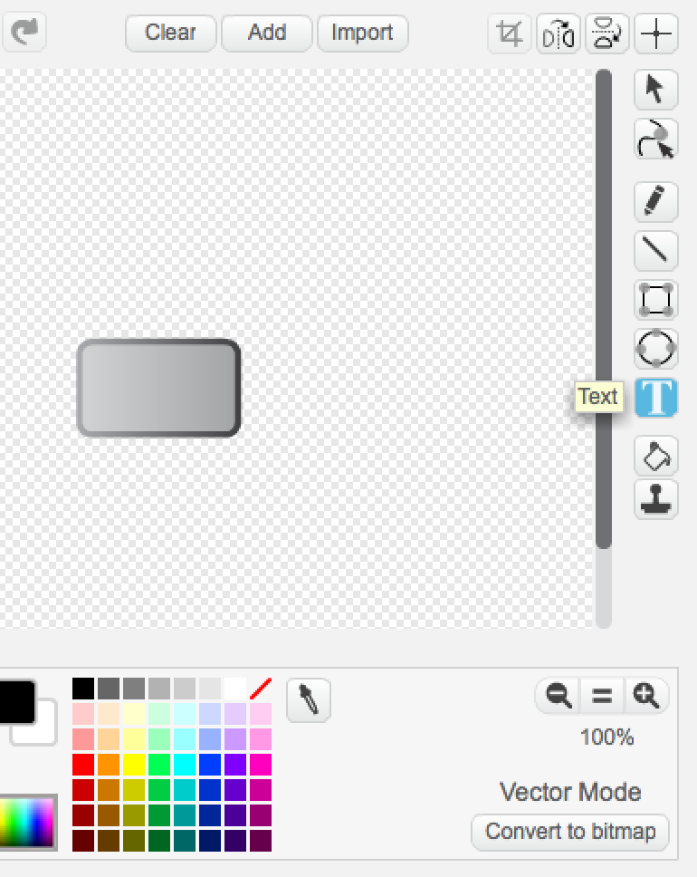
Diver
With your mouse, click the ‘T’ button and then click on your new button.
Now you can type a word. The word ‘Restart’ should fit perfectly.
Press the ‘Esc’ key on the keyboard and (if needed) move the word to make it align in the center nicely.

Slide 11
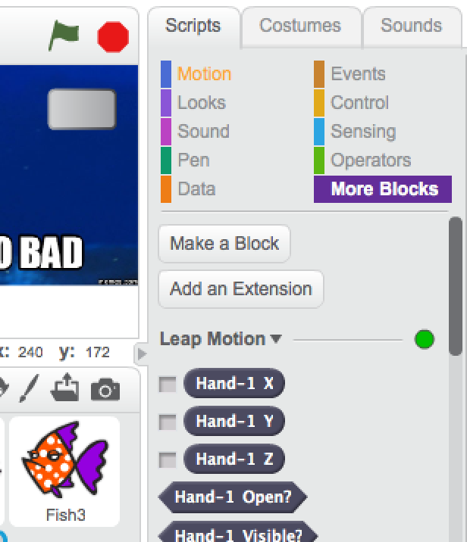
Diver
Now we need to make the button actually do something:
Appear on the ‘end game’ screen.
Disappear when clicked.
We need building blocks that control the button.
Click the ‘Scripts’ tab.

Slide 12
Diver
In Scratch your sprites can send messages. Other sprites in your Scratch program can then listen to these messages.
In this game a message is sent when the game starts and when it ends.
These messages are good ways to control your button.

Slide 13
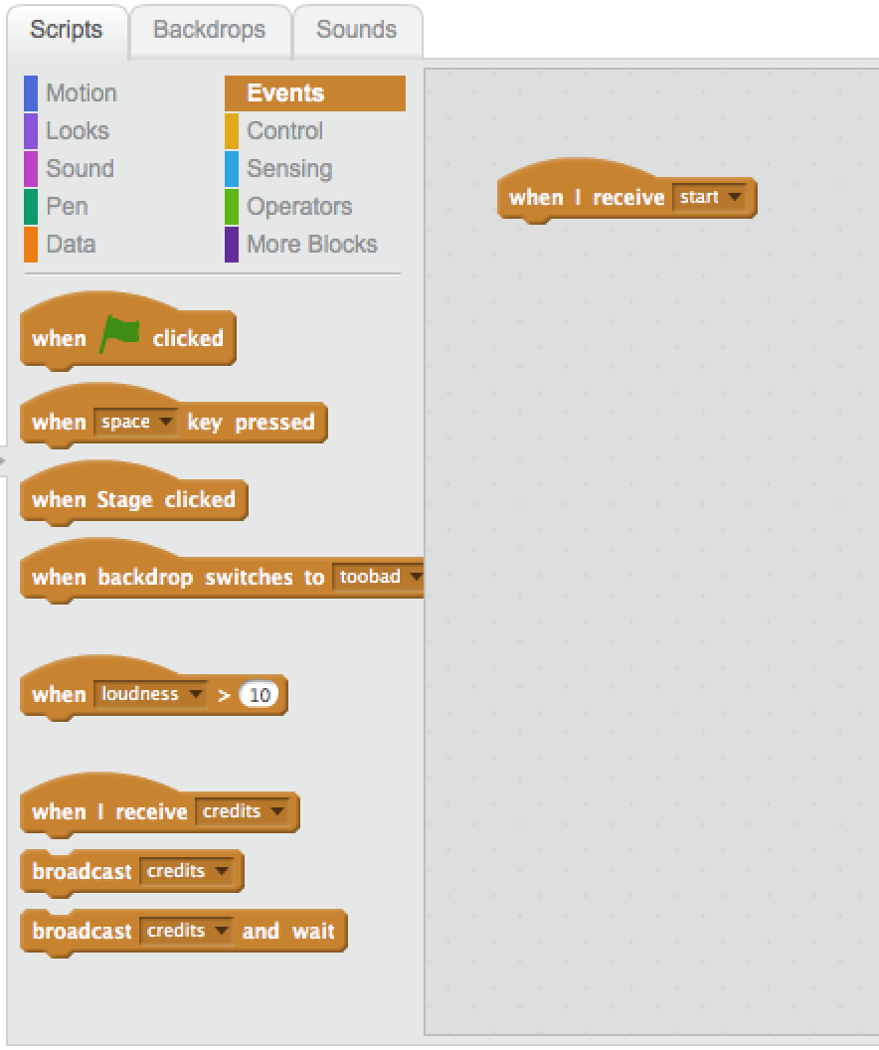
Diver
Click the ‘Events’ building blocks.
Then drag the building block
‘when I receive …’ to the program panel and choose start from the list.

Slide 14
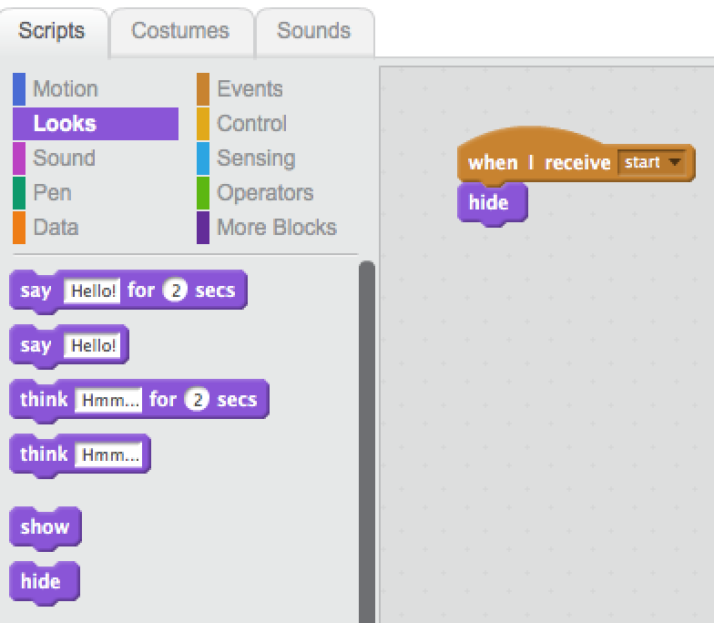
Diver
Click the ‘Looks’ building block.
Then drag the building block ‘hide’ to the program panel and attach it underneath the other block.
Now the button will disappear when the game starts.

Slide 15
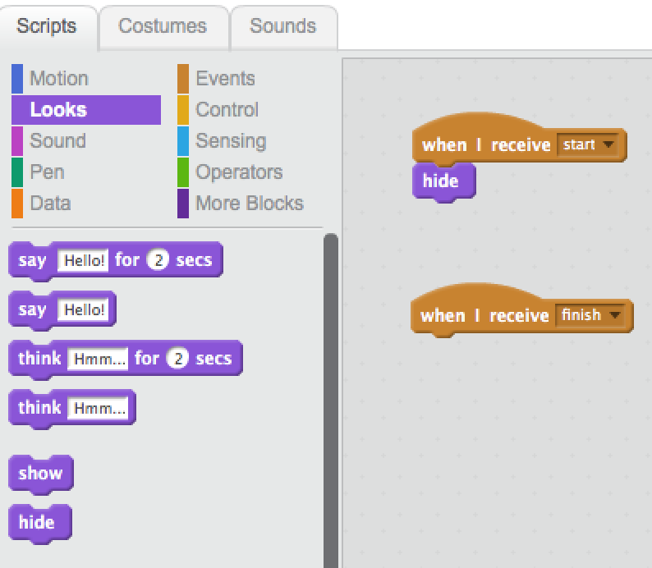
Diver
When the finish message is sent, the button also needs to do something.
Click the ‘Events’ building block.
Drag the building block ‘when I receive …’ to the program panel and select finish from the list.

Slide 16
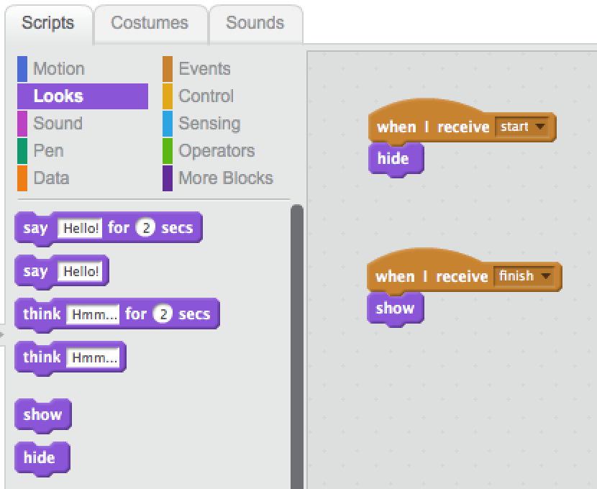
Diver
When the finish message is sent, the ‘Restart’ button has to appear.
Click the ‘Looks’ building blocks.
Drag the building block ‘show’ to the program panel and attach it underneath the other builing block.

Slide 17
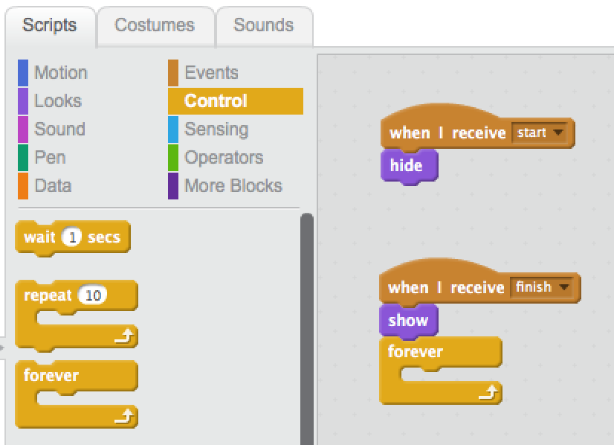
Diver
Our program has to wait for the player to move the mouse over the button.
To wait, we can use the ‘forever’ building block.
Click on ‘Control’.
Then drag the building block ‘forever’ to the program area and attach it underneath the ‘show’ block you just placed.

Slide 18
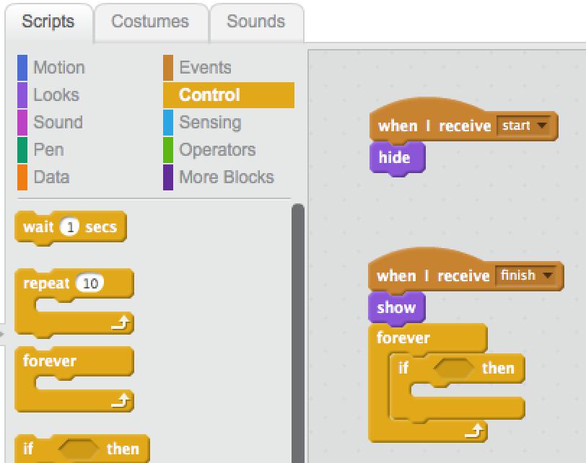
Diver
We’re waiting, but now we need to check if the player is moving the mouse.
To do so, we can use the ‘if <> then’ building block.
Drag it to the program panel, inside the ‘forever’ block.

Slide 19
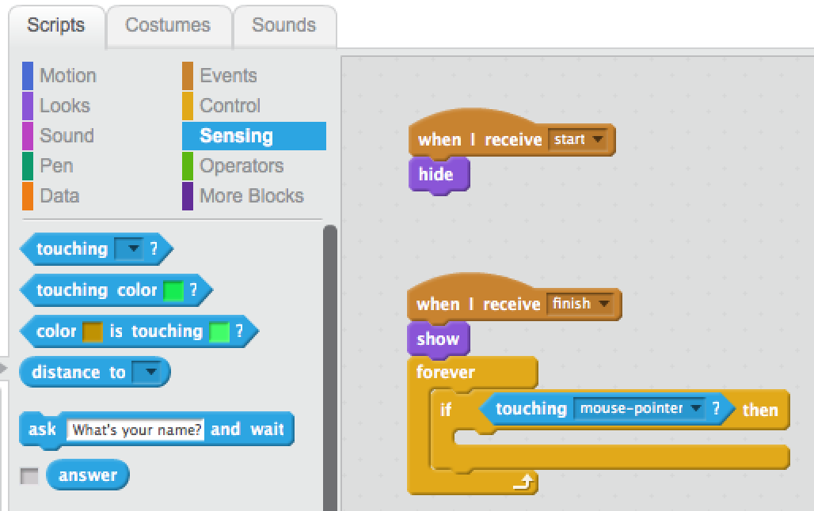
Diver
If the mouse touches the button, we want it to react.
For this, you click the ‘Sensing’ building blocks.
Then drag the building block ‘touching …?’ in the ‘if <> then’ block.
Choose ‘mouse-pointer’ from the list.

Slide 20
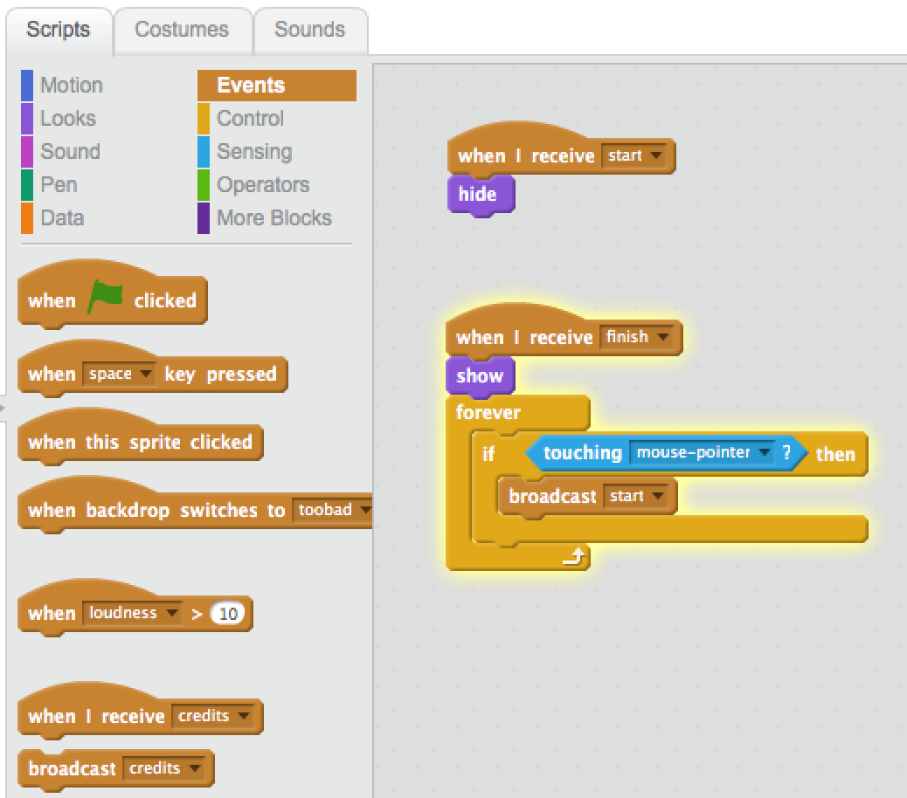
Diver
We want to restart the game when the mouse moves over the button.
In other words, we want to send a ‘start’ message.
Click ‘Events’.
Drag the building block ‘broadcast ….’ to the program and put it in the ‘if touching mouse-pointer? then’ block.
Choose start from the list.

Slide 21
Diver
Let’s check another one of our goals
the diver to following our hand.
to restart the game.
to be able to win the game.
Now we’re going to make sure the player can actually win the game.
For this, we’re going to make starfishes float around in the water.
When the diver hits one, he gets 1 point.
At 10 points the game is won.

Slide 22
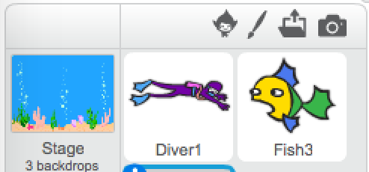
Diver
To make it easier, we already made the starfishes for you.
Add these to the program by clicking the folder in the sprits screen.
Then choose ‘diver.starfish’

Slide 23
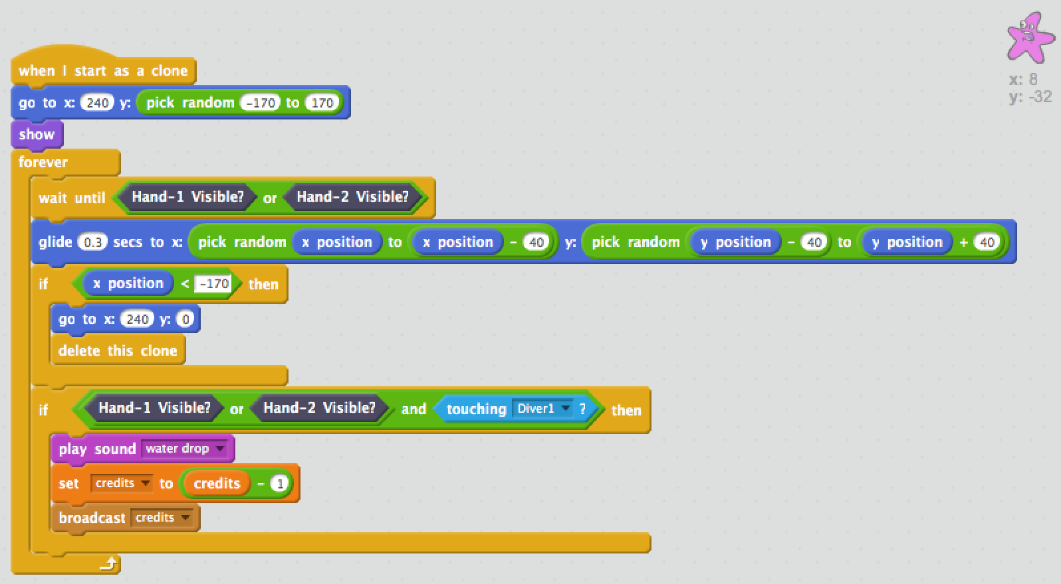
Diver
If the starfish is loaded, you’ll see all the building blocks that control the starfish.
But something is wrong!
If the diver hits a starfish, he still loses a point, while he should get 1 point.
So we need to make a change to the building blocks.

Slide 24
Diver
When our hands are visible to the Leap Motion, and the diver is hit by a starfish, the following happens:
A sound is played.
The credits are decreased by one.
A credits message is broadcasted.
But the credits shouldn’t
decrease, but increase!

Slide 25
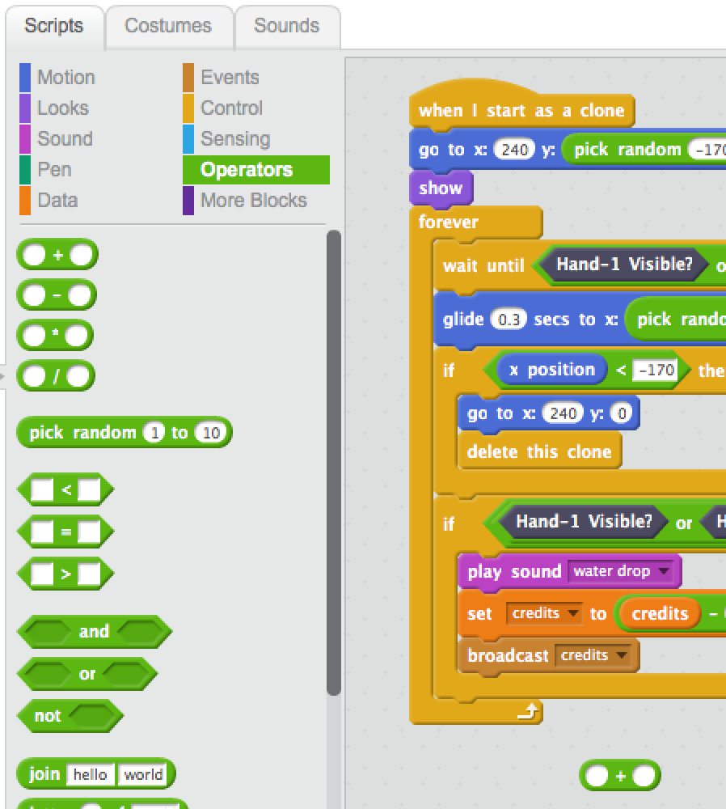
Diver
Click ‘Operators’.
Drag the ‘0 + 0’ building block to your program.

Slide 26
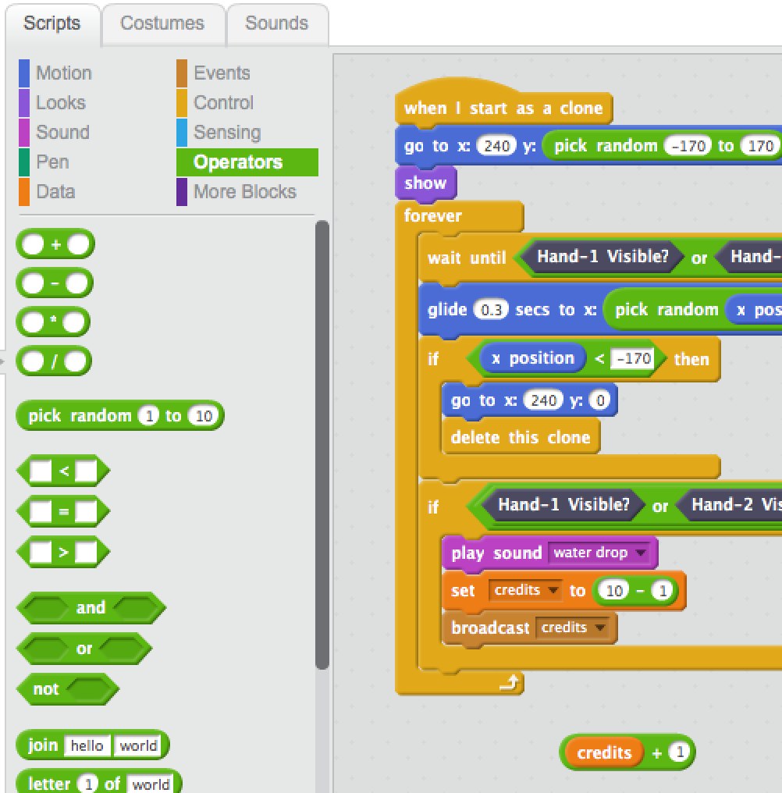
Diver
Drag the building block with ‘credits’ to the left side of building block ‘0 + 0’.
Type a ‘1’ in the right side of the building block ‘0 + 0’.

Slide 27
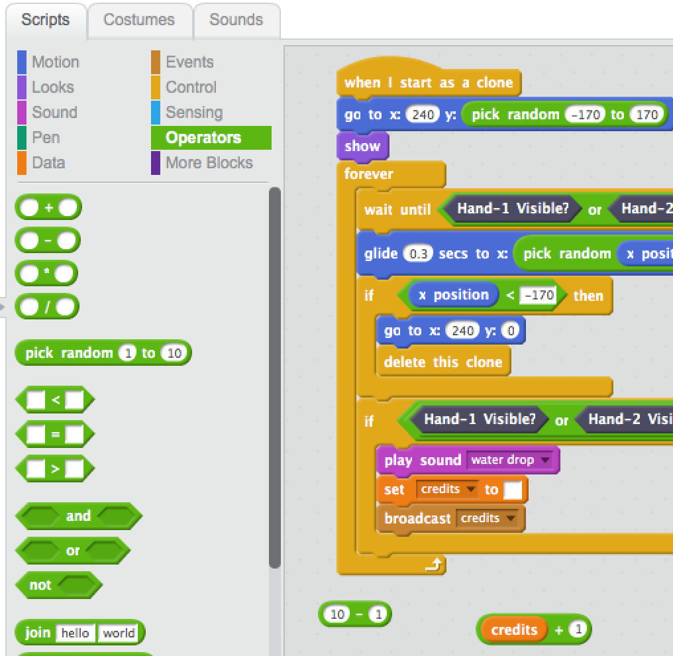
Diver
Now drag the building block with ‘10 - 1’ to the panel with building blocks. This will make it disappear.
And drag the building block with ‘credits + 1’ in it to building block
‘set [credits] to []’

Slide 28
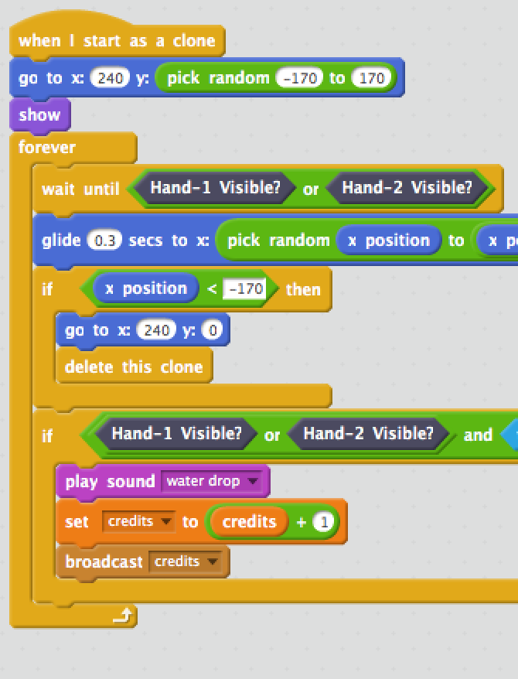
Diver
Now the game will work correctly when the diver hits a starfish.
Try it. The game should be complete now.
the diver to following our hand.
to restart the game.
to be able to win the game.

