Slide 1


Programmeren Basketbal

Slide 2
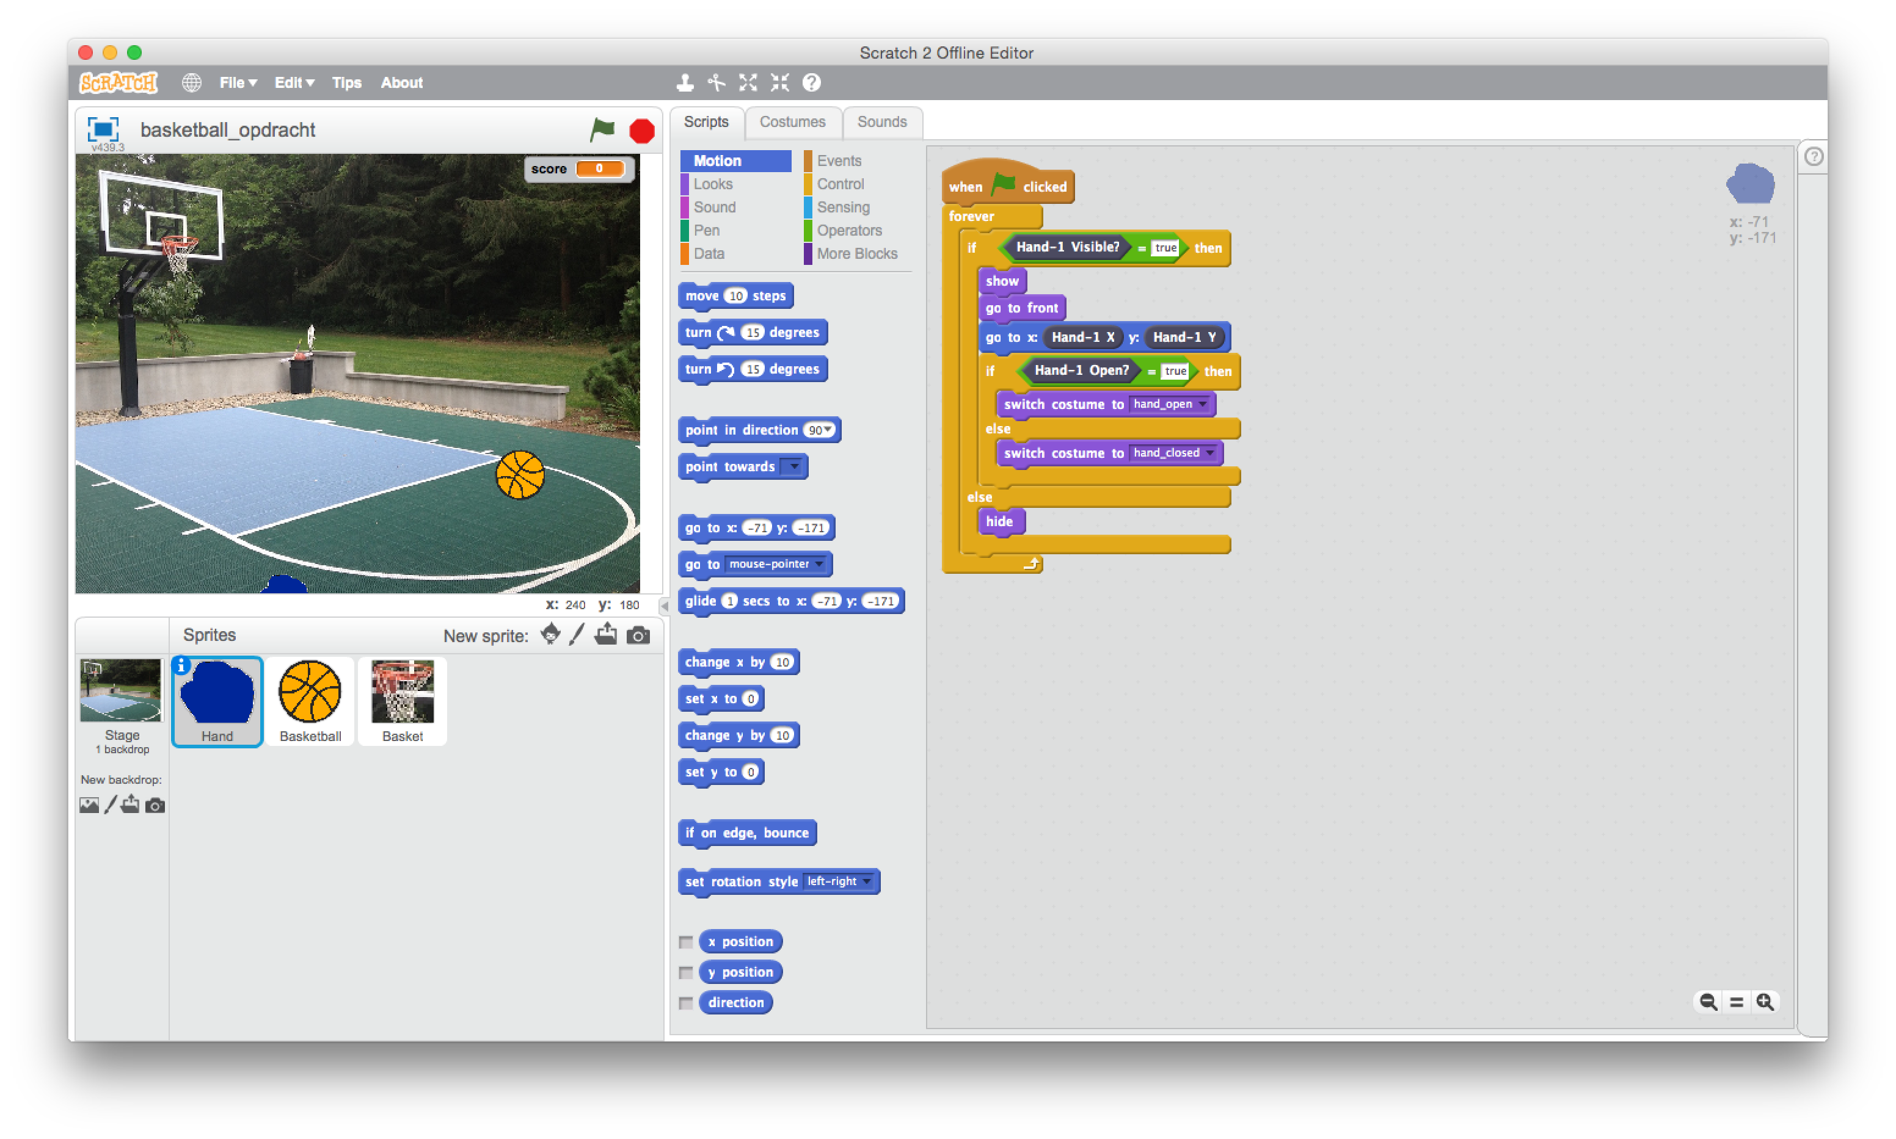
Basketball
In this assignment you have to finish a game.
Start by opening the project ‘Basketball.sb2’.
To do that, go to the file menu:
File->Open
Select ‘Basketball.sb2’ and click OK.

Slide 3
Basketball
You see a basketball court and a ball.
The goal of the game is for you to get the ball into the basket using your hand. Once the game starts, the ball starts to move around.
The game is not working properly yet:
You cannot pickup and hold the ball.
You cannot score yet.

Slide 4

Basketball
Check out what happens when you click the green flag.
When your hand moves above the leap motion device, you will see a blue hand on the screen. When you close your hand the hand on te screen closes as well.
When you grab the bal with your hand a sound is played.

Slide 5
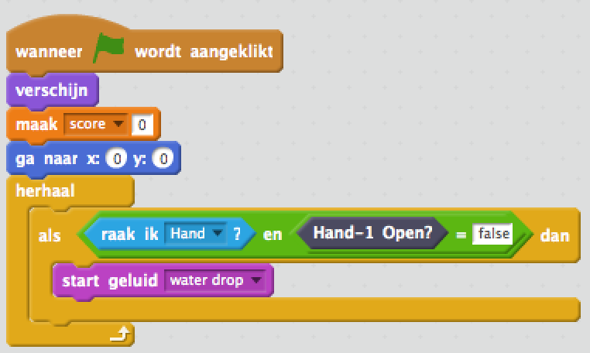
Basketball
But we want to be able to put the ball in the basket.
Click on the basketball on the screen (in the sprites section)
In the script area the building blocks are shown that will control the ball and its movements.
Study the script and find the spot where the sound is played when touching the ball with your hand.

Slide 6
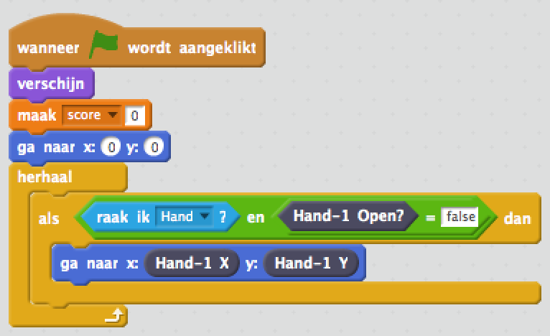
Basketball
Now lets make it possible to grab the basketball.
Remove the building block that plays the sound
Select the ‘Motion’ building blocks and drag the block with ‘go to x: 0 y: 0’ to the script area to the same position as where the sound block was.
Select ‘More Blocks’.
Drag the block ‘Hand-1 X’ to the opening in ‘go to x’.
Now drag the block ‘Hand-1 Y’ to the opening at ‘y’.
Start the game. You should now be able to grab the basketball and it will follow your hands movements.

Slide 7
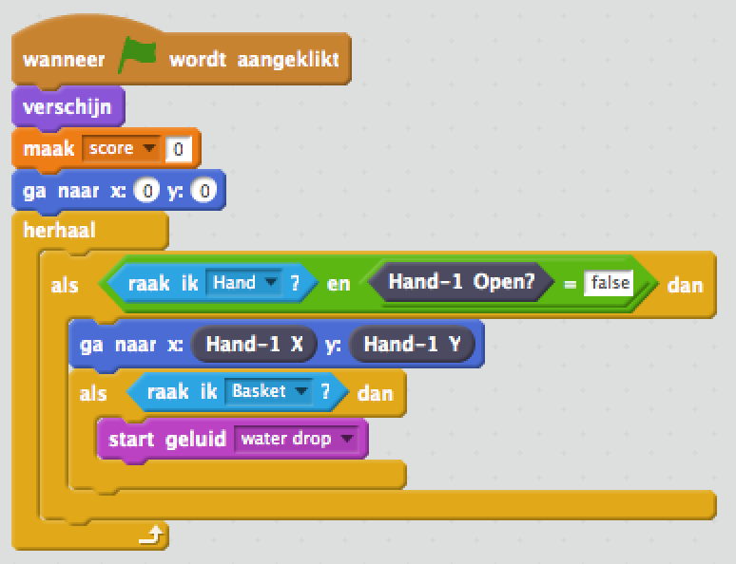
Basketbal
Now we still need to add the ability to score a goal!
Select ‘Control’ and drag the building block ‘if… then’ to the script area underneath the ’go to’ block.
Select ‘Sensing’ and drag the block ‘touching…?’ to the open spot within the block ‘if … then’.
Drag the block ’start sound’ from ’Sound’ to the spot underneath the ‘if … then’ block and choose a sound.
Start the game. When you grab the ball and bring it to the basket you will here a sound.

Slide 8
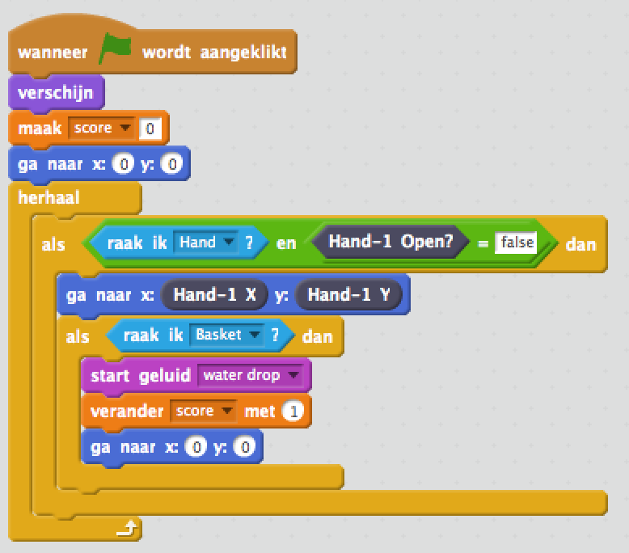
Basketbal
We are almost done! Now we need to keep score and make sure the ball is moving away from the basket after a score.
Select ‘Data’ and drag the block ‘change … by’ to the script area underneath the ’start geluid’ block. Select ’score’ and make sure it is increased by 1.
Select ‘Motion’ and drag the block ‘Go to x: 0 y: 0’ to the program area underneath the ‘change … by’ block.
Continue on the next page…

Slide 9
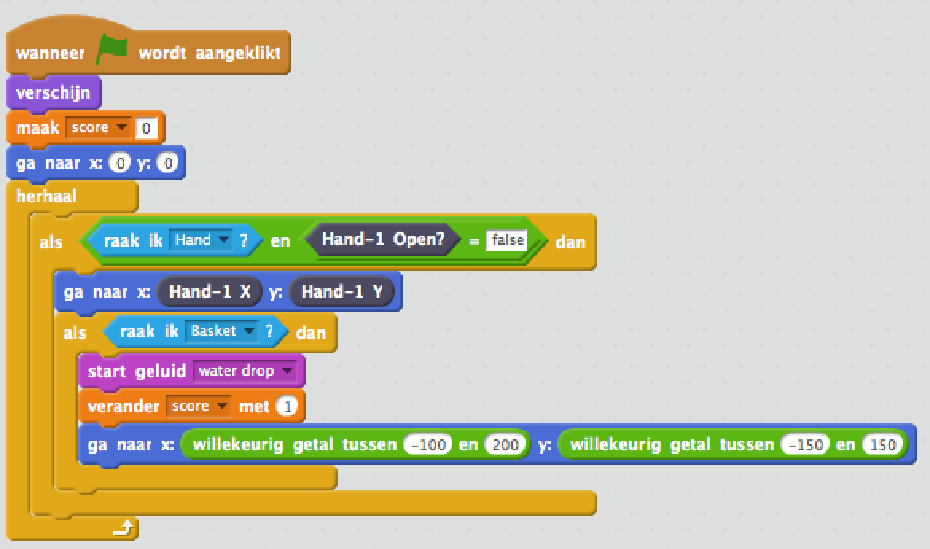
Basketbal
Select ‘Operators’ and drag the block ‘pick random …’ to the open spot in ’go to x’. Do the same at the opening for ’y’.
Enter for ’go to x’ at ‘pick random …’ -100 and 200.
Enter for ’y’ at ’pick random …’ -150 and 150. This causes the ball to start moving around again after a score.
Try the game. See if you can score 5 times in a row!

