Slide 1

Python Lecture 2 – Programming
Data types
Lambda expressions
Input
Flow control instructions
Iterators
Simple matrix examples

Slide 2
Bibliography and learning materials
Bibliography:
https://www.python.org/doc/
http://docs.python.it/
and much more available in internet
Learning Materials:
https://github.com/gtaffoni/Learn-Python/tree/master/Lectures
https://github.com/bertocco/bash_lectures

Slide 3
Data types
Python has two families of data types:
Simple data types:
– Int
– Float
– Complex
– Boolean
– String
Container data types:
– list []
– tuple ()
– dict {}
– set
Notes:
• Uno dei punti di forza di Python è nei contenitori disponibili, che sono molto efficienti, comodi da usare, e versatili:

Slide 4
Simple Data Types
– Int
– Float
– Complex
– Boolean
– String
Notes:
• It used to be that there was an int type and a long type, and values were automatically promoted from int to long when they got too large (or too small) for int to hold them anymore. long used as many bytes as is necessary to hold the value at the cost of some performance.
It was possible, however, to have a long that could have been an int, and there was special literal syntax for long values. That is, 0L was zero as a long, whereas 0 was zero as an int. These values were equal, but still of different types.
In Python 3, these two types were unified. There is only one type, but its internal representation uses either a machine integer (32-bit or 64-bit depending on version of Python) or an arbitrary-length integer (like long) as needed.

Slide 5
Numeric types
In python there are 3 numeric types:
In general, an n-bit integer has values ranging
from -2^(n-1) to 2^(n-1) – 1
information about integer dimension:
>>> sys.maxsize
9223372036854775807
information about the internal representation of floating point
>>> sys.float_info
sys.float_info(max=1.7976931348623157e+308, max_exp=1024, max_10_exp=308, min=2.2250738585072014e-308, min_exp=-1021, min_10_exp=-307, dig=15, mant_dig=53,
epsilon=2.220446049250313e-16, radix=2, rounds=1)
• Integer
• Float
• Complex
• + Boolean (extension of int)
Notes:
• It used to be that there was an int type and a long type, and values were automatically promoted from int to long when they got too large (or too small) for int to hold them anymore. long used as many bytes as is necessary to hold the value at the cost of some performance.
It was possible, however, to have a long that could have been an int, and there was special literal syntax for long values. That is, 0L was zero as a long, whereas 0 was zero as an int. These values were equal, but still of different types.
In Python 3, these two types were unified. There is only one type, but its internal representation uses either a machine integer (32-bit or 64-bit depending on version of Python) or an arbitrary-length integer (like long) as needed.

Slide 6
Numeric types: Examples
int type can be:
in base 2 (using the prefix 0b) bin(19)
in base 10,
in base 16 (using the prefix 0x) hex(300)
in base 8 (using the prefix 0) oct(300)
>>> a=300
>>> oct(a)
'0454'
>>> hex(a)
'0x12c'
>>> bin(a)
'0b100101100'
>>> bin(19)
'0b10011'
Notes:
• int and long were "unified" a few versions back. Before that it was possible to overflow an int through math ops.
3.x has further advanced this by eliminating int altogether and only having long.
Python 2: sys.maxint contains the maximum value a Python int can hold.
On a 64-bit Python 2.7, the size is 24 bytes. Check with sys.getsizeof().
Python 3: sys.maxsize contains the maximum size in bytes a Python int can be.
This will be gigabytes in 32 bits, and exabytes in 64 bits.
Such a large int would have a value similar to 8 to the power of sys.maxsize.

Slide 7
Numeric types
float are real number in double precision.
Examples:
>>> a = 12.456
>>> c = 12232e-2
>>> b = .2
>>> a=6.12244e-5
>>> type(a)
<class 'float'>
Be careful using int and float:
What happens doing...
100/3 division int/int
100//3 floor division int/int (gets the integer part)
100.0/3 division float/int
100.0//3 floor division float/int
100%3 remainder of the division int/int
divmod(100,3) The divmod() method takes two numbers and returns a pair of
numbers (a tuple) consisting of their quotient and remainder.
Note: floor (troncamento) function is the function that takes as input a real number x and gives as output the greatest integer less than or equal to x.
floor: 2.1 → 2 -0.1 → -1
The ceiling (arrotondamento) function maps x to the least integer greater than or equal to x
ceiling: -0.99 → 0 2.1 → 3
Notes:
10/4=2,5 <----normal division
10//4=2 <----floor division
it basically cuts of the part after the period
If you imagine a room where 3 is on the ceiling and 2 is on the floor. 2.5 would fit in the middle. Floor division means the "//" will always take the floor or the lower number.

Slide 8
Numeric types
Complex Number represents a complex number in double precision.
The real and the imaginary parts can be accessed using the functions
‘real’ and ‘imag’.
Example:
>>> r=12+5j # ‘j’ symbol means the imaginary part
>> r=10+5j
>>> type(r)
<class 'complex'>
>>> r.real
12.0
>>> r.imag
5.0
>>> type(r.real)
<type 'float'>
>>> type(r.imag)
<type 'float'>
Notes:
a

Slide 9
Operations on numeric types
In Python operations on numeric types are managed by the following operators:
• Arithmetic operators
• Comparison operators
• logical operators
• bitwise (bit a bit) operators
• membership operators
• identity operators
Some built-in functions working on numeric data:
- abs(number) returns the absolute value of a number
- pow(x, y[, z]) returns the value of x to the power of y (x^{y}). If a third parameter is present, it returns x to the power of y, modulus z.
- round(number[, ndigits]) returns a floating point number that is a rounded version of the specified number, with the specified number of decimals.
Executing operations between different numeric type variables,
the implicit conversion rule is:
Int Float Complex
Notes:
la funzione modulo, indicato con mod {\displaystyle \operatorname {mod} } {\displaystyle \operatorname {mod} }, che dà come risultato il resto della divisione euclidea del primo numero per il secondo

Slide 10
Arithmetic operators
a=10 b=21
/ Floor Division
Operator | Description | Example
+ Addition | Adds values on either side of the operator. | a+b=31
- Subtraction | Subtracts right hand operand from left hand operand. | a-b=-11
* Multiplication | Multiplies values on either side of the operator | a*b=210
/ Division | Divides left hand operand by right hand operand | b/a=2.1
% Modulus | Divides left hand operand by right hand operand and returns remainder | b%a=1
** Exponent | Performs exponential (power) calculation on operators | a**b=10²⁰
// Floor division | The division of operands where the result is the quotient in which the digits after the decimal point are removed. But if one of the operands is negative, the result is floored, i.e., rounded away from zero (towards negative infinity) | 9//2 = 4 9.0//2.0 = 4.0, -11//3 = -4, -11.0//3 = -4.0
https://www.tutorialspoint.com/python3/python_basic_operators.htm
Notes:
la funzione modulo, indicato con mod {\displaystyle \operatorname {mod} } {\displaystyle \operatorname {mod} }, che dà come risultato il resto della divisione euclidea del primo numero per il secondo

Slide 11
Comparison operators
a=10 b=20
Operator | Description | Example
== | If the values of two operands are equal, then the condition becomes true. | (a == b) is not true
!= | If values of two operands are not equal, then condition becomes true. | (a!= b) is true
> | If the value of left operand is greater than the value of right operand, then condition becomes true. | (a > b) is not true
< | If the value of left operand is less than the value of right operand, then condition becomes true. | (a < b) is true
>= | If the value of left operand is greater than or equal to the value of right operand, then condition becomes true. | (a >= b) is not true
<= | If the value of left operand is less than or equal to the value of right operand, then condition becomes true. | (a <= b) is true
(a > b) is not true
https://www.tutorialspoint.com/python3/python_basic_operators.htm
Notes:
la funzione modulo, indicato con mod {\displaystyle \operatorname {mod} } {\displaystyle \operatorname {mod} }, che dà come risultato il resto della divisione euclidea del primo numero per il secondo

Slide 12
Bitwise Operators
Bitwise operator performs bit-by-bit operation.
Examples:
a = 60 and b = 13 in binary format they will be
a = 0011 1100
b = 0000 1101
a&b = 0000 1100
a|b = 0011 1101
a^b = 0011 0001
~a = 1100 0011
Python's built-in function bin() can be used to obtain binary representation of an integer number.
https://www.tutorialspoint.com/python3/python_basic_operators.htm
Notes:
la funzione modulo, indicato con mod {\displaystyle \operatorname {mod} } {\displaystyle \operatorname {mod} }, che dà come risultato il resto della divisione euclidea del primo numero per il secondo

Slide 13
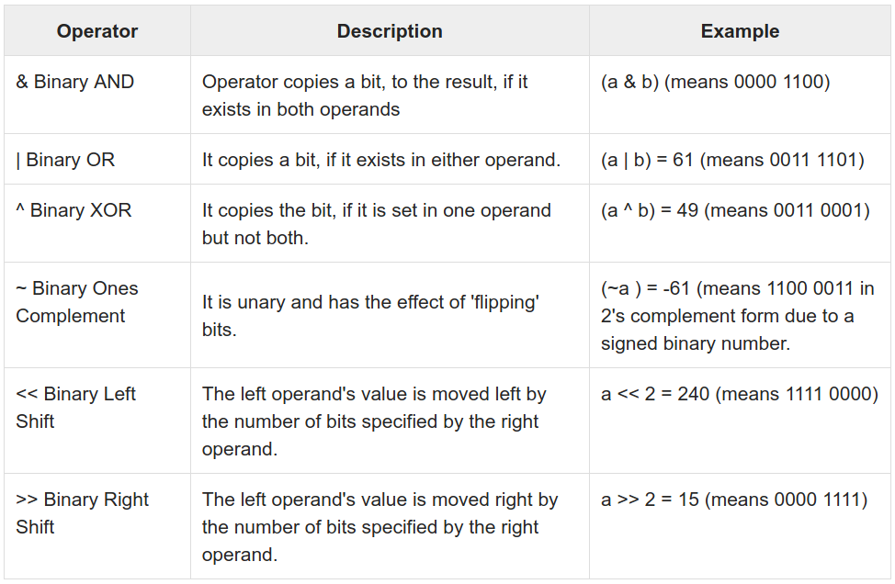
Bitwise Operators
https://www.tutorialspoint.com/python3/python_basic_operators.htm
Notes:
la funzione modulo, indicato con mod {\displaystyle \operatorname {mod} } {\displaystyle \operatorname {mod} }, che dà come risultato il resto della divisione euclidea del primo numero per il secondo

Slide 14
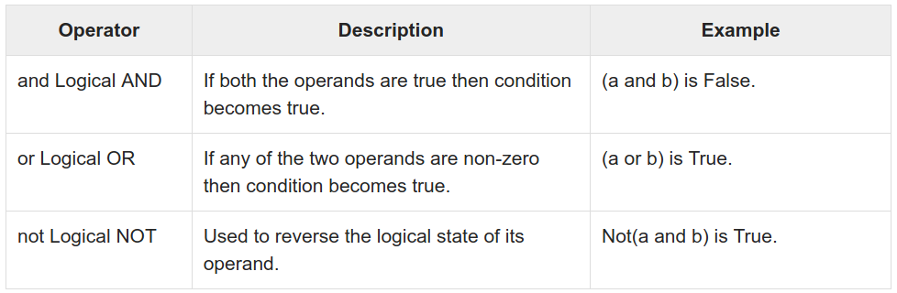
Logical Operators
https://www.tutorialspoint.com/python3/python_basic_operators.htm
Notes:
la funzione modulo, indicato con mod {\displaystyle \operatorname {mod} } {\displaystyle \operatorname {mod} }, che dà come risultato il resto della divisione euclidea del primo numero per il secondo

Slide 15
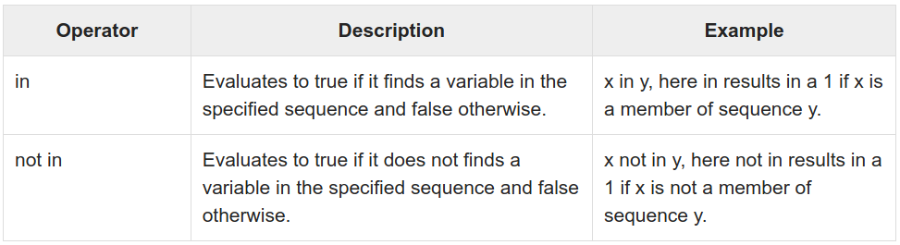
Membership Operators
https://www.tutorialspoint.com/python3/python_basic_operators.htm
Notes:
la funzione modulo, indicato con mod {\displaystyle \operatorname {mod} } {\displaystyle \operatorname {mod} }, che dà come risultato il resto della divisione euclidea del primo numero per il secondo

Slide 16
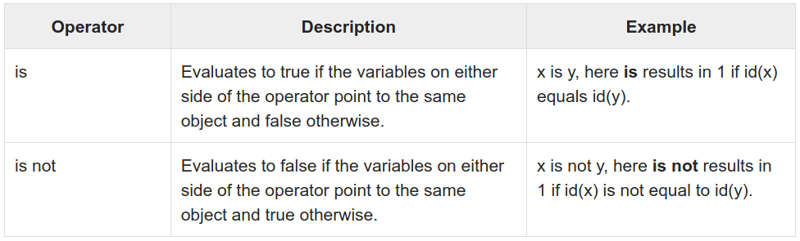
Identity Operators
https://www.tutorialspoint.com/python3/python_basic_operators.htm
Notes:
la funzione modulo, indicato con mod {\displaystyle \operatorname {mod} } {\displaystyle \operatorname {mod} }, che dà come risultato il resto della divisione euclidea del primo numero per il secondo

Slide 17
Examples: Operations on numeric types
>>> k=5
>>> s=5+1j # imaginary part cannot be only j
>>> type(s+k) # imaginary number conversion
<type 'complex'>
>>> 4 and 2 # logical comparison
2
>>> 4 & 2 # bitwise comparison between the binaries 100 and 010
0
>>> 4 | 2 # bitwise comparison between the binaries 100 and 010
6
Notes:
a

Slide 18
Operations on numeric types: math module
The math module provides some of the more commons mathematical operations.
It does not work with complex numbers.
cmath module works for complex numbers.
The available functions are:
• Trigonometric functions: cos, sin, tan, asin, acos, atan, sinh, cosh, tanh.
• Exponentiaiton and logarithmic functions: pow, exp, log, log10, sqrt
• Angles representation and conversions: degrees, radians, ceil , floor, fabs
In the math module are defined the numerical constants pi and e
>>> import math
>>> math.pi
3.141592653589793
>>> math.e
2.718281828459045
Notes:
a

Slide 19
Bool type
Booleans True and False are available in Python.
bool is a subclass of int
True corresponds to 1
False corresponds to 0
Integer values can be used to reprsent boolean values with the following convention:
0 corresponds to False
all integer values greater than zero correspond to True
It is good practice to use the bool type to represent boolean values.
Example:
>>> a=1
>>> type(a)
<type 'int'>
>>> if(a):
print 'True'
True
>>> a=False
>>> type(a)
<type 'bool'>
Notes:
a

Slide 20
String type
Literal strings are character sequences enclosed in quotes, single or double.
Creating strings is as simple as assigning a value to a variable.
Sequences of triple ‘double quotes’ or triple ‘single quotes’ can be used to assign strings spanning in more than one row or containing single or double quotes of the other type.
Example 1:
>>> a="""I am a string spanning in 3 rows,
... containing 'sigle quotes',
... containing "double quotes",
... containing '''triple quotes'''
... """
>>> print(a)
I am a string spanning in 3 rows,
containing 'sigle quotes',
containing "double quotes",
containing '''triple quotes'''
Example 2:
>>> b='''I am a string spanning in 3 rows,
... containing 'sigle quotes',
... containing "double quotes",
... containing """triple quotes"""
... '''
>>> print(b)
I am a string spanning in 3 rows,
containing 'sigle quotes',
containing "double quotes",
containing """triple quotes"""
Notes:
a

Slide 21
String type
We can create strings by enclosing characters in quotes (single or double).
Creating strings is as simple as assigning a value to a variable.
Example:
var1 = 'Hello World!'
var2 = "Python Programming"
To access substrings, use the square brackets for slicing along with the index or indices to obtain your substring.
Example:
#!/usr/bin/python3
var1 = 'Hello World!'
var2 = "Python Programming"
print ("var1[0]: ", var1[0])
print ("var2[1:5]: ", var2[1:5])
Output:
var1[0]: H
var2[1:5]: ytho
Notes:
a

Slide 22
String type
The type char does not exists. A single char can be accesed using the operator [] or slicing the string with the operator [begin:end] (slicing)
Example:
>>> a = “Hello world”
>>> a[1]
‘e’
>>> a[1:2]
‘e’
The single char can not be accessed, but a new value can be assigned to the string
Example:
>>> a=‘Primo valore’
>>> a = “Prima valore” # Ok string re-assignment
>>> a[4] = ‘o’ #Errore # NOT Ok single character assignment
File "<stdin>", line 1
a[4] = ‘o’
^
SyntaxError: invalid syntax
Notes:
a

Slide 23
String type: operators
The operators + and * can be used for string operations.
Operators priority is maintained.
Example
>>> a = ‘Hello’
>>> a+a+a # Concatenation
‘HelloHelloHello’
>>> a = ‘He’+’l’*2+’o World’ # Multiple concatenation
>>> a
‘Hello World’
It exists also the possibility to insert wherever in the string using the operator %
Example
name = "Peter"
my_string = "Hello %s" % name # Append or insert
my_string = "Hello %s, how are you? %s" % (name, 'ok') # Insert multiple values
Notes:
a

Slide 24
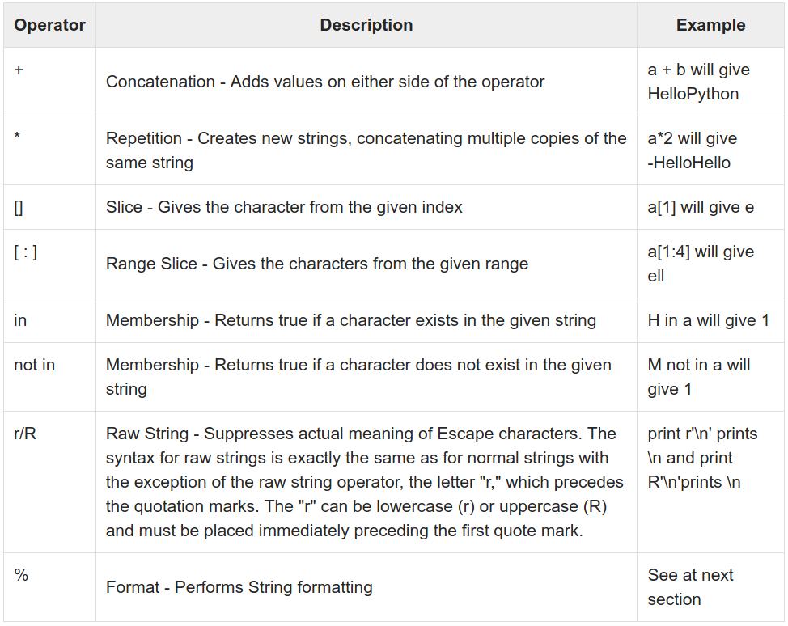
String type: operators
Notes:
a

Slide 25
String type: escape characters
Escaping allows to add special characters inside a string.
Example
>>> a = ‘What’s your name?’ #Errore
SyntaxError: invalid syntax
>>> a = “What’s your name?” # Ok if I create the string with double quotes
>>> a = ‘What\’s your name?’ # Ok if you escape the single quote character
Most common escape characters in string manipulation:
• \t Tab ‘Ciao\tciao!’ Ciao ciao!
• \n New Line ‘Ciao\nciao!’ Ciao
ciao!
• \\ Backslash ‘c:\\Programmi\\pp’ c:\Programmi\pp
• \” Double quote ‘Repeat: \”Hello\”’ Repeat: ”Hello”
• \’ Single quote “Repeat:\’Hello\’” Repeat: ‘Hello’
Notes:
a

Slide 26
String type: row string
Row string is a string preceded by r or R in front of it.
In a row string a character preceded by \ is included without changes.
Esempio
>>> a = r’Hello \t World’
#Raw string
>>> a
‘Hello \t World’
Notes:
a

Slide 27
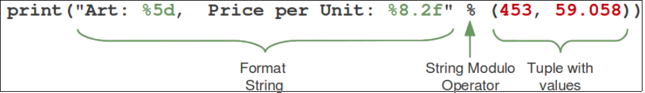
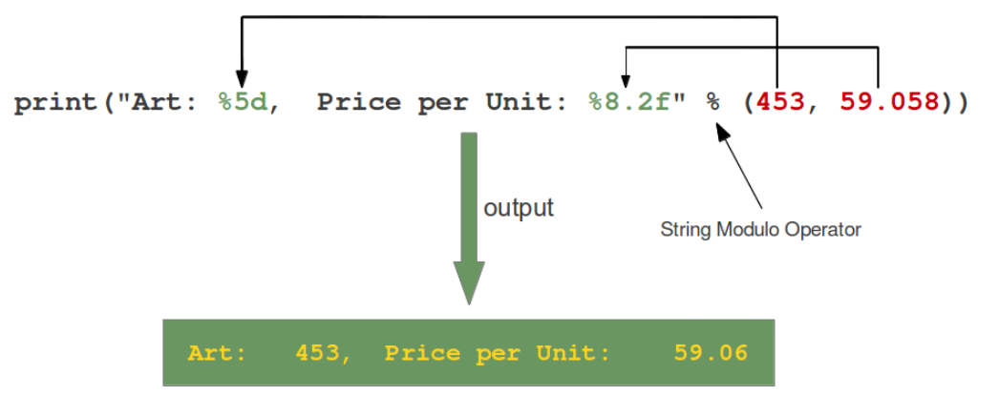
String type: format output
Python allows output formatting.
The % charactes has a special meaning when used in strings, because it is used to format output.
Notes:
a

Slide 28
String type: format output
Ther are a lot of possibility to format output.
Examples:
%s, String
%f, Floating point decimal format
%c, Single character (accepts integer or single character string)
%x, Unsigned hexadecimal (lowercase)
%o, Unsigned octal
%%, No argument is converted, results in a "%" character in the result
%e, Floating point exponential format (lowercase)
Format output: https://www.python-course.eu/python3_formatted_output.php
https://www.tutorialspoint.com/python3/python_strings.htm
Notes:
a

Slide 29
String type: format output
Example
>>> ”Oggi è %s %d %s” % (“Venerdì’’,20,”Febbraio”)
>>> print _
Oggi è Venerdì 20 Febbraio
Already seen example:
name = "Peter"
my_string = "Hello %s" % name # Append and Insert
my_string = "Hello %s, how are you? %s" % (name, 'ok') # Insert multiple values
Notes:
a

Slide 30
String type: built-in functions
Strings, as all the python objects, have a set of functionalities accessible with built-in Python functions (i.e. functions always available in the python interpreter).
• Manipulate: concat, split, characters deletion and unions.
-split([sep [,maxsplit]])
-replace (old, new[, count])
-strip([chars])
Example
Split:
>>> s='Ciao Mondo'
>>> s.split('o',1)
['Cia', ' Mondo‘]
Replace:
>>> s.replace('o','i',1)
'Ciai Mondo‘
Strip:
>>> s.strip('C')
'iao Mondo '
Notes:
a

Slide 31
String type: format built-in functions
Formattazione: align, upper case, lower case
-upper() e lower() e swapcase()
-center(width[, fillchar]) e ljust(width[, fillchar]) e rjust(width[,fillchar])
Example
>>> s = ‘Hello’
>>> s.center(10,’.’)
‘..Hello...’
>>> s.upper()
‘HELLO’
Notes:
a

Slide 32
String type: search built-in functions
- find(sub [,start [,end]])
- rindex(sub [,start [,end]]) returns the highest index of the substring inside the string
(if found). If the substring is not found, it raises an
exception.
- index(sub [,start [,end]])
- rfind(sub [,start [,end]]) returns the highest index of the substring (if found). If not found, it returns -1.
- count(sub[, start[, end]])
- isupper() returns whether or not all characters in a string are
uppercased or not.
- islower() returns whether or not all characters in a string are
lowercased or not.
- startswith(prefix[, start[, end]])
- endswith(prefix[, start[, end]])
Notes:
a

Slide 33
Container Data Types
– list []
– tuple ()
– dict {}
– set
– frozenset
Notes:
•

Slide 34
list[]
A list is initialized putting elements comma separated inside squared brackets.
Items in a list can be of different type, both built-in and user defined.
Indexes in a list start from zero.
A list can be istantiated without specifing the list length or data type.
Single list elements can be accessed with the operator [ ]
Example:
>>>l=[] # empty list instance
>>> print(l)
[]
>>>m=[‘Lista’,’di’,4,’elementi’] # initialize a list
>>>print m[2],m[0] # access single list elements
>>>4 Lista
A list is an ordered sequence list, so the list items order is maintained.
Notes:
•

Slide 35
list[] : Basic List Operations
Lists respond to the operators
+ concatenation
* repetition
like strings, except that the result is a new list, not a string.
In fact, lists respond to all of the general sequence operations we saw on strings.
Python Expression | Results | Description
len([1, 2, 3]) | 3 | Length
[1, 2, 3] + [4, 5, 6] | [1, 2, 3, 4, 5, 6] | Concatenation
['Hi!'] * 4 | ['Hi!', 'Hi!', 'Hi!', 'Hi!'] | Repetition
3 in [1, 2, 3] | True | Membership
for x in [1, 2, 3]: print x, | 1 2 3 | Iteration
Notes:
•

Slide 36
list[] : slicing operator
List support the slicing operator [start:stop:step]
L = ['spam', 'Spam', 'SPAM!']
L[2] SPAM! # Offsets start at zero
L[-2] Spam # Negative: count from the right
L[1:] ['Spam', 'SPAM!'] # Slicing fetches sections
Example:
>>>a=[0,1,2,3,4,5,6,7]
>>>a[0:6]
[0,1,2,3,4,5]
>>>a[1:6:2]
[1,3,5]
>>>a[1::2] # no ‘stop’ means until the end of list
[1,3,5,7]
>>>a[::2] # no ‘start’ means from the first item of the list
[0,2,4,6]
Slicing can be also negative
>>>a[6:0:-2] # starts fom index 6, ends to index 0 going back with step 2
[6,4,2]
Notes:
•

Slide 37
list[] : range() built-in function
The range() function is used to generate lists of integer numbers.
Syntax:
range(start,stop,step) generates a list of integer from ‘start’ to ‘stop’ with interval ‘step’
Example
>>>a=range(3)
[0,1,2]
>>>type(a)
<type 'list'>
>>>a=range(1,10)
[0,1,2,3,4,5,6,7,8,9]
>>>a=range(1,10,2)
[1,3,5,7,9]
Notes:
• It used to be that there was an int type and a long type, and values were automatically promoted from int to long when they got too large (or too small) for int to hold them anymore. long used as many bytes as is necessary to hold the value at the cost of some performance.
It was possible, however, to have a long that could have been an int, and there was special literal syntax for long values. That is, 0L was zero as a long, whereas 0 was zero as an int. These values were equal, but still of different types.
In Python 3, these two types were unified. There is only one type, but its internal representation uses either a machine integer (32-bit or 64-bit depending on version of Python) or an arbitrary-length integer (like long) as needed.

Slide 38
list[] : Complex Operations
Lists supports complex operations.
Examples:
>>>a=range(10)
>>>b=[el*2 for el in a]
[0, 2, 4, 6, 8, 10, 12, 14, 16, 18]
>>> l=[1,2]
>>> l2=['a','b']
>>> l3=[4,5]
>>> f=[(e1,e2,e3) for e1 in l for e2 in l2 for e3 in l3]
[(1, 'a', 4), (1, 'a', 5), (1, 'b', 4), (1, 'b', 5), (2, 'a', 4), (2, 'a', 5), (2, 'b', 4), (2, 'b', 5)]
This can be done also with:
>>> for e1 in l:
for e2 in l2:
for e3 in l3:
f.append((e1,e2,e3))
Notes:
•

Slide 39
list[] : main functions
Function | Description
cmp(list1, list2) | Compare elements of lists
len(list) | Gives the total length of the list
max(list) | Returns item from the list with max value
min(list) | Returns item from the list with min value
list(seq) | Converts a tuple into list
Syntax : cmp(list1, list2)
Parameters :
list1 : The first argument list to be compared.
list2 : The second argument list to be compared.
Returns : This function returns 1, if first list is “greater” than second list, -1 if first list is smaller than the second list else it returns 0 if both the lists are equal.
Notes:
•

Slide 40
list[] : main methods
List containers can be modified.
List objects contain built-in methods to modify members of a list.
Method | Description
list.append(object) | Appends object to list
list.insert(index, object) | Inserts object obj into list at offset index
list.extend(seq) | Appends the contents of seq to list
list.pop(index) | Removes and returns last object or obj at index from list
list.remove(obj) | Removes object obj from list
list.count(value) | Returns count of how many times value occurs in list
list.index(obj) | Returns the lowest index in list where obj appears
list.reverse() | Reverses objects of list in place
list.sort([func]) | Sorts objects of list, use compare func if given
Notes:
• It

Slide 41
list[] : main methods exercises
Practice with the list methods proposed in the previous slide
Notes:
• It

Slide 42
list[] : about efficiency
The operators concatenation + (or +=) and repetition * are supported by lists.
The operator + and the function extend() have the same functionality, but different execution time (efficiency)
Example:
import time
l=range(100000000)
v=range(1000000)
T1=time.clock()
s=l+v
T2=time.clock()
print(‘ + execution time: :’ , T2-T1, ‘s’)
, “s”
T3=time.clock()
l.extend(v)
T4=time.clock()
print(‘extend execution time:’, T4-T3 , ‘s’)
Output:
+ execution time: 2.81 s
extend execution time: 0.033 s
Notes:
a

Slide 43
list[] for queue and stack
List can be easily used as stack or queue.
pop and append methods can be used to implement the LIFO logic typical of stacks.
pop with index 0 and append can be used to implement the FIFO logic typical of queue.
Example:
stack=[1, 2, 3, 4]
print(‘Initial Stack : ’, stack)
for i in range(5,7):
stack.append(i)
print (“Append: “, stack)
stack.pop()
print (“Pop: ” , stack)
queue=[ ‘a’,’b’,’c’,’d’ ]
print(“Initial Queue : ”, queue)
queue.append(‘e’)
queue.append(‘f’)
print(“Append : ”, queue)
queue.pop(0)
print(“Pop : ”, queue)
Output:
Initial Stack : [1, 2, 3, 4]
Append: [1, 2, 3, 4, 5, 6]
Pop: [1, 2, 3, 4, 5]
Initial Queue : ['a', 'b', 'c', 'd']
Append: ['a', 'b', 'c', 'd', 'e', 'f']
Pop: ['b', 'c', 'd', 'e', 'f']
Notes:
STACK is a LIFO (last in, first out) list. means suppose 3 elements are inserted in stack i.e 10,20,30. ...
QUEUE is FIFO list(First In First Out).means one element is inserted first which is to be deleted first.e.g queue of peoples.

Slide 44
tuple()
A tuple is a sequence ordered data enclosed between ().
Tuples are sequences, just like lists. The differences between tuples and lists are,
the tuples cannot be changed unlike lists, tuple are immutable.
tuples use parentheses, whereas lists use square brackets.
A tuple is created putting in it different comma-separated values. Optionally, can be put these comma-separated values between parentheses also.
Example:
tup1 = "a", "b", "c", "d";
tup2 = ('physics', 'chemistry', 1997, 2000); # Data in a tuple can be heterogeneous
tup3 = (1, 2, 3, 4, 5 );
The empty tuple is written as two parentheses containing nothing. Example:
tup1 = ();
A tuple containing a single value must be written including a comma. Example:
tup1 = (50,);
Tuple indices start at 0, like string indices.
Notes:
•

Slide 45
tuple() : Accessing Values in Tuples
To access values in tuple, use the square brackets for access the single element.
slicing [start:end] is also available to obtain value available at that index.
Example
tup1 = ('physics', 'chemistry', 1997, 2000)
tup2 = (1, 2, 3, 4, 5, 6, 7)
print("tup1[0]: ", tup1[0]) # access to single element
print("tup2[1:5]: ", tup2[1:5]) # access to slice
Output:
tup1[0]: physics
tup2[1:5]: [2, 3, 4, 5]
tuple are immutable, so does NOT contain methods to:
  eliminate elements
  insert elements
'tuple' object does not support item assignment
Example:
>>>t1=(1,2,3,4,’ciao’,’mondo’,[2,3])
>>>t1[3]=‘jkjk’
Output:
Traceback (most recent call last):
File "<pyshell#26>", line 1, in <module>
t1[1]=3
TypeError: 'tuple' object does not support item assignment
Notes:
•

Slide 46
tuple() : Delete
Removing individual tuple elements is not possible.
It can be created a new tuple with the undesired elements discarded.
To explicitly remove an entire tuple, just use the del statement.
Example
tup = ('physics', 'chemistry', 1997, 2000)
print tup
del tup
print("After deleting tup : ")
print(tup)
This produces an exception raised, because after del tup tuple does not exist any more
Output:
('physics', 'chemistry', 1997, 2000)
After deleting tup :
Traceback (most recent call last):
File "test.py", line 9, in <module>
print tup;
NameError: name 'tup' is not defined
Notes:
•

Slide 47
tuple() : basic operations
Tuples respond to the + and * operators much like strings;
+ means concatenation
* means repetition
the result is a new tuple, not a string.
Tuples respond to all of the general sequence operations availble on strings:
Python Expression | Results | Description
len((1, 2, 3)) | 3 | Length
(1, 2, 3) + (4, 5, 6) | (1, 2, 3, 4, 5, 6) | Concatenation
('Hi!',) * 4 | ('Hi!', 'Hi!', 'Hi!', 'Hi!') | Repetition
3 in (1, 2, 3) | True | Membership
for x in (1, 2, 3): print x, | 1 2 3 | Iteration
Notes:
•

Slide 48
tuple() : Built-in Tuple Functions
Function | Description
cmp(tuple1, tuple2) | Compares elements of both tuples
len(tuple) | Gives the total length of the tuple
max(tuple) | Returns item from the tuple with max value
min(tuple) | Returns item from the tuple with min value
tuple(seq) | Converts a list into tuple
Notes:
•

Slide 49
dict{}
Python dictionary is an unordered collection of items.
Elements in a dictionary are key:value pairs.
values can be of any data type and can repeat,
keys must be of immutable type (string, number or tuple with immutable elements) and must be unique. Keys are case-sensitive
Each element in a dictionary is identified by the key.
Dictionaries are optimized to retrieve values when the key is known.
Example how to create a dictionary:
>>>d={ } # empty dictionary
>>>d={1: ’Hello’, ‘due’: ’World’} # dictionary with two elements
>>>d[1] # access to a dictionary element
‘hello’
Notes:
•

Slide 50
dict{} : Creation examples
# empty dictionary
my_dict = {}
# dictionary with integer keys
my_dict = {1: 'apple', 2: 'ball'}
# dictionary with mixed keys
my_dict = {'name': 'John', 1: [2, 4, 3]}
# using dict()
my_dict = dict({1:'apple', 2:'ball'})
# from sequence having each item as a pair
my_dict = dict([(1,'apple'), (2,'ball')])
Notes:
•

Slide 51
dict{} : Access elements
In the other container types indexing is used to access values,
Dictionary uses keys to access values.
Key can be used either inside square brackets or with the get() method.
get() returns None if the key is not found.
[ ] returns KeyError if the key is not found.
Example:
my_dict = {'name':'Jack', 'age': 26}
print(my_dict['name']) # Output: Jack
print(my_dict.get('age')) # Output: 26
# Trying to access keys which doesn't exist throws error (try)
# my_dict.get('address')
# my_dict['address']
keys() and values() functions return respectively the keys and the values present in a dictionary.
Notes:
•

Slide 52
dict{} : change or add elements in a dictionary
Dictionary are mutable. We can add new items or change the value of existing items using assignment operator.
If the key is already present, value gets updated,
else a new key: value pair is added to the dictionary.
Example:
my_dict = {'name':'Jack', 'age': 26}
# update value
my_dict['age'] = 27
#Output: {'age': 27, 'name': 'Jack'}
print(my_dict)
# add item
my_dict['address'] = 'Downtown'
# Output: {'address': 'Downtown', 'age': 27, 'name': 'Jack'}
print(my_dict)
Notes:
•

Slide 53
dict{}: delete or remove elements
We can remove a particular item in a dictionary by using the method pop(). This method removes as item with the provided key and returns the value.
The method, popitem() can be used to remove and return an arbitrary item (key, value) form the dictionary.
All the items can be removed at once using the clear() method.
del keyword can be used to remove individual items or the entire dictionary itself.
Notes:
•

Slide 54
dict{}: delete or remove elements examples
# create a dictionary
squares = {1:1, 2:4, 3:9, 4:16, 5:25}
# remove a particular item
print(squares.pop(4)) # Output: 16
print(squares) # Output: {1: 1, 2: 4, 3: 9, 5: 25}
# remove an arbitrary item
print(squares.popitem()) # Output: (1, 1)
print(squares) # Output: {2: 4, 3: 9, 5: 25}
# delete a particular item
del squares[5]
print(squares) # Output: {2: 4, 3: 9}
# remove all items
squares.clear()
print(squares) # Output: {}
# delete the dictionary itself
del squares
# print(squares) # Throws Error
Notes:
•

Slide 55
dict{}: built-in functions
Function | Description
all() | Return True if all keys of the dictionary are true (or if the dictionary is empty).
any() | Return True if any key of the dictionary is true. If the dictionary is empty, return False.
len() | Return the length (the number of items) in the dictionary.
cmp() | Compares items of two dictionaries.
sorted() | Return a new sorted list of keys in the dictionary.
Example:
squares = {1: 1, 3: 9, 5: 25, 7: 49, 9: 81}
print(len(squares)) # Output: 5
print(sorted(squares)) # Output: [1, 3, 5, 7, 9]
Exercise: Practice with these functions
Notes:
•

Slide 56
dict{}: built-in methods
Method | Description
clear() | Remove all items form the dictionary.
copy() | Return a shallow copy of the dictionary.
fromkeys(seq[, v]) | Return a new dictionary with keys from seq and value equal to v (defaults to None).
get(key[,d]) | Compares items of two dictionaries.
items() | Return a new sorted list of keys in the dictionary.
keys() | Return a new view of the dictionary's keys.
pop(key[,d]) | Remove the item with key and return its value or d if key is not found. If d is not provided and key is not found, raises KeyError.
popitem() | Remove and return an arbitary item (key, value). Raises KeyError if the dictionary is empty.
setdefault(key[,d]) | If key is in the dictionary, return its value. If not, insert key with a value of d and return d (defaults to None).
update([other]) | Update the dictionary with the key/value pairs from other, overwriting existing keys.
values() | Return a new view of the dictionary's values
has_key(k) | Return True or Falese if key is in the dictionary
Notes:
•

Slide 57
dict{}: Built-in methods example
marks = {}.fromkeys(['Math','English','Science'], 0)
print(marks) # Output: {'English': 0, 'Math': 0, 'Science': 0}
for item in marks.items():
print(item)
list(sorted(marks.keys())) # Output: ['English', 'Math', 'Science']
Notes:
•

Slide 58
dict{}: Other operations
Iterating Through a Dictionary
Using a for loop we can iterate though each key in a dictionary.
Example:
squares = {1: 1, 3: 9, 5: 25, 7: 49, 9: 81}
for i in squares:
print(squares[i])
Dictionary Membership Test
We can test if a key is in a dictionary or not using the keyword in. Notice that membership test is for keys only, not for values.
Example:
squares = {1: 1, 3: 9, 5: 25, 7: 49, 9: 81}
print(1 in squares) # Output: True
print(2 not in squares) # Output: True
# membership tests for key only not value
print(49 in squares) # Output: False
Notes:
•

Slide 59
dict{}: Python dictionary comprehension
Dictionary comprehension is an elegant and concise way to create new dictionary from an iterable in Python.
Dictionary comprehension consists of an expression pair (key: value) followed by for statement inside curly braces {}.
Example to make a dictionary with each item being a pair of a number and its square.
squares = {x: x*x for x in range(6)}
print(squares) # Output: {0: 0, 1: 1, 2: 4, 3: 9, 4: 16, 5: 25}
Equivalent to:
odd_squares = {x: x*x for x in range(11) if x%2 == 1}
print(odd_squares) # Output: {1: 1, 3: 9, 5: 25, 7: 49, 9: 81}
A dictionary comprehension can optionally contain more for or if statements.
An optional if statement can filter out items to form the new dictionary.
Example to make dictionary with only odd items.
odd_squares = {x: x*x for x in range(11) if x%2 == 1}
print(odd_squares) # Output: {1: 1, 3: 9, 5: 25, 7: 49, 9: 81}
Notes:
•

Slide 60
set - fronzenset
Python has two structures to represent sets of elements:
set is a mutable, unordered collection of etherogeneous objects
frozenset is an immutable, unordered collection of etherogeneous objects. It is a freezed set
In both cases, elements are unique.
Example:
>>>s=set((‘ciao’,1,’Mondo’))
>>>fs=frozenset((‘ciao’,2))
Sets provide methods to modify the data set:
  insert with add(obj)
  modify with update(obj)
Example:
>>>s=set(('abc','def',1,2,3,'ghi'))
>>>s.add(4)
>>>s.update((‘lmn’,5))
>>>s
set([1, 2, 3, 4, 5, 'abc', 'lmn', 'ghi', 'def'])
Notes:
Since Python2.6 we can define sets use curly braces in place of using the built-in set function. In this case a set is distinguishable from dictionaryby the lack of colons separating keys and values:
set_display ::= "{" (expression_list | comprehension) "}"
A set display yields a new mutable set object, the contents being specified by either a sequence of expressions or a comprehension. When a comma-separated list of expressions is supplied, its elements are evaluated from left to right and added to the set object. When a comprehension is supplied, the set is constructed from the elements resulting from the comprehension.
An empty set cannot be constructed with {}; this literal constructs an empty dictionary.
Be careful:
Compare also the difference between {} and set() with a single word argument.
>>> a = set('aardvark')
>>> a
{'d', 'v', 'a', 'r', 'k'}
>>> b = {'aardvark'}
>>> b
{'aardvark'}
but both a and b are sets of course.

Slide 61
set - frozenset
Removal
  discard(x)
  remove(x)
  clear()
  pop()
Example:
>>> s=set([2, 3, 'abc', 'ghi', 'def'])
>>> s
set([2, 3, 'abc', 'def', 'ghi'])
>>> s.remove(3)
>>> s.discard(2)
>>> s.pop()
'abc'
>>> s.clear(); s
set([])
Notes:
•

Slide 62
set - frozenset
Both containers contain methods to manage operations :
  union,
  intersection,
  difference,
  issubset,
  issuperset
Example:
>>>s=set((1,2))
>>>s2=frozenset((2,3,4))
>>>s3=s.union(s2)
>>>s4=s.difference(s2)
>>>s5=s2.intersection(s)
>>>s.issubset(s2)
False
>>>print(’s3’, s3 , ’s4’, s4, ’s5’, s5)
s3
s3 {1, 2, 3, 4} s4 {1} s5 frozenset({2})
In both cases data can be of different types.
=> frozenset are immutable, so they can be used to index dictionaries
In both cases data can be of different types.
=> frozenset are immutable, so they can be used to index dictionaries
Notes:
•

Slide 63
The Anonymous Functions or Lambdas
Anonymous functions or lambdas are small functions which do not need a name (i.e., an identifier).
In Python an anonymous function has 3 parts:
The lambda keyword, used in place of the keyword ‘def’ used for generic functions
A set of parameters (can take any number of parameters)
The function body, which can contain only one expression (in one line of code).
Syntax:
lambda [arg1 [,arg2,.....argn]]:expression
Features:
The lambda function return just one value in the form of an expression.
The lambda function cannot be a direct call to print because lambda requires an expression
Lambda functions have their own local namespace and cannot access variables other than those in their parameter list and those in the global namespace.

Slide 64
Example 1: The Lambda/Anonymous Functions
#!/usr/bin/python
# Function definition is here
sum = lambda arg1, arg2: arg1 + arg2;
# Now you can call sum as a function
print "Value of total : ", sum( 10, 20 )
print "Value of total : ", sum( 20, 20 )
When the above code is executed, it produces the following result:
Value of total : 30
Value of total : 40
Keyword
Parameters
Expression

Slide 65
Example 2: The print and lambda function (1)
Code:
string=’Hello World!’
print(lambda string : print(string))
Output:
$ python3
Python 3.6.9 (default, Apr 18 2020, 01:56:04)
[GCC 8.4.0] on linux
Type "help", "copyright", "credits" or "license" for more information.
>>> string='Hello World!'
>>> print(lambda string : print(string))
<function <lambda> at 0x7fe0922ebd90>
Explanation:
Define a string
Declare a lambda that calls a print statement
prints the result, passing the string as parameter.
Why doesn't the program print the string we pass?
Because the lambda itself returns a function object.
The external print instruction prints the result of the lambda function, i.e. the function object and the memory location where it is stored.
Works with python3 where
print is a function (and a function
application is an expression, so it will
work in a lambda). In python2 print is a
statement and this example does not work.
Notes:
Statement vs Expression [https://www.quora.com/]
A statement is a complete line of code that performs some action,
statement is the unit code which can be interpreted and won’t produce any error and
will do it’s job.
An expression is any section of the code that evaluates to a value.
expression is always evaluated to a single value but it’s not true about statement.
Basically
a statement does something
example: printf() or a = 2
an expression evaluates to some value
example: 2 + 3 or 2 == 2
Every expression can be used as a statement (whose effect is to evaluate the expression
and ignore the resulting value), but most statements cannot be used as expressions.
Expressions can be combined “horizontally” into larger expressions using operators, while statements can only be combined “vertically” by writing one after another, or with block constructs. Every expression can be used as a statement (whose effect is to evaluate the expression and ignore the resulting value), but most statements cannot be used as expressions. Here’s a complete list of statements.
That print is a statement is one of many warts in the Python 2 language that’s corrected in Python 3. Now print is a normal function that can be used in an expression. In case you aren’t using Python 3 yet, you can get this new behavior in Python 2.6 by writing from __future__ import print_function.

Slide 66
Input parameters
A script can require one or more input parameters.
There are different ways to provide input parameters to a script:
by command line
by user
by an input file

Slide 67
Input parameters by command line.sys.argv
A script requiring parameters can be executed with:
$ python script.py param_1 param_2 param_3 …… param_n
• The argv[*] provided by tye sys module can be used to read the input parameters:
– argv[0]: contains the script name
– argv[1]: param_1
– …...
– argv[i]: param_i

Slide 68
Example: command line input (try)
# script reqiring 2 input parameters
import sys
usage="""Requires two parameters (param1, param2)
Usage: python script.py param1 param2"""
if len(sys.argv) < 3:
print('The script: ',sys.argv[0],usage)
sys.exit(0) # exits after help printing
# read the two input parameters
param1 = sys.argv[1]
param2 = sys.argv[2]
# output the read parameters
print('''The two parameters received as input
for the script are:\n ''',param1, param2)

Slide 69
Input parameters user provided
The input parameters provided by the user can be read from the standard input (stdin) using the function input()
Example (try):
# the script takes from the user two input parameters
import sys
while(True):
print('PLEASE INSERT AN INTEGER NUMBER IN THE RANGE 0-10')
param1 = input()
if int(param1) in range(11):
while(True):
print( 'PLEASE INSERT A CHAR PARAMETER IN [A,B,C]')
param2 = input()
if param2 in ['A','B','C']:
print('uso I due parametri passati dall utente: ',param1,param2)
sys.exit()
else: print('TRY AGAIN PLEASE')
else: print('TRY AGAIN PLEASE')

Slide 70
Input parameters from file
infile='mydata.dat'
outfile='myout.dat'
indata = open( infile, 'r')
linee=indata.readlines()
indata.close()
processati=[ ]
x=[ ]
for el in linee:
valori = el.split()
x.append(float(valori[0])); y = float(valori[1])
processati.append(f(y))
outdata = open(outfile, 'w')
i=0
for el in processati:
outdata.write('%g %12.5e\n' % (x[i],el))
i+=1
outdata.close()
Format output: https://www.python-course.eu/python3_formatted_output.php
def f(y):
if y >= 0.0:
return y**5*math.exp(-y)
else:
return 0.0
cat mydata.dat
2 16
13 5
19.3 11

Slide 71
Input parameters from file
You can read the file with file.read()
file = open('.env', "r")
filecontent = file.read()
print("File content:")
print(filecontent)
my_line = ""
for line in filecontent.splitlines():
print("Working on line", line)
if line.find("DB_DATABASE="):
print("Found line containing DB_DATABASE=")
break
Source file:
cat .env
DB_HOST= http://localhost/
DB_DATABASE= bheng-local
DB_USERNAME= root
DB_PASSWORD= 1234567890
UNIX_SOCKET= /tmp/mysql.sock
Next lesson will go deeply on structured data and how to red them from files

Slide 72
The if statement
The if statement is used for conditional execution: if a condition is true, we run a block of statements (called the if-block), else we process another block of statements (called the else-block).
The else clause is optional.
Syntax:
if test_expression :
statement(s)
or
if test_expression :
body of if
else:
body of else
if test_expression1 :
body of if
elif test_expression2 :
body of elif
else:
body of else
switch-case
simulation
Notes:
• It selects exactly one of the suites by evaluating the expressions one by one until one is found to be true (see Boolean operations for the definition of true and false); then that suite is executed (and no other part of the if statement is executed or evaluated). If all expressions are false, the suite of the else clause, if present, is executed

Slide 73
Control flow instructions
Choose
Cicle

Slide 74
The if statement: example
number = 23
guess = int(input('Enter an integer : '))
if guess == number:
# New block starts here
print('Congratulations, you guessed it.')
print('(but you do not win any prizes!)')
# New block ends here
elif guess < number:
# Another block
print('No, it is a little higher than that')
# You can do whatever you want in a block ...
else:
print('No, it is a little lower than that')
# you must have guessed > number to reach here
print('Done')
# This last statement is always executed,
# after the if statement is executed.
Notes:
•In this program, we take guesses from the user and check if it is the number that we have. We set the variable number to any integer we want, say 23. Then, we take the user's guess using the input() function. Functions are just reusable pieces of programs.
We supply a string to the built-in input function which prints it to the screen and waits for input from the user. Once we enter something and press kbd:[enter] key, the input() function returns what we entered, as a string. We then convert this string to an integer using int and then store it in the variable guess. You can use int to convert a string to an integer (assuming the string contains a valid integer in the text).
Next, we compare the guess of the user with the number we have chosen. If they are equal, we print a success message. Notice that we use indentation levels to tell Python which statements belong to which block.
Notice how the if statement contains a colon at the end - we are indicating to Python that a block of statements follows.
Then, we check if the guess is less than the number, and if so, we inform the user that they must guess a little higher than that. What we have used here is the elif clause which actually combines two related if else-if else statements into one combined if-elif-else statement. This makes the program easier and reduces the amount of indentation required.
The elif and else statements must also have a colon at the end of the logical line followed by their corresponding block of statements (with proper indentation, of course)
You can have another if statement inside the if-block of an if statement and so on - this is called a nested if statement.
Remember that the elif and else parts are optional. A minimal valid if statement is:
if True:
print('Yes, it is true')
After Python has finished executing the complete if statement along with the associated elif and else clauses, it moves on to the next statement in the block containing the if statement. In this case, it is the main block (where execution of the program starts), and the next statement is the print('Done') statement. After this, Python sees the ends of the program and simply finishes up.

Slide 75
The while statement
The while statement allows you to repeatedly execute a block of statements as long as a condition is true.
A while statement is an example of what is called a looping statement.
A while statement can have an optional else clause. If the else clause is present, it is always executed once after the while loop is over unless a break statement is encountered.
Syntax:
while test_condition :
while-statement(s)
[else:
else-statement(s)]
else clause is optional
Notes:
•

Slide 76
The while statement: example
number = 23
running = True
while running:
guess = int(input('Enter an integer : '))
if guess == number:
print('Congratulations, you guessed it.')
# this causes the while loop to stop
running = False
elif guess < number:
print('No, it is a little higher than that.')
else:
print('No, it is a little lower than that.')
else:
print('The while loop is over.')
# Do anything else you want to do here
print('Done')
Notes:
•How It Works
In this program, we are still playing the guessing game, but the advantage is that the user is allowed to keep guessing until he guesses correctly - there is no need to repeatedly run the program for each guess, as we have done in the previous section. This aptly demonstrates the use of the while statement.
We move the input and if statements to inside the while loop and set the variable running to True before the while loop. First, we check if the variable running is True and then proceed to execute the corresponding while-block. After this block is executed, the condition is again checked which in this case is the running variable. If it is true, we execute the while-block again, else we continue to execute the optional else-block and then continue to the next statement.
The else block is executed when the while loop condition becomes False - this may even be the first time that the condition is checked. If there is an else clause for a while loop, it is always executed unless you break out of the loop with a break statement.
The True and False are called Boolean types and you can consider them to be equivalent to the value 1 and 0 respectively.

Slide 77
The for statement
The for statement is a looping statement which iterates over a sequence of objects, i.e. go through each item in a sequence. A sequence is just an ordered collection of items.
In general we can use any kind of sequence of any kind of objects.
An else clause is optional, when included, it is always executed once after the for loop is over unless a break statement is encountered.
Syntax:
for iterating_var in sequence:
statements(s)
[else:
else-statement(s)]
Example:
for i in range(1, 5):
print(i)
else:
print('The for loop is over')
else clause is optional
Notes:
• In this program, we are printing a sequence of numbers. We generate this sequence of numbers using the built-in range function (python 3).
We supply to range() two numbers and range returns a sequence of numbers starting from the first number and up to the second number. For example, range(1,5) gives the sequence [1, 2, 3, 4]. By default, range takes a step count of 1. If we supply a third number to range, then that becomes the step count. For example, range(1,5,2) gives [1,3]. Remember that the range extends up to the second number i.e. it does not include the second number.
Note that range() generates only one number at a time (python3), if you want the full list of numbers, call list() on the range(), for example, list(range(5)) will result in [0, 1, 2, 3, 4].
The for loop then iterates over this range - for i in range(1,5) is equivalent to for i in [1, 2, 3, 4] which is like assigning each number (or object) in the sequence to i, one at a time, and then executing the block of statements for each value of i. In this case, we just print the value in the block of statements.
Here, we have a list of numbers generated by the built-in range function, but in general we can use any kind of sequence of any kind of objects!

Slide 78
The break statement
The break statement is used to break out of a loop statement i.e. stop the execution of a looping statement, even if the loop condition has not become False or the sequence of items has not been completely iterated over.
An important note is that if you break out of a for or while loop, any corresponding loop else block is not executed.
Example (break.py):
while True:
s = input('Enter something : ')
if s == 'quit':
break
print('Length of the string is', len(s))
print('Done')
Notes:
•In this program, we repeatedly take the user's input and print the length of each input each time. We are providing a special condition to stop the program by checking if the user input is 'quit'. We stop the program by breaking out of the loop and reach the end of the program.
The length of the input string can be found out using the built-in len function.

Slide 79
Exercise
Try a for and a while loop with an else clause verifying that the else clause is always executed except in case a break statement is found.
Notes:
•How It Works
In this program, we accept input from the user, but we process the input string only if it is at least 3 characters long. So, we use the built-in len function to get the length and if the length is less than 3, we skip the rest of the statements in the block by using the continue statement. Otherwise, the rest of the statements in the loop are executed, doing any kind of processing we want to do here.

Slide 80
The continue statement
The continue statement is used to tell Python to skip the rest of the statements in the current loop block and to continue to the next iteration of the loop.
Example:
while True:
s = input('Enter something : ')
if s == 'quit':
break
if len(s) < 3:
print('Too small')
continue
print('Input is of sufficient length')
# Do other kinds of processing here…
=> the continue statement works with the for loop as well.
Notes:
•How It Works
In this program, we accept input from the user, but we process the input string only if it is at least 3 characters long. So, we use the built-in len function to get the length and if the length is less than 3, we skip the rest of the statements in the block by using the continue statement. Otherwise, the rest of the statements in the loop are executed, doing any kind of processing we want to do here.

Slide 81
The pass statement
The pass statement does nothing. It can be used when a statement is required syntactically but the program requires no action.
Example:
>>> while True:
... pass # Busy-wait for keyboard interrupt (Ctrl+C)
This is commonly used for creating minimal classes:
>>> class MyEmptyClass:
... pass
Another place pass can be used is as a place-holder for a function or conditional body when you are working on new code, allowing you to keep thinking at a more abstract level. The pass is silently ignored:
>>> def initlog():
... pass # Remember to implement this!
Notes:
•

Slide 82
Exercise: control_flow_step0
Prepare a python script where all the presented examples on flow control statements are converted in functions.
Write a main block of code printing instructions and explanations useful to the user and then calling the functions.
Example of expected output:
This is if statement usage example.
You have to guess the right number trying repetitively:
Enter an integer :
…….
This is while statement usage example.
…….
and so on…...
Notes:
•

Slide 83
Exercise: control_flow_step1
Complicate the previous script giving the user the ability to choose which statement he likes to try.
Output example:
Choose if try
1. if statement
2. while statement
3. for statement
make your choose entering the number (1 or 2 or 3)
……..
Notes:
Suggestions:
read from input the number
if 1:
run the if function
elif 2:
run the while function
elif 3:
run the for function
else
print an error message to the user

Slide 84
Exercise: control_flow_step2
Complicate the previous script giving the user the ability to choose how much iteration execute in case it is trying the for statement
Output example:
Choose if try
1. if statement
2. while statement
3. for statement
make your choose entering the number (1 or 2 or 3)
3
Enter how much iteration you want execute (integer)
Notes:
•

Slide 85
Exercise: control_flow_step3
Complicate the previous script giving the user the ability to choose repeatedly the control statement to test.
Notes:
Suggestion:
encapsulate the choose instructions in an infinite while cicle and add a fourth choose possibility corresponding to “Exit”
or put the exit in the default statement

Slide 86
Exercise: control_flow_step4
Complicate one of the previous scripts giving the user the ability to choose the reference number used for comparison in if and while statements (fixed to guess=23 in the already done exercices).
Notes:
•

Slide 87
Iterators
for cicle is generally used to iterate on iterable types like list, tuple, string, and in general containers.
Iterable types contain an object called iterator used by the for operator to iterate in the container.
The iterator object contains a next() method, returning the first available data in the container, useful to iterate in the container.
Notes:
•

Slide 88
Iterators. examples
>>> a = iter(list(range(10)))
>>> for i in a:
... print(i)
0
1
2
3
4
5
6
7
8
9
>>> a = iter(list(range(10)))
>>> for i in a:
... next(a)
...
1
3
5
7
9
>>> for i in a:
... print("Printing: %s" % i)
... next(a)
...
Printing: 0
1
Printing: 2
3
Printing: 4
5
Printing: 6
7
Printing: 8
9
>>>
Notes:
•

Slide 89
Data sequences and cicles
for cicle allows to iterate on every kind of iterable object like
list, tuple, string, set, dictionary.
Example:
LIST
>>> a=[1,2,3,4,5]
>>> for el in a:
print(el)
1
2
3
4
5
STRING
>>> a=‘’’Ciao’’’
>>> for el in a:
print(el)
C
i
a
o
SET
>>>a=set([1,2,3,4])
>>> for el in a:
print(el)
1
2
3
4
Notes:
•

Slide 90
Data sequences and cicles
for cicle allows to iterate on every kind of iterable object like
list, tuple, string, set, dictionary.
Example:
DICTIONARY(by value)
>>> a={1:’a’,2:’b’}
>>> for el in a.values():
print(el)
a
b
DICTIONARY(by key-val)
>>> a={1:’a’,2:’b’}
>>> for k,v in a.items():
print(k,v)
1 a
2 b
DICTIONARY (by key)
>>> a={1:’a’,2:’b’}
>>> for el in a.keys():
print(el)
1
2
DICTIONARY
>>> a={1:’a’,2:’b’}
>>> for el in a:
print(el)
1
2
DICTIONARY
>>> a={1:’a’,2:’b’}
>>> for el in (1,2,3):
print(a.get(el))
a
b
None
Notes:
•

Slide 91
range() function
The function range take in three arguments in total, however two of them are optional. The arguments are "start", "stop" and "step". "start" is what integer you'd like to start your list with, "stop" is what integer you'd like your list to stop at, and "step" is what your list elements will increment by.
>>> for i in range(1, 10, 2):
... print(i)
...
1
3
5
7
9
Python's range with Negative Numbers:
>>> for i in range(-1, -10, -1):
... print(i)
...
-1
-2
-3
-4
-5
-6
-7
-8
-9
Note that if "start" is larger than "stop", the list returned will be empty. Also, if "step" is larger that "stop" minus "start", then "stop" will be raised to the value of "step" and the list will contain "start" as its only element.
Example:
>>> for i in xrange(70, 60):
... print(i)
...
# Nothing is printed
>>> for i in xrange(10, 60, 70):
... print(i)
...
10
you must do it this way for negative lists. Trying to use range(-10) will not work because range uses a default "step" of one.
Syntax:
range(stop)
range(start, stop[, step])
Notes:
•

Slide 92
Read text file in matrix
Input1.txt:
0,0,0,0,0,0,0,0,0,0
0,0,0,0,0,0,0,0,0,0
0,0,0,0,0,0,0,0,0,0
0,0,0,0,0,0,0,0,0,0
0,0,0,0,0,0,0,0,0,0
0,0,0,0,0,0,0,0,0,0
0,0,2,1,0,2,0,0,0,0
0,0,2,1,1,2,2,0,0,1
0,0,1,2,2,1,1,0,0,2
1,0,1,1,1,2,1,0,2,1
Code to read file:
l = []
with open('input.txt', 'r') as f:
for line in f:
line = line.strip()
if len(line) > 0:
l.append(map(int, line.split(',')))
print(l)
Notes:
•

Slide 93
Read text file in matrix
Input1.txt:
0,0,0,0,0,0,0,0,0,0
0,0,0,0,0,0,0,0,0,0
0,0,0,0,0,0,0,0,0,0
0,0,0,0,0,0,0,0,0,0
0,0,0,0,0,0,0,0,0,0
0,0,0,0,0,0,0,0,0,0
0,0,2,1,0,2,0,0,0,0
0,0,2,1,1,2,2,0,0,1
0,0,1,2,2,1,1,0,0,2
1,0,1,1,1,2,1,0,2,1
Code to read file:
fin = open('input.txt','r')
a=[]
for line in fin.readlines():
a.append( [ int (x) for x in line.split(',') ] )
l = []
with open('input.txt', 'r') as f:
for line in f:
line = line.strip()
if len(line) > 0:
l.append(map(int, line.split(',')))
print(l)
fin = open('input.txt','r')
a=[]
for line in fin.readlines():
a.append( [ int (x) for x in line.split(',') ] )
Notes:
•

Slide 94
Read text file in matrix using numpy
Input1.txt:
0,0,0,0,0,0,0,0,0,0
0,0,0,0,0,0,0,0,0,0
0,0,0,0,0,0,0,0,0,0
0,0,0,0,0,0,0,0,0,0
0,0,0,0,0,0,0,0,0,0
0,0,0,0,0,0,0,0,0,0
0,0,2,1,0,2,0,0,0,0
0,0,2,1,1,2,2,0,0,1
0,0,1,2,2,1,1,0,0,2
1,0,1,1,1,2,1,0,2,1
Code to read file:
import numpy as np
input = np.loadtxt("input.txt", dtype='i', delimiter=',')
print(input)
numpy is a library
numpy.loadtxt(fname, dtype=<class 'float'>, comments='#', delimiter=None, converters=None, skiprows=0, usecols=None, unpack=False, ndmin=0, encoding='bytes', max_rows=None)[source]
Load data from a text file.
Each row in the text file must have the same number of values.
https://docs.scipy.org/doc/numpy/reference/generated/numpy.loadtxt.html
Notes:
•

Slide 95
Read text file in matrix: example
Input2.txt:
"0","0","0","0","1","0"
"0","0","0","2","1","0"
Code to read file:
with open('Input2.txt', 'r') as f:
data = f.readlines() # read raw lines into an array
cleaned_matrix = []
for raw_line in data:
split_line = raw_line.strip().split(",") # ["1", "0" ... ]
nums_ls = [int(x.replace('"', '')) for x in split_line] # get rid of the quotation marks and convert to int
cleaned_matrix.append(nums_ls)
print(cleaned_matrix)
Notes:
•

Slide 96
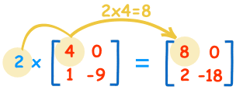
Multiply matrices: Matrix Multiply Constant
To multiply a matrix by a single number is easy:
These are the calculations:
2×4=8 2×0=0
2×1=2 2×-9=-18
We call the number ("2" in this case) a scalar, so this is called "scalar multiplication".
https://www.mathsisfun.com/algebra/matrix-multiplying.html
Notes:
•

Slide 97
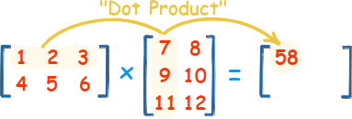
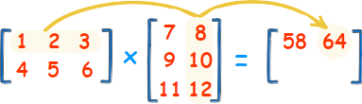

Multiply matrices: Multiplying a Matrix by Another Matrix
1st row X 1st column:
(1, 2, 3) • (7, 9, 11) = 1×7 + 2×9 + 3×11
= 58
1st row X 2nd column:
(1, 2, 3) • (8, 10, 12) = 1×8 + 2×10 + 3×12
= 64
2nd row X 1st column:
(4, 5, 6) • (7, 9, 11) = 4×7 + 5×9 + 6×11
= 139
2nd row X 2nd column:
(4, 5, 6) • (8, 10, 12) = 4×8 + 5×10 + 6×12
= 154
Matrix product is possible only
between matrices
nXm mXp → nXp (result
dimension)
https://www.mathsisfun.com/algebra/matrix-multiplying.html
Notes:
•

Slide 98
Example
# Program to multiply two matrices using nested loops
# 3x3 matrix
X = [[12,7,3],
[4 ,5,6],
[7 ,8,9]]
# 3x4 matrix
Y = [[5,8,1,2],
[6,7,3,0],
[4,5,9,1]]
# result is 3x4
result = [[0,0,0,0],
[0,0,0,0],
[0,0,0,0]]
# iterate through rows of X
for i in range(len(X)):
# iterate through columns of Y
for j in range(len(Y[0])):
# iterate through rows of Y
for k in range(len(Y)):
result[i][j] += X[i][k] * Y[k][j]
for r in result:
print(r)
Output:
[114, 160, 60, 27]
[74, 97, 73, 14]
[119, 157, 112, 23]
Notes:
•

Slide 99
Example Matrix Multiplication Using Nested List Comprehension
# Program to multiply two matrices using list comprehension
# 3x3 matrix
X = [[12,7,3],
[4 ,5,6],
[7 ,8,9]]
# 3x4 matrix
Y = [[5,8,1,2],
[6,7,3,0],
[4,5,9,1]]
# result is 3x4
result = [[sum(a*b for a,b in zip(X_row,Y_col)) for Y_col in zip(*Y)] for X_row in X]
for r in result:
print(r)
Output:
[114, 160, 60, 27]
[74, 97, 73, 14]
[119, 157, 112, 23]
Notes:
•

Slide 100
Exercise
Write a python script to multiply two matrices.
You can use the previous example.
The matrices can be defined inside the program or read by file.
Try the case in which matrices are in two different files or in one unique file.
Try also the special case of product between matrix and vector
[mXn X nX1]
Verify with an example that
AXB != BXA [must be mXn * nXm]
Suggestion: incapsulate the matrix product in a function receiving the two matrices as parameters.
Notes:
•

