Slide 1
Bash Lecture 2 – Advanced Bash

Slide 2
Traditional service delivery
Bibliography and learning materials
Bibliography:
https://www.rigacci.org/docs/biblio/online/sysadmin/toc.htm
https://www.tldp.org/LDP/abs/html/
Learning Materials:
http://www.ee.surrey.ac.uk/Teaching/Unix/
https://github.com/bertocco/abilita_info_units_1920

Slide 3
Traditional service delivery
Arguments of this lesson
Bash configuration and user’s environment manipulation
Locating commands (which)
File information commands (find, file)
UNIX processes
Process related commands (kill, ps, wait, nohup, sleep)
File content related commands (more, less, tail, read, tee, wc)
Redirection
File content search commands (grep, egrep)
Status commands
Unix wildcards (* ? [ ])
Editors

Slide 4
Traditional service delivery
Bash configuration
Bash has more configuration startup files.
They are executed at bash start-up time.
The files and sequence of the files executed differ from the type of shell. Shell can be:
Interactive
Non-interactive
Login shell
Non-login shell

Slide 5
Traditional service delivery
Bash types
Interactive: means that the commands are run with user-interaction from keyboard. E.g. the shell can prompt the user to enter input.
Non-interactive: the shell is probably run from an automated process. Typically input from standard input and output to log file.
Login: shell is run as part of the login of the user to the system.
Non-login: any shell run by the user after logging on, or run by any automated process not coupled to a logged in user.

Slide 6
Traditional service delivery
Bash startup files (1)
http://www.gnu.org/software/bash/manual/html_node/Bash-Startup-Files.html
Interactive login shell, or with –login:
/etc/profile, if that file exists
~/.bash_profile,
~/.bash_login
~/.profile, in that order, and reads and executes
--noprofile option may be used to inhibit this behavior.
When an interactive login shell exits, or a non-interactive login shell executes the exit builtin command, Bash reads and executes commands from the file ~/.bash_logout, if it exists.

Slide 7
Traditional service delivery
Bash startup files (2)
http://www.gnu.org/software/bash/manual/html_node/Bash-Startup-Files.html
interactive non-login shell
[Example: when you open a new terminal window by pressing Ctrl+Alt+T, or just open a new terminal tab.]
bash reads and executes commands from
~/.bashrc, if that file exists.
--norc option ti inhibit this behaviour.
--rcfile file option will force Bash to read and execute commands from file instead of ~/.bashrc.
So, typically, your ~/.bash_profile contains the line
if [ -f ~/.bashrc ]; then . ~/.bashrc; fi
after (or before) any login-specific initializations.

Slide 8
Traditional service delivery
Bash startup files (3)
http://www.gnu.org/software/bash/manual/html_node/Bash-Startup-Files.html
Invoked non-interactively
[Example: to run a shell script]
bash looks for the variable BASH_ENV in the environment, expands its value if it appears there, and uses the expanded value as the name of a file to read and execute. Bash behaves as if the following command were executed:
if [ -n "$BASH_ENV" ]; then . "$BASH_ENV"; fi
but the value of the PATH variable is not used to search for the filename.
If a non-interactive shell is invoked with the --login option, Bash attempts to read and execute commands from the login shell startup files.

Slide 9
Traditional service delivery
Set user’s PATH environment variable
$ cat .profile
# ~/.profile: executed by the command interpreter for login shells.
# This file is not read by bash(1), if ~/.bash_profile or
# ~/.bash_login exists.
# if running bash
if [ -n "$BASH_VERSION" ]; then
# include .bashrc if it exists
if [ -f "$HOME/.bashrc" ]; then
. "$HOME/.bashrc"
fi
fi
# set PATH so it includes user's private bin directories
PATH="$HOME/bin:$HOME/.local/bin:$PATH"

Slide 10
Traditional service delivery
~/.bashrc file
User specific, hidden by default.
~/.bashrc
If not there simply create one.
System wide:
/etc/bash.bashrc

Slide 11
Traditional service delivery
`export`
`export` exports environment variables (also to children of the current process). Example:
ubuntu~$ export a=test_env
ubuntu:~$ echo $a
test_env
ubuntu:~$ /bin/bash
ubuntu:~$ echo $a
test_env
ubuntu:~$ exit
exit
ubuntu:~$ echo $a
test_env
`export` called with no arguments prints all of the variables in the shell's environment.
`unset` frees variables

Slide 12
Shell alias
A shell alias is a shortcut to reference a command.
It can be used to avoid typing long commands or as a means to correct incorrect input.
Example: it is used to set default options on commands
alias ls=`ls -l`
alias rm=`rm -i`
Exercises:
1) try to define and use the previous aliases
2) Define the aliases in the ~/.bashrc, open a new terminal and verify the aliases running them

Slide 13
Traditional service delivery
Locating commands
To execute a command, UNIX has to locate the command before it can execute it
UNIX uses the concept of search path to locate the commands.
Search path is a list of directories in the order to be searched for locating commands. Usually it contains standard paths (/bin, /usr/bin, …)
Modify the search path for your environment modifying the PATH environment variable

Slide 14
Traditional service delivery
`which`
`which` can be used to find whether a particular command exists in you search path. If it does exist, which tells you which directory contains that command.
Examples (try with existing and not existing commands):
which pippo
which gedit
which vim

Slide 15
Traditional service delivery
User related commands: passwd
`passwd` changes user’s password
Example: type `passwd`
$ passwd
Changing password for bertocco.
(current) UNIX password:
Enter new UNIX password:
Retype new UNIX password:
Sorry, passwords do not match
passwd: Authentication token manipulation error
passwd: password unchanged
$ passwd
Changing password for bertocco.
(current) UNIX password:
Enter new UNIX password:
Retype new UNIX password:
passwd: password updated successfully

Slide 16
Traditional service delivery
User related commands: who and whoami
`who` show who is logged on
Print information about users who are currently logged in.
`whoami`
Print the user name associated with the current effective user ID.
Exercise:
try the commands and then type `man who`
and try some option

Slide 17
Traditional service delivery
File information commands
Each file and directory in UNIX has several attributes associated with it. UNIX provides several commands to inquire about and process these attributes

Slide 18
Traditional service delivery
`find`
`find` searches for the particular file giving the flexibility to search for a file by various attributes: name, size, permission, and so on.
Command general form:
find directory-name search-expression

Slide 19
Traditional service delivery
`find` Examples (try)
find . -name pippo
find /etc -name networking
find /etc -name netw # nothing found
find /etc -name netw\*
find -size 18 # 18 blocks files
find -size 1024c # 1024 bytes
find . -print
Read the manual and try other options
Try, if possible, a find case insensitive

Slide 20
Traditional service delivery
`file`
`file` can be used to determine the type of the specified file.
Examples (try):
$ file /etc/networking/interfaces
/etc/networking/interfaces: cannot open `/etc/networking/interfaces’ (No such file or directory)
$ file /etc/network/interfaces
/etc/network/interfaces: ASCII text

Slide 21
Traditional service delivery
UNIX Processes
Usually, a command or a script that you can execute consists of one or more processes.
The processes can be categorized into the following broad groups:
Interactive processes, which are those executed at the terminal. Can execute either in foreground or in background. In a foreground process, the input is accepted from standard input, output is displayed to standard output, and error messages to standard error. In background, the terminal is detached from the process so that it can be used for executing other commands. It is possible to move a process from foreground to background and vice versa (<ctrl+bg>; <ctrl+fg>.
Batch processes are not submitted from terminals. They are submitted to job queues to be executed sequentially.
Deamons are never-ending processes that wait to service requests from other processes.

Slide 22
Traditional service delivery
Process Related Commands
a command or a script that you can execute consists of one or more processes.
The main are:
  `ps`
  `kill`
  `wait`
  `nohup`
  `sleep`

Slide 23
Traditional service delivery
`ps`
`ps` command is used to find out which processes are currently running.
Exercises:
  Try the following commands, check the differences in the output. Read the flag meaning using
  `man ps`:
  ps
  ps -ef
  ps -aux

Slide 24
Traditional service delivery
`kill`
`kill` is used to send signals to an executing process. The process must be a nonforeground process for you to be able to send a signal to it using this command.
The default action of the command is to terminate the process by sending it a signal. If the process has been programmed for receiving such a signal. In such a case, the process will process the signal as programmed.
You can kill only the processes initiated by you. However, the root user can kill any process in the system.
The flags associated with the kill commands are as follows:
-l to obtain a list of all the signal numbers and their names that are supported by the system.
-’signal number’ is the signal number to be sent to the process. You can also use a signal name in place of the number. The strongest signal you can send to a process is 9 or kill.

Slide 25
Traditional service delivery
`kill` Exercises
Look for a process PID of a process belonging of you (using ps) and kill it using two different signals:
-9 and -15.
List all available signals and red the differences between the two signal previously used

Slide 26
Traditional service delivery
`wait` with exercises
`wait` is tp wait for completion of jobs. It takes one or more process IDs as arguments. This is useful while doing shell programming when you want a process to be finished before the next process is invoked.
If you do not specify a process ID, UNIX will find out all the processes running for the current environment and wait for termination of all of them.
Examples:
  `wait` If you want to find out whether all the processes you have started have completed
  `wait 15060` If you want to find out whether the process ID 15060 has completed
The return code from the wait command is zero if you invoked the wait command without any arguments. If you invoked the wait command with multiple process IDs, the return code depends on the return code from the last process ID specified.

Slide 27
Traditional service delivery
`wait`: exercise
From a shell launch an infinite process using:
`while true; do echo looping; sleep 2; done`
From another shell find the pid of this process using `ps` command
From a third shell launch a process waiting for the end of the initial infinite loop
pid=<your_process_pid>; wait $pid
From a fourth shell kill the first process (pid)
Check in the third shell that your waiting process ended
NOT WORKING using shells. Needs scripting: next time.

Slide 28
Traditional service delivery
`nohup`
When you are executing processes under UNIX, they can be running in foreground or background. In a foreground process, you are waiting at the terminal for the process to finish. Under such circumstances, you cannot use the terminal until the process is finished. You can put the foreground process into background as follows:
  ctrl-z
  bg
The processes in UNIX will be terminated when you logout of the system or exit the current shell whether they are running in foreground or background. The only way to ensure that the process currently running is not terminated when you exit is to use the nohup command.

Slide 29
Traditional service delivery
`nohup`
The nohup command has default redirection for the standard output. It redirects the messages to a file called nohup.out under the directory from which the command was executed. That is, if you want to execute a script called sample_script in background from the current directory, use the following command:
nohup sample_script &
The & (ampersand) tells UNIX to execute the command in background. If you omit the &, the command is executed in foreground. In this case, all the messages will be redirected to nohup.out under the current directory. If the nohup.out file already exists, the output will be appended to it.

Slide 30
Traditional service delivery
`nohup`: Examples
nohup grep sample_string * &
nohup grep sample_string * > mygrep.out &
nohup my_script > my_script.out &

Slide 31
Traditional service delivery
`sleep`
`sleep` wait for a certain period of time between execution of commands. This can be used in cases where you want to check for, say, the presence of a file, every 15 minutes. The argument is specified in seconds.
Examples: If you want to wait for 5 minutes between commands, use:
sleep 300
Small shell script that reminds you twice to go home, with a 5-minute wait between reminders:
echo "Time to go home"
sleep 300
echo "Final call to go home ....."

Slide 32
Traditional service delivery
File Content Related Commands
Commands that can be used to look at the contents of the file or parts of it. You can use these commands to look at the top or bottom of a file, search for strings in the file, and so on.

Slide 33
Traditional service delivery
`more`
`more` can be used to display the contents of a file one screen at a time. By default, the more command displays one screen worth of data at a time. The more command pauses at the end of display of each page. To continue, press a space bar so that the next page is displayed or press the Return or Enter key to display the next line. Mostly the more command is used where output from other commands are piped into the more command for display.
Try

Slide 34
Traditional service delivery
`less`
`less` is to view the contents of a file. This may not be available by default on all UNIX systems. It behaves similarly to the more command. The less command allows you to go backward as well as forward in the file by default.
Try
Cat <a big file> | less

Slide 35
Traditional service delivery
`tail`
`tail` to display, on standard output, a file starting from a specified point from the start or bottom of the file. Whether it starts from the top of the file or end of the file depends on the parameter and flags used. One of the flags, -f, can be used to look at the bottom of a file continuously as it grows in size. By default, tail displays the last 10 lines of the file.

Slide 36
Traditional service delivery
`tail` exercises
tail -f500 /var/log/syslog
list of flags that can be used with the tail command:
-c number to start from the specified character position number.
-b number to start from the specified 512-byte block position number.
-k number to start from the specified 1024-byte block position number.
-n number to start display of the file in the specified line number.
-r number to display lines from the file in reverse order.
-f to display the end of the file continuously as it grows in size.

Slide 37
Traditional service delivery
`read`
`read` is used in shell scripts to read each field from a file and assign them to shell variables.
A field is a string of bytes that are separated by a space or newline character. If the number of fields read is less than the number of variables specified, the rest of the fields are unassigned.
Flag -r to treat a \(backslash) as part of the input record and not as a control character.

Slide 38
Traditional service delivery
`read` Examples
Example following is a piece of shell script code that reads first name and last name from namefile and prints them:
- create the file
cat <<EOF > names_list.txt
Sara Bertocco
Mario Rossi
John Doe
EOF
- Read the file by line and print on standard output
while read -r lname fname
do
echo $lname","$fname
done < names_list.txt

Slide 39
Traditional service delivery
`read` Examples
Example following is a piece of shell script code that reads a file by line:
while read -r line
do
printf 'Line: %s\n' "$line"
done < names_list.txt
The file name can be indicate also with full path name.

Slide 40
Traditional service delivery
`tee`
`tee` to execute a command and want its output redirected to multiple files in addition to the standard output, use the tee command. The tee command accepts input from the standard input, so it is possible to pipe another command to the tee command.
The default of the tee command is to overwrite the specified file.
-a is an optional flag to append to the end of the specified file

Slide 41
Traditional service delivery
`tee` Examples (try)
- use the cat command on file1 to display on the screen and make a copy of file1 on file2, use the tee command as follows:
cat file1 | tee file2 | more
- make the same but appending file1 to the end of an already existing file2 using the flag -a :
cat file1 | tee -a file2 | more

Slide 42
Traditional service delivery
`wc`
`wc` counts the number of bytes, words, and lines in specified files. A word is a number of characters stringed together delimited either by a space or a newline character.
Following is a list of flags that can be used with the wc command:
-l to count only the number of lines in the file.
-w to count only the number of words in the file.
-c to count only the number of bytes in the file.
You can use multiple filenames as argument to the wc command.

Slide 43
Traditional service delivery
`wc` exercices
wc file
wc -w file
cat <file> | wc -l
wc -w <file1> <file2>

Slide 44
Traditional service delivery
Redirection (1)
Each UNIX command (or program) is connected to three communication channels between the command and its environment:
Standard input (stdin) where the command read its input
Standard output (stdout) where the command writes its output
Standard error (stderr) where the command writes its error
When a command is executed via an interactive shell, the streams are typically connected to the text terminal on which the shell is running, but can be changed with redirection or with a pipeline
Standard Input, Standard Output and Standard Error Symbols:
redirect stdout to a file | redirect stderr and stdout to a file
redirect stderr to a file | redirect stderr and stdout to stdout
redirect stdout to stderr | redirect stderr and stdout to stderr
redirect stderr to stdout
standard input | 0<
standard output | 1>
standard error | 2>
Notes:
stdin
Generally standard input, referred to as "stdin", comes from the keyboard.
When you type stuff, you're typing it on stdin (a standard input terminal). A standard input device, which is usually the keyboard, but Linux also allows you take standard input from a file.
For example:
cat < myfirstscript
stdout
Standard output, as created at process creating time, goes to the console, your terminal or an X terminal. Exactly where output is sent clearly depends on where the process originated.
Our console or terminal should be the device that is accepting the output. Running the command:
cat file

Slide 45
Traditional service delivery
Redirection (2)
Redirection [> &> >& >>].
Redirect stdout to file (overwrite filename if it already exists):
scriptname > filename
scriptname >> filename # appends the output of scriptname to file filename. If
# filename does not already exist, it is created
Redirect stderr to file (overwrite filename if it already exists):
scriptname 2> filename
Redirect both the stdout and the stderr of command to filename:
command &> filename redirects both the stdout and the stderr of command to filename
Redirects stdout of command to stderr:
command >&2
Redirects stderr of command to stdout:
command 2>&1

Slide 46
Traditional service delivery
Redirection: Examples
Stdout redirected to file
find . -name pippo > find-output.txt
Stderr redirected to file
find . -name pippo 2> find-errors.txt
discards any errors that are generated by the find command
find / -name "*" -print 2> /dev/null
/dev/null is a simple device (implemented in software and not corresponding to any hardware device on the system).
/dev/null looks empty when you read from it.
Writing to /dev/null does nothing: data written to this device simply "disappear."
Often a command's standard output is silenced by redirecting it to /dev/null, and this is perhaps the null device's commonest use in shell scripting:
command > /dev/null
Redirect both stdout and stderr to file
find . -name pippo &> out_and_err.txt
Redirect stderr to stdout: find . -name filename 2>&1
Redirect stdout to stderr: find . -name filename 1>&2

Slide 47
Traditional service delivery
Special characters: Pipe
Pipe [ | ]. Passes the output (stdout) of a previous command to the input (stdin) of the next one, or to the shell. This is a method of chaining commands together.
echo ls -l | sh
# Passes the output of "echo ls -l" to the shell,
#+ with the same result as a simple "ls -l".
cat *.lst | sort | uniq
# Merges and sorts all ".lst" files, then deletes duplicate lines.
A pipe sends the stdout of one process to the stdin of another. In a typical case, a command, such as cat or echo, pipes a stream of data to a command that transforms it in input for processing:
cat $filename1 $filename2 | grep $search_word

Slide 48
Traditional service delivery
Redirection with pipe and tee examples
Examples of redirection of the output of a command to be used as input of another:
Display the output of a command (in this case ls) by pages:
ls -la | less
Count files in a directory:
ls -l | wc -l
Count the number of rows containing of the word “canadesi” in the file vialactea.txt
grep canadesi vialactea.txt | wc -l
Count the number of words in the rows containing the word “canadesi”
`tee` is useful to redirect output both to stdout and to a file. Example:
find . -name filename.ext 2>&1 | tee -a log.txt
This will take stdout and append it to log file. The stderr will then get converted to stdout which is piped to tee which appends it to the log and sends it to stdout which will either appear on the tty or can be piped to another command.
To go deep: https://stackoverflow.com/questions/2871233/write-stdout-stderr-to-a-logfile-also-write-stderr-to-screen

Slide 49
Traditional service delivery
Exercise: redirection
Create a directory and file tree like this one:
my_examples /ex1.dir
/ex2.txt
/ex3.dir
/ex3.dir/file1.txt
/ex3.dir/file2.txt
/ex3.dir/file3.txt
Remove read permissions to directory /ex2.dir
Redirect output on a file. Error is displayed on terminal
Redirect error on a file. Output is displayed on terminal
Verify the content of the files
Stderr redirected to file
Redirect output and errors symultaneously
Use pipe to redirect the output of a command to another command and to a file
Use tee to redirect output both to stdout and to a file

Slide 50
Traditional service delivery
File Content Search Commands
For searching for a pattern in one or more files, use the grep series of commands. The grep commands search for a string in the specified files and display the output on standard output.

Slide 51
Traditional service delivery
`egrep`
`egrep` extended version of grep command. This command searches for a specified pattern in one or more files and displays the output to standard output. The pattern can be a regular expression to match any single character.
* to match one or more single characters that precede the asterisk.
^ to match the regular expression at the beginning of a line.
$ to match the regular expression at the end of a line.
+ to match one or more occurrences of a preceding regular expression.
? to match zero or more occurrences of a preceding regular expression.
[ ] to match any of the characters specified within the brackets.

Slide 52
Traditional service delivery
`egrep` Examples
Let us assume that we have a file called file1 whose contents are shown below using the more command:
more file1
***** This file is a dummy file *****
which has been created
to run a test for egrep
grep series of commands are used by the following types of people
programmers
end users
Believe it or not, grep series of commands are used by pros and novices alike
***** THIS FILE IS A DUMMY FILE *****

Slide 53
Traditional service delivery
`egrep` Examples
If you are just interested in finding the number of lines in which the specified pattern occurs, use the -c flag as in the following command:
egrep -i -c dummy file1
If you want to get a list of all lines that do not contain the specified pattern, use the -v flag as in the following command:
egrep -i -v dummy file1
If you are interested in searching for a pattern that you want to search as a word, use the -w flag as in the following command:
egrep -w grep file1

Slide 54
Traditional service delivery
`egrep` Examples
If you want to find all occurrences of dummy, use the following command:
egrep dummy file1
***** This file is a dummy file *****
If you want to find all occurrences of dummy, irrespective of the case, use the -i flag as in the following command:
egrep -i dummy file1
***** This file is a dummy file *****
***** THIS FILE IS A DUMMY FILE *****
If you want to display the relative line number of the line that contains the pattern being searched, use the -n flag as in the following command:
egrep -i -n dummy file1
1:***** This file is a dummy file *****
8:***** THIS FILE IS A DUMMY FILE *****

Slide 55
Traditional service delivery
Status commands
Several commands that display the status of various parts of the system. These commands can be used to monitor the system status at any point in time.

Slide 56
Traditional service delivery
`date`
`date` command to display the current date and time in a specified format. If you are root user, use the date command to set the system date.
To display the date and time, you must specify a + (plus) sign followed by the format. The format can be as follows:
%A to display date complete with weekday name.
%b or %h to display short month name.
%B to display complete month name.
%c to display default date and time representation.
%d to display the day of the month as a number from 1 through 31.
%D to display the date in mm/dd/yy format.
%H to display the hour as a number from 00 through 23.
%I to display the hour as a number from 00 through 12.
%j to display the day of year as a number from 1 through 366.
%m to display the month as a number from 1 through 12.
%M to display the minutes as a number from 0 through 59.
%p to display AM or PM appropriately.
%r to display 12-hour clock time (01-12) using the AM-PM notation.
%S to display the seconds as a number from 0 through 59.

Slide 57
Traditional service delivery
`date`
Other format flags:
%T to display the time in hh:mm:ss format for 24 hour clock.
%U to display the week number of the year as a number from 1 through 53 counting Sunday as first day of the week.
%w to display the day of the week as a number from 0 through 6 with Sunday counted as 0.
%W to display the week number of the year as a number from 1 through 53 counting Monday as first day of the week.
%x to display the default date format.
%X to display the time format.
%y to display the last two digits of the year from 00 through 99.
%Y to display the year with century as a decimal number.
%Z to display the time-zone name, if available.

Slide 58
Traditional service delivery
`date`: Exercises
Try some example of `date` command usage with different display of day, month, year
If you want to display the date without formatting, use date without any formatting descriptor as follows:
date
Sat Dec 7 11:50:59 EST 1996
If you want to display only the date in mm/dd/yy format, use the following commands:
date +%m/%d/%y
12/07/96
If you want to format the date in yy/mm/dd format and time in hh:mm:ss format, use the following command:
date "+%y/%m/%d %H:%M:%S"
96/12/07 11:57:27
Following is another way of formatting the date:
date +%A","%B" "%d","%Y
Sunday,December 15,1996

Slide 59
Traditional service delivery
Linux wildcards
There are three main wildcards in Linux:
Asterisk (*) – matches one or more occurrences of any character, including no character.
Question mark (?) – represents or matches a single occurrence of any character.
Bracketed characters ([ ]) – matches any occurrence of character enclosed in the square brackets.

Slide 60
Traditional service delivery
Editors
Editor
In dictionary.cambridge.org: is a piece of software for editing text on a compute
In www.merriam-webster.com: is a computer program that permits the user to create or modify data (such as text or graphics) especially on a display screen

Slide 61
Traditional service delivery
Editor types
In Linux, text editor are of two kinds:
graphical user interface (GUI) based
  gedit
  bluefish
  lime ……...
command line text editors (console or terminal)
  nano
  pico
  vi/vim
  emacs …….
Notes:
The console is typically the primary interface for managing a computer, eg while it is still booting up. A terminal is a session which can receive and send input and output for command-line programs. The console is a special case of these. The shell is a program which is used for controlling and running programs.
Shell is a program which processes commands and returns output , like bash in Linux . Terminal is a program that run a shell , in the past it was a physical device (Before terminals were monitors with keyboards, they were teletypes) and then its concept was transferred into software , like Gnome-Terminal .

Slide 62
Traditional service delivery
Nano
Nano is the built-in basic text editor for many popular linux distros.
It doesn’t take any learning or getting used to, and all its commands and prompts are displayed at the bottom.
Use Nano if:
  You’re new to the terminal
  you just need to get into a file for a quick change.
Compared to more advanced editors in the hands of someone who knows what they’re doing, some tasks are cumbersome and non-customizable.
How to Nano:
from your terminal, enter `nano` and the filename you want to edit.
If the file doesn’t already exist, it will once you save it.
Commands are listed across the bottom and are triggered with the Control (CTRL) key. For example, to find something in your file, hold CTRL and press W, tell it what you’re searching for, and press Enter. Press CTRL+X to exit, then follow the prompts at the bottom of the screen.
Notes:
The console is typically the primary interface for managing a computer, eg while it is still booting up. A terminal is a session which can receive and send input and output for command-line programs. The console is a special case of these. The shell is a program which is used for controlling and running programs.
Shell is a program which processes commands and returns output , like bash in Linux . Terminal is a program that run a shell , in the past it was a physical device (Before terminals were monitors with keyboards, they were teletypes) and then its concept was transferred into software , like Gnome-Terminal .

Slide 63
Traditional service delivery
GNU emacs
Emacs has so many available features like a terminal, calculator, calendar, email client, web browser, and Tetris, it’s often spoken of as an operating system itself.
Starting Emacs is relatively simple, but more you learn, the more there is to learn.
How to Emacs:
Emacs commands are accessed through keyboard combinations of CTRL or ALT and another keystroke. When you see shortcuts that read C-h or M-x, C stands for the control key and M stands for the Alt key (or Escape, depending on your system).
Enter `emacs` in your terminal, and access the built-in tutorial with C-h t. That means, while holding CTRL, press H, then T.
Or, try key combination C-h r to open the manual within Emacs. You can also use the manual as a playground; just remember to quit without saving by pressing key combination C-x C-c.
Notes:
The console is typically the primary interface for managing a computer, eg while it is still booting up. A terminal is a session which can receive and send input and output for command-line programs. The console is a special case of these. The shell is a program which is used for controlling and running programs.
Shell is a program which processes commands and returns output , like bash in Linux . Terminal is a program that run a shell , in the past it was a physical device (Before terminals were monitors with keyboards, they were teletypes) and then its concept was transferred into software , like Gnome-Terminal .

Slide 64
Traditional service delivery
Helpful Emacs links
Emacs wiki
https://www.emacswiki.org/emacs/SiteMap
GNU Guided Tour
https://www.gnu.org/software/emacs/tour/
Cornell Emacs Quick Reference
https://www.cs.cornell.edu/courses/cs312/2006fa/software/quick-emacs.html
Notes:
The console is typically the primary interface for managing a computer, eg while it is still booting up. A terminal is a session which can receive and send input and output for command-line programs. The console is a special case of these. The shell is a program which is used for controlling and running programs.
Shell is a program which processes commands and returns output , like bash in Linux . Terminal is a program that run a shell , in the past it was a physical device (Before terminals were monitors with keyboards, they were teletypes) and then its concept was transferred into software , like Gnome-Terminal .

Slide 65
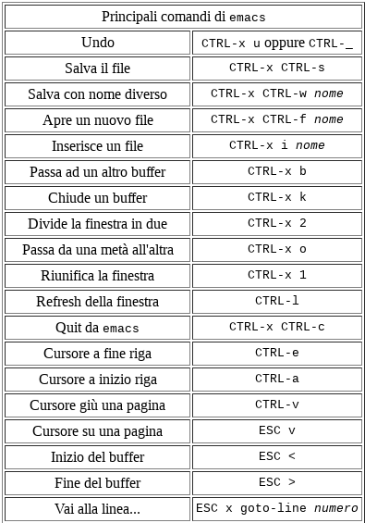
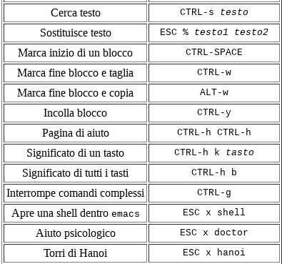
Traditional service delivery
Main Emacs commands
http://www.di.unipi.it/~bozzo/fino/appunti/node2.html

Slide 66
Traditional service delivery
vi/vim
Vi, typically comes with your distro-of-choice.
Vim is a vi successor with some improvements. It runs by default on OS X and some Linux distributions when `vi` is run.
VI has two modes of operation (is a “modal” editor):
Command mode for navigating files: commands which cause action to be taken on the file
Insert mode for editing text: in which entered text is inserted into the file.
Because Vi is navigated through the use of keyboard commands and shortcuts, it is better experienced than explained.

Slide 67
Traditional service delivery
How to Vi or Vim
Enter `vi` or `vim` in your terminal.
When you enter Vi, you begin in command mode and navigate using keyboard commands and the H, J, K, and L keys to move left, down, up, and right, respectively (but arrows use is possible in the most recent versions).
To enter in editing mode press:
‘a’ to append to the file
‘i’ to insert
pressing the <Esc> (Escape) key turns off the Insert mode.
To exit Vim without saving, press ESC to enter command mode, then press : (colon) to access the command line (a prompt appears at the very bottom) and enter q!.
To save and quit, you could use that prompt and the key combination :wq, or hold down SHIFT and press Z two times (the shortcut SHIFT+ZZ).
The : (colon) operator begins many commands like :help for help, or :w to save.
If you’re stuck at the prompt and don’t remember the operator you want to use, enter : (colon), then press CTRL+D for a list of possibilities.

Slide 68
Traditional service delivery
Helpful VI links
Basic vi Commands
https://www.cs.colostate.edu/helpdocs/vi.html
Swathmore’s Tips and Tricks
https://www.cs.swarthmore.edu/oldhelp/vim/home.html
Linux Academy’s Vim Reference Guide
https://linuxacademy.com/blog/wp-content/uploads/2016/06/vim-2.png
Notes:
The console is typically the primary interface for managing a computer, eg while it is still booting up. A terminal is a session which can receive and send input and output for command-line programs. The console is a special case of these. The shell is a program which is used for controlling and running programs.
Shell is a program which processes commands and returns output , like bash in Linux . Terminal is a program that run a shell , in the past it was a physical device (Before terminals were monitors with keyboards, they were teletypes) and then its concept was transferred into software , like Gnome-Terminal .

Slide 69
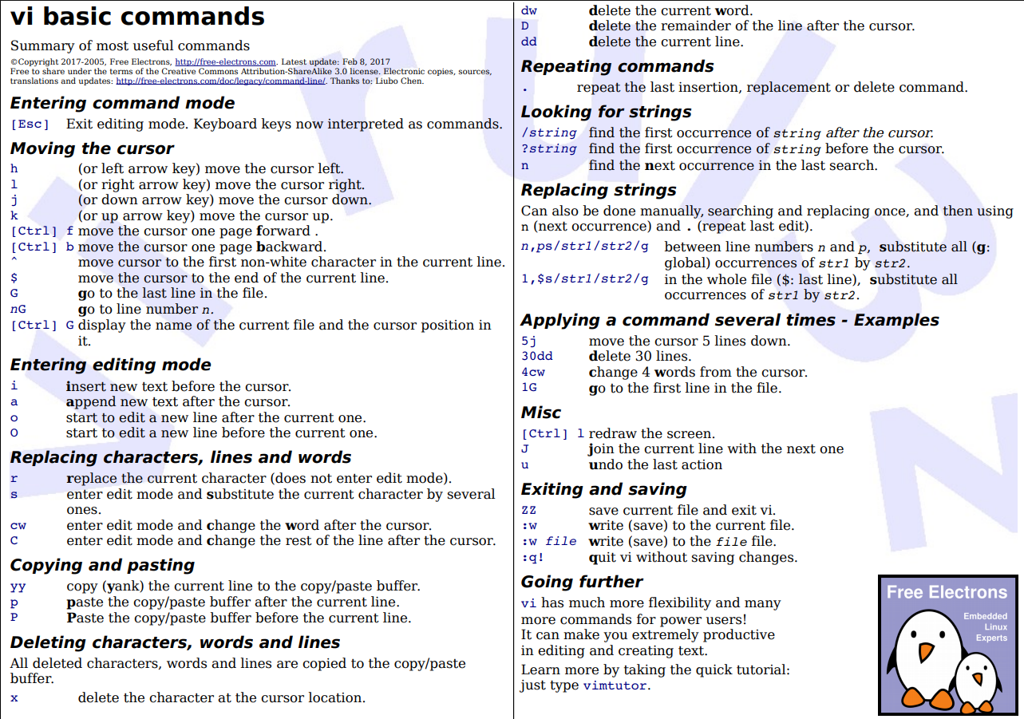

Slide 70
Traditional service delivery
The editor war
Technologies available in Information Technology are a lot.
Often, to solve a problem, you can choose between different instruments. The rule to base your choose is:
It does not exist “the best tool” but “the best tool to solve your specific problem”.
Sometimes different tools are more or less equivalent.
This is the case of editors emacs and vim:
https://en.wikipedia.org/wiki/Editor_war

Slide 71
Traditional service delivery
Choose your editor
Try an editor and its tutorial,
watch videos on how to use it for your intended purpose,
spend a day or two using it with real files training your fingers.
The best editor for you is the one that makes you feel like you’re easily getting things done.

