Slide 1
Bash Lecture 1 - Basics

Slide 2
Traditional service delivery
Why this lecture series
To know UNIX/Linux command line
To gain ability in command line usage
To introduce scripting (in bash)
To have some basic programming
To introduce python programming
To introduce useful python libraries

Slide 3
Traditional service delivery
Bibliography and learning materials
Bibliography:
https://www.rigacci.org/docs/biblio/online/sysadmin/toc.htm
https://www.tldp.org/LDP/abs/html/
Learning Materials:
http://www.ee.surrey.ac.uk/Teaching/Unix/
https://github.com/gtaffoni/Learn-Python/blob/master/Lectures/ShellLecture01.pdf
https://github.com/gtaffoni/Learn-Python/blob/master/Lectures/ShellLecture02.pdf
https://github.com/bertocco/abilita_info_units_1920

Slide 4
Traditional service delivery
Arguments of this lesson
How the shell works with you and linux
Features of a shell
Manipulating the shell environment

Slide 5
Traditional service delivery
What is a shell?
SHELL is the human interface point for UNIX
SHELL is a program layer that provides an environment to enter commands and parameters to produce a given result.
To meet varying needs, UNIX has provided different shells.
Bourne (sh)
Bourne Again (bash)
Korn (ksh)
C shells (csh)
TC-Shell (tcsh)
Z shell (zsh)

Slide 6
Traditional service delivery
Shell differences
They differ in
  the various options they give the user to manipulate the commands
  the complexity and capabilities of the scripting language.

Slide 7
Traditional service delivery
Why bash?
Flexible
More friendly than others
The default in the most part of linux distributions

Slide 8
Traditional service delivery
UNIX commands (1)
General form of a command:
command [flags] [argument1] [argument2] …
Example:
`ls -a -l` or `ls -al`
`ls -al mydir`
argument
flag
command

Slide 9
Traditional service delivery
UNIX commands
Arguments can be optional or mandatory
All commands have a return code (0 if OK)
Read return code: `echo $?`
The return codes can be used as part of control
logic in shell scripts
All UNIX commands have an help:
`man command` or `man <number> command

Slide 10
Traditional service delivery
UNIX commands
Arguments can be optional or mandatory
Exercise: Try
  create the folder
  mkdir myFolder
  jump inside the created folder
  cd myFolder
  create two files
  touch pippo pluto
  jump outside the folder
  cd ..
  list the content of the folder where you are
  ls Argument NOT mandatory. Optional
  list a specific folder content
  ls myFolder

Slide 11
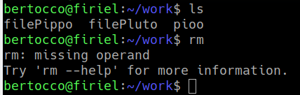
Traditional service delivery
UNIX commands
Arguments can be optional or mandatory
Exercise: Try
  create a folder
  mkdir testFolder
  create (inside the folder) one or two files inside the folder
  cd testFolder ; touch filePippo ; touch filePluto
  or: cd testFolder ; touch filePippo filePluto
  inside the folder try the command to remove files (without arguments)
  pwd # to be sure to be in the folder
  rm
  An argument (indicating the file to remove) is mandatory
  rm filePippo # remove only the indicated file
  rm * # remove all files

Slide 12
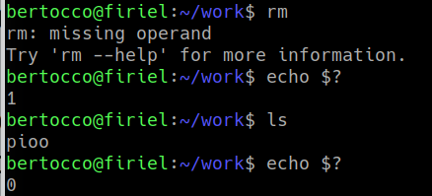
Traditional service delivery
UNIX commands
All commands have a return code (0 if OK)
Read return code: `echo $?`
The return codes can be used as part of control
logic in shell scripts
Exercise: try
ls
echo $? # the result will be 0 : correct command
rm
echo $? # the result will be 1: command failure

Slide 13
Traditional service delivery
UNIX commands
All UNIX commands have an help:
`man command` or
`man <number> command
Example:
man ls
man wait
man 7 signal

Slide 14
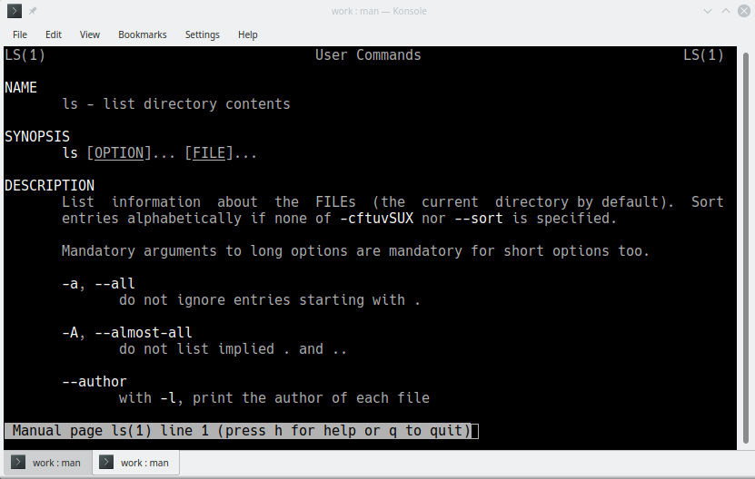
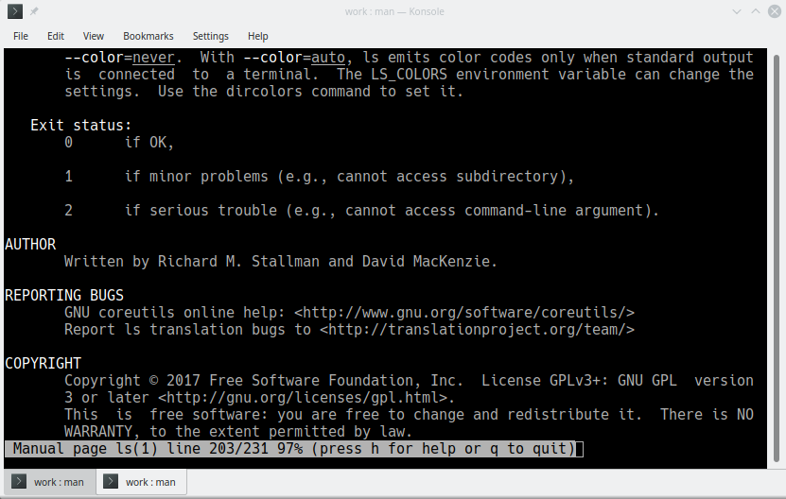
Traditional service delivery
`ls` help

Slide 15
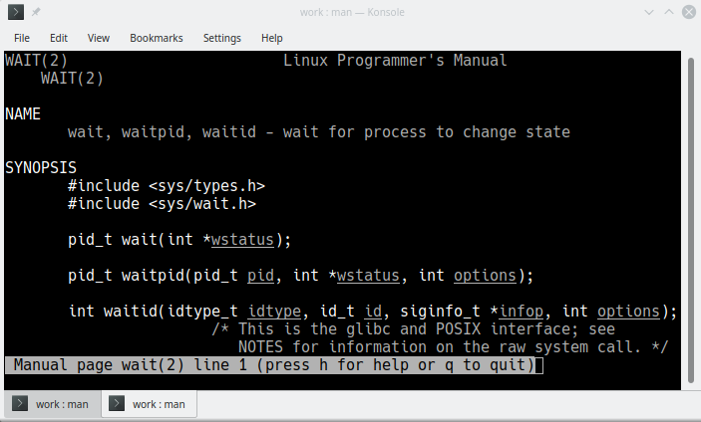
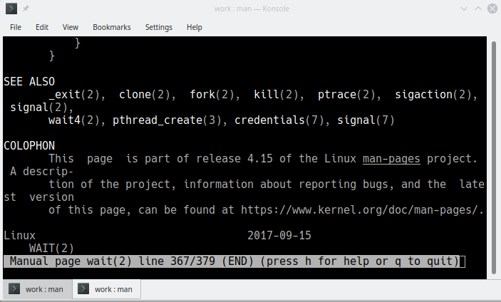
Traditional service delivery
`wait` help

Slide 16
Traditional service delivery
UNIX commands (2)
All commands:
  accept inputs from the standard input,
  is where UNIX gets the input for a command
  display output on standard output
  is where UNIX displays output from a command
  display error message on standard error
  is where UNIX displays any errors as a result of the execution of a command
UNIX has redirection capabilities: to redirect one or more of these (see “advanced bash” lesson)
Notes:
STREAMS is the native framework in Unix System V for implementing character device drivers, network protocols, and inter-process communication.
A Linux stream is data traveling in a Linux shell from one process to another through a pipe, or from one file to another as a redirect. ... Characters in Linux streams are either standard input (STDIN) or output (STDOUT) from a file or process, or error output streams from commands given to the Linux shell (STDERR)

Slide 17
Traditional service delivery
`ls` (1)
`ls` can be used to inquire about the various attributes of one or more files or directories.
You must have read permission to a directory to be able to use the ls command on that directory and the files under that directory.
The `ls` command generates the output to standard output, which can be redirected, using the UNIX redirection operator >, to a file.

Slide 18
Traditional service delivery
`ls` (2)
You can provide the names of one or more filenames or directories to the ls command. The file and directory names are optional. If you do not provide them, UNIX processes the current directory.
Be default, the list of files within a directory is sorted by filename. You can modify the sort order by using some of the flags.
You should also be aware that the files starting with . (period) will not be processed unless you use the -a flag with the ls command. This means that the entries . (single period) and .. (two consecutive periods) will not be processed by default.

Slide 19
Traditional service delivery
`ls`: Exercices
  Try and understand differences:
ls; ls -l; ls -al
  Try and understand differences:
ls -trl; ls -tl
- Try an output redirection:
ls -l > myfileout.txt

Slide 20
Traditional service delivery
File manipulation commands
File manipulation commands
It exists a set of file manipulation commands to manage files and directories.
To use these commands, the user needs to have right on the file to manage.
drwxrwxr-x 2 bertocco bertocco 20480 Dec 14 09:00 BACKUP
owner group size last_access_date file-name
drwxrwxr-x permissions representation:
d means it is a directory (- for a file)
rwx means readable, writable, executable by owner
rwx readable, writable, executable by group
r-x readable, NOT writable, executable by

Slide 21
Traditional service delivery
File manipulation commands
File Permissions
Understand the meaning of:
drwxrwxr-x 2 bertocco bertocco 4096 Apr 26 2018 config
-rw-rw-r-- 1 bertocco bertocco 10240 Mar 13 2017 config.tar
-rw------- 1 bertocco bertocco 960065536 Dec 3 22:02 core.3040
-rw-rw-r-- 1 bertocco bertocco 7290880 May 8 2017 demo_EGIconf.tar
drwxr-xr-x. 4 bertocco bertocco 4096 Dec 7 15:57 Desktop
drwx------. 12 bertocco bertocco 4096 Aug 13 19:01 dev
drwxr-xr-x. 14 bertocco bertocco 4096 Nov 28 17:18 Documents
drwxr-----. 13 bertocco bertocco 8192 Dec 10 12:35 Downloads
drwxrwxr-x 2 bertocco bertocco 147 Apr 24 2018 exchange
-rw-r--r-- 1 bertocco bertocco 181 Apr 13 2017 filmatini_utili.txt

Slide 22
Traditional service delivery
File manipulation commands
Change File Permissions
Chenge read permission (similarly for write ‘w’ and execute ‘x’):
-rw-rw-r-- 1 bertocco bertocco 0 Dec 14 15:30 pippo
$ chmod -r pippo # remove all read permissions. Check:
$ ls -l pippo
--w--w---- 1 bertocco bertocco 0 Dec 14 15:30 pippo
$ chmod +r pippo # add all read permissions, Check:
$ ls -l pippo
-rw-rw-r-- 1 bertocco bertocco 0 Dec 14 15:30 pippo
$ chmod -r pippo # remove a new time all permissions, to restart from
--w--w---- 1 bertocco bertocco 0 Dec 14 15:30 pippo
$ chmod u+r pippo # add read permission to user
$ ls -l pippo
-rw--w---- 1 bertocco bertocco 0 Dec 14 15:30 pippo
$ chmod g+r pippo # add read permission to group
$ ls -l pippo
-rw-rw---- 1 bertocco bertocco 0 Dec 14 15:30 pippo
$ chmod a+r pippo # add read permission to all
$ ls -l pippo
-rw-rw-r-- 1 bertocco bertocco 0 Dec 14 15:30 pippo

Slide 23
Traditional service delivery
File manipulation commands
Main file manipulation commands
  `touch` creates a file
  `mkdir mydir` creates a directory (where you are)
  `mkdir -p /onedir/twodir/threedir`
  `rmdir mydir` delete an empty directory
  `rm -rf` force to recursively delete a non empty directory
  `cp file1 file2` copy file1 on file2 (overwriting it if already exists,
  creating file2 if it does not exist)
  `cp -i file1 file2` before copy asks “are you sure?”
  `\cp file1 file2` remove the -i flag if set
  `rm file1` removes file1
  `mv file1 file2` moves file1 on file2 # it is the same of :
  `cp file1 file2`; `rm file1`
  BE VERY
  CAREFUL!!!

Slide 24
Traditional service delivery
File manipulation commands: Exercises
  Create a file
  Create a directory
  Create a directory tree
  Create files in the directory tree
  Remove a file
  remove a directory (emprty and not empty)
  remove a directory tree (emprty and not empty)
  Rename a file

Slide 25
Traditional service delivery
`cat`
`cat` is used to display a text file or to concatenate multiple files into a single file.
By default, the cat command generates outputs into the standard output and accepts input from standard input.
The cat command takes in one or more filenames as its arguments. The files are concatenated in the order they appear in the argument list.

Slide 26
Traditional service delivery
`cat`: Exercices
  Display file on a terminal
  cat testfile
  concatenate multiple files for display on the terminal
  cat testfile1 testfile2 testfile3
  concatenate these files into a file called testfile, use the redirection operator > as follows:
  cat testfile1 testfile2 testfile2 > testfile
  If the file testfile already exists, it is overwritten with the concatenated files testfile1, testfile2 and testfile3. If testfile already exists and you want to concatenate at the end of the existing file, instead of using the redirection operator >, you must use the >> (two consecutive greater than sign) operator as follows:
  cat testfile1 testfile2 testfile2 >> testfile

Slide 27
Traditional service delivery
`ln`
`ln` provides alternate names for the same file.
It links a file name to another one and it is possible to link a file to another name in the same directory or the same name in another directory.
When linking a filename to another filename, you can specify only two arguments: the source filename and the target filename. When linking a filename to a directory, you can specify multiple filenames to be linked to the same directory.
The flags that can be used with the ln command are as follows:
-s to create a soft link to another file or directory. In a soft link, the linked file contains the name of the original file. When an operation on the linked filename is done, the name of the original file in the link is used to reference the original file.
-f to ensure that the destination filename is replaced by the linked filename if the file already exists.

Slide 28
Traditional service delivery
`ln`: Exercices
If you want to link testfile1 to testfile2 in the current directory, execute the following command:
ln testfile1 testfile2
This creates a hard linked testfile2 linking it to tesftfile1. In this case, if one of the files is removed, the other will remain unaltered.
If testfile is in the current directory and is to be linked to testfile in the directory /u/testuser/testdir, execute the following command:
ln testfile /u/testuser/testdir
To create a symbolic link of testfile1 in the current directory, execute the following command:
ln -s testfile1 testfile2
This creates a linked testfile2, which will contain the name of testfile1. If you remove testfile1, you will be left with an orphan testfile2, which points to nowhere.

Slide 29
Traditional service delivery
Exercises
Verify that you are using bash:
echo $SHELL
Explore help command
type `help`
Explore help for `ls` command
type `man command_name`
List files `ls` or `ls -l` and check differences
List all files `ls -al`
List files by date (direct and reverse order) `ls -trl`

Slide 30
Traditional service delivery
Command `echo` and strings
When one or more strings are provided as arguments, echo by default repeats those stings on the screen.
Example (try)
echo This is a pen.
It is not necessary to surround the strings with quotes, as it does not affect what is written on the screen. If quotes (either single or double) are used, they are not repeated on the screen (try `echo “This is a pen.”`).
`echo` can also show the value of a particular variable if the name of the variable is preceded directly (i.e., with no intervening spaces) by the dollar character ($), which tells the shell to substitute the value of the variable for its name. Example (try):
x=5; echo The number is $x.

Slide 31
Traditional service delivery
Command `echo` examples
echo This is a pen.
x=5
echo The number is $x.
echo “The number is $x.”
Simple backup script
OF=/home/me/my-backup-$(date +%Y%m%d).tgz
tar -czf $OF <path>/dir_or_file_to_tar
ls -l (to check the result)

Slide 32
Traditional service delivery
`export`
`export` exports environment variables (also to children of the current process). Example:
ubuntu~$ export a=test_env
ubuntu:~$ echo $a
test_env
ubuntu:~$ /bin/bash
ubuntu:~$ echo $a
test_env
ubuntu:~$ exit
exit
ubuntu:~$ echo $a
test_env
`export` called with no arguments prints all of the variables in the shell's environment.
`unset` frees variables

Slide 33
Traditional service delivery
User related commands: passwd
`passwd` changes user’s password
Example: type `passwd`
$ passwd
Changing password for bertocco.
(current) UNIX password:
Enter new UNIX password:
Retype new UNIX password:
Sorry, passwords do not match
passwd: Authentication token manipulation error
passwd: password unchanged
$ passwd
Changing password for bertocco.
(current) UNIX password:
Enter new UNIX password:
Retype new UNIX password:
passwd: password updated successfully

Slide 34
Traditional service delivery
User related commands: who and whoami
`who` show who is logged on
Print information about users who are currently logged in.
`whoami`
Print the user name associated with the current effective user ID.
Exercise:
try the commands and then type `man who`
and try some option

Slide 35
Traditional service delivery
Locating commands
To execute a command, UNIX has to locate the command before it can execute it
UNIX uses the concept of search path to locate the commands.
Search path is a list of directories in the order to be searched for locating commands. Usually it contains standard paths (/bin, /usr/bin, ...)
Modify the search path for your environment modifying the PATH environment variable

Slide 36
Traditional service delivery
`which`
`which` can be used to find whether a particular command exists in you search path. If it does exist, which tells you which directory contains that command.
Examples (try with existing and not existing commands):
which pippo
which gedit
which vim

Slide 37
Traditional service delivery
File information commands
Each file and directory in UNIX has several attributes associated with it. UNIX provides several commands to inquire about and process these attributes

Slide 38
Traditional service delivery
`find`
`find` search for the particular file giving the flexibility to search for a file by various attributes: name, size, permission, and so on. Additionally, the find command allows to execute commands on the files that are found as a result of the search.
Command:
find directory-name search-expression

Slide 39
Traditional service delivery
`find` Examples (try)
find . -name pippo
find /etc -name networking
find /etc -name netw # nothing found
find /etc -name netw\*
find -size 18 # 18 blocks files
find -size 1024c # 1024 bytes
find . -print
Try other options

Slide 40
Traditional service delivery
`file`
`file` can be used to determine the type of the specified file.
Examples (try):
$ file /etc/networking/interfaces
/etc/networking/interfaces: cannot open `/etc/networking/interfaces’ (No such file or directory)
$ file /etc/network/interfaces
/etc/network/interfaces: ASCII text

Slide 41
Traditional service delivery
UNIX Processes
Usually, a command or a script that you can execute consists of one or more processes.
The processes can be categorized into the following broad groups:
Interactive processes, which are those executed at the terminal. Can execute either in foreground or in background. In a foreground process, the input is accepted from standard input, output is displayed to standard output, and error messages to standard error. In background, the terminal is detached from the process so that it can be used for executing other commands. It is possible to move a process from foreground to background and vice versa (<ctrl+bg>; <ctrl+fg>.
Batch processes are not submitted from terminals. They are submitted to job queues to be executed sequentially.
Deamons are never-ending processes that wait to service requests from other processes.

Slide 42
Traditional service delivery
Process attributes
In UNIX, each process has a number of attributes associated with it. The following is a list of some of these attributes:
  Process ID is a unique identifier assigned to each process
  Real User ID is the user ID of the user who initiated the process.
  Effective User ID is the user ID associated with each process. It determines the process's access to system resources. Under normal circumstances, the Real User ID and Effective User ID are one and the same. They can differ by setting the Set User ID flag on the executable program, if you want a program to be executed with special privilege without actually granting the user special privilege.
  Real Group ID is the group ID of the user who initiated the process.
  Effective Group ID is the group ID that determines the access rights. The effective group ID is similar to the effective user ID.
  Priority (Nice Number) is the priority associated with a process relative to the other processes executing in the system.

Slide 43
Traditional service delivery
Process Related Commands
a command or a script that you can execute consists of one or more processes.
The main are:
  `kill`
  `ps`
  `wait`
  `nohup`
  `sleep`

Slide 44
Traditional service delivery
`ps`
`ps` command is used to find out which processes are currently running.
Exercises:
  Try the following commands, check the differences in the output. Read the flag meaning using
  `man ps`:
  ps
  ps -ef
  ps -aux

Slide 45
Traditional service delivery
`kill`
`kill` is used to send signals to an executing process. The process must be a nonforeground process for you to be able to send a signal to it using this command.
The default action of the command is to terminate the process by sending it a signal. If the process has been programmed for receiving such a signal. In such a case, the process will process the signal as programmed.
You can kill only the processes initiated by you. However, the root user can kill any process in the system.
The flags associated with the kill commands are as follows:
-l to obtain a list of all the signal numbers and their names that are supported by the system.
-’signal number’ is the signal number to be sent to the process. You can also use a signal name in place of the number. The strongest signal you can send to a process is 9 or kill.

Slide 46
Traditional service delivery
`kill` Exercises
Look for a process PID of a process belonging of you (using ps) and kill it using two different signals:
-9 and -15.
List all available signals and red the differences between the two signal previously used

Slide 47
Traditional service delivery
`wait` with exercises
`wait` is tp wait for completion of jobs. It takes one or more process IDs as arguments. This is useful while doing shell programming when you want a process to be finished before the next process is invoked.
If you do not specify a process ID, UNIX will find out all the processes running for the current environment and wait for termination of all of them.
Examples:
  `wait` If you want to find out whether all the processes you have started have completed
  `wait 15060` If you want to find out whether the process ID 15060 has completed
The return code from the wait command is zero if you invoked the wait command without any arguments. If you invoked the wait command with multiple process IDs, the return code depends on the return code from the last process ID specified.

Slide 48
Traditional service delivery
`wait`: exercise
From a shell launch an infinite process using:
`while true; do echo looping; sleep 2; done`
From another shell find the pid of this process using `ps` command
From a third shell launch a process waiting for the end of the initial infinite loop
pid=<your_process_pid>; wait $pid
From a fourth shell kill the first process (pid)
Check in the third shell that your waiting process ended
NOT WORKING using shells. Needs scripting: next time.

Slide 49
Traditional service delivery
`nohup`
When you are executing processes under UNIX, they can be running in foreground or background. In a foreground process, you are waiting at the terminal for the process to finish. Under such circumstances, you cannot use the terminal until the process is finished. You can put the foreground process into background as follows:
  ctrl-z
  bg
The processes in UNIX will be terminated when you logout of the system or exit the current shell whether they are running in foreground or background. The only way to ensure that the process currently running is not terminated when you exit is to use the nohup command.

Slide 50
Traditional service delivery
`nohup`
The nohup command has default redirection for the standard output. It redirects the messages to a file called nohup.out under the directory from which the command was executed. That is, if you want to execute a script called sample_script in background from the current directory, use the following command:
nohup sample_script &
The & (ampersand) tells UNIX to execute the command in background. If you omit the &, the command is executed in foreground. In this case, all the messages will be redirected to nohup.out under the current directory. If the nohup.out file already exists, the output will be appended to it.

Slide 51
Traditional service delivery
`nohup`: Examples
nohup grep sample_string * &
nohup grep sample_string * > mygrep.out &
nohup my_script > my_script.out &

Slide 52
Traditional service delivery
`sleep`
`sleep` wait for a certain period of time between execution of commands. This can be used in cases where you want to check for, say, the presence of a file, every 15 minutes. The argument is specified in seconds.
Examples: If you want to wait for 5 minutes between commands, use:
sleep 300
Small shell script that reminds you twice to go home, with a 5-minute wait between reminders:
echo "Time to go home"
sleep 300
echo "Final call to go home ....."

Slide 53
Traditional service delivery
File Content Related Commands
Commands that can be used to look at the contents of the file or parts of it. You can use these commands to look at the top or bottom of a file, search for strings in the file, and so on.

Slide 54
Traditional service delivery
`more`
`more` can be used to display the contents of a file one screen at a time. By default, the more command displays one screen worth of data at a time. The more command pauses at the end of display of each page. To continue, press a space bar so that the next page is displayed or press the Return or Enter key to display the next line. Mostly the more command is used where output from other commands are piped into the more command for display.
Try

Slide 55
Traditional service delivery
`less`
`less` is to view the contents of a file. This may not be available by default on all UNIX systems. It behaves similarly to the more command. The less command allows you to go backward as well as forward in the file by default.
Try
Cat <a big file> | less

Slide 56
Traditional service delivery
`tail`
`tail` to display, on standard output, a file starting from a specified point from the start or bottom of the file. Whether it starts from the top of the file or end of the file depends on the parameter and flags used. One of the flags, -f, can be used to look at the bottom of a file continuously as it grows in size. By default, tail displays the last 10 lines of the file.

Slide 57
Traditional service delivery
`tail` exercises
tail -f500 /var/log/syslog
list of flags that can be used with the tail command:
-c number to start from the specified character position number.
-b number to start from the specified 512-byte block position number.
-k number to start from the specified 1024-byte block position number.
-n number to start display of the file in the specified line number.
-r number to display lines from the file in reverse order.
-f to display the end of the file continuously as it grows in size.

Slide 58
Traditional service delivery
`wc`
`wc` counts the number of bytes, words, and lines in specified files. A word is a number of characters stringed together delimited either by a space or a newline character.
Following is a list of flags that can be used with the wc command:
-l to count only the number of lines in the file.
-w to count only the number of words in the file.
-c to count only the number of bytes in the file.
You can use multiple filenames as argument to the wc command.

Slide 59
Traditional service delivery
`wc` exercices
wc file
wc -w file
cat <file> | wc -l
wc -w <file1> <file2>

Slide 60
Traditional service delivery
`read`
`read` is used in shell scripts to read each field from a file and assign them to shell variables.
A field is a string of bytes that are separated by a space or newline character. If the number of fields read is less than the number of variables specified, the rest of the fields are unassigned.
Flag -r to treat a \(backslash) as part of the input record and not as a control character.

Slide 61
Traditional service delivery
`read` Examples
Example following is a piece of shell script code that reads first name and last name from namefile and prints them:
- create the file
cat <<EOF > names_list.txt
Sara Bertocco
Mario Rossi
John Doe
EOF
- Read the file by line and print on standard output
while read -r lname fname
do
echo $lname","$fname
done < names_list.txt

Slide 62
Traditional service delivery
`read` Examples
Example following is a piece of shell script code that reads a file by line:
while read -r line
do
printf 'Line: %s\n' "$line"
done < names_list.txt
The file name can be indicate also with full path name.

Slide 63
Traditional service delivery
`tee`
`tee` to execute a command and want its output redirected to multiple files in addition to the standard output, use the tee command. The tee command accepts input from the standard input, so it is possible to pipe another command to the tee command.
The default of the tee command is to overwrite the specified file.
-a is an optional flag to append to the end of the specified file

Slide 64
Traditional service delivery
`tee` Examples (try)
- use the cat command on file1 to display on the screen and make a copy of file1 on file2, use the tee command as follows:
cat file1 | tee file2 | more
- make the same but appending file1 to the end of an already existing file2 using the flag -a :
cat file1 | tee -a file2 | more

