Slide 1
Bash Lecture 3 – Bash Scripting

Slide 2
Traditional service delivery
Bibliography and learning materials
Bibliography:
https://www.rigacci.org/docs/biblio/online/sysadmin/toc.htm
https://www.tldp.org/LDP/abs/html/
Learning Materials:
http://www.ee.surrey.ac.uk/Teaching/Unix/
https://github.com/bertocco/abilita_info_units_2021

Slide 3
Traditional service delivery
Arguments of this lesson
Process related commands (nohup, sleep)
File content related commands (more, less, tail, read, tee, wc)
Redirection
File content search commands (grep, egrep)
Status commands
Unix wildcards (* ? [ ])
Editors
Bash scripting programming:
  Scripts
  Variables

Slide 4
Traditional service delivery
`nohup`
When you are executing processes under UNIX, they can be running in foreground or background. In a foreground process, you are waiting at the terminal for the process to finish. Under such circumstances, you cannot use the terminal until the process is finished. You can put the foreground process into background as follows:
  ctrl-z
  bg
The processes in UNIX will be terminated when you logout of the system or exit the current shell whether they are running in foreground or background. The only way to ensure that the process currently running is not terminated when you exit is to use the nohup command.

Slide 5
Traditional service delivery
`nohup`
The nohup command has default redirection for the standard output. It redirects the messages to a file called nohup.out under the directory from which the command was executed. That is, if you want to execute a script called sample_script in background from the current directory, use the following command:
nohup sample_script &
The & (ampersand) tells UNIX to execute the command in background. If you omit the &, the command is executed in foreground. In this case, all the messages will be redirected to nohup.out under the current directory. If the nohup.out file already exists, the output will be appended to it.

Slide 6
Traditional service delivery
`nohup`: Examples
nohup grep sample_string * &
nohup grep sample_string * > mygrep.out &
nohup my_script > my_script.out &

Slide 7
Traditional service delivery
`sleep`
`sleep` wait for a certain period of time between execution of commands. This can be used in cases where you want to check for, say, the presence of a file, every 15 minutes. The argument is specified in seconds.
Examples: If you want to wait for 5 minutes between commands, use:
sleep 300
Small shell script that reminds you twice to go home, with a 5-minute wait between reminders:
echo "Time to go home"
sleep 300
echo "Final call to go home ....."

Slide 8
Traditional service delivery
File Content Related Commands
Commands that can be used to look at the contents of the file or parts of it. You can use these commands to look at the top or bottom of a file, search for strings in the file, and so on.

Slide 9
Traditional service delivery
`more`
`more` can be used to display the contents of a file one screen at a time. By default, the more command displays one screen worth of data at a time. The more command pauses at the end of display of each page. To continue, press a space bar so that the next page is displayed or press the Return or Enter key to display the next line. Mostly the more command is used where output from other commands are piped into the more command for display.
Try

Slide 10
Traditional service delivery
`less`
`less` is to view the contents of a file. This may not be available by default on all UNIX systems. It behaves similarly to the more command. The less command allows you to go backward as well as forward in the file by default.
Try
Cat <a big file> | less

Slide 11
Traditional service delivery
`tail`
`tail` to display, on standard output, a file starting from a specified point from the start or bottom of the file. Whether it starts from the top of the file or end of the file depends on the parameter and flags used. One of the flags, -f, can be used to look at the bottom of a file continuously as it grows in size. By default, tail displays the last 10 lines of the file.

Slide 12
Traditional service delivery
`tail` exercises
tail -f500 /var/log/syslog
list of flags that can be used with the tail command:
-c number to start from the specified character position number.
-b number to start from the specified 512-byte block position number.
-k number to start from the specified 1024-byte block position number.
-n number to start display of the file in the specified line number.
-r number to display lines from the file in reverse order.
-f to display the end of the file continuously as it grows in size.

Slide 13
Traditional service delivery
`read`
`read` is used in shell scripts to read each field from a file and assign them to shell variables.
A field is a string of bytes that are separated by a space or newline character. If the number of fields read is less than the number of variables specified, the rest of the fields are unassigned.
Flag -r to treat a \(backslash) as part of the input record and not as a control character.

Slide 14
Traditional service delivery
`read` Examples
Example following is a piece of shell script code that reads first name and last name from namefile and prints them:
- create the file
cat <<EOF > names_list.txt
Sara Bertocco
Mario Rossi
John Doe
EOF
- Read the file by line and print on standard output
while read -r lname fname
do
echo $lname","$fname
done < names_list.txt

Slide 15
Traditional service delivery
`read` Examples
Example following is a piece of shell script code that reads a file by line:
while read -r line
do
printf 'Line: %s\n' "$line"
done < names_list.txt
The file name can be indicated also with full path name.

Slide 16
Traditional service delivery
`tee`
`tee` to execute a command and want its output redirected to multiple files in addition to the standard output. The tee command accepts input from the standard input, so it is possible to pipe another command to the tee command.
The default of the tee command is to overwrite the specified file.
-a is an optional flag to append to the end of the specified file

Slide 17
Traditional service delivery
`tee` Examples (try)
- use the cat command on file1 to display on the screen and make a copy of file1 on file2, use the tee command as follows:
cat file1 | tee file2 | more
- make the same but appending file1 to the end of an already existing file2 using the flag -a :
cat file1 | tee -a file2 | more

Slide 18
Traditional service delivery
`wc`
`wc` counts the number of bytes, words, and lines in specified files. A word is a number of characters stringed together delimited either by a space or a newline character.
Following is a list of flags that can be used with the wc command:
-l to count only the number of lines in the file.
-w to count only the number of words in the file.
-c to count only the number of bytes in the file.
You can use multiple filenames as argument to the wc command.

Slide 19
Traditional service delivery
`wc` exercices
wc file
wc -w file
cat <file> | wc -l
wc -w <file1> <file2>

Slide 20
Traditional service delivery
Redirection (1)
Each UNIX command (or program) is connected to three communication channels between the command and its environment:
Standard input (stdin) where the command read its input
Standard output (stdout) where the command writes its output
Standard error (stderr) where the command writes its error
When a command is executed via an interactive shell, the streams are typically connected to the text terminal on which the shell is running, but can be changed with redirection or with a pipeline
Standard Input, Standard Output and Standard Error Symbols:
redirect stdout to a file | redirect stderr and stdout to a file
redirect stderr to a file | redirect stderr and stdout to stdout
redirect stdout to stderr | redirect stderr and stdout to stderr
redirect stderr to stdout
standard input | 0<
standard output | 1>
standard error | 2>
Notes:
stdin
Generally standard input, referred to as "stdin", comes from the keyboard.
When you type stuff, you're typing it on stdin (a standard input terminal). A standard input device, which is usually the keyboard, but Linux also allows you take standard input from a file.
For example:
cat < myfirstscript
stdout
Standard output, as created at process creating time, goes to the console, your terminal or an X terminal. Exactly where output is sent clearly depends on where the process originated.
Our console or terminal should be the device that is accepting the output. Running the command:
cat file

Slide 21
Traditional service delivery
Redirection (2)
Redirection [> &> >& >>].
Redirect stdout to file (overwrite filename if it already exists):
scriptname > filename
scriptname >> filename # appends the output of scriptname to file filename. If
# filename does not already exist, it is created
Redirect stderr to file (overwrite filename if it already exists):
scriptname 2> filename
Redirect both the stdout and the stderr of command to filename:
command &> filename redirects both the stdout and the stderr of command to filename
Redirects stdout of command to stderr:
command >&2
Redirects stderr of command to stdout:
command 2>&1

Slide 22
Traditional service delivery
Redirection: Examples
Stdout redirected to file
find . -name pippo > find-output.txt
Stderr redirected to file
find . -name pippo 2> find-errors.txt
discards any errors that are generated by the find command
find / -name "*" -print 2> /dev/null
/dev/null is a simple device (implemented in software and not corresponding to any hardware device on the system).
/dev/null looks empty when you read from it.
Writing to /dev/null does nothing: data written to this device simply "disappear."
Often a command's standard output is silenced by redirecting it to /dev/null, and this is perhaps the null device's commonest use in shell scripting:
command > /dev/null
Redirect both stdout and stderr to file
find . -name pippo &> out_and_err.txt
Redirect stderr to stdout: find . -name filename 2>&1
Redirect stdout to stderr: find . -name filename 1>&2

Slide 23
Traditional service delivery
Special characters: Pipe
Pipe [ | ]. Passes the output (stdout) of a previous command to the input (stdin) of the next one, or to the shell. This is a method of chaining commands together.
echo ls -l | sh
# Passes the output of "echo ls -l" to the shell,
#+ with the same result as a simple "ls -l".
cat *.lst | sort | uniq
# Merges and sorts all ".lst" files, then deletes duplicate lines.
A pipe sends the stdout of one process to the stdin of another. In a typical case, a command, such as cat or echo, pipes a stream of data to a command that transforms it in input for processing:
cat $filename1 $filename2 | grep $search_word

Slide 24
Traditional service delivery
Redirection with pipe and tee examples
Examples of redirection of the output of a command to be used as input of another:
Display the output of a command (in this case ls) by pages:
ls -la | less
Count files in a directory:
ls -l | wc -l
Count the number of rows containing of the word “canadesi” in the file vialactea.txt
grep canadesi vialactea.txt | wc -l
Count the number of words in the rows containing the word “canadesi”
`tee` is useful to redirect output both to stdout and to a file. Example:
find . -name filename.ext 2>&1 | tee -a log.txt
This will take stdout and append it to log file. The stderr will then get converted to stdout which is piped to tee which appends it to the log and sends it to stdout which will either appear on the tty or can be piped to another command.
To go deep: https://stackoverflow.com/questions/2871233/write-stdout-stderr-to-a-logfile-also-write-stderr-to-screen

Slide 25
Traditional service delivery
Exercise: redirection
Create a directory and file tree like this one:
my_examples /ex1.dir
/ex2.txt
/ex3.dir
/ex3.dir/file1.txt
/ex3.dir/file2.txt
/ex3.dir/file3.txt
Remove read permissions to directory /ex2.dir
Redirect output on a file. Error is displayed on terminal
Redirect error on a file. Output is displayed on terminal
Verify the content of the files
Stderr redirected to file
Redirect output and errors symultaneously
Use pipe to redirect the output of a command to another command and to a file
Use tee to redirect output both to stdout and to a file

Slide 26
Traditional service delivery
File Content Search Commands
For searching for a pattern in one or more files, use the grep series of commands. The grep commands search for a string in the specified files and display the output on standard output.

Slide 27
Traditional service delivery
`egrep`
`egrep` extended version of grep command. This command searches for a specified pattern in one or more files and displays the output to standard output. The pattern can be a regular expression to match any single character.
* to match one or more single characters that precede the asterisk.
^ to match the regular expression at the beginning of a line.
$ to match the regular expression at the end of a line.
+ to match one or more occurrences of a preceding regular expression.
? to match zero or more occurrences of a preceding regular expression.
[ ] to match any of the characters specified within the brackets.

Slide 28
Traditional service delivery
`egrep` Examples
Let us assume that we have a file called file1 whose contents are shown below using the more command:
more file1
***** This file is a dummy file *****
which has been created
to run a test for egrep
grep series of commands are used by the following types of people
programmers
end users
Believe it or not, grep series of commands are used by pros and novices alike
***** THIS FILE IS A DUMMY FILE *****

Slide 29
Traditional service delivery
`egrep` Examples
If you are just interested in finding the number of lines in which the specified pattern occurs, use the -c flag as in the following command:
egrep -i -c dummy file1
If you want to get a list of all lines that do not contain the specified pattern, use the -v flag as in the following command:
egrep -i -v dummy file1
If you are interested in searching for a pattern that you want to search as a word, use the -w flag as in the following command:
egrep -w grep file1

Slide 30
Traditional service delivery
`egrep` Examples
If you want to find all occurrences of dummy, use the following command:
egrep dummy file1
***** This file is a dummy file *****
If you want to find all occurrences of dummy, irrespective of the case, use the -i flag as in the following command:
egrep -i dummy file1
***** This file is a dummy file *****
***** THIS FILE IS A DUMMY FILE *****
If you want to display the relative line number of the line that contains the pattern being searched, use the -n flag as in the following command:
egrep -i -n dummy file1
1:***** This file is a dummy file *****
8:***** THIS FILE IS A DUMMY FILE *****

Slide 31
Traditional service delivery
Status commands
Several commands that display the status of various parts of the system. These commands can be used to monitor the system status at any point in time.

Slide 32
Traditional service delivery
`date`
`date` command to display the current date and time in a specified format. If you are root user, use the date command to set the system date.
To display the date and time, you must specify a + (plus) sign followed by the format. The format can be as follows:
%A to display date complete with weekday name.
%b or %h to display short month name.
%B to display complete month name.
%c to display default date and time representation.
%d to display the day of the month as a number from 1 through 31.
%D to display the date in mm/dd/yy format.
%H to display the hour as a number from 00 through 23.
%I to display the hour as a number from 00 through 12.
%j to display the day of year as a number from 1 through 366.
%m to display the month as a number from 1 through 12.
%M to display the minutes as a number from 0 through 59.
%p to display AM or PM appropriately.
%r to display 12-hour clock time (01-12) using the AM-PM notation.
%S to display the seconds as a number from 0 through 59.

Slide 33
Traditional service delivery
`date`
Other format flags:
%T to display the time in hh:mm:ss format for 24 hour clock.
%U to display the week number of the year as a number from 1 through 53 counting Sunday as first day of the week.
%w to display the day of the week as a number from 0 through 6 with Sunday counted as 0.
%W to display the week number of the year as a number from 1 through 53 counting Monday as first day of the week.
%x to display the default date format.
%X to display the time format.
%y to display the last two digits of the year from 00 through 99.
%Y to display the year with century as a decimal number.
%Z to display the time-zone name, if available.

Slide 34
Traditional service delivery
`date`: Exercises
Try some example of `date` command usage with different display of day, month, year
If you want to display the date without formatting, use date without any formatting descriptor as follows:
date
Sat Dec 7 11:50:59 EST 1996
If you want to display only the date in mm/dd/yy format, use the following commands:
date +%m/%d/%y
12/07/96
If you want to format the date in yy/mm/dd format and time in hh:mm:ss format, use the following command:
date "+%y/%m/%d %H:%M:%S"
96/12/07 11:57:27
Following is another way of formatting the date:
date +%A","%B" "%d","%Y
Sunday,December 15,1996

Slide 35
Traditional service delivery
Linux wildcards
There are three main wildcards in Linux:
Asterisk (*) – matches one or more occurrences of any character, including no character.
Question mark (?) – represents or matches a single occurrence of any character.
Bracketed characters ([ ]) – matches any occurrence of character enclosed in the square brackets.

Slide 36
Traditional service delivery
Editors
Editor
In dictionary.cambridge.org: is a piece of software for editing text on a compute
In www.merriam-webster.com: is a computer program that permits the user to create or modify data (such as text or graphics) especially on a display screen

Slide 37
Traditional service delivery
Editor types
In Linux, text editor are of two kinds:
graphical user interface (GUI) based
  gedit
  bluefish
  lime ……...
command line text editors (console or terminal)
  nano
  pico
  vi/vim
  emacs …….
Notes:
The console is typically the primary interface for managing a computer, eg while it is still booting up. A terminal is a session which can receive and send input and output for command-line programs. The console is a special case of these. The shell is a program which is used for controlling and running programs.
Shell is a program which processes commands and returns output , like bash in Linux . Terminal is a program that run a shell , in the past it was a physical device (Before terminals were monitors with keyboards, they were teletypes) and then its concept was transferred into software , like Gnome-Terminal .

Slide 38
Traditional service delivery
Nano
Nano is the built-in basic text editor for many popular linux distros.
It doesn’t take any learning or getting used to, and all its commands and prompts are displayed at the bottom.
Use Nano if:
  You’re new to the terminal
  you just need to get into a file for a quick change.
Compared to more advanced editors in the hands of someone who knows what they’re doing, some tasks are cumbersome and non-customizable.
How to Nano:
from your terminal, enter `nano` and the filename you want to edit.
If the file doesn’t already exist, it will once you save it.
Commands are listed across the bottom and are triggered with the Control (CTRL) key. For example, to find something in your file, hold CTRL and press W, tell it what you’re searching for, and press Enter. Press CTRL+X to exit, then follow the prompts at the bottom of the screen.
Notes:
The console is typically the primary interface for managing a computer, eg while it is still booting up. A terminal is a session which can receive and send input and output for command-line programs. The console is a special case of these. The shell is a program which is used for controlling and running programs.
Shell is a program which processes commands and returns output , like bash in Linux . Terminal is a program that run a shell , in the past it was a physical device (Before terminals were monitors with keyboards, they were teletypes) and then its concept was transferred into software , like Gnome-Terminal .

Slide 39
Traditional service delivery
GNU emacs
Emacs has so many available features like a terminal, calculator, calendar, email client, web browser, and Tetris, it’s often spoken of as an operating system itself.
Starting Emacs is relatively simple, but more you learn, the more there is to learn.
How to Emacs:
Emacs commands are accessed through keyboard combinations of CTRL or ALT and another keystroke. When you see shortcuts that read C-h or M-x, C stands for the control key and M stands for the Alt key (or Escape, depending on your system).
Enter `emacs` in your terminal, and access the built-in tutorial with C-h t. That means, while holding CTRL, press H, then T.
Or, try key combination C-h r to open the manual within Emacs. You can also use the manual as a playground; just remember to quit without saving by pressing key combination C-x C-c.
Notes:
The console is typically the primary interface for managing a computer, eg while it is still booting up. A terminal is a session which can receive and send input and output for command-line programs. The console is a special case of these. The shell is a program which is used for controlling and running programs.
Shell is a program which processes commands and returns output , like bash in Linux . Terminal is a program that run a shell , in the past it was a physical device (Before terminals were monitors with keyboards, they were teletypes) and then its concept was transferred into software , like Gnome-Terminal .

Slide 40
Traditional service delivery
Helpful Emacs links
Emacs wiki
https://www.emacswiki.org/emacs/SiteMap
GNU Guided Tour
https://www.gnu.org/software/emacs/tour/
Cornell Emacs Quick Reference
https://www.cs.cornell.edu/courses/cs312/2006fa/software/quick-emacs.html
Notes:
The console is typically the primary interface for managing a computer, eg while it is still booting up. A terminal is a session which can receive and send input and output for command-line programs. The console is a special case of these. The shell is a program which is used for controlling and running programs.
Shell is a program which processes commands and returns output , like bash in Linux . Terminal is a program that run a shell , in the past it was a physical device (Before terminals were monitors with keyboards, they were teletypes) and then its concept was transferred into software , like Gnome-Terminal .

Slide 41
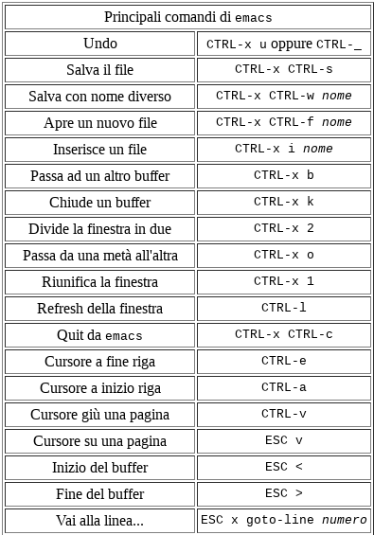
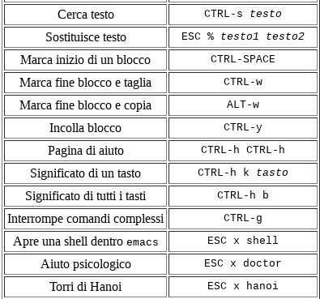
Traditional service delivery
Main Emacs commands
http://www.di.unipi.it/~bozzo/fino/appunti/node2.html

Slide 42
Traditional service delivery
vi/vim
Vi, typically comes with your distro-of-choice.
Vim is a vi successor with some improvements. It runs by default on OS X and some Linux distributions when `vi` is run.
VI has two modes of operation (is a “modal” editor):
Command mode for navigating files: commands which cause action to be taken on the file
Insert mode for editing text: in which entered text is inserted into the file.
Because Vi is navigated through the use of keyboard commands and shortcuts, it is better experienced than explained.

Slide 43
Traditional service delivery
How to Vi or Vim
Enter `vi` or `vim` in your terminal.
When you enter Vi, you begin in command mode and navigate using keyboard commands and the H, J, K, and L keys to move left, down, up, and right, respectively (but arrows use is possible in the most recent versions).
To enter in editing mode press:
‘a’ to append to the file
‘i’ to insert
pressing the <Esc> (Escape) key turns off the Insert mode.
To exit Vim without saving, press ESC to enter command mode, then press : (colon) to access the command line (a prompt appears at the very bottom) and enter q!.
To save and quit, you could use that prompt and the key combination :wq, or hold down SHIFT and press Z two times (the shortcut SHIFT+ZZ).
The : (colon) operator begins many commands like :help for help, or :w to save.
If you’re stuck at the prompt and don’t remember the operator you want to use, enter : (colon), then press CTRL+D for a list of possibilities.

Slide 44
Traditional service delivery
Helpful VI links
Basic vi Commands
https://www.cs.colostate.edu/helpdocs/vi.html
Swathmore’s Tips and Tricks
https://www.cs.swarthmore.edu/oldhelp/vim/home.html
Linux Academy’s Vim Reference Guide
https://www.linuxtrainingacademy.com/vim-cheat-sheet/
https://acloudguru.com/blog/engineering/a-vim-cheat-sheet-reference-guide
Notes:
The console is typically the primary interface for managing a computer, eg while it is still booting up. A terminal is a session which can receive and send input and output for command-line programs. The console is a special case of these. The shell is a program which is used for controlling and running programs.
Shell is a program which processes commands and returns output , like bash in Linux . Terminal is a program that run a shell , in the past it was a physical device (Before terminals were monitors with keyboards, they were teletypes) and then its concept was transferred into software , like Gnome-Terminal .

Slide 45
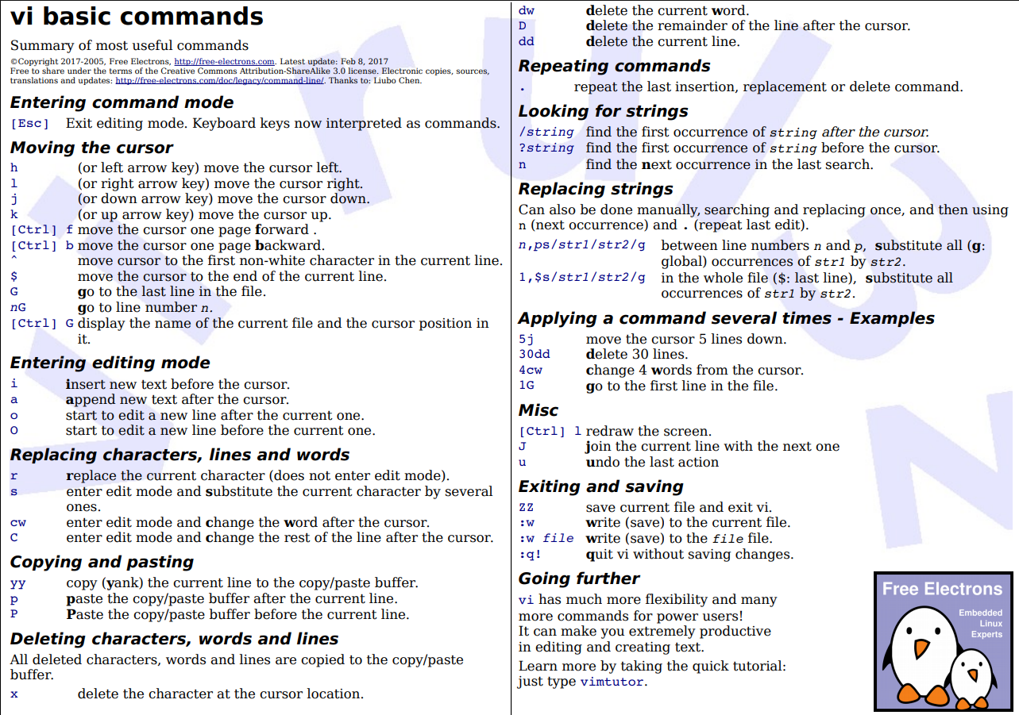

Slide 46
Traditional service delivery
The editor war
Technologies available in Information Technology are a lot.
Often, to solve a problem, you can choose between different instruments. The rule to base your choose is:
It does not exist “the best tool” but “the best tool to solve your specific problem”.
Sometimes different tools are more or less equivalent.
This is the case of editors emacs and vim:
https://en.wikipedia.org/wiki/Editor_war

Slide 47
Traditional service delivery
Choose your editor
Try an editor and its tutorial,
watch videos on how to use it for your intended purpose,
spend a day or two using it with real files training your fingers.
The best editor for you is the one that makes you feel like you’re easily getting things done.

Slide 48
Traditional service delivery
Shell scripting abilities
Many shells have scripting abilities:
Executes sequentially multiple commands written in a script as if they were typed from the keyboard.
Most shells offer additional programming constructs that extend the scripting feature into a programming language.

Slide 49
Traditional service delivery
What is a script
A script is, in the simplest case, a list of system commands stored in a file.
Place commands in a script is useful
to avoid having to retype them time and again
to be able to modify and customize the script for a particular application
to use the script as a program/command

Slide 50
Traditional service delivery
The sha-bang #!
Every script starts with the sha-bang (#!) at the head, followed by the full path name of an interpreter.
Examples:
#!/bin/sh
#!/bin/bash
#!/usr/bin/perl
This tells your system that the file is a set of commands to be fed to the command interpreter indicated by the path.
The command interpreter executes the commands in the script, starting at the top (the line following the sha-bang line), and ignoring comments.
Notes:
The path given at the "sha-bang" must be correct, otherwise an error message -- usually "Command not found." -- will be the only result of running the script.
The #! line in a shell script will be the first thing the command interpreter (sh or bash) sees. Since this line begins with a #, it will be correctly interpreted as a comment when the command interpreter finally executes the script. The line has already served its purpose - calling the command interpreter.
If, in fact, the script includes an extra #! line, then bash will interpret it as a comment.

Slide 51
Traditional service delivery
Execute the script
The script execution requires the script has “execute” permissions:
chmod +rx scriptname (gives everyone read/execute permission)
chmod u+rx scriptname (gives only the script owner read/execute permission)
The script can be executed issuing:
./scriptname
The script can be made available as a command:
  moving the script to /usr/local/bin (as root), making it available to all users as a system wide executable. The script could then be invoked by simply typing scriptname [ENTER] from the command-line.
  Including the directory containing the script in the user's $PATH

Slide 52
Traditional service delivery
Exercise: a first script
Write a script that upon invocation
  Says “Hello!”
  shows the time and date
  The script then saves this information to a logfile
Make the script executable
Execute the script
Make the script available as a command

Slide 53
Traditional service delivery
Special characters (1)
Special characters have a meaning beyond its literal meaning
Comments [#]. Lines beginning with a # (with the exception of #!)
# This line is a comment.
Comments may also occur following the end of a command.
echo "A comment will follow." # Comment here.
Comments may also follow whitespace at the beginning of a line.
# Note
Command separator [semicolon ;] Permits putting two or more commands on the same line.
echo hello; echo world
Escape [backslash \] This is a mechanism to express litterally a special charactrer.
For example the \ may be used to escape " and ' echoing a string:
echo This is a double quote \” # This is a double quote ”

Slide 54
Traditional service delivery
Special characters (2)
Command substitution [backquotes or backticks `]. The `command` construct makes available the output of command for assignment to a variable.
a=`pwd`
echo $a # display the path of your location
Wild card [asterisk *]. The * character serves as a "wild card", it matches every filename in a given directory or every character in a string.
Run job in background [and &]. A command followed by an & will run in the background.
bash$ sleep 10 &
[1] 850
[1]+ Done sleep 10
Within a script, commands and even loops may run in the background.
To bring the script in foreground type `fg` or `CTRL Z fg`
To bring the script in background type `fg` or `CTRL Z bg`
Complete reference:
https://www.tldp.org/LDP/abs/html/special-chars.html

Slide 55
Exercise: special characters
Write a commented command and execute it
Write two commands on the same row and execute them
Make the echo of a string containing one or more escaped characters
Make the echo of a command (like ls or pwd) output
Use wildcard to list all files starting with ‘a’ in your directory
Download from github the script infinite_loop_noout.sh, make it executable if needed, execute it in background, recall it in foreground, stop it

Slide 56
Traditional service delivery
UNIX Variables
Variables are how programming and scripting languages represent data. A variable is a label, a name assigned to a location holding data.
Standard UNIX variables are split into two categories:
  environment variables:
  if set at login, are valid for the duration of the session
  shell variables:
  apply only to the current instance of the shell and are used to set short-term working conditions;
By convention, environment variables have UPPER CASE and shell variables have lower case names.
Environment variables are a way of passing information from the shell to programs when you run them. Programs look "in the environment" for variables and if found, will use the values stored.
Variables can be set: by the system, by you, by the shell, by any program that loads another program.

Slide 57
Traditional service delivery
bash variables
Variable in bash are untyped.
Bash variables are character strings: can contain a number, a character, a string of characters.
Depending on context (i.e. depending whether the value of a variable contains only digits or not), bash permits arithmetic operations and comparisons on variables.
There is no need to declare a variable, just assigning a value to its reference will create it.

Slide 58
Traditional service delivery
bash variables: assignment (1)
It must distinguish between the name (right value) of a variable and its value (left value).
If variable1 is the name of a variable,
then $variable1 is a reference to its value, i.e. the data item it contains.
$variable1 is actually a simplified form of ${variable1}. In contexts where the $variable syntax causes an error, the longer form ${variable} may work.
Referencing (retrieving) the variable value is called variable substitution.
=> No space permitted on either side of = sign when initializing variables.
Example:
a=375 # Initialize variable
hello=$a # No space permitted on either side of = sign when initializing variables.
# ^ ^
# What happens if there is a space? Bash will treat the variable name as a program to
# execute, and the = as its first parameter. TRY
#
echo hello # hello ## Not a variable reference, just the string "hello" ...
echo $hello # 375 ## This *is* a variable reference, i.e. shows the value.
echo ${hello} # 375 ## Likewise a variable reference, as above.

Slide 59
Traditional service delivery
assignment disambiguation with {}
In the previous slide: “In contexts where the $variable syntax causes an error, the longer form ${variable} may work”. This is called variable disambiguation.
Example:
If the variable $type contains a singular noun and we want to transform it on a plural one adding an ‘s’, we can't simply add an ‘s’ character to $type since that would turn it into a different variable, $types.
Although we could utilize code contortions such as
echo "Found 42 "$type"s"
the best way to solve this problem is to use curly braces:
echo "Found 42 ${type}s",
which allows us to tell bash where the name of a variable starts and ends

Slide 60
Traditional service delivery
Exercise: bash variables
Try:
1) STR=’Hello World!’
echo $STR
2) Try assignment and echo the variable content:
  a=5324
  a=(1, 3, 4, 6, 5, “otto”) # array
3) Very simple backup script example:
OF=/tmp/my-backup-$(date +%Y%m%d).tgz
tar -czf $OF ./subdir_of_where_i_am

Slide 61
Traditional service delivery
bash variables: assignment examples
“naked variable”, i.e. lacking ‘$’ in front, is when a variable is being assigned, rather than referenced.
# Assignment simple
a=879 ; echo "The value of \"a\" is $a."
# Assignment using 'let' (arithmetic expression)
let a=16+5; echo "The value of \"a\" is now $a."
# In a 'for' loop (see for details later in this lesson):
echo -n "Values of \"a\" in the loop are: "
for a in 7 8 9 11
do
echo -n "$a "
done
# In a 'read' statement (also a type of assignment):
echo -n "Enter \"a\" "
read a
echo "The value of \"a\" is now $a."

Slide 62
Traditional service delivery
bash variables: assignment examples(2)
#!/bin/bash
# With command substitution
a=`echo Hello!` # Assigns result of 'echo' command to 'a' ...
echo $a
a=`ls -l` # Assigns result of 'ls -l' command to 'a'
echo $a # Unquoted, however, it removes tabs and newlines.
echo "$a" # The quoted variable preserves whitespace.

Slide 63
Exercise 3: practice with variables assignment
Try different variable assignments and print the variable content to standard output
  Simple assignment
  Command output assignment

Slide 64
Traditional service delivery
bash variables: quoting
Quoting means just that, bracketing a string in quotes.
This has the effect of protecting special characters in the string from reinterpretation or expansion by the shell or shell script. (A character is "special" if it has an interpretation other than its literal meaning. For example, the asterisk * represents a wild card character in Regular Expressions).
Partial quoting consists in enclosing a referenced value in double quotes (" ... "). This does not interfere with variable substitution. Sometimes referred also as "weak quoting."
Full quoting consists in using single quotes ('...').
It causes the variable name to be used literally, and no substitution will take place.
Examples (Try):
a=352
echo $a # 352
echo “$a” # 352
echo ‘$a’ # $a
=> Quoting a variable preserves white spaces.

Slide 65
Traditional service delivery
Exercise 2: variables assignment and quoting
In a bash script:
Assign a variable
Print the variable value
Print a string containing the variable value
Print a string containing the partial quoted variable
Print the same string fully quoted
Assign a variable containing multiple spaces
Print this new variable
Print this new variable quoted
Run the script
Run the script redirecting the output on a file

