Slide 1

Python Lecture 2 – Data in python
Data types
Input

Slide 2
Bibliography and learning materials
Bibliography:
https://www.python.org/doc/
http://docs.python.it/
https://www.w3schools.com/python/
and much more available in internet
Learning Materials:
https://github.com/gtaffoni/Learn-Python/tree/master/Lectures
https://github.com/bertocco/abilita_info_units_2021

Slide 3
Data types
Python has two families of data types:
Simple data types:
– Int
– Float
– Complex
– Boolean
– String
Container data types:
– list []
– tuple ()
– dict {}
– set
– frozenset
Notes:
• Uno dei punti di forza di Python è nei contenitori disponibili, che sono molto efficienti, comodi da usare, e versatili:

Slide 4
Simple Data Types
– Int
– Float
– Complex
– Boolean
– String
Notes:
• It used to be that there was an int type and a long type, and values were automatically promoted from int to long when they got too large (or too small) for int to hold them anymore. long used as many bytes as is necessary to hold the value at the cost of some performance.
It was possible, however, to have a long that could have been an int, and there was special literal syntax for long values. That is, 0L was zero as a long, whereas 0 was zero as an int. These values were equal, but still of different types.
In Python 3, these two types were unified. There is only one type, but its internal representation uses either a machine integer (32-bit or 64-bit depending on version of Python) or an arbitrary-length integer (like long) as needed.

Slide 5
Numeric types
In python there are 3 numeric types:
In general, an n-bit integer has values ranging
from -2^(n-1) to 2^(n-1) – 1
information about integer dimension:
>>> sys.maxsize
9223372036854775807
information about the internal representation of floating point
>>> sys.float_info
sys.float_info(max=1.7976931348623157e+308, max_exp=1024, max_10_exp=308, min=2.2250738585072014e-308, min_exp=-1021, min_10_exp=-307, dig=15, mant_dig=53,
epsilon=2.220446049250313e-16, radix=2, rounds=1)
• Integer
• Float
• Complex
Notes:
• It used to be that there was an int type and a long type, and values were automatically promoted from int to long when they got too large (or too small) for int to hold them anymore. long used as many bytes as is necessary to hold the value at the cost of some performance.
It was possible, however, to have a long that could have been an int, and there was special literal syntax for long values. That is, 0L was zero as a long, whereas 0 was zero as an int. These values were equal, but still of different types.
In Python 3, these two types were unified. There is only one type, but its internal representation uses either a machine integer (32-bit or 64-bit depending on version of Python) or an arbitrary-length integer (like long) as needed.

Slide 6
Numeric types: Examples
int type can be:
in base 2 (using the prefix 0b) bin(19)
in base 10,
in base 16 (using the prefix 0x) hex(300)
in base 8 (using the prefix 0) oct(300)
>>> a=300
>>> oct(a)
'0454'
>>> hex(a)
'0x12c'
>>> bin(a)
'0b100101100'
>>> bin(19)
'0b10011'
Notes:
• int and long were "unified" a few versions back. Before that it was possible to overflow an int through math ops.
3.x has further advanced this by eliminating int altogether and only having long.
Python 2: sys.maxint contains the maximum value a Python int can hold.
On a 64-bit Python 2.7, the size is 24 bytes. Check with sys.getsizeof().
Python 3: sys.maxsize contains the maximum size in bytes a Python int can be.
This will be gigabytes in 32 bits, and exabytes in 64 bits.
Such a large int would have a value similar to 8 to the power of sys.maxsize.

Slide 7
Numeric types
float are real number in double precision.
Examples:
>>> a = 12.456
>>> c = 12232e-2
>>> b = .2
>>> a=6.12244e-5
>>> type(a)
<class 'float'>
Be careful using int and float:
What happens doing...
100/3 division int/int
100//3 floor division int/int (gets the integer part)
100.0/3 division float/int
100.0//3 floor division float/int
100%3 remainder of the division int/int
divmod(100,3) The divmod() method takes two numbers and returns a pair of
numbers (a tuple) consisting of their quotient and remainder.
Note: floor (troncamento) function is the function that takes as input a real number x and gives as output the greatest integer less than or equal to x.
floor: 2.1 → 2 -0.1 → -1
The ceiling (arrotondamento) function maps x to the least integer greater than or equal to x
ceiling: -0.99 → 0 2.1 → 3
Notes:
10/4=2,5 <----normal division
10//4=2 <----floor division
it basically cuts of the part after the period
If you imagine a room where 3 is on the ceiling and 2 is on the floor. 2.5 would fit in the middle. Floor division means the "//" will always take the floor or the lower number.

Slide 8
Numeric types
Complex Number represents a complex number in double precision.
The real and the imaginary parts can be accessed using the functions
‘real’ and ‘imag’.
Example:
>>> r=12+5j # ‘j’ symbol means the imaginary part
>> r=10+5j
>>> type(r)
<class 'complex'>
>>> r.real
12.0
>>> r.imag
5.0
>>> type(r.real)
<type 'float'>
>>> type(r.imag)
<type 'float'>
Notes:
a

Slide 9
Operations on numeric types
In Python operations on numeric types are managed by the following operators:
• Arithmetic operators
• Comparison operators
• logical operators
• bitwise (bit a bit) operators
• membership operators
• identity operators
Some built-in functions working on numeric data:
- abs(number) returns the absolute value of a number
- pow(x, y[, z]) returns the value of x to the power of y (x^{y}). If a third parameter is present, it returns x to the power of y, modulus z.
- round(number[, ndigits]) returns a floating point number that is a rounded version of the specified number, with the specified number of decimals.
Executing operations between different numeric type variables,
the implicit conversion rule is:
Int Float Complex
Notes:
la funzione modulo, indicato con mod {\displaystyle \operatorname {mod} } {\displaystyle \operatorname {mod} }, che dà come risultato il resto della divisione euclidea del primo numero per il secondo

Slide 10
Arithmetic operators
a=10 b=21
/ Floor Division
Operator | Description | Example
+ Addition | Adds values on either side of the operator. | a+b=31
- Subtraction | Subtracts right hand operand from left hand operand. | a-b=-11
* Multiplication | Multiplies values on either side of the operator | a*b=210
/ Division | Divides left hand operand by right hand operand | b/a=2.1
% Modulus | Divides left hand operand by right hand operand and returns remainder | b%a=1
** Exponent | Performs exponential (power) calculation on operators | a**b=10²⁰
// Floor division | The division of operands where the result is the quotient in which the digits after the decimal point are removed. But if one of the operands is negative, the result is floored, i.e., rounded away from zero (towards negative infinity) | 9//2 = 4 9.0//2.0 = 4.0, -11//3 = -4, -11.0//3 = -4.0
https://www.tutorialspoint.com/python3/python_basic_operators.htm
Notes:
la funzione modulo, indicato con mod {\displaystyle \operatorname {mod} } {\displaystyle \operatorname {mod} }, che dà come risultato il resto della divisione euclidea del primo numero per il secondo

Slide 11
Comparison operators
a=10 b=20
Operator | Description | Example
== | If the values of two operands are equal, then the condition becomes true. | (a == b) is not true
!= | If values of two operands are not equal, then condition becomes true. | (a!= b) is true
> | If the value of left operand is greater than the value of right operand, then condition becomes true. | (a > b) is not true
< | If the value of left operand is less than the value of right operand, then condition becomes true. | (a < b) is true
>= | If the value of left operand is greater than or equal to the value of right operand, then condition becomes true. | (a >= b) is not true
<= | If the value of left operand is less than or equal to the value of right operand, then condition becomes true. | (a <= b) is true
(a > b) is not true
https://www.tutorialspoint.com/python3/python_basic_operators.htm
Notes:
la funzione modulo, indicato con mod {\displaystyle \operatorname {mod} } {\displaystyle \operatorname {mod} }, che dà come risultato il resto della divisione euclidea del primo numero per il secondo

Slide 12
Bitwise Operators
Bitwise operator performs bit-by-bit operation.
Examples:
a = 60 and b = 13 in binary format they will be
a = 0011 1100
b = 0000 1101
a&b = 0000 1100 a and b
a|b = 0011 1101 a or b (o uno o l’altro o entrambi)
a^b = 0011 0001 a xor b (o uno o l’altro, non entrambi)
~a = 1100 0011 complement (1→0 and 0->1)
a << 2 = 1111 0000 left shift
a >> 2 = 0000 1111 right shift
Python's built-in function bin() can be used to obtain binary representation of an integer number.
https://www.tutorialspoint.com/python3/python_basic_operators.htm
Notes:
la funzione modulo, indicato con mod {\displaystyle \operatorname {mod} } {\displaystyle \operatorname {mod} }, che dà come risultato il resto della divisione euclidea del primo numero per il secondo

Slide 13
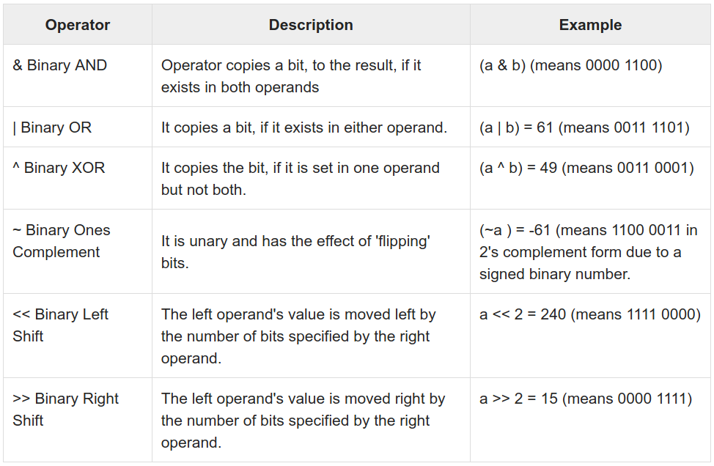
Bitwise Operators
https://www.tutorialspoint.com/python3/python_basic_operators.htm
Notes:
la funzione modulo, indicato con mod {\displaystyle \operatorname {mod} } {\displaystyle \operatorname {mod} }, che dà come risultato il resto della divisione euclidea del primo numero per il secondo

Slide 14
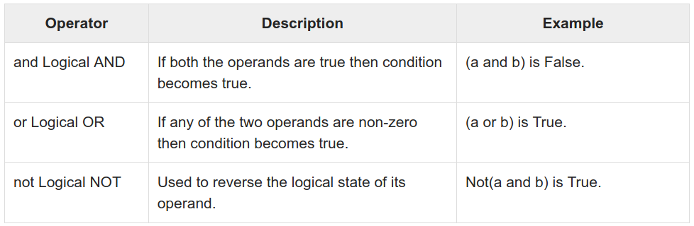
Logical Operators
a = True
b = False
https://www.tutorialspoint.com/python3/python_basic_operators.htm
Notes:
la funzione modulo, indicato con mod {\displaystyle \operatorname {mod} } {\displaystyle \operatorname {mod} }, che dà come risultato il resto della divisione euclidea del primo numero per il secondo

Slide 15
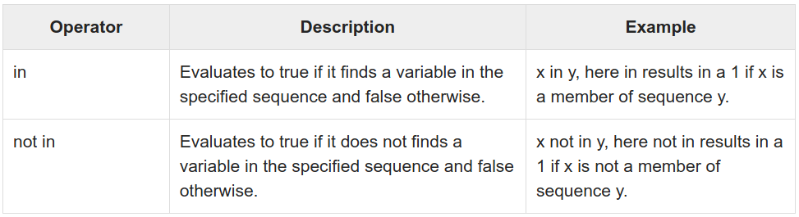
Membership Operators
https://www.tutorialspoint.com/python3/python_basic_operators.htm
Notes:
la funzione modulo, indicato con mod {\displaystyle \operatorname {mod} } {\displaystyle \operatorname {mod} }, che dà come risultato il resto della divisione euclidea del primo numero per il secondo

Slide 16
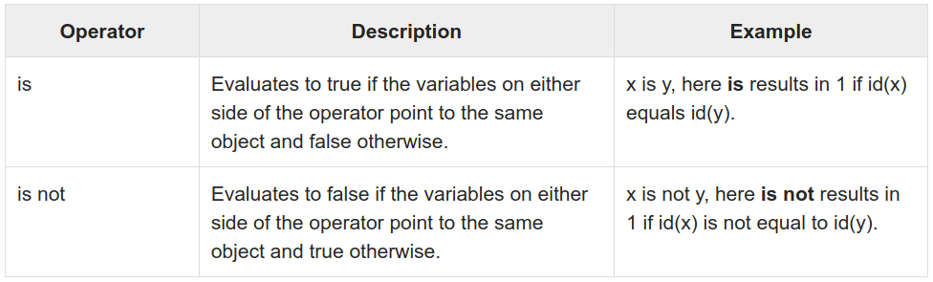
Identity Operators
https://www.tutorialspoint.com/python3/python_basic_operators.htm
Notes:
la funzione modulo, indicato con mod {\displaystyle \operatorname {mod} } {\displaystyle \operatorname {mod} }, che dà come risultato il resto della divisione euclidea del primo numero per il secondo

Slide 17
Examples: Operations on numeric types
>>> k=5
>>> s=5+1j # imaginary part cannot be only j
>>> type(s+k) # imaginary number conversion
<type 'complex'>
>>> 4 and 2 # logical comparison
2
>>> 4 & 2 # bitwise comparison between the binaries 100 and 010
0
>>> 4 | 2 # bitwise comparison between the binaries 100 and 010
6
Notes:
a

Slide 18
Operations on numeric types: math module
The math module provides some of the more commons mathematical operations.
It does not work with complex numbers.
cmath module works for complex numbers.
The available functions are:
• Trigonometric functions: cos, sin, tan, asin, acos, atan, sinh, cosh, tanh.
• Exponentiaiton and logarithmic functions: pow, exp, log, log10, sqrt
• Angles representation and conversions: degrees, radians, ceil , floor, fabs
In the math module are defined the numerical constants pi and e
>>> import math
>>> math.pi
3.141592653589793
>>> math.e
2.718281828459045
Notes:
a

Slide 19
Bool type
Booleans True and False are available in Python.
bool is a subclass of int
True corresponds to 1
False corresponds to 0
Integer values can be used to reprsent boolean values with the following convention:
0 corresponds to False
all integer values greater than zero correspond to True
It is good practice to use the bool type to represent boolean values.
Example:
>>> a=1
>>> type(a)
<type 'int'>
>>> if(a):
print 'True'
True
>>> a=False
>>> type(a)
<type 'bool'>
Notes:
a

Slide 20
String type
Literal strings are character sequences enclosed in quotes, single or double.
Creating strings is as simple as assigning a value to a variable.
Sequences of triple ‘double quotes’ or triple ‘single quotes’ can be used to assign strings spanning in more than one row or containing single or double quotes of the other type.
Example 1:
>>> a="""I am a string spanning in 3 rows,
... containing 'sigle quotes',
... containing "double quotes",
... containing '''triple quotes'''
... """
>>> print(a)
I am a string spanning in 3 rows,
containing 'sigle quotes',
containing "double quotes",
containing '''triple quotes'''
Example 2:
>>> b='''I am a string spanning in 3 rows,
... containing 'sigle quotes',
... containing "double quotes",
... containing """triple quotes"""
... '''
>>> print(b)
I am a string spanning in 3 rows,
containing 'sigle quotes',
containing "double quotes",
containing """triple quotes"""
Notes:
a

Slide 21
String type
We can create strings by enclosing characters in quotes (single or double).
Creating strings is as simple as assigning a value to a variable.
Example:
var1 = 'Hello World!'
var2 = "Python Programming"
To access substrings, use the square brackets for slicing along with the index or indices to obtain your substring.
Example:
#!/usr/bin/python3
var1 = 'Hello World!'
var2 = "Python Programming"
print ("var1[0]: ", var1[0])
print ("var2[1:5]: ", var2[1:5])
Output:
var1[0]: H
var2[1:5]: ytho
Notes:
a

Slide 22
String type
The type char does not exists. A single char can be accesed using the operator [] or slicing the string with the operator [begin:end] (slicing)
Example:
>>> a = “Hello world”
>>> a[1]
‘e’
>>> a[1:2]
‘e’
The single char can not be accessed, but a new value can be assigned to the string
Example:
>>> a=‘Primo valore’
>>> a = “Prima valore” # Ok string re-assignment
>>> a[4] = ‘o’ #Errore # NOT Ok single character assignment
File "<stdin>", line 1
a[4] = ‘o’
^
SyntaxError: invalid syntax
Notes:
a

Slide 23
String type: operators
The operators + and * can be used for string operations.
Operators priority is maintained.
Example
>>> a = ‘Hello’
>>> a+a+a # Concatenation
‘HelloHelloHello’
>>> a = ‘He’+’l’*2+’o World’ # Multiple concatenation
>>> a
‘Hello World’
It exists also the possibility to insert wherever in the string using the operator %
Example
name = "Peter"
my_string = "Hello %s" % name # Append or insert
my_string = "Hello %s, how are you? %s" % (name, 'ok') # Insert multiple values
Notes:
a

Slide 24
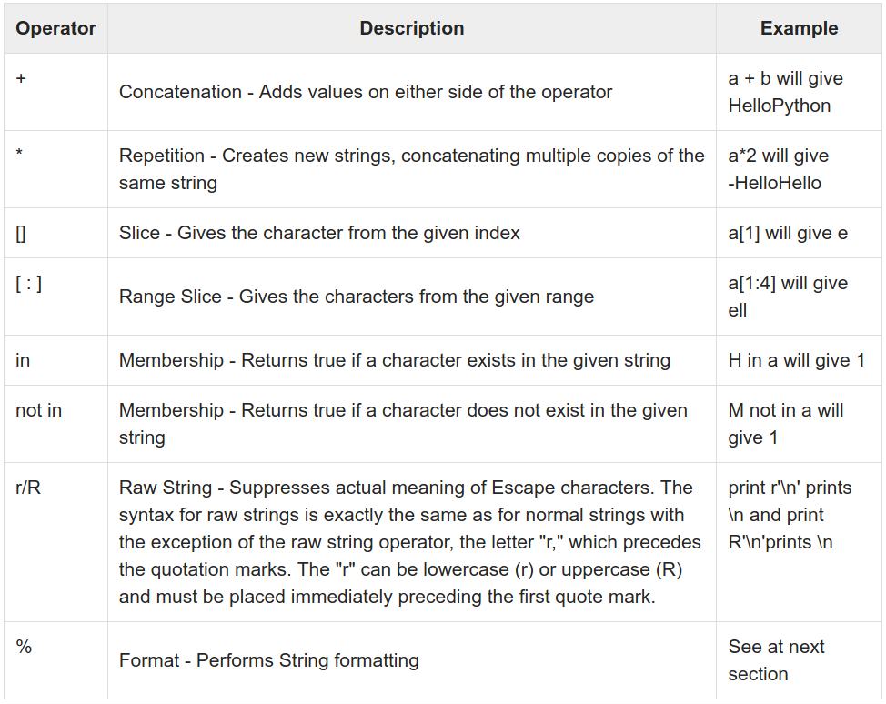
String type: operators
Notes:
a

Slide 25
String type: escape characters
Escaping allows to add special characters inside a string.
Example
>>> a = ‘What’s your name?’ #Errore
SyntaxError: invalid syntax
>>> a = “What’s your name?” # Ok if I create the string with double quotes
>>> a = ‘What\’s your name?’ # Ok if you escape the single quote character
Most common escape characters in string manipulation:
• \t Tab ‘Ciao\tciao!’ Ciao ciao!
• \n New Line ‘Ciao\nciao!’ Ciao
ciao!
• \\ Backslash ‘c:\\Programmi\\pp’ c:\Programmi\pp
• \” Double quote ‘Repeat: \”Hello\”’ Repeat: ”Hello”
• \’ Single quote “Repeat:\’Hello\’” Repeat: ‘Hello’
Notes:
a

Slide 26
String type: row string
Row string is a string preceded by r or R in front of it.
In a row string a character preceded by \ is included without changes.
Esempio
>>> a = r’Hello \t World’
#Raw string
>>> a
‘Hello \t World’
Notes:
a

Slide 27
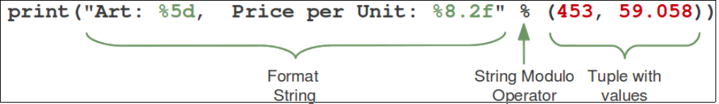
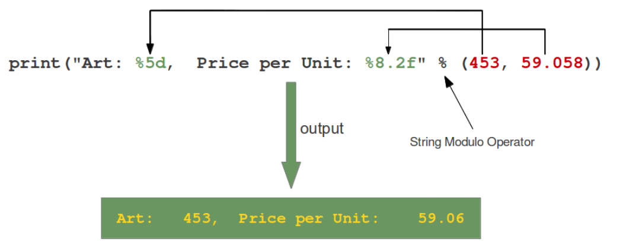
String type: format output
Python allows output formatting.
The % charactes has a special meaning when used in strings, because it is used to format output.
The general syntax for a format
placeholder is:
%[flags][width][.precision]type
Format output: https://www.python-course.eu/python3_formatted_output.php
https://www.tutorialspoint.com/python3/python_strings.htm
Notes:
a

Slide 28
String type: format output
Ther are a lot of possibility to format output.
Examples:
%d or %i Integer
%s, String
%f, Floating point decimal format
%c, Single character (accepts integer or single character string)
%x, Unsigned hexadecimal (lowercase)
%o, Unsigned octal
%%, No argument is converted, results in a "%" character in the result
%e, Floating point exponential format (lowercase)
Format output: https://www.python-course.eu/python3_formatted_output.php
https://www.tutorialspoint.com/python3/python_strings.htm
Notes:
a

Slide 29
String type: format output
Example
>>> ”Oggi è %s %d %s” % (“Venerdì’’,20,”Febbraio”)
Oggi è Venerdì 20 Febbraio
Already seen example:
name = "Peter"
my_string = "Hello %s" % name # Append and Insert
my_string = "Hello %s, how are you? %s" % (name, 'ok') # Insert multiple values
print(my_string)
With dictionaries:
person = {"name": "John", "age": 19}
print(f"{person['name']} is {person['age']} years old.")
# f-string
# full Python expressions inside the braces.
Notes:
a

Slide 30
String type: built-in functions
Strings, as all the python objects, have a set of functionalities accessible with built-in Python functions (i.e. functions always available in the python interpreter).
• Manipulate: concat, split, characters deletion and unions.
-split([sep [,maxsplit]])
-replace (old, new[, count])
-strip([chars])
Example
Split:
>>> s='Ciao Mondo'
>>> s.split('o',1)
['Cia', ' Mondo‘]
Replace:
>>> s.replace('o','i',1)
'Ciai Mondo‘
Strip:
>>> s.strip('C')
'iao Mondo '
Notes:
a

Slide 31
String type: format built-in functions
Formattazione: align, upper case, lower case
-upper() e lower() e swapcase()
-center(width[, fillchar]) e ljust(width[, fillchar]) e rjust(width[,fillchar])
Example
>>> s = ‘Hello’
>>> s.center(10,’.’)
‘..Hello...’
>>> s.upper()
‘HELLO’
Notes:
a

Slide 32
String type: search built-in functions
- find(sub [,start [,end]])
- rindex(sub [,start [,end]]) returns the highest index of the substring inside the string
(if found). If the substring is not found, it raises an
exception.
- index(sub [,start [,end]])
- rfind(sub [,start [,end]]) returns the highest index of the substring (if found). If not found, it returns -1.
- count(sub[, start[, end]])
- isupper() returns whether or not all characters in a string are
uppercased or not.
- islower() returns whether or not all characters in a string are
lowercased or not.
- startswith(prefix[, start[, end]])
- endswith(prefix[, start[, end]])
Notes:
a

Slide 33
Container Data Types
– list []
– tuple ()
– dict {}
– set
– frozenset
Notes:
•

Slide 34
list[]
A list is initialized putting elements comma separated inside squared brackets.
Items in a list can be of different type, both built-in and user defined.
Indexes in a list start from zero.
A list can be instantiated without specifying the list length or data type.
Single list elements can be accessed with the operator [ ]
Example:
>>>l=[] # empty list instance
>>> print(l)
[]
>>>m=[‘Lista’,’di’,4,’elementi’] # initialize a list
>>>print m[2],m[0] # access single list elements
>>>4 Lista
A list is an ordered sequence list, so the list items order is maintained.
Notes:
•

Slide 35
list[] : Basic List Operations
Lists respond to the operators
+ concatenation
* repetition
like strings, except that the result is a new list, not a string.
In fact, lists respond to all of the general sequence operations we saw on strings.
Python Expression | Results | Description
len([1, 2, 3]) | 3 | Length
[1, 2, 3] + [4, 5, 6] | [1, 2, 3, 4, 5, 6] | Concatenation
['Hi!'] * 4 | ['Hi!', 'Hi!', 'Hi!', 'Hi!'] | Repetition
3 in [1, 2, 3] | True | Membership
for x in [1, 2, 3]: print x, | 1 2 3 | Iteration
Notes:
•

Slide 36
list[] : slicing operator
List support the slicing operator [start:stop:step]
L = ['spam', 'Spam', 'SPAM!']
L[2] SPAM! # Offsets start at zero
L[-2] Spam # Negative: count from the right
L[1:] ['Spam', 'SPAM!'] # Slicing fetches sections
Example:
>>>a=[0,1,2,3,4,5,6,7]
>>>a[0:6]
[0,1,2,3,4,5]
>>>a[1:6:2]
[1,3,5]
>>>a[1::2] # no ‘stop’ means until the end of list
[1,3,5,7]
>>>a[::2] # no ‘start’ means from the first item of the list
[0,2,4,6]
Slicing can be also negative
>>>a[6:0:-2] # starts fom index 6, ends to index 0 going back with step 2
[6,4,2]
Notes:
•

Slide 37
list[] : range() built-in function
The range() function is used to generate lists of integer numbers.
Syntax:
range(start,stop,step) generates a list of integer from ‘start’ to ‘stop’ with interval ‘step’
Example
>>>a=range(3)
[0,1,2]
>>>type(a)
<type 'list'>
>>>a=range(1,10)
[0,1,2,3,4,5,6,7,8,9]
>>>a=range(1,10,2)
[1,3,5,7,9]
Notes:
• It used to be that there was an int type and a long type, and values were automatically promoted from int to long when they got too large (or too small) for int to hold them anymore. long used as many bytes as is necessary to hold the value at the cost of some performance.
It was possible, however, to have a long that could have been an int, and there was special literal syntax for long values. That is, 0L was zero as a long, whereas 0 was zero as an int. These values were equal, but still of different types.
In Python 3, these two types were unified. There is only one type, but its internal representation uses either a machine integer (32-bit or 64-bit depending on version of Python) or an arbitrary-length integer (like long) as needed.

Slide 38
list[] : Complex Operations
Lists supports complex operations.
Examples:
>>> a=range(10)
>>> b=[el*2 for el in a]
>>> b
[0, 2, 4, 6, 8, 10, 12, 14, 16, 18]
>>> l=[1,2]
>>> l2=['a','b']
>>> l3=[4,5]
>>> f=[(e1,e2,e3) for e1 in l for e2 in l2 for e3 in l3]
>>> f
[(1, 'a', 4), (1, 'a', 5), (1, 'b', 4), (1, 'b', 5), (2, 'a', 4), (2, 'a', 5), (2, 'b', 4), (2, 'b', 5)]
This can be done also with:
>>> for e1 in l:
for e2 in l2:
for e3 in l3:
f.append((e1,e2,e3))
Notes:
•

Slide 39
list[] : main functions
Function | Description
cmp(list1, list2) | Compare elements of lists
len(list) | Gives the total length of the list
max(list) | Returns item from the list with max value
min(list) | Returns item from the list with min value
list(seq) | Converts a tuple into list
Syntax : cmp(list1, list2)
Parameters :
list1 : The first argument list to be compared.
list2 : The second argument list to be compared.
Returns : This function returns 1, if first list is “greater” than second list, -1 if first list is smaller than the second list else it returns 0 if both the lists are equal.
Notes:
•

Slide 40
list[] : main methods
List containers can be modified.
List objects contain built-in methods to modify members of a list.
Method | Description
list.append(object) | Appends object to list
list.insert(index, object) | Inserts object obj into list at offset index
list.extend(seq) | Appends the contents of seq to list
list.pop(index) | Removes and returns last object or obj at index from list
list.remove(obj) | Removes object obj from list
list.count(value) | Returns count of how many times value occurs in list
list.index(obj) | Returns the lowest index in list where obj appears
list.reverse() | Reverses objects of list in place
list.sort([func]) | Sorts objects of list, use compare func if given
Notes:
• It

Slide 41
list[] : main methods exercises
Practice with the list methods proposed in the previous slide
Notes:
• It

Slide 42
list[] : about efficiency
The operators concatenation + (or +=) and repetition * are supported by lists.
The operator + and the function extend() have the same functionality, but different execution time (efficiency)
Example:
import time
l=range(100000000)
v=range(1000000)
T1=time.clock()
s=l+v
T2=time.clock()
print(‘ + execution time: :’ , T2-T1, ‘s’)
, “s”
T3=time.clock()
l.extend(v)
T4=time.clock()
print(‘extend execution time:’, T4-T3 , ‘s’)
Output:
+ execution time: 2.81 s
extend execution time: 0.033 s
Notes:
a

Slide 43
list[] for queue and stack
List can be easily used as stack or queue.
pop and append methods can be used to implement the LIFO logic typical of stacks.
pop with index 0 and append can be used to implement the FIFO logic typical of queue.
Example:
stack=[1, 2, 3, 4]
print(‘Initial Stack : ’, stack)
for i in range(5,7):
stack.append(i)
print (“Append: “, stack)
stack.pop()
print (“Pop: ” , stack)
queue=[ ‘a’,’b’,’c’,’d’ ]
print(“Initial Queue : ”, queue)
queue.append(‘e’)
queue.append(‘f’)
print(“Append : ”, queue)
queue.pop(0)
print(“Pop : ”, queue)
Output:
Initial Stack : [1, 2, 3, 4]
Append: [1, 2, 3, 4, 5, 6]
Pop: [1, 2, 3, 4, 5]
Initial Queue : ['a', 'b', 'c', 'd']
Append: ['a', 'b', 'c', 'd', 'e', 'f']
Pop: ['b', 'c', 'd', 'e', 'f']
Notes:
STACK is a LIFO (last in, first out) list. means suppose 3 elements are inserted in stack i.e 10,20,30. ...
QUEUE is FIFO list(First In First Out).means one element is inserted first which is to be deleted first.e.g queue of peoples.

Slide 44
tuple()
A tuple is a sequence ordered data enclosed between ().
Tuples are sequences, just like lists. The differences between tuples and lists are,
the tuples cannot be changed unlike lists, tuple are immutable.
tuples use parentheses, whereas lists use square brackets.
A tuple is created putting in it different comma-separated values. Optionally, can be put these comma-separated values between parentheses also.
Example:
tup1 = "a", "b", "c", "d";
tup2 = ('physics', 'chemistry', 1997, 2000); # Data in a tuple can be heterogeneous
tup3 = (1, 2, 3, 4, 5 );
The empty tuple is written as two parentheses containing nothing. Example:
tup1 = ();
A tuple containing a single value must be written including a comma. Example:
tup1 = (50,);
Tuple indices start at 0, like string indices.
Notes:
•

Slide 45
tuple() : Accessing Values in Tuples
To access values in tuple, use the square brackets for access the single element.
slicing [start:end] is also available to obtain value available at that index.
Example
tup1 = ('physics', 'chemistry', 1997, 2000)
tup2 = (1, 2, 3, 4, 5, 6, 7)
print("tup1[0]: ", tup1[0]) # access to single element
print("tup2[1:5]: ", tup2[1:5]) # access to slice
Output:
tup1[0]: physics
tup2[1:5]: [2, 3, 4, 5]
tuple are immutable, so does NOT contain methods to:
  eliminate elements
  insert elements
'tuple' object does not support item assignment
Example:
>>>t1=(1,2,3,4,’ciao’,’mondo’,[2,3])
>>>t1[3]=‘jkjk’
Output:
Traceback (most recent call last):
File "<pyshell#26>", line 1, in <module>
t1[1]=3
TypeError: 'tuple' object does not support item assignment
Notes:
•

Slide 46
tuple() : Delete
Removing individual tuple elements is not possible.
It can be created a new tuple with the undesired elements discarded.
To explicitly remove an entire tuple, just use the del statement.
Example
tup = ('physics', 'chemistry', 1997, 2000)
print tup
del tup
print("After deleting tup : ")
print(tup)
This produces an exception raised, because after del tup tuple does not exist any more
Output:
('physics', 'chemistry', 1997, 2000)
After deleting tup :
Traceback (most recent call last):
File "test.py", line 9, in <module>
print tup;
NameError: name 'tup' is not defined
Notes:
•

Slide 47
tuple() : basic operations
Tuples respond to the + and * operators much like strings;
+ means concatenation
* means repetition
the result is a new tuple, not a string.
Tuples respond to all of the general sequence operations availble on strings:
Python Expression | Results | Description
len((1, 2, 3)) | 3 | Length
(1, 2, 3) + (4, 5, 6) | (1, 2, 3, 4, 5, 6) | Concatenation
('Hi!',) * 4 | ('Hi!', 'Hi!', 'Hi!', 'Hi!') | Repetition
3 in (1, 2, 3) | True | Membership
for x in (1, 2, 3): print x, | 1 2 3 | Iteration
Notes:
•

Slide 48
tuple() : Built-in Tuple Functions
Function | Description
cmp(tuple1, tuple2) | Compares elements of both tuples
len(tuple) | Gives the total length of the tuple
max(tuple) | Returns item from the tuple with max value
min(tuple) | Returns item from the tuple with min value
tuple(seq) | Converts a list into tuple
Notes:
•

Slide 49
dict{}
Python dictionary is an unordered collection of items.
Elements in a dictionary are key:value pairs.
values can be of any data type and can repeat,
keys must be of immutable type (string, number or tuple with immutable elements) and must be unique. Keys are case-sensitive
Each element in a dictionary is identified by the key.
Dictionaries are optimized to retrieve values when the key is known.
Example how to create a dictionary:
>>>d={ } # empty dictionary
>>>d={1: ’Hello’, ‘due’: ’World’} # dictionary with two elements
>>>d[1] # access to a dictionary element
‘hello’
Notes:
•

Slide 50
dict{} : Creation examples
# empty dictionary
my_dict = {}
# dictionary with integer keys
my_dict = {1: 'apple', 2: 'ball'}
# dictionary with mixed keys
my_dict = {'name': 'John', 1: [2, 4, 3]}
# using dict()
my_dict = dict({1:'apple', 2:'ball'})
# from sequence having each item as a pair
my_dict = dict([(1,'apple'), (2,'ball')])
Notes:
•

Slide 51
dict{} : Access elements
In the other container types indexing is used to access values,
Dictionary uses keys to access values.
Key can be used either inside square brackets or with the get() method.
get() returns None if the key is not found.
[ ] returns KeyError if the key is not found.
Example:
my_dict = {'name':'Jack', 'age': 26}
print(my_dict['name']) # Output: Jack
print(my_dict.get('age')) # Output: 26
# Trying to access keys which doesn't exist throws error (try)
# my_dict.get('address')
# my_dict['address']
keys() and values() functions return respectively the keys and the values present in a dictionary.
Notes:
•

Slide 52
dict{} : change or add elements in a dictionary
Dictionary are mutable. We can add new items or change the value of existing items using assignment operator.
If the key is already present, value gets updated,
else a new key: value pair is added to the dictionary.
Example:
my_dict = {'name':'Jack', 'age': 26}
# update value
my_dict['age'] = 27
#Output: {'age': 27, 'name': 'Jack'}
print(my_dict)
# add item
my_dict['address'] = 'Downtown'
# Output: {'address': 'Downtown', 'age': 27, 'name': 'Jack'}
print(my_dict)
Notes:
•

Slide 53
dict{}: delete or remove elements
We can remove a particular item in a dictionary by using the method pop(). This method removes as item with the provided key and returns the value.
The method, popitem() can be used to remove and return an arbitrary item (key, value) form the dictionary.
All the items can be removed at once using the clear() method.
del keyword can be used to remove individual items or the entire dictionary itself.
Notes:
•

Slide 54
dict{}: delete or remove elements examples
# create a dictionary
squares = {1:1, 2:4, 3:9, 4:16, 5:25}
# remove a particular item
print(squares.pop(4)) # Output: 16
print(squares) # Output: {1: 1, 2: 4, 3: 9, 5: 25}
# remove an arbitrary item
print(squares.popitem()) # Output: (1, 1)
print(squares) # Output: {2: 4, 3: 9, 5: 25}
# delete a particular item
del squares[5]
print(squares) # Output: {2: 4, 3: 9}
# remove all items
squares.clear()
print(squares) # Output: {}
# delete the dictionary itself
del squares
# print(squares) # Throws Error
Notes:
•

Slide 55
dict{}: built-in functions
Function | Description
all() | Return True if all keys of the dictionary are true (or if the dictionary is empty).
any() | Return True if any key of the dictionary is true. If the dictionary is empty, return False.
len() | Return the length (the number of items) in the dictionary.
cmp() | Compares items of two dictionaries.
sorted() | Return a new sorted list of keys in the dictionary.
Example:
squares = {1: 1, 3: 9, 5: 25, 7: 49, 9: 81}
print(len(squares)) # Output: 5
print(sorted(squares)) # Output: [1, 3, 5, 7, 9]
Exercise: Practice with these functions
Notes:
•

Slide 56
dict{}: built-in methods
Method | Description
clear() | Remove all items form the dictionary.
copy() | Return a shallow copy of the dictionary.
fromkeys(seq[, v]) | Return a new dictionary with keys from seq and value equal to v (defaults to None).
get(key[,d]) | Compares items of two dictionaries.
items() | Return a new sorted list of keys in the dictionary.
keys() | Return a new view of the dictionary's keys.
pop(key[,d]) | Remove the item with key and return its value or d if key is not found. If d is not provided and key is not found, raises KeyError.
popitem() | Remove and return an arbitary item (key, value). Raises KeyError if the dictionary is empty.
setdefault(key[,d]) | If key is in the dictionary, return its value. If not, insert key with a value of d and return d (defaults to None).
update([other]) | Update the dictionary with the key/value pairs from other, overwriting existing keys.
values() | Return a new view of the dictionary's values
has_key(k) | Return True or Falese if key is in the dictionary
Notes:
•

Slide 57
dict{}: Built-in methods example
marks = {}.fromkeys(['Math','English','Science'], 0)
print(marks) # Output: {'English': 0, 'Math': 0, 'Science': 0}
for item in marks.items():
print(item)
list(sorted(marks.keys())) # Output: ['English', 'Math', 'Science']
Notes:
•

Slide 58
dict{}: Other operations
Iterating Through a Dictionary
Using a for loop we can iterate though each key in a dictionary.
Example:
squares = {1: 1, 3: 9, 5: 25, 7: 49, 9: 81}
for i in squares:
print(squares[i])
Dictionary Membership Test
We can test if a key is in a dictionary or not using the keyword in. Notice that membership test is for keys only, not for values.
Example:
squares = {1: 1, 3: 9, 5: 25, 7: 49, 9: 81}
print(1 in squares) # Output: True
print(2 not in squares) # Output: True
# membership tests for key only not value
print(49 in squares) # Output: False
Notes:
•

Slide 59
dict{}: Python dictionary comprehension
Dictionary comprehension is an elegant and concise way to create new dictionary from an iterable in Python.
Dictionary comprehension consists of an expression pair (key: value) followed by for statement inside curly braces {}.
Example to make a dictionary with each item being a pair of a number and its square.
squares = {x: x*x for x in range(6)}
print(squares) # Output: {0: 0, 1: 1, 2: 4, 3: 9, 4: 16, 5: 25}
Equivalent to:
odd_squares = {x: x*x for x in range(11) if x%2 == 1}
print(odd_squares) # Output: {1: 1, 3: 9, 5: 25, 7: 49, 9: 81}
A dictionary comprehension can optionally contain more for or if statements.
An optional if statement can filter out items to form the new dictionary.
Example to make dictionary with only odd items.
odd_squares = {x: x*x for x in range(11) if x%2 == 1}
print(odd_squares) # Output: {1: 1, 3: 9, 5: 25, 7: 49, 9: 81}
Notes:
•

Slide 60
set - fronzenset
Python has two structures to represent sets of elements:
set is a mutable, unordered collection of etherogeneous objects
frozenset is an immutable, unordered collection of etherogeneous objects. It is a freezed set
In both cases, elements are unique.
Example:
>>>s=set((‘ciao’,1,’Mondo’))
>>>fs=frozenset((‘ciao’,2))
Sets provide methods to modify the data set:
  insert with add(obj)
  modify with update(obj)
Example:
>>>s=set(('abc','def',1,2,3,'ghi'))
>>>s.add(4)
>>>s.update((‘lmn’,5))
>>>s
set([1, 2, 3, 4, 5, 'abc', 'lmn', 'ghi', 'def'])
Notes:
Since Python2.6 we can define sets use curly braces in place of using the built-in set function. In this case a set is distinguishable from dictionaryby the lack of colons separating keys and values:
set_display ::= "{" (expression_list | comprehension) "}"
A set display yields a new mutable set object, the contents being specified by either a sequence of expressions or a comprehension. When a comma-separated list of expressions is supplied, its elements are evaluated from left to right and added to the set object. When a comprehension is supplied, the set is constructed from the elements resulting from the comprehension.
An empty set cannot be constructed with {}; this literal constructs an empty dictionary.
Be careful:
Compare also the difference between {} and set() with a single word argument.
>>> a = set('aardvark')
>>> a
{'d', 'v', 'a', 'r', 'k'}
>>> b = {'aardvark'}
>>> b
{'aardvark'}
but both a and b are sets of course.

Slide 61
set - frozenset
Removal
  discard(x)
  remove(x)
  clear()
  pop()
Example:
>>> s=set([2, 3, 'abc', 'ghi', 'def'])
>>> s
set([2, 3, 'abc', 'def', 'ghi'])
>>> s.remove(3)
>>> s.discard(2)
>>> s.pop()
'abc'
>>> s.clear(); s
set([])
Notes:
•

Slide 62
set - frozenset
Both containers contain methods to manage operations :
  union,
  intersection,
  difference,
  issubset,
  issuperset
Example:
>>>s=set((1,2))
>>>s2=frozenset((2,3,4))
>>>s3=s.union(s2)
>>>s4=s.difference(s2)
>>>s5=s2.intersection(s)
>>>s.issubset(s2)
False
>>>print(’s3’, s3 , ’s4’, s4, ’s5’, s5)
s3
s3 {1, 2, 3, 4} s4 {1} s5 frozenset({2})
In both cases data can be of different types.
=> frozenset are immutable, so they can be used to index dictionaries
In both cases data can be of different types.
=> frozenset are immutable, so they can be used to index dictionaries
Notes:
•

