Slide 1
Bash Lecture 1
Bash and Linux command line introduction

Slide 2
Traditional service delivery
Bibliography and learning materials
Bibliography:
https://www.rigacci.org/docs/biblio/online/sysadmin/toc.htm
https://www.tldp.org/LDP/abs/html/
Learning Materials:
http://www.ee.surrey.ac.uk/Teaching/Unix/
https://github.com/bertocco/abilita_info_units_1920

Slide 3
Traditional service delivery
Arguments of this lesson
How the shell works with you and linux
Features of a shell
Manipulating the shell environment

Slide 4
Traditional service delivery
What is a shell?
SHELL is the human interface point for UNIX
SHELL is a program layer that provides an environment to enter commands and parameters to produce a given result.
To meet varying needs, UNIX has provided different shells.
Bourne (sh)
Bourne Again (bash)
Korn (ksh)
C shells (csh)
TC-Shell (tcsh)
Z shell (zsh)

Slide 5
Traditional service delivery
Shell differences
They differ in
  the various options they give the user to manipulate the commands
  the complexity and capabilities of the scripting language.

Slide 6
Traditional service delivery
Why bash?
Flexible
More friendly than others
The default in the most part of linux distributions

Slide 7
Traditional service delivery
UNIX commands (1)
General form of a command:
command [flags] [argument1] [argument2] …
Example:
`ls -a -l` or `ls -al`
`ls -al mydir`
argument
flag
command

Slide 8
Traditional service delivery
UNIX commands
Arguments can be optional or mandatory
All commands have a return code (0 if OK)
Read return code: `echo $?`
The return codes can be used as part of control
logic in shell scripts
All UNIX commands have an help:
`man command` or `man <number> command

Slide 9
Traditional service delivery
UNIX commands
Arguments can be optional or mandatory
Exercise: Try
  create the folder
  mkdir myFolder
  jump inside the created folder
  cd myFolder
  create two files
  touch pippo pluto
  jump outside the folder
  cd ..
  list the content of the folder where you are
  ls Argument NOT mandatory. Optional
  list a specific folder content
  ls myFolder

Slide 10
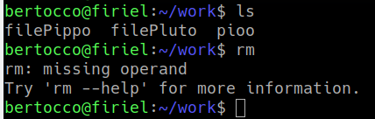
Traditional service delivery
UNIX commands
Arguments can be optional or mandatory
Exercise: Try
  create a folder
  mkdir testFolder
  create (inside the folder) one or two files inside the folder
  cd testFolder ; touch filePippo ; touch filePluto
  or: cd testFolder ; touch filePippo filePluto
  inside the folder try the command to remove files (without arguments)
  pwd # to be sure to be in the folder
  rm
  An argument (indicating the file to remove) is mandatory
  rm filePippo # remove only the indicated file
  rm * # remove all files

Slide 11
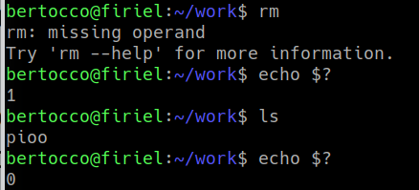
Traditional service delivery
UNIX commands
All commands have a return code (0 if OK)
Read return code: `echo $?`
The return codes can be used as part of control
logic in shell scripts
Exercise: try
ls
echo $? # the result will be 0 : correct command
rm
echo $? # the result will be 1: command failure

Slide 12
Traditional service delivery
UNIX commands
All UNIX commands have an help:
`man command` or
`man <number> command
Example:
man ls
man wait
man 7 signal

Slide 13
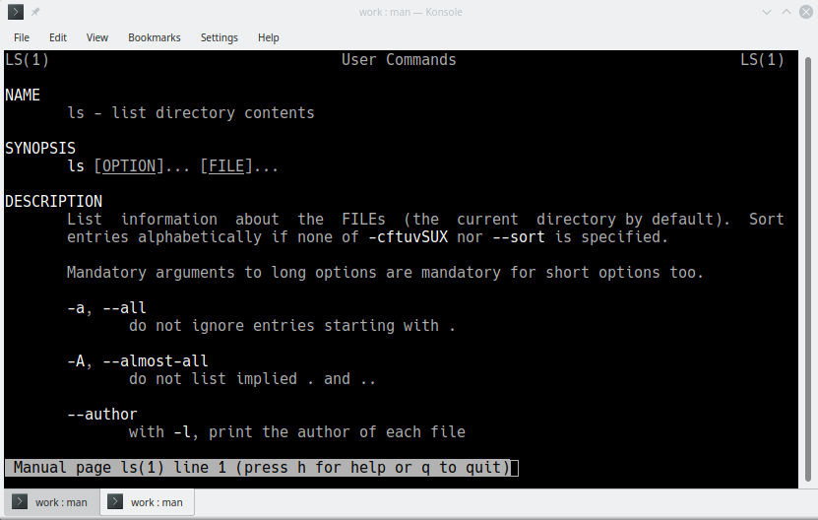
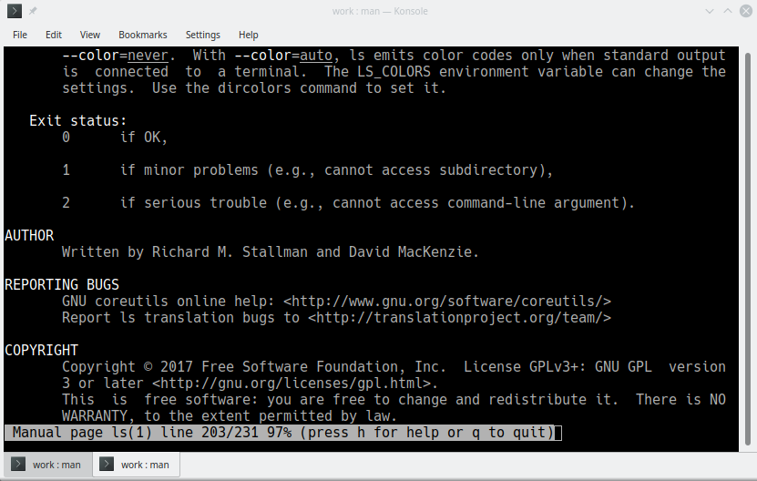
Traditional service delivery
`ls` help

Slide 14
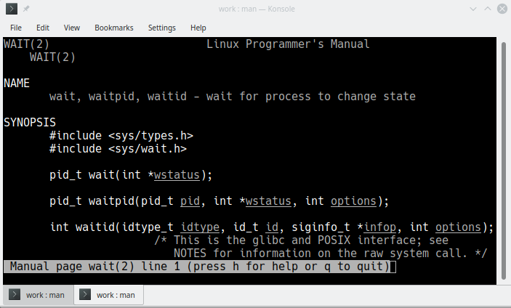
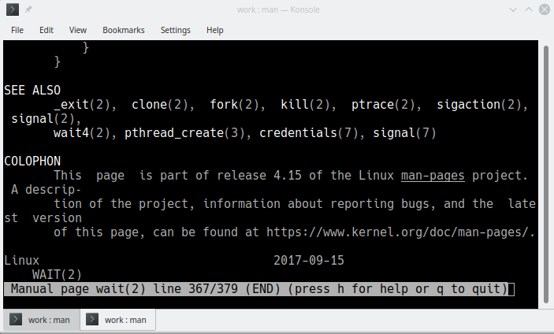
Traditional service delivery
`wait` help

Slide 15
Traditional service delivery
UNIX commands (2)
All commands:
  accept inputs from the standard input,
  is where UNIX gets the input for a command
  display output on standard output
  is where UNIX displays output from a command
  display error message on standard error
  is where UNIX displays any errors as a result of the execution of a command
UNIX has redirection capabilities: to redirect one or more of these (see “advanced bash” lesson)
Notes:
STREAMS is the native framework in Unix System V for implementing character device drivers, network protocols, and inter-process communication.
A Linux stream is data traveling in a Linux shell from one process to another through a pipe, or from one file to another as a redirect. ... Characters in Linux streams are either standard input (STDIN) or output (STDOUT) from a file or process, or error output streams from commands given to the Linux shell (STDERR)

Slide 16
Traditional service delivery
`ls` (1)
`ls` can be used to inquire about the various attributes of one or more files or directories.
You must have read permission to a directory to be able to use the ls command on that directory and the files under that directory.
The `ls` command generates the output to standard output, which can be redirected, using the UNIX redirection operator >, to a file.

Slide 17
Traditional service delivery
`ls` (2)
You can provide the names of one or more filenames or directories to the ls command. The file and directory names are optional. If you do not provide them, UNIX processes the current directory.
Be default, the list of files within a directory is sorted by filename. You can modify the sort order by using some of the flags.
You should also be aware that the files starting with . (period) will not be processed unless you use the -a flag with the ls command. This means that the entries . (single period) and .. (two consecutive periods) will not be processed by default.

Slide 18
Traditional service delivery
`ls`: Exercices
  Try and understand differences:
ls; ls -l; ls -al
  Try and understand differences:
ls -trl; ls -tl
- Try an output redirection:
ls -l > myfileout.txt

Slide 19
Traditional service delivery
File manipulation commands
File manipulation commands
It exists a set of file manipulation commands to manage files and directories.
To use these commands, the user needs to have right on the file to manage.
drwxrwxr-x 2 bertocco bertocco 20480 Dec 14 09:00 BACKUP
owner group size last_access_date file-name
drwxrwxr-x permissions representation:
d means it is a directory (- for a file)
rwx means readable, writable, executable by owner
rwx readable, writable, executable by group
r-x readable, NOT writable, executable by

Slide 20
Traditional service delivery
File manipulation commands
File Permissions
Understand the meaning of:
drwxrwxr-x 2 bertocco bertocco 4096 Apr 26 2018 config
-rw-rw-r-- 1 bertocco bertocco 10240 Mar 13 2017 config.tar
-rw------- 1 bertocco bertocco 960065536 Dec 3 22:02 core.3040
-rw-rw-r-- 1 bertocco bertocco 7290880 May 8 2017 demo_EGIconf.tar
drwxr-xr-x. 4 bertocco bertocco 4096 Dec 7 15:57 Desktop
drwx------. 12 bertocco bertocco 4096 Aug 13 19:01 dev
drwxr-xr-x. 14 bertocco bertocco 4096 Nov 28 17:18 Documents
drwxr-----. 13 bertocco bertocco 8192 Dec 10 12:35 Downloads
drwxrwxr-x 2 bertocco bertocco 147 Apr 24 2018 exchange
-rw-r--r-- 1 bertocco bertocco 181 Apr 13 2017 filmatini_utili.txt

Slide 21
Traditional service delivery
File manipulation commands
Change File Permissions (1)
Chenge read permission (similarly for write ‘w’ and execute ‘x’):
-rw-rw-r-- 1 bertocco bertocco 0 Dec 14 15:30 pippo
$ chmod -r pippo # remove all read permissions. Check:
$ ls -l pippo
--w--w---- 1 bertocco bertocco 0 Dec 14 15:30 pippo
$ chmod +r pippo # add all read permissions, Check:
$ ls -l pippo
-rw-rw-r-- 1 bertocco bertocco 0 Dec 14 15:30 pippo
$ chmod -r pippo # remove a new time all permissions, to restart from
--w--w---- 1 bertocco bertocco 0 Dec 14 15:30 pippo
$ chmod u+r pippo # add read permission to user
$ ls -l pippo
-rw--w---- 1 bertocco bertocco 0 Dec 14 15:30 pippo
$ chmod g+r pippo # add read permission to group
$ ls -l pippo
-rw-rw---- 1 bertocco bertocco 0 Dec 14 15:30 pippo
$ chmod a+r pippo # add read permission to all
$ ls -l pippo
-rw-rw-r-- 1 bertocco bertocco 0 Dec 14 15:30 pippo

Slide 22
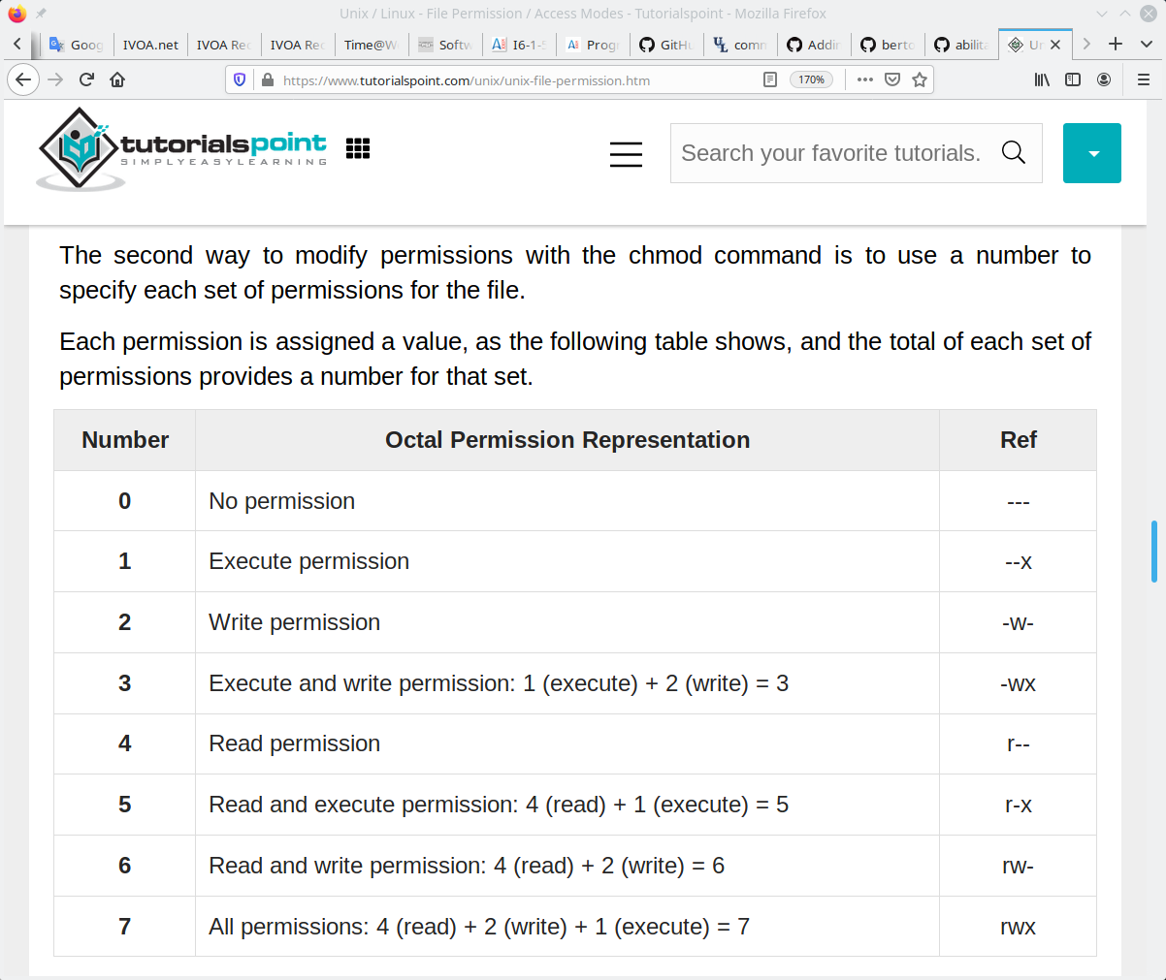
Traditional service delivery
File manipulation commands
Change File Permissions (2)

Slide 23
Traditional service delivery
File manipulation commands
Main file manipulation commands
Create an empty file in the current path
  `touch testFile` creates a file
Create an empty file in a specified path
  `touch one_dir_more/target_dir/testFile
Create an empty directory in the current path
  `mkdir mydir`
Create an empty directory in the specified path forcing intermediate folders if needed
  `mkdir -p /onedir/twodir/threedir`

Slide 24
Traditional service delivery
File manipulation commands
Main file manipulation commands
Delete a single file
  `rm file1`
Delete a single file in the specified path
  rm one_dir_more/target_dir/testFile
Delete all files in the current path
  `rm *`
Delete all files in the specified path
  `rm one_dir_more/target_dir/*`
Delete an empty folder
  `rm myFolder` works only if myFolder is empty
Delete recursively all files and folders contained in myFolder and myFolder itself
  `rm -r myFolder`
  * is a UNIX wildcard: here it matches all files

Slide 25
Traditional service delivery
File manipulation commands
Copy file1 on file2
overwrite file2 if already exists create it if it does not exist:
  `cp file1 file2`
Copy file1 on file2, but asking before: “are you sure?”
  `cp -i file1 file2`
Copy file1 on file2 removing the -i flag if set
  `\cp file1 file2`
Rename a file:
  `mv file1 file2` moves file1 on file2
  # same result using two commands (but less neat)
  `cp file1 file2`; `rm file1` # but not the best way
  BE VERY
  CAREFUL!!!

Slide 26
Traditional service delivery
File manipulation commands
Main file manipulation commands:
summary
  `touch` creates a file
  `mkdir mydir` creates a directory (where you are)
  `mkdir -p /onedir/twodir/threedir`
  `rmdir mydir` delete an empty directory
  `rm -rf` force to recursively delete a non empty directory
  `cp file1 file2` copy file1 on file2 (overwriting it if already exists,
  creating file2 if it does not exist)
  `cp -i file1 file2` before copy asks “are you sure?”
  `\cp file1 file2` remove the -i flag if set
  `rm file1` removes file1
  `mv file1 file2` moves file1 on file2 # it is the same of :
  `cp file1 file2`; `rm file1`
  BE VERY
  CAREFUL!!!

Slide 27
Traditional service delivery
File manipulation commands: Exercises
  Create a file
  Create a directory
  Create a directory tree
  Create files in the directory tree
  Remove a file
  remove a directory (emprty and not empty)
  remove a directory tree (emprty and not empty)
  Rename a file

Slide 28
Traditional service delivery
`cat`
`cat` is used to display a text file or to concatenate multiple files into a single file.
By default, the cat command generates outputs into the standard output and accepts input from standard input.
The cat command takes in one or more filenames as its arguments. The files are concatenated in the order they appear in the argument list.

Slide 29
Traditional service delivery
`cat`: Exercices
  Display file on a terminal
  cat testfile
  concatenate multiple files for display on the terminal
  cat testfile1 testfile2 testfile3
  concatenate these files into a file called testfile, use the redirection operator > as follows:
  cat testfile1 testfile2 testfile2 > testfile
  If the file testfile already exists, it is overwritten with the concatenated files testfile1, testfile2 and testfile3. If testfile already exists and you want to concatenate at the end of the existing file, instead of using the redirection operator >, you must use the >> (two consecutive greater than sign) operator as follows:
  cat testfile1 testfile2 testfile2 >> testfile

Slide 30
`ln`
`ln` provides alternate names for the same file.
It links a file name to another one and it is possible to link a file to another name in the same directory or the same name in another directory.
The flags that can be used with the ln command are as follows:
-s to create a soft link to another file or directory. In a soft link, the linked file contains the name of the original file. When an operation on the linked filename is done, the name of the original file in the link is used to reference the original file.
-f to ensure that the destination filename is replaced by the linked filename if the file already exists. Remove destination files, if existing

Slide 31
`ln`: hard link
Hard link (ln without flags):
  ln sourceFile targetFile
  The hard link refers directly to the physical location of another file. It points to the same “node” in the filesystem that the original file points to
  The hard link acts like a mirror of the original file. The content pointed by the two names is synchronized
  When the source of the link “sourceFile” is moved or removed, the hard link still refer to the source
  The hard link cannot refer to a directory and cannot cross file system boundaries (ex.: can not link a file in a mounted removable disk from home)

Slide 32
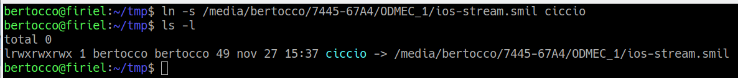
`ln -s`: soft/symbolic link
Soft/symbolic link (ln with flag s):
  ln -s sourceFile targetFile
  A symbolic link is a symbolic path indicating the location of the source file. It is some way an alias to a file-name.
  A symbolic link can refer to a directory
  A symbolic link can cross file system boundaries ( can link a file in a mounted removable disk from home).
  If the sourceFile of the link is moved or removed, then the symbolic link is not updated (the ‘alias’ results broken).

Slide 33
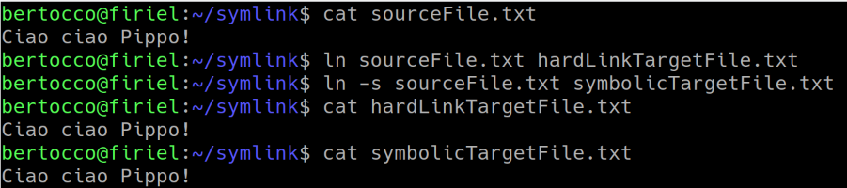
`ln`: hard link vs soft/symbolic link
Create a simple source file
create a hard link
create a soft link
inspect the content of the hard link
inspect the content of the soft link:
contents are the same

Slide 34
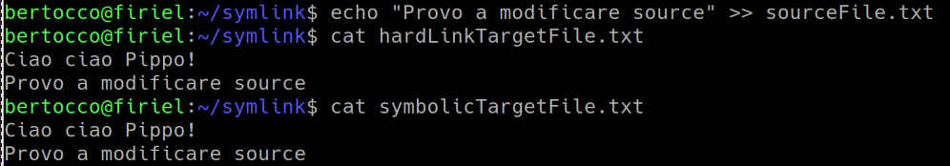
`ln`: hard link vs soft/symbolic link
Modify the source file
inspect the content of the hard link
inspect the content of the soft link:
contents have the same modifications

Slide 35
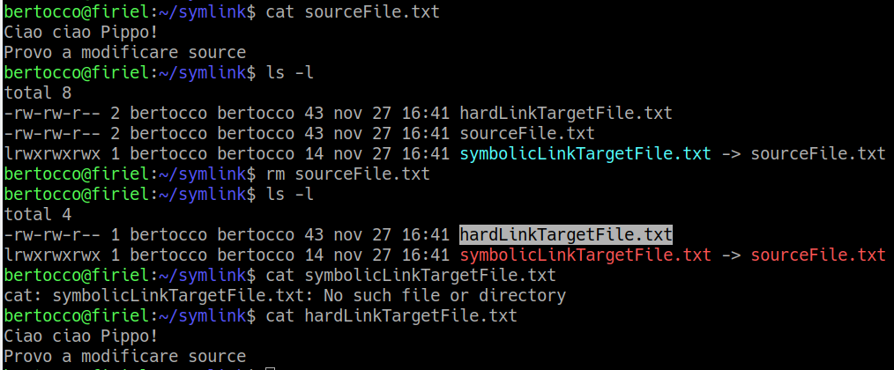
`ln`: hard link vs soft/symbolic link
list the folder content to check the file status
remove the source file
list the folder content to check the file status
the soft link is broken, the hard link is untouched

Slide 36
Traditional service delivery
`ln`: Exercices
If you want to link testfile1 to testfile2 in the current directory, execute the following command:
ln testfile1 testfile2
This creates a hard linked testfile2 linking it to tesftfile1. In this case, if one of the files is removed, the other will remain unaltered.
If testfile is in the current directory and is to be linked to testfile in the directory /u/testuser/testdir, execute the following command:
ln testfile u/testuser/testdir
To create a symbolic link of testfile1 in the current directory, execute the following command:
ln -s testfile1 testfile2
This creates a linked testfile2, which will contain the name of testfile1. If you remove testfile1, you will be left with an orphan testfile2, which points to nowhere.

Slide 37
Traditional service delivery
Command `echo` and strings
When one or more strings are provided as arguments, echo by default repeats those stings on the screen.
Example (try)
echo This is a pen.
It is not necessary to surround the strings with quotes, as it does not affect what is written on the screen. If quotes (either single or double) are used, they are not repeated on the screen (try `echo “This is a pen.”`).
`echo` can also show the value of a particular variable if the name of the variable is preceded directly (i.e., with no intervening spaces) by the dollar character ($), which tells the shell to substitute the value of the variable for its name. Example (try):
x=5; echo The number is $x.

Slide 38
Traditional service delivery
Command `echo` examples
echo This is a pen.
x=5
echo The number is $x.
echo “The number is $x.”
Simple backup script
OF=/home/me/my-backup-$(date +%Y%m%d).tgz
tar -czf $OF <path>/dir_or_file_to_tar
ls -l (to check the result)

Slide 39
Traditional service delivery
Exercises
Verify that you are using bash:
echo $SHELL
Explore help command
type `help`
Explore help for `ls` command
type `man command_name`
List files `ls` or `ls -l` and check differences
List all files `ls -al`
List files by date (direct and reverse order) `ls -trl`

