Slide 1

Python Lecture 4 – Python libraries usage:
numpy, matplotlib e scipy examples
Numpy
Scipy
Matplotlib
Exceptions
Classes

Slide 2
Bibliography and learning materials
Bibliography:
https://docs.scipy.org/doc/
http://docs.python.it/
https://matplotlib.org/
and much more available in internet
Learning Materials:
https://github.com/bertocco/abilita_info_units_2021

Slide 3
Numpy
numpy states for Numerical Python.
NumPy is the fundamental package for scientific computing in Python.
NumPy is a Python library that provides:
a multidimensional array object,
various derived objects (such as masked arrays and matrices),
an assortment of routines for fast operations on arrays, including:
  mathematical, logical, shape manipulation
  sorting
  selecting
  I/O
  discrete Fourier transforms
  basic linear algebra
  basic statistical operations
  random simulation
  and much more…..
Notes:
Masked arrays are arrays that may have missing or invalid entries.
A masked array is the combination of a standard numpy.ndarray and a mask. A mask is either nomask, indicating that no value of the associated array is invalid, or an array of booleans that determines for each element of the associated array whether the value is valid or not. When an element of the mask is False, the corresponding element of the associated array is valid and is said to be unmasked. When an element of the mask is True, the corresponding element of the associated array is said to be masked (invalid).
The package ensures that masked entries are not used in computations.
As an illustration, let’s consider the following dataset:
>>>
>>> import numpy as np
>>> import numpy.ma as ma
>>> x = np.array([1, 2, 3, -1, 5])
We wish to mark the fourth entry as invalid. The easiest is to create a masked array:
>>>
>>> mx = ma.masked_array(x, mask=[0, 0, 0, 1, 0])
We can now compute the mean of the dataset, without taking the invalid data into account:
>>>
>>> mx.mean()
2.75

Slide 4
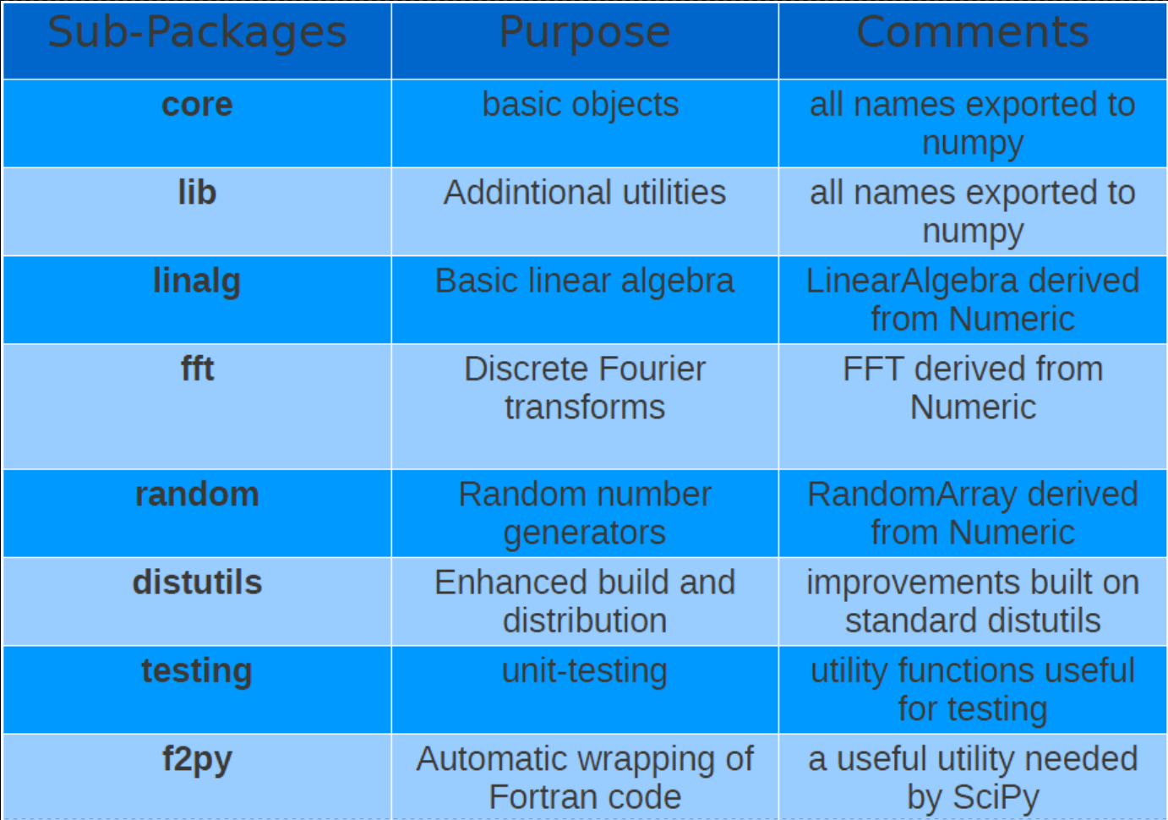
Numpy module organization
Notes:
Masked arrays are arrays that may have missing or invalid entries.
A masked array is the combination of a standard numpy.ndarray and a mask. A mask is either nomask, indicating that no value of the associated array is invalid, or an array of booleans that determines for each element of the associated array whether the value is valid or not. When an element of the mask is False, the corresponding element of the associated array is valid and is said to be unmasked. When an element of the mask is True, the corresponding element of the associated array is said to be masked (invalid).
The package ensures that masked entries are not used in computations.
As an illustration, let’s consider the following dataset:
>>>
>>> import numpy as np
>>> import numpy.ma as ma
>>> x = np.array([1, 2, 3, -1, 5])
We wish to mark the fourth entry as invalid. The easiest is to create a masked array:
>>>
>>> mx = ma.masked_array(x, mask=[0, 0, 0, 1, 0])
We can now compute the mean of the dataset, without taking the invalid data into account:
>>>
>>> mx.mean()
2.75

Slide 5
Scipy
SciPy is a collection of
  mathematical algorithms and
  convenience functions
built on the numpy extension of Python.
It provides the user with high-level commands and classes for manipulating and visualizing data.
Using an interactive Python session with scipy we have a data-processing and system-prototyping environment rivaling systems such as MATLAB and IDL.

Slide 6
Scipy modules
SciPy is organized into subpackages covering different scientific computing domains:
Subpackage | Description
cluster | Clustering algorithms
constants | Physical and mathematical constants
fftpack | Fast Fourier Transform routines
integrate | Integration and ordinary differential equation solvers
interpolate | Interpolation and smoothing splines
io | Input and Output
linalg | Linear algebra
ndimage | N-dimensional image processing
odr | Orthogonal distance regression
optimize | Optimization and root-finding routines
signal | Signal processing
sparse | Sparse matrices and associated routines
spatial | Spatial data structures and algorithms
special | Special functions
stats | Statistical distribution and function
Scipy sub-packages need to be imported separately. Example:
from scipy import linalg, io

Slide 7
Matplotlib
Matplotlib is a Python 2D plotting library which produces publication quality figures in a variety of hardcopy formats and interactive environments across platforms.
You can generate plots, histograms, power spectra, bar charts, errorcharts, scatterplots, etc., with just a few lines of code.
For simple plotting the pyplot sub-module provides a MATLAB-like interface, particularly when combined with IPython. It provides users with full control of line styles, font properties, axes properties, etc, via an object oriented interface or via a set of functions familiar to MATLAB users.

Slide 8
How to find documentation (1)
The dir(module) function can be used to look at the namespace of a module or package, i.e. to find out names that are defined inside the module.
The help(function) function is available for each module/object and allows to know the documentation for each module or function.
Try (in the interpreter) the commands:
import math
dir()
help(math.acos)
The type(object) function allows to know the type of the object passed as argument.
l = [1, "alfa", 0.9, (1, 2, 3)]; print [type(i) for i in l]
The source(function) function, when given a function written in Python as an argument, prints out a listing of the source code for that function. This can be helpful in learning about an algorithm or understanding exactly what a function is doing with its arguments.

Slide 9
How to find documentation (2)
numpy/scipy-specific help system is also available under the command numpy.info.
Example (try):
>>> import scipy.optimize
>>> import numpy as np
>>> np.info(scipy.optimize.fmin)
If you use a second keyword argument of numpy.info, it defines the maximum width of the line for printing. If a module is passed as the argument to help then a list of the functions and classes defined in that module is printed.
Example (try):
>>> np.info(scipy.optimize)

Slide 10
Name convention
Generally, for brevity and convenience, it is used a convention on names used to import packages (numpy, scipy, and matplotlib):
>>> import numpy as np
>>> import matplotlib as mpl
>>> import matplotlib.pyplot as plt
Generally scipy is not imported as module because interesting functions in scipy are actually located in the submodules, so submodules or single functions are imported:
The scipy namespace itself only contains functions imported from numpy. Therefore, importing only the scipy base package does only provide numpy content, which could be imported from numpy directly.
These functions still exist for backwards compatibility, but should be imported from numpy directly.
NOT used
used
from scipy import fftpack
from scipy import integrate
import scipy

Slide 11
numpy

Slide 12
Python arrays: numpy ndarray
ndarray object is an n-dimensional array of homogeneous data types, with many operations being performed in compiled code for performance.
Important differences between NumPy arrays and the standard Python sequences:
NumPy arrays have a fixed size at creation, unlike Python lists (which can grow dynamically). Changing the size of an ndarray will create a new array and delete the original.
The elements in a NumPy array are all required to be of the same data type, and thus will be the same size in memory. The exception: one can have arrays of (Python, including NumPy) objects, thereby allowing for arrays of different sized elements.
NumPy arrays facilitate advanced mathematical and other types of operations on large numbers of data. Typically, such operations are executed more efficiently and with less code than is possible using Python’s built-in sequences.
To know how to use NumPy arrays is needed to efficiently use much (perhaps even most) of today’s scientific/mathematical Python-based software because a growing plethora of scientific and mathematical Python-based packages are using NumPy arrays.
Notes:
Masked arrays are arrays that may have missing or invalid entries.
A masked array is the combination of a standard numpy.ndarray and a mask. A mask is either nomask, indicating that no value of the associated array is invalid, or an array of booleans that determines for each element of the associated array whether the value is valid or not. When an element of the mask is False, the corresponding element of the associated array is valid and is said to be unmasked. When an element of the mask is True, the corresponding element of the associated array is said to be masked (invalid).
The package ensures that masked entries are not used in computations.
As an illustration, let’s consider the following dataset:
>>>
>>> import numpy as np
>>> import numpy.ma as ma
>>> x = np.array([1, 2, 3, -1, 5])
We wish to mark the fourth entry as invalid. The easiest is to create a masked array:
>>>
>>> mx = ma.masked_array(x, mask=[0, 0, 0, 1, 0])
We can now compute the mean of the dataset, without taking the invalid data into account:
>>>
>>> mx.mean()
2.75

Slide 13
ndarray efficiency
In NumPy element-by-element operations are the “default mode” when an ndarray is involved, but the element-by-element operation is speedily executed by pre-compiled C code.
In NumPy
c = a * b
does the operation at near-C speeds
Notes:
Masked arrays are arrays that may have missing or invalid entries.
A masked array is the combination of a standard numpy.ndarray and a mask. A mask is either nomask, indicating that no value of the associated array is invalid, or an array of booleans that determines for each element of the associated array whether the value is valid or not. When an element of the mask is False, the corresponding element of the associated array is valid and is said to be unmasked. When an element of the mask is True, the corresponding element of the associated array is said to be masked (invalid).
The package ensures that masked entries are not used in computations.
As an illustration, let’s consider the following dataset:
>>>
>>> import numpy as np
>>> import numpy.ma as ma
>>> x = np.array([1, 2, 3, -1, 5])
We wish to mark the fourth entry as invalid. The easiest is to create a masked array:
>>>
>>> mx = ma.masked_array(x, mask=[0, 0, 0, 1, 0])
We can now compute the mean of the dataset, without taking the invalid data into account:
>>>
>>> mx.mean()
2.75

Slide 14
Vectorization and broadcasting
Vectorization and broadcasting are two of NumPy’s features which are the basis of much of its power.
Broadcasting is the term used to describe the implicit element-by-element behavior of operations.
In NumPy all operations, not just arithmetic operations, but logical, bit-wise, functional, etc., behave in this implicit element-by-element fashion.
In the example above, a and b could be multidimensional arrays of the same shape, or a scalar and an array, or even two arrays of with different shapes, provided that the smaller array is “expandable” to the shape of the larger in such a way that the resulting broadcast is unambiguous.
Vectorization describes the absence of any explicit looping, indexing, etc., in the code - these things are taking place, of course, just “behind the scenes” in optimized, pre-compiled C code. Main vectorized code advantages are:
vectorized code is more concise and easier to read
fewer lines of code generally means fewer bugs
the code more closely resembles standard mathematical notation (making it easier, typically, to correctly code mathematical constructs)
Notes:
Masked arrays are arrays that may have missing or invalid entries.
A masked array is the combination of a standard numpy.ndarray and a mask. A mask is either nomask, indicating that no value of the associated array is invalid, or an array of booleans that determines for each element of the associated array whether the value is valid or not. When an element of the mask is False, the corresponding element of the associated array is valid and is said to be unmasked. When an element of the mask is True, the corresponding element of the associated array is said to be masked (invalid).
The package ensures that masked entries are not used in computations.
As an illustration, let’s consider the following dataset:
>>>
>>> import numpy as np
>>> import numpy.ma as ma
>>> x = np.array([1, 2, 3, -1, 5])
We wish to mark the fourth entry as invalid. The easiest is to create a masked array:
>>>
>>> mx = ma.masked_array(x, mask=[0, 0, 0, 1, 0])
We can now compute the mean of the dataset, without taking the invalid data into account:
>>>
>>> mx.mean()
2.75

Slide 15
numpy array glossary (1)
array size is the number of elements in the array
array rank is the number of axis/dimentions of the array
array shape is the array dimention, i.e. an integer tupla containing the number of integers for each dimention
The shape attribute specifies the array shape. Example:
import numpy as np
a=np.array([[1,2],[2,2]])
a.shape
(2,2)
b=np.array([[[1,2],[3,4]],[[5,6],[7,8]]])
b.shape
(2, 2, 2)
• L’attributo ndim specifica la dimensione dell’array
a.ndim
2
b.ndim
3
Notes:
Masked arrays are arrays that may have missing or invalid entries.
A masked array is the combination of a standard numpy.ndarray and a mask. A mask is either nomask, indicating that no value of the associated array is invalid, or an array of booleans that determines for each element of the associated array whether the value is valid or not. When an element of the mask is False, the corresponding element of the associated array is valid and is said to be unmasked. When an element of the mask is True, the corresponding element of the associated array is said to be masked (invalid).
The package ensures that masked entries are not used in computations.
As an illustration, let’s consider the following dataset:
>>>
>>> import numpy as np
>>> import numpy.ma as ma
>>> x = np.array([1, 2, 3, -1, 5])
We wish to mark the fourth entry as invalid. The easiest is to create a masked array:
>>>
>>> mx = ma.masked_array(x, mask=[0, 0, 0, 1, 0])
We can now compute the mean of the dataset, without taking the invalid data into account:
>>>
>>> mx.mean()
2.75

Slide 16
numpy array glossary (2)
itemsize allows to specify the dimension of each array element.
>>>b=array([[1, 2,3],[3, 4,5]])
>>> b.itemsize
8
>>> b.dtype
dtype('int64')
>>> b.strides # bytes to jump to get to the next element
# of each dimension
(24, 8) # skyp_byte_row, skype_byte_col
Notes:
Masked arrays are arrays that may have missing or invalid entries.
A masked array is the combination of a standard numpy.ndarray and a mask. A mask is either nomask, indicating that no value of the associated array is invalid, or an array of booleans that determines for each element of the associated array whether the value is valid or not. When an element of the mask is False, the corresponding element of the associated array is valid and is said to be unmasked. When an element of the mask is True, the corresponding element of the associated array is said to be masked (invalid).
The package ensures that masked entries are not used in computations.
As an illustration, let’s consider the following dataset:
>>>
>>> import numpy as np
>>> import numpy.ma as ma
>>> x = np.array([1, 2, 3, -1, 5])
We wish to mark the fourth entry as invalid. The easiest is to create a masked array:
>>>
>>> mx = ma.masked_array(x, mask=[0, 0, 0, 1, 0])
We can now compute the mean of the dataset, without taking the invalid data into account:
>>>
>>> mx.mean()
2.75

Slide 17
array creation
A NumPy array can be created by an object
Example:
>>>import numpy as np
>>>a = np.array([1,2,3,4])
>>>list1 = [1,2,3,4]
>>>tupla = (5,6,7,8)
>>>a = np.array(list) # from a list
>>>b = np.array(tupla) # from a tupla
>>>c = np.array([list1,tupla]) # from a list and from a tupla
>>> c
array([[1, 2, 3, 4],
[5, 6, 7, 8]])
>>>a.dtype # check the array type
dtype('int32')
Notes:
Masked arrays are arrays that may have missing or invalid entries.
A masked array is the combination of a standard numpy.ndarray and a mask. A mask is either nomask, indicating that no value of the associated array is invalid, or an array of booleans that determines for each element of the associated array whether the value is valid or not. When an element of the mask is False, the corresponding element of the associated array is valid and is said to be unmasked. When an element of the mask is True, the corresponding element of the associated array is said to be masked (invalid).
The package ensures that masked entries are not used in computations.
As an illustration, let’s consider the following dataset:
>>>
>>> import numpy as np
>>> import numpy.ma as ma
>>> x = np.array([1, 2, 3, -1, 5])
We wish to mark the fourth entry as invalid. The easiest is to create a masked array:
>>>
>>> mx = ma.masked_array(x, mask=[0, 0, 0, 1, 0])
We can now compute the mean of the dataset, without taking the invalid data into account:
>>>
>>> mx.mean()
2.75

Slide 18
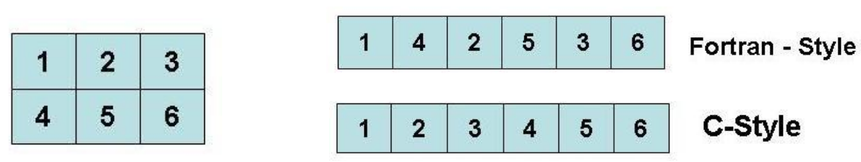
array memory allocation
Memory allocation refers to data store.
C-style memory allocation stores multi-dimensional data in row-major order in memory
Fortran-style memory allocation stores multi-dimensional data in column-major order in memory
Array to store:
Notes:
Masked arrays are arrays that may have missing or invalid entries.
A masked array is the combination of a standard numpy.ndarray and a mask. A mask is either nomask, indicating that no value of the associated array is invalid, or an array of booleans that determines for each element of the associated array whether the value is valid or not. When an element of the mask is False, the corresponding element of the associated array is valid and is said to be unmasked. When an element of the mask is True, the corresponding element of the associated array is said to be masked (invalid).
The package ensures that masked entries are not used in computations.
As an illustration, let’s consider the following dataset:
>>>
>>> import numpy as np
>>> import numpy.ma as ma
>>> x = np.array([1, 2, 3, -1, 5])
We wish to mark the fourth entry as invalid. The easiest is to create a masked array:
>>>
>>> mx = ma.masked_array(x, mask=[0, 0, 0, 1, 0])
We can now compute the mean of the dataset, without taking the invalid data into account:
>>>
>>> mx.mean()
2.75

Slide 19
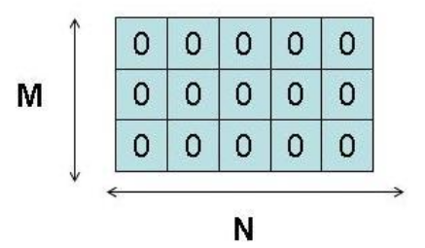
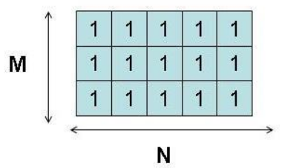
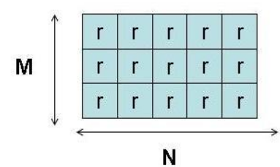
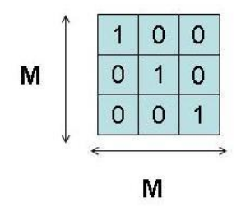
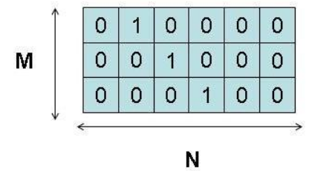
Other array creations
If the array content is unknown, there are functions to fill the array.
zeros( shape, dtype=float, order =‘C’ ) function
create an array of 0 of shape dimension
ones( shape,dtype=None, order =‘C’ )
create an array of 1 of shape dimension
empty( shape, dtype=None, order =‘C’ )
creates an array with shape dimension without initializing it
identity( n, dtype=None )
creates the NxN identity matrix
eye( N, M=None, k=0, dtype=float )
creates an MxM matrix filling with 1 the k-esima diagonal
Note: order : {‘C’, ‘F’}, optional, default: ‘C’. Means whether to store multi-dimensional data in row-major (C-style) or column-major (Fortran-style) order in memory.
Notes:
Masked arrays are arrays that may have missing or invalid entries.
A masked array is the combination of a standard numpy.ndarray and a mask. A mask is either nomask, indicating that no value of the associated array is invalid, or an array of booleans that determines for each element of the associated array whether the value is valid or not. When an element of the mask is False, the corresponding element of the associated array is valid and is said to be unmasked. When an element of the mask is True, the corresponding element of the associated array is said to be masked (invalid).
The package ensures that masked entries are not used in computations.
As an illustration, let’s consider the following dataset:
>>>
>>> import numpy as np
>>> import numpy.ma as ma
>>> x = np.array([1, 2, 3, -1, 5])
We wish to mark the fourth entry as invalid. The easiest is to create a masked array:
>>>
>>> mx = ma.masked_array(x, mask=[0, 0, 0, 1, 0])
We can now compute the mean of the dataset, without taking the invalid data into account:
>>>
>>> mx.mean()
2.75

Slide 20
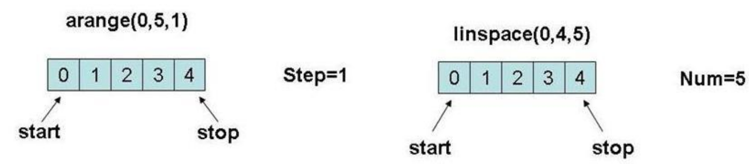
arange() and linspace()
An array can be created from a numbers sequence with functions similar to function range() for lists:
=> arange( [start,] stop[, step,], dtype=None )
creates an array of numbers between ‘start’ and ‘stop’ with step ‘step’
=> linspace( start, stop, num=50, endpoint=True, restep=False )
creates a sequence of num numbers uniformely distributed between start and stop,
If endpoint=True, stop is the last sample; If restep=True, return (samples, step)
Notes:
Masked arrays are arrays that may have missing or invalid entries.
A masked array is the combination of a standard numpy.ndarray and a mask. A mask is either nomask, indicating that no value of the associated array is invalid, or an array of booleans that determines for each element of the associated array whether the value is valid or not. When an element of the mask is False, the corresponding element of the associated array is valid and is said to be unmasked. When an element of the mask is True, the corresponding element of the associated array is said to be masked (invalid).
The package ensures that masked entries are not used in computations.
As an illustration, let’s consider the following dataset:
>>>
>>> import numpy as np
>>> import numpy.ma as ma
>>> x = np.array([1, 2, 3, -1, 5])
We wish to mark the fourth entry as invalid. The easiest is to create a masked array:
>>>
>>> mx = ma.masked_array(x, mask=[0, 0, 0, 1, 0])
We can now compute the mean of the dataset, without taking the invalid data into account:
>>>
>>> mx.mean()
2.75

Slide 21
Create an array from string
An array can be created from a string using the function fromstring()
Example:
>>> np.fromstring('1 2', dtype=int, sep=' ')
array([1, 2])
>>> np.fromstring('1, 2', dtype=int, sep=',')
array([1, 2])
Notes:
Masked arrays are arrays that may have missing or invalid entries.
A masked array is the combination of a standard numpy.ndarray and a mask. A mask is either nomask, indicating that no value of the associated array is invalid, or an array of booleans that determines for each element of the associated array whether the value is valid or not. When an element of the mask is False, the corresponding element of the associated array is valid and is said to be unmasked. When an element of the mask is True, the corresponding element of the associated array is said to be masked (invalid).
The package ensures that masked entries are not used in computations.
As an illustration, let’s consider the following dataset:
>>>
>>> import numpy as np
>>> import numpy.ma as ma
>>> x = np.array([1, 2, 3, -1, 5])
We wish to mark the fourth entry as invalid. The easiest is to create a masked array:
>>>
>>> mx = ma.masked_array(x, mask=[0, 0, 0, 1, 0])
We can now compute the mean of the dataset, without taking the invalid data into account:
>>>
>>> mx.mean()
2.75

Slide 22
Numerical operations on arrays
Numerical operators in numpy acts elementwise (element-by-element) on arrays.
This rule is valid both for unary and binary operators and also for transcendental functions (like sin, cos, log, etc.)
Example:
b=np.array([5,6,7,8])
c=np.arange(1,5)
d=c+b
print("Sum " ,b,"+",c, "= ", b+c)
b+=1
print("Autoincrement b +=1 b=", b)
print("Multiply c*3 " ,c, "* 3= ",c*3)
print("Sin (c)", np.sin(c))
Output:
Sum [5,6,7,8] + [1,2,3,4] = [6,8,10,12]
Autoincrement b+=1 b= [6,7,8,9]
Multiply c*3 [1,2,3,4] *3 = [3,6,9,12]
Sin(c) [ 0.84147098, 0.90929743, 0.14112001, -0.7568025 ]
To deep:
http://scipy-lectures.org/intro/numpy/operations.html
Notes:
Masked arrays are arrays that may have missing or invalid entries.
A masked array is the combination of a standard numpy.ndarray and a mask. A mask is either nomask, indicating that no value of the associated array is invalid, or an array of booleans that determines for each element of the associated array whether the value is valid or not. When an element of the mask is False, the corresponding element of the associated array is valid and is said to be unmasked. When an element of the mask is True, the corresponding element of the associated array is said to be masked (invalid).
The package ensures that masked entries are not used in computations.
As an illustration, let’s consider the following dataset:
>>>
>>> import numpy as np
>>> import numpy.ma as ma
>>> x = np.array([1, 2, 3, -1, 5])
We wish to mark the fourth entry as invalid. The easiest is to create a masked array:
>>>
>>> mx = ma.masked_array(x, mask=[0, 0, 0, 1, 0])
We can now compute the mean of the dataset, without taking the invalid data into account:
>>>
>>> mx.mean()
2.75

Slide 23
Numerical operations on arrays
Product vector-matrices
Given two vectors
v1=np.array([1,2,3])
v2=np.array([10,20,30])
product element by element between monodimensional array
v1*v2
Output:
array([10, 40, 90])
scalar product between monodimensional array
np.dot(v1,v2)
Output:
140
Notes:
Masked arrays are arrays that may have missing or invalid entries.
A masked array is the combination of a standard numpy.ndarray and a mask. A mask is either nomask, indicating that no value of the associated array is invalid, or an array of booleans that determines for each element of the associated array whether the value is valid or not. When an element of the mask is False, the corresponding element of the associated array is valid and is said to be unmasked. When an element of the mask is True, the corresponding element of the associated array is said to be masked (invalid).
The package ensures that masked entries are not used in computations.
As an illustration, let’s consider the following dataset:
>>>
>>> import numpy as np
>>> import numpy.ma as ma
>>> x = np.array([1, 2, 3, -1, 5])
We wish to mark the fourth entry as invalid. The easiest is to create a masked array:
>>>
>>> mx = ma.masked_array(x, mask=[0, 0, 0, 1, 0])
We can now compute the mean of the dataset, without taking the invalid data into account:
>>>
>>> mx.mean()
2.75

Slide 24
Numerical operations on arrays
Numerical operations on arrays
product between matrices
use the np.matrix type
m1=np.matrix(v1)
m2=np.matrix(v2)
are bidimensional arrays:
m1.shape,m2.shape
Output:
((1, 3), (1, 3))
You can use standard operators
like in traditional linear algebra:
try:
m1*m2 #ERRORE
except Exception as err:
print(err)
Output:
shapes (1,3) and (1,3) not aligned: 3 (dim 1) != 1 (dim 0)
e quindi:
In [10]:
m1*m2
Out[10]:
matrix([[140]])
che è equivalente a:
In [11]:
np.dot(m1,m2)
Out[11]:
matrix([[140]])
Re-define m2 as column vector:
m2=np.matrix(v2[:,np.newaxis])
re-try:
m1*m2
Output:
matrix([[140]])
The same doing:
np.dot(m1,m2)
Output:
matrix([[140]])
Notes:
Masked arrays are arrays that may have missing or invalid entries.
A masked array is the combination of a standard numpy.ndarray and a mask. A mask is either nomask, indicating that no value of the associated array is invalid, or an array of booleans that determines for each element of the associated array whether the value is valid or not. When an element of the mask is False, the corresponding element of the associated array is valid and is said to be unmasked. When an element of the mask is True, the corresponding element of the associated array is said to be masked (invalid).
The package ensures that masked entries are not used in computations.
As an illustration, let’s consider the following dataset:
>>>
>>> import numpy as np
>>> import numpy.ma as ma
>>> x = np.array([1, 2, 3, -1, 5])
We wish to mark the fourth entry as invalid. The easiest is to create a masked array:
>>>
>>> mx = ma.masked_array(x, mask=[0, 0, 0, 1, 0])
We can now compute the mean of the dataset, without taking the invalid data into account:
>>>
>>> mx.mean()
2.75

Slide 25
Reshaping and resizing arrays
Methods resize e reshape allow to modify shape and dimension of an array.
reshape(shape, order=‘C’)
Return a new data structure with array elements re-distributed on the base of the new shape with the new order
With reshape() the number of array elements is unmodified
resize(new_shape, refcheck=True, order=False)
Allow to modify the array shape and the dimension also
Resize gives an error if the array is referenced.
Examples:
>>>a=arange(20)
>>>a.resize(5,6)
#Ok
>>>b=a
>>>a.resize(3,3)
#Error a is referenced by b
Traceback (most recent call last):
File "<pyshell#160>", line 1, in <module>
a.resize(3,3)
ValueError: cannot resize an array that has been referenced or is referencing another array in this way. Use the resize function
Notes:
Masked arrays are arrays that may have missing or invalid entries.
A masked array is the combination of a standard numpy.ndarray and a mask. A mask is either nomask, indicating that no value of the associated array is invalid, or an array of booleans that determines for each element of the associated array whether the value is valid or not. When an element of the mask is False, the corresponding element of the associated array is valid and is said to be unmasked. When an element of the mask is True, the corresponding element of the associated array is said to be masked (invalid).
The package ensures that masked entries are not used in computations.
As an illustration, let’s consider the following dataset:
>>>
>>> import numpy as np
>>> import numpy.ma as ma
>>> x = np.array([1, 2, 3, -1, 5])
We wish to mark the fourth entry as invalid. The easiest is to create a masked array:
>>>
>>> mx = ma.masked_array(x, mask=[0, 0, 0, 1, 0])
We can now compute the mean of the dataset, without taking the invalid data into account:
>>>
>>> mx.mean()
2.75

Slide 26
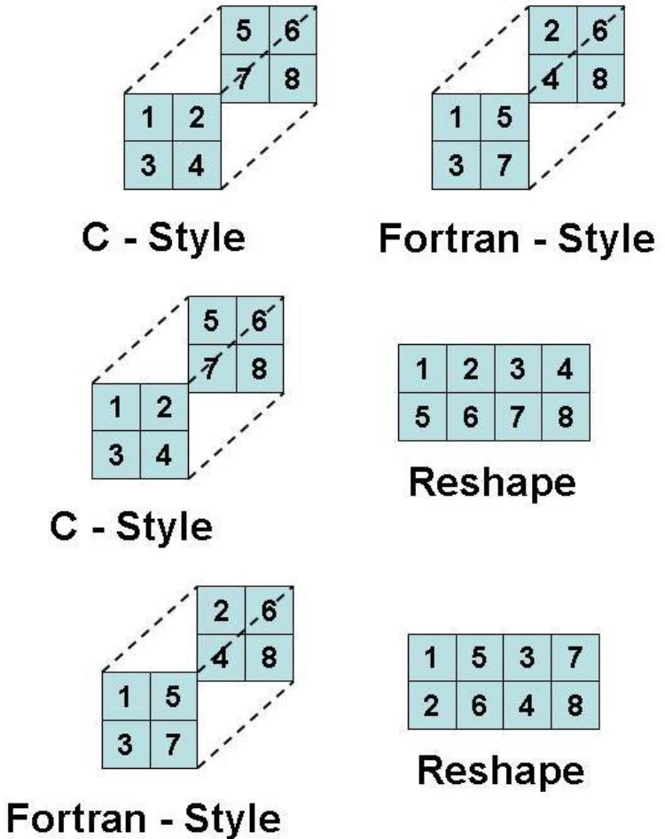
reshape() example output
Shape (8,)
C-style c_style [ [ [1, 2],
[3, 4] ],
[ [5, 6],
[7, 8] ] ]
Fortran-style f_style [ [ [1,5],
[3, 7] ]
[ [2, 6],
[4, 8] ] ]
Reshape c_style [[1, 2, 3, 4],
[5, 6, 7,8]]
Reshape f_style [[1, 5, 3, 7],
[2, 6, 4,8]]
Notes:
Masked arrays are arrays that may have missing or invalid entries.
A masked array is the combination of a standard numpy.ndarray and a mask. A mask is either nomask, indicating that no value of the associated array is invalid, or an array of booleans that determines for each element of the associated array whether the value is valid or not. When an element of the mask is False, the corresponding element of the associated array is valid and is said to be unmasked. When an element of the mask is True, the corresponding element of the associated array is said to be masked (invalid).
The package ensures that masked entries are not used in computations.
As an illustration, let’s consider the following dataset:
>>>
>>> import numpy as np
>>> import numpy.ma as ma
>>> x = np.array([1, 2, 3, -1, 5])
We wish to mark the fourth entry as invalid. The easiest is to create a masked array:
>>>
>>> mx = ma.masked_array(x, mask=[0, 0, 0, 1, 0])
We can now compute the mean of the dataset, without taking the invalid data into account:
>>>
>>> mx.mean()
2.75

Slide 27
reshape() example (try)
>>> a=np.array(range(1,9))
>>> print(“Shape” , a.shape)
>>> c_style = a.reshape((2,2,2),order=‘C’) # Array Method: C Style
>>> f_style = a.reshape((2,2,2),order=‘F’) # Array Method: Fortran Style
>>> print(“C-style “, c_style)
>>> print(“Fortran-style “, f_style)
>>> c_style = c_style.reshape((2,4))
>>> print(“Reshape c_style“, c_style)
>>> f_style = f_style.reshape((2,4))
>>>print(“Reshape f_style”,f_style)
Notes:
Masked arrays are arrays that may have missing or invalid entries.
A masked array is the combination of a standard numpy.ndarray and a mask. A mask is either nomask, indicating that no value of the associated array is invalid, or an array of booleans that determines for each element of the associated array whether the value is valid or not. When an element of the mask is False, the corresponding element of the associated array is valid and is said to be unmasked. When an element of the mask is True, the corresponding element of the associated array is said to be masked (invalid).
The package ensures that masked entries are not used in computations.
As an illustration, let’s consider the following dataset:
>>>
>>> import numpy as np
>>> import numpy.ma as ma
>>> x = np.array([1, 2, 3, -1, 5])
We wish to mark the fourth entry as invalid. The easiest is to create a masked array:
>>>
>>> mx = ma.masked_array(x, mask=[0, 0, 0, 1, 0])
We can now compute the mean of the dataset, without taking the invalid data into account:
>>>
>>> mx.mean()
2.75

Slide 28
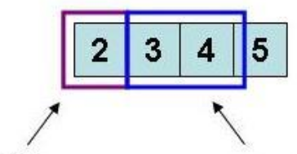
indexing – slicing – iteration (1)
The access to array elements is done by the operator[]
array has the slicing operator[:]
In case of monodimensional arrays the built-in list notation
Example
>>> a = np.ones(4)
>>> a
array([ 1., 1., 1., 1.])
>>> b = np.arange(1,5)
>>> b
array([1, 2, 3, 4])
>>> a+=b ; a # a+=b means a=a+b
array([ 2., 3., 4., 5.])
>>> print(“a[0] “, a[0])
>>> 2.0
>>> a[1:3]=a[1:3]*3 # Modify the elements from 1 to 3
>>> print(a)
>>> [ 2., 9., 12., 5.]
a[0]
a[1:3]
Notes:
Masked arrays are arrays that may have missing or invalid entries.
A masked array is the combination of a standard numpy.ndarray and a mask. A mask is either nomask, indicating that no value of the associated array is invalid, or an array of booleans that determines for each element of the associated array whether the value is valid or not. When an element of the mask is False, the corresponding element of the associated array is valid and is said to be unmasked. When an element of the mask is True, the corresponding element of the associated array is said to be masked (invalid).
The package ensures that masked entries are not used in computations.
As an illustration, let’s consider the following dataset:
>>>
>>> import numpy as np
>>> import numpy.ma as ma
>>> x = np.array([1, 2, 3, -1, 5])
We wish to mark the fourth entry as invalid. The easiest is to create a masked array:
>>>
>>> mx = ma.masked_array(x, mask=[0, 0, 0, 1, 0])
We can now compute the mean of the dataset, without taking the invalid data into account:
>>>
>>> mx.mean()
2.75

Slide 29
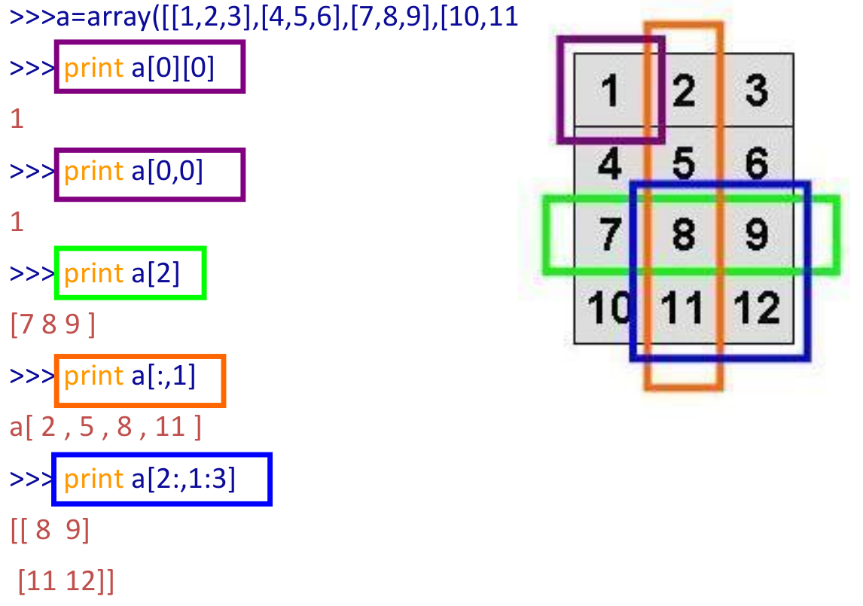
indexing – slicing – iteration (2)
,12]])
(
)
(
)
(
)
(
)
(
)
Notes:
Masked arrays are arrays that may have missing or invalid entries.
A masked array is the combination of a standard numpy.ndarray and a mask. A mask is either nomask, indicating that no value of the associated array is invalid, or an array of booleans that determines for each element of the associated array whether the value is valid or not. When an element of the mask is False, the corresponding element of the associated array is valid and is said to be unmasked. When an element of the mask is True, the corresponding element of the associated array is said to be masked (invalid).
The package ensures that masked entries are not used in computations.
As an illustration, let’s consider the following dataset:
>>>
>>> import numpy as np
>>> import numpy.ma as ma
>>> x = np.array([1, 2, 3, -1, 5])
We wish to mark the fourth entry as invalid. The easiest is to create a masked array:
>>>
>>> mx = ma.masked_array(x, mask=[0, 0, 0, 1, 0])
We can now compute the mean of the dataset, without taking the invalid data into account:
>>>
>>> mx.mean()
2.75

Slide 30
indexing – slicing – iteration (3)
Example:
>>> a=np.arange(25)
>>> a=a.reshape((5,5)) ; print(a)
array([[ 0, 1, 2, 3, 4],
[ 5, 6, 7, 8, 9],
[10, 11, 12, 13, 14],
[15, 16, 17, 18, 19],
[20, 21, 22, 23, 24]])
>>> print(a[::,1])
array([ 1, 6, 11, 16, 21])
>>> print(a[1])
array([5, 6, 7, 8, 9])
>>> print(a[1,:])
array([5, 6, 7, 8, 9])
>>> print(a[1,::])
array([5, 6, 7, 8, 9])
>>> print(a[1,::2])
array([5, 7, 9])
>>> print(a[1,10::-1])
array([9, 8, 7, 6, 5])
Notes:
Masked arrays are arrays that may have missing or invalid entries.
A masked array is the combination of a standard numpy.ndarray and a mask. A mask is either nomask, indicating that no value of the associated array is invalid, or an array of booleans that determines for each element of the associated array whether the value is valid or not. When an element of the mask is False, the corresponding element of the associated array is valid and is said to be unmasked. When an element of the mask is True, the corresponding element of the associated array is said to be masked (invalid).
The package ensures that masked entries are not used in computations.
As an illustration, let’s consider the following dataset:
>>>
>>> import numpy as np
>>> import numpy.ma as ma
>>> x = np.array([1, 2, 3, -1, 5])
We wish to mark the fourth entry as invalid. The easiest is to create a masked array:
>>>
>>> mx = ma.masked_array(x, mask=[0, 0, 0, 1, 0])
We can now compute the mean of the dataset, without taking the invalid data into account:
>>>
>>> mx.mean()
2.75

Slide 31
Array copy
Copy can be of two types:
copy by reference (it is the copy of memory area pointer)
copy by value (a new memori area is crested with the same value)
Array copy is by default by reference:
>>>a=np.arange(5)
a: [0,1,2,3,4]
>>>b=a
>>>b[0]=100
>>>print ("a:", a , "b:" , b)
a: [100,1,2,3,4] b: [100,1,2,3,4]
Array assignment by value is done using method copy: >>>c=a.copy()
>>print("id(a): ", id(a), "id(c):", id(c))
id(a): 18820584 id(c): 21335648
>>> c[0]=122
>>> print("c" , c , "a", a)
c [122, 1, 2, 3, 4] a [100, 1, 2, 3, 4]
a
a = b means:
b
a
3
b
3
a
100 1 2 3 4
b
Notes:
Masked arrays are arrays that may have missing or invalid entries.
A masked array is the combination of a standard numpy.ndarray and a mask. A mask is either nomask, indicating that no value of the associated array is invalid, or an array of booleans that determines for each element of the associated array whether the value is valid or not. When an element of the mask is False, the corresponding element of the associated array is valid and is said to be unmasked. When an element of the mask is True, the corresponding element of the associated array is said to be masked (invalid).
The package ensures that masked entries are not used in computations.
As an illustration, let’s consider the following dataset:
>>>
>>> import numpy as np
>>> import numpy.ma as ma
>>> x = np.array([1, 2, 3, -1, 5])
We wish to mark the fourth entry as invalid. The easiest is to create a masked array:
>>>
>>> mx = ma.masked_array(x, mask=[0, 0, 0, 1, 0])
We can now compute the mean of the dataset, without taking the invalid data into account:
>>>
>>> mx.mean()
2.75

Slide 32
Copy element by element is by value
The copy is done element-by-element and the two objects are different.
Example:
>>> a = np.arange(5)
>>> b = np.zeros_like(a) # Return an array of zeros with the same shape and type as a given array.
>>> b[:] = a[:] # Copy is element-by-element and the two objects are different
>>> b[3] = 1000
>>> b == a
array([True,True,True,False,True],dtype=bool)
Notes:
Masked arrays are arrays that may have missing or invalid entries.
A masked array is the combination of a standard numpy.ndarray and a mask. A mask is either nomask, indicating that no value of the associated array is invalid, or an array of booleans that determines for each element of the associated array whether the value is valid or not. When an element of the mask is False, the corresponding element of the associated array is valid and is said to be unmasked. When an element of the mask is True, the corresponding element of the associated array is said to be masked (invalid).
The package ensures that masked entries are not used in computations.
As an illustration, let’s consider the following dataset:
>>>
>>> import numpy as np
>>> import numpy.ma as ma
>>> x = np.array([1, 2, 3, -1, 5])
We wish to mark the fourth entry as invalid. The easiest is to create a masked array:
>>>
>>> mx = ma.masked_array(x, mask=[0, 0, 0, 1, 0])
We can now compute the mean of the dataset, without taking the invalid data into account:
>>>
>>> mx.mean()
2.75

Slide 33
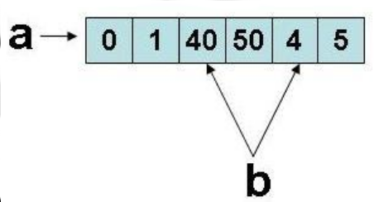
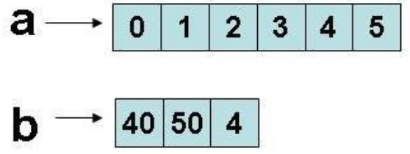
Slicing is by reference
Note:
The slicing operation for numpy arrays is different from slicing for python built-in lists:
in numpy array slicing the generated sub-array is a reference to the original memory area
in built-in python lists the generated sub-list is a by-value copy of the original memory area
>>> a=np.arange(6) ; a
array([0, 1, 2, 3, 4, 5])
>>> b=a[2:5] ; b
array([2, 3, 4])
>>> b[0]=40
>>> b[1]=50
>>> print “a:“, a , “b:”, b
a: [ 0 1 40 50 4 5] b: [40 50 4]
This impacts on performances and memory consumption and results.
>>> a=range(6) ; a
[0, 1, 2, 3, 4, 5]
>>> b=a[2:5] ; b
[2, 3, 4]
>>> b[0]=40
>>> b[1]=50
>>> print “a:“, a , “b:”, b
a: [ 0 1 2 3 4 5] b: [40 50 4]
Notes:
Masked arrays are arrays that may have missing or invalid entries.
A masked array is the combination of a standard numpy.ndarray and a mask. A mask is either nomask, indicating that no value of the associated array is invalid, or an array of booleans that determines for each element of the associated array whether the value is valid or not. When an element of the mask is False, the corresponding element of the associated array is valid and is said to be unmasked. When an element of the mask is True, the corresponding element of the associated array is said to be masked (invalid).
The package ensures that masked entries are not used in computations.
As an illustration, let’s consider the following dataset:
>>>
>>> import numpy as np
>>> import numpy.ma as ma
>>> x = np.array([1, 2, 3, -1, 5])
We wish to mark the fourth entry as invalid. The easiest is to create a masked array:
>>>
>>> mx = ma.masked_array(x, mask=[0, 0, 0, 1, 0])
We can now compute the mean of the dataset, without taking the invalid data into account:
>>>
>>> mx.mean()
2.75

Slide 34
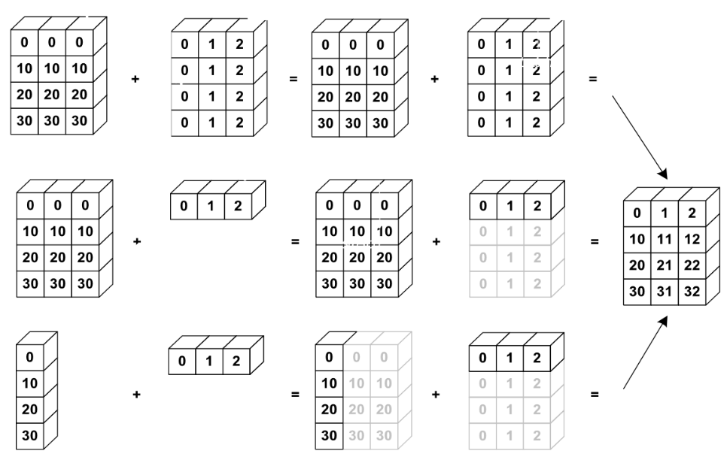
Broadcasting
Basic operations on numpy arrays (addition, etc.) are elementwise (element-by-element)
This works on arrays of the same size.
Nevertheless, It’s also possible to do operations on arrays of different sizes if NumPy can transform these arrays so that they all have the same size: this conversion is called broadcasting.
The image below gives an example of broadcasting:
Notes:
Masked arrays are arrays that may have missing or invalid entries.
A masked array is the combination of a standard numpy.ndarray and a mask. A mask is either nomask, indicating that no value of the associated array is invalid, or an array of booleans that determines for each element of the associated array whether the value is valid or not. When an element of the mask is False, the corresponding element of the associated array is valid and is said to be unmasked. When an element of the mask is True, the corresponding element of the associated array is said to be masked (invalid).
The package ensures that masked entries are not used in computations.
As an illustration, let’s consider the following dataset:
>>>
>>> import numpy as np
>>> import numpy.ma as ma
>>> x = np.array([1, 2, 3, -1, 5])
We wish to mark the fourth entry as invalid. The easiest is to create a masked array:
>>>
>>> mx = ma.masked_array(x, mask=[0, 0, 0, 1, 0])
We can now compute the mean of the dataset, without taking the invalid data into account:
>>>
>>> mx.mean()
2.75

Slide 35
Broadcasting rules
The broadcasting has two rules:
If the two arrays have not the same number of dimension
then the more little array is re-shaped (adding dimension ‘1’ until both arrays have the same dimension
Arrays with dimension ‘1’ along one direction behaves as the array bigger along that version. The value is repeated along the broadcast direction.
Notes:
Masked arrays are arrays that may have missing or invalid entries.
A masked array is the combination of a standard numpy.ndarray and a mask. A mask is either nomask, indicating that no value of the associated array is invalid, or an array of booleans that determines for each element of the associated array whether the value is valid or not. When an element of the mask is False, the corresponding element of the associated array is valid and is said to be unmasked. When an element of the mask is True, the corresponding element of the associated array is said to be masked (invalid).
The package ensures that masked entries are not used in computations.
As an illustration, let’s consider the following dataset:
>>>
>>> import numpy as np
>>> import numpy.ma as ma
>>> x = np.array([1, 2, 3, -1, 5])
We wish to mark the fourth entry as invalid. The easiest is to create a masked array:
>>>
>>> mx = ma.masked_array(x, mask=[0, 0, 0, 1, 0])
We can now compute the mean of the dataset, without taking the invalid data into account:
>>>
>>> mx.mean()
2.75

Slide 36
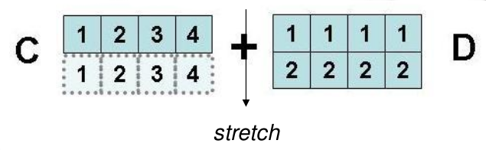
Broadcasting example
c=np.arange(1,5)
d=np.array([[1,1,1,1],[2,2,2,2]])
print d, ”+”, c “= “ d+c
Notes:
Masked arrays are arrays that may have missing or invalid entries.
A masked array is the combination of a standard numpy.ndarray and a mask. A mask is either nomask, indicating that no value of the associated array is invalid, or an array of booleans that determines for each element of the associated array whether the value is valid or not. When an element of the mask is False, the corresponding element of the associated array is valid and is said to be unmasked. When an element of the mask is True, the corresponding element of the associated array is said to be masked (invalid).
The package ensures that masked entries are not used in computations.
As an illustration, let’s consider the following dataset:
>>>
>>> import numpy as np
>>> import numpy.ma as ma
>>> x = np.array([1, 2, 3, -1, 5])
We wish to mark the fourth entry as invalid. The easiest is to create a masked array:
>>>
>>> mx = ma.masked_array(x, mask=[0, 0, 0, 1, 0])
We can now compute the mean of the dataset, without taking the invalid data into account:
>>>
>>> mx.mean()
2.75

Slide 37
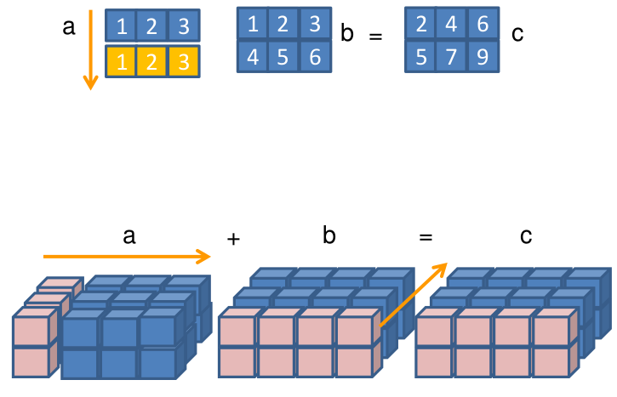
Broadcasting example
Broadcast can always be used on 1-dimensional arrays.
Examples:
a=np.array([1,2,3])
a.shape # (3,)
b=np.array([[1,2,3],[4,5,6]])
b.shape #(2,3)
c=a+b # OK!! Broadcastable
a=np.arange(6)
a=a.reshape((2,1,3))
b=np.arange(8)
b=b.reshape((2,4,1))
c=a+b # OK!! Broadcastable
a=np.arange(30)
a=a.reshape((2,5,3))
b=np.arange(8)
b=b.reshape((2,4,1))
c=a+b # No Broadcastable
Traceback (most recent call last):
File "<stdin>", line 1, in <module>
ValueError: operands could not be broadcast together with shapes (2,5,3) (2,4,1)
Notes:
Masked arrays are arrays that may have missing or invalid entries.
A masked array is the combination of a standard numpy.ndarray and a mask. A mask is either nomask, indicating that no value of the associated array is invalid, or an array of booleans that determines for each element of the associated array whether the value is valid or not. When an element of the mask is False, the corresponding element of the associated array is valid and is said to be unmasked. When an element of the mask is True, the corresponding element of the associated array is said to be masked (invalid).
The package ensures that masked entries are not used in computations.
As an illustration, let’s consider the following dataset:
>>>
>>> import numpy as np
>>> import numpy.ma as ma
>>> x = np.array([1, 2, 3, -1, 5])
We wish to mark the fourth entry as invalid. The easiest is to create a masked array:
>>>
>>> mx = ma.masked_array(x, mask=[0, 0, 0, 1, 0])
We can now compute the mean of the dataset, without taking the invalid data into account:
>>>
>>> mx.mean()
2.75

Slide 38
Vectorization
For loops are slow in Python.
One advatage in using numpy arrays is the provided ability to execute a lot of operations avoiding explicit loops.
Avoiding explicit loops is called vectorization.
Example:
a=np.arange(0,4*np.pi,0.1)
VECTORIZED VERSION
y=np.sin(a)*2
SCALAR VERSION
y=np.zeros(len(a))
for i in range(len(a)):
y[i]=np.sin(a[i])*2
Sometimes it is needed to vectorize explicitely the algorithm:
• Directly: vectorize(function) # a bit slow!
• Manually: with suitable techniques, like slicing for example
Notes:
Masked arrays are arrays that may have missing or invalid entries.
A masked array is the combination of a standard numpy.ndarray and a mask. A mask is either nomask, indicating that no value of the associated array is invalid, or an array of booleans that determines for each element of the associated array whether the value is valid or not. When an element of the mask is False, the corresponding element of the associated array is valid and is said to be unmasked. When an element of the mask is True, the corresponding element of the associated array is said to be masked (invalid).
The package ensures that masked entries are not used in computations.
As an illustration, let’s consider the following dataset:
>>>
>>> import numpy as np
>>> import numpy.ma as ma
>>> x = np.array([1, 2, 3, -1, 5])
We wish to mark the fourth entry as invalid. The easiest is to create a masked array:
>>>
>>> mx = ma.masked_array(x, mask=[0, 0, 0, 1, 0])
We can now compute the mean of the dataset, without taking the invalid data into account:
>>>
>>> mx.mean()
2.75

Slide 39
Vectorization
Vectorization is not always possible. Example:
def func(x):
if x<0: return 1
else: return np.sin(x)
func(3)
func(np.array([1,-2,9]))
Traceback (most recent call last):
ValueError: The truth value of an array with more than one element is
ambiguous. Use
a.any() or a.all()
Scalar version to work with arrays. Example:
def func_NumPy(x):
r = x.copy() # allocate result array
for i in range(np.size(x)):
if x[i] < 0:
r[i] = 0.0
else:
r[i] = sin(x[i])
return r
This implementation is very slow in Python and it works only for 1-dimensional arrays
=> The ‘where’ statement can be used instead
Notes:
Masked arrays are arrays that may have missing or invalid entries.
A masked array is the combination of a standard numpy.ndarray and a mask. A mask is either nomask, indicating that no value of the associated array is invalid, or an array of booleans that determines for each element of the associated array whether the value is valid or not. When an element of the mask is False, the corresponding element of the associated array is valid and is said to be unmasked. When an element of the mask is True, the corresponding element of the associated array is said to be masked (invalid).
The package ensures that masked entries are not used in computations.
As an illustration, let’s consider the following dataset:
>>>
>>> import numpy as np
>>> import numpy.ma as ma
>>> x = np.array([1, 2, 3, -1, 5])
We wish to mark the fourth entry as invalid. The easiest is to create a masked array:
>>>
>>> mx = ma.masked_array(x, mask=[0, 0, 0, 1, 0])
We can now compute the mean of the dataset, without taking the invalid data into account:
>>>
>>> mx.mean()
2.75

Slide 40
Vectorization
def f(x):
if condition:
x = <expression1>
else:
x = <expression2>
return x
def f_vectorized(x):
x1 = <expression1>
x2 = <expression2>
return where(condition, x1, x2)
Using vectorization, the previous examples becomes:
def func_NumPyV2(x):
return where(x < 0, 0.0, sin(x))
• Avoid for cicle usage
• Run on molti-dimentional structures
This is the famous pythonic way of work
Notes:
Masked arrays are arrays that may have missing or invalid entries.
A masked array is the combination of a standard numpy.ndarray and a mask. A mask is either nomask, indicating that no value of the associated array is invalid, or an array of booleans that determines for each element of the associated array whether the value is valid or not. When an element of the mask is False, the corresponding element of the associated array is valid and is said to be unmasked. When an element of the mask is True, the corresponding element of the associated array is said to be masked (invalid).
The package ensures that masked entries are not used in computations.
As an illustration, let’s consider the following dataset:
>>>
>>> import numpy as np
>>> import numpy.ma as ma
>>> x = np.array([1, 2, 3, -1, 5])
We wish to mark the fourth entry as invalid. The easiest is to create a masked array:
>>>
>>> mx = ma.masked_array(x, mask=[0, 0, 0, 1, 0])
We can now compute the mean of the dataset, without taking the invalid data into account:
>>>
>>> mx.mean()
2.75

Slide 41
Vectorization
Array slicing can be used to vectorize operations.
In scientific field, for example, applications regarding
– schemas for finite differences equations
– image processing
it is common to find expressions like:
xk = xk-1 + 2xk + xk-1 k=1,2,...,n-1
It can be managed:
with scalar functions
for i in range(len(x)-1):
x[i]=x[i-1]+2*x[i]+x[i+2]
or using vectorization:
x[1:n-1]=x[0:n-2]+2*x[1:n-1]+x[2:n]
Notes:
Masked arrays are arrays that may have missing or invalid entries.
A masked array is the combination of a standard numpy.ndarray and a mask. A mask is either nomask, indicating that no value of the associated array is invalid, or an array of booleans that determines for each element of the associated array whether the value is valid or not. When an element of the mask is False, the corresponding element of the associated array is valid and is said to be unmasked. When an element of the mask is True, the corresponding element of the associated array is said to be masked (invalid).
The package ensures that masked entries are not used in computations.
As an illustration, let’s consider the following dataset:
>>>
>>> import numpy as np
>>> import numpy.ma as ma
>>> x = np.array([1, 2, 3, -1, 5])
We wish to mark the fourth entry as invalid. The easiest is to create a masked array:
>>>
>>> mx = ma.masked_array(x, mask=[0, 0, 0, 1, 0])
We can now compute the mean of the dataset, without taking the invalid data into account:
>>>
>>> mx.mean()
2.75

Slide 42
I/O with array NumPy
Functions eval and repr can be used to write and read ASCII format files
a = linspace(1, 21, 21)
a.shape = (2,10)
# ASCII format:
file = open(’tmp.dat’, ’w’)
file.write(’Here is an array a:\n’)
file.write(repr(a)) # dump string representation of a
file.close()
# load the array from file into b:
file = open(’tmp.dat’, ’r’)
file.readline() # load the first line (a comment)
b = eval(file.read())
file.close()
Files I/O can be managed with loadtxt and savetxt
Read file:
numpy.loadtxt(fname, dtype=<type'float'>, comments='#', delimiter=None, converters=None, skiprows=0,usecols=None, unpack=False, ndmin=0)
Write file:
numpy.savetxt(fname, X, fmt='%.18e', delimiter='', newline='\n', header='', footer='',comments='#)
Notes:
Masked arrays are arrays that may have missing or invalid entries.
A masked array is the combination of a standard numpy.ndarray and a mask. A mask is either nomask, indicating that no value of the associated array is invalid, or an array of booleans that determines for each element of the associated array whether the value is valid or not. When an element of the mask is False, the corresponding element of the associated array is valid and is said to be unmasked. When an element of the mask is True, the corresponding element of the associated array is said to be masked (invalid).
The package ensures that masked entries are not used in computations.
As an illustration, let’s consider the following dataset:
>>>
>>> import numpy as np
>>> import numpy.ma as ma
>>> x = np.array([1, 2, 3, -1, 5])
We wish to mark the fourth entry as invalid. The easiest is to create a masked array:
>>>
>>> mx = ma.masked_array(x, mask=[0, 0, 0, 1, 0])
We can now compute the mean of the dataset, without taking the invalid data into account:
>>>
>>> mx.mean()
2.75

Slide 43
I/O with array NumPy
Text.txt
Student test1 test2 test3 test4
Lisa 98.3 94.2 95.3 91.3
Carlo 47.2 49.1 54.2 34.7
Mario 84.2 85.3 94.1 76.4
>>>a = loadtxt('textfile.txt',skiprows=2,usecols=range(1,5))‫‫‫‬
>>>print a
[[ 98.3 94.2 95.3 91.3]
[ 47.2 49.1 54.2 34.7]
[ 84.2 85.3 94.1 76.4]]
>>>b = loadtxt(‘textfile.txt’,skiprows=2,usecols=(1,-2))‫‫‫‬
>>> print b
[[ 98.3 95.3]
[ 47.2 54.2]
[ 84.2 94.1]]
Notes:
Masked arrays are arrays that may have missing or invalid entries.
A masked array is the combination of a standard numpy.ndarray and a mask. A mask is either nomask, indicating that no value of the associated array is invalid, or an array of booleans that determines for each element of the associated array whether the value is valid or not. When an element of the mask is False, the corresponding element of the associated array is valid and is said to be unmasked. When an element of the mask is True, the corresponding element of the associated array is said to be masked (invalid).
The package ensures that masked entries are not used in computations.
As an illustration, let’s consider the following dataset:
>>>
>>> import numpy as np
>>> import numpy.ma as ma
>>> x = np.array([1, 2, 3, -1, 5])
We wish to mark the fourth entry as invalid. The easiest is to create a masked array:
>>>
>>> mx = ma.masked_array(x, mask=[0, 0, 0, 1, 0])
We can now compute the mean of the dataset, without taking the invalid data into account:
>>>
>>> mx.mean()
2.75

Slide 44
Matrix
Numpy provides standard classes, inheriting by array and using its internal structure
• Matrix inherit from ndarray methods and attributes
• Matrix class specific attributes
– .T trasposta
– .H coniugata trasposta
– .I inversa
– .A array bidimensionale
• Matrix defines only bidimensional objects
• Matrix * operator executes multiplication
• Matrix objects have priority respect to simple arrays
Notes:
Masked arrays are arrays that may have missing or invalid entries.
A masked array is the combination of a standard numpy.ndarray and a mask. A mask is either nomask, indicating that no value of the associated array is invalid, or an array of booleans that determines for each element of the associated array whether the value is valid or not. When an element of the mask is False, the corresponding element of the associated array is valid and is said to be unmasked. When an element of the mask is True, the corresponding element of the associated array is said to be masked (invalid).
The package ensures that masked entries are not used in computations.
As an illustration, let’s consider the following dataset:
>>>
>>> import numpy as np
>>> import numpy.ma as ma
>>> x = np.array([1, 2, 3, -1, 5])
We wish to mark the fourth entry as invalid. The easiest is to create a masked array:
>>>
>>> mx = ma.masked_array(x, mask=[0, 0, 0, 1, 0])
We can now compute the mean of the dataset, without taking the invalid data into account:
>>>
>>> mx.mean()
2.75

Slide 45
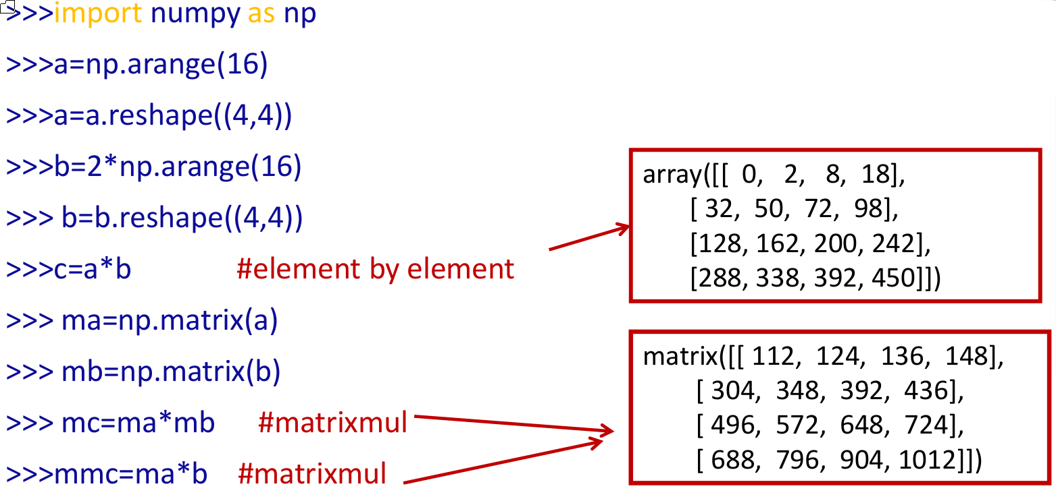
Matrix
Notes:
Masked arrays are arrays that may have missing or invalid entries.
A masked array is the combination of a standard numpy.ndarray and a mask. A mask is either nomask, indicating that no value of the associated array is invalid, or an array of booleans that determines for each element of the associated array whether the value is valid or not. When an element of the mask is False, the corresponding element of the associated array is valid and is said to be unmasked. When an element of the mask is True, the corresponding element of the associated array is said to be masked (invalid).
The package ensures that masked entries are not used in computations.
As an illustration, let’s consider the following dataset:
>>>
>>> import numpy as np
>>> import numpy.ma as ma
>>> x = np.array([1, 2, 3, -1, 5])
We wish to mark the fourth entry as invalid. The easiest is to create a masked array:
>>>
>>> mx = ma.masked_array(x, mask=[0, 0, 0, 1, 0])
We can now compute the mean of the dataset, without taking the invalid data into account:
>>>
>>> mx.mean()
2.75

Slide 46
linalg
The Numpy module contains interesting submodules. One of them is
linalg
containing some algorithm of linear algebra.
It contains functions to solve:
  linear systems
  compute eigenvalues
  compute eigenvectors
  factorization
  invert matrix
  matrix multiply
>>> dir(linalg)
Notes:
Masked arrays are arrays that may have missing or invalid entries.
A masked array is the combination of a standard numpy.ndarray and a mask. A mask is either nomask, indicating that no value of the associated array is invalid, or an array of booleans that determines for each element of the associated array whether the value is valid or not. When an element of the mask is False, the corresponding element of the associated array is valid and is said to be unmasked. When an element of the mask is True, the corresponding element of the associated array is said to be masked (invalid).
The package ensures that masked entries are not used in computations.
As an illustration, let’s consider the following dataset:
>>>
>>> import numpy as np
>>> import numpy.ma as ma
>>> x = np.array([1, 2, 3, -1, 5])
We wish to mark the fourth entry as invalid. The easiest is to create a masked array:
>>>
>>> mx = ma.masked_array(x, mask=[0, 0, 0, 1, 0])
We can now compute the mean of the dataset, without taking the invalid data into account:
>>>
>>> mx.mean()
2.75

Slide 47
linalg: example
>>> A = np.zeros((10,10)) # arrays initialization
>>> x = np.arange(10)/2.0
>>> for i in range(10):
… for j in range(10):
… A[i,j] = 2.0 + float(i+1)/float(j+i+1)
>>> b = np.dot(A, x)
>>> y = np.linalg.solve(A, b) # A*y=b → y=x
# eigenvalues only:
>>> A_eigenvalues = np.linalg.eigvals(A)
# eigenvalues and eigenvectors:
>>> A_eigenvalues, A_eigenvectors = np.linalg.eig(A)
Notes:
Masked arrays are arrays that may have missing or invalid entries.
A masked array is the combination of a standard numpy.ndarray and a mask. A mask is either nomask, indicating that no value of the associated array is invalid, or an array of booleans that determines for each element of the associated array whether the value is valid or not. When an element of the mask is False, the corresponding element of the associated array is valid and is said to be unmasked. When an element of the mask is True, the corresponding element of the associated array is said to be masked (invalid).
The package ensures that masked entries are not used in computations.
As an illustration, let’s consider the following dataset:
>>>
>>> import numpy as np
>>> import numpy.ma as ma
>>> x = np.array([1, 2, 3, -1, 5])
We wish to mark the fourth entry as invalid. The easiest is to create a masked array:
>>>
>>> mx = ma.masked_array(x, mask=[0, 0, 0, 1, 0])
We can now compute the mean of the dataset, without taking the invalid data into account:
>>>
>>> mx.mean()
2.75

Slide 48
Autovettore e autovalore
Datala matrice A, quadrata di ordine n, esistono
•uno scalareλ
•un vettore (a n componenti) v, non nullo,
tali che, scrivendo v come colonna, risulti
Av=λv ?
Se si,
λ viene detto autovalore di A e
v viene detto autovettore di A relativo a λ

Slide 49
random
random is another NumPy sub-module to generate random numbers
>>> dir(random)
The standard numpy module is not efficient in random number ganeration, it is more efficient to use numpy.random
Example:
>>> np.random.seed(100)
>>> x = np.random.random(4)
array([ 0.89132195, 0.20920212, 0.18532822,0.10837689])
>>> y = np.random.uniform(1, 1, n) # n uniform
numbers in interval (1,1)
Distribuzione normale
>>> mean = 0.0; stdev = 1.0
>>> u = np.random.normal(mean, stdev, n)
Notes:
Masked arrays are arrays that may have missing or invalid entries.
A masked array is the combination of a standard numpy.ndarray and a mask. A mask is either nomask, indicating that no value of the associated array is invalid, or an array of booleans that determines for each element of the associated array whether the value is valid or not. When an element of the mask is False, the corresponding element of the associated array is valid and is said to be unmasked. When an element of the mask is True, the corresponding element of the associated array is said to be masked (invalid).
The package ensures that masked entries are not used in computations.
As an illustration, let’s consider the following dataset:
>>>
>>> import numpy as np
>>> import numpy.ma as ma
>>> x = np.array([1, 2, 3, -1, 5])
We wish to mark the fourth entry as invalid. The easiest is to create a masked array:
>>>
>>> mx = ma.masked_array(x, mask=[0, 0, 0, 1, 0])
We can now compute the mean of the dataset, without taking the invalid data into account:
>>>
>>> mx.mean()
2.75

Slide 50
scipy

Slide 51
Scipy
SciPy is a collection of
  mathematical algorithms and
  convenience functions
built on the numpy extension of Python.
It provides the user with high-level commands and classes for manipulating and visualizing data.
Using an interactive Python session with scipy we have a data-processing and system-prototyping environment rivaling systems such as MATLAB, IDL.
https://docs.scipy.org/doc/scipy/reference/tutorial/index.html

Slide 52
Scipy modules
SciPy is organized into subpackages covering different scientific computing domains:
Subpackage | Description
cluster | Clustering algorithms
constants | Physical and mathematical constants
fftpack | Fast Fourier Transform routines
integrate | Integration and ordinary differential equation solvers
interpolate | Interpolation and smoothing splines
io | Input and Output
linalg | Linear algebra
ndimage | N-dimensional image processing
odr | Orthogonal distance regression
optimize | Optimization and root-finding routines
signal | Signal processing
sparse | Sparse matrices and associated routines
spatial | Spatial data structures and algorithms
special | Special functions
stats | Statistical distribution and function
Scipy sub-packages need to be imported separately. Example:
from scipy import linalg, io

Slide 53
matplotlib

Slide 54
Matplotlib
Matplotlib is a Python 2D plotting library which produces publication quality figures in a variety of hardcopy formats and interactive environments across platforms.
You can generate plots, histograms, power spectra, bar charts, errorcharts, scatterplots, etc., with just a few lines of code.
For simple plotting the pyplot sub-module provides a MATLAB-like interface, particularly when combined with IPython. For the power user, you have full control of line styles, font properties, axes properties, etc, via an object oriented interface or via a set of functions familiar to MATLAB users.

Slide 55
Matplotlib: Gallery
https://matplotlib.org/gallery/index.html#examples-index
This gallery contains examples of the many things you can do with Matplotlib.
It is completely searchable from the search page:
https://matplotlib.org/search.html
A set of tutorial is accessible:
https://matplotlib.org/tutorials/index.html

Slide 56
example code: simple_plot.py
Simple plot of a sin function, with labels on x and y axis (simple_plot.py):
import matplotlib.pyplot as plt
import numpy as np
t = np.arange(0.0, 2.0, 0.01)
s = 1 + np.sin(2*np.pi*t)
plt.plot(t, s)
plt.xlabel('time (s)')
plt.ylabel('voltage (mV)')
plt.title('About as simple as it gets, folks')
plt.grid(True)
plt.savefig("test.png")
plt.show()
https://matplotlib.org/examples/pylab_examples/simple_plot.html

Slide 57
Exercise
Using the previous example, make some try changing the scale and the labels.
Try to plot also different functions.

Slide 58
Example: subplots
import numpy as np
import matplotlib.pyplot as plt
x1 = np.linspace(0.0, 5.0)
x2 = np.linspace(0.0, 2.0)
y1 = np.cos(2 * np.pi * x1) * np.exp(-x1)
y2 = np.cos(2 * np.pi * x2)
plt.subplot(2, 1, 1)
plt.plot(x1, y1, 'o-')
plt.title('A tale of 2 subplots')
plt.ylabel('Damped oscillation')
plt.subplot(2, 1, 2)
plt.plot(x2, y2, '.-')
plt.xlabel('time (s)')
plt.ylabel('Undamped')
plt.show()
https://matplotlib.org/gallery/subplots_axes_and_figures/subplot.html

Slide 59
Example: statisctics
import numpy as np
from matplotlib import pyplot as plt
# read data by file
data = np.loadtxt('data/populations.txt')
# read variables by line
year, hares, lynxes, carrots = data.T
# plot populations
print("plot the 4 populations on the same graph")
plt.axes([0.2, 0.1, 0.5, 0.8])
plt.plot(year, hares, year, lynxes, year, carrots)
plt.legend(('Hare', 'Lynx', 'Carrot'), loc=(1.05, 0.5))
plt.show()
plt.close()
http://scipy-lectures.org/intro/numpy/operations.html
print("The mean populations over time:")
populations = data[:, 1:]
print(populations.mean(axis=0))
# Expected result:
# [ 34080.95238095 20166.66666667 42400. ]
print("The sample standard deviations:")
print(populations.std(axis=0))
# Expected result:
# [ 20897.90645809 16254.59153691 3322.5062]
print("Which species has the highest population
each year?:")
print(np.argmax(populations, axis=1))
# Expected result:
# [2 2 0 0 1 1 2 2 2 2 2 2 0 0 0 1 2 2 2 2 2]

Slide 60
astropy

Slide 61
Astropy
The astropy package contains key functionality and common tools needed for performing astronomy and astrophysics with Python.
It is at the core of the Astropy Project, which aims to enable the community to develop a robust ecosystem of Affiliated Packages covering a broad range of needs for astronomical research, data processing, and data analysis.
http://docs.astropy.org/en/stable/

Slide 62
Astropy: content
Data structures and transformations
Constants (astropy.constants)
Units and Quantities (astropy.units)
N-dimensional datasets (astropy.nddata)
Data Tables (astropy.table)
Time and Dates (astropy.time)
Astronomical Coordinate Systems (astropy.coordinates)
World Coordinate System (astropy.wcs)
Models and Fitting (astropy.modeling)
Uncertainties and Distributions (astropy.uncertainty)
Files, I/O, and Communication
Unified file read/write interface
FITS File handling (astropy.io.fits)
ASCII Tables (astropy.io.ascii)
VOTable XML handling (astropy.io.votable)
Miscellaneous: HDF5, YAML, ASDF, pickle (astropy.io.misc)
SAMP (Simple Application Messaging Protocol (astropy.samp)
http://docs.astropy.org/en/stable/

Slide 63
Astropy: content
Computations and utilities
Cosmological Calculations (astropy.cosmology)
Convolution and filtering (astropy.convolution)
Data Visualization (astropy.visualization)
Astrostatistics Tools (astropy.stats)
Nuts and bolts
Configuration system (astropy.config)
I/O Registry (astropy.io.registry)
Logging system
Python warnings system
Astropy Core Package Utilities (astropy.utils)
Astropy Testing Tools
Try the development version
http://docs.astropy.org/en/stable/

Slide 64
Exceptions
Errors detected during execution are called exceptions.
Exceptions are errors raised executing a statement or an expression,
also in case they are syntactically correct.
Exceptions are not unconditionally fatal: they can be handled in Python programs. Most exceptions are not handled by programs, however, and result in error messages.
Example:
>>> 10 * (1/0)
Traceback (most recent call last):
File "<stdin>", line 1, in <module>
ZeroDivisionError: integer division or modulo by zero
Exceptions come in different types, and the type is printed as part of the message. Example are ZeroDivisionError, NameError and TypeError.
Notes:
•

Slide 65
Classes
Classes provide a means of bundling data and functionality together. Creating a new class creates a new type of object, allowing new instances of that type to be made. Each class instance can have attributes attached to it for maintaining its state. Class instances can also have methods (defined by its class) for modifying its state.
Example:
Create class
class MyClass:
def __init__(self, name, age):
self.attribute1 = value1
self.attribute2 = value2
def myfunc(self):
print("Hello my attrib1 is " + self.attribute1)
Example:
Create and use object
p1 = MyClass()
p1.myfunc()
print(p1.attribute1)
Notes:
•

Slide 66
Classes: the __init__ object
To understand the meaning of classes we have to understand the built-in __init__() function.
All classes have a function called __init__(), which is always executed when the class is being initiated, i.e.every time the class is being used to create a new object.
Use the __init__() function to assign values to object properties, or other operations that are necessary to do when the object is being created.
Example
Create a class named Person, use the __init__() function to assign values for name and age:
class Person:
def __init__(self, name, age):
self.name = name
self.age = age
p1 = Person("John", 36)
print(p1.name)
print(p1.age)
Notes:
•

Slide 67
Classes: methods
Classes can also contain methods. Methods in objects are functions that belongs to the object.
Let us create a method in the Person class that prints a greeting, and execute it on the p1 object:
Example
class Person:
def __init__(self, name, age):
self.name = name
self.age = age
def myfunc(self):
print("Hello my name is " + self.name)
p1 = Person("John", 36)
p1.myfunc()
Notes:
•

Slide 68
User Defined Exceptions
Programs may name their own exceptions by creating a new exception class.
Notes:
•

Slide 69
Exceptions handling
Programs can handle exceptions with the following structure
try:
statement(s)
except ExceptionType1:
statement(s)
except exceptionType2, exceptionType3:
statement(s)
……
except:
statement(s)
else:
statement(s)
finally:
statement(s)
except EceptionType1 is executed if an Exception of Type1 is raised in the try block
except is executed if a not previously catchd exception is thrown
else is executed if no one exception is thrown in try block
finally is always executed
Notes:
•

Slide 70
Exceptions handling: try….except clause
The try statement works as follows: the try clause (the statement(s) between the try and except keywords) is executed.
If no exception occurs, the except clause is skipped and the execution of the try statement is finished.
If an exception occurs during execution of the try clause, the rest of the clause is skipped. Then if its type matches the exception named after the except keyword, the except clause is executed, and then execution continues after the try statement.
If an exception occurs which does not match the exception named in the except clause, it is passed on to other except statements and at the end, to the generic except clause, if it is present. If no handler is found, it is an unhandled exception and execution stops with a message.
When a try statement has more than one except clause, to specify handlers for different exceptions, at most one handler will be executed. Handlers only handle exceptions that occur in the corresponding try clause, not in other handlers of the same try statement.
Notes:
•

Slide 71
Exceptions handling: except clause
An except clause may name multiple exceptions as a parenthesized tuple. Example:
... except (RuntimeError, TypeError, NameError):
... pass
Notes:
•

Slide 72
Exceptions handling: else clause
The try … except statement has an optional else clause, which, when present, must follow all except clauses. It is useful for code that must be executed if the try clause does not raise an exception. Example:
for arg in sys.argv[1:]:
try:
f = open(arg, 'r')
except OSError:
print('cannot open', arg)
else:
print(arg, 'has', len(f.readlines()), 'lines')
f.close()
The use of the else clause is better than adding additional code to the try clause because it avoids accidentally catching an exception that wasn’t raised by the code being protected by the try … except statement.
Notes:
•

Slide 73
Exceptions handling: final clause
The try statement has the final optional clause.
The final clause, which is intended to define clean-up actions,
is always executed before leaving the try statement, whether an exception has occurred or not.
When an exception has occurred in the try clause and has not been handled by an except clause (or it has occurred in an except or else clause), it is re-raised after the finally clause has been executed.
The finally clause is also executed “on the way out” when any other clause of the try statement is left via a break, continue or return statement.
Notes:
•

Slide 74
Exceptions handling: a complete example
>>> def divide(x, y):
... try:
... result = x / y
... except ZeroDivisionError:
... print("division by zero!")
... else:
... print("result is", result)
... finally:
... print("executing finally clause")
...
>>> divide(2, 1)
result is 2.0
executing finally clause
>>> divide(2, 0)
division by zero!
executing finally clause
>>> divide("2", "1")
executing finally clause
Traceback (most recent call last):
File "<stdin>", line 1, in <module>
File "<stdin>", line 3, in divide
TypeError: unsupported operand type(s) for /: 'str' and 'str'
Notes:
•

Slide 75
Exceptions handling: the raise statement
The raise statement allows the programmer to force a specified exception to occur. For example:
>>>
>>> raise NameError('HiThere')
Traceback (most recent call last):
File "<stdin>", line 1, in <module>
NameError: HiThere
Notes:
•

