Slide 1
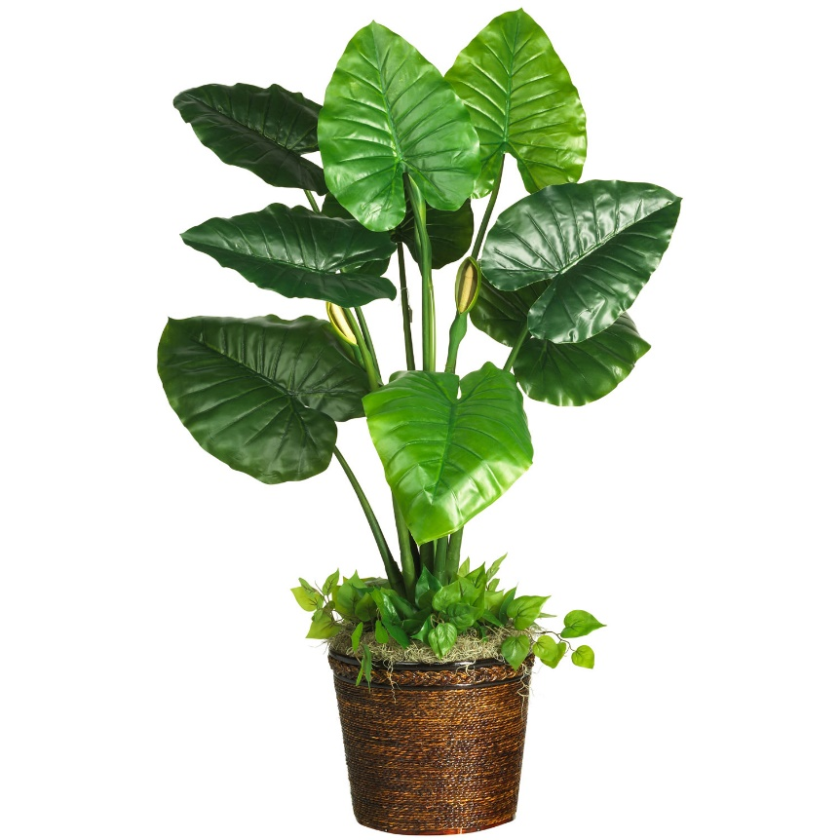

Slide 2
What factors determine the price I’m willing to pay for this plant, and how does each factor influence that price?

Slide 3
Size
Height
Width
Rarity
Health
Type

Slide 4
Size
Height (in)
Width (in)
Rarity (# of times seen before)
Healthy (yes/no)
Type (succulent/nonsucculent)

Slide 5
Characteristic | Coefficient
Height (in) | 2
Width (in) | 2
Rarity (# of times seen before) | 2
Healthy (yes/no) | 2
Is succulent (yes/no) | 2

Slide 6
Characteristic | Coefficient
Height (in) | 2
Width (in) | -1
Rarity (# of times seen before) | -3.5
Healthy (yes/no) | 2.5
Is succulent (yes/no) | 5

