Slide 1
Interpreting Regressions with Categorical Variables: Rank

Slide 2

Our regression equation is familiar.

Slide 3
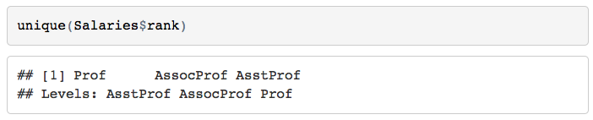
But: “rank” has three levels!

Slide 4
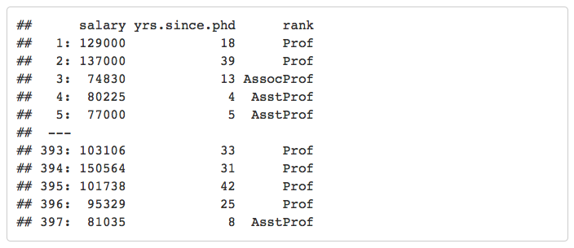
Our original dataset looks like this:

Slide 5
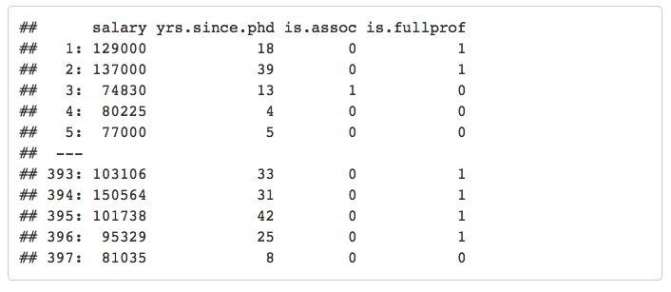
But we should conceptualize a dataset like this:

Slide 6
Such that our new regression equation is this:

Slide 7
Let’s say we come up with these coefficients:

Slide 8

Predicting at 0 yrs.since.phd: Assistant Professors

Slide 9

Predicting at 0 yrs.since.phd: Associate Professors

Slide 10

Predicting at 0 yrs.since.phd: Full Professors

Slide 11
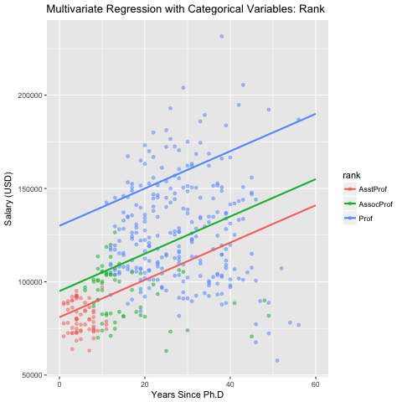
Our regression results, visually:

Slide 12
Remember: You don’t have to manually create those new columns when you’re running regressions– R does it for you automatically.

