Slide 1
Logistic Regression

Slide 2
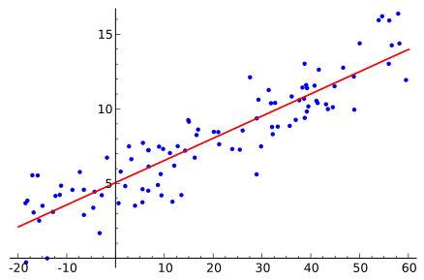
What if your outcome variable is binary?

Slide 3
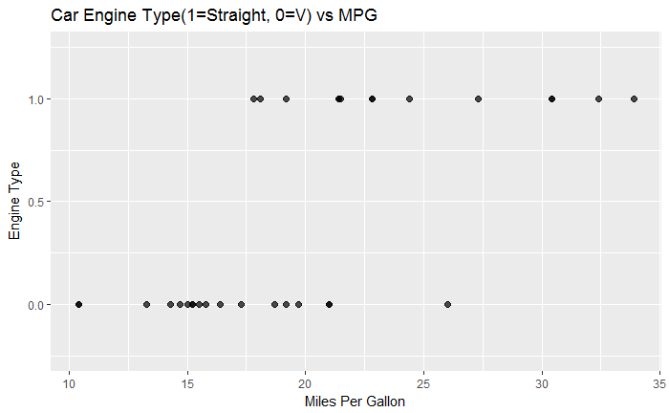
What if your outcome variable is binary?

Slide 4
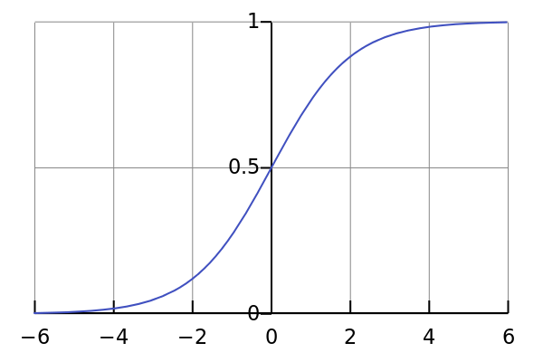
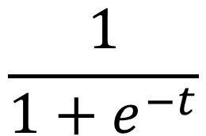
You can map the whole number line to the interval [0,1] with the logistic function.
$$\frac{1}{1+e^{−t}}$$

Slide 5
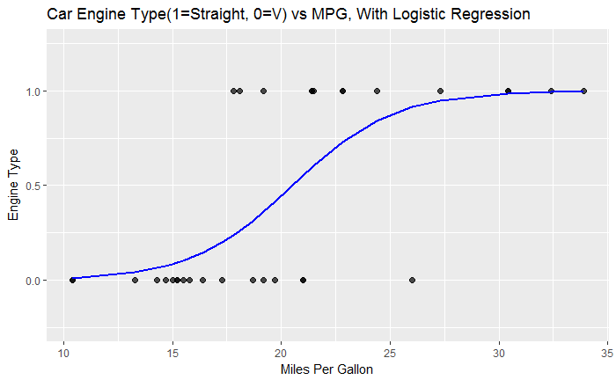
You can map the whole number line to the interval [0,1] with the logistic function.
$$\frac{1}{1+e^{−t}}$$

Slide 6
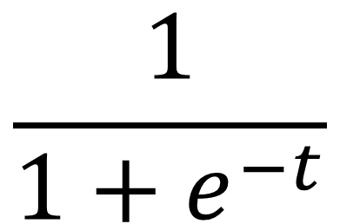
Make the logistic function into a regression by adding variables to the exponent.
$$\frac{1}{1+e^{−t}}$$

Slide 7
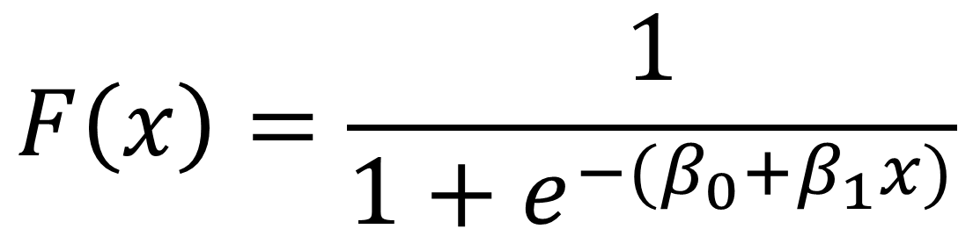
Make the logistic function into a regression by adding variables to the exponent.
$$F\left(x\right)=\frac{1}{1+e^{−{(β}_{0}+β_{1}x)}}$$

Slide 8
What do these beta values mean?
$$F\left(x\right)=\frac{1}{1+e^{−{(β}_{0}+β_{1}x)}}$$

Slide 9
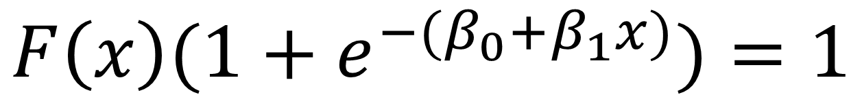
What do these beta values mean?
$$F\left(x\right)(1+e^{−{(β}_{0}+β_{1}x)})=1$$

Slide 10
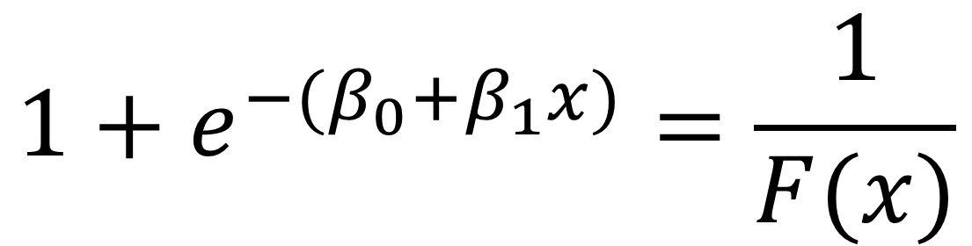
What do these beta values mean?
$$1+e^{−{(β}_{0}+β_{1}x)}=\frac{1}{F(x)}$$

Slide 11
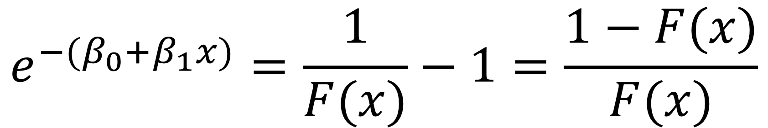
What do these beta values mean?
$$e^{−{(β}_{0}+β_{1}x)}=\frac{1}{F(x)}−1=\frac{1−F(x)}{F(x)}$$

Slide 12
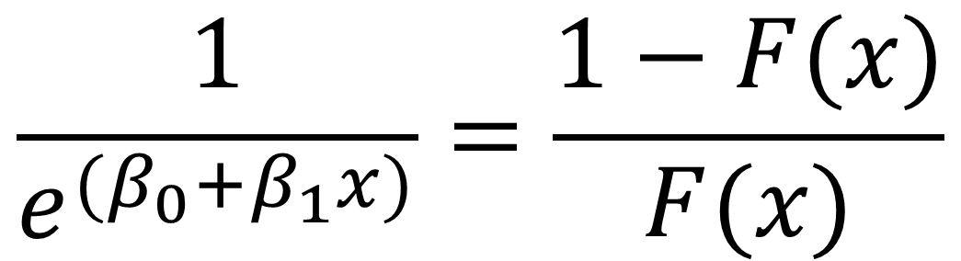
What do these beta values mean?
$$\frac{1}{e^{{(β}_{0}+β_{1}x)}}=\frac{1−F(x)}{F(x)}$$

Slide 13
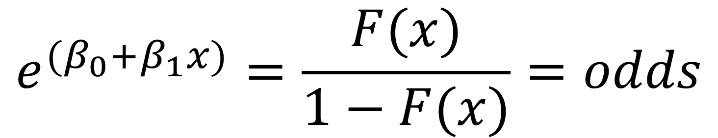
What do these beta values mean?
$$e^{{(β}_{0}+β_{1}x)}=\frac{F(x)}{1−F(x)}=odds$$

Slide 14
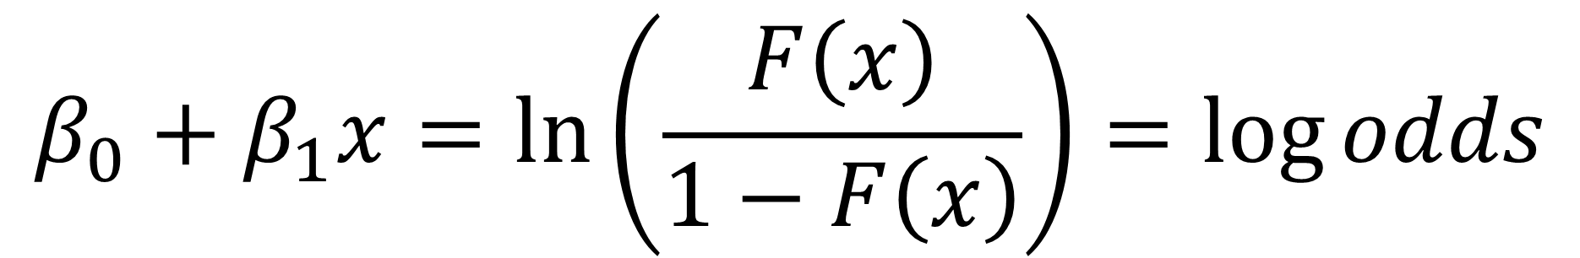
What do these beta values mean?
$$β_{0}+β_{1}x=ln⁡\left(\frac{F\left(x\right)}{1−F\left(x\right)}\right)=\log{odds}$$

