Slide 1
Odds and Odds Ratios

Slide 2
Odds: probability of occurrence vs. probability of not-occurrence.
Say something has a probability p of happening.

Slide 3
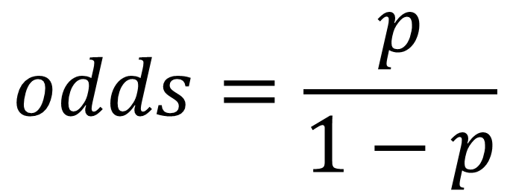
Odds: probability of occurrence vs. probability of not-occurrence.
Say something has a probability p of happening.
$$odds=\frac{p}{1−p}$$

Slide 4
Odds: probability of occurrence vs. probability of not-occurrence.
Say something has a probability p=0.25 of happening.

Slide 5
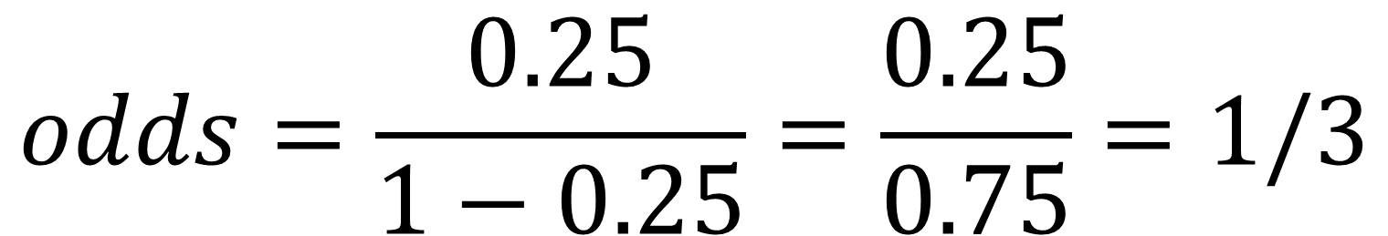
Odds: probability of occurrence vs. probability of not-occurrence.
Say something has a probability p=0.25 of happening.
$$odds=\frac{0.25}{1−0.25}=\frac{0.25}{0.75}=1/3$$

Slide 6
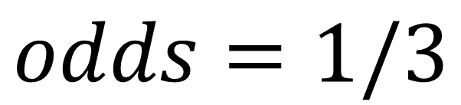
Odds: probability of occurrence vs. probability of not-occurrence.
Say something has a probability p=0.25 of happening.
$$odds=1/3$$
Equivalent: odds are “1 to 3”, odds equal 0.3333…

Slide 7
Odds Ratio: a ratio of two odds.
Consider some product. How much more/less likely are men to purchase it than women?

Slide 8
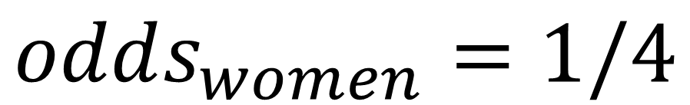
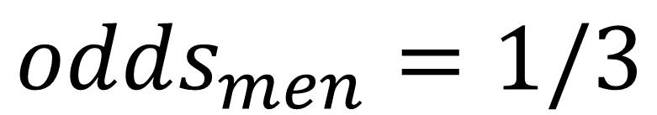
Odds Ratio: a ratio of two odds.
Consider some product. How much more/less likely are men to purchase it than women?
$$odds_{men}=1/3$$
$$odds_{women}=1/4$$

Slide 9
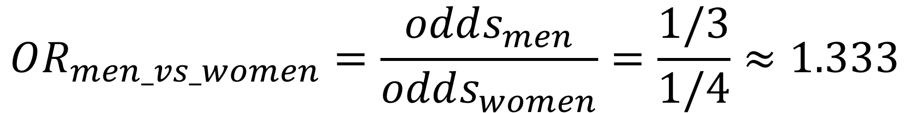
Odds Ratio: a ratio of two odds.
$$OR_{men_vs_women}=\frac{odds_{men}}{odds_{women}}=\frac{1/3}{1/4}≈1.333$$

Slide 10
Odds Ratio: a ratio of two odds.
$$OR_{men_vs_women}=\frac{odds_{men}}{odds_{women}}=\frac{1/3}{1/4}≈1.333$$
“A man is 1.333 times as likely to purchase as a woman is.”

Slide 11
Odds Ratio: a ratio of two odds.
$$OR_{men_vs_women}=\frac{odds_{men}}{odds_{women}}=\frac{1/3}{1/4}≈1.333$$
“A man is 1.333 times as likely to purchase as a woman is.”
“A man is 33.3% more likely than a woman to purchase item.”

Slide 12
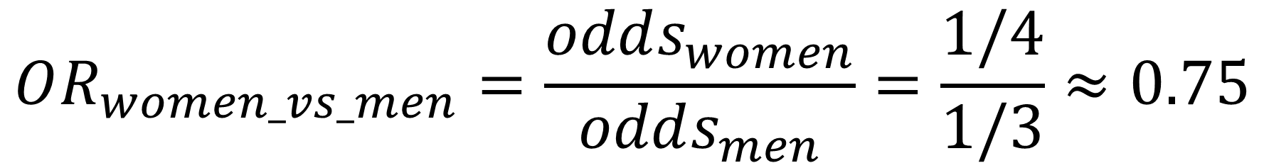
Odds Ratio: a ratio of two odds.
$$OR_{women_vs_men}=\frac{odds_{women}}{odds_{men}}=\frac{1/4}{1/3}≈0.75$$

Slide 13
Odds Ratio: a ratio of two odds.
$$OR_{women_vs_men}=\frac{odds_{women}}{odds_{men}}=\frac{1/4}{1/3}≈0.75$$
“A woman is 0.75 times as likely to purchase as a man is.”

Slide 14
Odds Ratio: a ratio of two odds.
$$OR_{women_vs_men}=\frac{odds_{women}}{odds_{men}}=\frac{1/4}{1/3}≈0.75$$
“A woman is 0.75 times as likely to purchase as a man is.”
“A woman is 25% less likely than a man to purchase item.”

Slide 15
You can compare odds at two points on a spectrum, not just between two different groups.
Consider the odds that a 5-year-old makes it through the year, in 1895 vs 1896.

Slide 16
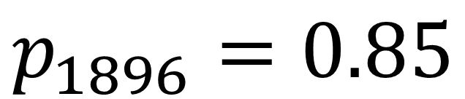
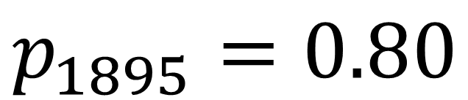
You can compare odds at two points on a spectrum, not just between two different groups.
Consider the odds that a 5-year-old makes it through the year, in 1895 vs 1896.
$$p_{1895}=0.80$$
$$p_{1896}=0.85$$

Slide 17
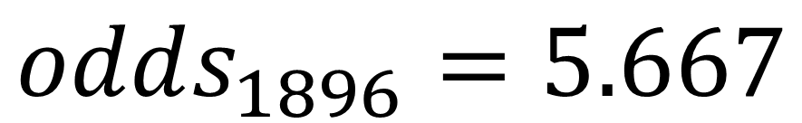
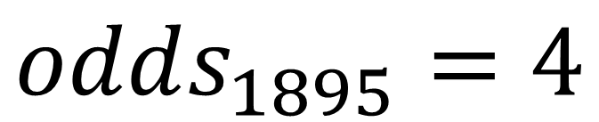
You can compare odds at two points on a spectrum, not just between two different groups.
Consider the odds that a 5-year-old makes it through the year, in 1895 vs 1896.
$$p_{1895}=0.80$$
$$odds_{1895}=4$$
$$p_{1896}=0.85$$
$$odds_{1896}=5.667$$

Slide 18
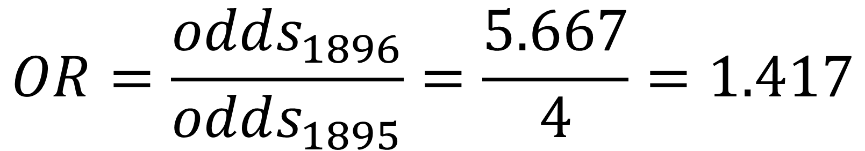
You can compare odds at two points on a spectrum, not just between two different groups.
Consider the odds that a 5-year-old makes it through the year, in 1895 vs 1896.
$$OR=\frac{odds_{1896}}{odds_{1895}}=\frac{5.667}{4}=1.417$$

Slide 19
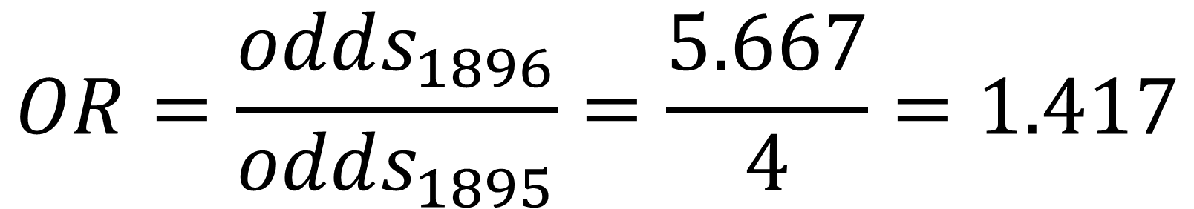
You can compare odds at two points on a spectrum, not just between two different groups.
$$OR=\frac{odds_{1896}}{odds_{1895}}=\frac{5.667}{4}=1.417$$
“A 5-year-old was 1.417 times as likely to survive the year in 1896 as 1895.”

Slide 20
You can compare odds at two points on a spectrum, not just between two different groups.
$$OR=\frac{odds_{1896}}{odds_{1895}}=\frac{5.667}{4}=1.417$$
“A 5-year-old was 1.417 times as likely to survive the year in 1896 as 1895.”
“A 5-year-old was 41.7% more likely to survive 1896 as 1895.”

Slide 21
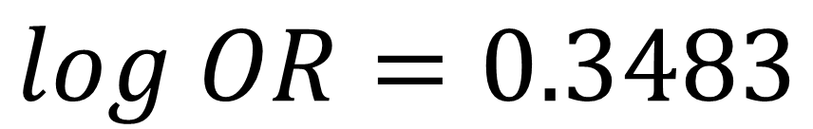
Sometimes people will give you log odds or log ORs, not odds or ORs.
$$log OR=0.3483$$

Slide 22
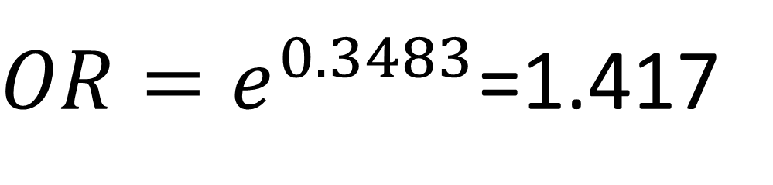
Sometimes people will give you log odds or log ORs, not odds or ORs.
$$log OR=0.3483$$
$OR=e^{0.3483}$=1.417

