Slide 1
Logistic Regression

Slide 2
What if your outcome variable is binary?

Slide 3
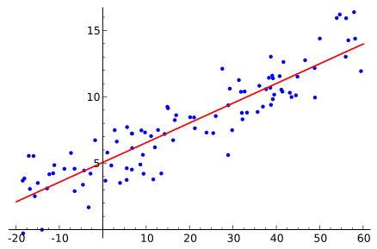
What if your outcome variable is binary?

Slide 4
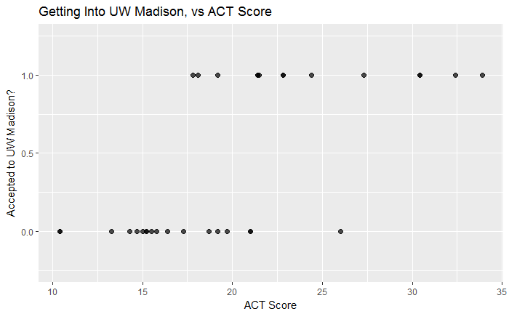
What if your outcome variable is binary?

Slide 5
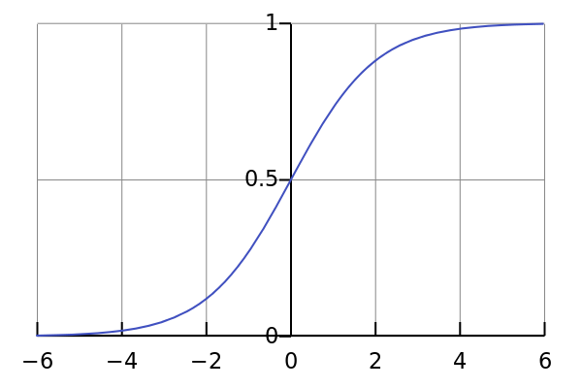
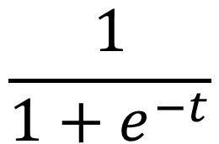
You can map the whole number line to the interval [0,1] with the logistic function.
$$\frac{1}{1+e^{−t}}$$

Slide 6
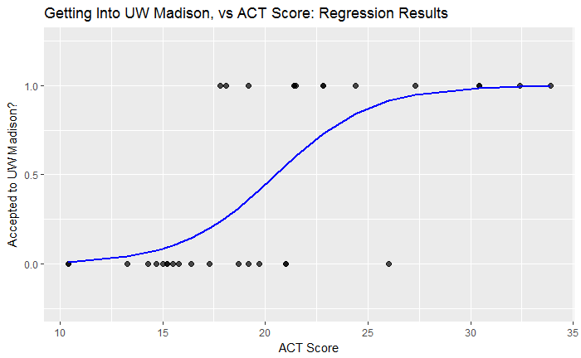
You can map the whole number line to the interval [0,1] with the logistic function.
$$\frac{1}{1+e^{−t}}$$

Slide 7
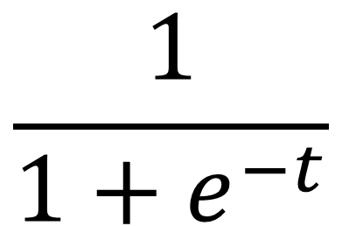
Make the logistic function into a regression by adding variables to the exponent.
$$\frac{1}{1+e^{−t}}$$

Slide 8
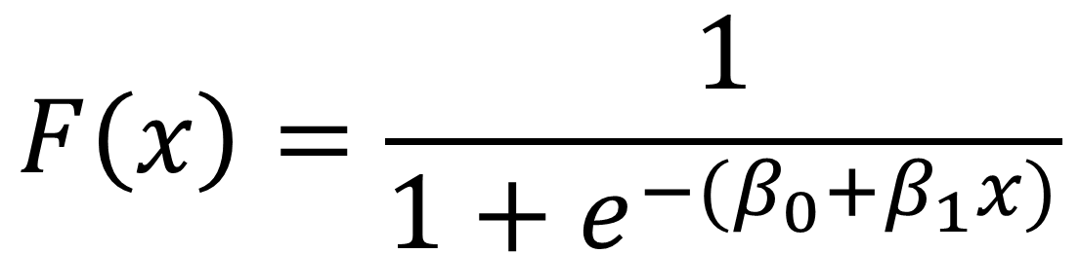
Make the logistic function into a regression by adding variables to the exponent.
$$F\left(x\right)=\frac{1}{1+e^{−{(β}_{0}+β_{1}x)}}$$

Slide 9
What do these beta values mean?
$$F\left(x\right)=\frac{1}{1+e^{−{(β}_{0}+β_{1}x)}}$$

Slide 10
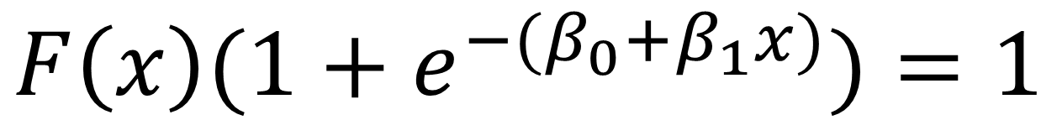
What do these beta values mean?
$$F\left(x\right)(1+e^{−{(β}_{0}+β_{1}x)})=1$$

Slide 11
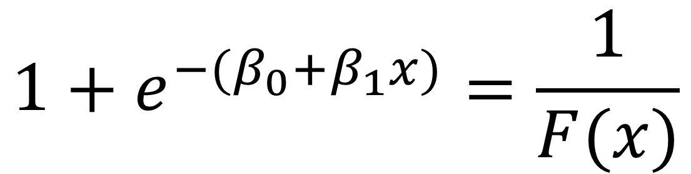
What do these beta values mean?
$$1+e^{−{(β}_{0}+β_{1}x)}=\frac{1}{F(x)}$$

Slide 12
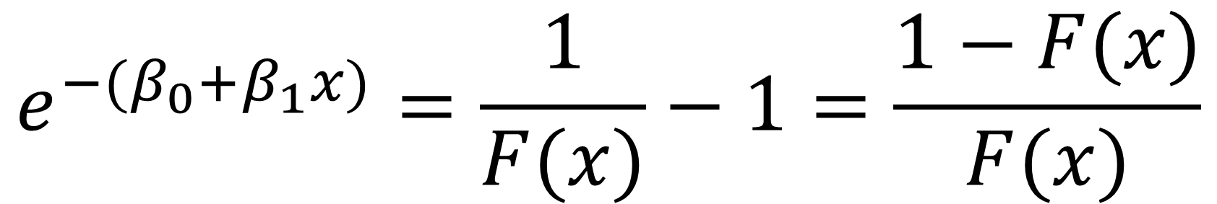
What do these beta values mean?
$$e^{−{(β}_{0}+β_{1}x)}=\frac{1}{F(x)}−1=\frac{1−F(x)}{F(x)}$$

Slide 13
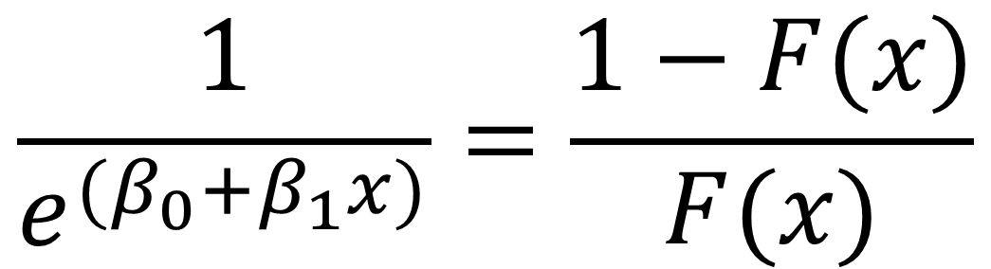
What do these beta values mean?
$$\frac{1}{e^{{(β}_{0}+β_{1}x)}}=\frac{1−F(x)}{F(x)}$$

Slide 14
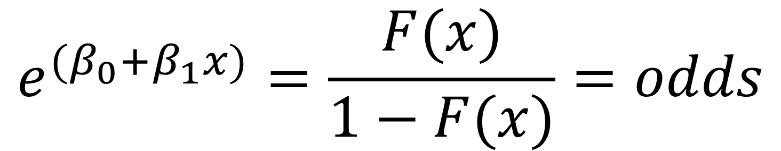
What do these beta values mean?
$$e^{{(β}_{0}+β_{1}x)}=\frac{F(x)}{1−F(x)}=odds$$

Slide 15
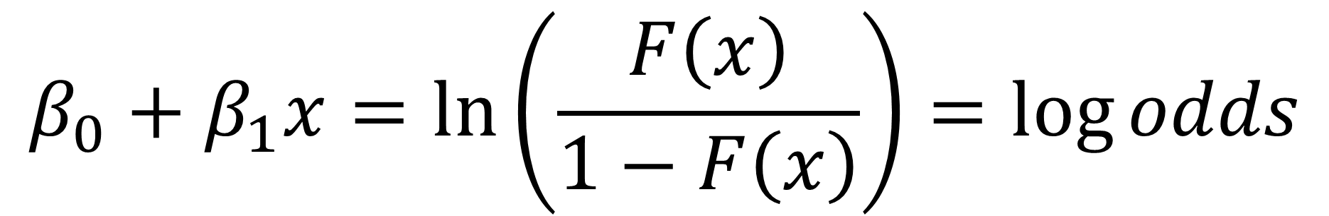
What do these beta values mean?
$$β_{0}+β_{1}x=ln⁡\left(\frac{F\left(x\right)}{1−F\left(x\right)}\right)=\log{odds}$$

Slide 16
Example: Getting into college.
Goal: Determine how 1) someone’s sex, and 2) someone’s ACT score affects their likelihood of going to college.

Slide 17
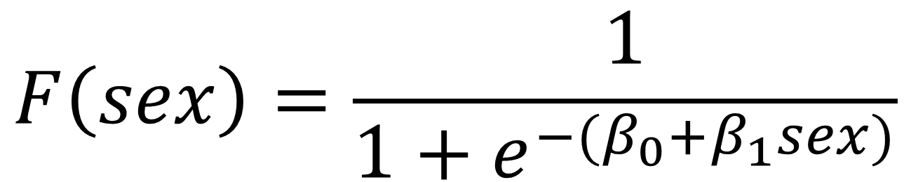
Example 1: Gender and college admittance
$$F\left(sex\right)=\frac{1}{1+e^{−{(β}_{0}+β_{1}sex)}}$$

Slide 18
Example 1: Gender and college admittance
$$F\left(sex\right)=\frac{1}{1+e^{−{(β}_{0}+β_{1}sex)}}$$
How likely is a male student to get into college, compared to a female student?

Slide 19


Example 1: Gender and college admittance
$$F\left(sex\right)=\frac{1}{1+e^{−{(β}_{0}+β_{1}sex)}}$$
$$sex=0→female$$
$$sex=1→male$$

Slide 20


Example 1: Gender and college admittance
$$F\left(sex\right)=\frac{1}{1+e^{−{(β}_{0}+β_{1}sex)}}$$
$$sex=0→female$$
$$β_{0}=−1.609$$
$$sex=1→male$$
$$β_{1}=0.095$$

Slide 21

Example 1: Gender and college admittance
$$e^{{(β}_{0}+β_{1}sex)}=\frac{F(sex)}{1−F(sex)}=odds$$

Slide 22
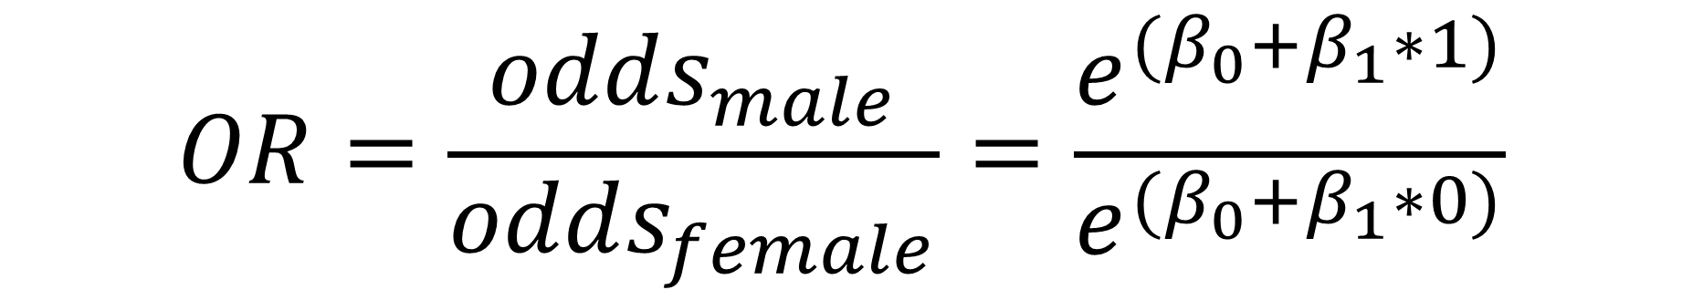
Example 1: Gender and college admittance
$$e^{{(β}_{0}+β_{1}sex)}=\frac{F(sex)}{1−F(sex)}=odds$$
$$OR=\frac{odds_{male}}{odds_{female}}=\frac{e^{{(β}_{0}+β_{1}∗1)}}{e^{{(β}_{0}+β_{1}∗0)}}$$

Slide 23

Example 1: Gender and college admittance
$$OR=\frac{e^{{(β}_{0}+β_{1}∗1)}}{e^{{(β}_{0}+β_{1}∗0)}}=\frac{e^{{(β}_{0}+β_{1})}}{e^{β_{0}}}$$

Slide 24

Example 1: Gender and college admittance
$$OR=\frac{e^{{(β}_{0}+β_{1}∗1)}}{e^{{(β}_{0}+β_{1}∗0)}}=\frac{e^{{(β}_{0}+β_{1})}}{e^{β_{0}}}$$
$$OR=\frac{e^{β_{0}}e^{β_{1}}}{e^{β_{0}}}=e^{β_{1}}$$

Slide 25
Example 1: Gender and college admittance
$$OR=e^{β_{1}}$$
The exponentiated coefficient represents the odds ratio between men and women for college acceptance.

Slide 26
Example 1: Gender and college admittance
$$OR=e^{0.095}=1.1$$
Men are 1.1 times as likely (aka 10% more likely) to get into college than women are.

Slide 27

Example 1: What about beta 0?
$$e^{{(β}_{0}+β_{1}sex)}=\frac{F(sex)}{1−F(sex)}=odds$$
The exponentiated “intercept” coefficient represents the odds of a female (baseline) student getting into college.

Slide 28

Example 1: What about $β_{0}$?
$$odds_{female}=e^{−1.609}=0.2$$
Women have 1 to 5 odds of getting into college, and men are 1.1 times as likely (aka 10% more likely) to get into college than women are.

Slide 29
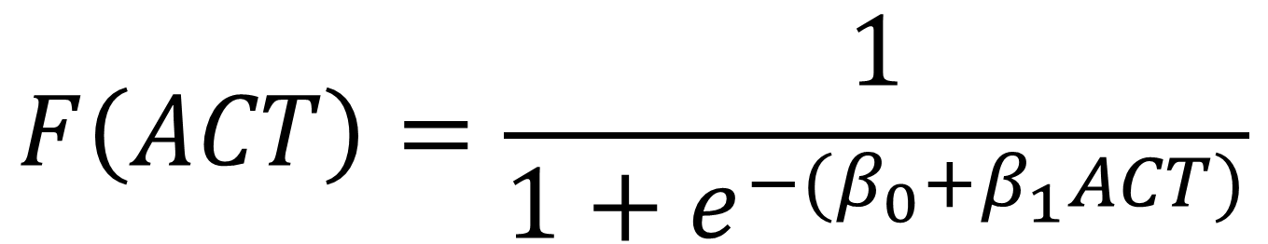
Example 2: ACT score and college admittance
$$F\left(ACT\right)=\frac{1}{1+e^{−{(β}_{0}+β_{1}ACT)}}$$

Slide 30
Example 2: ACT score and college admittance
$$F\left(ACT\right)=\frac{1}{1+e^{−{(β}_{0}+β_{1}ACT)}}$$
How much does an extra point on the ACT contribute to college admittance?

Slide 31


Example 2: ACT score and college admittance
$$F\left(ACT\right)=\frac{1}{1+e^{−{(β}_{0}+β_{1}ACT)}}$$
$$β_{0}=−9.21$$
$$β_{1}=0.157$$

Slide 32
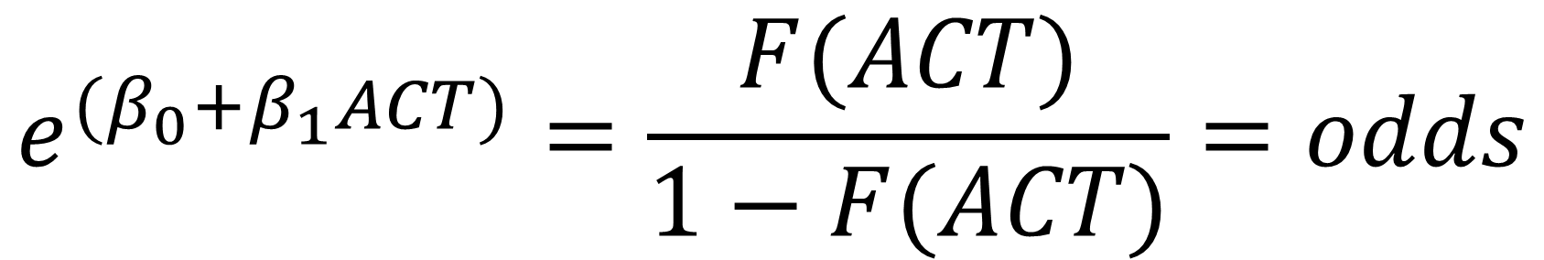
Example 2: ACT score and college admittance
$$e^{{(β}_{0}+β_{1}ACT)}=\frac{F(ACT)}{1−F(ACT)}=odds$$

Slide 33
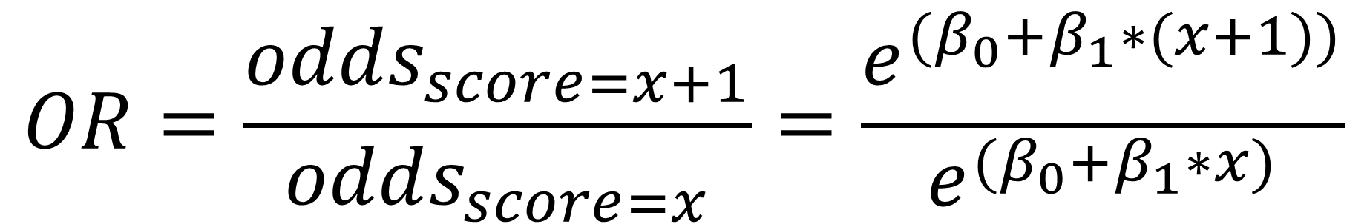
Example 2: ACT score and college admittance
$$e^{{(β}_{0}+β_{1}ACT)}=\frac{F(ACT)}{1−F(ACT)}=odds$$
$$OR=\frac{odds_{score=x+1}}{odds_{score=x}}=\frac{e^{{(β}_{0}+β_{1}∗(x+1))}}{e^{{(β}_{0}+β_{1}∗x)}}$$

Slide 34
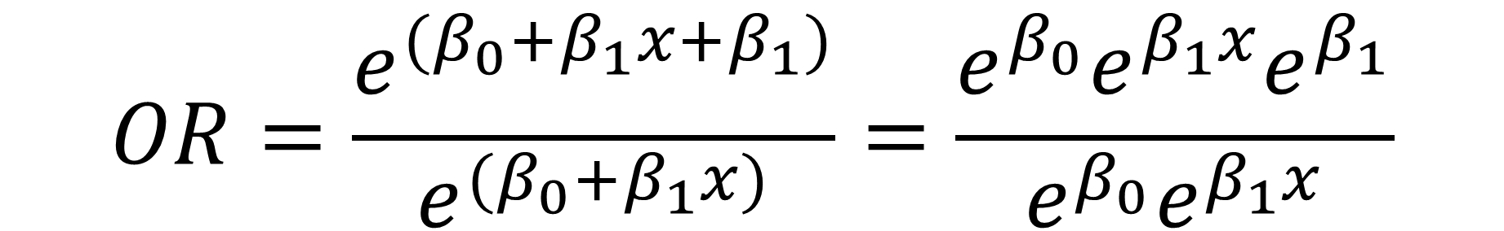
Example 2: ACT score and college admittance
$$OR=\frac{e^{{(β}_{0}+β_{1}x+β_{1})}}{e^{{(β}_{0}+β_{1}x)}}=\frac{e^{β_{0}}e^{β_{1}x}e^{β_{1}}}{e^{β_{0}}e^{β_{1}x}}$$

Slide 35
Example 2: ACT score and college admittance
$$OR=\frac{e^{{(β}_{0}+β_{1}x+β_{1})}}{e^{{(β}_{0}+β_{1}x)}}=\frac{e^{β_{0}}e^{β_{1}x}e^{β_{1}}}{e^{β_{0}}e^{β_{1}x}}$$
$$OR=e^{β_{1}}$$

Slide 36
Example 2: ACT score and college admittance
$$OR=e^{β_{1}}$$
The exponentiated coefficient represents the odds ratio of an extra point of ACT score.

Slide 37
Example 2: ACT score and college admittance
$$OR=e^{0.157}=1.17$$
An extra point on the ACT increases a student’s chance of getting into college 1.17 times (or 17%).

Slide 38
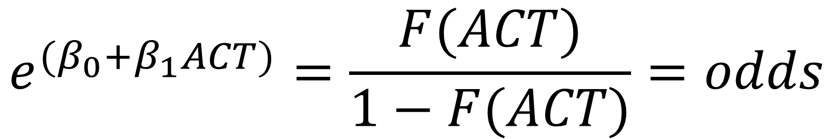
Example 2: What about beta 0?
$$e^{{(β}_{0}+β_{1}ACT)}=\frac{F(ACT)}{1−F(ACT)}=odds$$
The exponentiated “intercept” coefficient represents the odds of getting into college when your ACT score is ZERO.

Slide 39
Example 2: What about beta 0?
$$odds_{score=0}=e^{−9.21}=0.0001$$
The odds of getting into college with an ACT score of zero are 1 to 10,000, and an extra point on the ACT increases a student’s chance of getting into college 1.17 times (or 17%).

