Slide 1
Interpreting Regressions with Categorical Variables: Rank

Slide 2

Our regression equation is familiar.

Slide 3
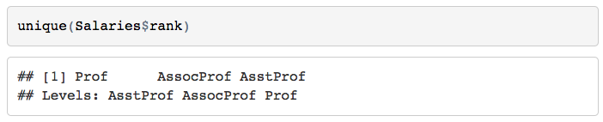
But: “rank” has three levels!

Slide 4
You might think:
Female, Male → 0, 1
Therefore:
AsstProf, AssocProf, Prof → 0, 1, 2

Slide 5
You might think:
Female, Male → 0, 1
Therefore:
AsstProf, AssocProf, Prof → 0, 1, 2

Slide 6
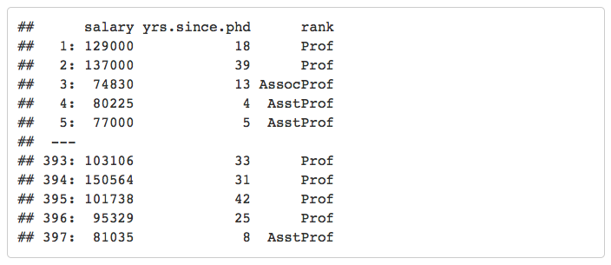
Our original dataset looks like this:

Slide 7
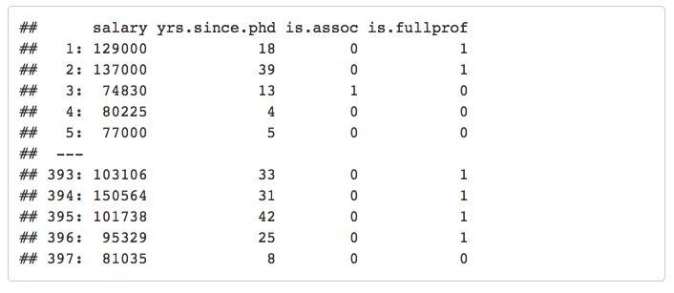
But we should conceptualize a dataset like this:

Slide 8
Such that our new regression equation is this:

Slide 9
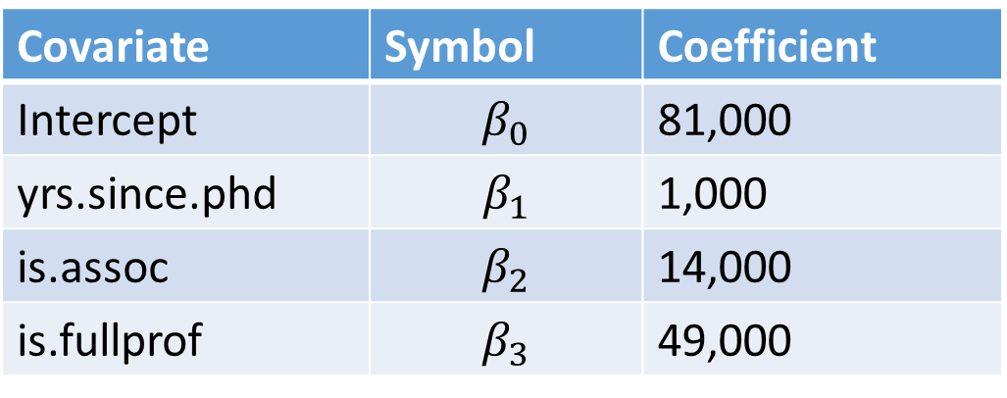
Let’s say we come up with these coefficients:
Covariate | Symbol | Coefficient
Intercept | $$β_{0}$$ | 81,000
yrs.since.phd | $$β_{1}$$ | 1,000
is.assoc | $$β_{2}$$ | 14,000
is.fullprof | $$β_{3}$$ | 49,000

Slide 10

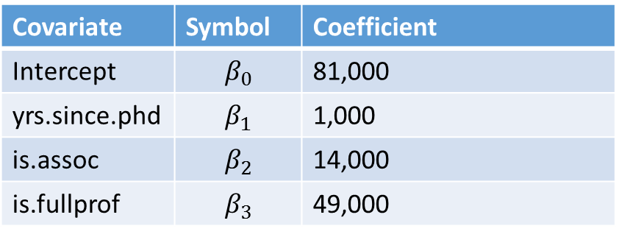
Predicting at 0 yrs.since.phd: Assistant Professors
Covariate | Symbol | Coefficient
Intercept | $$β_{0}$$ | 81,000
yrs.since.phd | $$β_{1}$$ | 1,000
is.assoc | $$β_{2}$$ | 14,000
is.fullprof | $$β_{3}$$ | 49,000

Slide 11

Predicting at 0 yrs.since.phd: Associate Professors
Covariate | Symbol | Coefficient
Intercept | $$β_{0}$$ | 81,000
yrs.since.phd | $$β_{1}$$ | 1,000
is.assoc | $$β_{2}$$ | 14,000
is.fullprof | $$β_{3}$$ | 49,000

Slide 12

Predicting at 0 yrs.since.phd: Full Professors
Covariate | Symbol | Coefficient
Intercept | $$β_{0}$$ | 81,000
yrs.since.phd | $$β_{1}$$ | 1,000
is.assoc | $$β_{2}$$ | 14,000
is.fullprof | $$β_{3}$$ | 49,000

Slide 13
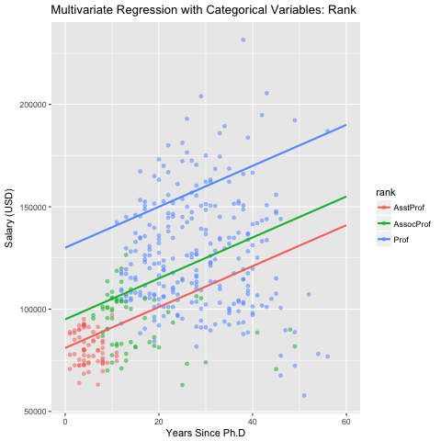
Our regression results, visually:

Slide 14
Remember: You don’t have to manually create those new columns when you’re running regressions– R does it for you automatically.

