Slide 1
Introduction SVN
Presented by Zacky Mughni M

Slide 2
Apa itu Subversion?

Slide 3
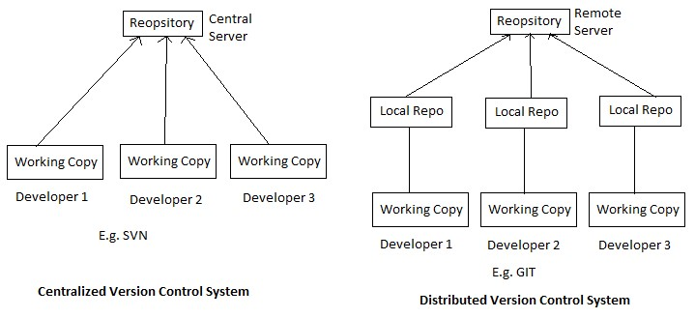
Version Control System

Slide 4
Installation
https://github.com/beruang/svn_training

Slide 5
Life Cycle
Life Cycle of Subversion
Create Repository
Checkout
Update
Perform Changes
Review Changes
Fix Mistakes
Commit Changes

Slide 6
Terima kasih

