Slide 1
InsightAgent
Enterprise Sales Data API with an LLM-Powered Self-Loop Analysis Agent
FastAPI + MySQL 8 + Docker Compose deployment
Classic Models business schema extended with audit and agent tables
CRUD routes, analytics endpoints, and a controlled natural-language analysis path
Project scope
A database-backed web API that combines conventional engineering discipline with a modern tool-using analysis agent.
Core highlight
The agent does not answer from memory: it must observe the schema, execute analysis code, and terminate with a grounded final answer.
Why it fits the coursework
It demonstrates CRUD, analytics, API documentation, deployment, testing, and creative high-level GenAI use in one coherent system.
Notes:
[Sources] - User-provided technical report PDF: InsightAgent_Technical_Report_final_nosubmissionblock_fig2singlecol(1).pdf, pp.1-5. - User-provided API documentation PDF: API(1).pdf, pp.1-3.

Slide 2
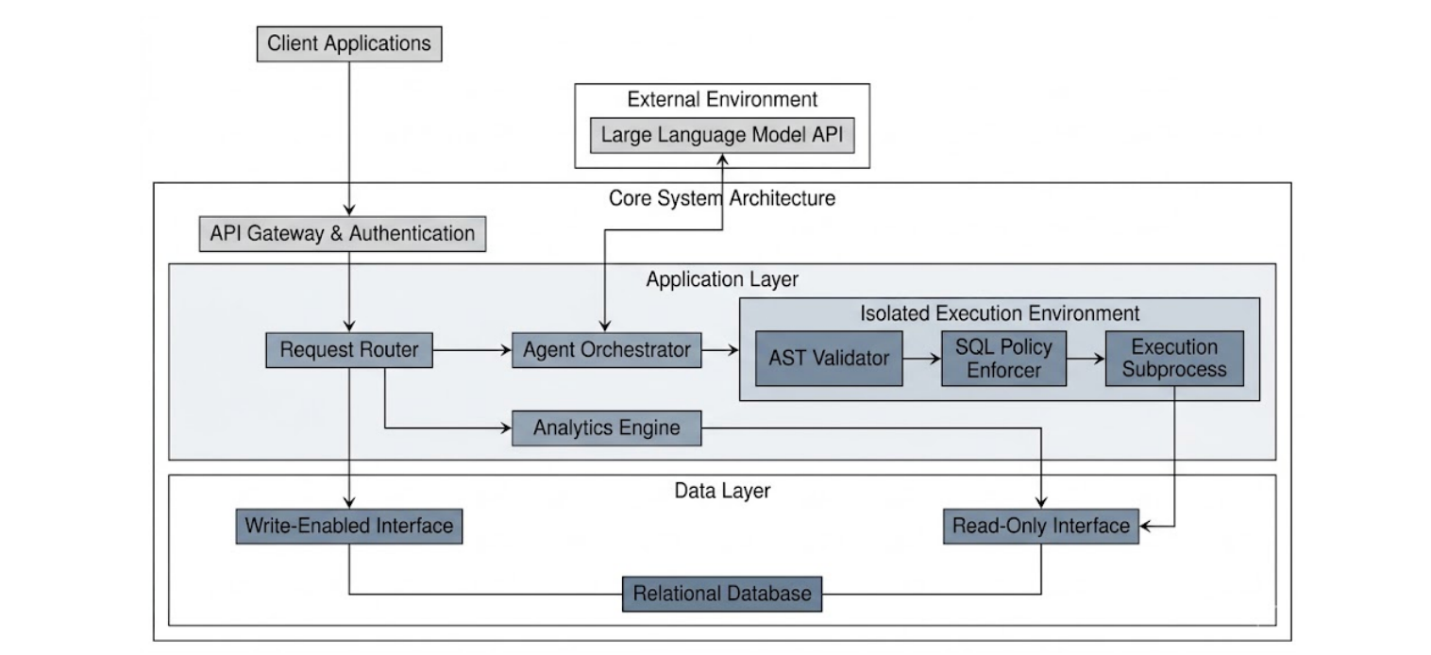
System Architecture
The API server, LLM orchestration layer, isolated execution environment, and read-only / read-write data paths are explicitly separated.
Key idea: standard business routes use the write-enabled path, while the agent and skill execution path are isolated and restricted to the read-only side.
Notes:
[Sources] - User-provided architecture image: 994c43e8-b114-4e37-89df-98550d780042.png. - User-provided technical report PDF, p.2 Figure 1.

Slide 3
Data Model
Classic Models business tables are extended with saved_queries, analysis_logs, and agent_turns to support auditability and the agent workflow.
Notes:
[Sources] - User-provided Mermaid ER specification from chat message on 2026-04-21. - User-provided technical report PDF, pp.1-2 for business tables and custom audit tables.

Slide 4
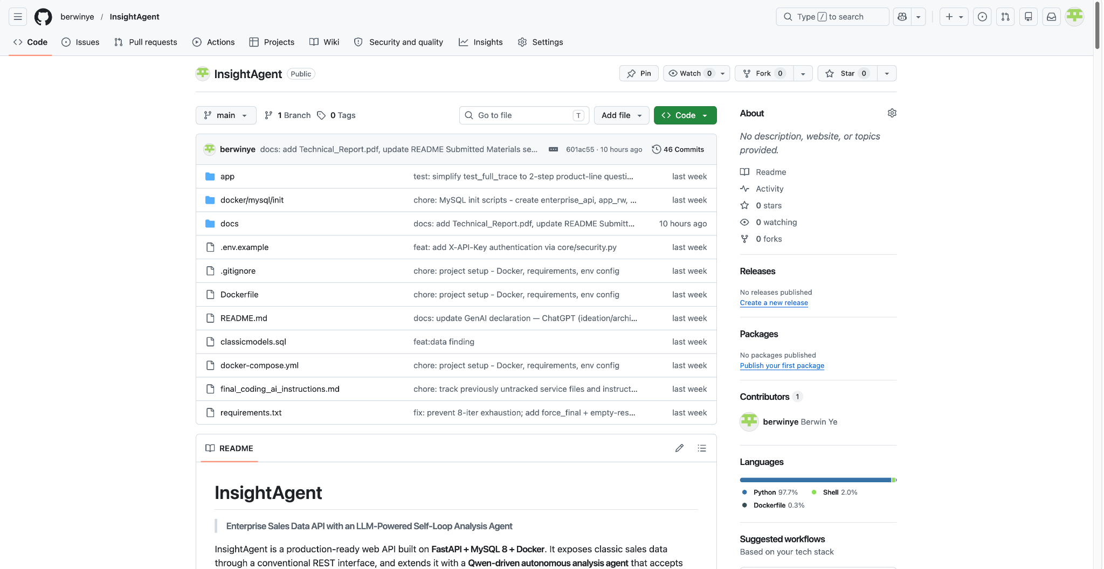
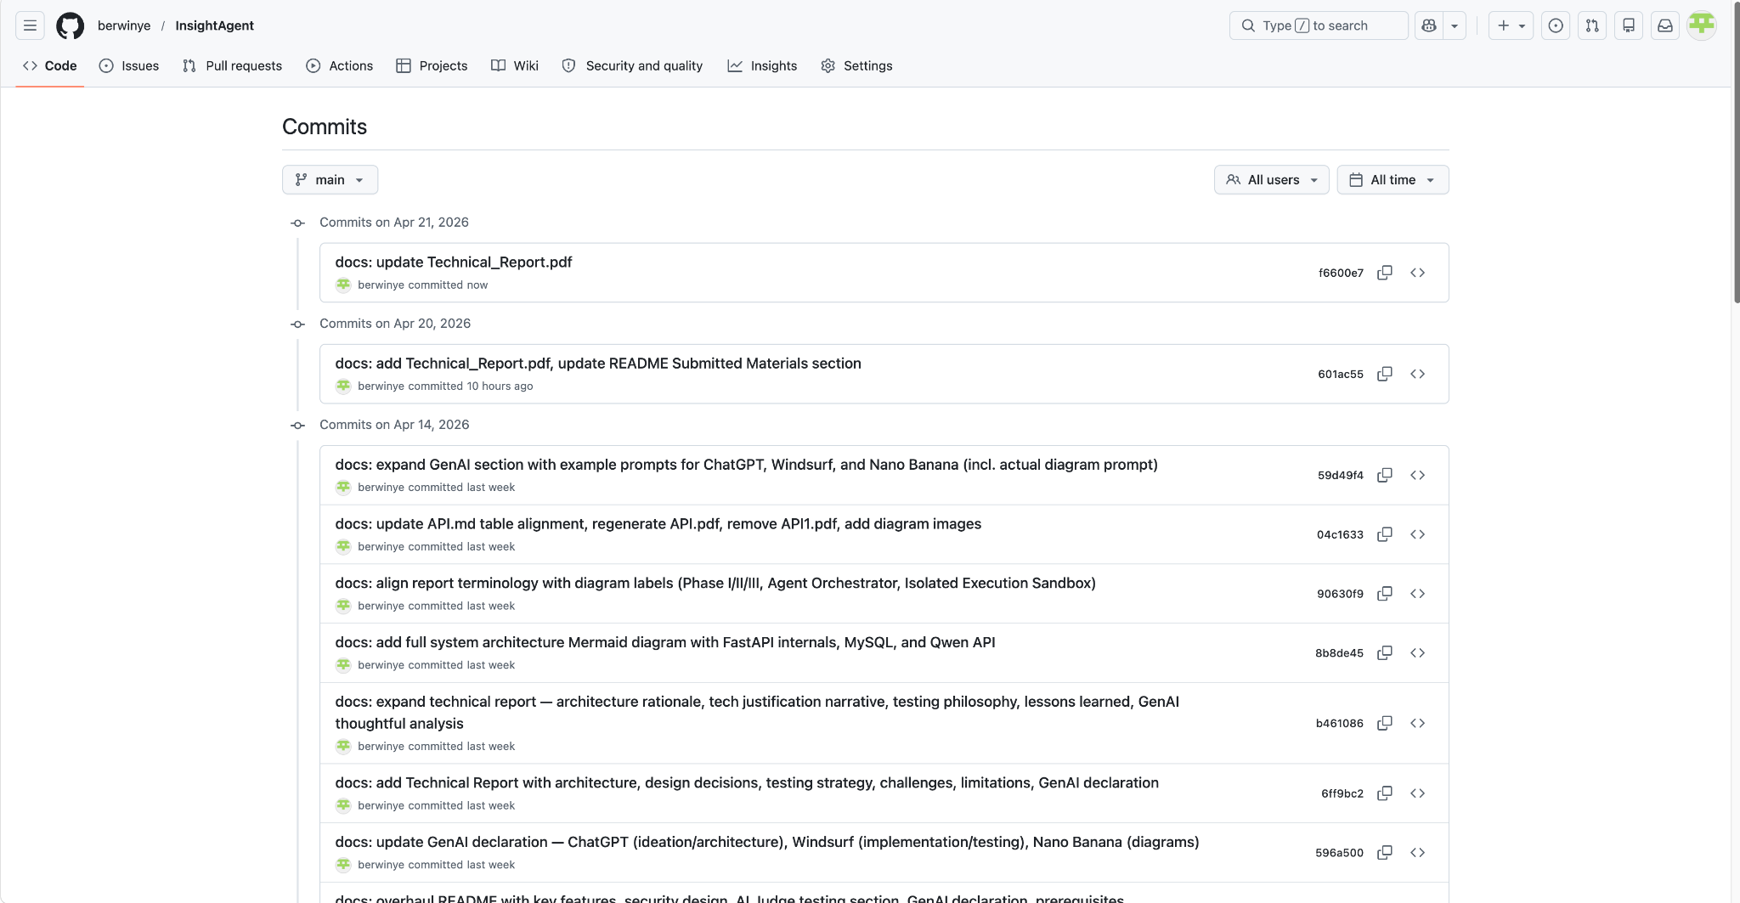
Version Control & GitHub Evidence
The repository is public, structured, and backed by a visible multi-commit history.
Repository homepage
Commit history
Evidence shown: public repo, README/docs structure, classicmodels.sql, Docker files, and visible iterative commits for documentation and hardening work.
Notes:
[Sources] - User-provided GitHub repository screenshot: 58ab371d-7a4f-42ae-9b96-739c447604b7.png. - User-provided GitHub commit-history screenshot: 12e4d12a-ebee-4cc1-9ad6-2a5fcdad6be0.png.

Slide 5
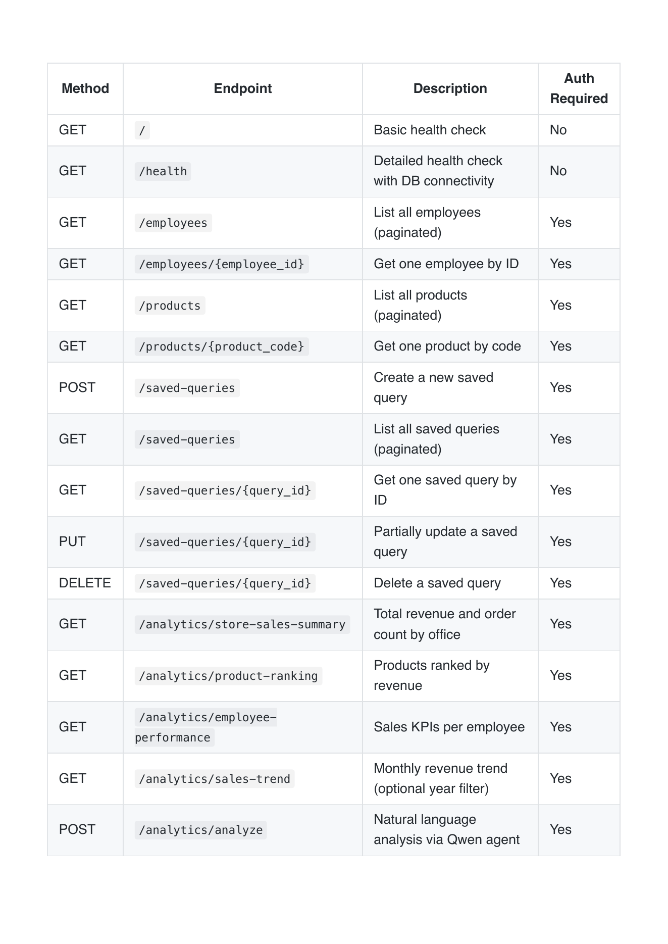
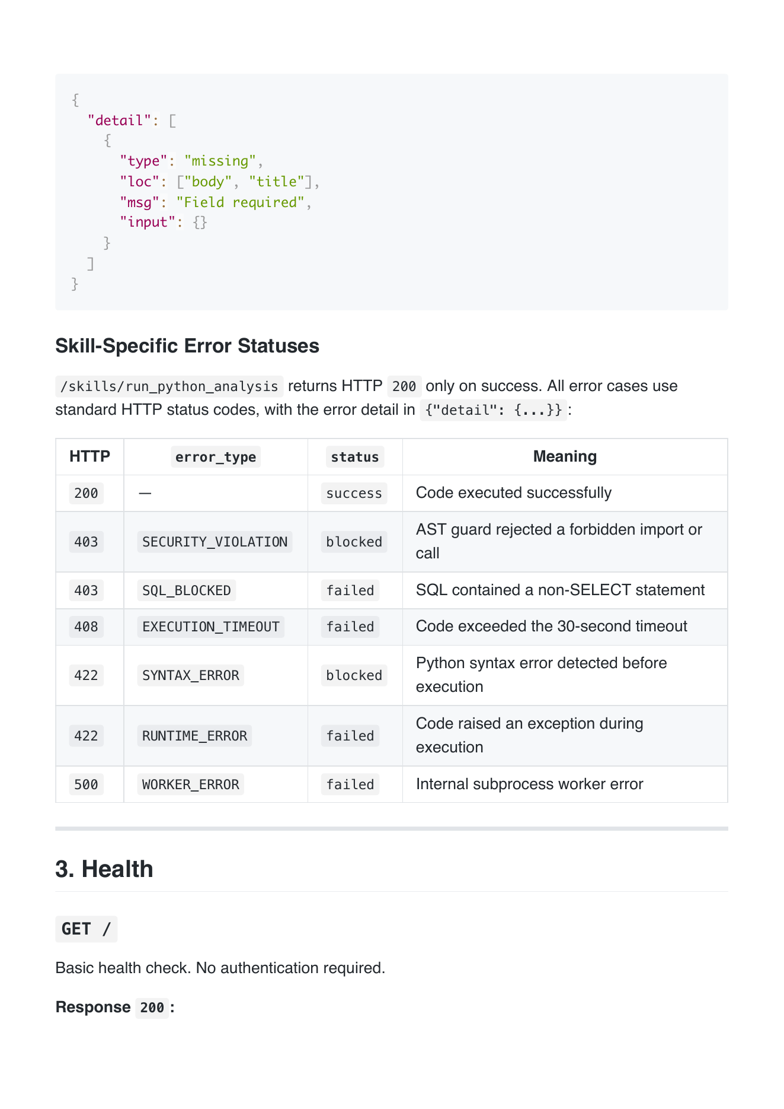
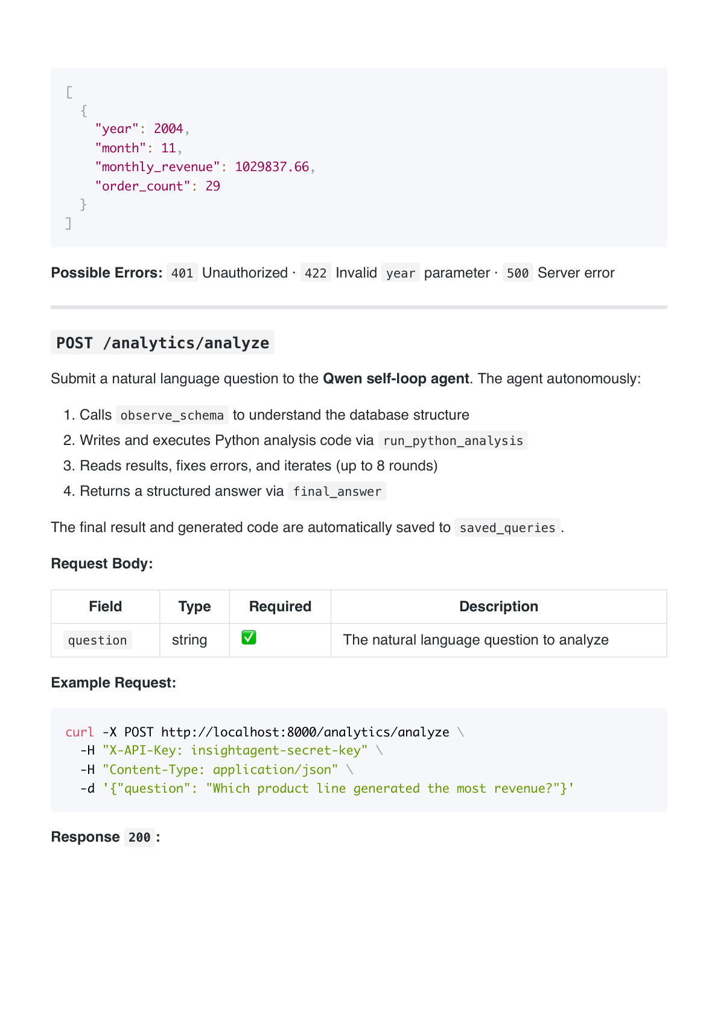
API Documentation Overview
The written API documentation covers endpoint groups, authentication, error codes, skill-specific failures, and the natural-language analysis route.
Endpoint overview
Skill error statuses
/analytics/analyze route
Highlights: 19 REST endpoints across health, reference data, saved-query CRUD, analytics, and skills; authentication and structured failure semantics are documented explicitly.
Notes:
[Sources] - User-provided API documentation PDF: API(1).pdf, pp.2, 6, and 19.

Slide 6
Technology Choices
The stack was selected to balance reproducibility, relational analytics, controlled LLM integration, and coursework-friendly implementation complexity.
FastAPI + Python 3.11
MySQL 8 + SQLAlchemy 2.0
Docker Compose
Type-driven validation, automatic OpenAPI/Swagger generation, and lightweight routing for an API-first project.
Strong fit for the Classic Models relational dump, dual-account read/write split, and explicit session management.
Reproducible two-container deployment with service-name networking between the API and the database.
Qwen via Alibaba Model Studio
Subprocess sandbox
pytest + rerun plugin
OpenAI-compatible surface for agent orchestration, with provider changes handled by configuration rather than route rewrites.
Isolates model-generated Python from the main API process and simplifies timeout, stdout capture, and failure containment.
Supports API, negative, and end-to-end agent tests while reducing noise from occasional upstream model instability.
Design rationale from the technical report: the final architecture combines a conventional data API with a self-loop agent that must work through inspectable tools rather than answer directly from LLM memory.
Notes:
[Sources] - User-provided technical report PDF, pp.1-3 (Technology Stack Justification and Table 1).

Slide 7
Deliverables
The repository, API documentation, technical report, and slides are aligned so the same system is described consistently across all submitted materials.
Code repository
API documentation
Technical report
Presentation slides
Public GitHub repo with source code, Docker files, classicmodels.sql, README, and visible commit history.
Written PDF plus OpenAPI / Swagger UI, covering endpoints, authentication, examples, and skill-specific error cases.
Architecture rationale, stack choices, database design, security model, testing strategy, limitations, and GenAI declaration.
A concise oral-exam deck with architecture, data model, GitHub evidence, API docs, deliverables, and key LLM feature slides.
Submission readiness
What the marker can inspect
The running system, repository structure, documentation set, and slide ordering are aligned deliberately to reduce “documentation drift” during the viva.
GitHub repo, commit history, API PDF, technical report PDF, and the live behaviour demonstrated during the 5-minute presentation.
This mirrors the coursework brief: version control, API docs, technical report highlights, and all deliverables are explicitly represented in the presentation.
Notes:
[Sources] - User-provided coursework brief PDFs: XJCO3011_Coursework1_Brief__2025_2026*.pdf, deliverables and presentation sections. - User-provided technical report PDF, p.4-5 (submission readiness).

Slide 8
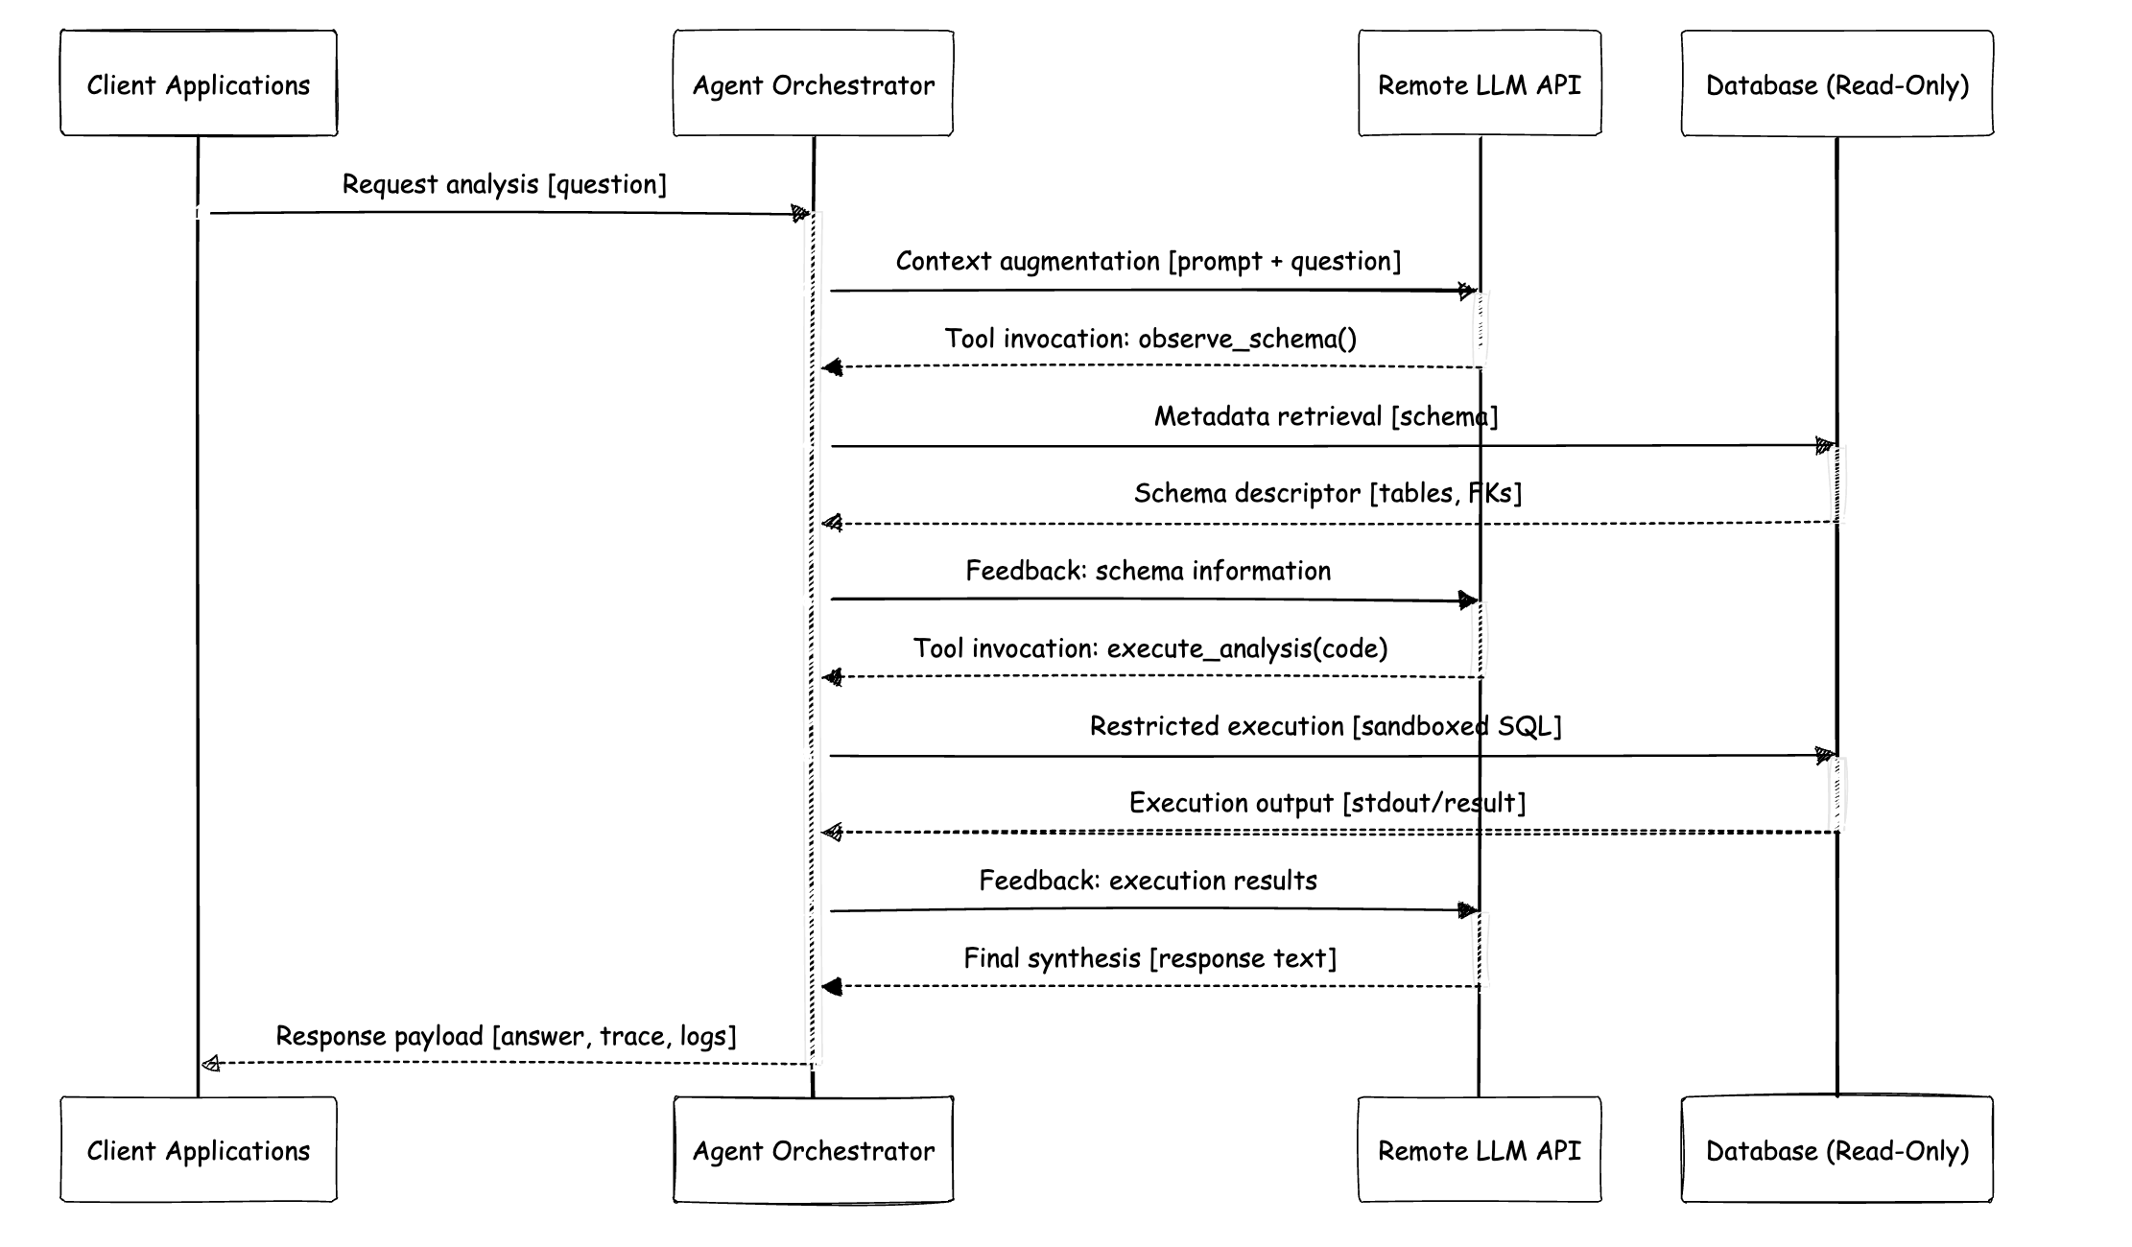
Feature Highlight: LLM-Driven Analysis Flow
Natural-language business questions are handled by a self-loop agent that must inspect the schema, execute code, and only then synthesise a final answer.
Why this is distinctive
The client sends a natural-language question instead of a fixed SQL query.
The agent first calls observe_schema() to understand tables, columns, and foreign keys.
It then writes Python analysis code and runs it through run_python_analysis().
If execution fails or is blocked, the agent reads the error, revises the code, and tries again.
The loop terminates with final_answer, plus saved query and analysis log records.
Notes:
[Sources] - User-provided technical report PDF, pp.2-4 (Natural-Language Analysis Path, LLM Agent Design, Figure 3). - User-provided API documentation PDF, pp.19-20 (/analytics/analyze).

Slide 9
Feature Highlight: Skill Design
The agent works through a deliberately small tool surface so the analysis path remains inspectable, auditable, and easier to defend in the viva.
POST /skills/observe_schema
POST /skills/run_python_analysis
Purpose:
Return the full database schema for the current MySQL database.
Role in the loop:
- first tool invoked
- gives the agent grounded table/column context
- avoids guessing the schema from LLM memory
Purpose:
Execute sandboxed Python analysis code generated by the agent.
Role in the loop:
- reads data only through restricted helpers
- returns stdout / print output on success
- returns structured failure information on blocked or failed execution
observe_schema → run_python_analysis → final_answer
The small tool surface is intentional: it reduces audit complexity while still supporting flexible analytics.
Notes:
[Sources] - User-provided technical report PDF, pp.2-3 and p.6 (architecture decision and ChatGPT architecture exploration appendix). - User-provided API documentation PDF, pp.3, 6, and 19-22.

Slide 10
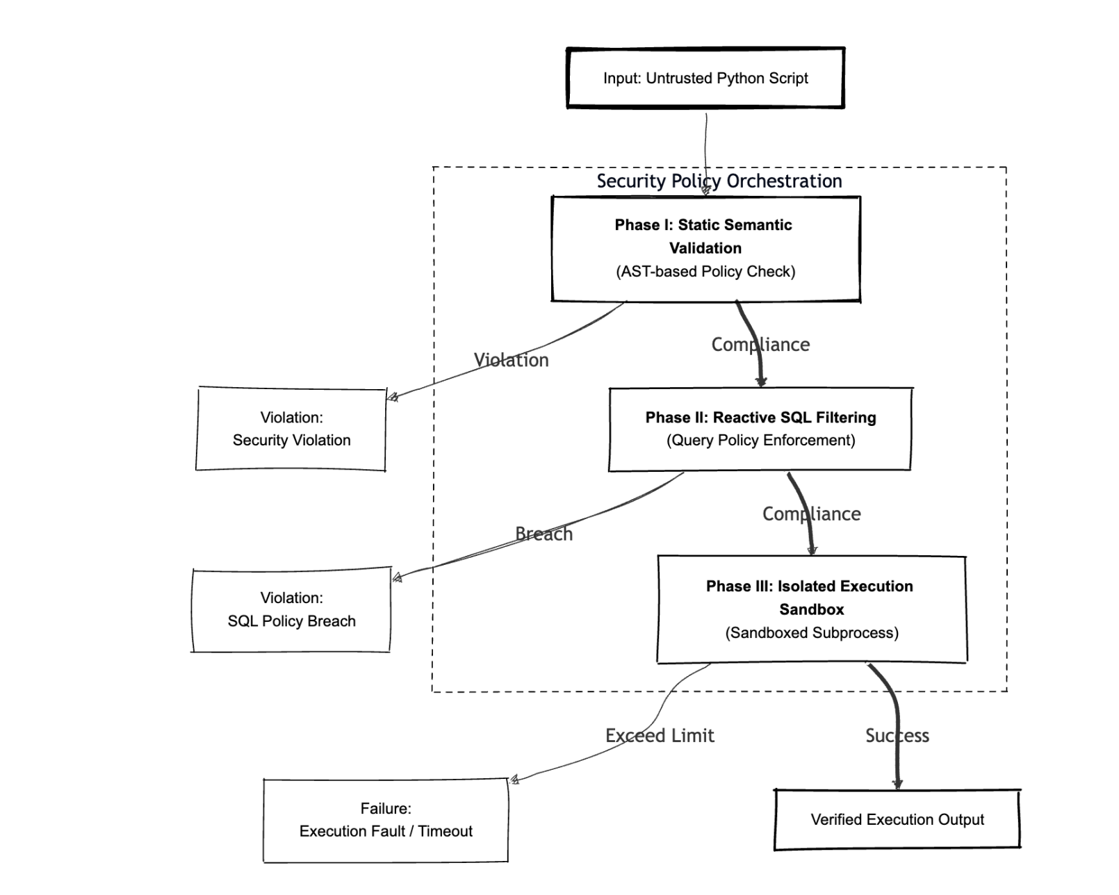
Feature Highlight: Controlled Execution & Safety
The analysis path is powerful because it is constrained: layered checks stop dangerous code, non-read SQL, and unstable execution before they affect the main API process.
Three-phase policy orchestration
AST validation →
SQL filtering →
isolated subprocess
Main protections
• app_ro database account is SELECT-only
• AST blocks dangerous imports and calls
• read_sql() blocks non-SELECT statements
• worker process enforces timeout and failure containment
• the API returns structured error types instead of raw crashes
Notes:
[Sources] - User-provided technical report PDF, p.3 Figure 2 and Section 5.2. - User-provided API documentation PDF, p.6 (skill-specific error statuses).

Slide 11
Testing Summary
93/93 tests passed in 5m 04s, covering security checks, CRUD, negative API cases, multistep agent reasoning, and anomaly detection.
93
Tests
0
Failures
0
Skipped
6
Test Files
5m 04s
Runtime
Coverage Areas
observe_schema: schema correctness, PK/FK metadata, custom tables, authentication failure paths
run_python_analysis: allowed execution, forbidden imports/calls, SQL filtering, syntax/runtime errors, timeout handling
saved_queries CRUD: create, read, update, delete, 404/401/422 validation paths
negative API tests: employees, products, analytics, logs, invalid parameters and missing resources
Higher-Value Evidence
Multistep agent tests verify schema-first behaviour and tool_trace ordering
Security tests show jailbreak attempts are blocked rather than silently ignored
Anomaly-detection tests validate domain reasoning over real business data
End-to-end runs prove the LLM layer is grounded in tool outputs, not hard-coded answers
Notes:
[Sources] - User-provided technical report PDF, p.3 Figure 2 and Section 5.2. - User-provided API documentation PDF, p.6 (skill-specific error statuses).

Slide 12
Test Breakdown
93/93 tests passed in 5m 04s, covering security checks, CRUD, negative API cases, multistep agent reasoning, and anomaly detection.
File
Tests
What it validates
test_observe_schema.py
10
Schema structure, business tables, PK/FK metadata, custom tables, auth failures
test_run_python_analysis.py
20
Sandbox success path, forbidden imports/calls, SQL blocks, syntax/runtime errors, timeout handling
test_saved_queries.py
15
Full CRUD lifecycle, validation, 404/401 behaviour, pagination constraints
test_api_negative.py
26
Cross-endpoint negative cases: auth, invalid params, non-existent IDs/codes, malformed input
test_multistep_agent.py
11
Schema-before-code ordering, multistep reasoning, tool trace completeness, jailbreak resilience
test_anomaly_detection.py
11
Dead-stock detection, margin checks, overdue shipping, NLQ anomaly explanation, auto-save
Takeaway
The testing evidence supports both software-engineering quality (CRUD, validation, error handling) and AI-layer credibility (tool use, security, multistep reasoning).
Notes:
[Sources] - User-provided technical report PDF, p.3 Figure 2 and Section 5.2. - User-provided API documentation PDF, p.6 (skill-specific error statuses).

