Slide 1


TREAPS

Slide 2

What are treaps?
ROOT
PRIORITY: P₀
KEY: K₀
In terms of priorities:
  P₀ > P₁ & P₂ > P₃
In terms of keys:
  K₁ < K₀ < K₃ < K₂
Combines the ordered structure of a binary search tree and the rules of a max heap (greatest value on top)
PRIORITY: P₁
KEY: K₁
PRIORITY: P₂
KEY: K₂
PRIORITY: P₃
KEY: K₃

Slide 3

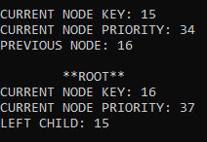
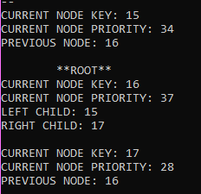
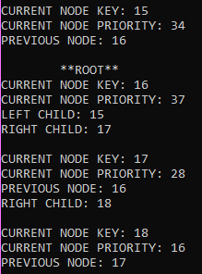
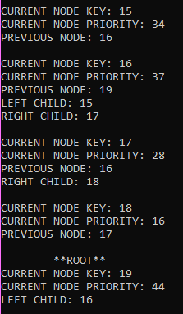
15/34
15/34
16/37
15/34
16/37
17/28
16
17
18
19
15
15/34
16/37
17/28
18/26
16/37
15/34
17/28
18/26
19/44

Slide 4
Uses for treaps
In a regular BST, the root is a fixed value, so there is the possibility of degradation with time, and the tree essentially becoming a linked list
With treaps, there is always a possibility that a new node could become the new root, or that a new node could cause a rotation in the tree, since priorities are random
Keeps the structure balanced

Slide 5
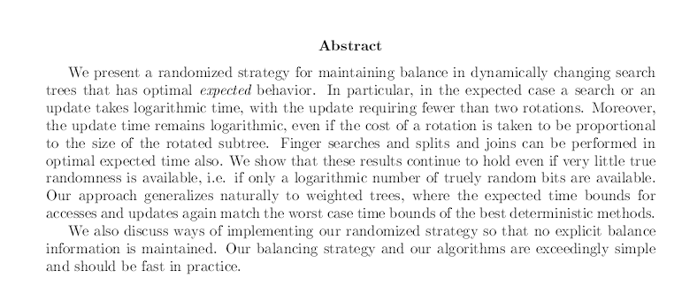
History
Treaps were first proposed in Raimund Seidel and Cecilia R. Aragon’s paper, “Randomized Search Trees” (1989)
Implementations vary based on programming language, basic functions are outlined in the paper
  Includes insert, delete, search, rotations, ect.

Slide 6
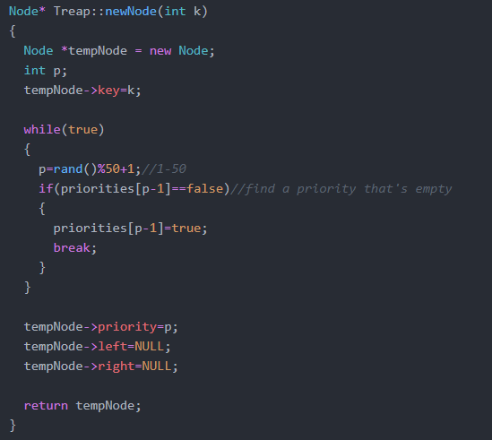
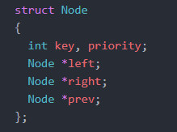
Implementation in C++
The insert function calls the newNode helper function, passing along the value of the key
For a treap that only accepts 50 values:
Each node has five variables:
Its key value, determined by the user
Its priority, randomly determined when a new node is made
A pointer to its left child and right child, if they exist
A pointer to its previous node, the parent

Slide 7
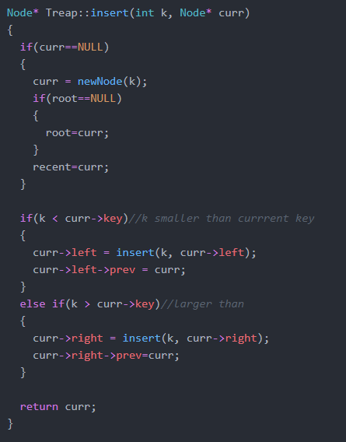
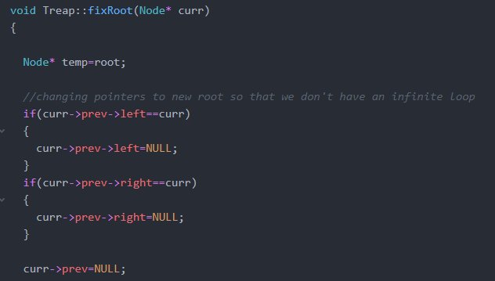
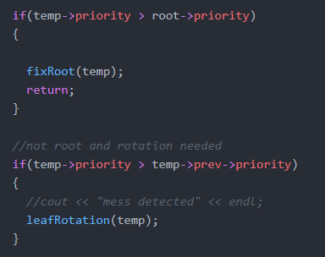
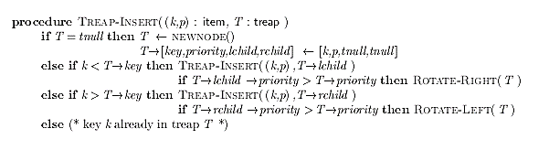
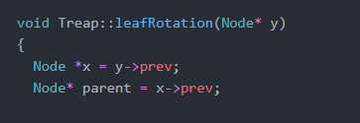
No.
If there are no values currently in the structure, new value becomes root.
Yes, tell user and exit function.
Does value already exit in the tree?
Else, search for position where new node will be inserted.
Make new node.
Check the priority of the new node
If the priority of the new node is larger than the priority of root: fixRoot
If the priority of the node is greater than the priority of its parent: leafRotation
Insert

Slide 8
Endless Rotations!
Parent
K_{p}
P_{p}
Problem:
P_{p} > P_{y} > P_{x}
K_{p} < K_{y} < K_{x}
X
K_{x}
P_{x}
Best case scenario: y is a leaf and x doesn’t have any other children besides y
Rotation functions leafRotation & loadedRotation are adirectional
Y
K_{y}
P_{y}

Slide 9
Find node
Node is root, choose new root from its children
Node is neither
Left child becomes new root, right root becomes child of left root
Right child becomes new root, left root becomes child of right root
Choose one of the children to promote
If the promoted child does not have any children, make the other a child of it
If the newly promoted child does have children, search for an opening along its family line
Node is leaf
Remove parent’s pointer to child
Heap rules are not violated
Heap rules are violated, call for as many rotations as it takes to restore it
Remove

Slide 10
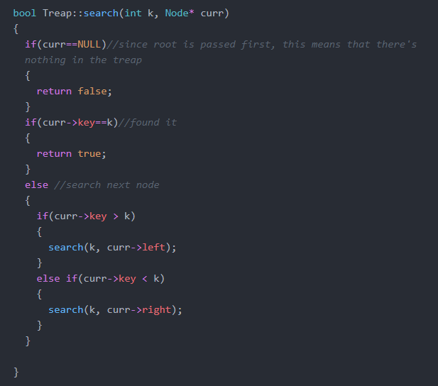
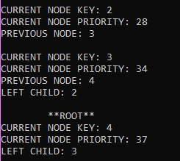
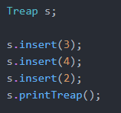
Other functions
Print
Search
Provides all information about a node and all the nodes in the treap
Prints in order
Returns true if value is in treap
Insert & remove call search before running to ensure no extra work is done

Slide 11
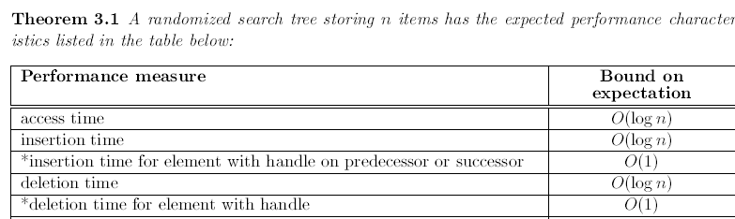
Runtimes for functions
Search is dependent on the number of ancestors the searched value has, and if it does not exist, then it is equal to the depth of the treap
Insert requires a search and then as many rotations as it takes to ensure the heap rule is not violated
Delete is the inverse of insert, at best no rotations are required, at worse several rotations could be required
These runtimes can be faster without having to start at the root node each time, having a “handle” on the parent node where the new child will be inserted/deleted
  In a treap where it costs the same to travel from one node to another, runtime is constant

