Slide 1
The associations of behavioral/emotional problems with testosterone and amygdala volume in early adolescent boys
2022/11/13 @ 9th BESETO International Psychiatry Conference
Masahiro Kiyota*, Naohiro Okada, Kiyoto Kasai
Graduate student,
Department of Neuropsychiatry, Graduate School of Medicine,
The University of Tokyo

Slide 2
Background
Adolescence is a time of marked development and maturation in many aspects, but is also a time of increased risk for mental health disorders and psychobehavioral problems
However, biological processes that dictate psychobehavioral features are not well understood
Notable biological changes during adolescence:
- Sex hormone surge: 30-fold increase in testosterone production in boys
- Brain remodeling: Axonal growth, myelination, synaptogenesis and synapse elimination (microscopically)
Decrease in GMV, sex difference in amygdalar and hippocampal volume (macroscopically)
We focus on the association of psychobehavioral problems with testosterone and amygdala
- Testosterone: Affects brain through organizational/activational effects; Related to aggression, social rank, social withdrawal, …
- Amygdala: High density of androgen receptors; Related to aggression, fear/anxiety, …

Slide 3
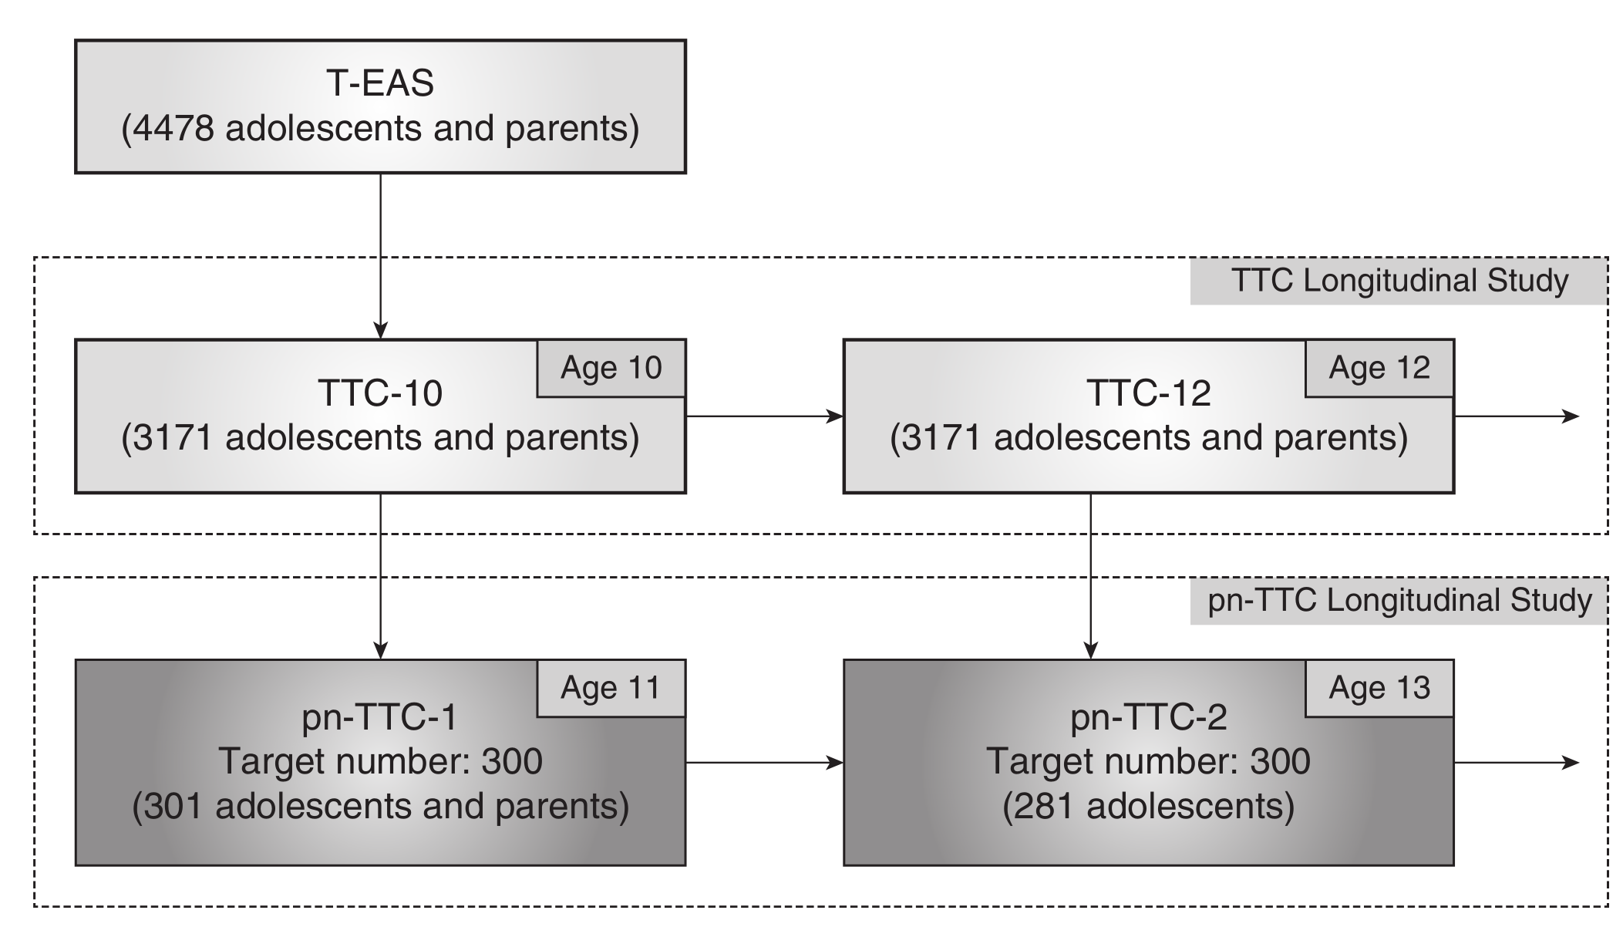
The participants were adolescent boys from population-neuroscience study of the Tokyo TEEN Cohort (pn-TTC), a longitudinal general population-based study to explore the neurobiological substrates of development. The following data was used in the analysis: - Child Behavior Checklist (CBCL) [TTC wave 1 (10 y.o.), 2 (12 y.o.)] - Brain structural MR image [pnTTC wave 1 (11 y.o.),2 (13 y.o.)] - Salivary testosterone level [pnTTC wave 1 (11 y.o.),2 (13 y.o.)] - Parent-rated Tanner stage [pnTTC wave 1 (11 y.o.),2 (13 y.o.)] Only the participants with all the information and good quality MRI and testosterone measurements were included in this study. (n = 106 for wave 1, n = 98 for wave 2; 69 of them included in both waves)
Methods: Participants & Data Collected

Slide 4
Brain structural MR images were processed with FreeSurfer 7.1.1 to obtain volumes of subcortical regions, including the amygdala, along with the estimated total intracranial volume (eTIV). The associations of each syndrome scale of CBCL with testosterone and amygdala volume were analyzed cross-sectionally using Poisson regression at 2 timepoints, namely, wave 1 and 2 of TTC/pnTTC study. Amygdala volumes were adjusted for age at MRI acquisition and eTIV before putting into the model. The covariates included in the models were age at CBCL collection for amygdala volume analysis, and age at CBCL collection and parent-rated Tanner stage for testosterone analysis.
Methods: Data Processing & Statistical Analysis

Slide 5
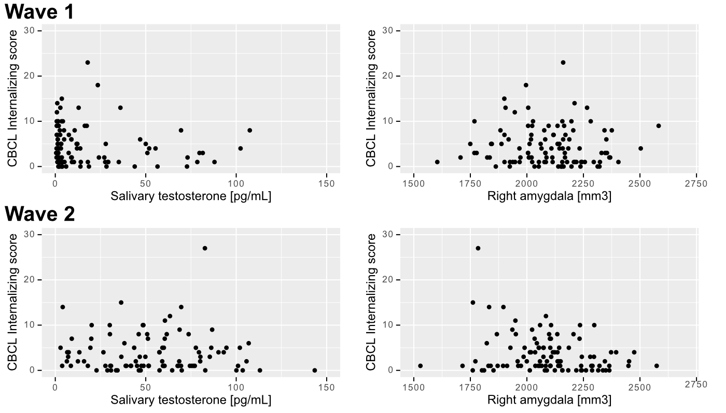
Relation of CBCL internalizing score with testosterone and right amygdala volume

Slide 6
- Testosterone showed negative corr. w/ withdrawn, attention problems, rule-breaking behavior, internalizing, externalizing score in wave 1 (age 10-11) - Right amygdala volume showed positive corr. w/ somatic complaints in wave 1, negative corr. w/ somatic complaints, anxious/depressed and internalizing score in wave 2 (age 12-13)
Association of CBCL with testosterone and amygdala volume
 | CBCL score | Testosterone |  |  | Left Amygdala |  |  | Right Amygdala |  |  | Bilateral Amygdalae |  |  | Amygdala LI
 |  | β [95% CI] | p | FDR p | β [95% CI] | p | FDR p | β [95% CI] | p | FDR p | β [95% CI] | p | FDR p | β [95% CI] | p | FDR p
Wave 1 | Withdrawn | -0.29 [-0.52, -0.05] | 0.016 | 0.038 | -0.03 [-0.19, 0.13] | 0.710 | 0.799 | 0.01 [-0.16, 0.17] | 0.948 | 0.948 | -0.01 [-0.18, 0.15] | 0.861 | 0.874 | -0.03 [-0.19, 0.13] | 0.742 | 0.742
 | Somatic complaints | 0.10 [-0.22, 0.42] | 0.546 | 0.546 | 0.20 [-0.03, 0.43] | 0.087 | 0.732 | 0.35 [0.12, 0.58] | 0.003 | 0.031 | 0.30 [0.07, 0.53] | 0.011 | 0.108 | -0.13 [-0.38, 0.13] | 0.324 | 0.455
 | Anxious/depressed | -0.14 [-0.31, 0.03] | 0.104 | 0.140 | -0.08 [-0.20, 0.04] | 0.189 | 0.732 | -0.02 [-0.14, 0.10] | 0.750 | 0.917 | -0.06 [-0.18, 0.06] | 0.362 | 0.874 | -0.07 [-0.19, 0.05] | 0.228 | 0.455
 | Social problems | -0.20 [-0.39, -0.02] | 0.033 | 0.054 | 0.02 [-0.11, 0.14] | 0.799 | 0.799 | 0.07 [-0.06, 0.20] | 0.286 | 0.542 | 0.05 [-0.08, 0.17] | 0.476 | 0.874 | -0.07 [-0.19, 0.06] | 0.305 | 0.455
 | Thought problems | -0.37 [-0.86, 0.11] | 0.135 | 0.150 | -0.10 [-0.42, 0.21] | 0.520 | 0.799 | 0.03 [-0.27, 0.34] | 0.825 | 0.917 | -0.04 [-0.35, 0.27] | 0.806 | 0.874 | -0.14 [-0.45, 0.17] | 0.364 | 0.455
 | Attention problems | -0.18 [-0.33, -0.04] | 0.012 | 0.038 | -0.01 [-0.11, 0.09] | 0.776 | 0.799 | 0.05 [-0.05, 0.15] | 0.321 | 0.542 | 0.02 [-0.08, 0.12] | 0.713 | 0.874 | -0.08 [-0.18, 0.02] | 0.098 | 0.328
 | Rule-breaking behavior | -0.32 [-0.57, -0.07] | 0.013 | 0.038 | 0.04 [-0.14, 0.22] | 0.663 | 0.799 | 0.11 [-0.07, 0.29] | 0.215 | 0.542 | 0.08 [-0.10, 0.26] | 0.364 | 0.874 | -0.06 [-0.24, 0.11] | 0.480 | 0.534
 | Aggressive behavior | -0.10 [-0.21, 0.02] | 0.112 | 0.140 | -0.06 [-0.15, 0.03] | 0.220 | 0.732 | 0.04 [-0.05, 0.13] | 0.379 | 0.542 | -0.01 [-0.10, 0.08] | 0.822 | 0.874 | -0.11 [-0.20, -0.02] | 0.021 | 0.107
 | Internalizing | -0.15 [-0.28, -0.02] | 0.019 | 0.038 | -0.03 [-0.12, 0.06] | 0.572 | 0.799 | 0.04 [-0.05, 0.13] | 0.369 | 0.542 | 0.01 [-0.08, 0.10] | 0.874 | 0.874 | -0.07 [-0.16, 0.02] | 0.139 | 0.348
 | Externalizing | -0.14 [-0.25, -0.03] | 0.010 | 0.038 | -0.04 [-0.12, 0.04] | 0.368 | 0.799 | 0.06 [-0.03, 0.14] | 0.179 | 0.542 | 0.01 [-0.07, 0.09] | 0.836 | 0.874 | -0.10 [-0.18, -0.02] | 0.018 | 0.107
Wave 2 | Withdrawn | -0.19 [-0.41, 0.03] | 0.093 | 0.240 | 0.12 [-0.06, 0.30] | 0.192 | 0.414 | -0.09 [-0.27, 0.09] | 0.343 | 0.686 | 0.02 [-0.16, 0.20] | 0.827 | 0.969 | 0.23 [0.05, 0.40] | 0.010 | 0.051
 | Somatic complaints | 0.01 [-0.28, 0.29] | 0.964 | 0.964 | -0.27 [-0.51, -0.03] | 0.026 | 0.130 | -0.47 [-0.69, -0.25] | 0.000 | 0.000 | -0.42 [-0.65, -0.19] | 0.000 | 0.001 | 0.21 [-0.01, 0.44] | 0.065 | 0.191
 | Anxious/depressed | -0.13 [-0.30, 0.04] | 0.127 | 0.243 | -0.18 [-0.32, -0.04] | 0.014 | 0.130 | -0.27 [-0.40, -0.13] | 0.000 | 0.000 | -0.25 [-0.39, -0.11] | 0.000 | 0.002 | 0.11 [-0.03, 0.25] | 0.139 | 0.278
 | Social problems | -0.10 [-0.27, 0.07] | 0.262 | 0.374 | -0.09 [-0.23, 0.05] | 0.207 | 0.414 | -0.14 [-0.27, -0.00] | 0.050 | 0.124 | -0.12 [-0.26, 0.01] | 0.074 | 0.184 | 0.06 [-0.08, 0.20] | 0.432 | 0.719
 | Thought problems | -0.02 [-0.39, 0.36] | 0.934 | 0.964 | 0.09 [-0.20, 0.39] | 0.528 | 0.713 | -0.09 [-0.38, 0.21] | 0.562 | 0.803 | 0.01 [-0.29, 0.30] | 0.969 | 0.969 | 0.26 [-0.03, 0.54] | 0.076 | 0.191
 | Attention problems | 0.02 [-0.11, 0.14] | 0.813 | 0.964 | -0.05 [-0.16, 0.06] | 0.374 | 0.623 | -0.04 [-0.15, 0.07] | 0.441 | 0.734 | -0.05 [-0.16, 0.06] | 0.352 | 0.705 | 0.01 [-0.10, 0.12] | 0.900 | 0.907
 | Rule-breaking behavior | -0.19 [-0.45, 0.07] | 0.146 | 0.243 | -0.04 [-0.24, 0.16] | 0.718 | 0.718 | 0.03 [-0.18, 0.23] | 0.780 | 0.892 | -0.01 [-0.21, 0.20] | 0.959 | 0.969 | -0.06 [-0.27, 0.14] | 0.559 | 0.798
 | Aggressive behavior | -0.11 [-0.24, 0.02] | 0.096 | 0.240 | -0.02 [-0.13, 0.08] | 0.652 | 0.718 | 0.01 [-0.10, 0.11] | 0.892 | 0.892 | -0.01 [-0.11, 0.10] | 0.856 | 0.969 | -0.01 [-0.11, 0.10] | 0.907 | 0.907
 | Internalizing | -0.12 [-0.24, -0.00] | 0.047 | 0.235 | -0.10 [-0.20, 0.00] | 0.055 | 0.184 | -0.25 [-0.35, -0.15] | 0.000 | 0.000 | -0.20 [-0.30, -0.10] | 0.000 | 0.001 | 0.17 [0.07, 0.27] | 0.001 | 0.010
 | Externalizing | -0.13 [-0.24, -0.01] | 0.032 | 0.235 | -0.03 [-0.12, 0.07] | 0.571 | 0.713 | 0.01 [-0.08, 0.11] | 0.803 | 0.892 | -0.01 [-0.10, 0.08] | 0.853 | 0.969 | -0.02 [-0.11, 0.08] | 0.708 | 0.885

Slide 7
Discussion and Conclusion
This is the first study that analyzed the changes in the association of various psychobehavioral problems with testosterone and amygdala volume over time using population-based longitudinal cohort of early adolescent boys
In wave 1 (10-11 y.o.), testosterone showed negative correlation with both internalizing and externalizing problems
In wave 2 (12-13 y.o.), right amygdala volume showed negative correlation with somatic complaints, anxious/depressed and internalizing score
These results suggest biological factors that mediate psychobehavioral problems changes from (presumably fast-acting) hormonal factors to (longer-lasting) brain structures over time

