Slide 1


BESETO CONFERENCE
Therapeutic outcomes wide association scan (TOWAS) of different antipsychotics in schizophrenia
Presenter: Zhe Lu
Supervisor: Prof. Weihua Yue
Peking University Sixth Hospital

Slide 2
CONTENT
1
Background
2
2
Methods
3
3
Results
4
4
Conclusion
2

Slide 3
CONTENT
1
Background
2
2
Methods
3
3
Results
4
4
Conclusion
3

Slide 4
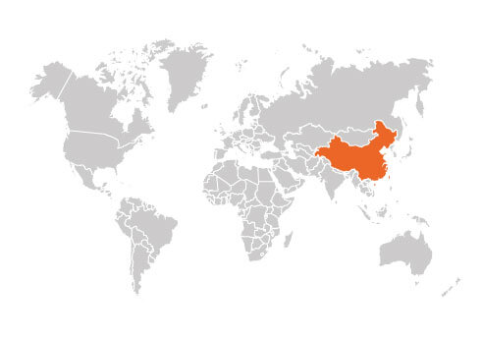
Schizophrenia with High Prevalence and Heavy disease burden
0·6% (0·1–1·0) in China
Affect 1% population worldwide
Huang et al., Lancet Psychiatry 2019
4

Slide 5
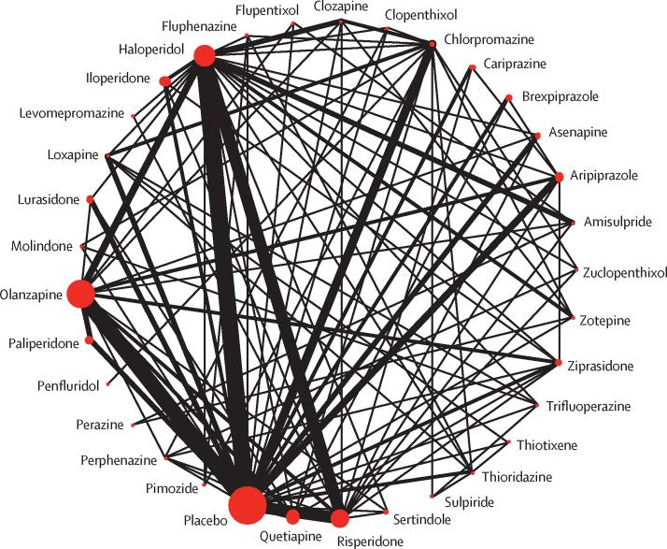
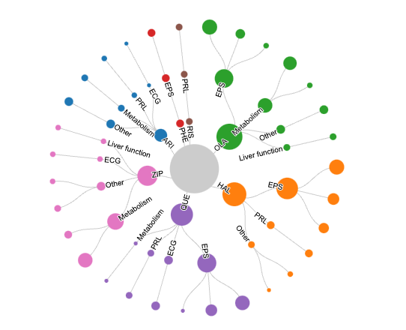
Marked Differences in Therapeutic Outcomes Across Antipsychotics
Antipsychotics are the first-line therapy of schizophrenia
Roughly 75% patients discontinue the treatment result from the poor efficacy and side-effects
Intolerability of antipsychotics is the most common reason for switching antipsychotics
Choosing the optimal antipsychotic is essential for management of schizophrenia
Network meta-analysis indirectly compared the therapeutic outcomes across different antipsychotics
The comparison of therapeutic outcomes across different antipsychotics in a randomized controlled clinical trial is limited
Efficacy
Huhn M et al., Lancet 2019
Side-effects
5

Slide 6
CONTENT
1
Background
2
2
Methods
3
3
Results
4
4
Conclusion
6

Slide 7
Methods and Materials
Subjects
Discovery cohort: 3030 participants
7 therapy modes
Validation cohort: 1395 participants
10 therapy modes
Therapeutic outcomes
10 classes and 209 outcomes
TOWAS pipeline
Using therapeutic outcomes in a linear or logistic regression
Adjusted for covariates
sex, age, onset age, first episode, disease course, psychiatric family history and centers
7

Slide 8
CONTENT
1
Background
2
2
Methods
3
3
Results
4
4
Conclusion
8

Slide 9
TOWAS of antipsychotic therapeutic outcomes in discovery cohort
The difference in symptom improvement among different antipsychotics were not significant
OLA: AIWG, Liver dysfunction, Sedation, Increased lipid, EPS
RIS: HPRL
QUE: Sedation, Palpitation, Increased lipid, HPRL, EPS
ARI: HPRL, AIWG, Sedation, QTc prolongation
ZIP: Increased QT, nausea, AIWG, Liver dysfunction, Increased lipid
HAL: EPS, HPRL, Increased salivation
PHE: EPS
9

Slide 10
TOWAS of antipsychotic therapeutic outcomes in validation cohort
Higher risk of ALT dysfunction in and lower risk of HPRL in ARI were confirmed
10

Slide 11
CONTENT
1
Background
2
2
Methods
3
3
Results
4
4
Conclusion
11

Slide 12
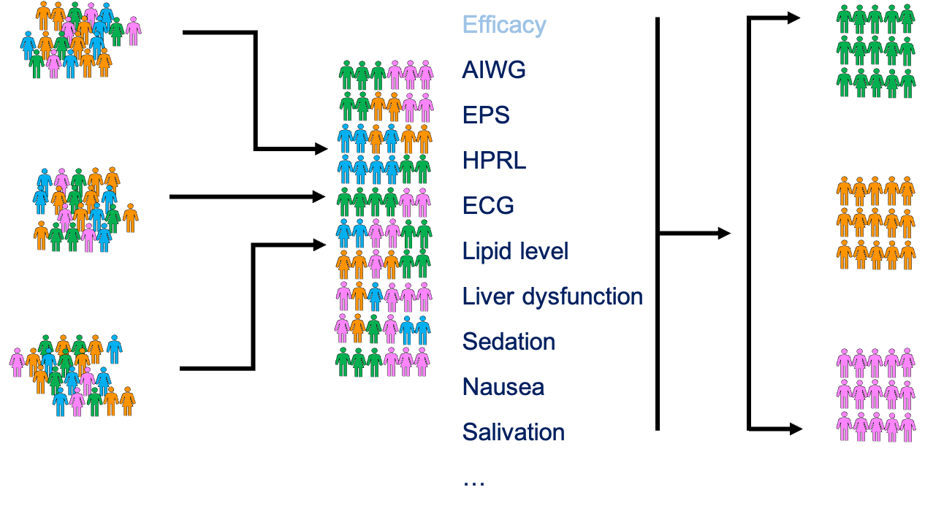
Pay more attention to the personalized side-effects
In clinic, so many antipsychotic options are available, our findings could help the clinicians find the optimal antipsychotic option for the individual patient, balancing side-effect profiles and the efficacy of different drugs
The future precision medicine may mainly focus on the difference in personalized side-effects
12

Slide 13
Thanks for you Listening !

