Slide 1

Increased neuromelanin accumulation in schizophrenia patients: a neuromelanin-sensitive MRI study
Sunah Choi
Clinical Cognitive Neuroscience Center
Seoul National University

Slide 2
Background

Slide 3
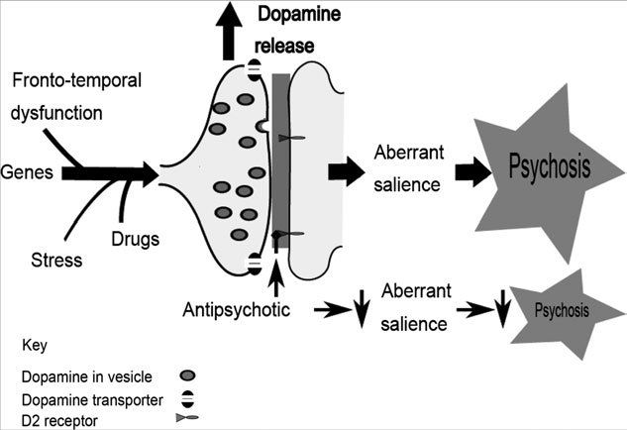
Schizophrenia and dopamine
Antipsychotic drugs targeting D2 receptors
“The dopamine hypothesis of schizophrenia”
- Risk factors (stress, drug use, genes…)
- Increased presynaptic striatal dopaminergic function
- Functional impairment
Howes & Kapur., Schizophr Bull. (2009)

Slide 4
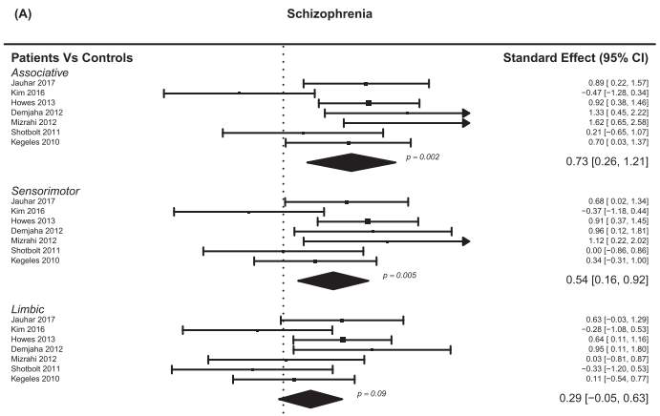
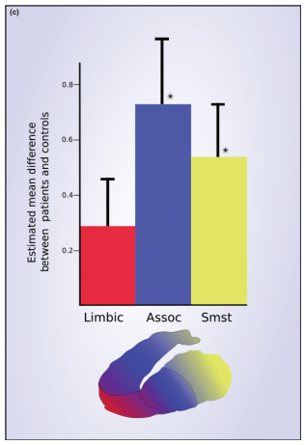
Dopamine increase in schizophrenia
Increase in striatal dopamine synthesis and release (PET/SPECT meta-analysis)
McCutcheon et al., Schizophr Bull. (2018)

Slide 5
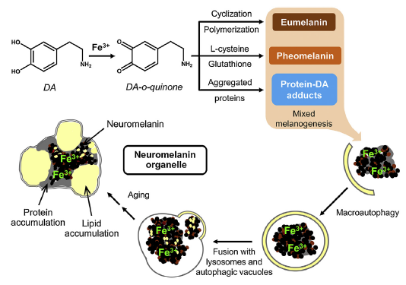
Neuromelanin in dopamine neurons
NM synthesis
Zucca et al., Prog Neurobiol. (2017)

Slide 6
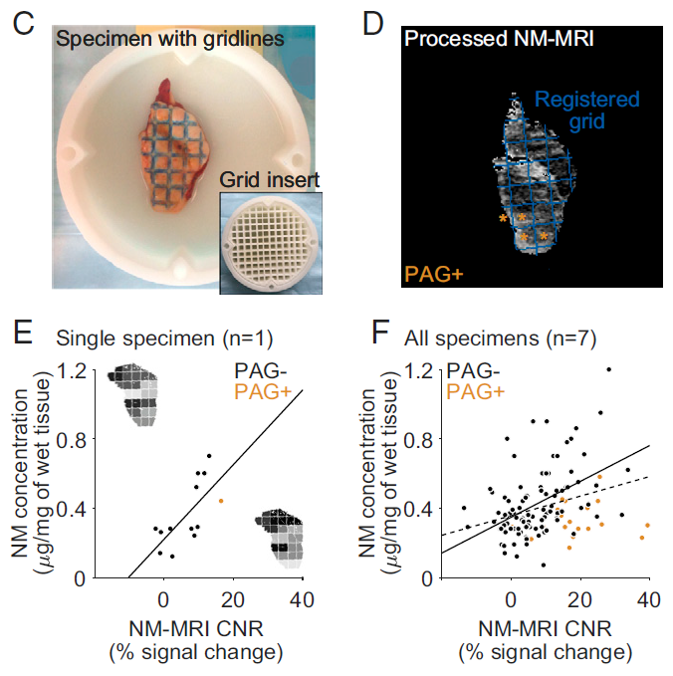
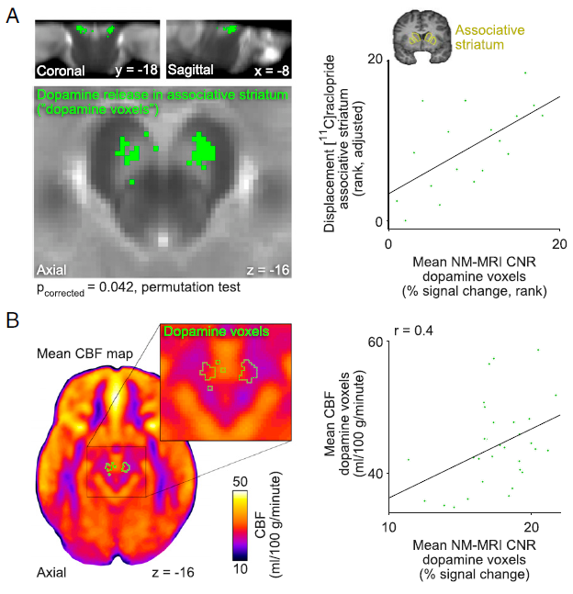
NM-MRI measure
Correlation with NM concentration
Correlation with PET and CBF measure
Cassidy et al., Proc Natl Acad Sci U S A. (2019)

Slide 7
NM in schizophrenia
NM-MRI (6), post-mortem (2), meta-analysis (2)
Study | Subjects | Methods | Results
Kaiya (1980) | SCZ(12), HC(40) | Post-mortem Microdensitometer | n.s.
Shibata et al. (2008) | SCZ(20), HC(34) | NM-MRI | SCZ>HC
Sasaki et al. (2010) | SCZ(23), HC(23) | NM-MRI | n.s.
Watanabe et al. (2014) | SCZ(52), HC(52) | NM-MRI | SCZ>HC (age<30)
Yamashita et al. (2016) | SCZ(14), HC(22) | NM-MRI | n.s.
Cassidy et al. (2019) | SCZ(33), HC(30) | NM-MRI | SCZ>HC (severe)
Mabry et al. (2020) | SCZ(12), HC(12) | Post-mortem immunohistochemistry | n.s.
Jalles et al. (2020) | FEP(30), HC(8) | NM-MRI | SCZ>HC
Wieland et al. (2021) | SCZ (158), HC(147) | Meta-analysis | SCZ>HC
Ueno et al. (2021) | SCZ (163), HC (228) | Meta-analysis | SCZ>HC
Parkinson’s Disease Normal

Slide 8
Methods

Slide 9
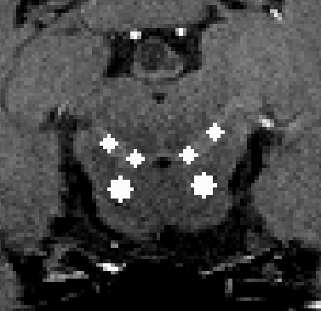
Methods
Participants: SCZ (29), HC (63)
Data acquisition: 3T Trio MRI scanner (0.75×0.75×1.5mm)
Data processing: manual segmentation (FSL)
Manual segmentation: 3mm diameter SN (4*3), 4.5mm diameter CC (2*3)
Threshold: upper quartile
CR calculation: CR_{SN}= (SI_{SN}–SI_{cc})/Si_{cc}
Statistical analysis: reliability test, t test (SPSS)

Slide 10
Results

Slide 11
Results
Demographic and clinical characteristics
 | NOR (n=63) | SPR (n=29) | t or X² | p
Age (years) | 24.13 (3.70) | 25.55 (4.43) | -1.612 | 0.110
Sex (male/female) | 30/33 | 14/15 | 0.003 | 0.953
Education |  | 13.78 (1.91)
IQ |  | 102.64 (17.58)
PANSS
Positive |  | 11.48 (3.09)
Negative |  | 13.33 (4.59)
General |  | 24.04 (4.70)
GAF |  | 56.37 (13.87)
HAMA |  | 2.96 (2.41)
HAMD |  | 3.96 (2.95)

Slide 12
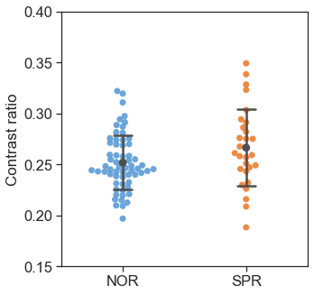
Results
NM CR
ICC
(2) Group comparison
 | ICC | p
NM CR | 0.933 | <0.001*
*
 | NOR (n=63) | SPR (n=29) | t | p | Cohen's d
NM CR | 0.252 (0.027) | 0.266 (0.038) | -2.12 | 0.037* | 0.425

Slide 13
Discussion

Slide 14
Neuromelanin in schizophrenia
Study | Subjects | Methods | Results
Kaiya (1980) | SCZ(12), HC(40) | Post-mortem Microdensitometer | n.s.
Shibata et al. (2008) | SCZ(20), HC(34) | NM-MRI | SCZ>HC
Sasaki et al. (2010) | SCZ(23), HC(23) | NM-MRI | n.s.
Watanabe et al. (2014) | SCZ(52), HC(52) | NM-MRI | SCZ>HC (age<30)
Yamashita et al. (2016) | SCZ(14), HC(22) | NM-MRI | n.s.
Cassidy et al. (2019) | SCZ(33), HC(30) | NM-MRI | SCZ>HC (severe)
Mabry et al. (2020) | SCZ(12), HC(12) | Post-mortem immunohistochemistry | n.s.
Jalles et al. (2020) | FEP(30), HC(8) | NM-MRI | SCZ>HC
Wieland et al. (2021) | SCZ (158), HC(147) | Meta-analysis | SCZ>HC
Ueno et al. (2021) | SCZ (163), HC (228) | Meta-analysis | SCZ>HC
Parkinson’s Disease Normal

Slide 15
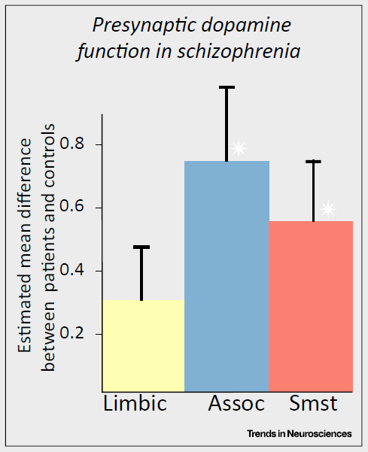
Neuromelanin in schizophrenia
Increased concentration of dopamine and tyrosine hydroxylase (postmortem studies)
Increased dopamine synthesis and release in the striatum (PET, SPECT studies)
Parkinson’s Disease Normal
McCutcheon et al., Schizophr Bull. (2018)

Slide 16
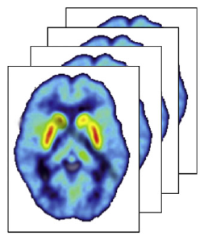
Limitations of PET
Long acquisition time
Use of radioactive tracers
High cost
Parkinson’s Disease Normal

Slide 17
Importance
Replicate previous NM-MRI studies
Support NM-MRI as a proxy measure of dopamine function
Parkinson’s Disease Normal

Slide 18
Thank you

