Slide 1
November 13, 2022 BESETO
Gender effect on the incidence of schizophrenia in Japan
Department of Neuropsychiatry, The University of Tokyo Hospital^{１}
Department of Structural Physiology, Graduate School of Medicine, The University of Tokyo^{２}
Yutaka Sawai¹ Akito Uno¹ Yusuke Takahashi¹ Sho Yagishita² Kiyoto Kasai¹

Slide 2
Introduction
The influence of social gender as well as biological sex has been pointed in the development of various diseases.
Gender difference is reported in incidence of schizophrenia. Attention was focused on biological factors.
Mauvais-Jarvis F, et al. Lancet 2020; 396(10250):565–582.
Gogos A, et al. Br. J. Pharmacol. 2019; 176(21):4119–4135.

Slide 3
Introduction
Epidemiological studies have confirmed
that the incidence of schizophrenia is socially determined
by factors such as urban living, race and immigration.
The role of social gender has not been fully examined.
Baumann PS, et al. Schizophrenia Bulletin Open 2021.
Söderström O, et al. Health Place 2016; 42:104–110.
Fitzgerald D, et al. Int. Health 2019; 11(S1):S1–S6.
Morgan C, et al. World Psychiatry 2019; 18(3):247–258.
Vassos E, et al. Schizophr. Bull. 2012; 38(6):1118–1123.
Pence AY, et al. Schizophr. Res. 2022; 243:120–137.

Slide 4
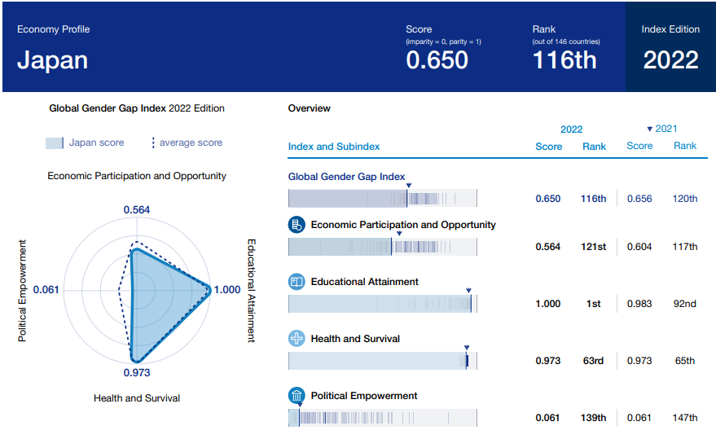
Gender gap in Japan
“Global Gender Gap Report 2022”. World Economic Forum, Geneva, Switzerland (2022)
Notes:
146か国中

Slide 5
Introduction
To infer the influence of social gender on the development of schizophrenia,
we examined changes over time of female-to-male ratio
in the schizophrenia incidence and social gender gap indicators in Japan by prefecture.

Slide 6
Methods
Data of schizophrenia incidence was obtained from the Global Burden of Disease Study. Disease incidence is accessible for each country/city, year, and sex.
Social gender gap indicators in Japan were acquired from e-Stat, which is the portal site for Japanese Government Statistics.
https://vizhub.healthdata.org/gbd-results/
https://www.e-stat.go.jp/

Slide 7
Methods
Random forest model was used to infer the influence
of social gender on the development of schizophrenia.
The female-to-male ratio of 200 social index was used
as features by year and by prefecture.
Features responsibility for the prediction was estimated
using SHapley Additive exPlanations (SHAP) values.
Lundberg SM, Lee S-I. Advances In Neural Information Processing Systems, 2017.

Slide 8
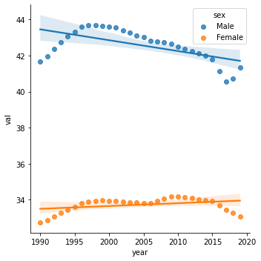
Results
Change over time in incidence rates
regression coefficient (95%CI)
male: -0.06(-0.09, -0.03), female: 0.02(0.00, 0.03)
Incidence rate of schizophrenia /100,000
Gradual decrease in males,
gradual increase in females
Notes:
全データを年でピボットしてプロットしたもの
✓右側に、人口密度が経時的に変わっていないことを図で示す
✓1次回帰分析の傾きが、男性で有意に〇〇、女性で0と有意差がないこと、男性と女性の傾きが有意であること

Slide 9
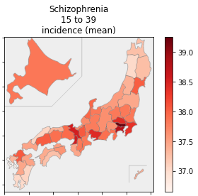
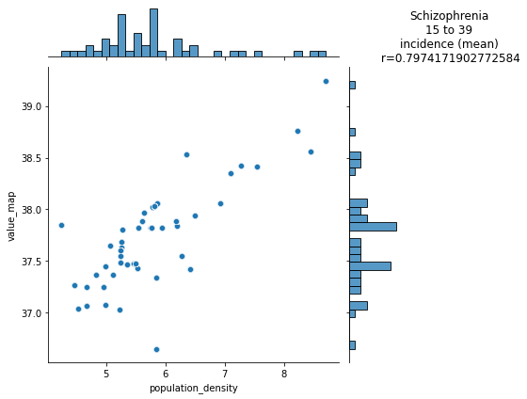
Results: average incidence rate by prefecture
Average incidence rates
of schizophrenia
Correlation between average incidence rate and population density
r=0.80
95%CI 0.66, 0.88
Incidence rate of schizophrenia /100,000
Incidence rate of schizophrenia /100,000
Population density (log)
Positive correlation with population density
Notes:
全データを、都道府県でピボットしたもの
帰無仮説：どの場所においても男女比は一定である
✓発症率の計算した年代を明記
✓相関係数の解析（フィッシャーのｚ変換）

Slide 10
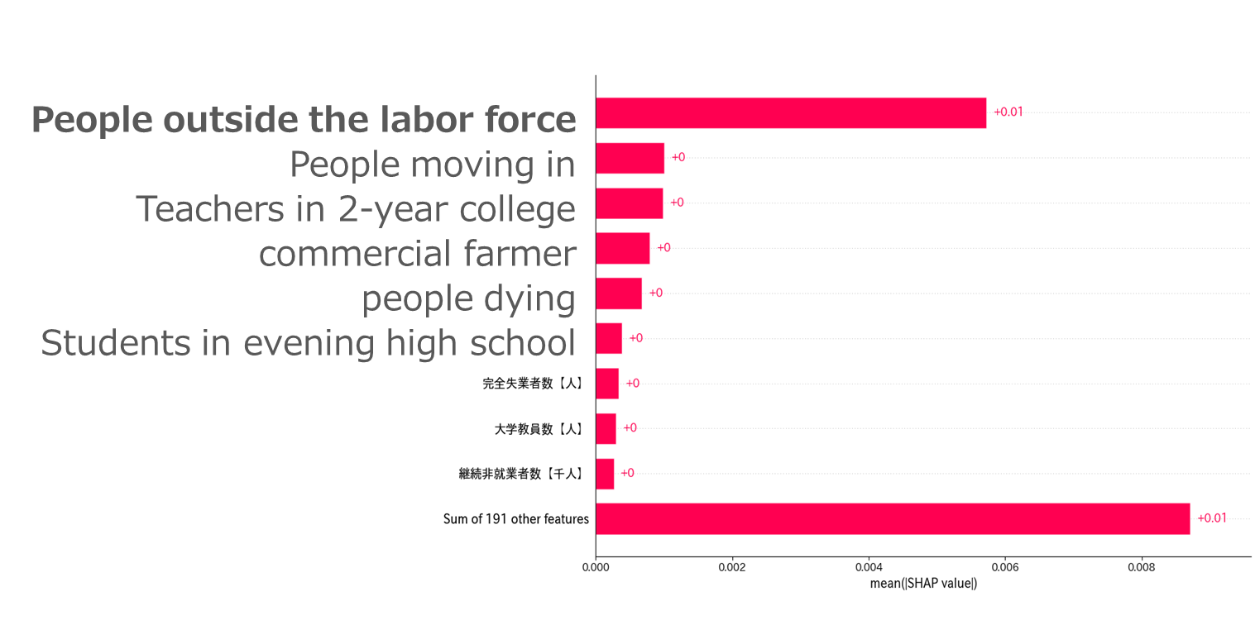
Results: features responsible for prediction
Mean |SHAP value|
Notes:
✓統合失調症の他に、コントロール疾患も示す

Slide 11
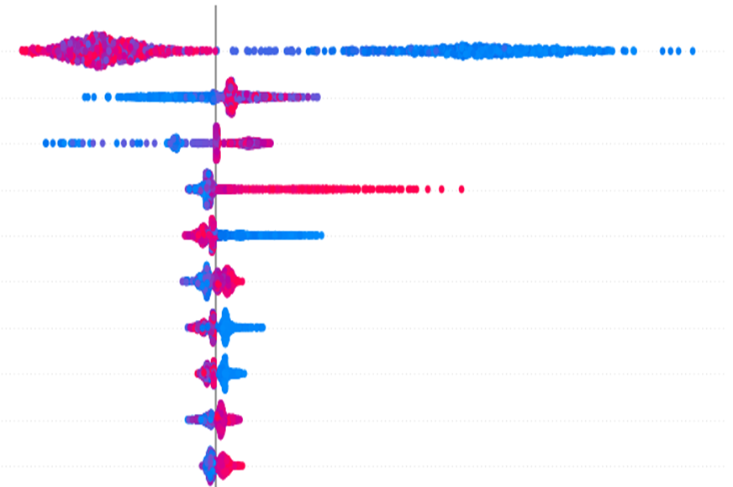
Results: features responsible for prediction, correlation
Red: associated with a reduction in the female/male ratio
Blue: associated with an increase in the female/male ratio
Notes:
✓統合失調症の他に、コントロール疾患も示す

Slide 12
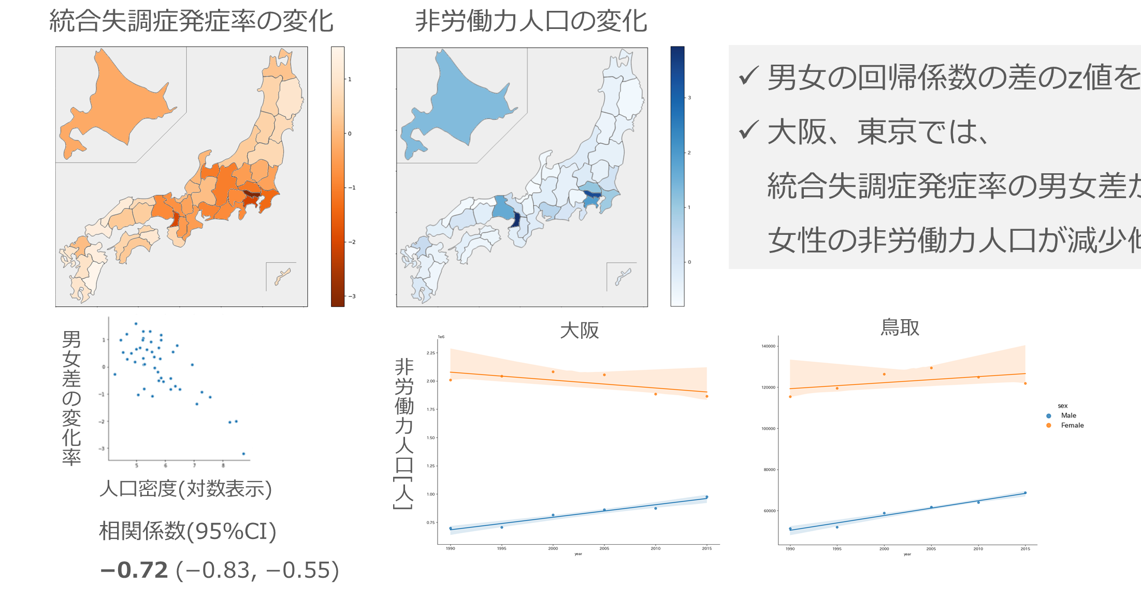
Results: reduction rate of the male-female gap
Incidence of schizophrenia
People outside the labor force
z value of the difference between the regression coefficients of males and females
Osaka
Tottori
Reduction rate of the male-female gap of incidence rate
People outside
the labor force
Population density (log)
r=−0.72
95%CI −0.83, −0.55
Notes:
結論に関係する結果（経時的、エリアごとの違いを示している）
✓線形のフィッティングで
✓変化率小さいほど色が濃くなるように修正

Slide 13
Discussion: role of social gender on incidence of schizophrenia
Studies from other countries have pointed out the issues of poverty and ethnicity (Europe) and industrialization (China since the 1980s)
While gender disparities are large in Japan, economic disparities are smaller than in other countries, racial backgrounds are relatively homogeneous.
Morgan C, et al. World Psychiatry 2019; 18: 247–58.
Chan KY, et al. World Psychiatry. 2015 Jun; 14(2) 251-252
DeVylder J, Journal of Migration and Health. 2022 Jan; 100078
We believe in the value of the impact of social gender on the incidence rate in Japan
Notes:
✓男女差の縮小の解釈

