Slide 1


Verbal fluency data as a predictor of clinical course of individuals at clinical high-risk for psychosis
Eugenie Choe
Seoul National University Hospital
2022-11-13

Slide 2
Clinical high risk for psychosis
converter
non-remitter
clinical high risk for psychosis
remitter
transition to psychosis
no conversion,
no remission
remission

Slide 3
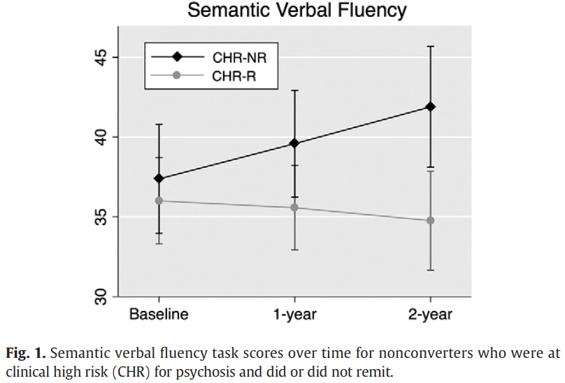
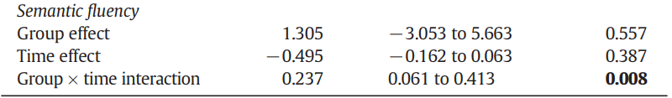
Category verbal fluency in CHR remitters
…
adapted from Lee et al., Schizophrenia Research, 2014

Slide 4
Verbal fluency task
category
animal
supermarket
letter
ㄱ
ㅇ
ㅅ

Slide 5
Complexity of the task
Verbal Fluency Task Performance
Semantic organization
Alogia
Executive control
Processing speed
…

Slide 6
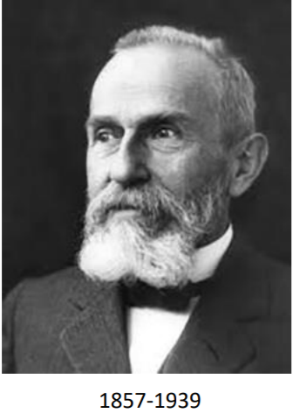
Schizophrenia
Bleuler’s 4 ‘A’s (fundamental symptoms)
Loosening of Association
Affective disturbance
Autism
Ambivalence

Slide 7
Hypothesis
A verbal fluency performance measure that is more directly related to semantic organization would better predict prognosis of CHR, especially remission.

Slide 8
Clustering vs switching
Clustering
reflects the relatively automatic processes of spreading activation to related concepts from an activated concept within a given subcategory
more associated with the lexical component of verbal fluency tasks
Switching
more related to semantic executive control abilities
Carpenter et al., Neurobiology of Language, 2021

Slide 9


Quantification of word meaning using FastText word embedding model
embedding model

Slide 10
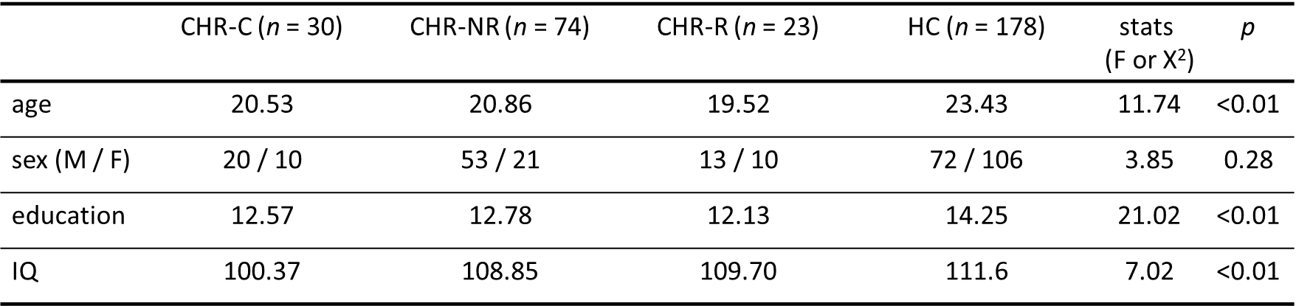
Study sample

Slide 11
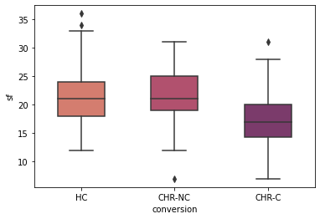
Word count

Slide 12
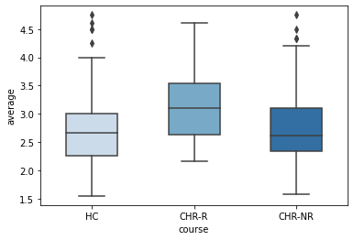
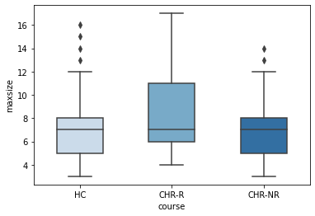
Cluster
Average cluster size
Maximum cluster size

Slide 13
Predicting conversion
Binomial logistic regression model
Word count (coefficient β = -0.164, p = 0.001)
Average cluster size (coefficient β = -0.817, p = 0.034)

Slide 14
Predicting remission
Binomial logistic regression model
Word count (coefficient β = 0.051, p = 0.953)
Average cluster size (coefficient β = 0.761, p = 0.037)

Slide 15
Conclusion
Verbal fluency task measure that is more related to semantic organization than word count would be a reliable clinical predictor

Slide 16
Thank you

