Slide 1


[2022 BESETO Symposium] Short Oral Presentation Clinical Characteristics of Comorbid Tic disorders in Autism Spectrum Disorder -Exploratory Analysis
Department of Psychiatry, Seoul National University Bundang Hospital
Presenter: Kim, Ye Rim

Slide 2

Background The exact mechanisms and clinical characteristics of comorbid tic disorders in individuals with ASD remain unclear.
Methods We included individuals diagnosed with ASD (n = 679) aged 4 to 18 years who completed the Yale Global Tic Severity Scale (YGTSS) questionnaire. Based on the YGTSS score, the included individuals were divided into two groups: ASD only (n = 554) and ASD with tics (n = 125). Individuals were assessed using the verbal and non-verbal intelligence quotient (IQ), Vineland Adaptive Behavior Scale (VABS-2), Social Responsiveness Scale-2 (SRS-2), Child Behavior Checklists for Ages 6-18 (CBCL), and Yale-Brown Obsessive-Compulsive Scale (YBOCS), followed by between-group comparisons. All tests were conducted using the Statistical Package for the Social Sciences (SPSS) version 26.

Slide 3
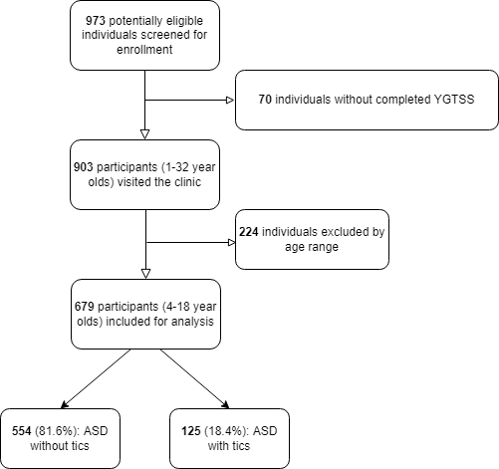
Figure 1: The prevalence of tic disorder in 679 individuals with autism spectrum disorder

Slide 4
Results Regarding the type of tics, both motor and vocal tics affected the majority of individuals (n = 40, 40.0%). The ASD with tics group had a significantly higher average age and full-scale IQ score than the ASD only group. Regarding clinical characteristics, the ASD with tics group showed significantly higher SRS-2, CBCL, and YBOCS subdomain scores after adjusting for age. Furthermore, all variables except the non-verbal IQ and VABS-2 scores were positively correlated with the YGTSS total score. Individuals with a higher IQ (IQ ≥70) showed a significantly greater proportion of tic symptoms.

Slide 5
Type of tics
In the ASD with tics group (N = 125, 18.4%), there were 50 (40.0%), 44 (35.2%), and 31 (24.8%) participants in both motor and vocal tic group, motor tic only group, and vocal tic only group, respectively.
Figure 2. Type of tics in 125 patients with autism spectrum disorder and tic disorder

Slide 6
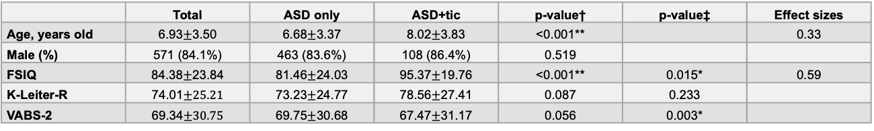
 | Total | ASD only | ASD+tic | p-value† | p-value‡ | Effect sizes
Age, years old | 6.93$±$3.50 | 6.68$±$3.37 | 8.02$±$3.83 | <0.001** |  | 0.33
Male (%) | 571 (84.1%) | 463 (83.6%) | 108 (86.4%) | 0.519
FSIQ | 84.38$±$23.84 | 81.46$±$24.03 | 95.37$±$19.76 | <0.001** | 0.015* | 0.59
K-Leiter-R | 74.01$±25.21$ | 73.23$±$24.77 | 78.56$±$27.41 | 0.087 | 0.233
VABS-2 | 69.34$±30.75$ | 69.75$±$30.68 | 67.47$±$31.17 | 0.056 | 0.003*
Table 1. Characteristics of both groups at baseline
ASD, autism spectrum disorder; FSIQ, full-scale intelligence quotient; VABS-2, Vineland Adaptive Behavior Scales; K-Leiter-R, Korean Leiter International Performance Scale-Revised
Continuous and categorical variables are expressed as mean ± SD and n (%), respectively.
* p < 0.05, ** p < 0.001 †Mann-Whitney U test, ‡ Quede’s rank of covariance, adjusted for age

Slide 7
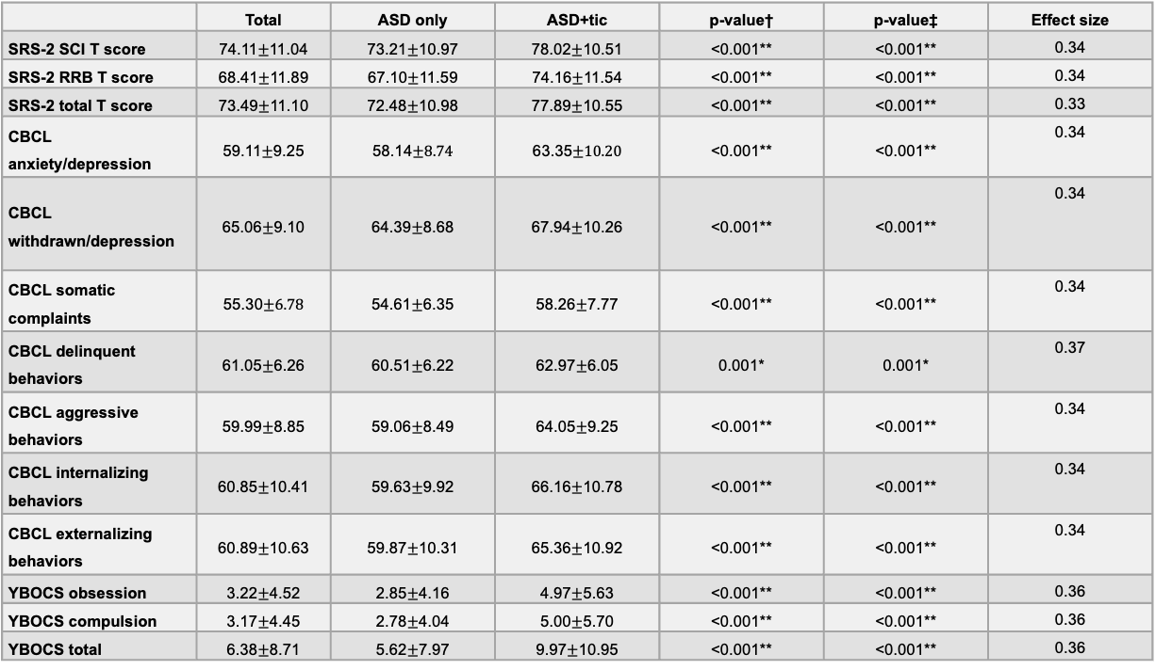
 | Total | ASD only | ASD+tic | p-value† | p-value‡ | Effect size
SRS-2 SCI T score | 74.11$±$11.04 | 73.21$±$10.97 | 78.02$±$10.51 | <0.001** | <0.001** | 0.34
SRS-2 RRB T score | 68.41$±$11.89 | 67.10$±$11.59 | 74.16$±$11.54 | <0.001** | <0.001** | 0.34
SRS-2 total T score | 73.49$±$11.10 | 72.48$±$10.98 | 77.89$±$10.55 | <0.001** | <0.001** | 0.33
CBCL anxiety/depression | 59.11$±$9.25 | 58.14$±8.74$ | 63.35$±10.20$ | <0.001** | <0.001** | 0.34
CBCL withdrawn/depression | 65.06$±$9.10 | 64.39$±$8.68 | 67.94$±$10.26 | <0.001** | <0.001** | 0.34
CBCL somatic complaints | 55.30$±6.78$ | 54.61$±$6.35 | 58.26$±$7.77 | <0.001** | <0.001** | 0.34
CBCL delinquent behaviors | 61.05$±$6.26 | 60.51$±$6.22 | 62.97$±$6.05 | 0.001* | 0.001* | 0.37
CBCL aggressive behaviors | 59.99$±$8.85 | 59.06$±$8.49 | 64.05$±$9.25 | <0.001** | <0.001** | 0.34
CBCL internalizing behaviors | 60.85$±$10.41 | 59.63$±$9.92 | 66.16$±$10.78 | <0.001** | <0.001** | 0.34
CBCL externalizing behaviors | 60.89$±$10.63 | 59.87$±$10.31 | 65.36$±$10.92 | <0.001** | <0.001** | 0.34
YBOCS obsession | 3.22$±$4.52 | 2.85$±$4.16 | 4.97$±$5.63 | <0.001** | <0.001** | 0.36
YBOCS compulsion | 3.17$±$4.45 | 2.78$±$4.04 | 5.00$±$5.70 | <0.001** | <0.001** | 0.36
YBOCS total | 6.38$±$8.71 | 5.62$±$7.97 | 9.97$±$10.95 | <0.001** | <0.001** | 0.36
Table 2. Comparison of clinical characterisitics according to the presence of tic symptoms
ASD, autism spectrum disorder; SRS-2, Social Responsiveness Scale; SCI, Social Communication Index; RRB, Restricted Interests and Repetitive Behavior; CBCL, Child Behavior Checklist; YBOCS, Yale-Brown Obsessive Compulsive Scale
* p < 0.05, ** p < 0.001 †Mann-Whitney U test ‡ Quede’s rank of covariance, adjusted for age

Slide 8
 | Pearson coefficient | p-value | N | Effect size
Age, years old | 0.154 | < 0.001** | 679 | 0.13
FSIQ | 0.152 | 0.034* | 195 | 0.23
K-Leiter-R | 0.028 | 0.586 | 369
VABS-2 | -0.066 | 0.096 | 632
SRS-2 SCI T score | 0.173 | < 0.001** | 663 | 0.13
SRS-2 RRB T score | 0.248 | < 0.001** | 668 | 0.13
SRS-2 total T score | 0.194 | < 0.001** | 663 | 0.13
CBCL anxiety/depression | 0.206 | < 0.001** | 667 | 0.13
CBCL withdrawn/depression | 0.139 | < 0.001** | 663 | 0.13
CBCL somatic complaints | 0.202 | < 0.001** | 661 | 0.13
CBCL delinquent behaviors | 0.157 | 0.001* | 478 | 0.15
CBCL aggressive behaviors | 0.236 | < 0.001** | 667 | 0.13
CBCL internalizing behaviors | 0.224 | < 0.001** | 667 | 0.13
CBCL externalizing behaviors | 0.199 | < 0.001** | 667 | 0.13
YBOCS obsession | 0.178 | < 0.001** | 609 | 0.13
YBOCS compulsion | 0.200 | < 0.001** | 607 | 0.13
YBOCS total | 0.195 | < 0.001** | 609 | 0.13
Table 3. Correlation of tic severity with clinical variables
FSIQ, full-scale intelligence quotient; VABS-2, Vineland Adaptive Behavior Scales; SRS-2, Social Responsiveness Scale; CI, Social Communication Index; RRB, Restricted Interests and Repetitive Behavior; CBCL, Child Behavior Checklist; YBOCS, Yale-Brown Obsessive Compulsive Scale
* p < 0.05, ** p < 0.001

Slide 9
 | Below IQ 70 | Above IQ 70 | Total | Odds ratio (95% CI) | p-value | Effect size
ASD only | 62 (91.2%) | 92 (72.4%) | 154 (79.0%) | 3.931 (1.560–9.904) | 0.001* | 0.26
ASD+tic | 6 (8.8%) | 35 (27.6%) | 41 (21.0%)
Total | 68 (100%) | 127 (100%) | 195 (100%)
Table 4. Relationship between HFA and comorbid tic disorders
ASD, autism spectrum disorder; IQ, Intelligence Quotient
* p < 0.05, ** p < 0.001

Slide 10
Limitations This study had several limitations. First, there may be a possible confounding effect of age. Second, we did not consider the current medications taken by the participants. Third, we only used the parent-reported YGTSS questionnaire. Fourth, this was a retrospective study. Fifth, symptom trajectories from an early age are warranted. Finally, we did not consider the individuals’ history or the severity of the tics.
Conclusions A higher IQ is associated with a greater proportion of tic symptoms in individuals with ASD. Moreover, the severity of ASD core and comorbid symptoms is associated with tic disorders and tic severity among affected individuals. Accordingly, there is a need for proper surveillance and clinical interventions for individuals with ASD.

Slide 11


