Slide 1

Betaine and Structural Changes in Schizophrenia
BESETO 2022
13th November 2022

Slide 2
INTRODUCTION: SCHIZOPHRENIA
Complex disorder with multifaceted aetiology
Early detection, diagnosis and efficient treatment - challenging

Slide 3
INTRODUCTION: METABOLOMICS
Metabolomics – Use of metabolite status to decipher mechanistic insights into disease pathophysiology
This approach can be expedient in identifying candidate biomarkers for disorders like schizophrenia
Notes:
Use of metabolite status to decipher mechanistic insights into disease pathophysiology because metabolite status reflects the pathophysiological status of a specific subject.
provides insight by revealing altered metabolic pathways – exploring disease from a holistic perspective – provide opportunity to discover distinct biomarkers that can aid in early intervention
Metabolomics (1) provide deeper insights into the biological underpinnings of psychiatric disorders, (2) be used as powerful diagnostic, disease-monitoring, and treatment response biomarkers, and (3) bring precision psychiatry closer to reality by enabling improved drug discovery and development processes, thereby advancing

Slide 4
INTRODUCTION: BETAINE
Betaine
Choline metabolite
Numerous important functions
Neuroprotective role
Osmoregulator
Anti-oxidative function
Homocysteine methylation,
Neurotransmitter synthesis
Gene expression
Altered in schizophrenia – reduction in betaine concentration in patients (Ohnishi et al., 2019)
Notes:
Located in the liver, kidney and brain
Carbonyl stress: elevated carbonyl stress and lowered betaine levels
FGF21: Betaine increased FGF21 in the liver – essential to the beneficial effects of betaine – FGF21 necessary for Betaine’s protective effects
Brain liver communication: liver communication with the brain relating to lipid metabolism can be targeted through the metabolic activity of betaine in the liver
Neurotransmitters: glutamine content is dramatically impacted by betaine supplementation but that impact is significantly influenced by osmolality – reduced GABA transport

Slide 5
PRESENT STUDY
1
2
3
Evaluate the structural differences (CV, CT, SA, LGI) and differences in Betaine levels between patients and controls
Examine the relationship between regional brain volume and clinical scales
Investigate the mediation effect between cortical volume, betaine and clinical scales

Slide 6
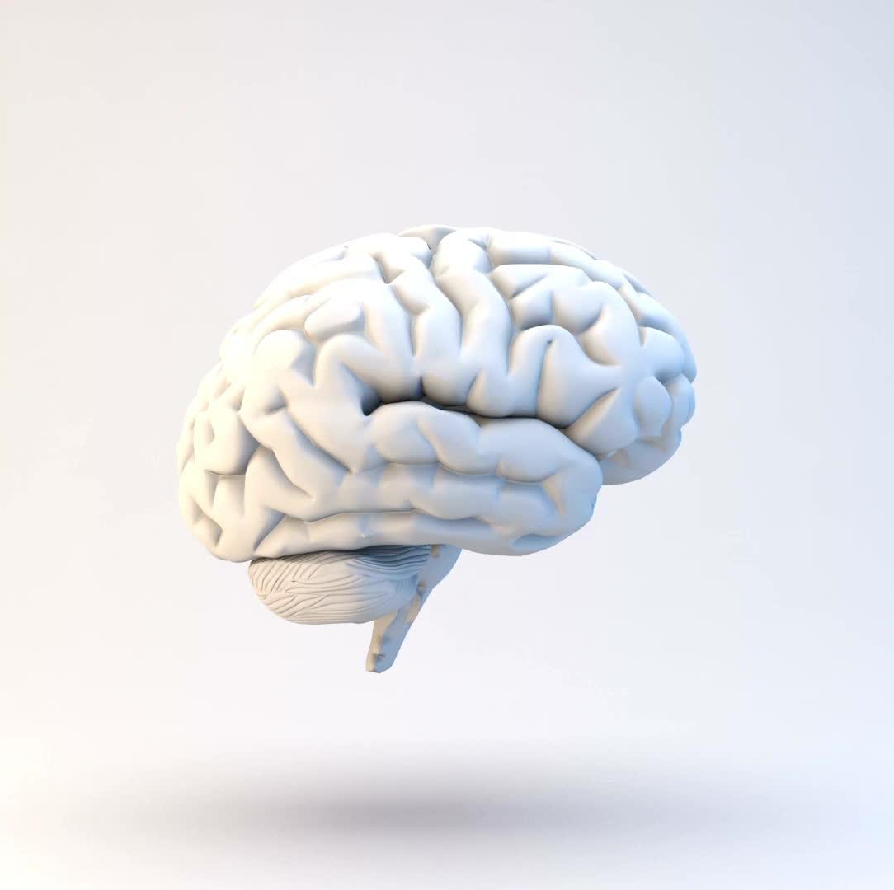
Main Focus
Examining the relationship between betaine levels and regional brain volume
Exploring whether Betaine effects across volumes are group-specific or across groups

Slide 7
METHODOLOGY: PARTICIPANTS
Participants – Betaine Collection – MRI – Exclusion/inclusion criteria
139 participants (43 patients and 96 controls)
76 participants MRI (27 patients and 49 controls)
MRI scanning and blood sampling for betaine analysis
Exclusion criteria : (1) previous history of brain injury with unconsciousness for five minutes or more, (2) previous history of electroconvulsive therapy, (3) previous and/or present alcohol addiction, (4) previous and/or present continuous substance use, and (5) low quality of MRI images.

Slide 8
METHODOLOGY: DEMOGRAPHICS
Demographic Variables | SZ (n=43) | HC (n=96) | P-Value
Age Mean (SD) | 32 (8) | 33 (9) | 0.62
Gender | M 25 F 18 | M 47 F 49 | 0.31
Betaine | 36.76 (6.22) | 40.17 (8.70) | 0.02
Illness Duration | 8.63 (7.28)
IQ | 101.91 (10.55) | 105.82 (10.14) | 0.06
PANSS-P | 16.74 (6.46)
PANSS-N | 19.59 (7.25)
PANSS-G | 34 (9.12)
MGAF-F | 48.19 (11.16) | 68.55 (37.37) | 0.00
MGAF-S | 49.19 (12.40) | 68.14 (37.18) | 0.00
MGAF | 45.89 (12.68) | 68.08 (37.14) | 0.00

Slide 9
Methodology: GLM Models
Betaine
Diagnosis
Age
Sex
Betaine*Diagnosis
Betaine*Age
Betaine*ETIV
Betaine*Sex
Models conducted for all brain regions across all brain variables (CV, CT, SA, LGI) for both hemispheres
FDR (p<0.05) correction conducted on the significant results
Correlations between Betaine and significant brain regions (age, sex and ICV kept constant)

Slide 10
GLM Multiple Comparisons (FDR 0.05)
CV LH STG – p= 0.039
LGI LH Frontal Pole – p=0.031
LGI LH Superior Frontal – p=0.016
LGI LH Medial Orbitofrontal – p=0.022

Slide 11
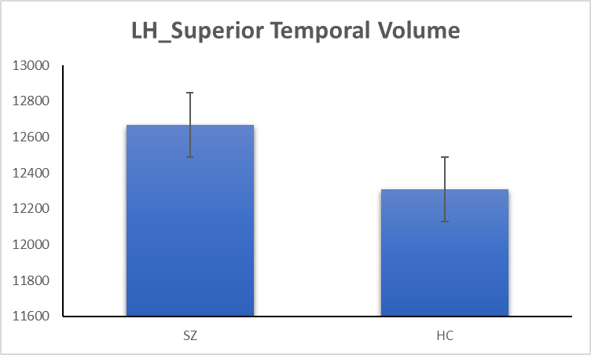
t(59)=0.09, p=0.18

Slide 12
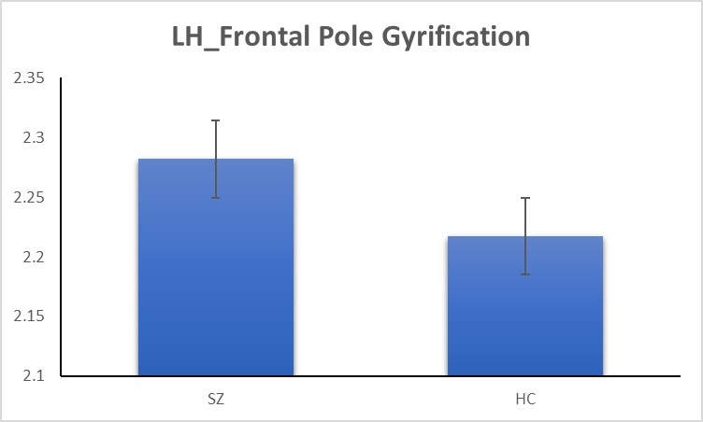
t(50)=2.64, p=0.005

Slide 13
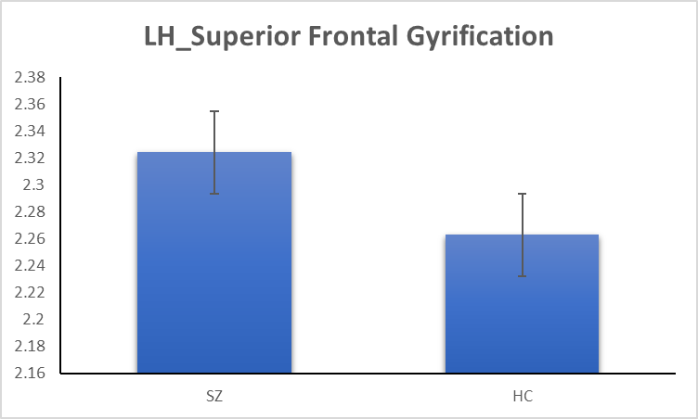
t(46)=2.49, p=0.008

Slide 14

t(45)=2.04, p=0.023

Slide 15
Betaine Correlations with significant regions SZ
CV LH STG – r=0.539, p=0.007
LGI LH Frontal Pole – r=0.460, p=0.024
LGI LH Superior Frontal – r=0.421, p=0.040

Slide 16
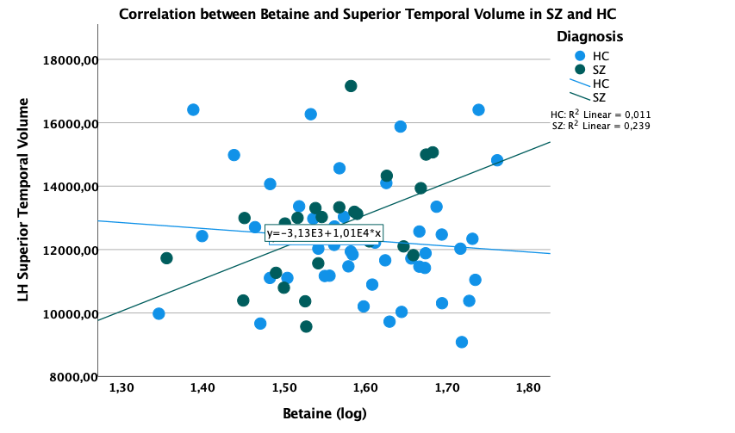

Slide 17


Slide 18
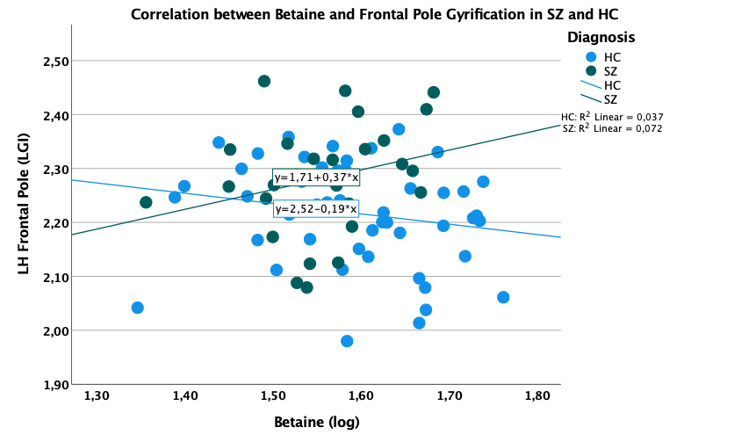

Slide 19
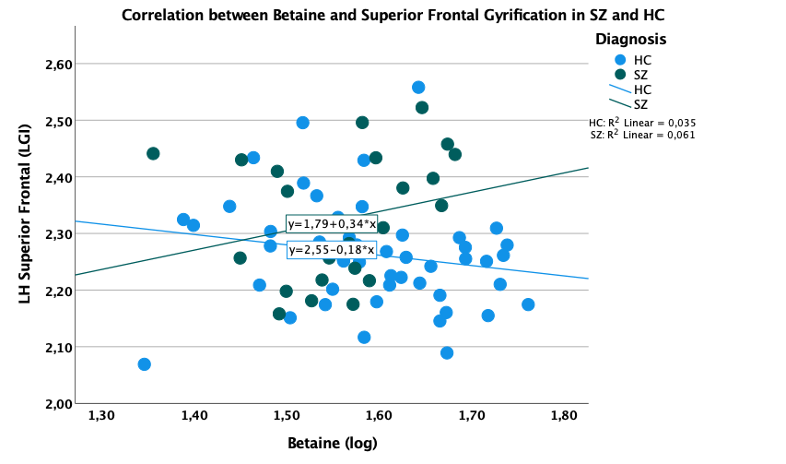

Slide 20
Discussion
Betaine effect group-specific
LH dominance aberration
STG’s role in schizophrenia
Gyrification and schizophrenia
Notes:
LH dominance
Failure of LH dominance in schizophrenia (Angrilli et al., 2009; Oertel et al., 2011)
STG’s role in schizophrenia
Abnormalities (mainly decrease in volume, some increase) in STG underlie symptoms like hallucinations, attention deficits and thought disorder (Allen et al., 2019; Cullen et al., 2013)
Gyrification and schizophrenia
Abnormal cortical gyrification (decrease and increase) in patients (Matsuda et al., 2018; Sasabayashi et al., 2020
Abnormal cortical gyrification (hypo-gyrification) was reported in the frontal cortex (Viet Pham et al., 2021; Zakharova et al., 2021)

Slide 21


Slide 23
Betaine & Structural changes: Mechanism of Action
Fluctuations in betaine concentration
Abnormalities in neurotransmitter synthesis and signalling
Results in increased oxidative stress, alterations in neuroinflammatory processes
Altered WM integrity – axon degeneration – loss of myelin sheath
Structural changes will affect brain’s function 🡪 cognition, language, perception
Reduced cortical GM volume, increased volume in subcortical structures – aberrations in cortical neuropil
Structural changes
Structural changes will affect brain’s function 🡪 pathological symptoms

