Slide 1


Cortical gyrification differences between early- and late- onset obsessive-compulsive disorder: Neurobiological evidence for neurodevelopmentally distinct subtypes
Inkyung Park
(Dr. Prof. Jun Soo Kwon’s lab at Seoul site)

Slide 2
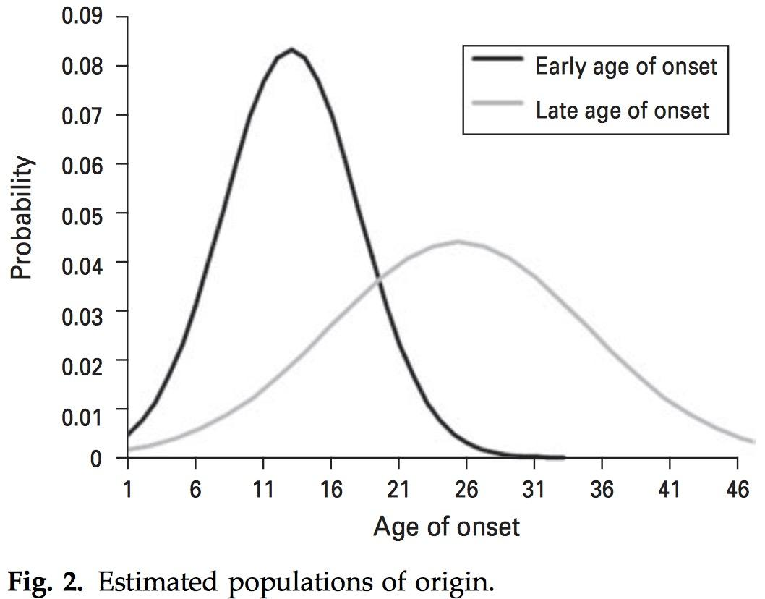

Neurodevelopmental model of early-onset OCD: Evidence for distinct subtypes
Early-onset
OCD
Onset age
Insel TR., 2014 Am J Psychiatry
Male
Genetic loading
Comorbidity
Development
of symptoms
Treatment outcome
Anholt et al., 2014
Anholt et al., 2014; Rosenberg & Keshavan, 1998;
Hyuser et al., 2009; Burchi & Pallanti, 2019

Slide 3
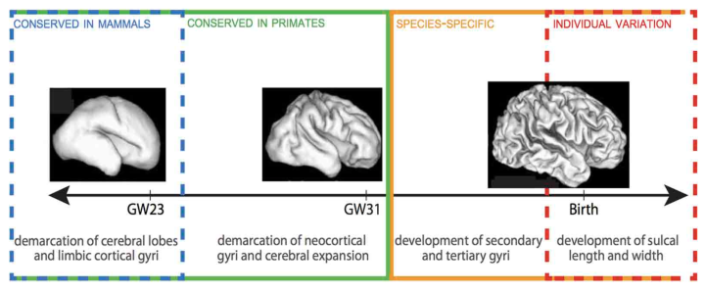
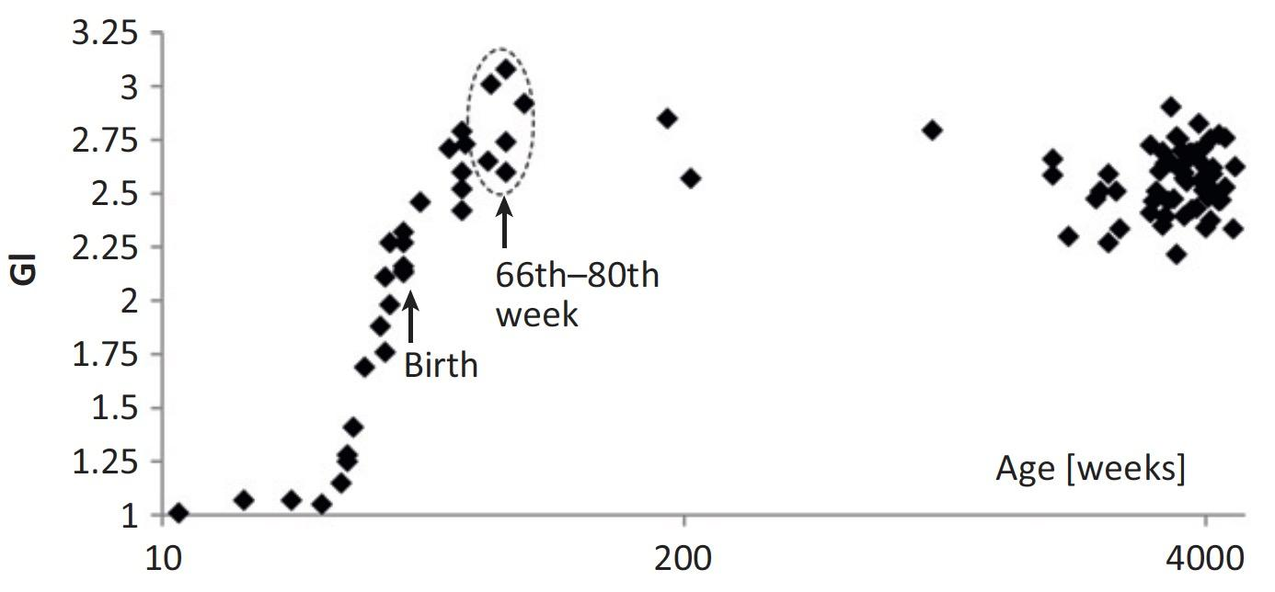
Gyrification as a potential marker for early neurodevelopment
Zille et al. (2013)

Slide 4
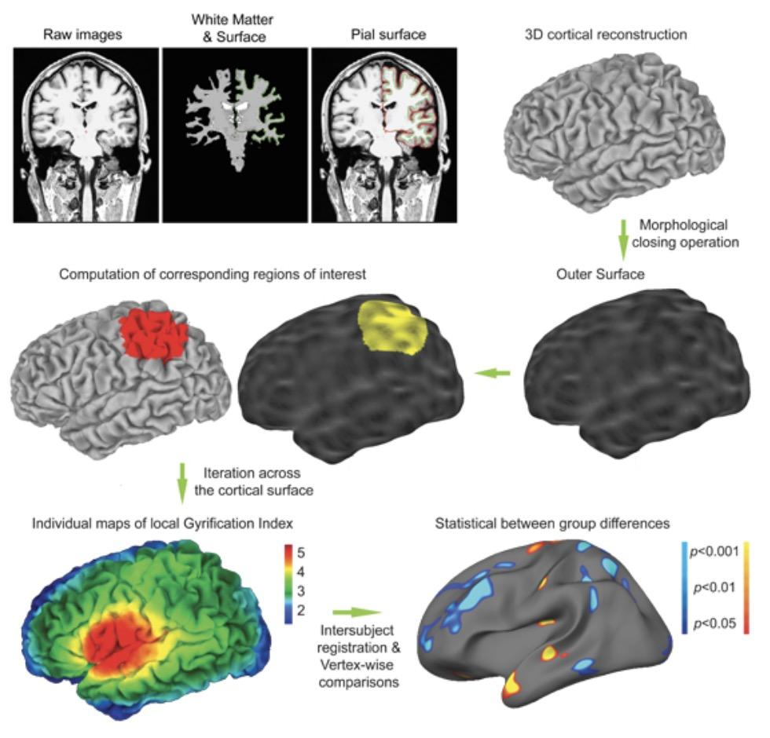
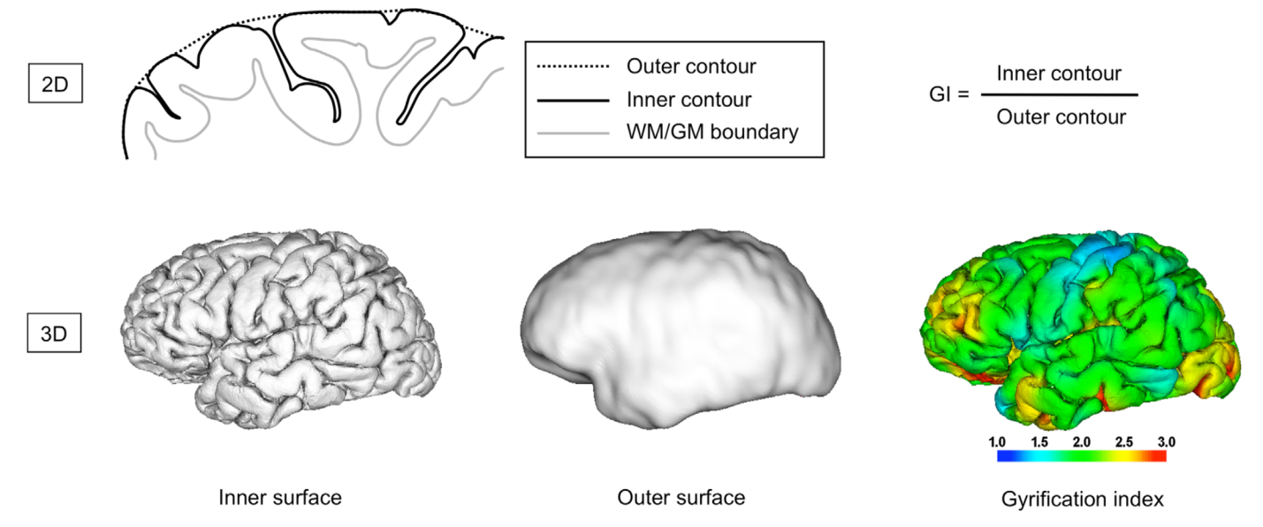
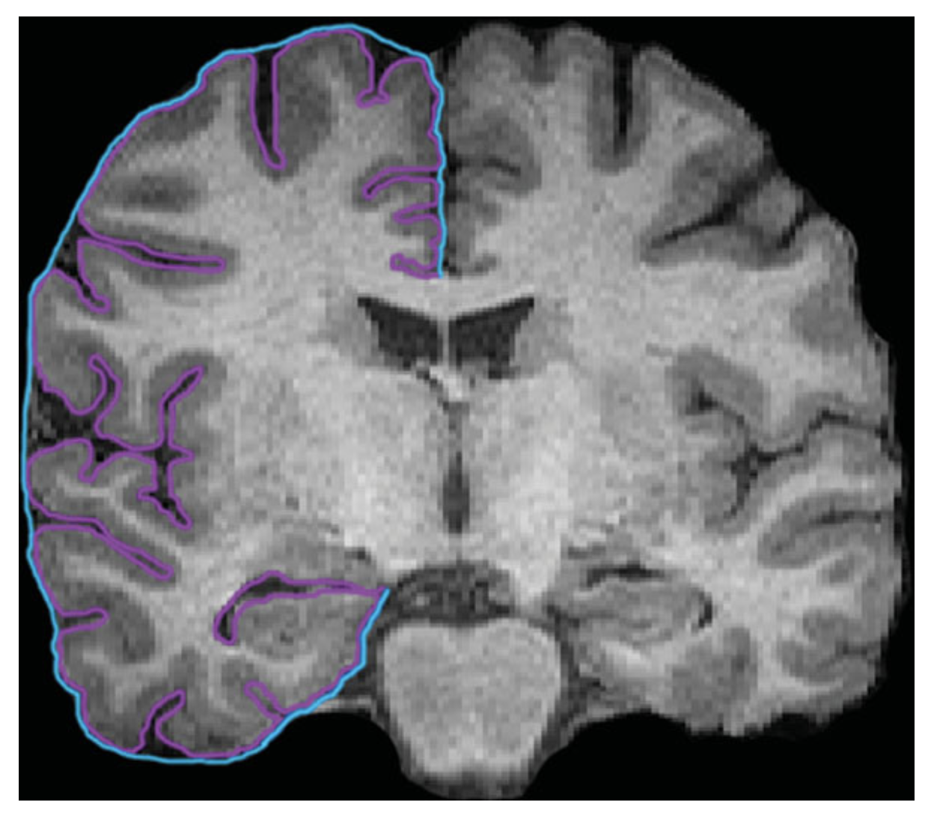
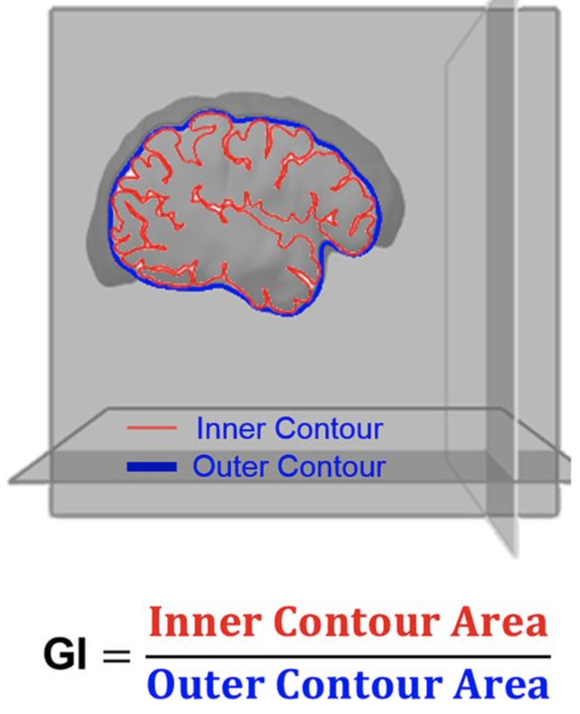
Method: local Gyrification Index (lGI)
Zilles et al. (1988)
Schaer et al. (2012)

Slide 5
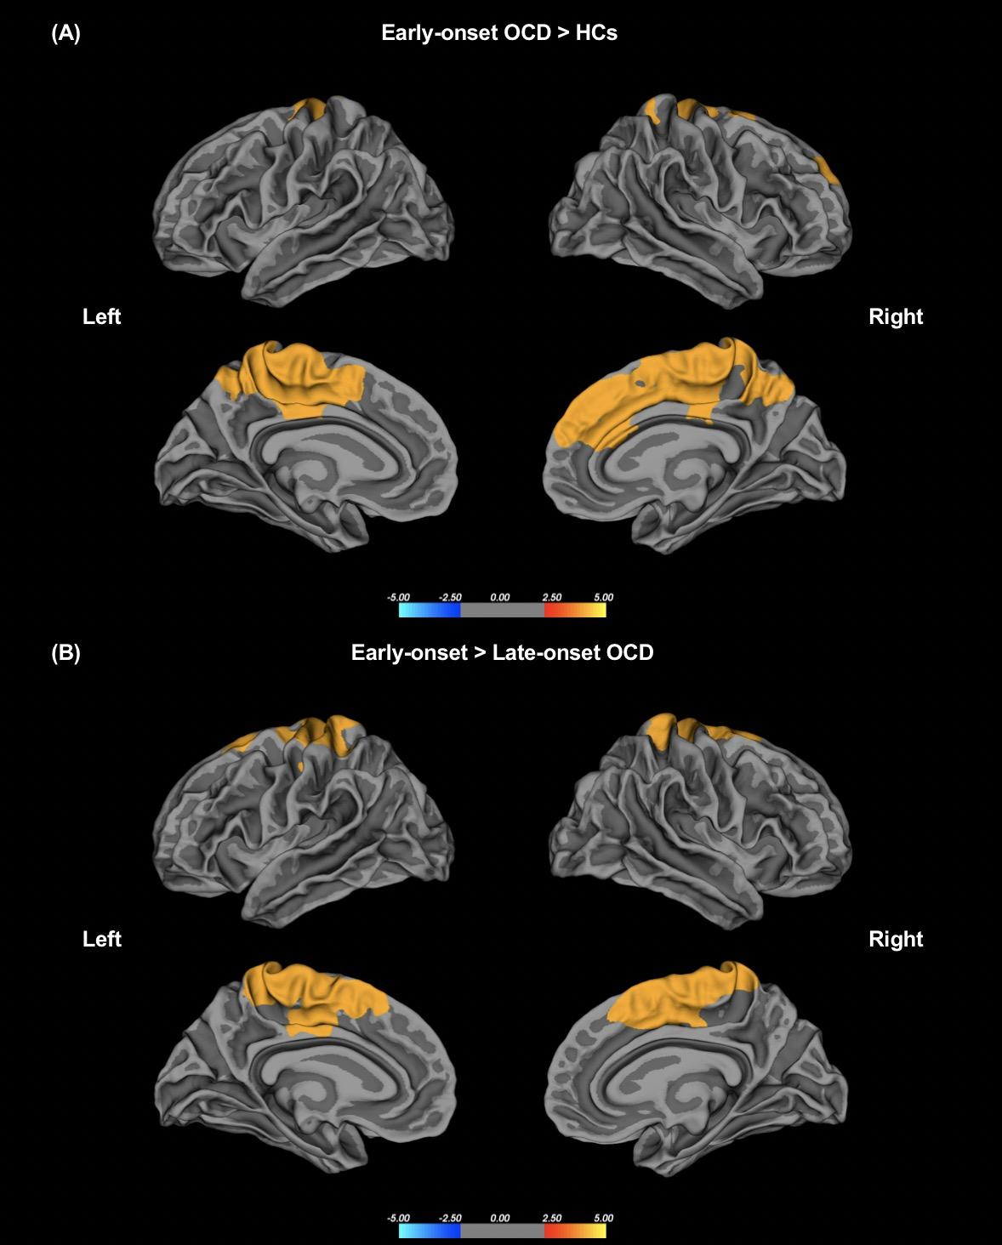
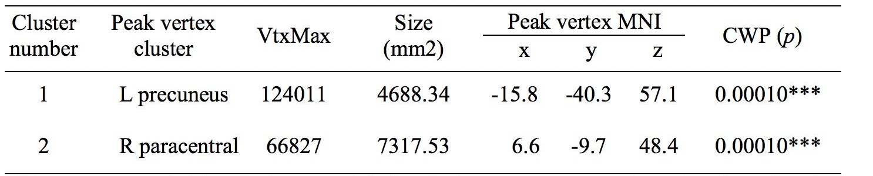
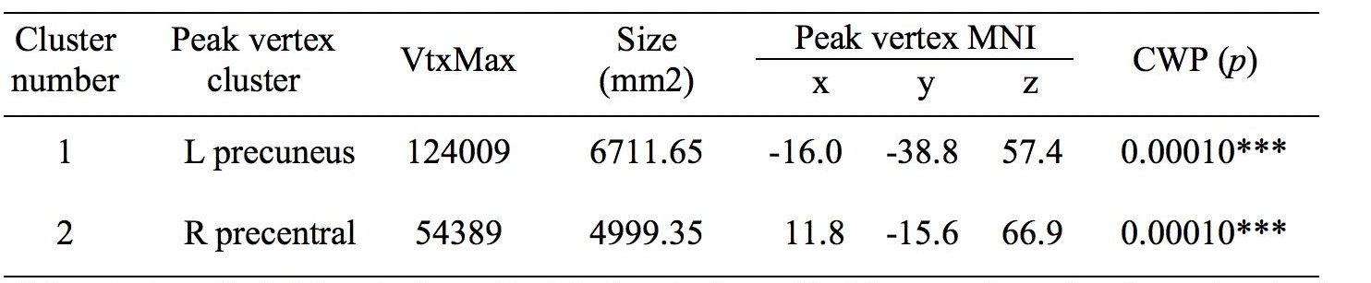
Results: Group differences in the whole-brain local gyrification index (lGI).

Slide 6
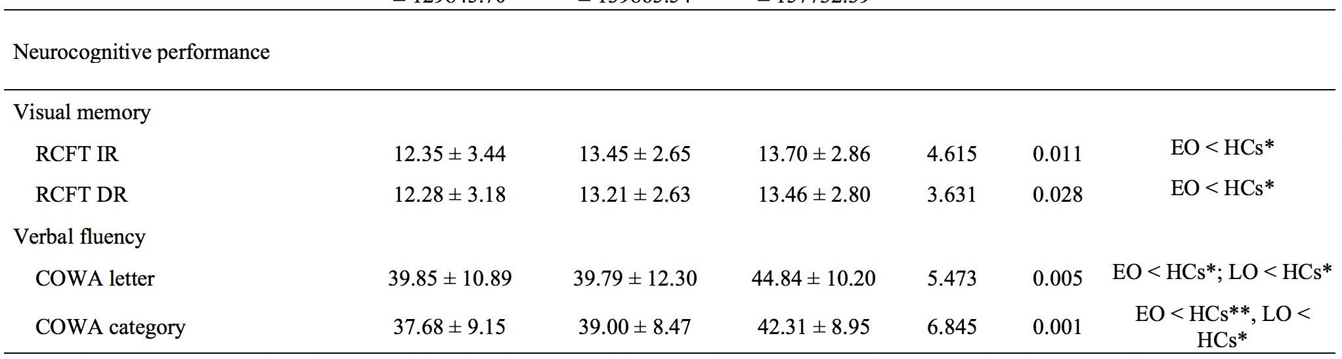
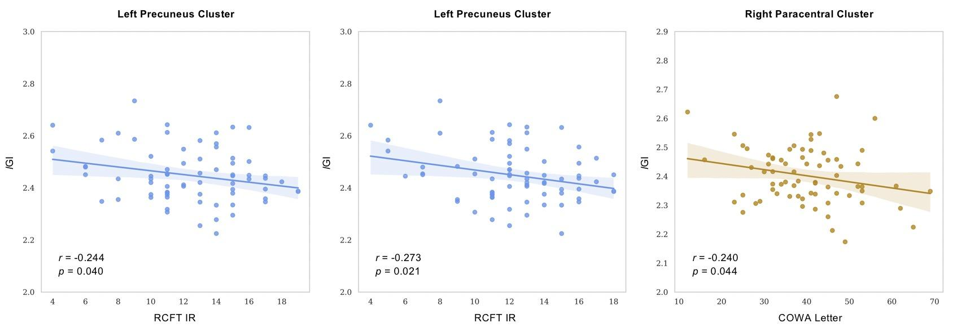
Results: Associations between lGI and neurocognitive variables

Slide 7
Thank you!

