Slide 1
Group-exercise participation, executive function and associated brain structures in children with ADHD
Rio Yamaguchi (PhD Candidate)

Slide 2
Common Deficits seen in children with ADHD- Executive function
Barkley (1997) suggested the core skills deficit in those with ADHD is their executive function
Executive function is the mental process that enables us to plan, focus attention, and allocate necessary resources successfully to complete a complex task. Working memory, mental flexibility and self-regulation are considered to be at its core.
Evidence suggests those with ADHD perform poorly at tasks involving working memory and inhibition control (see Martinussen et al., 2006 for a review）

Slide 3
Common Deficits seen in children with ADHD- Motor control/motor inhibition
At least 50% of children with ADHD have poor motor coordination, meeting criteria for developmental coordination disorder (Kadesjö & Gillberg, 1998)
Children with ADHD have been found to perform poorer than controls in tasks that require motor coordination and balance skills and their improvement overtime was delayed when compared to controls (Sweeney et al., 2018).
Children with ADHD perform significantly poorly in motor inhibition tasks when compared to controls (Mahone et al., 2006) and response inhibition is considered to be at the core of ADHD symptomatology

Slide 4
Exercise and its effect on executive function
Studies report involvement in aerobic exercises improves executive function in children (Davis et al., 2011)
Recent studies consistently provide evidence for the effectiveness of intense exercise by children diagnosed with ADHD and subsequent improvement in symptoms (Smith et al., 2013; Hoza et al., 2015) as well as their executive function (Choi et al., 2015; Chang et al., 2012; Pan et al., 2015)

Slide 5
What is it about exercise that improves executive function?
Whilst there are studies suggesting that aerobic exercise improves executive function in children, (Davis et al., 2011) questions have been raised regarding what component of “exercise” lead to this effect
Suggestions have been made that rather than aerobic exercise in itself improving executive functioning, perhaps it is the cognitive demand that is placed in certain exercises that improves performance on tasks requiring executive function (Diamond, 2015)
There is a need to investigate what exactly about the exercise interventions that improves an individual’s executive function

Slide 6
Brain Imaging studies- ADHD
A large-scale, longitudinal study found that the developmental curve for total white matter volumes were higher in the control subjects than children with ADHD (Castellanos et al., 2002), suggesting possible delays in white matter maturation in children with ADHD.
A meta-analysis exploring the structural brain differences in children with ADHD and controls, further revealed that the regions that had the largest significant difference between the two groups were cerebellar regions.
A study that investigated microstructural features of the white matter found significant negative relationship between inattentive symptoms and white matter integrity of the cerebellum. (Ashtari et al., 2005)

Slide 7
Cerebellum-making adjustments to motor response
Cerebellum plays a critical role in making fine adjustments to motor responses.
It receives motor information from the primary motor cortex, (via the pons) as well as proprioceptive (spinocerebellar tract)and vestibular information (vestibulocerebellar tract)
Once all the information is integrated, then it communicates via the thalamus to adjust the motor responses
→ Children with ADHD appear to have microstructural immaturity in these tracts that communicate with the cerebellum
→ Sports or exercise that involve complex movement could perhaps help these tracts to mature
Sanders & Levitin (2020)

Slide 8
Aim
To explore if frequent participation in group exercise is associated with improved performance in executive function tasks.
To explore if frequent participation in group exercise is associated with increased white matter volumes connected to the cerebellum (ROI)
To explore if the volumes of the white matter tracts connected to the cerebellum mediates the relationship between frequent participation in group exercise and executive function tasks.

Slide 9
Measures used (Independent Variable) PAQーC（Physical Activity Questionnaire For Older Children）Japanese version
Self-administered, 7-day recall questionnaire that measure general moderate to vigorous physical activity levels during the school year.
Question 1 of the PAQ-C lists 22 sports or activities and ask how frequently the child had participated in each of these sports/activities.
→ If the participants responded that they had participated in group exercise that involved another person, for more than three times a week, they were classified to be “participating in frequent group exercise”

Slide 10
Measures used (Dependent Variables)
Measure of executive function
- Planning subtest core of Cognitive Assessment System (CAS)
MRI –T1-weighted brain images used to calculate the volumes of the ROI (Cerebellum white matter and white matter tracts connected to the cerebellum)

Slide 11
Results

Slide 12
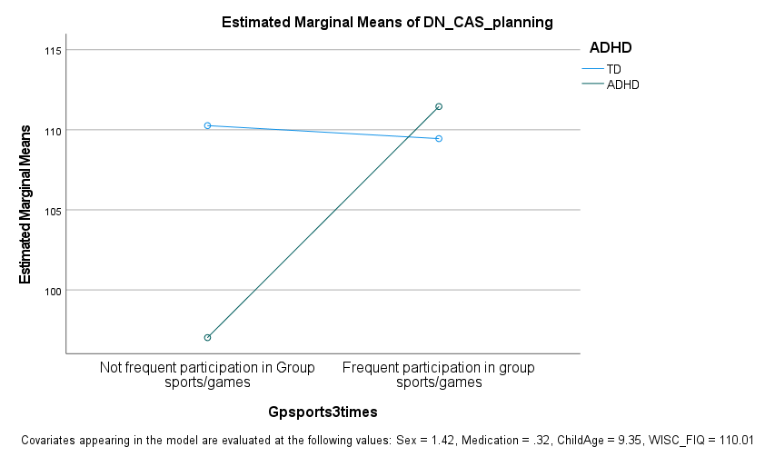
Results
- Interesting interaction in the executive functioning scores
Those who participated in frequent group exercise performed significantly better in their executive function task than those who did not participate in frequent group exercise and this effect was prominent for children with ADHD

Slide 13
Results

Slide 14
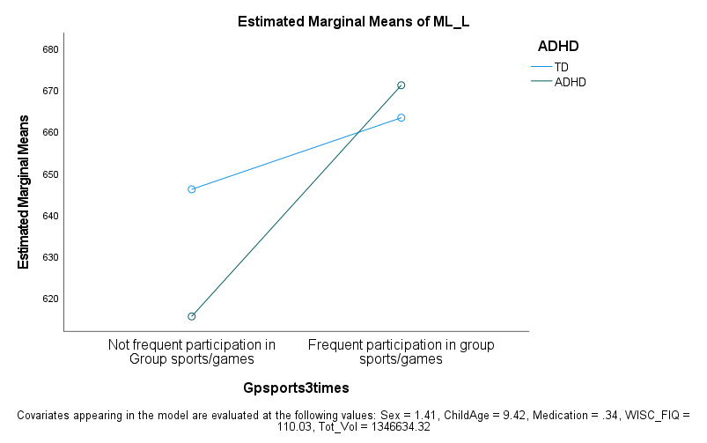
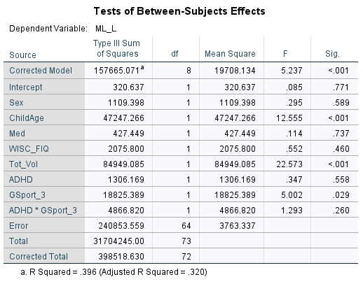
Results- Medial Lemniscus (left)

Slide 15
Mediation Analysis CAS (planning) scores and medial lemniscus volume
Medial lemniscus left （Volume）
β=0.29
β = 0.32
Indirect effect
β=0.09**, p=0.004
Frequent participation in group exercise
CAS-planning

Slide 16
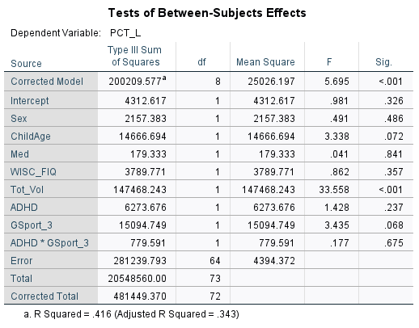
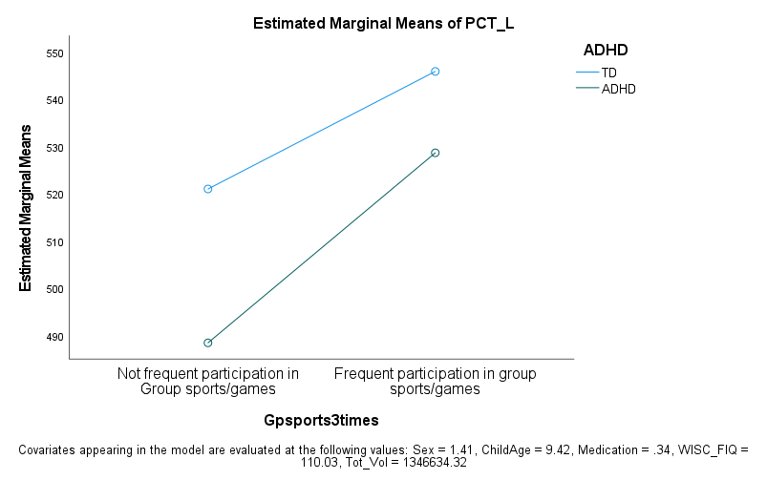
Results – Pontine crossing tract (left)

Slide 17
Mediation Analysis CAS (planning) scores and pontine crossing tract (left) volume
Pontine crossing tract (a part of MCP) left （Volume）
β=0.21
β = 0.34
Indirect effect
β=0.07*, p=0.036
Frequent participation in group exercise
CAS-Planning

Slide 18
References
Ashtari, M., Kumra, S., Bhaskar, S. L., Clarke, T., Thaden, E., Cervellione, K. L., . . . Milanaik, R. (2005). Attention-deficit/hyperactivity disorder: a preliminary diffusion tensor imaging study. Biological psychiatry, 57(5), 448-455.
Barkley, R. A. (1997). Attention-deficit/hyperactivity disorder, self-regulation, and time: Toward a more comprehensive theory. Journal of Developmental and Behavioral Pediatrics, 18(4), 271-279.
Chang, Y. K., Liu, S., Yu, H.H., & Lee, Y. H., (2012). Effect of acute exercise on executive function in children with attention deficit hyperactivity disorder. Archives of Clinical Neuropsychology, 27(2), 225-237.
Choi, J.W., Han, D. H., Kang, K. D., Jung, H. Y., & Renshaw, P. F. (2015). Aerobic exercise and attention–deficit/hyperactivity disorder: brain research. Medicine & Science in Sports & Exercise, 47 (1), 33-39.
Cortese, S., Kelly, C., Chabernaud, C., Proal, E., Di Martino, A., Milham, M. P., & Castellanos, F. X. (2012). Toward systems neuroscience of ADHD: a meta-analysis of 55 fMRI studies. The American Journal of Psychiatry, 169(10), 1028-1055.
Davis, C. L., Tomporowski, P. D., McDowell, J. E., Austin, B.P., Miller, P.H., Yanasak, N.E., Allison, J.D., & Naglieri, J.A. (2011) Exercise improves executive functions and achievement and alters brain activation in overweight children: A randomized, controlled trial. Health Psychology, 30:91–98.
Diamond, A., (2015) Effects of Physical Exercise on Executive Functions: Going beyond Simply Moving to Moving with Thought. Annals of Sports Medicine and Research, 2(1) 1011

Slide 19
References
Hoza, B., Smith, A.L., Shoulberg, E.K., Linnea, K.S., Dorsch, T.E., Blazo, J.A., Alerding, C.M., & McCabe, G.P. (2016). A randomized trial examining the effects of aerobic physical activity on attention-deficit/hyperactivity disorder symptoms in young children. Journal of Abnormal Child Psychology, 43 (4), 655-667.
Kadesjö, B., & Gillberg, C. (1998). Attention deficits and clumsiness in Swedish 7‐year‐old children. Developmental Medicine & Child Neurology, 40(12), 796-804.
Mahone, E. M., Powell, S. K., Loftis, C. W., Goldberg, M. C., Denckla, M. B., & Mostofsky, S. H. (2006). Motor persistence and inhibition in autism and ADHD. Journal of the International Neuropsychological Society, 12(5), 622-631.
Martinussen, R., Hayden, J., Hogg-Johnson, S., & Tannock, R. (2006). A meta-analysis of working memory impairments in children with attention deficit/hyperactivity disorder. Journal of the American Academy of Child and Adolescent Psychiatry, 44, 377-384.
Pan, C.Y., Tsai, C. L., Chu, C. H., Sung, M. C., Huang, C. Y., & Ma, W. Y., (2015). Journal of Attention Disorders, 23(4), 384-397.
Sanders, R. H., & Levitin, D. J. (2020). Towards an Understanding of Control of Complex Rhythmical “Wavelike” Coordination in Humans. Brain Sciences, 10(4), 215.
Smith, A. L., Hoza, B., Linnea, K., McQuade, J. D., Tomb, M., Vaughn, A. J., Shoulberg, E. K., & Hook, H. (2013). Journal of Attention Disorders, 17(1), 70-82.
Sweeney, K. L., Ryan, M., Schneider, H., Ferenc, L., Denckla, M. B., & Mahone, E. M. (2018). Developmental trajectory of motor deficits in preschool children with ADHD. Developmental neuropsychology, 43(5), 419-429.

