Slide 1
Whole-brain coherence declines in motor task – Wavelet analysis on task functional MRI data
13/11/2022 BESETO Conference
Eimu Shoji
Department of Neuropsychiatry, The University of Tokyo

Slide 2
Outline
FMRI provides putative activity of brain regions
Dynamic global synchronicity of brain BOLD activity is still unclear
We assessed the synchronicity of brain activity, using wavelet coherence analysis and graph theory
We found that whole-brain synchronicity declines while motor task, compared to resting state
Synchronicity decline was prominent in functionally primitive brain networks such as visual and motor networks, and was not so significant in functionally high-order brain networks such as DMN and fronto-parietal networks
We can assume that brain, especially primitive brain networks, reduce their synchronicity in task states and adapt to environment individually

Slide 3
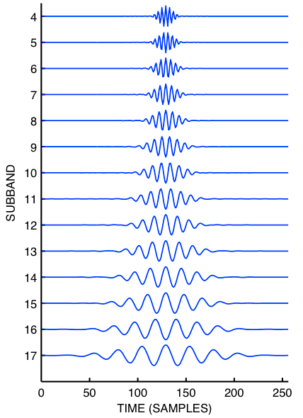
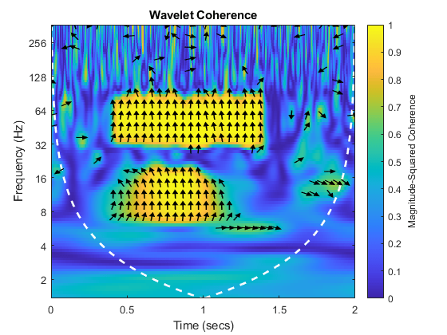
fMRI and wavelet coherence
Wavelet coherence is a tool for time-frequency analysis, which is preferably used in EEG study
Wavelet coherence addresses the extent of synchronicity between two signals on specific frequency
Range of wavelet coherence is between 0 to 1 (0 as no synchronicity and 1 as maximum synchronicity)
It can precisely approximate frequency, phase and timing of a signal at the same time
Brain BOLD signal is also a continuous signal, so wavelet analysis is applicable to assess synchronicity between two specific brain region
Wavelet analysis was also applied to resting fMRI data (Yaesoubi et al., 2015) and motor task fMRI data (Chen at al., 2021) and generated meaningful results about dynamic characteristics of brain synchronicity
Since previous researches focused on region-to-region coherence, whole-brain synchronicity is not fully scrutinized

Slide 4

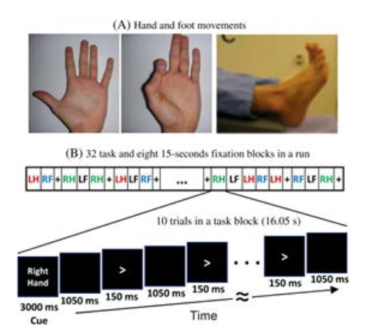
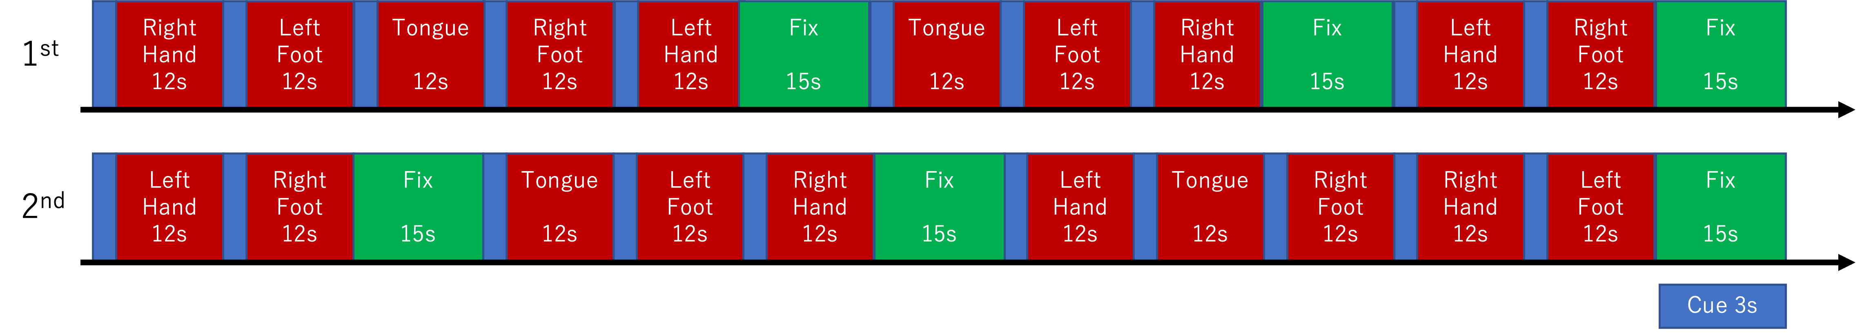
HCP motor task and wavelet coherence
Human Connectome Project (HCP) is a database of biological data of brain (MRI, MEG) and behavioural testing data, which can be freely accessed without application
Both task and resting fMRI data are included
Motor task data includes 1086 subjects (1079 subjects were valid for subsequent analysis)
Subjects move their body parts (L/R hand, L/R foot, tongue) according to the visual letter instruction on a screen (figure) while fMRI scanning
After preprocessing, we divided whole brain into 718 regions and calculated average wavelet coherence during task and rest condition

Slide 5
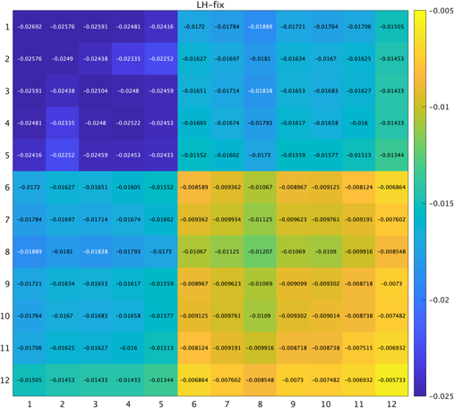
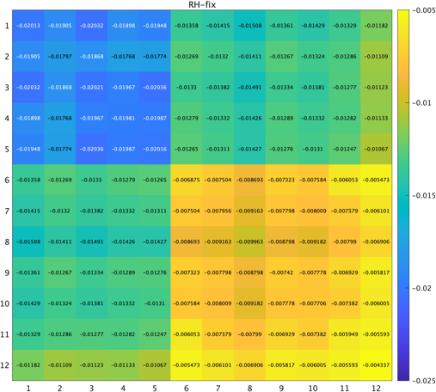
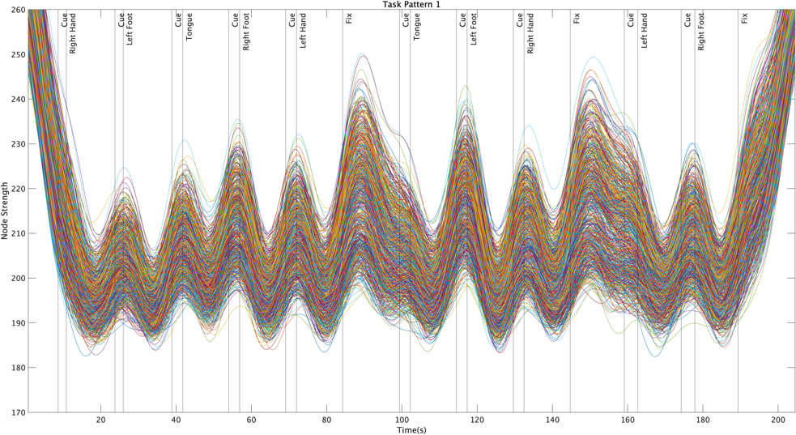
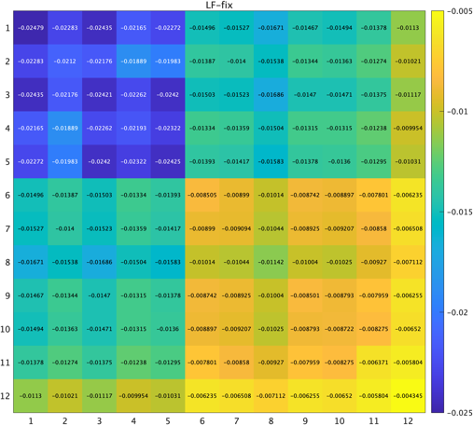
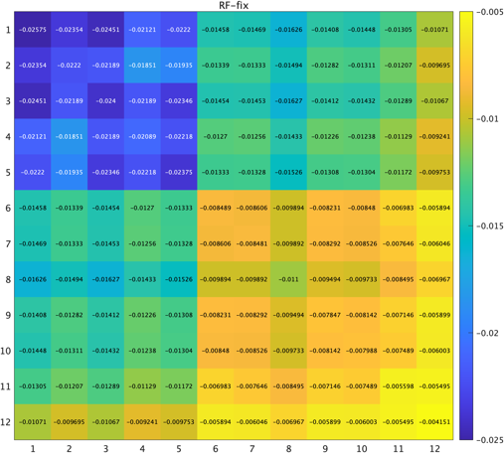
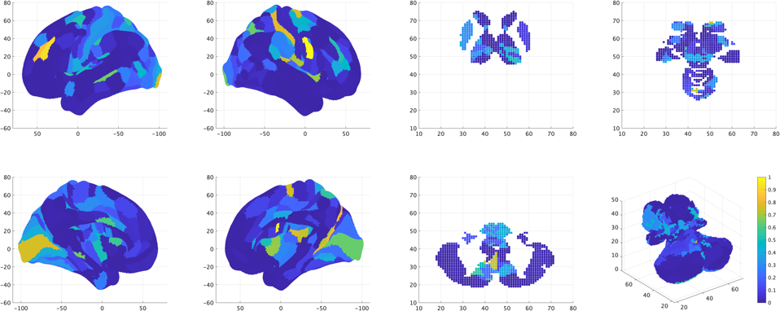
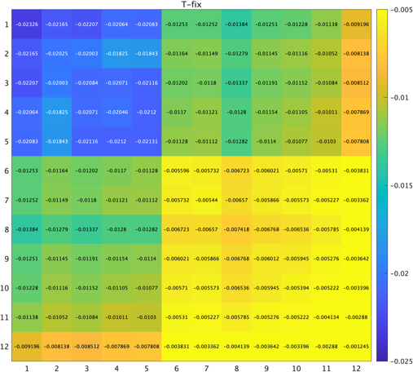
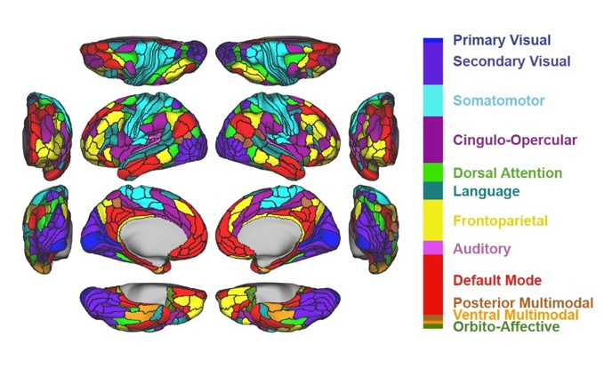
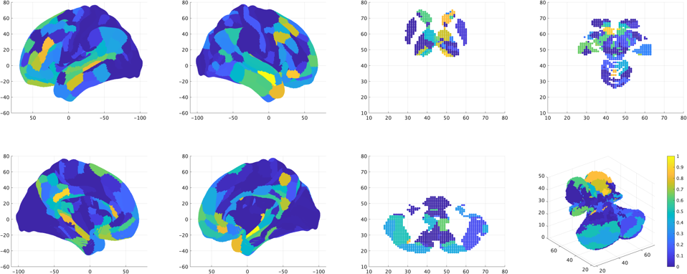
Results
718 region × 718 region matrix is obtained as to wavelet coherence, just like connectivity matrix
To quantitively compare wavelet coherence for each region or network, node strength (=simple sum of wavelet coherence, adopted from graph theory) is calculated
Whole brain showed significant decline in node strength (synchronicity) in motor task block
On network level, functionally primitive networks (V, SM…) mark prominent decline in synchronicity, while high-order ones (DMN, FPN…) don’t
On region level, left DLPFC and right PMv showed biggest decline in synchronicity
Left hand -Fix
Right hand -Fix
Whole-brain node strength
Left foot -Fix
Right foot -Fix
Most declined regions
Tongue-Fix
Corresponding Networks
Most unchanged regions

Slide 6

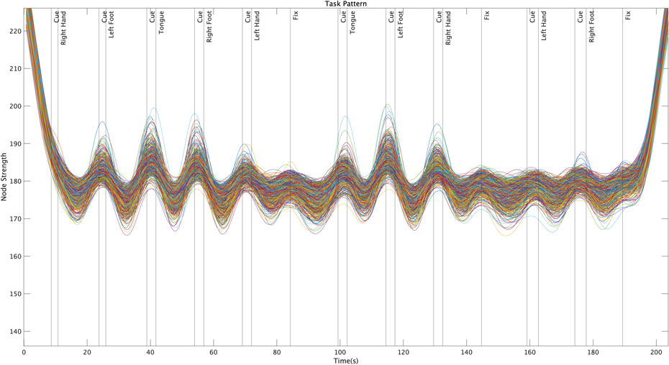
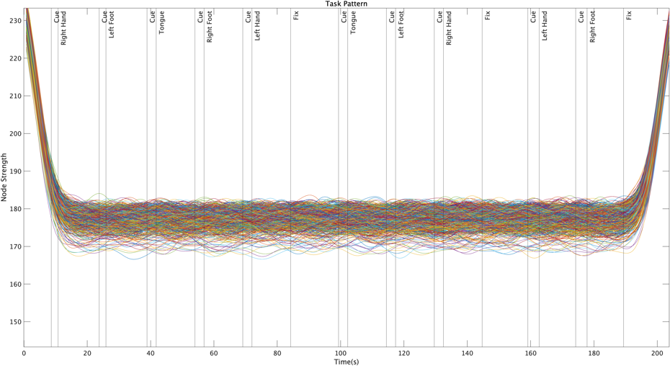
Validation of wavelet coherence
Hemodynamic response function (HRF) can skew the results of wavelet analysis
To assess the impact of HRF, we separated BOLD signals by the next formulation;
1. (Original BOLD signal) = (task induced portion; regressed out by task design) + (residual portion; true brain response)
2. (Mock BOLD signal) = (task induced portion) + timing randomized* (residual portion)
3. Mock BOLD signal with HRF has no difference in wavelet coherence for rest and task block
Validates that difference in wavelet coherence is induced by true brain response, not by the task design
1. Original
2. Mock BOLD signal
3. Mock BOLD signal with HRF

Slide 7

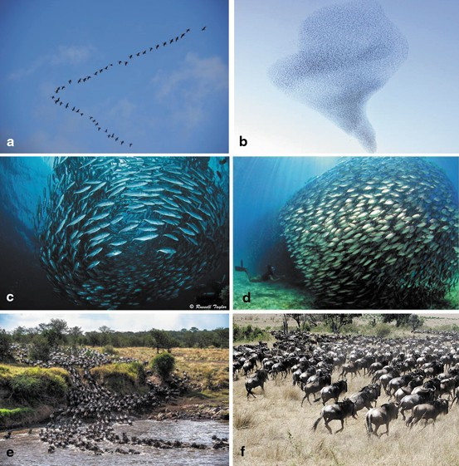
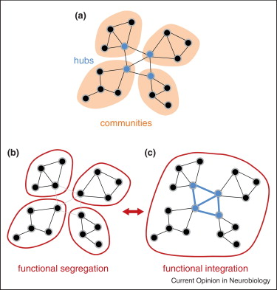
Synchronicity of brain
Whole brain synchronicity declines in motor task
Functionally primitive networks (such as motor, visual…) mark considerable decline in synchronicity, while high-order networks (such as DMN, fronto-parietal…) don’t make significant change
The most declined parts are right PMv and left DLPFC
The most unchanged parts is left precuneus
Those parts are individually related to motion planning and mind task-negative brain activity
Wavelet coherence can be used as a tool to assess synchronicity
Wild animals or insects adopt synchronization system in order to efficiently adapt to environment
It is possible that human brain system also uses synchronicity to reduce energy cost and integrate information, while segregates in acute environmental change
Wavelet analysis would be also fruitful if it can detect synchronicity anomaly in mental diseases such as schizophrenia, which is related to disorder of information integrity
(Sokol, 2015)
(Lewis et al., 2014)
(Sporns, 2013)

Slide 8
Thank you for your listening!
I appreciate your comments and questions

