Slide 1

A Phase 3, Multicenter, Double-blind, Randomized, Placebo-controlled Clinical Trial to Verify the Efficacy and Safety of Ansofaxine for
Major Depressive Disorder
Reporter：Mi Weifeng
Institutions：PKU Sixth Hospital

Slide 2
目 录
01
Depression Disorder
05
Primary Endpoint
02
Drug Developmet
06
Secondary Endpoints
03
Study Design
07
Safety
04
Baseline Characteristics
08
Conclusion&Limitations

Slide 3
01
Part
Depression Disorder
3

Slide 4

Depression
Depressive disorder：sadness, loss of interest or pleasure, feelings of guilt or low selfworth, disturbed sleep or appetite, feelings of tiredness, and poor concentration. Depression can be long lasting or recurrent, substantially impairing an individual’s ability to function at work or school or cope with daily life. At its most severe, depression can lead to suicide;
Major depressive disorder / depressive episode：which involves symptoms such as depressed mood,loss of interest and enjoyment, and decreased energy; depending on the number and severity of symptoms, a depressive episode can be categorized as mild, moderate, or severe。
Notes:
Xi, Shi-Jun et al. “Depressive symptoms, anxiety symptoms, and their co-occurrence among people living with schizophrenia in China: Prevalence and correlates.” Journal of clinical psychology vol. 77,10 (2021): 2137-2146. doi:10.1002/jclp.23141

Slide 5

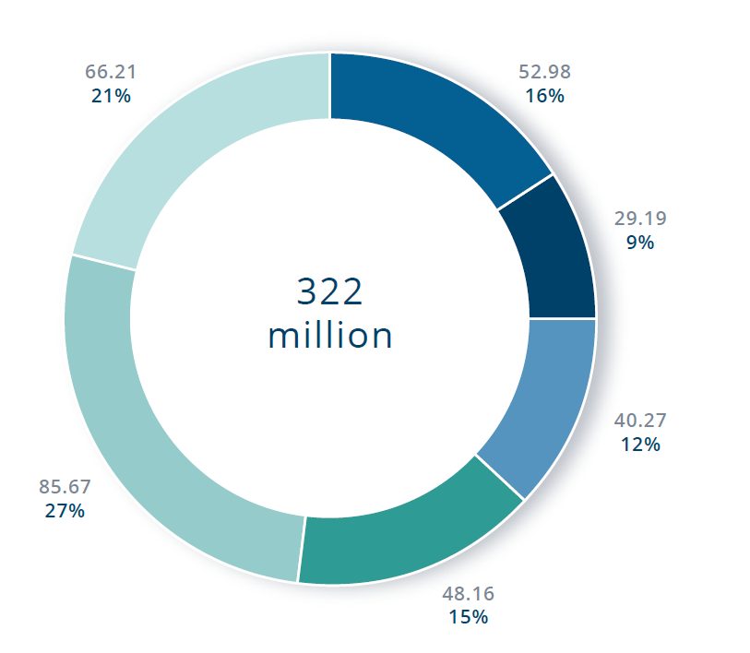
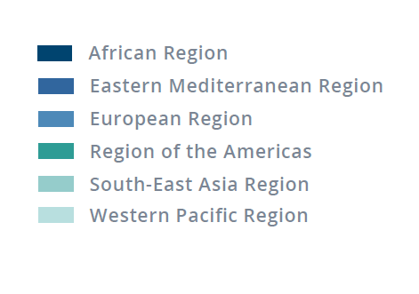
Epidemiology
According to the booklet of Word Health Organization（WHO）on January 2017：The total number of people living with depression in the world is 322 million，accounting for 4.3% of the global population；The total estimated number of people living with depression increased by 18.4% between 2005 and 2015;
Major depressive disorder (MDD) is one of the most common of depressive disorders, with an estimated 12-month prevalence rate of 6.6% and a lifetime prevalence rate of 16.2% ;
Furthermore, coronavirus disease 2019 (COVID-19) pandemic seems aggravate the burden of depression disorder since studies indicate that the mental health symptoms including depression, anxiety, insomnia, and acute stress are prevalent during COVID-19 pandemic.
Notes:
1）Depression and Other Common Mental Disorders- Global Health Estimates.World Health Organization.2017 Feb.2）Yueqin Huang, Yu Wang, Hong Wang,et al. Prevalence of mental disorders in China: a cross-sectional epidemiological study. Lancet Psychiatry.2019 Mar;6(3):211-224.

Slide 6
02
Part
Drug Developmet
6

Slide 7
Ansofaxine: Binding Affinity and Reuptake Inhibitor in vitro
Ansofaxine had high binding affinity to SERT, NET and DAT in Vitro
Ansofaxine had high binding affinity to SERT, NET and DAT.
Ansofaxine inhibit the reuptake of 5-HT, NE and DA, with IC50 of 31.40±0.43 nM,586.70±83.57 nM and 733.20±10.26 nM, respectively. However, Pristiq only inhibit the reuptake of 5-HT and NE, with IC50 of 53.46±7.55 nM and 568.70±29.85 nM.
Transporter | Ki (nM) | IC₅₀ (nM)
SERT | 763 ± 48.7 | 1330± 82.5
NET | 2040 ± 258 | 2200 ± 278
DAT | 197 ± 18.7 | 227± 21.7
Inhibitory Effects and IC₅₀ Values of Ansofaxine on 5-HT, NE and DA Reuptake in Vitro
Compound | IC₅₀ (nM)
 | DA | NE | 5-HT
Ansofaxine | 733.20 ±10.26 | 586.70 ± 83.57 | 31.40 ± 0.43
DOV21947 | 197.15 ± 25.80 | 223.10 ± 97.98 | 78.58 ± 16.19
DVS (Pristiq) | — | 568.70 ± 29.85 | 53.46 ± 7.55
SERT: serotonin transporter, NET: norepinephrine transporter, DAT: dopamine transporter, 5-HT: serotonin, NE: norepinephrine, DA: dopamine, Ki: inhibitor constant (indication of how potent an inhibitor is. The lower value indicates higher affinity.), IC50: half maximal (50%) inhibitory concentration (the concentration of an inhibitor required to reduce the rate of a reaction by 50%. The lower value indicates higher inhibitory effect.) DOV21947, also known as amitifadine or EB-1010

Slide 8
Ansofaxine: Plasma and Brain Distribution in Rats and Dogs
The parent drug Ansofaxine, has higher concentration in brain/hypothalamus in rats, and also highly distributes in hypothalamus and cortex in dogs，the concentration of Ansofaxine in brain/hypothalamus is much higher than that in plasma.
Plasma, brain and hypothalamus tissue distribution of the parent drug Ansofaxinee and ODV
following intragastric administration of Ansofaxine at 8 mg/kg in Rats
Time | Plasma (ng/mL) |  | Brain (ng/g) |  | Hypothalamus (ng/g) |  | Brain/Plasma Ratio |  | Hypothalamus/Plasma Ratio
 | ODV | Ansofaxine | ODV | Ansofaxine | ODV | Ansofaxine | ODV | Ansofaxine | ODV | Ansofaxine
15 min | 90.89±33.55 | 0.55±0.48 | 13.78±8.40 | 4.00±4.38 | 92.52±68.23 | 68.6±77.45 | 0.214 | 7.27 | 1.44 | 124.7
1 h | 68.20±23.56 | 0.34±0.47 | 20.88±6.80 | 1.45±1.01 | 97.88±57.98 | 46.12±41.44 | 0.306 | 4.26 | 1.44 | 135.6
12 h | 2.84±2.69 | 0.09±0.26 | 2.06±1.29 | 0.41±1.17 | 7.22±6.79 | 2.56±4.98 | 0.725 | 4.56 | 2.54 | 28.4
Plasma, brain and hypothalamus tissue distribution of the parent drug Ansofaxine and ODV
following oral administration of Ansofaxine extended-release tablet at 80 mg in Dogs
Time | Plasma （ng/mL） |  | Cerebrospinal fluid（ng/mL） |  | Cortex （ng/g） |  | Hypothalamus （ng/g） |  | Hypothalamus/Plasma Ratio
 | ODV | Ansofaxine | ODV | Ansofaxine | ODV | Ansofaxine | ODV | Ansofaxine | ODV | Ansofaxine
2 h | 37.16±16.14 | 0.46±0.11 | 19.73±8.51 | 0.29±0.18 | 66.15±31.38 | 11.25±5.46 | 48.84±17.77 | 28.53±30.95 | 1.31 | 62.0
4 h | 30.52±17.70 | 0.38±0.00 | 18.15±10.55 | 0.34±0.18 | 68.77±34.55 | 8.96±4.70 | 57.21±29.53 | 8.78±6.02 | 1.88 | 23.1

Slide 9
Ansofaxine : Pharmacodynamic Study in Rats
Ansofaxine 8 mg/kg significantly increased the locomotor activity and the sucrose consumption rate in chronic unpredictable mild stress (CUMS) induced depression Rats. Ansofaxine significantly increased the sucrose consumption rate, reduced the corticosterone at 8-16 mg/kg, and significantly increased the testosterone at 16 mg/kg in olfactory bulbectomized rats.
In summary, Ansofaxine, as a potential triple reuptake inhibitor, demonstrated antidepressant activity in animal models, which might improve sexual dysfunction and anhedonia in depressed patients.
Effects of Ansofaxine on the Locomotor Activity
and Sugar Consumption in CUMS Rats
Group | Dose (mg/kg) | Sugar consumption Rate (%) | Rearing Time (seconds) | Numbers of squares crossed
Control | - | 89.9 ± 6.15 | 24.4 ± 6.5 | 72.3 ± 21.4
Vehicle | - | 60.6 ± 13.9# | 6.8 ± 3.3# | 29.7 ± 13.9#
Pristiq | 7.3 | 82.1 ± 7.4** | 15.2 ± 3.9** | 47.0 ± 12.1*
Ansofaxine | 4 | 80.0 ± 7.7** | 13.6 ± 6.4* | 44.3 ± 8.6
 | 8 | 86.4 ± 3.7** | 18.6 ± 5.7** | 53.6 ± 14.0**
Effects of Ansofaxine on Sugar Consumption, Serum Corticosterone and Testosterone Levels in Olfactory Bulbectomized Rats
Group | Dose (mg/kg) | Sugar consumption rate (%) | Corticosterone (ng/L) | Testosterone (ng/mL)
Control | - | 75.8 ± 12.7 | 407.4 ± 216.5 | 4.7 ± 3.5
Vehicle | - | 49.7 ± 18.9# | 502.5 ± 102.0 | 1.7 ± 1.3
Pristiq | 7.3 | 58.1 ± 26.6 | 394.1 ± 231.6 | 2.4 ± 1.8
Ansofaxine | 4 | 62.1 ± 15.5 | 281.3 ± 118.8* | 2.0 ± 1.4
 | 8 | 70.7 ± 15.6* | 206.6 ± 91.2** | 3.3 ± 2.6
 | 16 | 73.4 ± 15.6** | 222.0 ± 99.6** | 5.4 ± 4.6*
*P < 0.05, **P < 0.01 vs Vehicle; # P < 0.01 vs control; Control is anon-Olfactory Bulbectomized or non-CUMS animal

Slide 10
03
Part
Study Design
10

Slide 11
Clinical Development of Ansofaxine
Phase I
Phase II
Phase III
Ansofaxine/CHN-101：SAD
Ansofaxine /CHN-102：Food effect
Ansofaxine /CHN-103：MAD
PK + Safety and Tolerability
Healthy Subjects
20mg~200mg
Ansofaxine /CHN-204
Dosage Exploration
MDD
Randomized, double-blind, placebo-controlled
40mg, 80mg, 120mg, 160mg
Ansofaxine /CHN-305
Efficacy Confirmation
MDD
Randomized, double-blind, placebo-controlled
80mg, 160mg

Slide 12
Phase III Clinical Design
Multicenter, randomized, double-blind, placebo-controlled
Primary Endpoint：Changes in the MADRS total scores from baseline at the end of treatment;
Secondary Endpoints： Total scores and factor scores of HAM-D17 and HAM-A, CGI-I, CGI-S, SDS scale, MADRS Response rate & Remission rate, HAM-D17 Response rate & Remission rate;
Safety：AE, vital signs, physical examination, laboratory tests, ECG, ASEX, C-SSRS
80mg
Endpoints
N=558
Screening
Titration
160mg
Placebo
1 week
Double-blind treatment：8 weeks
DSM-5：Diagnostic and Statistical Manual of Mental Disorders, 5th Edition (DSM-5)
HAM-D17：17-item Hamilton Rating Scale for Depression
MADRS：Montgomery- Åsberg Depression Scale
CGI-I：Clinical Total Impression Scale－Overall Progress
CGI-S：Clinical Total Impression Scale －Severity of disease
HAM-A：Hamilton Anxiety Scale
SDS： SHEEHAN Disability Scale
AE：Adverse Event
ECG：12-lead Electrocardiogram
ASEX：Arizona Sexual Experience Scale
C-SSRS：Columbia-Suicide Severity Rating Scale
18~65 years old
DSM-5 defined MDD
MADRS total score
≥26 points
CGI-S score ≥4 points
2 weeks
The 1st week：40mg Ansofaxine or placebo
The 2nd week：80mg Ansofaxine or placebo
1:1:1
Dosage maintenance

Slide 13

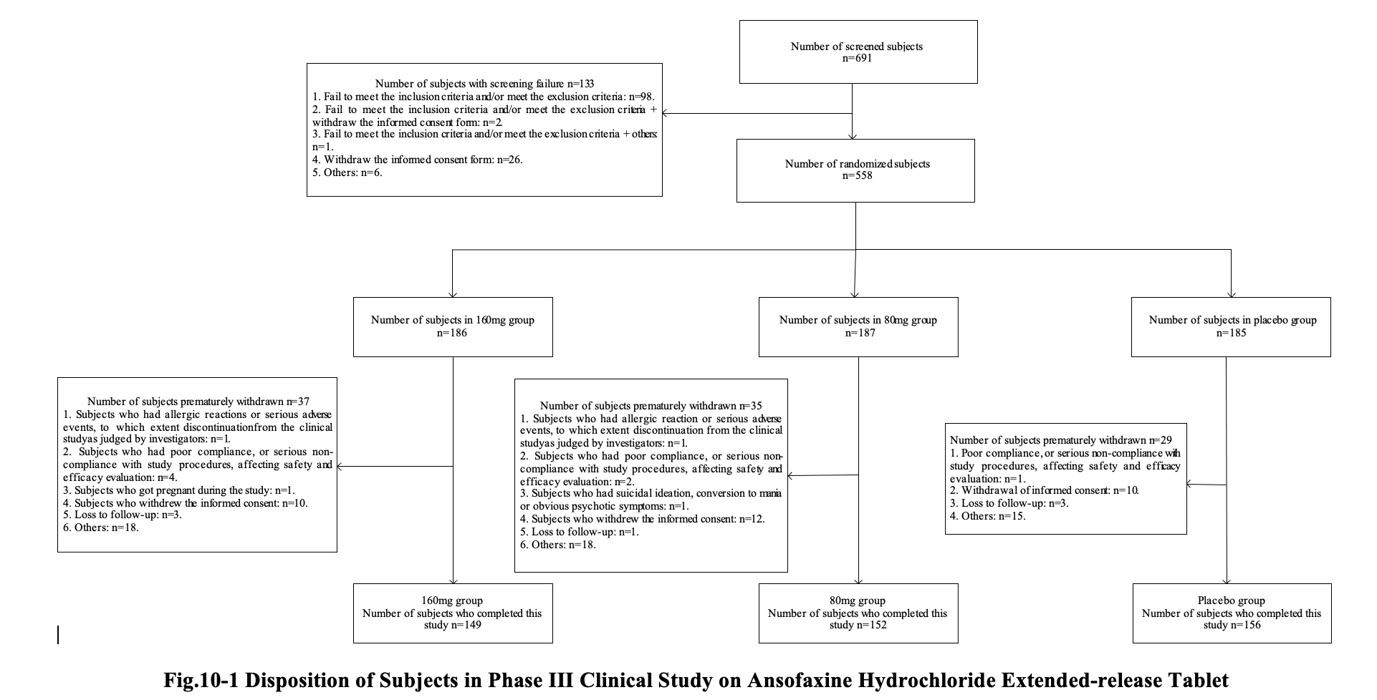
Population Study Flow

Slide 14

MADRS scale and factor score
Items | Score range
1. Apparent Sadness | 0~6
2. Reported Sadness | 0~6
3. Inner Tension | 0~6
4. Reduced Sleep | 0~6
5. Reduced Appetite | 0~6
6. Concentration Difficulties | 0~6
7. Lassitude | 0~6
8. Inability to Feel | 0~6
9. Pessimistic Thoughts | 0~6
10. Suicidal Thoughts | 0~6
Total | 0~60
Retardation factor
1, 6, 7, 8
SCORE：0~24
Anhedonia factor
5, 7, 8, 10
SCORE：0~24
Vegetative factor
3, 4, 5
SCORE：0~18
6 factor
1, 2, 3, 7, 8, 9
SCORE：0~36
Total
1-10 items
SCORE：0~60
Dysphoria factor
2, 9, 10
SCORE：0~18
Martin A.K, et al. J Psychopharmacology, 2020 Mar;34(3):280-292.

Slide 15

HAM-D17 Scale and Factor Score
Scale and factors | Items | Score Range
HAM-D17 | 1. Depressed mood (sadness, hopeless, helpless, worthless) | 0~4
 | 2. Feeling of Guilt | 0~4
 | 3. Suicide | 0~4
 | 4. Insomnia Early | 0~2
 | 5. Insomnia Middle | 0~2
 | 6. Insomnia Late | 0~2
 | 7. Work and Activities | 0~4
 | 8. Retardation (slowness of thought and speech, impaired ability to concentrate; and decreased motor activity) | 0~4
 | 9. Agitation | 0~4
 | 10. Anxiety Psychic | 0~4
 | 11. Anxiety Somatic (Physiological concomitants of anxiety, such as: -dry mouth, wind, indigestion, diarrhea, cramp, belching, palpitations, headache, hyperventilation, sighing, urinary, frequency, sweating) | 0~4
 | 12. Somatic Symptoms: Gastrointestinal | 0~2
 | 13. Somatic Symptoms: General | 0~2
 | 14. Genital Symptoms (loss of libido, menstrual disturbance) | 0~2
 | 15. Hypochondriasis | 0~4
 | 16. Loss of Weight | 0~2
 | 17. Insight | 0~2
HAM-D17 total score | 1~17 | 0~52
Anxiety/Somatization | 10, 11, 12, 15 and 17 | 0~16
Weight Loss | 16 | 0~2
Cognitive Disturbance | 2, 3 and 9 | 0~12
Retardation | 1, 7, 8 and 14 | 0~14
Sleep Disturbance | 4, 5 and 6 | 0~6

Slide 16

HAM-A Scale
Items | Score Range | Factor Scores
1. Anxiety mood | 0~4 | Psychic Anxiety factor | Item 1-6 and 14 | 0-28
2. Tension | 0~4
3. Fears | 0~4
4. Insomnia | 0~4
5. Intellectual | 0~4
6. Depressed mood | 0~4
7. Somatic (muscular) | 0~4 | Somatic Anxiety factor | Item 7-13 | 0-28
8. Somatic (sensory) | 0~4
9. Cardiovascular symptoms | 0~4
10. Respiratory symptoms | 0~4
11. Gastrointestinal symptoms | 0~4
12. Genitourinary symptoms | 0~4
13. Autonomic symptoms | 0~4
14. Behavior at interview | 0~4 | Psychic Anxiety factor | Item 1-6 and 14 | 0-28
Total：1-14 total score | 0~56

Slide 17
04
Part
Baseline Characteristics
17

Slide 18

Population Study Flow
Screening
N=691
Randomization
N=558
随机：558例
160mg
N=186
80mg
N=187
Placebo
N=185
Withdrawal
N=37
Withdrawal
N=35
Withdrawal
N=29

Slide 19
Baseline-Demographic Characteristics
Three groups were of comparability in terms of age, gender, nationality, marital and reproductive condition
 |  | 160mg (N=184) | 80mg (N=184) | Placebo (N=184)
Age（y） | MEAN (SD) (y) | 29.5 (10.66) | 29.4 (10.49) | 29.7 (10.93)
Age Group (Randomized) | 18-30 n(%) | 120 (65.22) | 122 (66.30) | 118 (64.13)
 | 31-40 n(%) | 33 (17.93) | 32 (17.39) | 35 (19.02)
 | 41-50 n(%) | 19 (10.33) | 18 (9.78) | 19 (10.33)
 | 51-65 n(%) | 12 (6.52) | 12 (6.52) | 12 (6.52)
Gender (Randomized) | Male n(%) | 50 (27.17) | 52 (28.26) | 49 (26.63)
 | Female n(%) | 134 (72.83) | 132 (71.74) | 135 (73.37)
Nationality | Han n(%) | 168 (91.30) | 173 (94.02) | 165 (89.67)
 | Others n(%) | 16 (8.70) | 11 (5.98) | 19 (10.33)
Marital Status | Single n(%) | 115 (62.50) | 110 (59.78) | 109 (59.24)
 | Married n(%) | 59 (32.07) | 62 (33.70) | 60 (32.61)
 | Devoiced n(%) | 10 (5.43) | 10 (5.43) | 11 (5.98)
 | Widowed n(%) | 0 (0.00) | 2 (1.09) | 4 (2.17)
Reproductive status | non-Reproductive n(%) | 127 (69.02) | 124 (67.39) | 120 (65.22)
 | Reproductive n(%) | 57 (30.98) | 60 (32.61) | 64 (34.78)

Slide 20

Baseline-Depression History and Mental Condition
The depression history and metal condition are comparable among three groups
 |  | 160mg | 80mg | Placebo
Depression History (Years) | MEAN (SD) | 3.1 (4.06) | 3.5 (4.50) | 3.4 (4.69)
Age of first onset (years) | MEAN (SD) | 26.4 (10.36) | 25.9 (9.87) | 26.4 (10.51)
 | Min, Max | 12, 60 | 12, 59 | 11, 62
Any predisposing factors for the first onset | No n(%) | 91 (49.46) | 73 (39.67) | 76 (41.30)
 | Yes n(%) | 92 (50.00) | 108 (58.70) | 107 (58.15)
 | NA n(%) | 1 (0.54) | 3 (1.63) | 1 (0.54)
Hospitalized by psychiatric disorder | No n(%) | 179 (97.28) | 175 (95.11) | 178 (96.74)
 | Yes n(%) | 5 (2.72) | 9 (4.89) | 6 (3.26)
Age of first Hospitalization (years) | MEAN (SD) | 39.6 (13.52) | 35.1 (11.12) | 35.8 (8.66)
 | Min, Max | 20, 58 | 22, 50 | 29, 51
Number of Previous Hospitalization | MEAN (SD) | 2.0 (1.00) | 1.8 (1.99) | 1.2 (0.41)
 | Min, Max | 1, 3 | 1, 7 | 1, 2
Number of Depression Onset | MEAN (SD) | 1.5 (1.24) | 1.7 (1.67) | 1.7 (1.12)
 | Min, Max | 1, 15 | 1, 20 | 1, 7
Any predisposing factors for this onset | No n(%) | 96 (52.17) | 89 (48.37) | 85 (46.20)
 | Yes n(%) | 87 (47.28) | 90 (48.91) | 97 (52.72)
 | NA n(%) | 1 (0.54) | 5 (2.72) | 2 (1.09)

Slide 21

Baseline：Scale scores
Three groups are comparable for the scale scores
 |  | 160mg | 80mg | Placebo
 |  | (N=184) | (N=184) | (N=184)
MADRS Total Score | MEAN (SD) | 31.2 (3.59) | 31.6 (3.94) | 31.3 (4.22)
HAM-D17 total score | MEAN (SD) | 21.9 (4.43) | 22.4 (4.31) | 21.7 (4.20)
HAM-A total score | MEAN (SD) | 18.9 (5.49) | 19.8 (6.19) | 19.0 (5.90)
CGI-S score | MEAN (SD) | 4.9 (0.63) | 4.9 (0.63) | 4.8 (0.67)
SDS score | MEAN (SD) | 16.0 (5.28) | 16.2 (5.56) | 16.9 (6.25)
ASEX score | MEAN (SD) | 20.7 (4.87) | 21.2 (4.97) | 20.8 (5.02)
HAM-D17：Hamilton Depression Scale-17；MADRS：Montgomery- Åsberg Depression Scale；HAM-A: Hamilton Anxiety Scale；CGI-S：Clinical Total Impression Scale – Severity of Illness；SDS： SHEEHAN Disability Scale；ASEX : Arizona Sexual Experience Scale

Slide 22
05
Part
Primary Endpoint
22

Slide 23

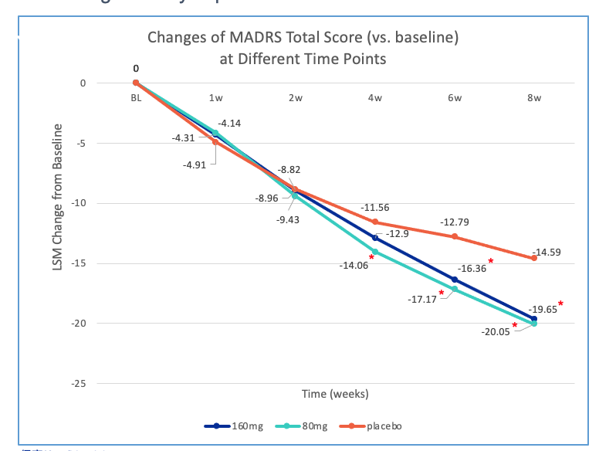
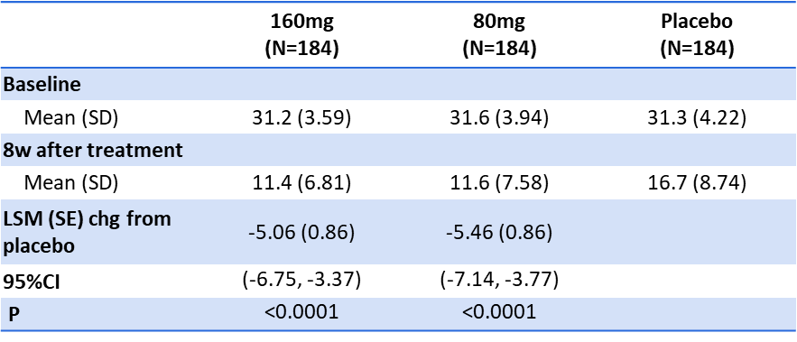
Changes of MADRS Total Score
After 8w treatment, the adjusted mean changes from baseline in the MADRS total score demonstrated a statistical significance for Ansofaxine 80mg and 160mg vs placebo respectively. Core symptoms of depression was significantly improved.
* Indicates a statistical significance vs placebo
MADRS：Montgomery- Åsberg Depression Scale
LSM：Least Square Mean
SD：Standard deviation
SE：Standard Error
CI：Confidence interval
BL: Baseline
chg: change

Slide 24

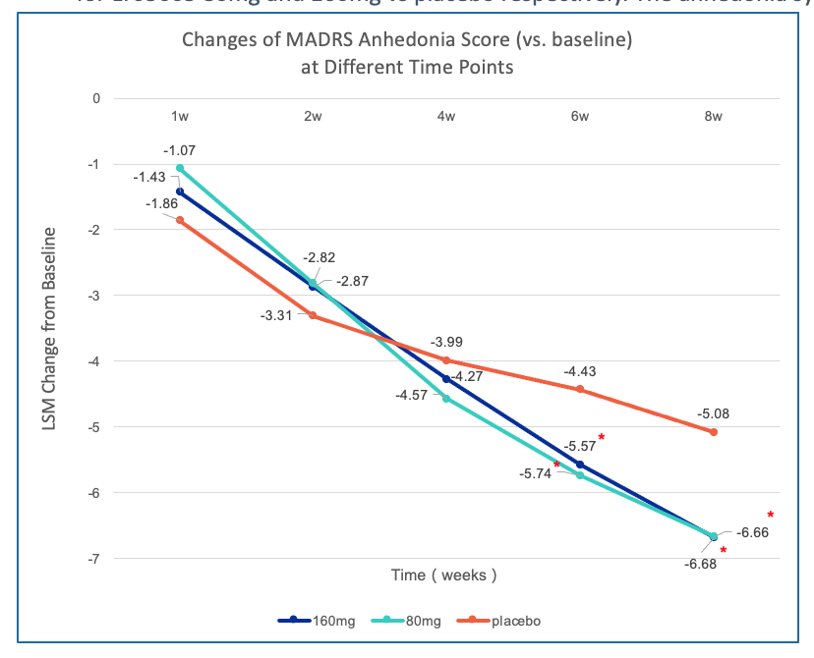
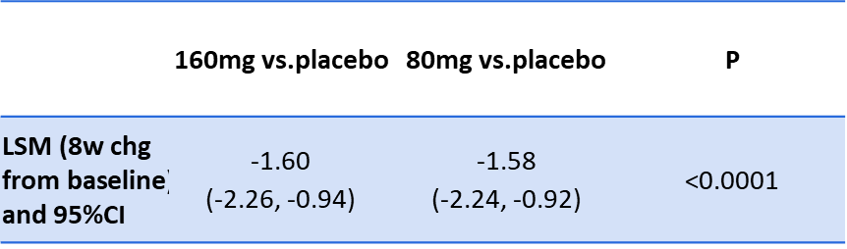
MADRS Anhedonia Factor (additional analysis)
The adjusted mean changes from baseline in the MADRS anhedonia factor score demonstrated a statistical significance for Ansofaxine 80mg and 160mg vs placebo respectively. The anhedonia symptom of MDD patients was significantly improved.
* Indicates a statistical significance vs placebo
MADRS Montgomery- Åsberg Depression Scale
Anhedonia ：
5. Reduced appetite
7. Lassitude
8. Inability to feel
10.Suicidal thoughts
LSM：Least Square Mean
CI：Confidence interval

Slide 25
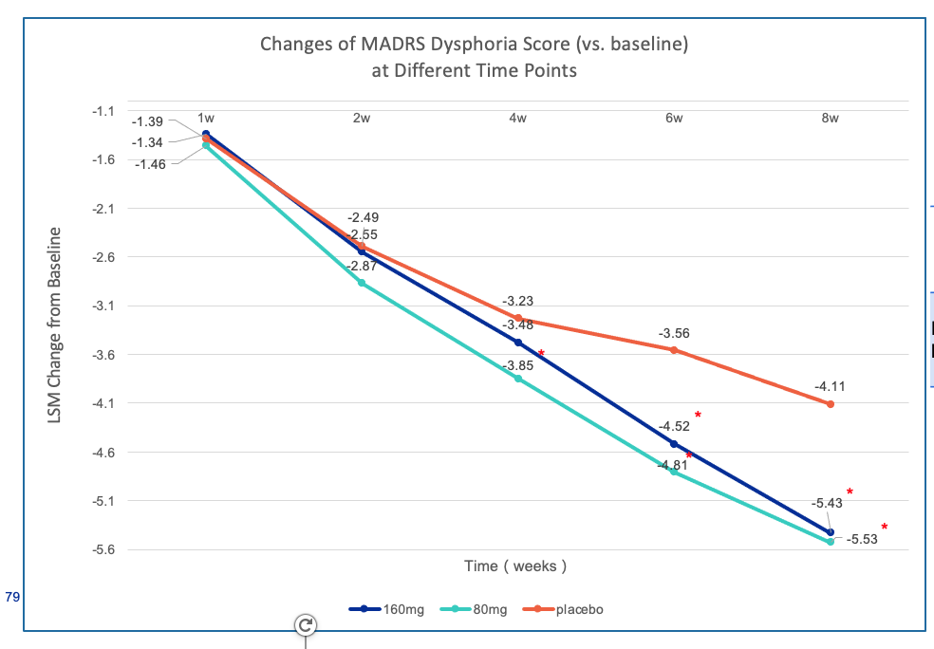
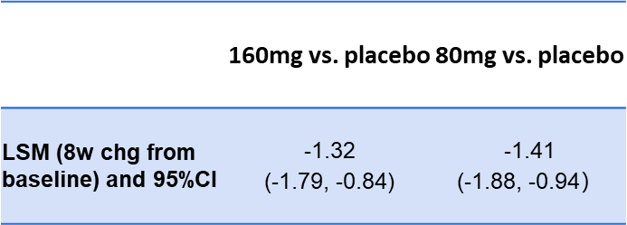
MADRS Dysphoria factor (additional analysis)
The adjusted mean changes from baseline in the MADRS dysphoria score displayed a statistical significance for Ansofaxine 80mg and 160mg vs placebo respectively.
* Indicates a statistical significance vs placebo
MADRS Montgomery- Åsberg Depression Scale
Dysphoria factor：
2. Reported Sadness
9. Pessimistic thoughts
10. Suicidal thoughts
LSM：Least Square Mean
CI：Confidence interval

Slide 26

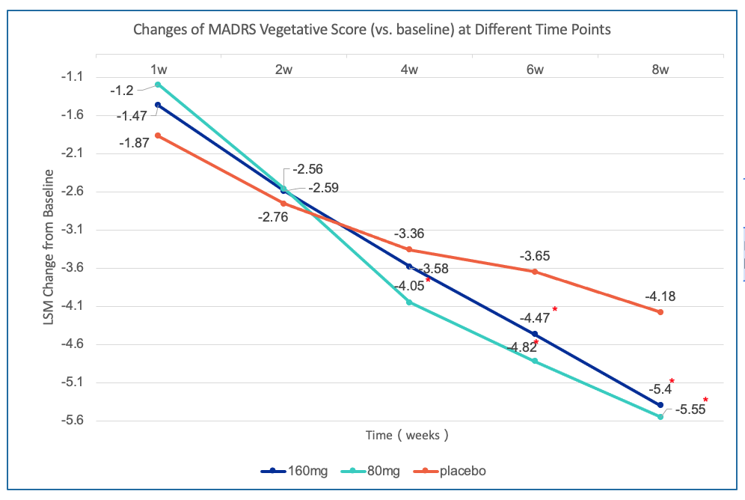
MADRS Vegetative factor (additional analysis)
The adjusted mean changes from baseline in the MADRS Vegetative factor score displayed a statistical significance
for Ansofaxine 80mg and 160mg vs. placebo respectively.
 | 160mg vs. placebo | 80mg vs. placebo
LSM (8w chg from baseline) and 95%CI | -1.22 (-1.78, -0.67) | -1.37 (-1.93, -0.82)
* Indicates a statistical significance vs placebo
MADRS Montgomery- Åsberg Depression Scale
Vegetative factor：
3. Inner tension
4. Reduced sleep
5. Reduced appetite
LSM：Least Square Mean
CI：Confidence interval

Slide 27
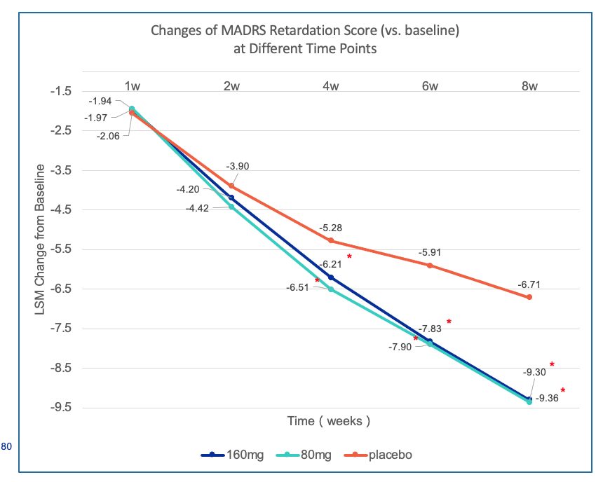
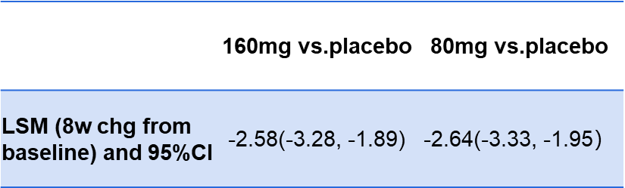
MADRS Retardation factor (additional analysis)
The adjusted mean changes from baseline in the MADRS retardation score displayed a statistical significance
for Ansofaxine 80mg and 160mg vs placebo respectively.
* Indicates a statistical significance vs placebo
MADRS Montgomery- Åsberg Depression Scale
Retardation factor：
1.Apparent Sadness
6. Concentration Difficulties
7. Lassitude
8. Inability to Feel
LSM：Least Square Mean
CI：Confidence interval

Slide 28
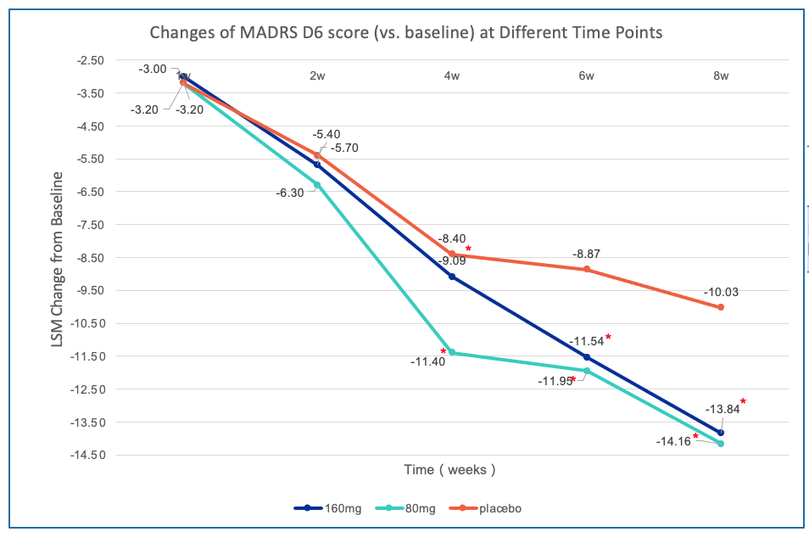
MADRS 6 factor (additional analysis)
The adjusted mean changes from baseline in the MADRS 6 score displayed a statistical significance for
Ansofaxine 80mg and 160mg vs placebo respectively. Somatic symptoms of MDD patients were significantly.
 | 160mg vs. placebo | 80mg vs. placebo
LSM (8w chg from baseline) and 95%CI | -3.81 (-4.96, -2.66) | -4.13 (-5.28, -2.98）
* Indicates a statistical significance vs placebo
MADRS Montgomery- Åsberg Depression Scale
D6： 1. Apparent Sadness
2. Reported Sadness
3. Inner tension
7. Lassitude
8. Inability to Feel
9. Pessimistic Thoughts
LSM：Least Square Mean
CI：Confidence interval

Slide 29
06
Part
Secondary Endpoints
29

Slide 30
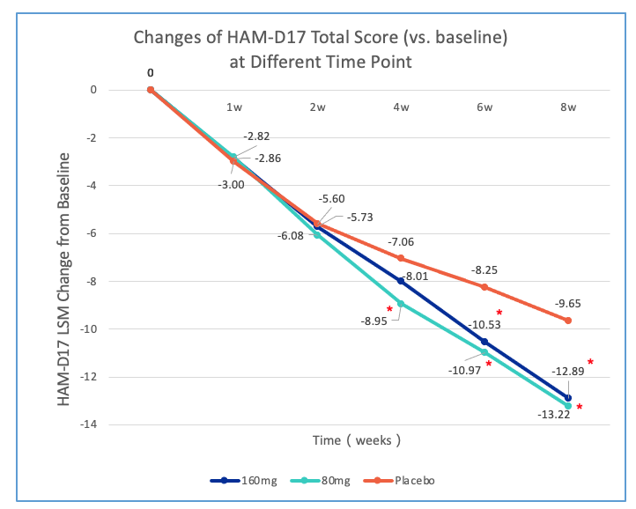
HAM-D17 Total Score
The adjusted mean changes from baseline in the HAM-D17 total score displayed a statistical significance for Ansofaxine 80mg and 160mg vs placebo respectively.
 | 160mg (N=184) | 80mg (N=184) | Placebo (N=184)
Baseline
Mean (SD) | 21.9 (4.43) | 22.4 (4.31) | 21.7 (4.20)
8w treatment
Mean (SD) | 8.9 (5.66) | 8.9 (5.89) | 12.1 (6.71)
LSM (SE) chg. from placebo | -3.24 (0.66) | -3.57 (0.66)
95%CI | (-4.54, -1.94) | (-4.87, -2.27)
P | <0.0001 | <0.0001
* Indicates a statistical significance vs placebo
HAM-D17：17 Hamilton Depression Scale
LSM：Least Square Mean
SD：Standard deviation
SE：Standard Error
CI：Confidence interval

Slide 31
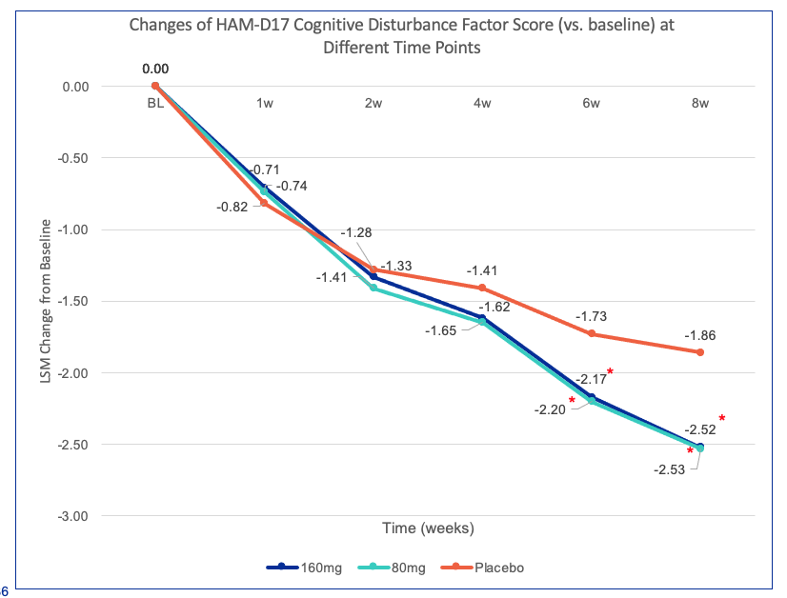
HAM-D17 Cognitive Disturbance Factor
The adjusted mean changes from baseline in the HAM-D17 Cognitive Disturbance Score displayed statistical significance for Ansofaxine 80mg and 160mg vs placebo respectively.
.
 | 160mg-placebo | 80mg-placebo
LSM (8w vs. baseline) and 95%CI | -0.65(-0.93, -0.37) | -0.66(-0.94, -0.38)
* Indicates a statistical significance vs placebo
HAM-D17：17 Hamilton Depression Scale
Cognitive Disturbance Factor:
2. Feeling of Guilty
3. Suicide
9. Agitation
LSM：Least Square Mean
CI：Confidence interval

Slide 32
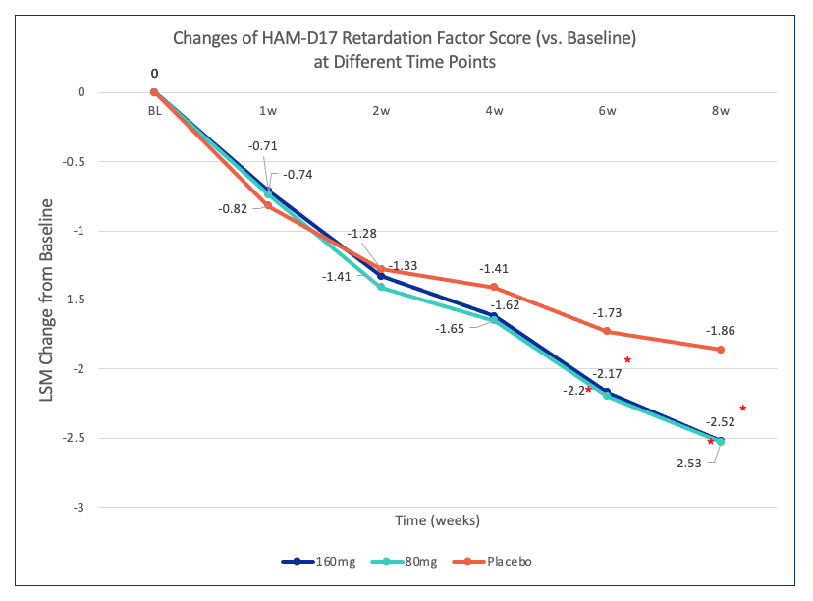
HAM-D17 Retardation Factor
The adjusted mean changes from baseline in the HAM-D17 Retardation factor score displayed statistical significance for Ansofaxine 80mg and 160mg vs placebo respectively.
 | 160mg vs. placebo | 80mg vs. placebo
LSM (8w chg from baseline) and 95%CI | -0.78(-1.20, -0.36) | -1.05(-1.48, -0.63)
* Indicates a statistical significance vs placebo
HAM-D17：17 Hamilton Depression Scale
Retardation factor:
1. Depressed mood (sad, hopeless, helpless, worthless)
7. Work and activities
8. Retardation (slowness of thought and speech, impaird ability to concentrate and decreased motor activity
14.Genital symptoms (loss of libido, menstrual disturbance)
LSM：Least Square Mean
CI：Confidence interval

Slide 33

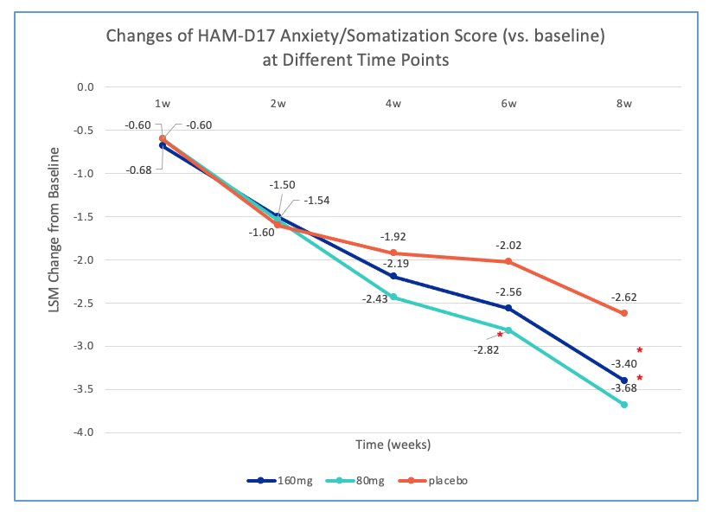
HAM-D17 Anxiety/Somatization
The adjusted mean changes from baseline in the HAM-D17 Anxiety/Somatization factor displayed statistical significance for Ansofaxine 80mg and 160mg vs placebo respectively. The anxiety symptoms of MDD patients were improved significantly.
 | 160mg vs. placebo | 80mg vs. placebo
LSM (8w chg from baseline) and 95%CI | -0.78(-1.20, -0.36) | -1.05(-1.48, -0.63)
* Indicates a statistical significance vs placebo
HAM-D17：17 Hamilton Depression Scale
Anxiety/somatization factor:
10. Anxiety
11. Anxiety Somatic (Physiological concomitants of anxiety, such as: -dry mouth, wind, indigestion, diarrhea, cramp, belching, palpitations, headache, hyperventilation, sighing, urinary, frequency, sweating)
12. Somatic symptoms: Gastrointestinal
15. Hypochondriasis
17. Insight
LSM：Least Square Mean
CI：Confidence interval

Slide 34
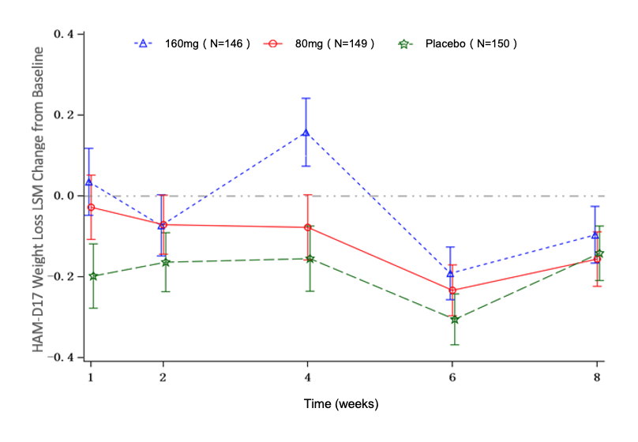
HAM-D17 Weight Loss Score
The adjusted mean changes from baseline in the HAM-D17 Weight Loss Score did not show statistical significance for Ansofaxine 80mg and 160mg vs placebo respectively.
 | 160mg vs. placebo | 80mg vs. placebo
LSM (8w chg from baseline) and 95%CI | 0.03 (-0.10, 0.17) | -0.02 (-0.15, 0.12)
HAM-D17：17 Hamilton Depression Scale Weight factor:
16. Weight loss
LSM：least squares mean
CI：confidence interval

Slide 35
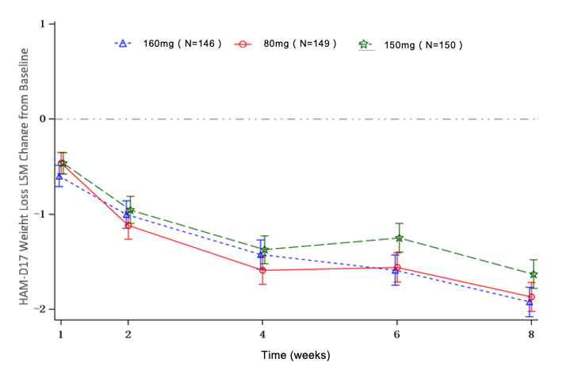
HAM-D17 Sleep Disturbance Score
The adjusted mean changes from baseline in the HAM-D17 sleep disturbance score did not show statistical significance for Ansofaxine 80mg and 160mg vs placebo respectively.
 | 160mg vs. placebo | 80mg vs. placebo
LSM (8w chg from baseline) and 95%CI | -0.29(-0.60, 0.02) | -0.24(-0.55, 0.07)
HAM-D17：17 Hamilton Depression Scale
Sleep disturbance:
4. Difficulty falling asleep
5. Not sleeping well
6. Wake up early
LSM：Least Square Mean
CI：Confidence interval

Slide 36
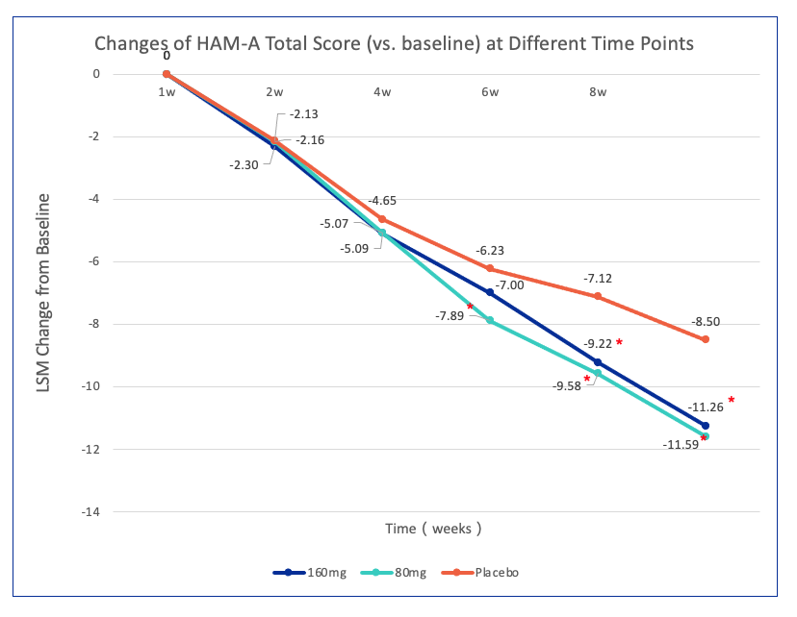
HAM-A Total Score
The adjusted mean changes from baseline in the HAM-A total score displayed statistical significance for
Ansofaxine 80mg and 160mg vs placebo respectively. The anxiety symptom of MDD patients were improved
significantly.
 | 160mg | 80mg | Placebo
 | (N=184) | (N=184) | (N=184)
Baseline
Mean (SD) | 18.9 (5.49) | 19.8 (6.19) | 19.0 (5.90)
8w treatment
Mean (SD) | 7.9 (5.44) | 8.1 (5.64) | 10.7 (6.79)
LSM (8w chg from baseline) and 95%CI | -2.76 (0.59) | -3.09 (0.58)
95%CI | (-3.91, -1.61) | (-4.24, -1.95)
P | <0.0001 | <0.0001
* Indicates a statistical significance vs placebo
HAM-A：Hamilton Anxiety Scale
LSM：Least Square Mean
SD：Standard deviation
SE：Standard Error
CI：Confidence interval

Slide 37
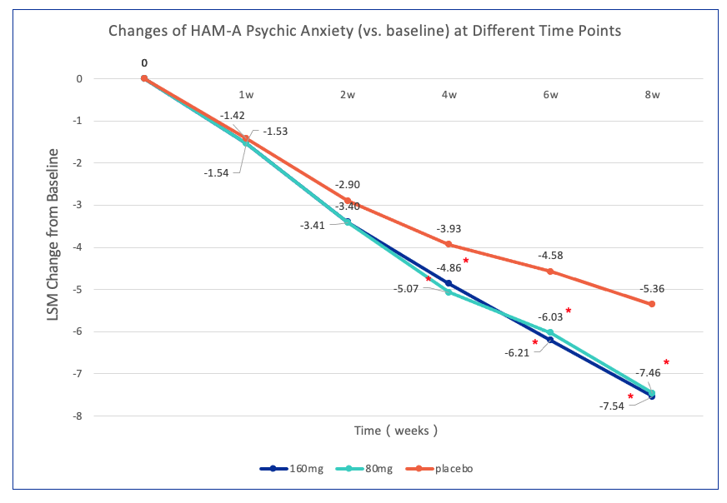
HAM-A Psychic Anxiety Score
The adjusted mean changes from baseline in the HAM-A psychic anxiety score displayed statistical significance for Ansofaxine 80mg and 160mg vs placebo respectively. The anxiety symptom of MDD patients were improved significantly.
 | 160mg vs. placebo | 80mg vs. placebo
LSM (8w chg from baseline) and 95%CI | -2.18(-2.90, -1.45) | -2.10(-2.82, -1.38)
P | <0.0001 | <0.0001
* Indicates a statistical significance vs placebo
HAM-A：Hamilton Anxiety Scale
Psychic Anxiety Score:
1. Anxious mood
2. Nervous
3. Fear
4. Insomnia
5. Memory or attention disorder
6. Depressed mood
14. Performance during the meeting
LSM：Least Square Mean
CI：Confidence interval

Slide 38
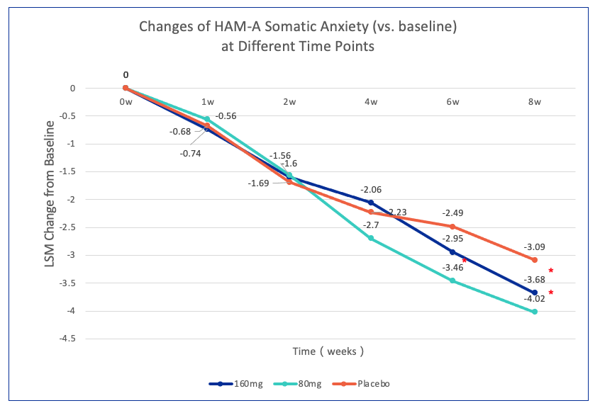
HAM-A Somatic Anxiety Score
The adjusted mean changes from baseline in the HAM-A somatic anxiety score displayed statistical significance for Ansofaxine 80mg and 160mg vs placebo respectively. The anxiety symptom of MDD patients were improved significantly.
 | 160mg vs. placebo | 80mg vs. placebo
LSM (8w chg from baseline) and 95%CI | -0.59(-1.14, -0.04) | -0.93(-1.48, -0.38)
P | 0.0355 | 0.0009
* Indicates a statistical significance vs placebo
HAM-A：Hamilton Anxiety Scale
Somatic Anxiety Score:
7. Muscle symptoms
8. Feeling symptoms
9. Cardiovascular symptoms
10. Respiratory symptoms
11. Gastrointestinal symptoms
12. Genitour urinary symptoms
13. Autonomic symptoms
LSM：Least Square Mean
CI：Confidence interval

Slide 39
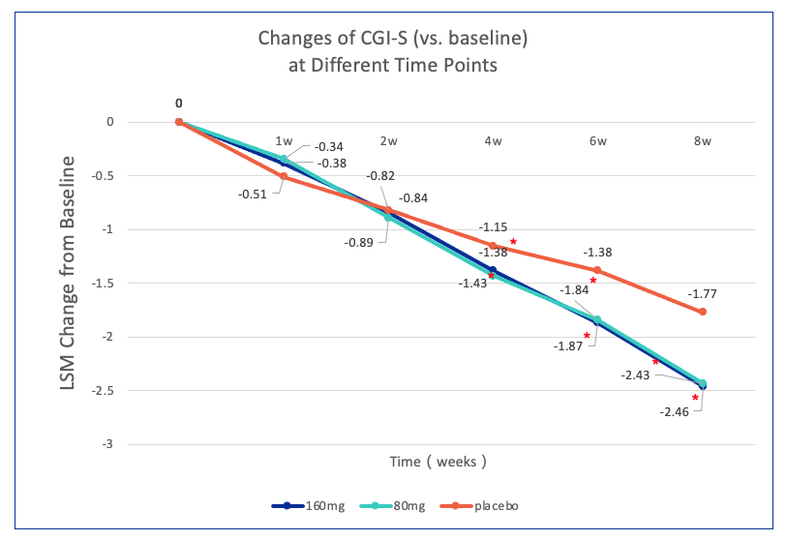
CGI-S Score
The adjusted mean changes from baseline in the CGI-S score displayed statistical significance for
Ansofaxine 80mg and 160mg vs placebo respectively.
 | 160mg vs. placebo | 80mg vs. placebo
LSM (8w chg from baseline) and 95%CI | -0.69(-0.92, -0.46) | -0.66(-0.89, -0.43)
P | <0.0001 | <0.0001
* Indicates a statistical significance vs placebo
CGI-S：Clinical Total Impression Scale - Severity of disease
LSM：Least Square Mean
CI：Confidence interval

Slide 40
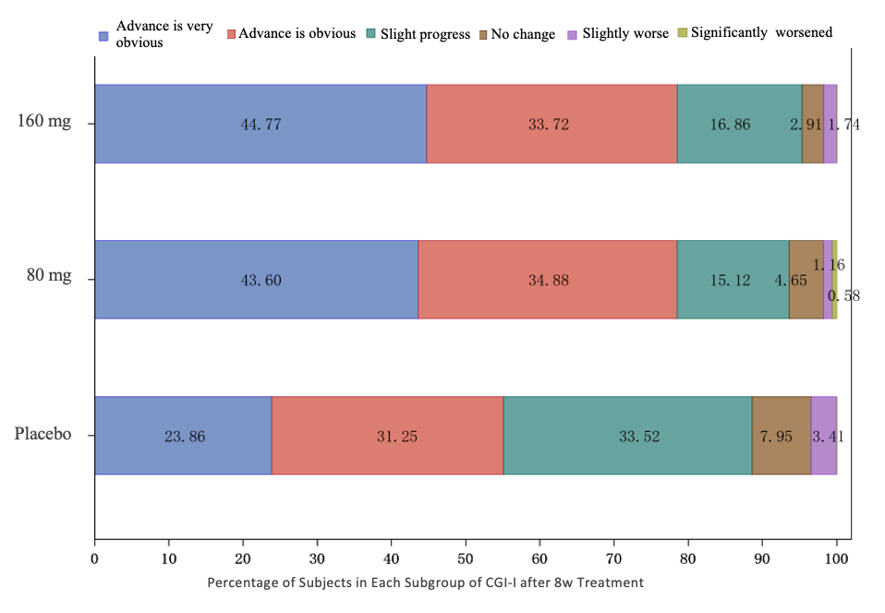
CGI-I Score
CGI-I score displayed a statistical significance among three groups.
CGI-I：Clinical Total Impression
Scale – Overall progress

Slide 41
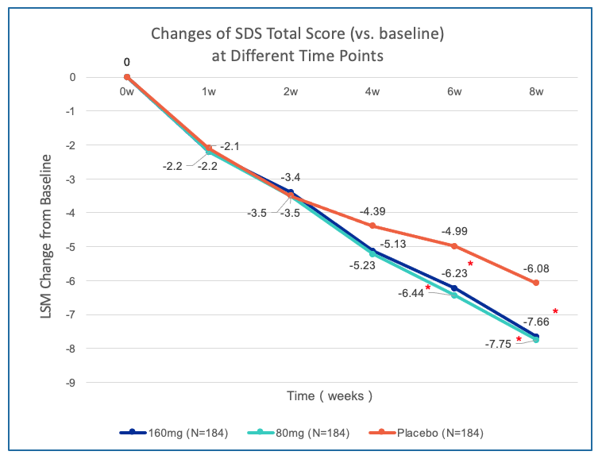
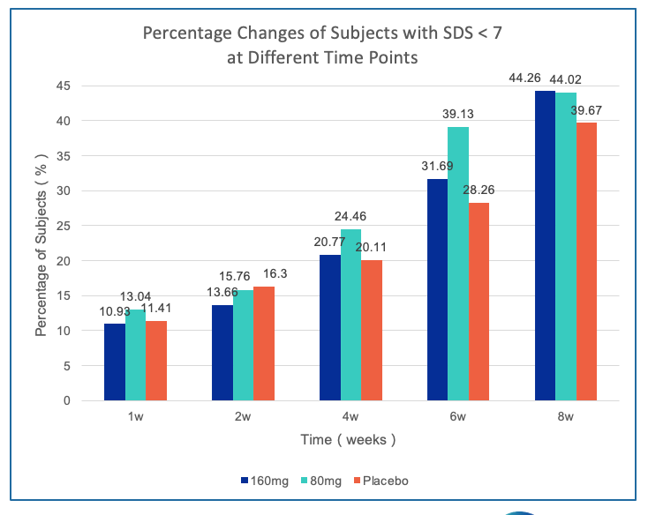
SDS Score
The adjusted mean changes from baseline in the SDS total score displayed statistical significance for
Ansofaxine 80mg and 160mg vs placebo respectively. The symptoms and social function of MDD patients were improved significantly.
* Indicates a statistical significance vs placebo
SDS： SHEEHAN Disability Scale

Slide 42

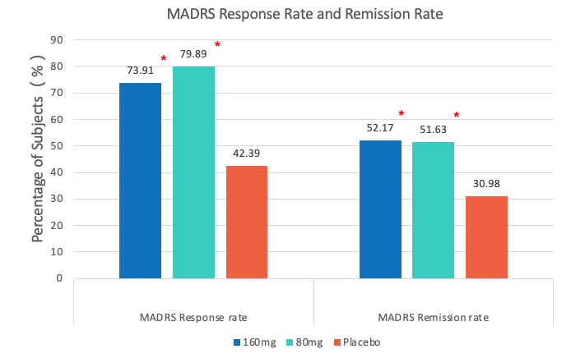
MADRS Response and Remission Rate
After 8w treatment，Ansofaxine 80mg and 160mg groups demonstrated significantly increased response and remission rate vs placebo respectively;
MADRS response rate：Change from baseline of MADRS score ≥50%;
MADRS remission rate：MADRS≤12 points.
* Indicates a statistical significance vs Placebo
MADRS Montgomery- Åsberg Depression Scale

Slide 43
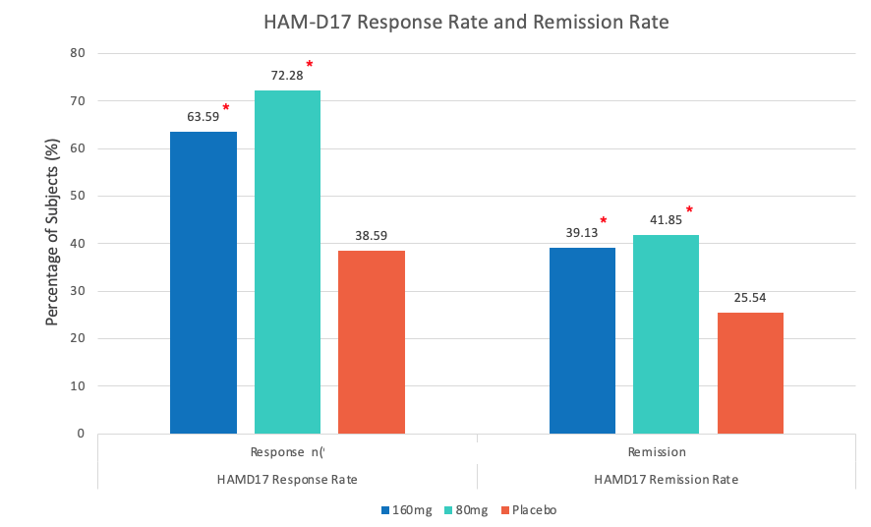
HAM-D17 Response and Remission Rate
After 8w treatment, Ansofaxine 80mg and 160mg groups demonstrated significantly improved response and remission rate vs placebo respectively;
HAM-D17 response rate：the reduction in HAM-D17 score ≥50% relative to the baseline value;
HAM-D17 remission rate：HAM-D17 ≤7 points.
* Indicates a statistical significance vs. placebo
HAM-D17：17 Hamilton Depression Scale

Slide 44
07
Part
Safety
44

Slide 45
TEAEs with Incidence > 5%
SOC | 160mg |  |  | 80mg |  |  | Placebo
 | (N=184) |  |  | (N=184) |  |  | (N=184)
PT | Events | No of subj. | Rate(%) | Events | No of subj. | Rate(%) | Events | No of subj. | Rate(%)
Gastrointestinal disorders
Nausea | 54 | 50 | 27.17 | 49 | 44 | 23.91 | 22 | 20 | 10.87
Dry mouth | 19 | 19 | 10.33 | 16 | 16 | 8.7 | 14 | 14 | 7.61
Vomiting | 19 | 15 | 8.15 | 4 | 4 | 2.17 | 4 | 4 | 2.17
Abdominal discomfort | 11 | 11 | 5.98 | 5 | 5 | 2.72 | 3 | 3 | 1.63
Investigations
Weight decreased | 12 | 12 | 6.52 | 17 | 15 | 8.15 | 4 | 4 | 2.17
Nervous system disorders
Dizziness | 21 | 21 | 11.41 | 29 | 27 | 14.67 | 22 | 18 | 9.78
Headache | 14 | 13 | 7.07 | 18 | 14 | 7.61 | 7 | 7 | 3.8
Lethargy | 13 | 12 | 6.52 | 9 | 9 | 4.89 | 2 | 2 | 1.09
Infections and infestations
Upper respiratory tract infection | 12 | 12 | 6.52 | 8 | 7 | 3.8 | 8 | 7 | 3.8
Cardiac disorders
Palpitations | 17 | 13 | 7.07 | 10 | 9 | 4.89 | 11 | 10 | 5.43
Metabolism and nutrition disorders
Decreased appetite | 8 | 8 | 4.35 | 11 | 10 | 5.43 | 2 | 2 | 1.09

Slide 46
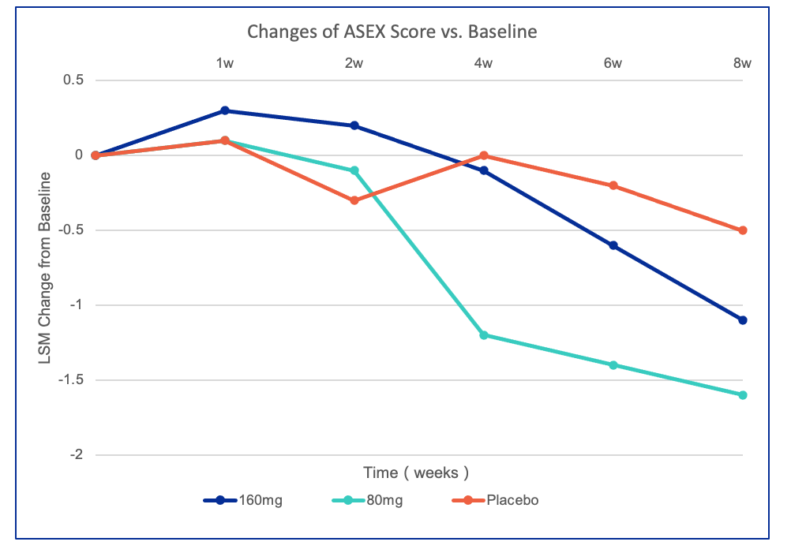
ASEX Score
The adjusted mean changes from baseline in the ASEX score did not show statistical significance for
Ansofaxine 80mg and 160mg vs placebo respectively.
 | 160mg vs. Placebo | 80mg vs. placebo
LSM (8w chg from baseline) and 95%CI | -0.63 (-1.64, 0.38) | -1.01 (-2.02, 0.01)
ASEX：Arizona Sexual Experience Scale
LSM：Least Square Mean
CI：Confidence interval

Slide 47
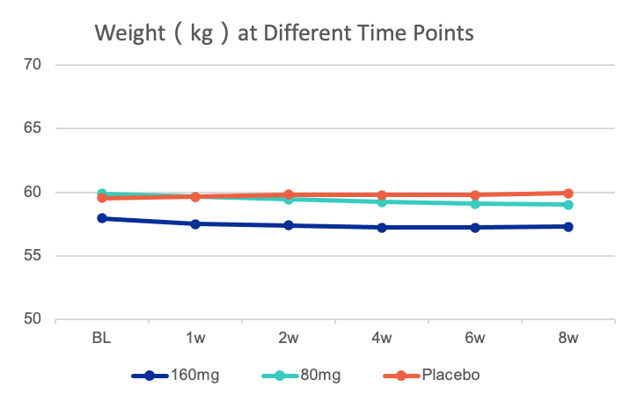
No Obvious Influence on Body Weight
Weight at different time points（kg）
Time | 160mg | 80mg | Placebo
Baseline | 57.931 | 59.868 | 59.543
1w | 57.491 | 59.649 | 59.657
2w | 57.406 | 59.444 | 59.827
4w | 57.214 | 59.235 | 59.764
6w | 57.216 | 59.074 | 59.776
8w | 57.294 | 59.032 | 59.903

Slide 48
Summary of Safety Results: Good Safety and Tolerability
Adverse Events
Adverse Reaction
Sexual Experience
Others
Placebo: 67.93%
Ansofaxine 80mg and 160mg: 74.46%, 78.26%
Most of the AEs were mild and moderate, with short duration and few therapeutic termination
Placebo: 45.11%
Ansofaxine 80 and 160mg：59.24%, 65.22%
Have a similar spectrum as other anti-depressants，no SAE
No significant difference between Ansofaxine and placebo in ASEX score at the visit time points
Few abnormal lab tests, vital signs and ECG, defined as clinical significance, related to study drug and most of them are mild and recovered automatically

Slide 49
08
Part
Conclusion&Limitations
49

Slide 50
Conclusion&Limitations
Limitations
The control used in this study was only placebo, did not include active comparators such as venlafaxine and
desvenlafaxine
The observational period of this study was only 8 weeks , we could not know the long-term efficacy of ansofaxine in MDD patients
The sample size was limited, and the majority of MDD patients (approximately 65% in each study group) being under 30 years of age and only approximately 6% of MDD patients enrolled in the study being over 65 years of age
Conclusion
Both dosages of Ansofaxine 80mg and 160 mg are safe, generally well tolerated, and remarkably effective at a clinically relevant level for the treatment of MDD

Slide 51

Thank you for listening

