Slide 1

Cerebral white matter hyperintensity probability map of older Koreans
Seoul National University
Jun Sung Kim, Ph.D.

Slide 2
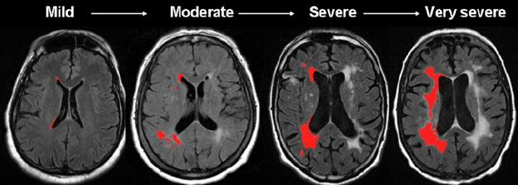








White matter hyperintensity (WMH)
White matter hyperintensity
01
02
Risk factors
Age
Hypertension
Smoking
Alcohol intake
Diabetes mellitus
Hyperlipidemia
Cerebrovascular disease
Impairment
Cognition
Physical
mental
02
03
01
04
03
Increase with age
04
WMH probability map
WMH naturally increase with age
(Chappel et al 2017; Lee et al 2017; Taylor e al 2003; Van Dalen et al 2017; Wardlaw et al 2017)
Previously developed WMHPMs have its own limitations

Slide 3



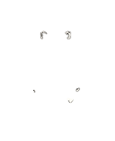

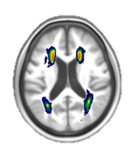
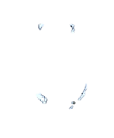
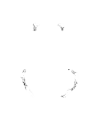
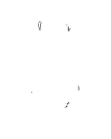
WMH probability map (WMHPM)
Age
Conditions
60 years or older with 5 age groups of 60 participants each
(60 – 64, 65 – 69, 70 – 74, 75 – 79, 80+)
- With Clinical Dementia Rating of 0
- Without MMSE below -1.0 SD
- Without impaired activities of daily living
- Without major neurologic and psychiatric disorders
- Without cardiovascular and metabolic diseases including hypertension and diabetes
Segmented
WMH
WMH frequency map
WMH probability map
Overlap
Divide by 60
1
2
3
… x 60

Slide 4
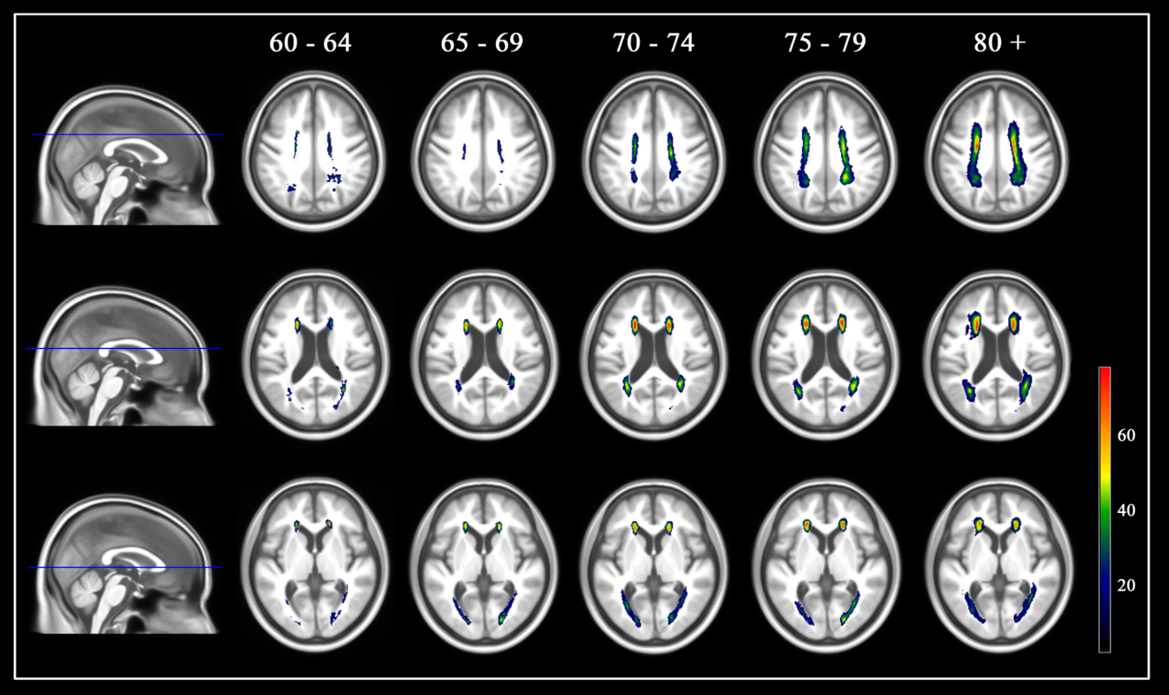
WMH probability map (WMHPM)

Slide 5
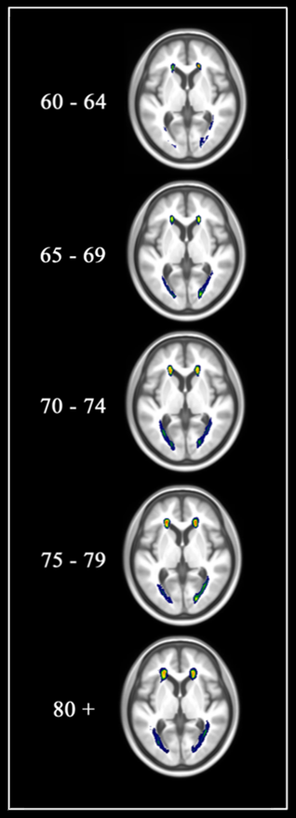
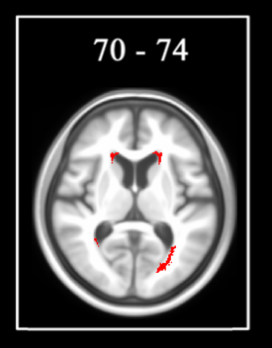
WMH age
Younger WMH age
Normal WMH age
Older WMH age

Slide 6
WMH age application
NC |  | Estimated white matter hyperintensity age
 |  | 60–64 | 65–69 | 70–74 | 75–79 | 80+
Chronological age | 60–64 | 7 | 1 | 0 | 0 | 0
 | 65–69 | 3 | 5 | 0 | 0 | 0
 | 70–74 | 0 | 1 | 6 | 0 | 0
 | 75–79 | 0 | 0 | 1 | 6 | 0
 | 80+ | 0 | 0 | 0 | 0 | 0
X² = 0.768
P = .857
HTN |  | Estimated white matter hyperintensity age
 |  | 60–64 | 65–69 | 70–74 | 75–79 | 80+
Chronological age | 60–64 | 3 | 3 | 2 | 0 | 0
 | 65–69 | 1 | 2 | 4 | 1 | 0
 | 70–74 | 0 | 0 | 3 | 4 | 0
 | 75–79 | 0 | 0 | 1 | 3 | 3
 | 80+ | 0 | 0 | 0 | 0 | 0
X² = 88.949
P < .001

Slide 7
Thank you!

