Slide 1
The 9th BESETO International Psychiatry Conference Epilepsy evaluation in psychiatric ward
Mao Fujioka¹, Yusuke Takahashi¹, Ryoichi Nishimura¹, Yumiko Okamura¹, Go Taniguchi^{1,2}, and Kiyoto Kasai¹
The Department of Neuropsychiatry, The University of Tokyo Hospital
National Center Hospital, National Center of Neurology and Psychiatry

Slide 2
Background
People with epilepsy (PWE) are more likely to suffer from psychiatric disorders than healthy people.
The number of psychiatrists who treat epilepsy is decreasing in Japan.
A need to increase the number of psychiatrists who can see PWE with psychiatric comorbidities in the future.

Slide 3
Who can see PWE with psychiatric comorbidity?
Psychiatric disorders comorbid with epilepsy
Peri-ictal psychiatric disorders
Interictal psychiatric disorders
Psychiatric disorders caused by anti-seizure medications
-> Need for some seizure evaluation
Peri-ictal
Interictal
Peri-ictal
Time
Seizure
Seizure

Slide 4
Psychogenic nonepileptic seizures (PNES)
PNES present as paroxysmal time-limited, alterations in motor, sensory, autonomic, and/or cognitive signs and symptoms, but unlike epilepsy, PNES are not caused by ictal epileptiform activity.
LaFrance, Epilepsia, 2013
Some patients with PNES have only PNES, while others have both PNES and epilepsy.

Slide 5
Diagnostic levels of certainty for PNES
 | History | Witnessed event or video recording |  |  | No epileptiform activity in routine EEG | No epileptiform activity during video EEG
 |  | By witness or self-report | By clinician | By clinician experienced in diagnosis of seizure disorders
Possible | ✓ | ✓ |  |  | interictal
Probable | ✓ |  | ✓ |  | interictal
Clinically established | ✓ |  |  | ✓ | ictal
Documented | ✓ |  |  | ✓ |  | ✓
LaFrance, Epilepsia, 2013

Slide 6
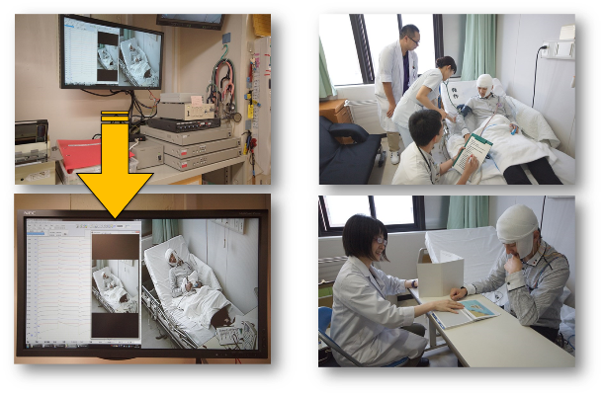
Epilepsy Monitoring Unit (EMU) in psychiatric ward provides seizure and psychiatric evaluation of PWE
Seizure interview
Long-term video EEG monitoring (LVEEG)
Multidisciplinary cooperation
Psychological tests
Epilepsy Monitoring Unit (EMU)
www.h.u-tokyo.ac.jp/topics/035.html

Slide 7
Standard schedule of EMU in our department
 |  | Mon | Tue | Wed | Thu | Fri
1st week | AM | ECG, CXR | blood test, LVEEG | LVEEG | LVEEG | LVEEG
 | PM | history taking, LVEEG | LVEEG | LVEEG | LVEEG | Holter ECG
2nd week | AM | SPECT | Psychological test | MEG | (reserve) | Feedback
 | PM | MRI | FDG-PET | Psychological test | (reserve) | discharge
ECG: electrocardiography, CXR: chest X-ray, LVEEG: long-term video EEG monitoring, EEG: electroencephalography,
SPECT: single photon emission computed tomography, MRI: magnetic resonance imaging, FDG-PET: Fluorodeoxyglucose positron emission tomography, MEG: magnetoencephalography

Slide 8
Main purposes for our EMU
Differential diagnosis (Epilepsy or non-epilepsy is unknown)
Epilepsy investigation (For determination of seizure/syndrome classification; already diagnosed as epilepsy)
Preoperative Investigation
Seizure examination (already diagnosed as both epilepsy and PNES; unclear whether the current seizure is epileptic or not)
Rule out epilepsy (PNES is evident)
+ psychiatric evaluation

Slide 9
Cases hospitalized after April 2021.
Case | sex | age | diagnosis at admission | Purpose of admission | diagnosis at discharge
1 | F | 30s | Epilepsy (focal epilepsy) s/o | Differential diagnosis | Focal epilepsy
2 | M | 20s | Unknown epilepsy, Depression s/o | Epilepsy investigation + psychiatric evaluation | Unknown epilepsy, mild intellectual disability s/o (r/o drug-induced cognitive dysfunction)
3 | F | 20s | Juvenile myoclonic epilepsy, Dissociative disorder | Seizure examination + psychiatric evaluation | Juvenile myoclonic epilepsy, Dissociative disorder
4 | F | 40s | PNES (Documented), Epilepsy s/o | Rule out epilepsy + psychiatric evaluation | PNES (Documented)
5 | F | 20s | Unknown epilepsy | Epilepsy investigation | Epilepsy s/o, Cardiogenic syncope s/o
6 | F | 20s | Temporal lobe epilepsy, PNES (Clinically established) | Epilepsy investigation, Seizure examination + psychiatric evaluation | Idiopathic generalized epilepsy, PNES (Clinically established)
Notes:
Epilepsy (focal epilepsy) suspected Unknown epilepsy, depression suspected
Juvenile myoclonic epilepsy, dissociative disorder
PNES (Documented), epilepsy suspected
temporal lobe epilepsy, PNES (Clinically established)
Differential diagnosis
Epilepsy investigation
Seizure examination
+ psychiatric evaluation
Rule out epilepsy

Slide 10
Our EMU: Present and future
After April 2022, on average, more than one patient per month is admitted to our EMU.
Giving young psychiatrists the opportunity to experience both seizure and psychiatric symptoms in patients with Epilepsy and/or PNES.
Many patients have achieved two primary outcomes: change in diagnosis and improved prognosis.

