Slide 1
Synergistic interaction of high blood pressure and cerebral Aβ on tau pathology
2022 BESETO short oral presentation
2022.11.13
Tae won kim
Snuh r3

Slide 2
Introduction
Hypertension related to higher risk of Alzheimer disease (AD) dementia (Kivipelto et al., 2002; Luchsinger et al., 2005)
Poorly understood underlying pathological link of hypertension & AD
Inconclusive direct association in autopsy and in vivo Biomarker studies (Langbaum et al., 2012) / (Glodzik et al., 2012; Vemuri et al., 2017a; Vemuri et al., 2017b)
Interaction of current systolic BP & Aβ on tau deposition (Rabin et al., 2019)
Few studies for both HTN history & current BP with AD pathologies

Slide 3
Aims of the study
Direct associations of BP markers (HTN history, current SBP, and DBP) & in vivo Aβ and tau in cognitively normal (CN) older adults
Interaction of BP markers & Aβ on tau deposition

Slide 4
Methods – Participants and assessment
KBASE, ongoing prospective cohort study from 2014
68 CN older adults with both amyloid and tau imaging data
Supine SBP and DBP measurement, HTN history data
Vascular risk score : DM, Dyslipidemia, coronary a. disease, TIA, and stroke
Global Aβ (PiB) and inferior temporal tau (AV-1451) PET

Slide 5
Methods - Statistics
Generalized linear regression model (GLM) for
Direct association of BP marker (HTN history or current BP) & global Aβ or IT tau - adjusting for age, sex, APOE4 positivity, and the VRS
Moderating effect of BP marker x global Aβ on IT tau - adjusting for age, sex, APOE4 positivity, VRS, global Aβ and IT tau SUVR

Slide 6
Results - Participant characteristics

Slide 7
Results - Participant characteristics

Slide 8
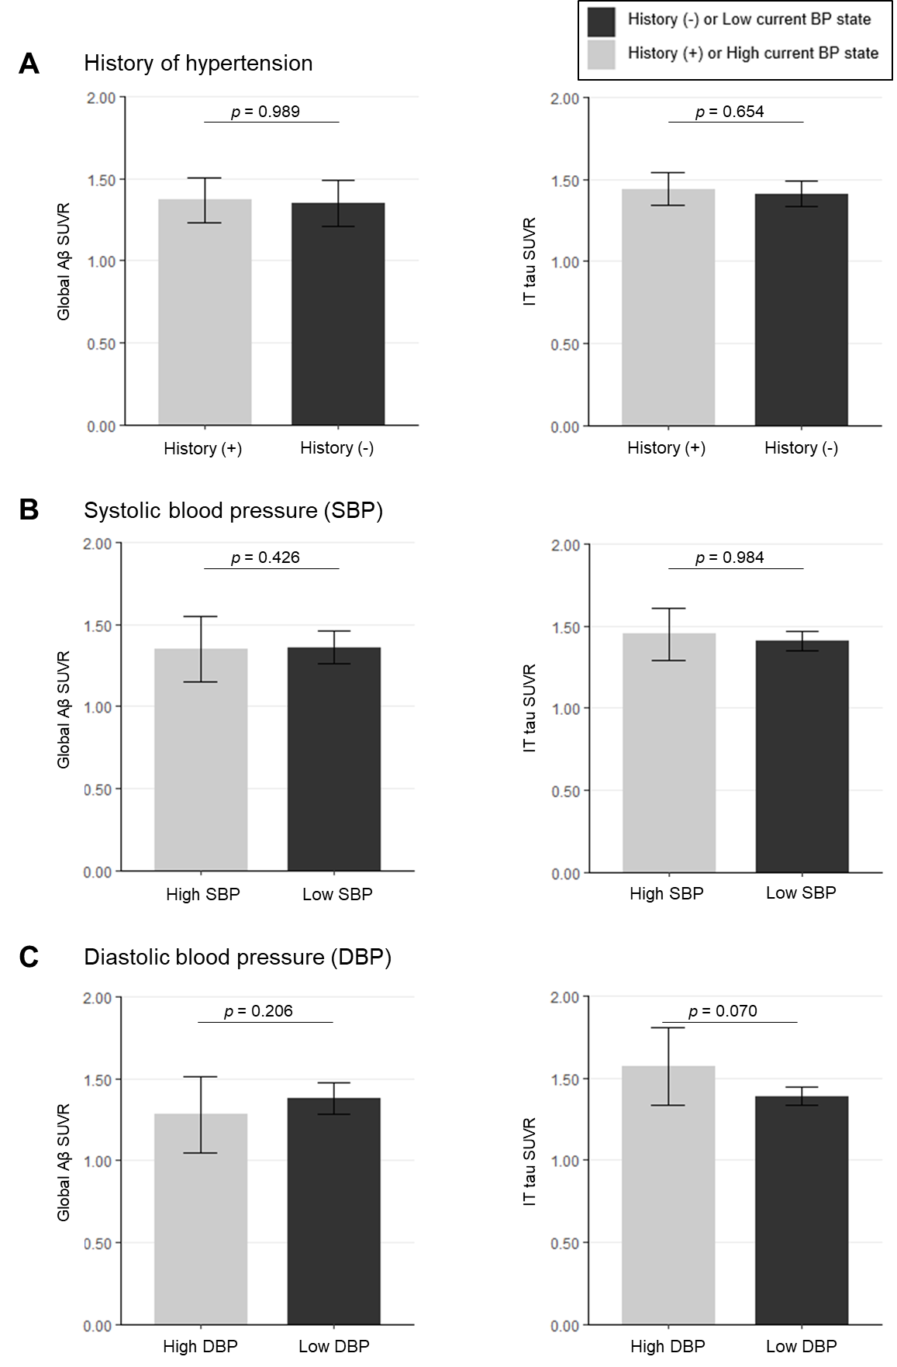
Results - HTN history & AD pathologies

Slide 9
Results - Current BP & AD pathologies

Slide 10
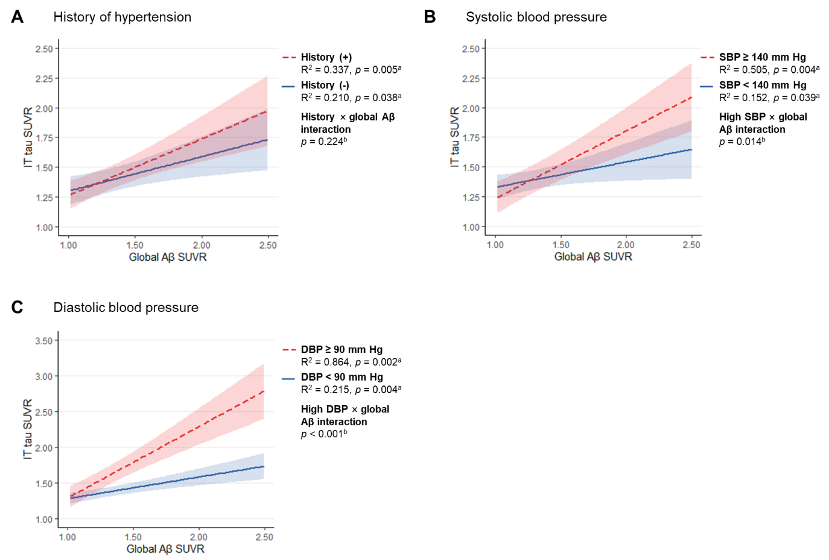
Results - Interaction effects

Slide 11
Discussion
1. Neither HTN history nor current BP had direct association with Aβ or tau deposition 2. Synergistic interaction of current BP (both SBP & DBP) with Aβ on tau deposition
Possible mechanism :
Known interaction of decreased CBF and damaged BBB, caused by high BP (Albrecht et al., 2020)
Increased tau hyperphosphorylation with lower glucose metabolism (Zhao and Gong, 2015)
Reduced clearance with impairment of BBB and glymphatic system (Michalicova et al., 2020; Mortensen et al., 2019)

Slide 12
Conclusion
Current BP, rather than history of hypertension
synergistically modulates the relationship of Aβ and tau in late-life
Importance of strict BP control in older adults to prevent AD pathogenesis

Slide 13
Strengths and limitations
Novel point that both SBP and DBP, but not HTN history, synergistically interact with Aβ on tau deposition
Cross-sectional design : cannot infer causality
Relatively narrow range of BP (SBP, 80 ~ 160 mm Hg; DBP, 50 ~ 100 mm Hg)
Relatively small sample size

Slide 14
Thank you

